Slide 1
Global Policy Seminar and NSC Simulation
IRP 401 - IRP 402
Week One 19 January 2024
Prof. Fulton T. Armstrong

Slide 2
Week 1 (19 Jan)
Week 2 (26 Jan)
Week 3 (2 Feb)
Week 4 (9 Feb)
Week 5 (16 Feb)
Week 6 (23 Feb)
Week 7 (1 Mar)
Week 8 (8 Mar)
BREAK
Week 9 (22 Mar)
Week 10 (29 Mar)
Week 11 (5 Apr)
Week 12 (12 Apr)
Week 13 (19 Apr)
Week 14 (26 Apr)
SPRING 2024

Slide 3
TODAY’S AGENDA
9:00 | 401/402 Welcome; Introductions; Questionnaire; Semester Overview; Syllabus and Projects
10:30 | Introduction to USG decision-making: What is the “Interagency Process”?
11:30 | Guest Speakers: Siobhan Sheils and Katie Tyner: “Washington Policymaking and Processes” Vice President and Senior Associate (respectively), The Cohen Group - Bios attached. - Introduced by Jessica
12:45 | Lunch
2:15 | Framing your project issues to make them actionable
~3:00 | Wrapup

Slide 4
TODAY’S AGENDA
9:00 | 401/402 Welcome; Introductions; Questionnaire; Semester Overview; Syllabus and Projects
10:30 | Introduction to USG decision-making: What is the “Interagency Process”?
11:30 | Guest Speakers: Siobhan Sheils and Katie Tyner: “Washington Policymaking and Processes” Vice President and Senior Associate (respectively), The Cohen Group - Bios attached. - Introduced by Jessica
12:45 | Lunch
2:15 | Framing your project issues to make them actionable
~3:00 | Wrapup

Slide 5
Ground Rules and Suggestions
Respect, inclusion, full participation – listen to each other
Openness, experiment with ideas
No such thing as a bad question
Take ego out of it (either offense or defense)
“Be here” – i.e., no distractions (phone, laptop)
Don’t assume there’s one right answer
Be contrarian
Go 360
THINK OF THIS AS A PROFESSIONAL WORKSPACE.
Other practices you’d like to suggest, drop me a line.

Slide 6
One more suggestion …
When you don’t agree with something you hear or read …
Before you react …
think …
Do we have different information?
Do we have different analysis?
Do we have different interests?
Do we have different values?

Slide 7
Fulton T. Armstrong
A spontaneous career in information, analysis, policy and politics
Forty-plus years of analytical writing
Linguistics and study in Spain
journalism in Taiwan
U.S. House of Representatives
CIA
State Department
National Security Council
National Intelligence Council
U.S. Military – Intelligence Advisor
U.S. Senate
Taught junior analysts
Led intelligence community
Wrote about tradecraft
Teach URJC and others
American University Syracuse University/Maxwell

Slide 8
Fulton T. Armstrong
A spontaneous career in information, analysis, policy and politics
Forty years of analytical writing
Linguistics and study in Spain
journalism in Taiwan
U.S. House of Representatives
CIA
State Department
National Security Council
National Intelligence Council
U.S. Military – Intelligence Advisor
U.S. Senate
American University Syracuse University/Maxwell

Slide 9
New York | Washington
Barcelona and Madrid | Taipei
Havana | Mons, Belgium
San José, CR
And traveled extensively between those periods.

Slide 10
BOOTCAMP
My Main Bias:
Good information and good analysis are at the heart of ALL good policy.
And bad information and bad analysis are at the heart of ALL bad policy.
A SECOND bias:
There’s rarely a *single* right answer.

Slide 11
A Third Bias:
Discussion is a lot richer (if less exciting) if we differentiate between
OPINION
and
ANALYSIS.

Slide 12
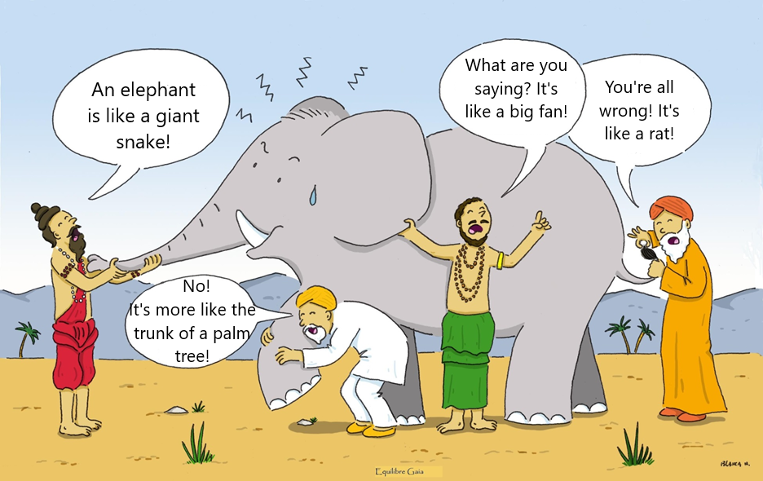
The Role of Intelligence: : The Blind Men and the Elephant
Second Purpose: Listening to all other points of view.
First Purpose: Putting facts together to say WHAT we perceive.
Notes:
Somos como en la historia india … los ciegos que quieren entender qué es un elefante. Cada uno lo toca, pero nadie entiende qué es hasta que se unan sus observaciones.
Un analista de una agencia de inteligencia … o un académico … o un periodista … o un representante de un negocio … quizás tenga información interesante, pero no es inteligencia hasta que, como sociedad, se una lo que saben y opinan del fenómeno que están observando.

Slide 13
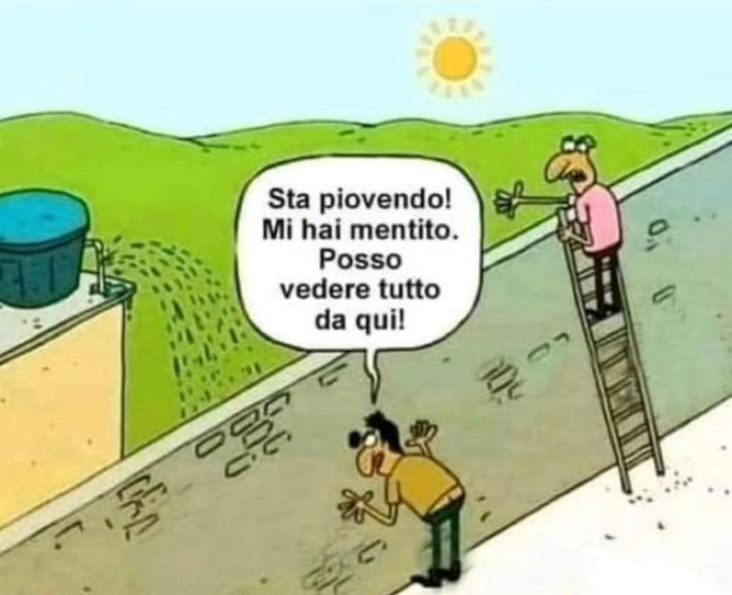
Italian version: Two men and a wall
It's raining!!! You lied! I can see everything from here!!!
Both are “right” … and
Both are wrong.
Does this help?
Notes:
Somos como en la historia india … los ciegos que quieren entender qué es un elefante. Cada uno lo toca, pero nadie entiende qué es hasta que se unan sus observaciones.
Un analista de una agencia de inteligencia … o un académico … o un periodista … o un representante de un negocio … quizás tenga información interesante, pero no es inteligencia hasta que, como sociedad, se una lo que saben y opinan del fenómeno que están observando.

Slide 14
Indian Story: The Blind Men and the Elephant
Notes:
Somos como en la historia india … los ciegos que quieren entender qué es un elefante. Cada uno lo toca, pero nadie entiende qué es hasta que se unan sus observaciones.
Un analista de una agencia de inteligencia … o un académico … o un periodista … o un representante de un negocio … quizás tenga información interesante, pero no es inteligencia hasta que, como sociedad, se una lo que saben y opinan del fenómeno que están observando.

Slide 15
As we proceed, I’ll ask you to explore … how do you know what you “know”?
How do you determine “real” or “fake”?
How do you control your wishes and biases when handling information?
How do you evaluate the accuracy of your information, analysis, and recommendations?
How do you think these practices play out on the issues you care about?

Slide 16
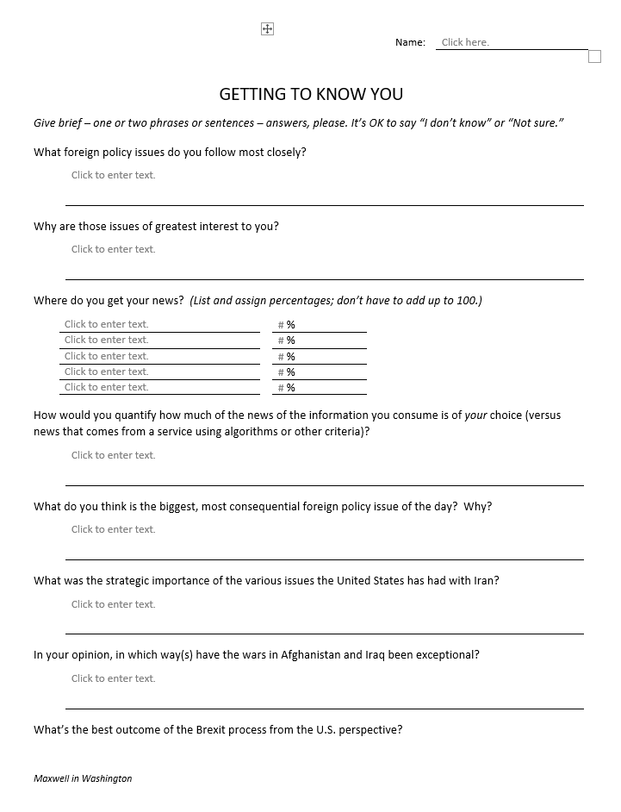
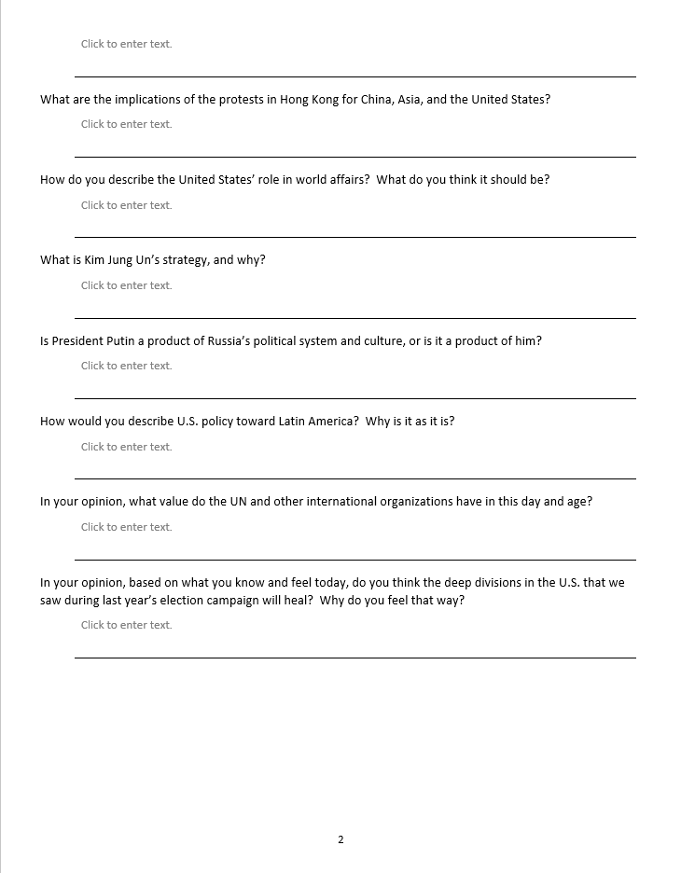
“Questionnaire”
Use MS “form” in SUBMIT ASSIGNMENTS section of Blackboard.
Getting to know you
~15 minutes

Slide 17
INTRODUCTIONS
Introductions
Preferred name
Hometown
Major/program
Main hope
Akosua
Matthew B
Jessica
Abigail
Meghan
Tavio
Bryce
Tashakee
Reese
Noah
Gavin
Matthew R
Marcus
Emma
Myia
Huiwen
Emily
Nicolas

Slide 18
INTRODUCTIONS
Introductions
Preferred name
Hometown
Major/program
Main hope
Akosua
Matthew B
Jessica
Abigail
Meghan
Tavio
Bryce
Tashakee
Reese
Noah
Gavin
Matthew R
Marcus
Emma
Myia
Huiwen
Emily
Nicolas

Slide 19
SPRING 2024
(notes)
Akosua
Matthew B
Jessica
Abigail
Meghan
Tavio
Bryce
Tashakee
Reese
Noah
Gavin
Matthew R
Marcus
Emma
Myia
Huiwen
Emily
Nicolas

Slide 20
Intro video for Zoom guests
Volunteer?

Slide 21
SYLLABUS
Objectives
Design
Assignments
Grading
Questions? Concerns?
In Blackboard

Slide 22
Course Description:
Combined six-credit policy seminar (IRP 401) and NSC simulation (IRP 402).
Explores U.S. interests in world affairs, available policy options, and how policies are made in Washington.
Also draws together internships and evening courses.

Slide 23
IRP 401 includes …
“Traveling” seminar that meets with U.S. and foreign government officials, experts and advocates, as well as journalists and public opinion specialists.
Introduction and practice of artforms used for developing policy options and communicating them in a Washington context, primarily information and policy memoranda.

Slide 24
IRP 402 features …
Simulation of a National Security Council policy review, through each stage – from analysis, to elaboration of options, to recommendation, through decision, and into implementation.
Small-team collaboration and responsibility.
Activities that should help you visualize selves as future policymakers, advocates and communicators.
Appreciation of the core professional skills needed for success in these areas.

Slide 25
Learning Objectives:
Critical elements and processes of the U.S. Government and foreign countries whose actions impact the United States.
Practical steps to identify and pursue opportunities in Washington, DC.
Learning from intern experiences, including workplace challenges and personal aspects of coping.

Slide 26
After taking this course, you will be better able to:
Evaluate U.S. foreign policy and the many the forces influencing it.
Understand different roles of the Executive Branch, Congress, media, NGOs, diplomatic missions in Washington, and international organizations.
Find, validate, and effectively use publicly available information. Obtain information from busy officials, activists, and media professionals.
Create, self-edit, and communicate analysis and policy proposals in both written (policy memos) and verbal (presentations, simulations) forms.
Think about your own futures.

Slide 27
Course Requirements and Expectations:
For the policy seminar (IRP 401), you will prepare three memos – two on a pressing policy topic, and one with personal reflections on policy and related processes over the course of the semester. You will also brief the class on their topics and on their internship experiences. You will prepare the following written and oral products (per guidance and examples provided):
A running individual journal, with short (one- or two-paragraph) entries in a reserved, private space in Blackboard with key observations and conclusions from your interaction with guest speakers and visits made as a class each week.
A completed analytical worksheet (“Memo #1”) on a topic of your choosing (coordinated with the professor).
A short (two-page) memorandum (“Memo #2”) updating and analyzing information on the same topic; identifying the U.S. government’s policy options as currently understood; and predicting how the policy debate will play out and why.
A briefing to the class on the conclusions reached during development of the analytical worksheet and memorandum.
At the end of the semester, a short (two- page) memorandum of reflections on key takeaways from the semester work and experiences, including, if desired, how they influenced your perceptions of their career interests.

Slide 28
For the National Security Council simulation (IRP 402), you – working in teams of two – will conduct a National Security Project, beginning with a mock National Security Council tasking memo, moving through each stage of policy preparation, and ending with a memo to the NSC “Deputies Committee” proposing a policy for the President’s approval. You will prepare the following written and oral products (per guidance and examples provided):
A project proposal (in the form of an NSC memo) on an issue in which you and teammate have interest and enough expertise to start, as coordinated with the professor.
A memo reporting on a Congressional hearing or public forum relevant to the chosen issue (by one team member) and a memo on U.S. and foreign public opinion relevant to that issue (by the other).
A memo reporting on an interview (one by each team member) with an expert source on the topic.
A final policy recommendation memo (jointly written) for the NSC “Deputies Committee” to consider on the issue with a final recommendation to the President.
A PowerPoint briefing for the simulated NSC meeting at which the team will brief the “Deputies” on its issue, including analysis, key interagency positions, and recommendations.

Slide 29
Look like a lot?

Slide 30
FORMAT NOTE
Submit all products in PDF format – so I can see exactly how you want it to appear (and so you have flexibility in software you use).
Use TIMES NEW ROMAN or CALIBRI; 12 point.
Paragraphs should be:
Single-spaced
NOT justified
With 12 points between them
WRITE CLEARLY, SIMPLY, CONCISELY. PROOFREAD!!!!!

Slide 31
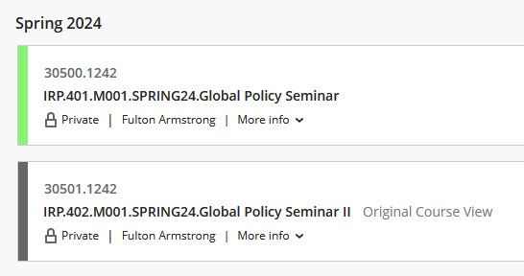
BLACKBOARD NOTES
We will use only 401.

Slide 32
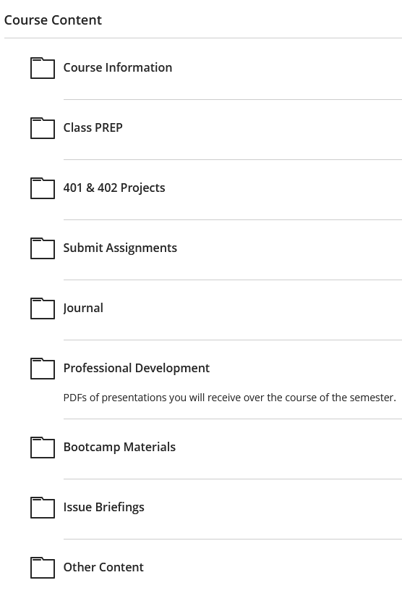
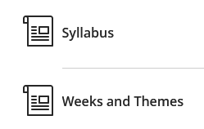

Slide 33
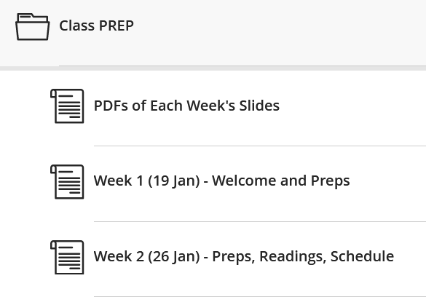
Weekly prep e-mails from me
Saturday or Sunday; updated as needed
Schedule
Readings (for discussions and quizzes)
Assigned introductions of guests

Slide 34
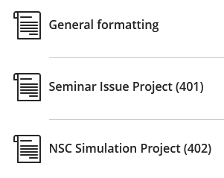
Guidance and Templates

Slide 35
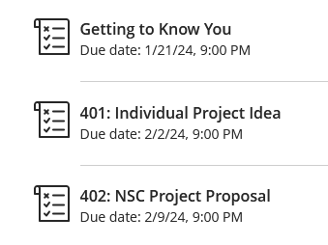

Slide 36
Weekly highlights from activities, speakers, readings
Short, but thoughtful
Counts toward participation grade but not graded each week

Slide 37
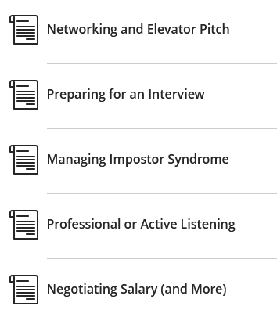

Slide 38
To be discussed

Slide 39
Grading
The course will provide varied opportunities for students to succeed and grow, and effort – as well as accomplishment – will be evaluated. Full attendance and active participation, including coming to each session prepared to discuss the readings and engage in thoughtful discussion with guest speakers, are expected.
Participation includes effective use of guest speakers to - Learn about the issues - Learn/practice elicitation - Explore new ideas

Slide 40
Religious Observance Notification Deadline: Tuesday, 6 February
Attendance and Preparation: Students are expected to attend (and be on time for) every class. Each Friday’s schedule is aggressive and requires that absences be for only exceptional purposes and be approved by the professor in advance. (Religious observances, health emergencies, and other compelling circumstances are understandable. Pursuit of long weekends is not an exceptional purpose.)
If you are absent, you will write a one-page (400 words) paper on the readings for that day.
If you feel that you cannot commit to attending every class, this may not be the right semester for you to be in the program.

Slide 41
Several words of wisdom:
Sometimes I will call you out, but … even if I don’t … don’t assume I don’t know what you’re doing.
Same thing on ethics issues such as use of ChatGPT.
I am concerned about artificial intelligence, but I worry more about natural stupidity.

Slide 42
Late Assignment Policy: All work should be handed in on time unless otherwise arranged with the professor. Five points (or one-half grade) will be deducted for each day an assignment is late. For example, if an assignment is due on a Friday – at which time it would receive a grade of 80 – Saturday submission will lower the grade to 75.

Slide 43
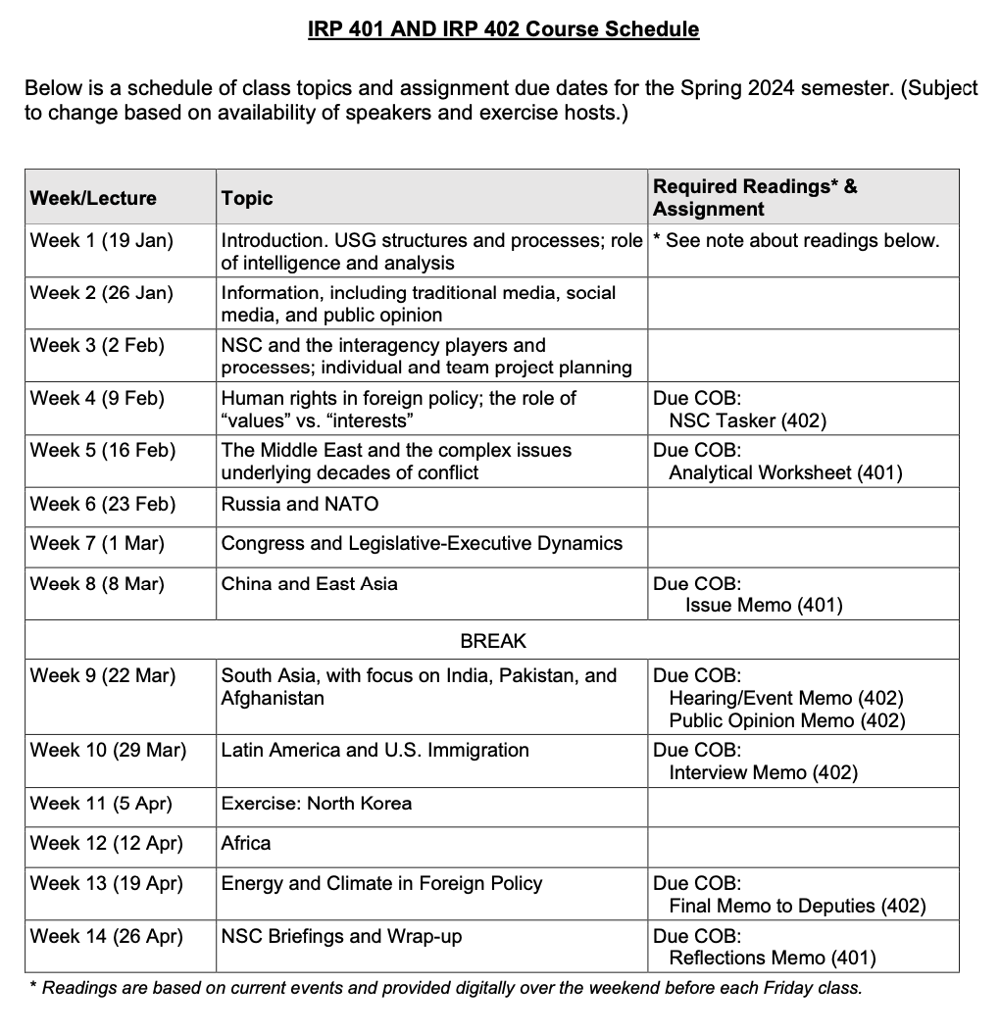
USE IN NEXT SLIDE. THIS IS PLAN AS OF 8JANUARY

Slide 44
✓
401
402
✓
✓
✓
✓
QUESTIONS?
✓
✓

Slide 45
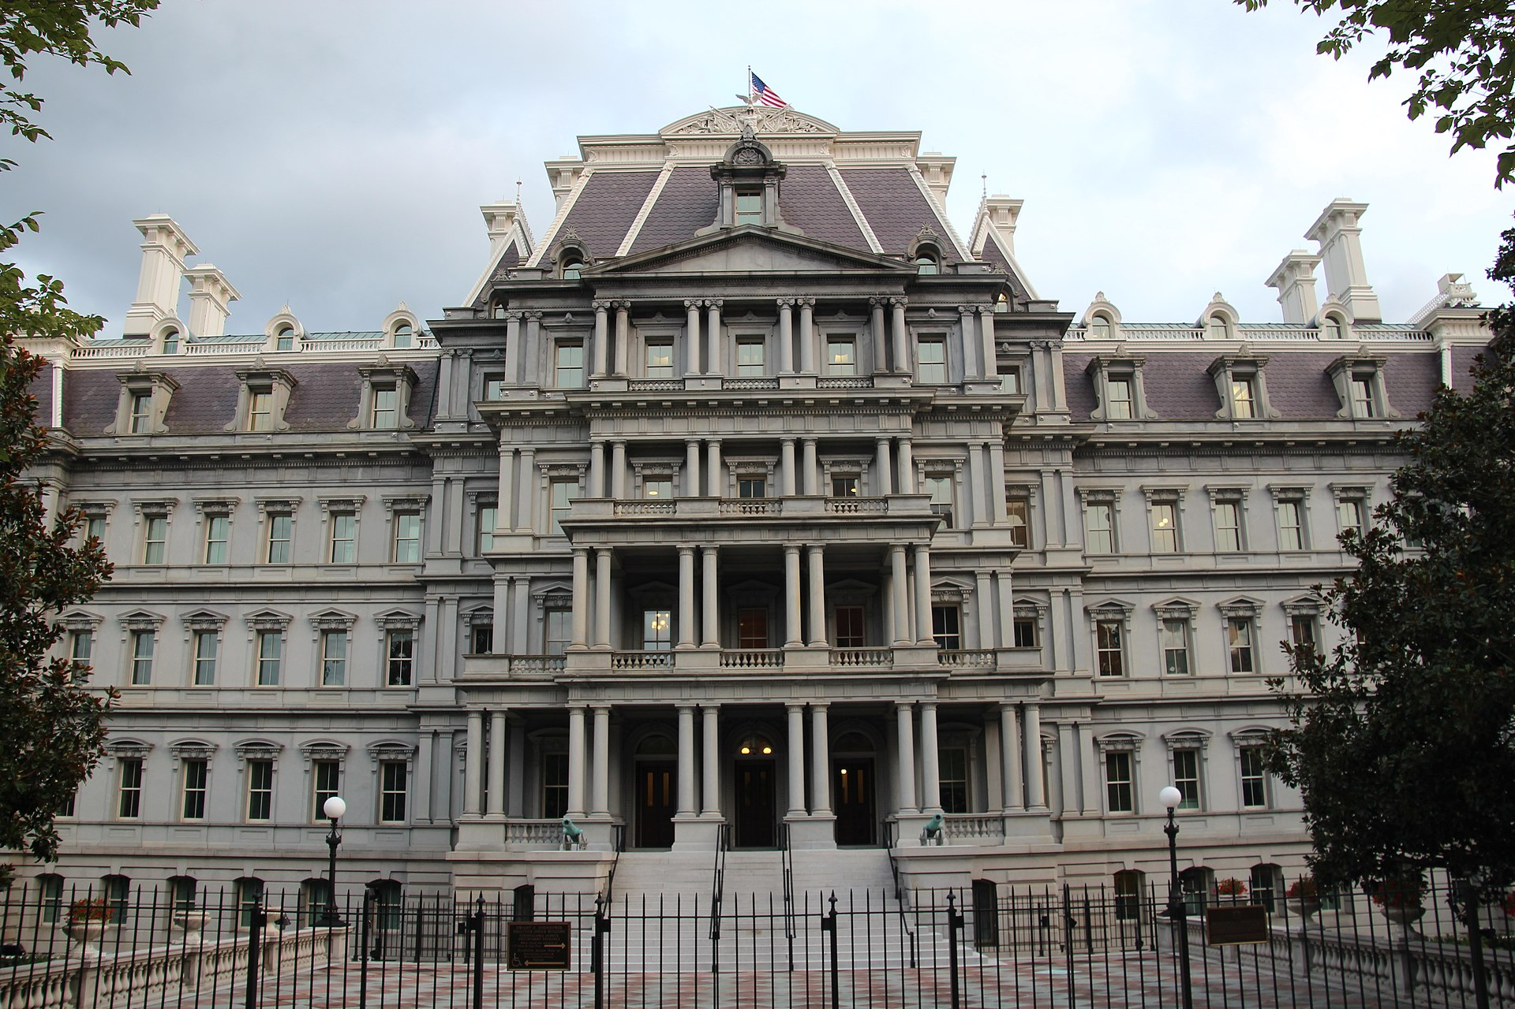
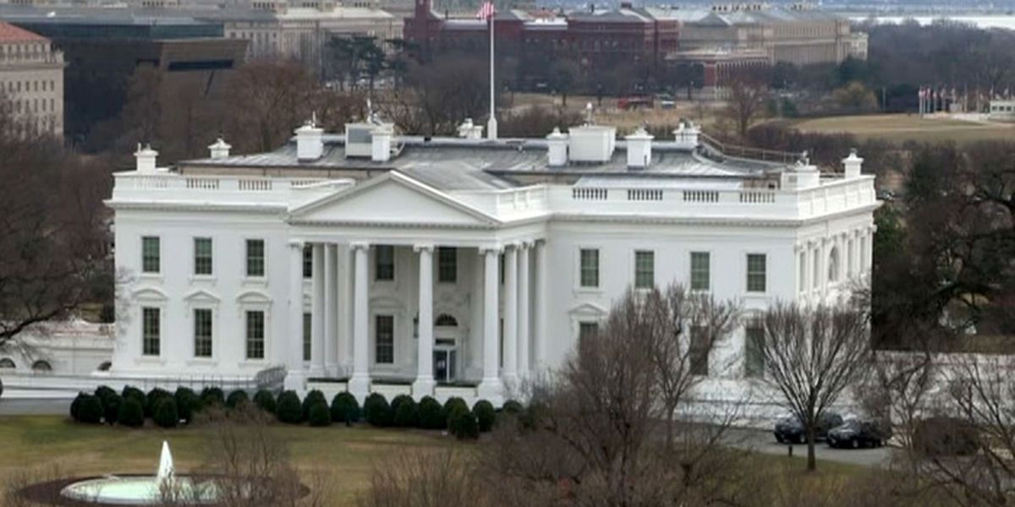
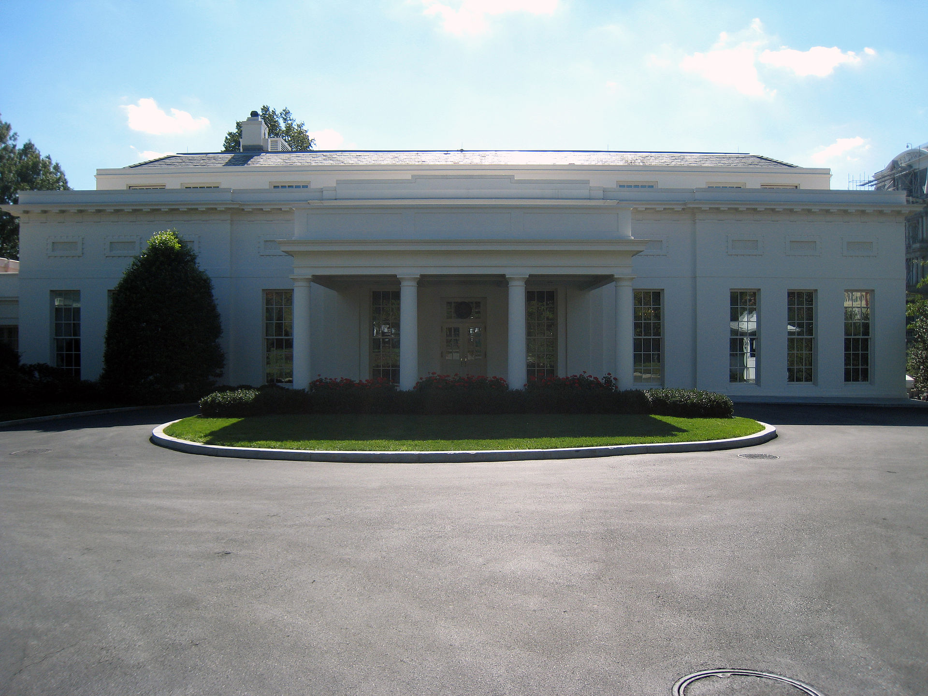
The National Security Council
NSC SIMULATION

Slide 46
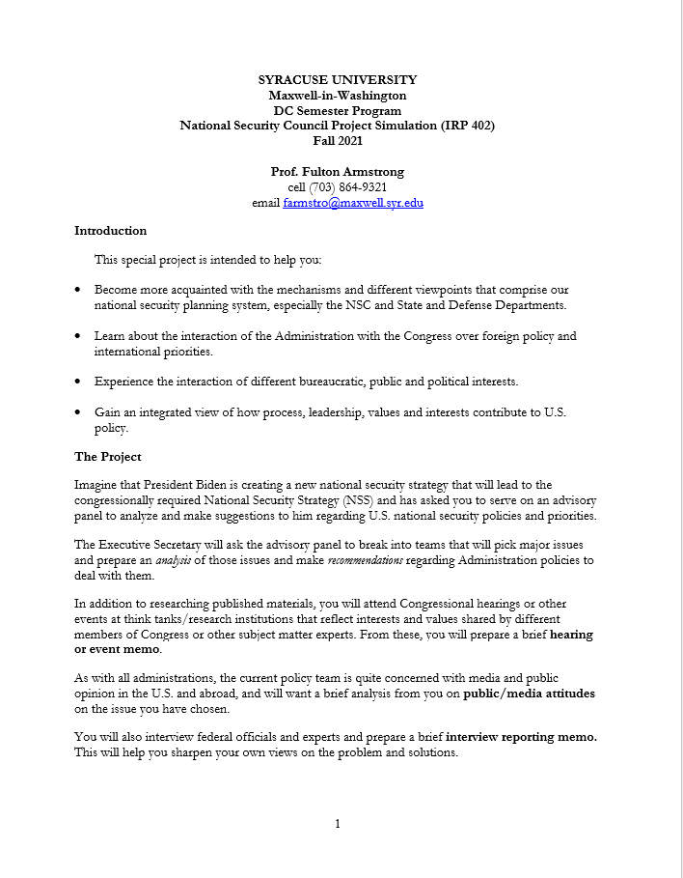
NSC PROJECT
From BlackBoard
Objectives
Design
Assignments
Grading
Any early ideas on topics you’d like to work?

Slide 47
NSC PROJECT
Teams and Proposals
1 or 2 people
“Major international issues and challenges to U.S. national security interests” or OTHER
Sample list in tasker
Other ideas, including non-IR
Common interest,
complementary skills, background

Slide 48
NSC PROJECT
DEADLINES
Choose partners and topics | Discuss today
Seek each other’s agreement and propose to me by e-mail | Deadline: 9pm on Friday, 26 Jan
Finalize Teams and topics by e-mail with me | Deadline: 9pm on Friday, 2 Feb
Finalize proposals; submit tasker | 9 Feb
Hearing/event memo | 22 Mar
Public opinion memo | 22 Mar
Interview memo | 29 Mar
Final memo | 19 Apr
Presentation and Defense | 26 Apr

Slide 49
SEMINAR PROJECT
“Issue focus worksheet”
DEADLINES
Choose a topic you’re interested in and already know pretty well | As soon as reasonable
Propose that topic to me in “Submit Assignments” area | Deadline: 9pm on Friday, 2 Feb
Begin organizing thoughts, finding info to fill gaps, thinking about issue. | As soon as reasonable
Prepare 1- or 2-sentence briefing on your topic for class | 9 Feb (in class)
Submit analytical worksheet | Deadline: 9pm on Friday, 16 Feb

Slide 50
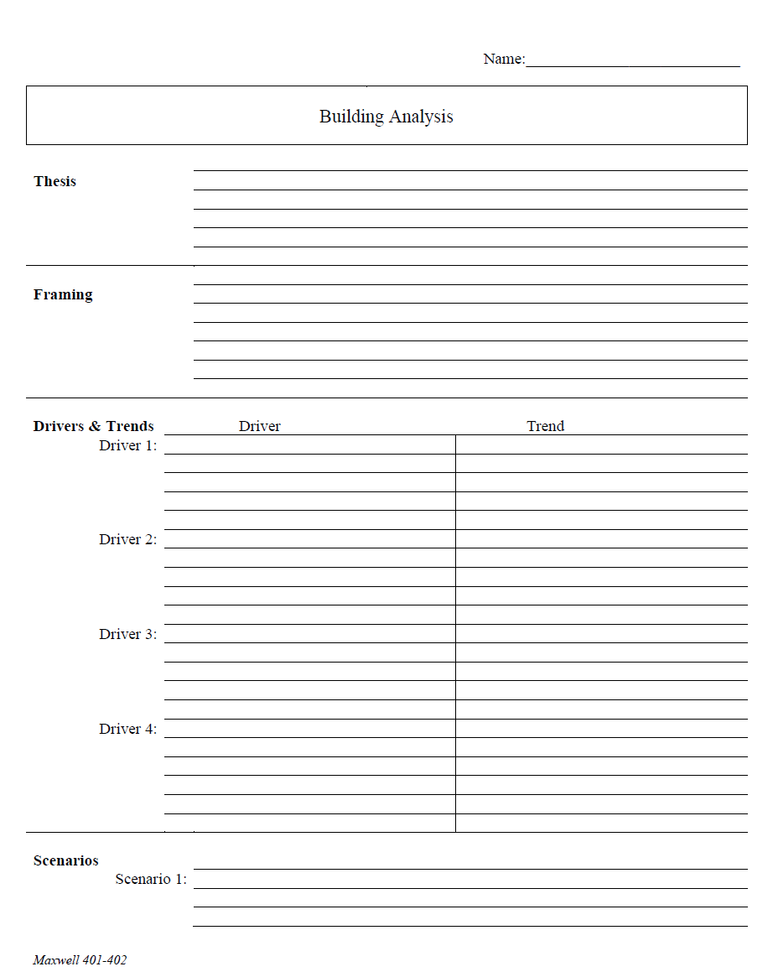
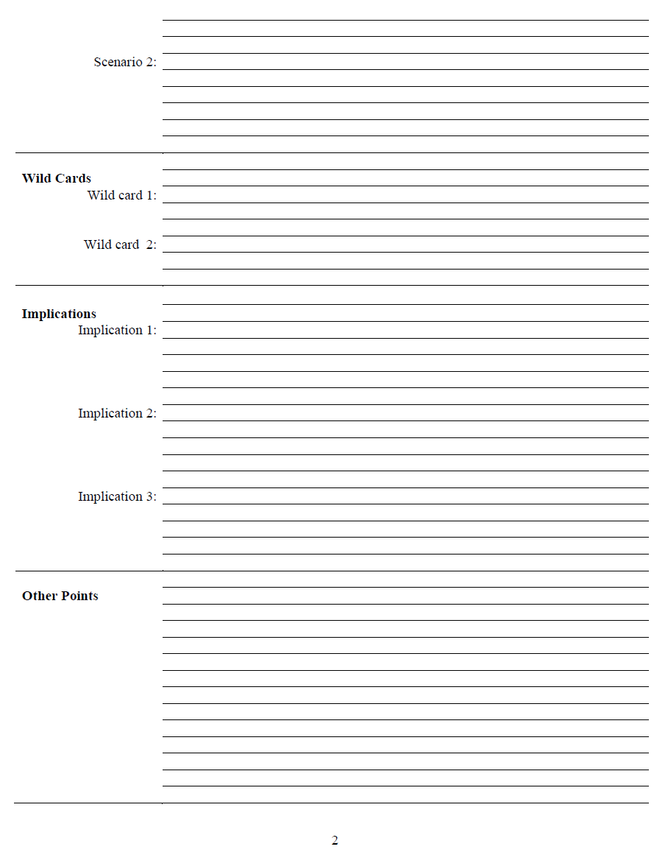
What is an analytical worksheet?
Purpose
Forms
ONE KIND
HANDOUT D

Slide 51
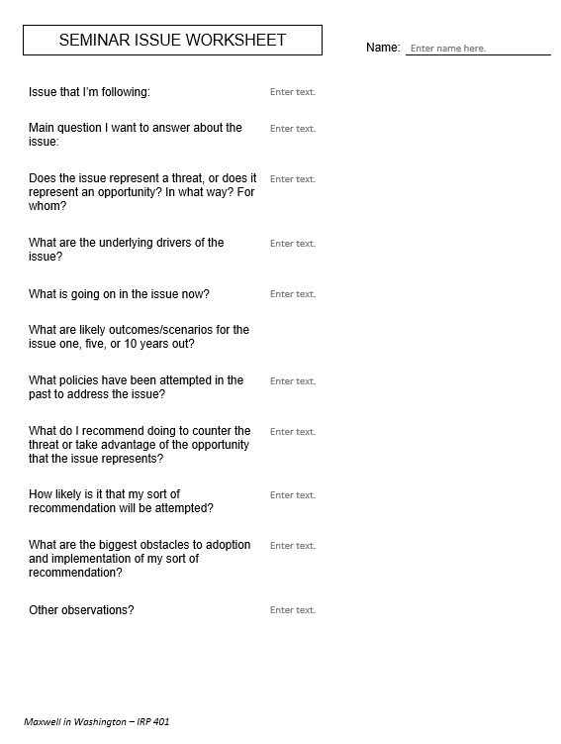
Issue that I’m following:
Main question I want to answer about the issue:
Does the issue represent a threat, or does it represent an opportunity? In what way? For whom?
What are the underlying drivers of the issue?
What is going on in the issue now?
What are likely outcomes/scenarios for the issue one, five, or 10 years out?
What policies have been attempted in the past to address the issue?
What do I recommend doing to counter the threat or take advantage of the opportunity that the issue represents?
How likely is it that my sort of recommendation will be attempted?
What are the biggest obstacles to adoption and implementation of my sort of recommendation?
Other observations?
for 401
drivers!!

Slide 52
Are you clear on what you’re going to do?

Slide 53
Also …
Journal entry each week (begin today)
short, short, short
insightful
main takeaway or impression

Slide 54
Break?
Guest?
Discussion?

Slide 55
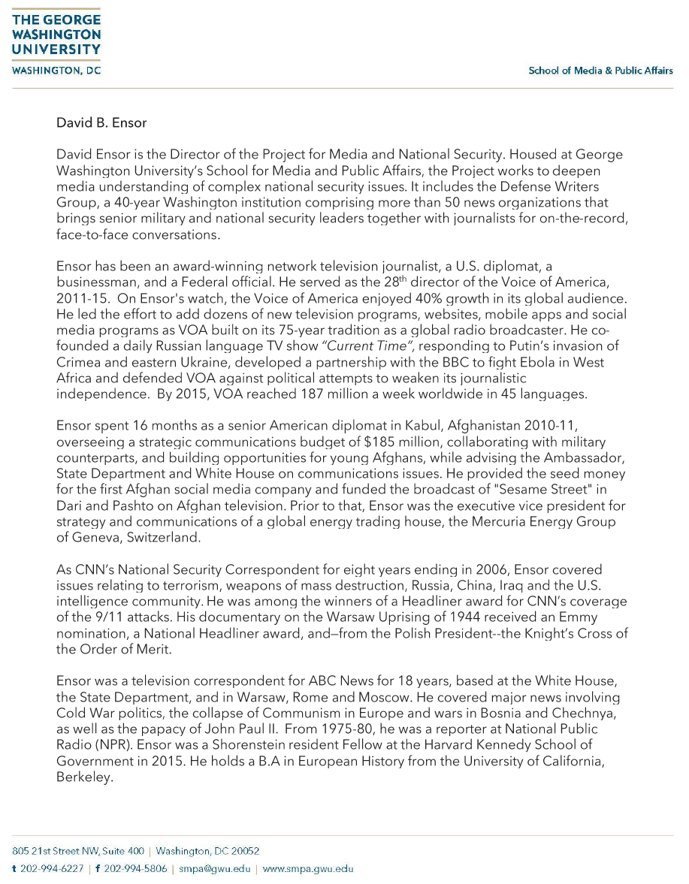
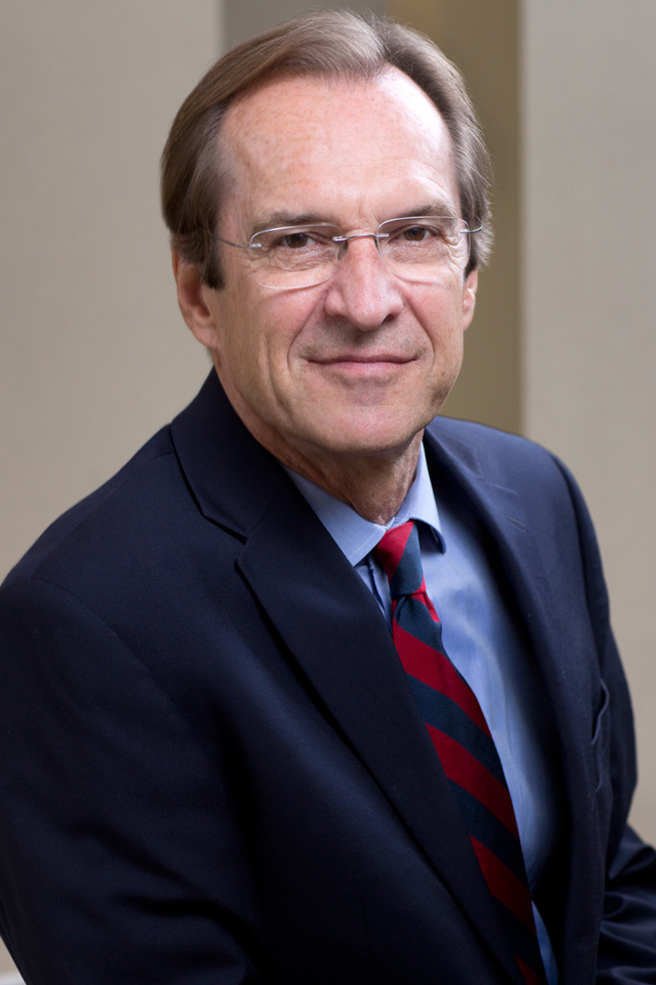
GUEST SPEAKER

Slide 56
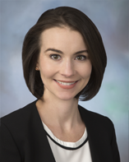
GUEST SPEAKER
Siobhan Sheils
Associate Vice President with The Cohen Group
2015-2017 | - NSC Director for Central America and the Caribbean - Reestablishment of US-Cuba ties
Prior | - Special Assistant to two Deputy Secretaries of State and the Under Secretary of State for Political Affairs
 | - Desk Officer for Guatemala; resolve CAFTA trade dispute
 | - Bureau of Human Resources and Staff Assistant in the Bureau of Western Hemisphere Affairs
 | - Superior honor award and four meritorious honor awards
Teach for America | Taught eighth grade English for four years in the South Bronx and Newark, New Jersey
Higher Education | Master’s of International Relations and Master’s in Public Relations, Syracuse University
 | Bachelor’s, Boston College

Slide 57
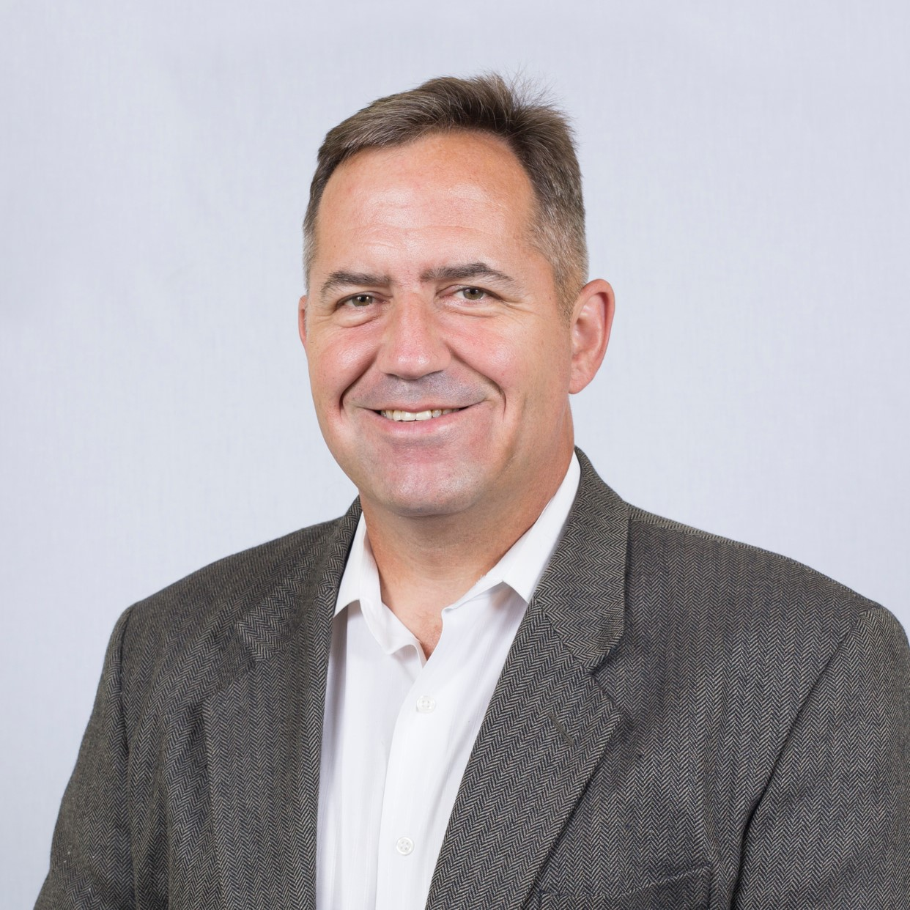
GUEST SPEAKER
COL (R) Bob Wilson
Director, Strategic Initiatives Global Venture National Resources Consulting Organic farmer Freelance writer
 | 27 years, U.S. Army Special Forces Northern and Western Africa CT activities Including al Qaeda, ISIS, Boko Haram Special Ops in Afghanistan
 | NSC Director for Counterterrorism, with focus on Africa
Education | MBA, Webster University
 | Master’s, Resource Strategy, NDU
 | Master’s, Military Arts and Sciences, School of Advanced Military Studies
 | Bachelor’s, Finance, UConn

Slide 58
The United States Government
How does it work?

Slide 59
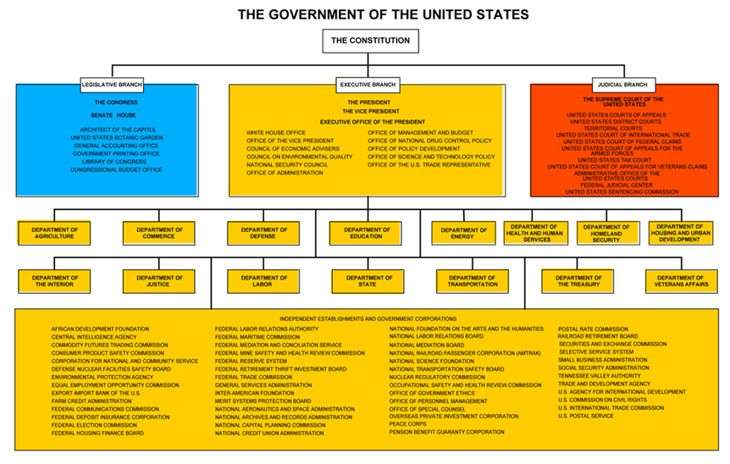
© Columbia University Library

Slide 60
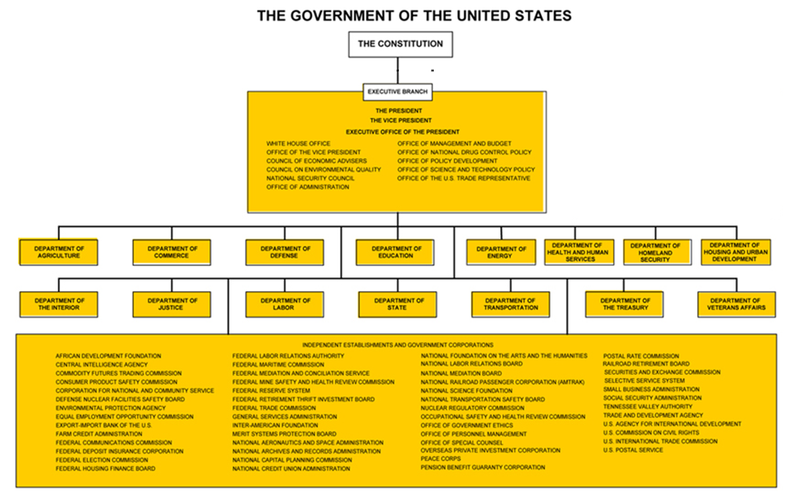
How do they
communicate?
intermediate?
coordinate?
The “Interagency Process”
NSC Principals
NSC Deputies
Interagency Policy Committees
Informal tools
© Columbia University Library

Slide 61
The U.S. “Interagency”
A super-fast tour
White House through NSC (and OMB)
“The interagency process”
Departments/agencies
State
Defense (OSD and JCS)
USTR
DHS (and agencies)
DOJ
Others with international role

Slide 62
How do they stay informed?
The media
Other public sources
Government sources
Print
Electronic
Social
Congress
Interest groups
Think tanks
Intelligence
Bureaucracy
Cabinet

Slide 63
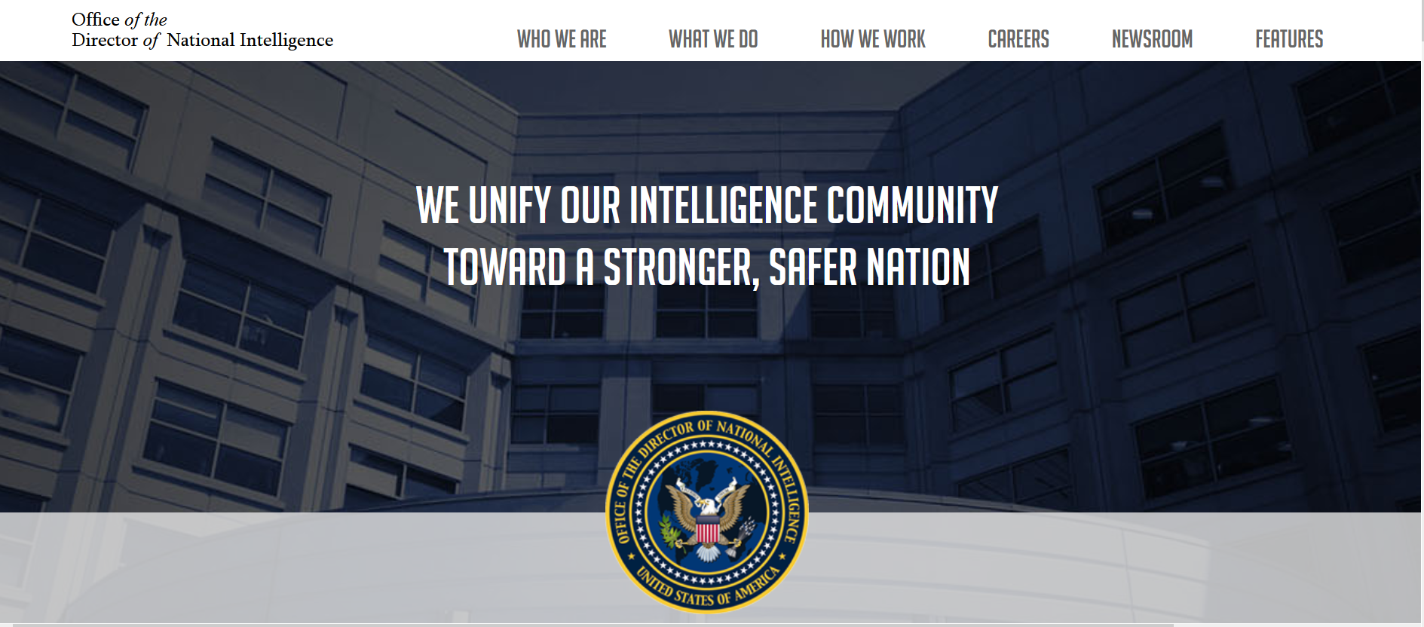
The U.S. Intelligence Community

Slide 64
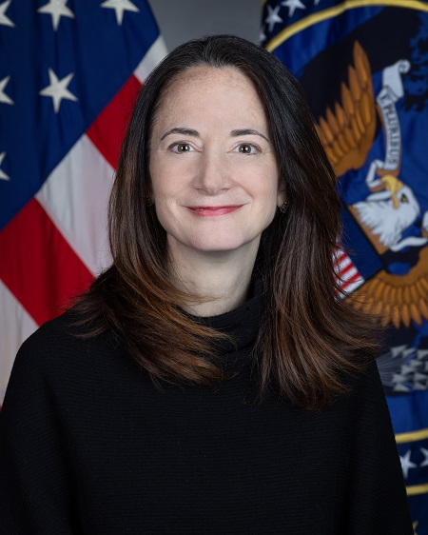
Avril Haines

Slide 65
The U.S. Intelligence Community is composed of the following 18 organizations:
Two independent agencies—the Office of the Director of National Intelligence (ODNI) and the Central Intelligence Agency (CIA);
Nine Department of Defense elements—the Defense Intelligence Agency (DIA), the National Security Agency (NSA), the National Geospatial- Intelligence Agency (NGA), the National Reconnaissance Office (NRO), and intelligence elements of the five DoD services; the Army, Navy, Marine Corps, Air Force, and Space Force.
Seven elements of other departments and agencies—the Department of Energy’s Office of Intelligence and Counter-Intelligence; the Department of Homeland Security’s Office of Intelligence and Analysis and U.S. Coast Guard Intelligence; the Department of Justice’s Federal Bureau of Investigation and the Drug Enforcement Agency’s Office of National Security Intelligence; the Department of State’s Bureau of Intelligence and Research; and the Department of the Treasury’s Office of Intelligence and Analysis

Slide 66
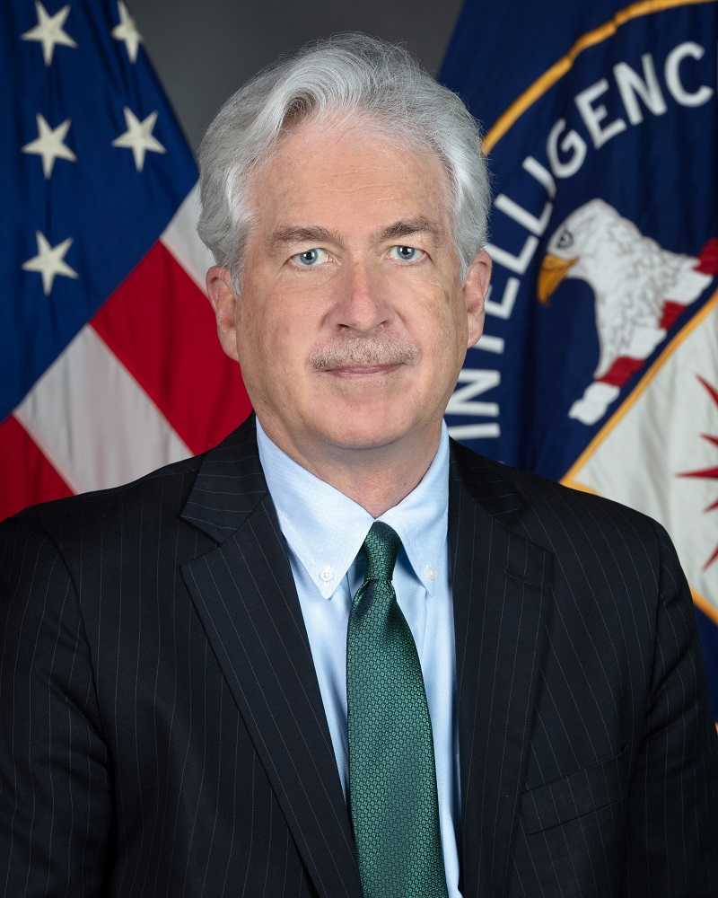
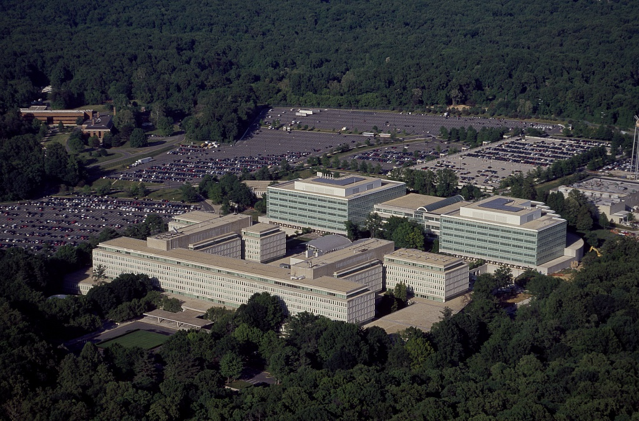
William J. Burns

Slide 67
“Our mission is straightforward but critical: leverage the power of information to keep our Nation safe.”
But is it just that?
Foreign Intelligence (FI)
Covert Action (CA)
Paramilitary (PM)

Slide 68
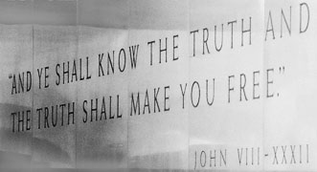
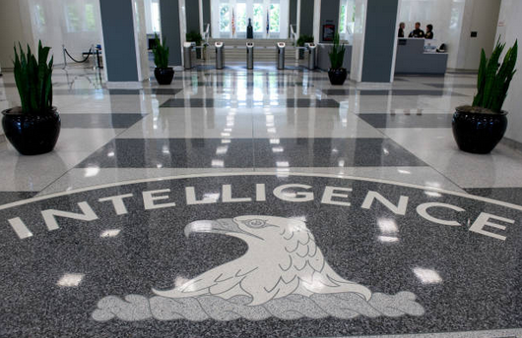
CIA (Informal) Motto??

Slide 69
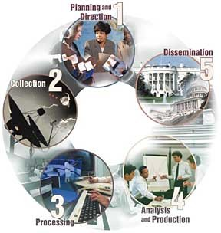
The “Intelligence Cycle”
“Requirements”

Slide 70
Discussion and Synthesis
What are your impressions of how decisions are made in Washington?
What voices influence it?
Do you think the mix of voices is correct?
Given the Intelligence Community’s mixed record, do you think it should be given more responsibility or less?
What improvements, if any, do you think should be considered, and who do you think should consider them or push them?

Slide 71
GUEST SPEAKERS

Slide 72
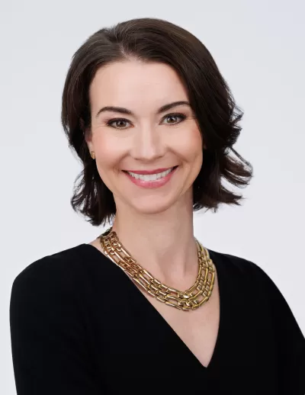
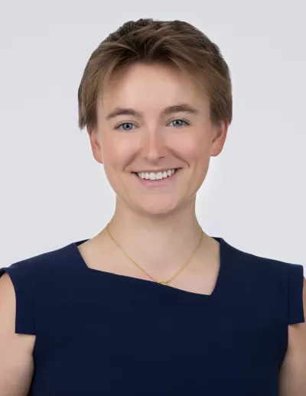
GUEST SPEAKERS
Introduced by Jessica
Siobhan Sheils
Katie Tyner

Slide 73
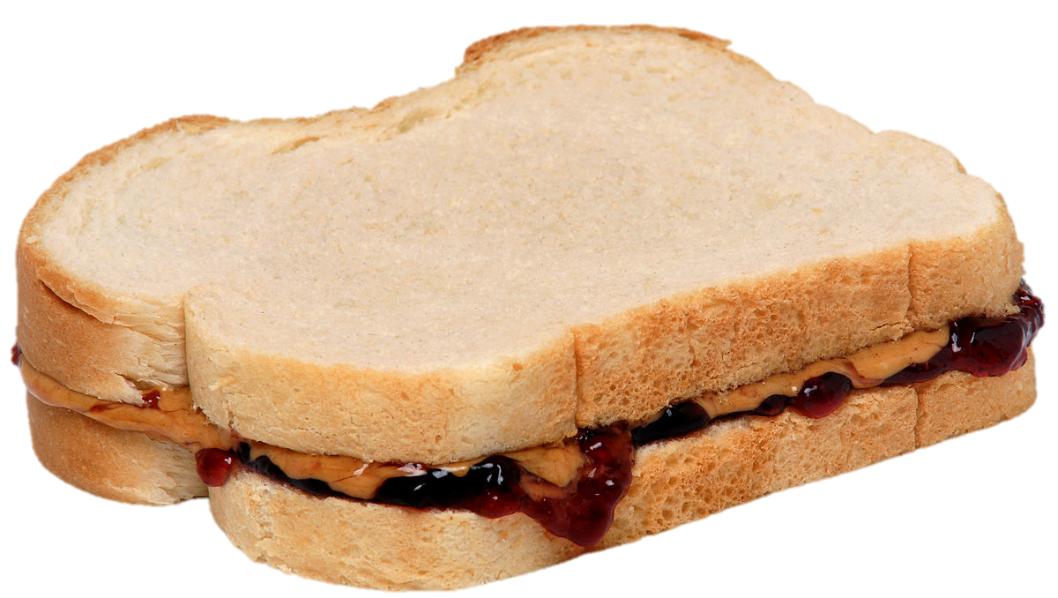
LUNCH

Slide 74
Interest
Expertise
Relevance
PROJECT ISSUES
Relevance
Information
Time
How to choose them?
How to frame them?
How to build them?
How to make them actionable?
Assess info and gaps
Develop hypothesis
Develop arguments
Develop options
Stay loyal to analysis
Write clearly, efficiently

Slide 75
The Heartbeat of Analysis (and Policy)
“DRIVERS”
The forces, needs, desires, and other factors that make things happen and influence outcomes.

Slide 76
What are drivers?
Interests
Borrowing from the “3-i framework” …
Ideas
Institutions
In our PERSONAL lives …
Interests | Ideas | Institutions
Work Food Love - Sex Family Home Transportation Entertainment Recreation Challenges | Education Religion or values Political thought Ideology Imposed expectations | Parents Boy/Girlfriend Husband/Wife Colleagues Friends Political party Employer
drivers

Slide 77
What are drivers?
Interests
BOOTCAMP
Borrowing from the “3-i framework” …
Ideas
Institutions
In our PERSONAL lives …
Interests | Ideas | Institutions
Work Food Love - Sex Family Home Transportation Entertainment Recreation Challenges | Education Religion or values Political thought Ideology Imposed expectations | Parents Boy/Girlfriend Husband/Wife Colleagues Friends Political party Employer
drivers

Slide 78
What are drivers?
Interests
Borrowing from the “3-i framework” …
Ideas
Institutions
In our NATIONAL lives …
Interests | Ideas | Institutions
Power/influence Needs Desires/ambitions Wealth Economic performance | Self-definition Nationalism History Concepts/logic Values Ideology | Leadership Abilities/constraints Economic structures Intermediation Inclusion Topography/geography Climate
drivers

Slide 79
What are drivers?
Interests
BOOTCAMP
Borrowing from the “3-i framework” …
Ideas
Institutions
In our NATIONAL lives …
Interests | Ideas | Institutions
Power/influence Needs Desires/ambitions Wealth Economic performance | Self-definition Nationalism History Concepts/logic Values Ideology | Leadership Abilities/constraints Economic structures Intermediation Inclusion Topography/geography Climate
drivers

Slide 80
What are drivers?
BOOTCAMP
“FUEL”
“FRICTION”
Effort/energy
Resources
Technology, etc.
to PUSH a solution.
Obstacles
Resistance
Limitations, etc.
that OBSTRUCT a solution.
“Forward” drivers
“Status Quo” or “Backward” drivers

Slide 81
The GOAL
For your work to be strong.
For you to be efficient.
For you to be confident.

Slide 82
Issue that I’m following:
Main question I want to answer about the issue:
Does the issue represent a threat, or does it represent an opportunity? In what way? For whom?
What are the underlying drivers of the issue?
What is going on in the issue now?
What are likely outcomes/scenarios for the issue one, five, or 10 years out?
What policies have been attempted in the past to address the issue?
What do I recommend doing to counter the threat or take advantage of the opportunity that the issue represents?
How likely is it that my sort of recommendation will be attempted?
What are the biggest obstacles to adoption and implementation of my sort of recommendation?
Other observations?
ALL CLEAR??

Slide 83
What topics are you interested in?
402 (team) project?
E-mail agreement on partners and topic:
Next Friday (26 Jan) evening
E-mail final agreement:
Friday, 2 Feb, evening
401 (individual) project?
E-mail on topic :
Next Friday (26 Jan) evening
Submit proposal as assignment:
Friday, 2 Feb, evening

Slide 84
Global Policy Seminar and NSC Simulation
IRP 401 - IRP 402
Week One 19 January 2024
Prof. Fulton T. Armstrong

Slide 85
GUEST SPEAKERS
Former intelligence officers.
What do intelligence agencies do, and what is their role in Washington policy processes?

Slide 86
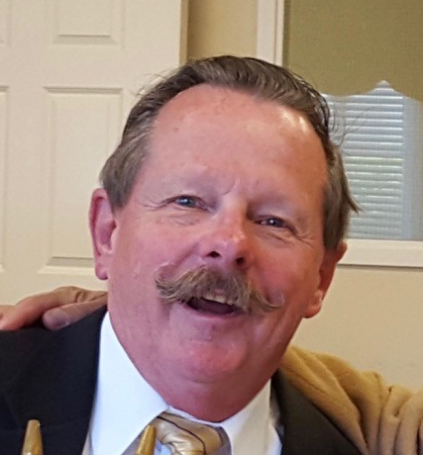
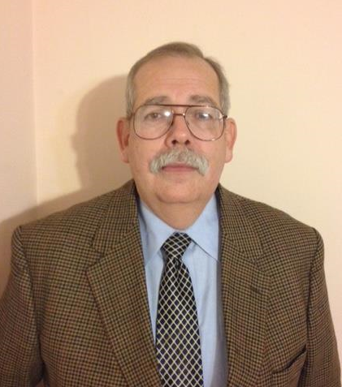
GUEST SPEAKERS (10:00am)
What is the role of intelligence (and intelligence agencies) in U.S. foreign policy?
How is intelligence collection planned and conducted?
What is the difference in substance and impact between “raw” and “finished” intelligence?
William Ortman
Rafael Aguirre-Sacasa

