Slide 1
Global Policy Seminar and NSC Simulation
IRP 401 - IRP 402
Week Three 2 February 2024
Prof. Fulton T. Armstrong

Slide 2
Week 1 (19 Jan)
Week 2 (26 Jan)
Week 3 (2 Feb)
Week 4 (9 Feb)
Week 5 (16 Feb)
Week 6 (23 Feb)
Week 7 (1 Mar)
Week 8 (8 Mar)
BREAK
Week 9 (22 Mar)
Week 10 (29 Mar)
Week 11 (5 Apr)
Week 12 (12 Apr)
Week 13 (19 Apr)
Week 14 (26 Apr)
SPRING 2024

Slide 3
Washington dialect
“as soon as possible”
“deadline”

Slide 4
TODAY’S AGENDA
9:00 | Discussion Nitya “Nits” Chagti and the Writing Lab Project planning – 401 and 402 Readings
10:00 | Depart for Pentagon
10:30 | Enter Pentagon Visitor Entrance (at Metro entrance)
11:00 | Lily Emamian, Douglas Burt, Christopher Pistritto Office of the Secretary of Defense – Policy Intros and discussion coordinator: Vaughn
12:30 | Metro back to lunch and CSIS
2:30 | Siobhan Sheils and Katie Tyner: “Washington Policymaking and Processes” Vice President and Senior Associate, The Cohen Group Introduced by Jessica
3:45 | Wrapup

Slide 5
TODAY’S AGENDA
9:00 | Discussion Nitya “Nits” Chagti and the Writing Lab Project planning – 401 and 402 Readings
10:00 | Depart for Pentagon
10:30 | Enter Pentagon Visitor Entrance (at Metro entrance)
11:00 | Lily Emamian, Douglas Burt, Christopher Pistritto Office of the Secretary of Defense – Policy Intros and discussion coordinator: Vaughn
12:30 | Metro back to lunch and CSIS
2:30 | Siobhan Sheils and Katie Tyner: “Washington Policymaking and Processes” Vice President and Senior Associate, The Cohen Group Introduced by Jessica
3:45 | Wrapup

Slide 6
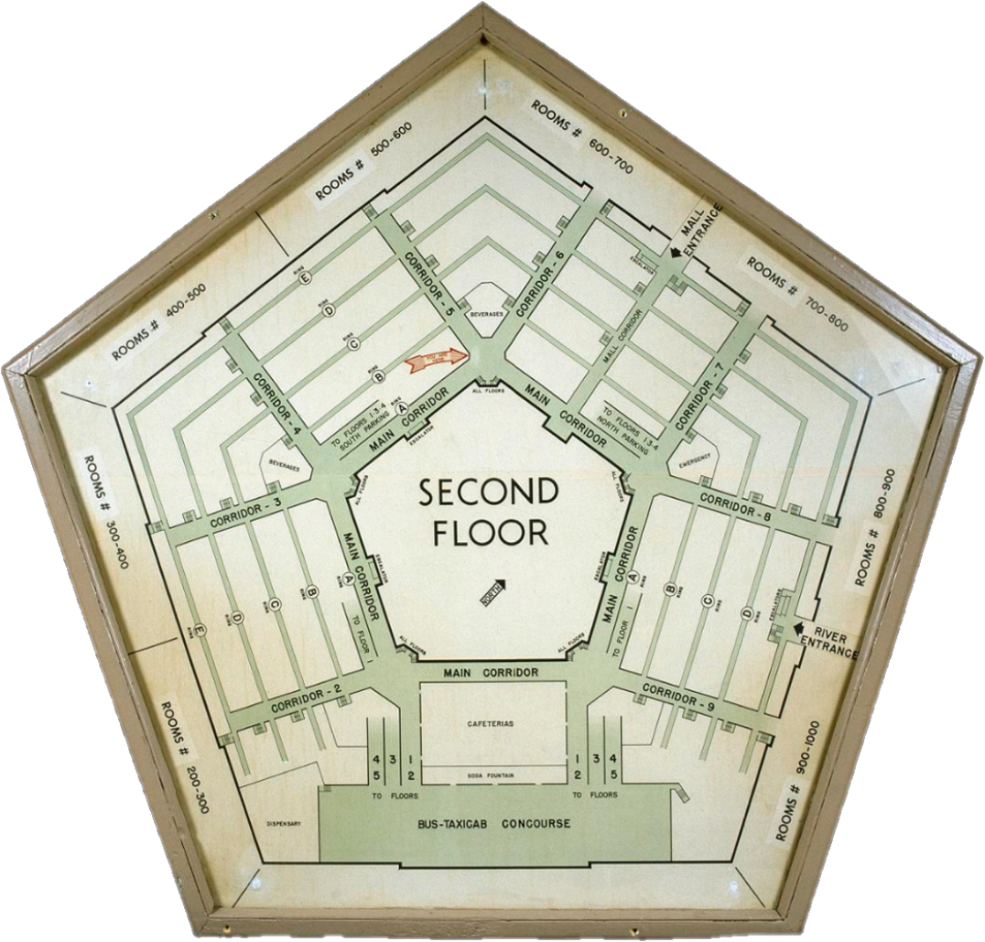
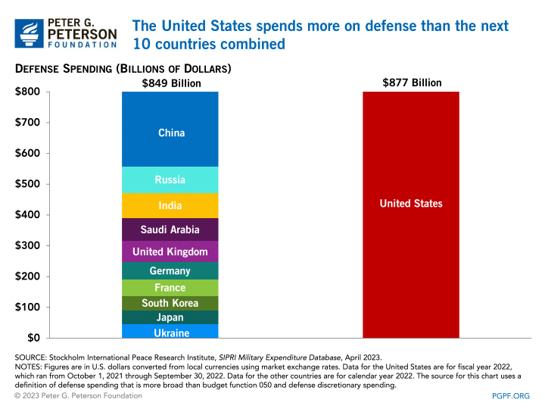
5B648A
Pretty cool?
Constructed 1941-45
Largest “low-rise” building (6.5m sq ft); 17.5 mi of corridors
Until 2011 had only 1 passenger elevator
26k people work there
Current military:
2.5+ million (1.4m active-duty mil)
Budget: ~$877 billion (12% of total spending and ~50% of discretionary spending)
Zillions of contractors
METRO

Slide 7
Lily Emamian
Douglas Burt
Christopher Pistritto
TOPICS
Ukraine
NATO
Cyber
Their bios
OSD vs JCS
The interagency

Slide 8
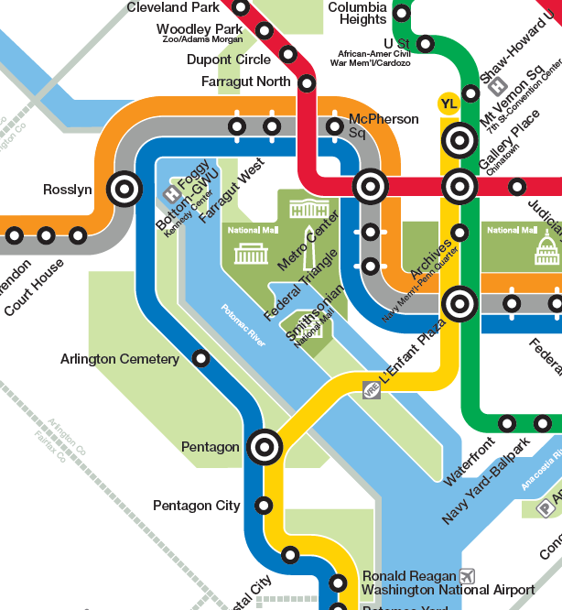
TRANSPORTATION

Slide 9
Nitya "Nits" Chagti

Slide 10
DISCUSSION
Project planning
Topics for individual (401) and partnered (402) projects?
Clear on criteria?
Clear on products and feasibility?
Ideas?

Slide 11
Project Planning
Akosua | U.S.-North Korea: How contain Kim? | Ensuring microchip competition and supply
Nicolas | ????????
Marcus | Tech/innovation ties with Vietnam | Education deficits in St. Paul, Minnesota
Mimi | ????????
Vaughn | Central America migration | Israel-Palestine: Two-state solution possible?
Matt | ????????
Gavin | Impact of COVID on mental health | U.S. policy toward Yemen and the Houthis
Noah | Reducing reliance on China trade
Meghan | Russia/Wagner influence in Africa | Impact of climate change on insurgency
Bryce | Improving gun control background checks
Emily | Russia-Ukraine (prospects? What next?) | How to deal with climate migrants/refugees
Tashakee | Executive promotion of abortion legislation
Reese | Central America climate migration | “War time policy”
Emma | U.S.-Mexico deaths
Ding | ???????? | ????????
Abby | Human trafficking | U.S. support to Ukraine defense against Russia
Jessica | Stopping the flow of fentanyl into U.S.

Slide 12
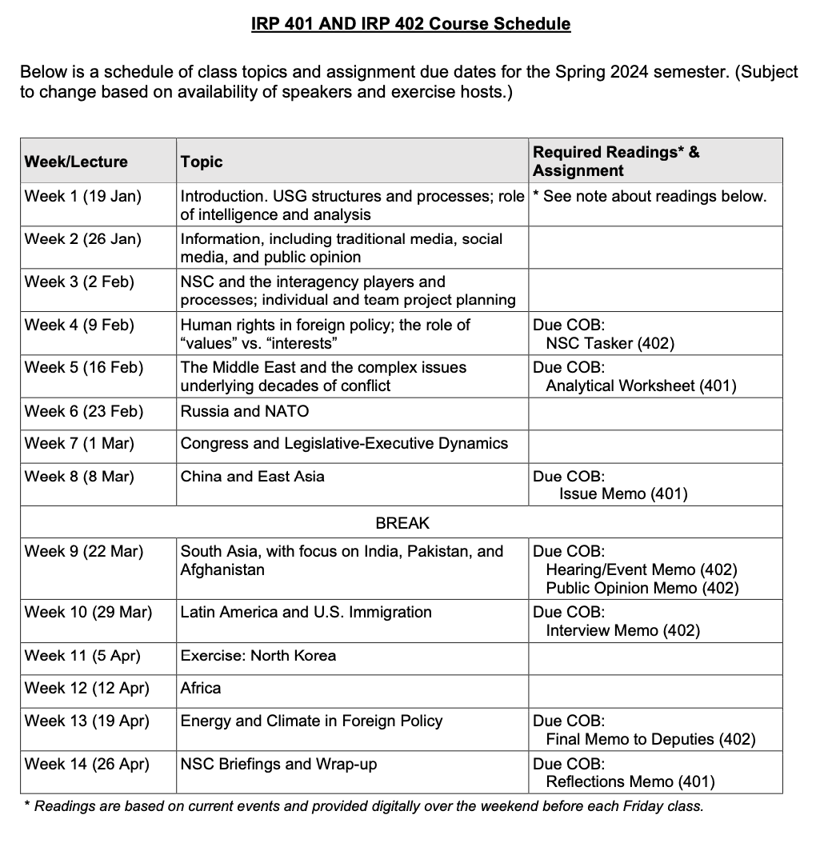
✓
401
402
✓
✓
✓
✓
QUESTIONS?
✓
✓

Slide 13
DISCUSSION
Readings
Quiz

Slide 14
TRANSPORTATION

Slide 15
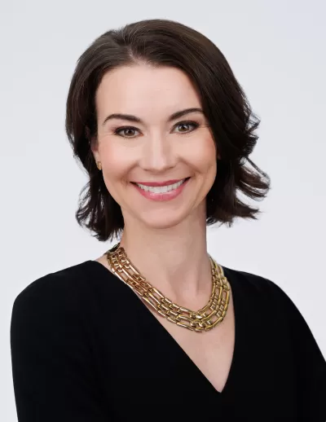
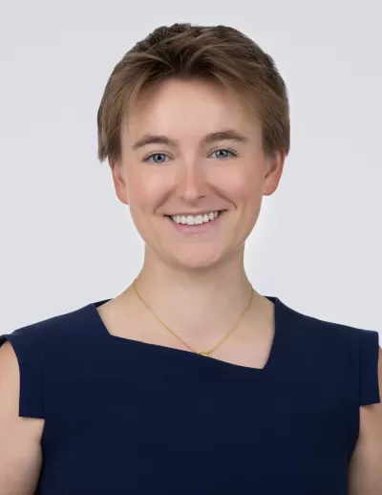
GUEST SPEAKERS
Introduced by Jessica
Siobhan Sheils
Katie Tyner

Slide 16
WRAPUP

Slide 17
✓
401
402
✓
✓
✓
✓
QUESTIONS?
✓
✓

Slide 18
NEXT WEEK …
Human Rights
Carter Center Media Training
The Holocaust Museum

Slide 19
Global Policy Seminar and NSC Simulation
IRP 401 - IRP 402
Week Three 2 February 2024
Prof. Fulton T. Armstrong

