Slide 1
Global Policy Seminar and NSC Simulation
IRP 401 - IRP 402
Week Six 23 February 2024
Prof. Fulton T. Armstrong

Slide 2
Week 1 (19 Jan)
Week 2 (26 Jan)
Week 3 (2 Feb)
Week 4 (9 Feb)
Week 5 (16 Feb)
Week 6 (23 Feb)
Week 7 (1 Mar)
Week 8 (8 Mar)
BREAK
Week 9 (22 Mar)
Week 10 (29 Mar)
Week 11 (5 Apr)
Week 12 (12 Apr)
Week 13 (19 Apr)
Week 14 (26 Apr)
SPRING 2024

Slide 3
Washington dialect
“Please submit it in the appropriate format.”

Slide 4
TODAY’S AGENDA
9:00 | Class Discussion - Project updates - Readings and last week’s meetings - Israel-Gaza - Ukraine-Russia
10:00 | Anca Agachi Defense Policy Analyst RAND Corporation - introduced by Abby
11:30 | Mitchell Plitnick President ReThinking Foreign Policy - introduced by Tashakee
12:45 | Lunch and Metro to International Spy Museum
2:10 | Enter Spy Museum (Must enter as group)

Slide 5
TODAY’S AGENDA
9:00 | Class Discussion - Project updates - Readings and last week’s meetings - Israel-Gaza - Ukraine-Russia
10:00 | Anca Agachi Defense Policy Analyst RAND Corporation - introduced by Abby
11:30 | Mitchell Plitnick President ReThinking Foreign Policy - introduced by Tashakee
12:45 | Lunch and Metro to International Spy Museum
2:10 | Enter Spy Museum

Slide 6
Offsite Visit
Remember …
Role of intelligence in policy
“Foreign Intelligence”
“Covert Action” and “PM”
The “INT’s”
HUMINT SIGINT
IMINT MASINT
OSINT
Evolution
Human vs technical
The International Spy Museum

Slide 7
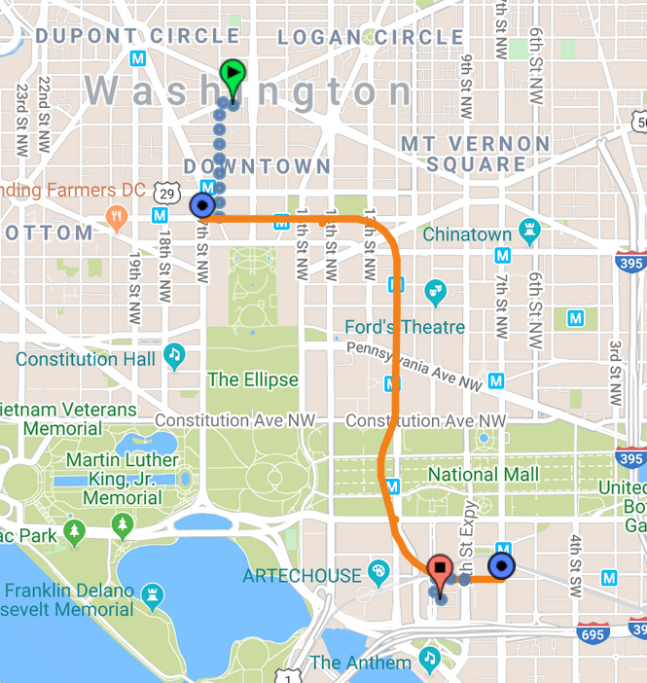
CSIS
International Spy Museum
700 L'Enfant Plaza, SW Washington, DC 20024
Farragut West
Metro – Orange,Blue or Silver Line from Farragut West to L’Enfant Plaza
L’Enfant Plaza

Slide 8
METRO: L'Enfant Plaza (Green, Yellow, Orange, Blue, and Silver lines).
L'Enfant Plaza Exit up the escalator to enter the L’Enfant Plaza food court.
Starbucks on your right as you reach the top of the escalator.
Enter the glass doors straight ahead to access the food court
At first hallway, at Roti Mediterranean Grill, turn right.
Straight Jamba Juice stand.
Up large flight of stairs in front of you, to ground level.
Exit through the glass doors to your left once you reach the top.
Walk towards 10th street, SW to access the Museum's main lobby doors.

Slide 9
Project Updates

Slide 10
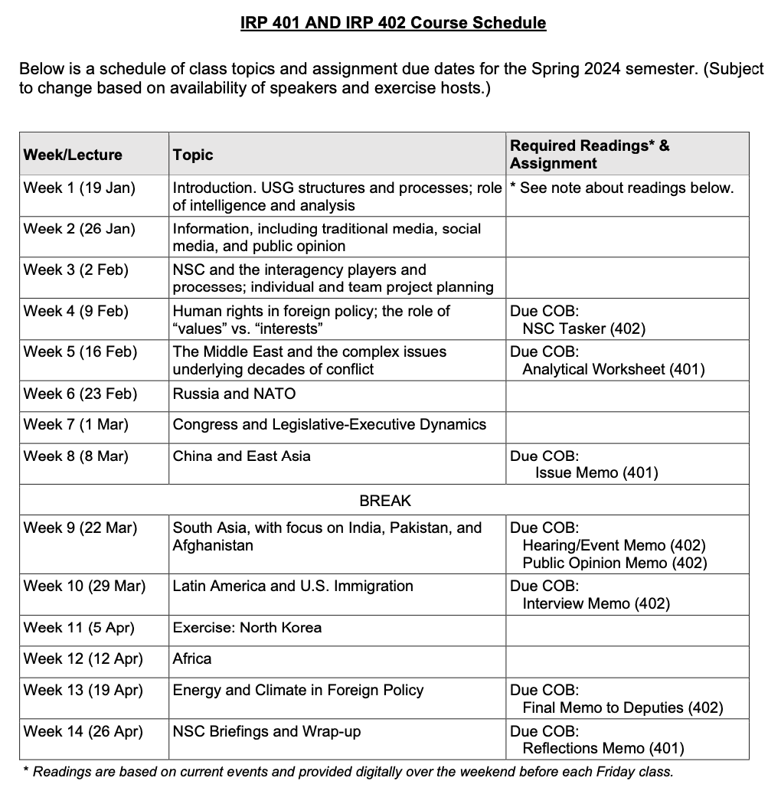
✓
401
402
✓
✓
What’s your plan?
✓
✓
QUESTIONS?
✓
✓

Slide 11
Project Planning
Akosua | U.S.-Russian: How constrain Putin? | Ensuring microchip competition and supply
Nicolas | U.S.-North Korea: How constrain Kim?
Marcus | U.S.-Vietnam tech/innovation ties | Education deficits in St. Paul, Minnesota
Mimi | Youth homelessness
Vaughn | Central America migration | Israel-Palestine: Two-state solution possible?
Matt | Crisis in Haiti
Gavin | Impact of COVID on mental health | U.S. policy toward Yemen and the Houthis
Noah | Reducing reliance on China trade
Meghan | Russia/Wagner influence in Africa | Impact of climate change on insurgency
Bryce | Improving gun control background checks
Emily | Russia WMD in wake of Ukraine war | How to deal with climate migrants/refugees
Tashakee | Negative impact of cobalt mining in DRC
Reese | South America climate migration | “War time policy”
Emma | U.S.-Mexico border deaths
Ding | Calming tensions on Korean peninsula | U.S. border-state challenges from immigration
Abby | Human trafficking | U.S. support to Ukraine defense against Russia
Jessica | Stopping the flow of fentanyl into U.S.

Slide 12
ETIQUETTE or PROTOCOL
Did this work for you?
Did you get enough info?
Professional respect
Smart, analytical questions
Non-combative tone
Depending on your style, perhaps preface question
What is your perspective on …?
What should we make of reports that …?
What do we need to know to understand …
Neutral vocabulary

Slide 13
ETIQUETTE or PROTOCOL
In ANY meeting … if guest/speaker is repeating self, consider …
Using body language to signal “message received”
Depending on your style, interrupting gently with a brief …
“thanks” or “I understand” or “I see”
paraphrasing
segue to colleague’s question/point
ask if you can ask followup
UNDERSTAND this: some people feel obligated to fill the time.

Slide 14
ETIQUETTE or PROTOCOL
Personal vs official views
Chatham House Rule
St. James’s Square London

Slide 15
READINGS AND MEETINGS
Foreign Assistance
Who gets what?

Slide 16
U.S. Senate Bill February 13, 2024
Vote 70-29
including 22 Republicans
$ 95 billion “emergency aid bill”
$ 60 billion Ukraine
$ 14 billion Israel
~$ 20 billion other
$ 15 billion to replenish U.S. stocks
$ 14 billion for UKR to purchase arms and munitions
$ 15 billion for U.S. support services, such as mil training and intel sharing
($ 7.9 billion in economic aid)
($ 1.6 billion for private sector)
$ 4 billion to boost air defenses
$ 1.2 billion for “Iron Beam” laser anti-missile system
$ 2.5 billion for U.S. military operations in the region
$ 5 billion for Taiwan and others in “Indo-Pacific” facing Chinese “aggression”
$ 9.2 billion humanitarian (food, water, shelter, medical in UKR, Gaza/WB, and other)
$ 400 million for anti hate crimes and fentanyl
Sen. McConnell: Package “reaffirming a commitment to rebuild and modernize our military, restore our credibility, and give the current Commander-in-Chief, as well as the next, more tools to secure our interests.”

Slide 18
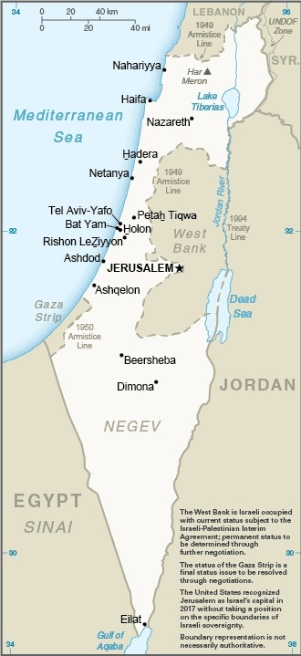
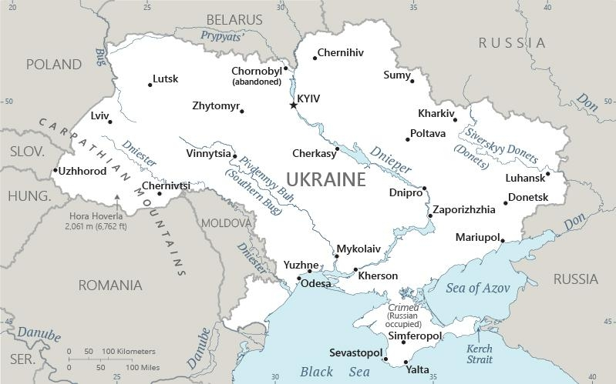
READINGS AND MEETINGS
What do you think is going on … and is going to happen?
Israel -Gaza
Ukraine-Russia

Slide 19
Break

Slide 20
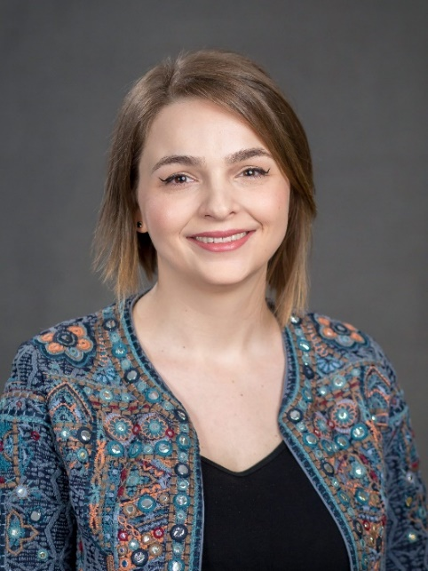
GUEST SPEAKER
RAND Corporation
Anca Agachi
Defense Policy Analyst RAND Corporation
Former Associate Director, Transatlantic Security Initiative Atlantic Council
Introduced by Abby

Slide 21
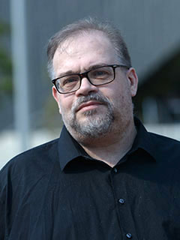
GUEST SPEAKER
Mitchell Plitnick
President, ReThinking Foreign Policy
Former VP, Foundation for Middle East Peace
Introduced by Tashakee

Slide 22
Lunch and Transit to Museum

Slide 23
Offsite Visit
Remember …
Role of intelligence in policy
“Foreign Intelligence”
“Covert Action” and “PM”
The “INT’s”
HUMINT SIGINT
IMINT MASINT
OSINT
Evolution
Human vs technical
The International Spy Museum

Slide 24
CSIS
International Spy Museum
700 L'Enfant Plaza, SW Washington, DC 20024
Farragut West
Enter at 2:10
Metro – Orange,Blue or Silver Line from Farragut West to L’Enfant Plaza
L’Enfant Plaza

Slide 25
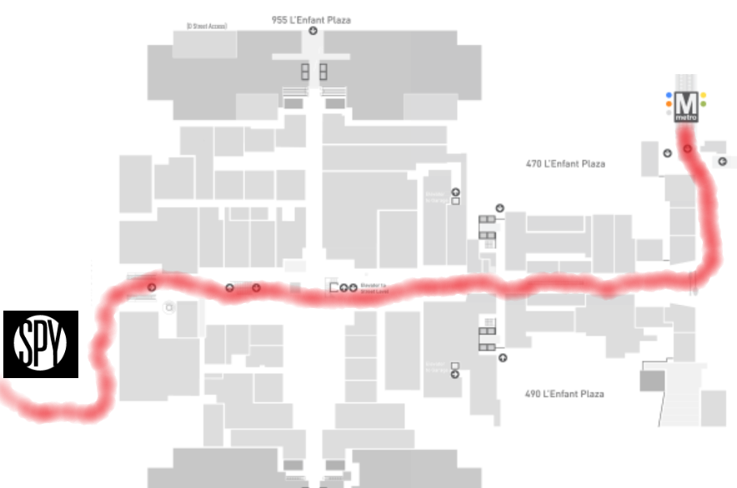
METRO: L'Enfant Plaza (Green, Yellow, Orange, Blue, and Silver lines).
L'Enfant Plaza Exit up the escalator to enter the L’Enfant Plaza food court.
Enter at 2:10

Slide 26
Global Policy Seminar and NSC Simulation
IRP 401 - IRP 402
Week Six 23 February 2024
Prof. Fulton T. Armstrong

