Slide 1
Global Policy Seminar and NSC Simulation
IRP 401 - IRP 402
Week Eight 8 March 2024
Prof. Fulton T. Armstrong

Slide 2
Week 1 (19 Jan)
Week 2 (26 Jan)
Week 3 (2 Feb)
Week 4 (9 Feb)
Week 5 (16 Feb)
Week 6 (23 Feb)
Week 7 (1 Mar)
Week 8 (8 Mar)
BREAK
Week 9 (22 Mar)
Week 10 (29 Mar)
Week 11 (5 Apr)
Week 12 (12 Apr)
Week 13 (19 Apr)
Week 14 (26 Apr)
SPRING 2024

Slide 3
TODAY’S AGENDA
9:00 | Class Discussion - Readings - Internship conversations: Gavin, Ding, Mimi
10:00 | Capt. Mike Orfini USN (Ret) Former Aide to Vice Presidents Gore and Cheney - Introduced by Meghan
11:30 | Lily McElwee Deputy Director and Fellow, Freeman Chair in China Studies Center for Strategic and International Studies (CSIS) - Introduced by Nicolas
12:40 | Lunch
2:00 | Ubers depart CSIS
2:30 | Counselor TAO Song Political Section, Embassy of China - First question and coordination by Ding

Slide 4
TODAY’S AGENDA
9:00 | Class Discussion - Readings - Internship conversations: Gavin, Ding, Mimi
10:00 | Capt. Mike Orfini USN (Ret) Former Aide to Vice Presidents Gore and Cheney - Introduced by Meghan
11:30 | Lily McElwee Deputy Director and Fellow, Freeman Chair in China Studies Center for Strategic and International Studies (CSIS) - Introduced by Nicolas
12:40 | Lunch
2:00 | Ubers depart CSIS
2:30 | Counselor TAO Song Political Section, Embassy of China - First question and coordination by Ding

Slide 5
Washington dialect
“Please submit it in the appropriate format.”

Slide 6
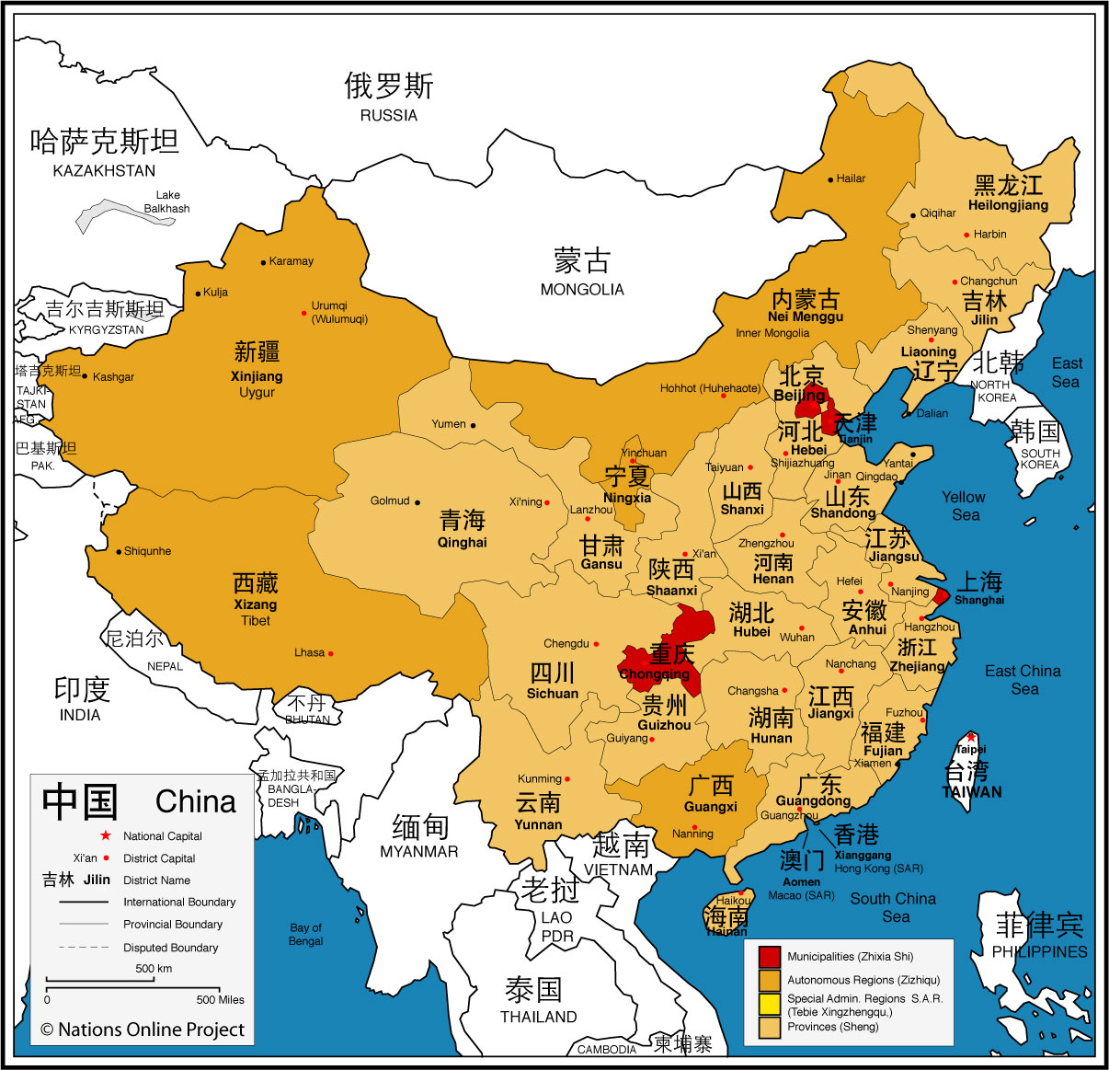
CHINA
Municipalities (Zhixia Shi) 北京 Beijing 重庆 Chongqing 上海 Shanghai and 天津 Tianjin
Self-governing districts under the direct jurisdiction of the central government.

Slide 7
CHINA
Autonomous Regions (Zizhiqu)
广西 Guangxi 内蒙古 Inner Mongolia 宁夏 Ningxia 西藏 Tibet 新疆 Xinjiang Uyghur Autonomous Region
An administrative region where the minority (Chinese Han) is the majority in the local government and congress.

Slide 8
CHINA
Special Administrative Regions (SAR)
香港 Hong Kong
澳门 Macau
This Special Administrative Regions under the policy of
"One Country, Two Systems.”

Slide 9
CHINA
1.4 billion
HAN = 91.1 percent
PRC recognizes 56 ethnic groups. Biggest include:
Zhang Hui Manchu Uighur Miao Yi Tujia Tibetan Mongol | Dong Buyei Yao Bai Korean Hani Li Kazakh Dai

Slide 10
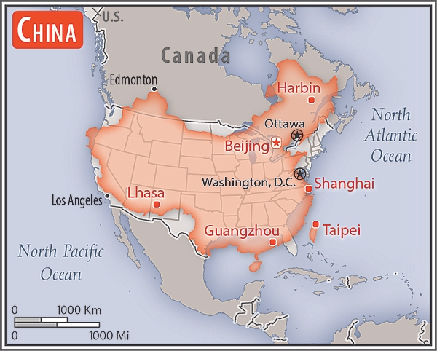
9,595,960 sq km
Slightly smaller than the United States (9,984,670 sq km).

Slide 11
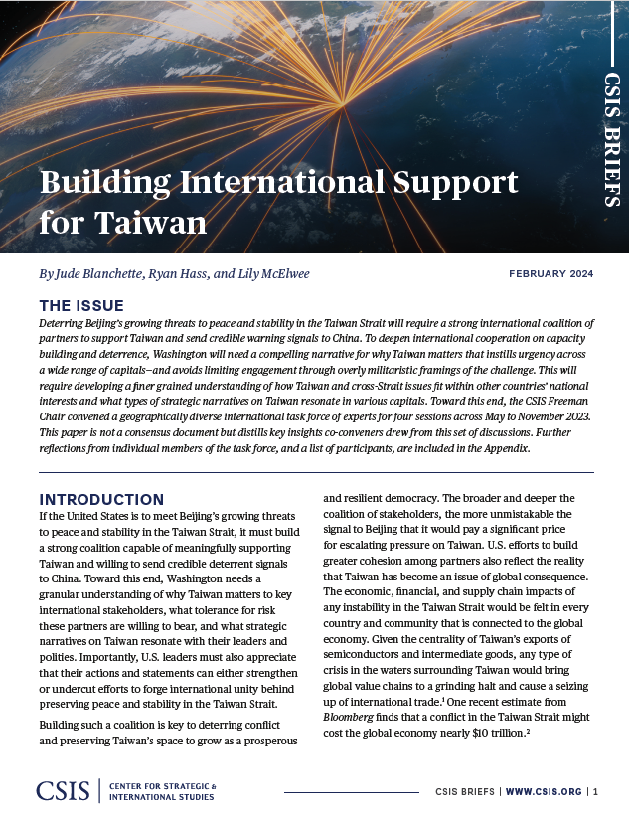
Taiwan International Support
What are the main points?
China is “growing threat to peace and stability in the Taiwan Strait.”
Deterring China requires a “strong international coalition of partners” amid “crisis fatigue.”
The coalition must send “credible warning signals.”
That includes “capacity building and deterrence.”
Washington needs …
narrative that shows Taiwan “fits within other countries’ national interests” (vice arguments about democracy or sovereignty).
avoid saying things that undercut unity.

Slide 12
Possible questions
If a “one China” policy was good enough from 1947 (recognizing the ROC) through normalization (recognizing the PRC), why is it no longer viable?
To clarify: Are the “bad” scenarios premised only on tensions from China taking Taiwan – and Taiwan (with or without international support) resisting? If so, are the solutions to persuade China to not take, or persuade Taiwan to not resist?
What are “credible deterrent signals”? Can such signals themselves be provocative? Which would be, and which not?
Is U.S. industry and business prepared for the U.S. to have prolonged tensions over Taiwan with China?

Slide 13
OTHER READINGS
Secretary Yellen’s remarks on the Economic Relationship
Wilson Center on Critical Challenge by Robert Daly
CRS China Primer
HuffPost on “Why China Works” by ZHANG Weiwei

Slide 14
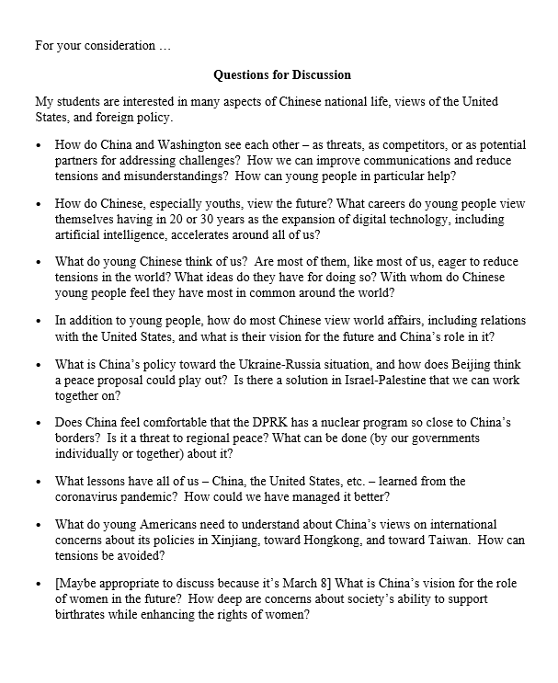
Mr. TAO Song, Counselor and Chief of Political Affairs
ZHAO Qi
YANG Yajun
Ding will ask first question.

Slide 15
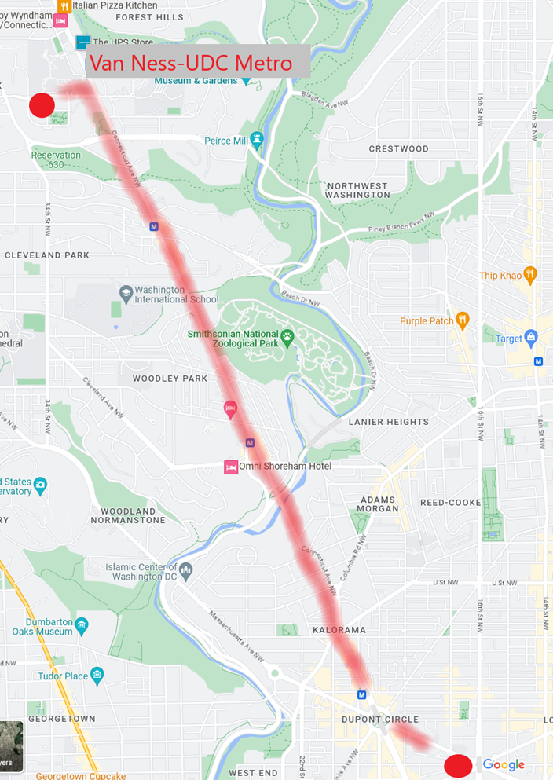
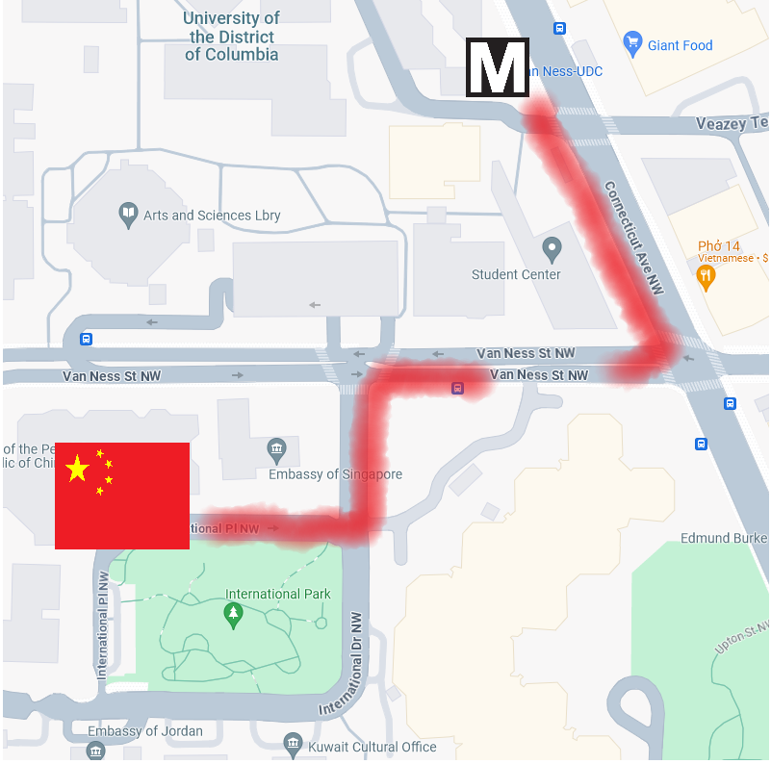
DEPART CSIS at 2:00pm
3 Uber-XL

Slide 16
Internship conversations
2-3 minutes each --
INFORMAL DISCUSSION
Organization name and business
In-person, virtual, hybrid
My tasks and responsibilities
Communications and team dynamics
Fun things and challenges
Gavin
Ding
Mimi

Slide 17
Project Planning
Akosua | U.S.-Russia: How constrain Putin? | Ensuring microchip competition and supply
Nicolas | U.S.-North Korea: How constrain Kim?
Marcus | U.S.-Vietnam tech/innovation ties | U.S. education deficits
Mimi | Youth homelessness
Vaughn | Central America migration | Israel-Palestine: Two-state solution possible?
Matt | Crisis in Haiti
Gavin | Impact of COVID on mental health | U.S. policy toward Yemen and the Houthis
Noah | Reducing reliance on China trade
Meghan | Russia/Wagner influence in Africa | Impact of climate change on insurgency
Bryce | Improving gun control background checks
Emily | Russia WMD in wake of Ukraine war | How to deal with climate migrants/refugees
Tashakee | Negative impact of cobalt mining in DRC
Reese | South America climate migration | “War time policy”
Emma | U.S.-Mexico border deaths
Ding | Calming tensions on Korean peninsula | U.S. border-state challenges from immigration
Abby | Human trafficking | U.S. support to Ukraine defense against Russia
Jessica | Stopping the flow of fentanyl into U.S.

Slide 18
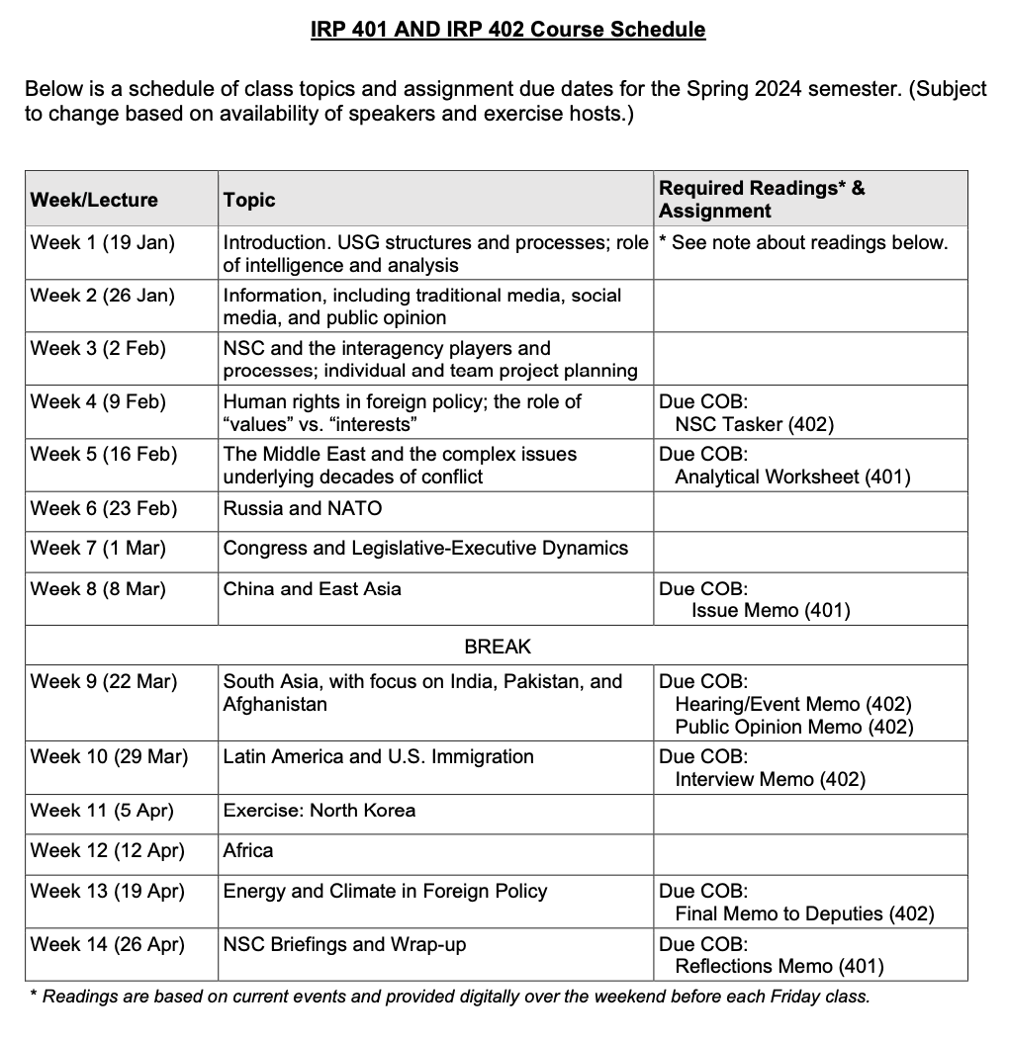
✓
401
402
✓
✓
Confirm: Everyone has a plan?
✓
✓
QUESTIONS?
✓
✓

Slide 19
Are you running into any difficulties?
- Finding information
- Doing analysis
- Developing 0ptions
- Formulating a recommendation
Do you remember the elements of a memo?
Are the templates working for you?

Slide 21
Encryption
Securely sending information
“One-time pad”
Book code or book cipher
Encryption machines
Computer encryption

Slide 22
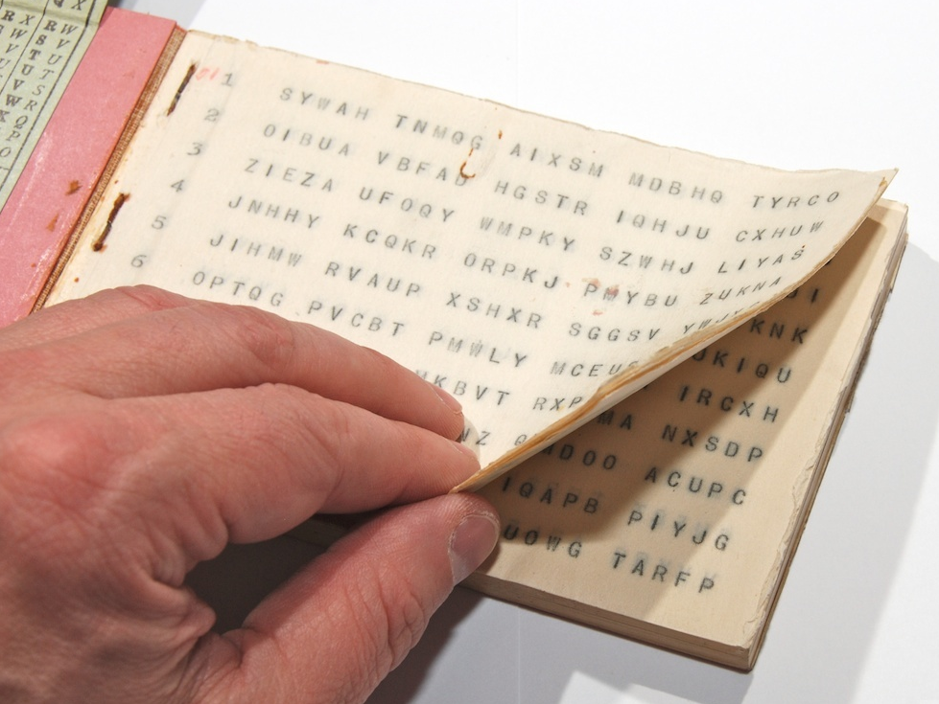
“One-time pad”
keys
A series of groups of letters
Two identical copies
Used agreed-upon day/time
Extremely secure (if pad is secure)
Notes:
NOTE FIVE GROUPS OF FIVE LETTERS – because A=0

Slide 23
“One-time pad”
keys
A series of groups of letters
Two identical copies
Used agreed-upon day/time
Extremely secure (if pad is secure)
AN EXAMPLE … Let’s say …
First key is SBMHR
Your requirement is: What is the enemy having for lunch?
Notes:
NOTE FIVE GROUPS OF FIVE LETTERS – because A=0

Slide 24
Key begins with: SBMHR
Message you want to send: PIZZA
Message: | P |  | I |  | Z |  | Z |  | A
Values: | 14 |  | 8 |  | 25 |  | 25 |  | 0
Key: | S |  | B |  | M |  | H |  | R
Values: | 17 |  | 1 |  | 12 |  | 7 |  | 16
Sum: | 5 |  | 9 |  | 11 |  | 6 |  | 16
Ciphertext: | F |  | J |  | L |  | G |  | R

Slide 25
Key begins with: SBMHR
Message you want to send: PIZZA
Message: | P |  | I |  | Z |  | Z |  | A
Values: | 14 |  | 8 |  | 25 |  | 25 |  | 0
Key: | S |  | B |  | M |  | H |  | R
Values: | 17 |  | 1 |  | 12 |  | 7 |  | 16
Sum: | 5 |  | 9 |  | 11 |  | 6 |  | 16
Ciphertext: | F |  | J |  | L |  | G |  | R
Notes:
Once again!!!

Slide 26
MSG from HQS:
What is the enemy going to eat for lunch?
Your encoded REPLY:
F J L G R
On subsequent mentions of PIZZA, you will not repeat F J L G R, because you’ll use a different key from the OTP.

Slide 27
“Book Code”
Two identical copies of a book
Commercially available; doesn’t look like a codebook
Flexible date/time
Caution: Vocabulary has to be appropriate to intelligence information

Slide 28
“Book Code”
page/line/word | 842914
paragraph/word | 1586

Slide 29
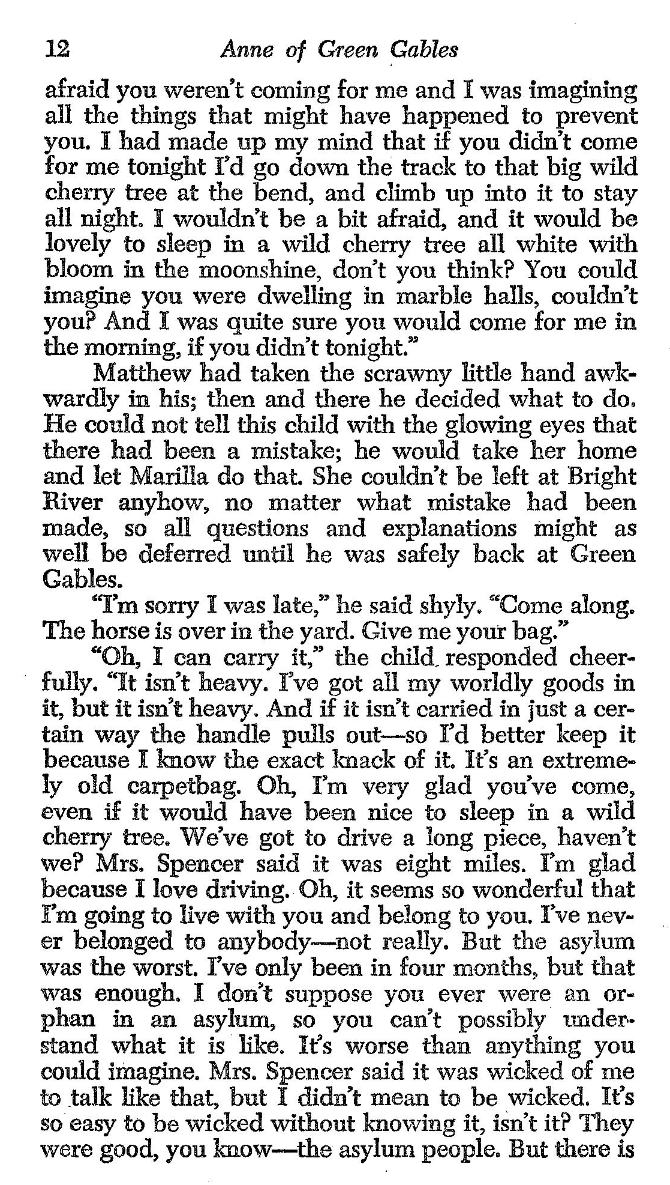
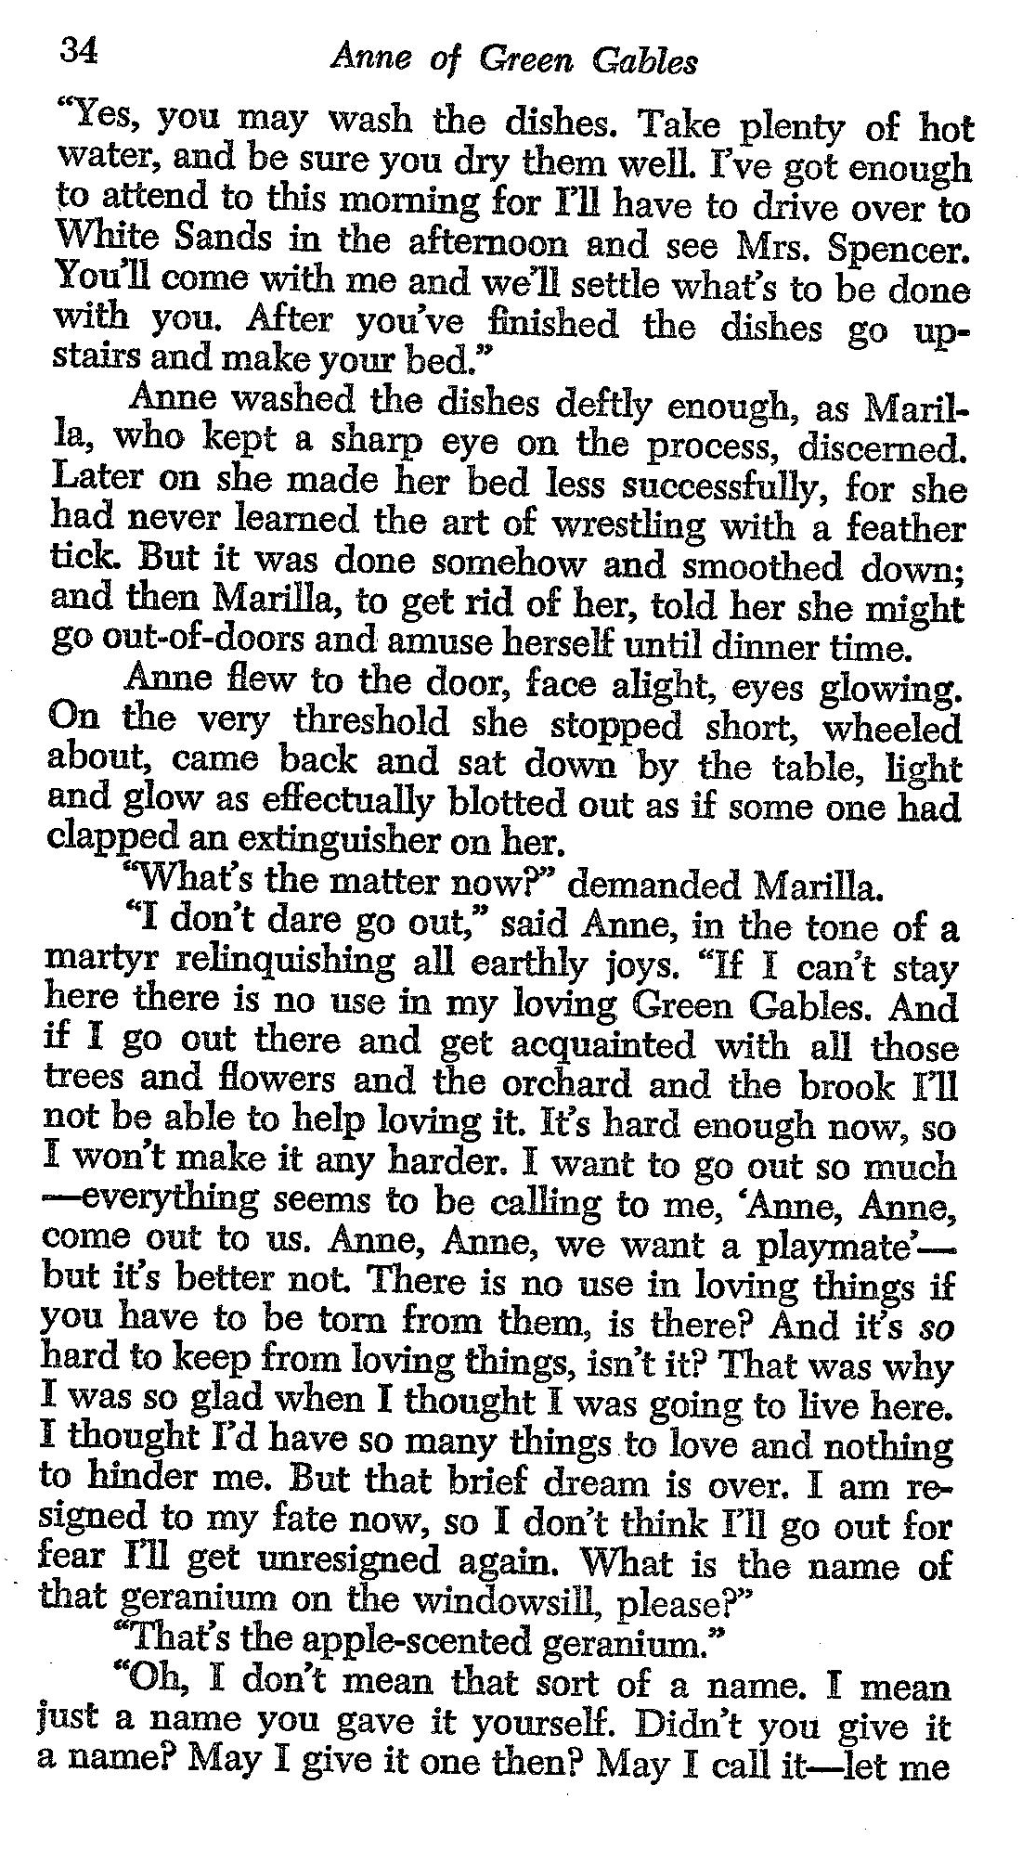
121003
343409
340102
I
LOVE
YOU

Slide 30
REMINDER
In ANY meeting … if guest/speaker is repeating self, consider …
Using body language to signal “message received”
Depending on your style, interrupting gently with a brief …
“thanks” or “I understand” or “I see”
paraphrasing
segue to colleague’s question/point
ask if you can ask followup
UNDERSTAND this: some people feel obligated to fill the time.

Slide 31
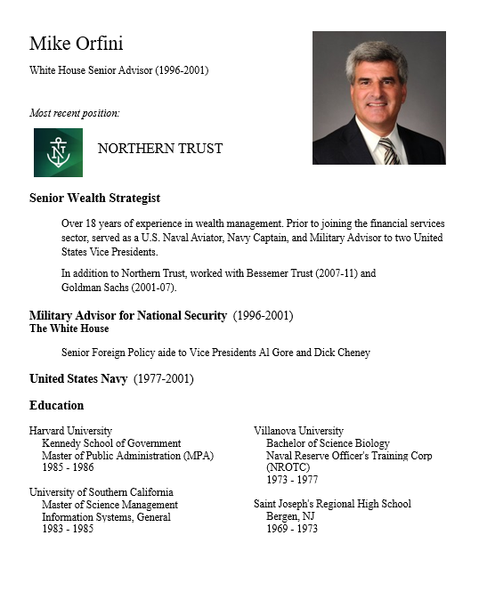
GUEST SPEAKER
Mike Orfini
former White House Senior Advisor
Introduced by Meghan

Slide 32
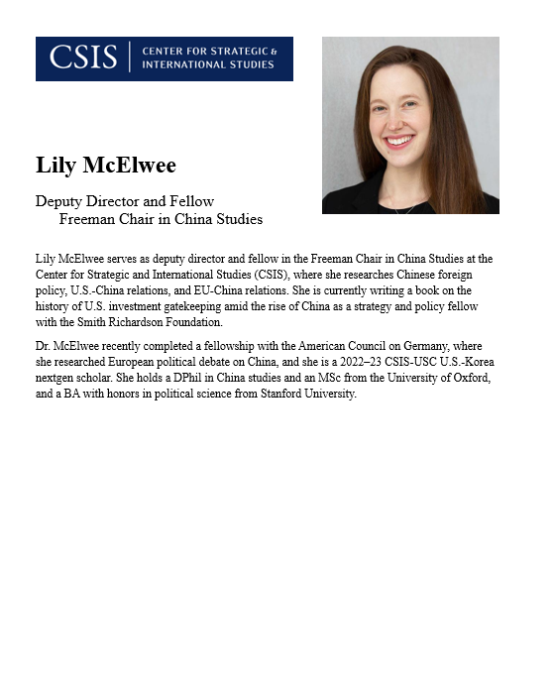
GUEST SPEAKER
Lily McElwee
CSIS Deputy Director and Fellow
Freeman Chair in China Studies
Introduced by Nicolas

Slide 33
WRAPUP

Slide 34
After the Break
Taiwan and China-Taiwan
South Asia
Afghanistan
Pakistan
More INTERNSHIP discussions Three volunteers?
Anything else?

Slide 35
Global Policy Seminar and NSC Simulation
IRP 401 - IRP 402
Week Eight 8 March 2024
Prof. Fulton T. Armstrong

