Slide 1
Outline
Introduction
General situation
US in Sub-Saharan Africa
What’s gone wrong
Way ahead

Slide 2
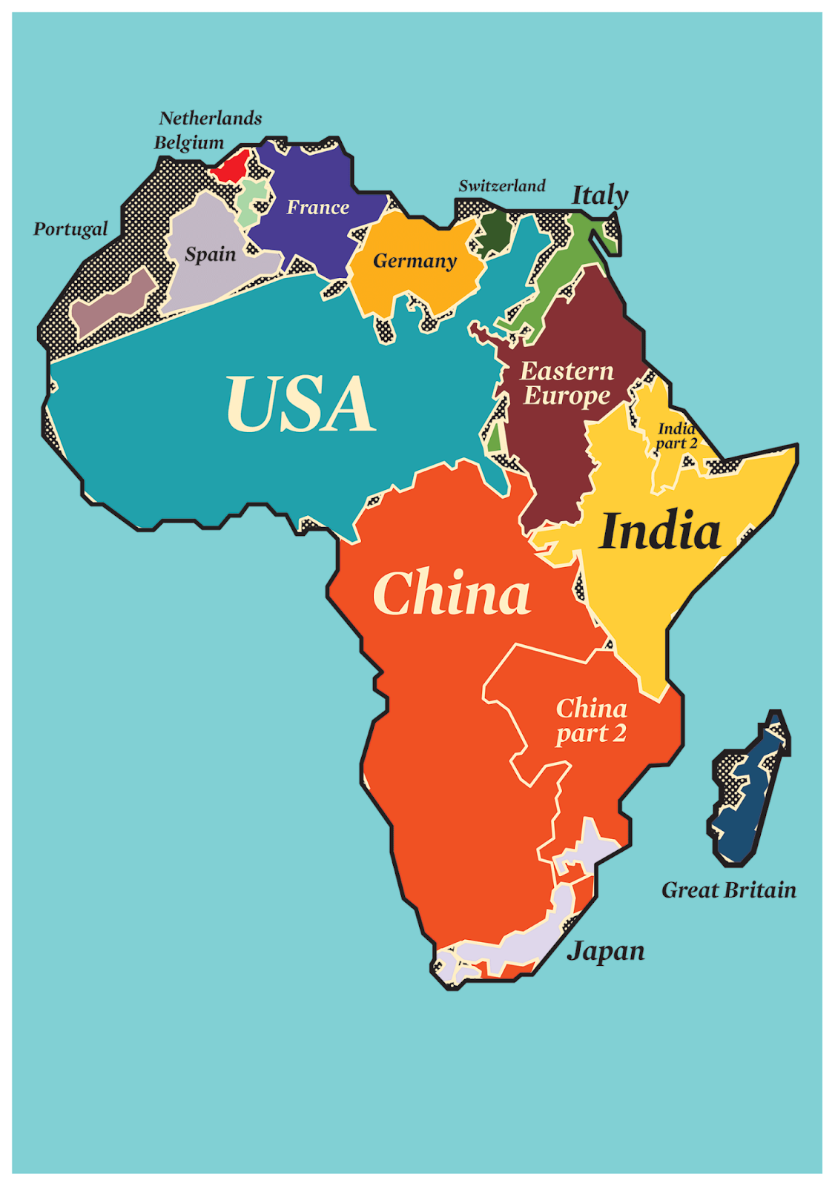
General Situation

Slide 3
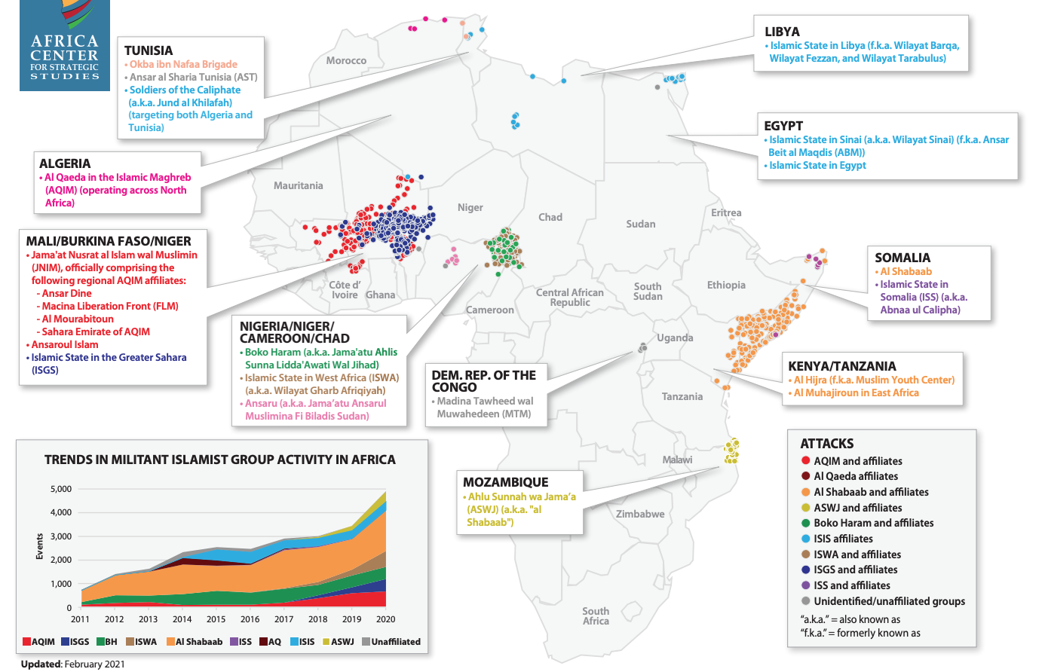
General Situation

Slide 4
Historical US Policy Toward Sub-Saharan Africa
Low Priority
The US has never concerned itself with Africans for their own sake
Cold War lens
1990s neo-liberal interlude
Post-9/11 Counter-Terrorism lens
China/Strategic minerals?

Slide 5
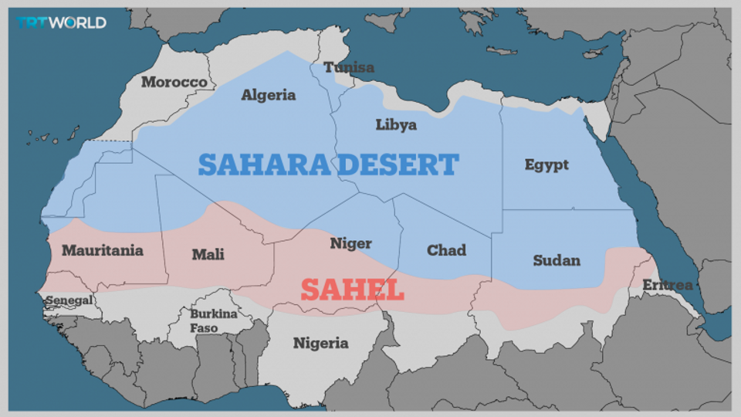
The Sahel

Slide 6
Mozambique: The Next Big Thing
Violent extremists aligned with IS
State failure
Hydrocarbons
Great Power Competition

Slide 7
Ethiopia

Slide 8
Sudan

