Slide 1

The Washington Policy Memo
- Writing for Policymakers who Need to Make Decisions -
Fulton T. Armstrong
Tuesday
16 January 2024

Slide 2
What is a Washington
Policy
Memo?
What kinds are there?
What do good memos have in common?
How are they different from academic papers?
Why is it important to write well?

Slide 3
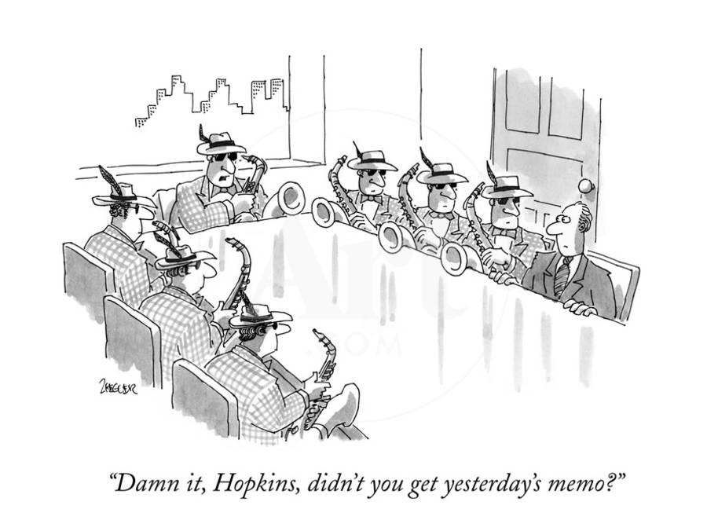
SOME memos …
notify of something that’s coming up
© New Yorker

Slide 4
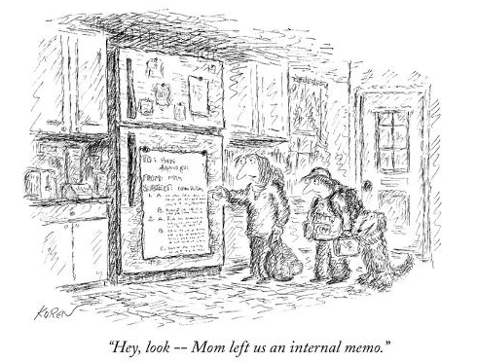
SOME memos …
notify of something that’s already decided
© New Yorker

Slide 5
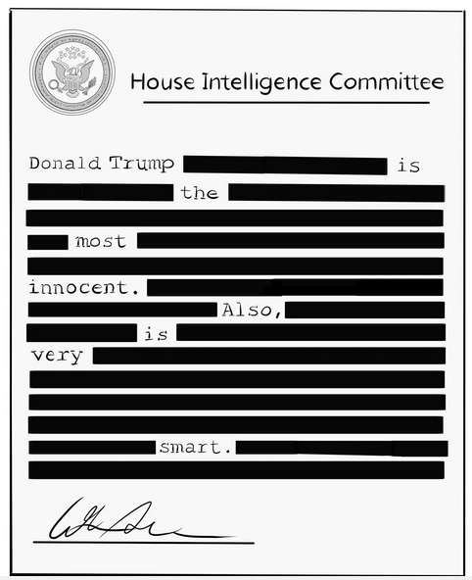
And SOME memos …
do not inform us of anything.
The President
© New Yorker (adapted)

Slide 6
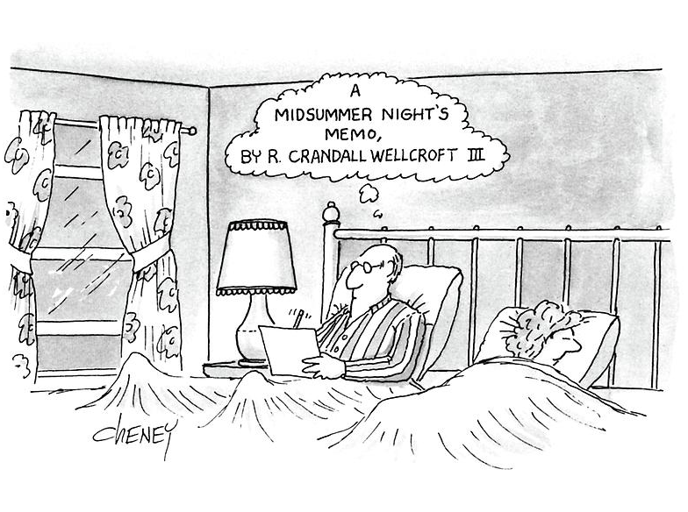
SOME memos …
explore new ideas
© New Yorker

Slide 7
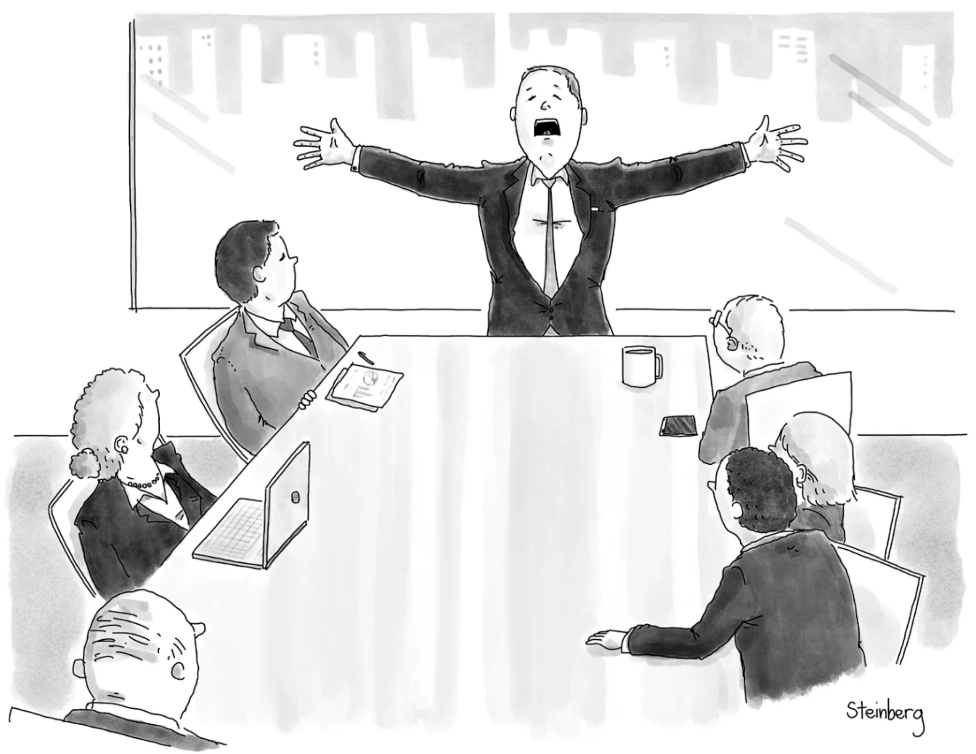
And SOME memos …
are intended to help people make decisions.
© New Yorker

Slide 8
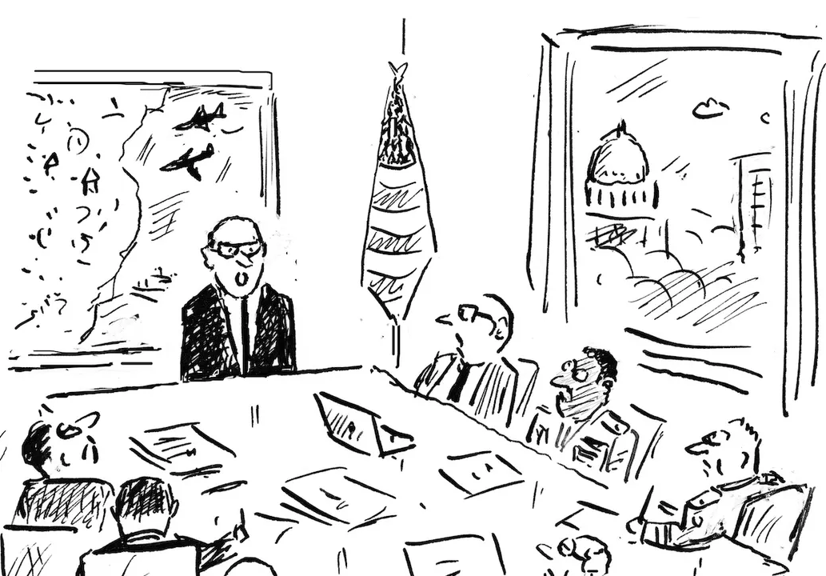
And SOME memos …
are intended to help people make decisions.
© New Yorker

Slide 9
In Washington Speak, they basically boil down to …
The information memo
The decision (or options) memo
The guidance memo
The Memorandum of Conversation
The intelligence (or research) memo
Summary of Conclusions
Talking points
Scenarios
Implementation

Slide 10
The ESSENTIAL ROLE of the intelligence (or research) memo – even though it’s not a “policy” memo
Like … the difference between source stories/analysis and editorials/opinion pieces in media.

Slide 11
Are all memos alike – with same structure, style, etc?
NO.
Approach to options
Language & terms
Values & objectives
(& politics?)
Different purposes (per above)
Different agencies
Different clearance/coordination
Different audience/dissemination
BUT ... all have IMPORTANT things in common ………..

Slide 12
What do good memos have in common?
JOB ONE:
MAKE IT EASY FOR YOUR READER TO GET WHAT THEY NEED TO KNOW.
Brevity | They don’t waste readers’ time.
Conciseness | They’re not sloppy, long-winded.
Clarity, precision | They don’t make reader sort through ambiguity.
Relevance | They don’t burden reader with clutter.
Objectivity | They don’t get bogged down in values, norms.
Readability | They’re not obtuse, ornate, distracting.

Slide 13
JOB ONE:
MAKE IT EASY FOR YOUR READER TO GET WHAT THEY NEED TO KNOW.
Digestible declarative sentences
Good, practical grammar
Unambiguous but “normal” vocabulary
Clear logic
Transparent drafter
Zero, minimal, or clearly labeled editorializing

Slide 14
What are the differences between academic writing and memo-writing?
“Washington Memo”
Purpose(s)
“Action”; empower reader by educating.
Scope
Background
Relevance
Only what reader needs to know to decide.
Only what’s relevant.
Examples to show point, not encyclopedia.
Style
Language
Length
Voice
Concise, direct, active.
“As brief as possible” (usually two pages).
Objective, not ornate.
Structure

Slide 15
Standard Info Memo
Standard Decision Memo
DIFFERENT EMPHASIS FOR DIFFERENT PURPOSES, OF COURSE
Subject: | Clear, crisp
Subject: | Clear, crisp
Thesis: | BLUF, analytical
Thesis: | BLUF, analytical
Framing: | What, when, who, where
Framing: | What, when, who, where
Dynamics: | Why, how
Dynamics: | Why, how
OPTIONS: | Stated, assessed; interagency views
Outcomes: | Likely, less likely (and why)
Outcomes: | Likely, less likely (and why)
Implications: | Why matter?
Implications: | Why matter?
RECOMMENDATION

Slide 16
Standard Info Memo
Standard Decision Memo
Subject: | Clear, crisp
Subject: | Clear, crisp
Thesis: | BLUF, analytical
Thesis: | BLUF, analytical
Framing: | What, when, who, where
STANDARD BRIEFING, TOO!
Framing: | What, when, who, where
Dynamics: | Why, how
Dynamics: | Why, how
OPTIONS | Stated, assessed; interagency views
Outcomes: | Likely, less likely (and why)
Outcomes: | Likely, less likely (and why)
Implications: | Why matter?
Implications: | Why matter?
RECOMMENDATION

Slide 17
The ways Washington memos are prepared, researched, drafted, and edited are different, too.
Obsessively ask ourselves ...
  What does the reader need to know (based on my understanding of my issue and their world)?
  Does every word, phrase, sentence, and paragraph make it easy for my reader to grab and run?
  If necessary, can I summarize my conclusions/ recommendations in 30 seconds or less?

Slide 18
Why is it important to be able to write a good “Washington Memo”?
Good writing is the single most important skill in this business
because it shows …
you can think
you can communicate
you know what’s relevant
you are ready to operate
Other skills are important, but writing is central to almost all of them.

Slide 19
What do you do this semester?
Listen to professors’ guidance on assignments and make sure you’re clear on …
    Purpose
    Agency and interests
    Style and voice
Become aware of the importance of quality writing in your internships and other Washington experiences
Care about your writing
    Realize its importance
    Explore resources that will help you improve
    Become your own toughest editor
    Re-read your own work after time (celebrate or improve)
Real success will depend on YOU, but your professors will give you guidance.

Slide 20
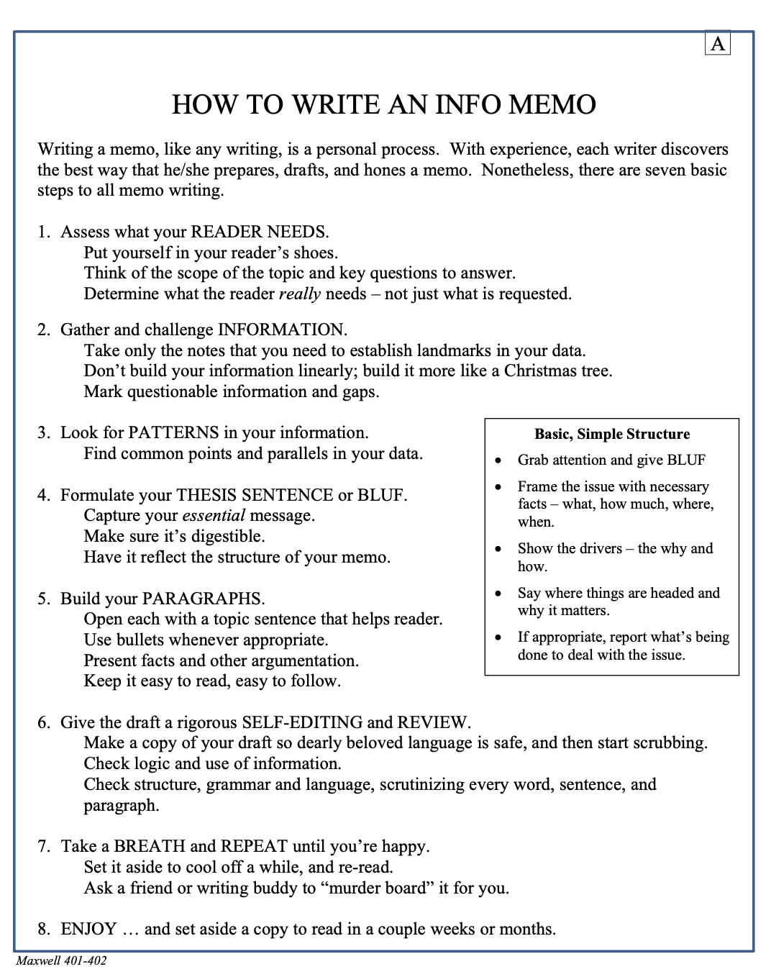
Use the resources at your disposal
Writing Consultant Nitya Chagti
Materials on Blackboard
Style guides and dictionaries
Handouts from professors
(and templates/rubrics)
HANDOUT A

Slide 21
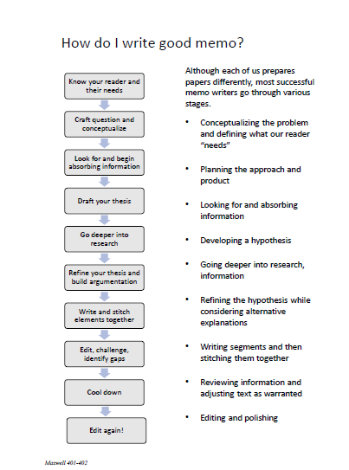
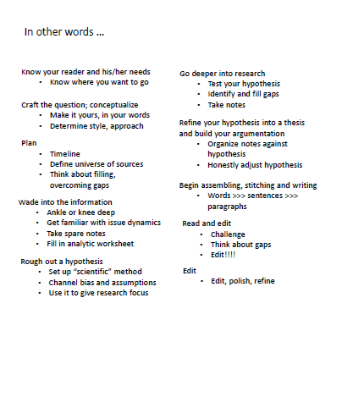
Use the resources at your disposal
Writing Consultant Nitya Chagti
Materials on Blackboard
Style guides and dictionaries
Handouts from professors
(and templates/rubrics)
HANDOUT B

Slide 22
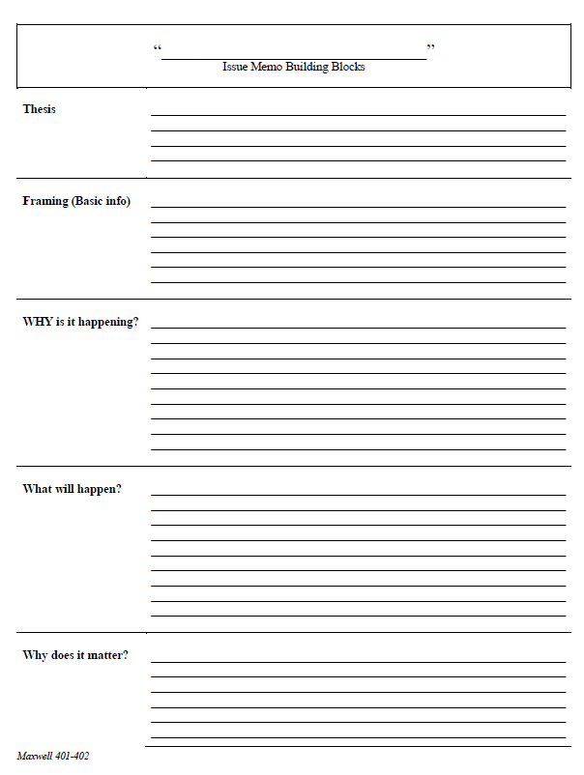
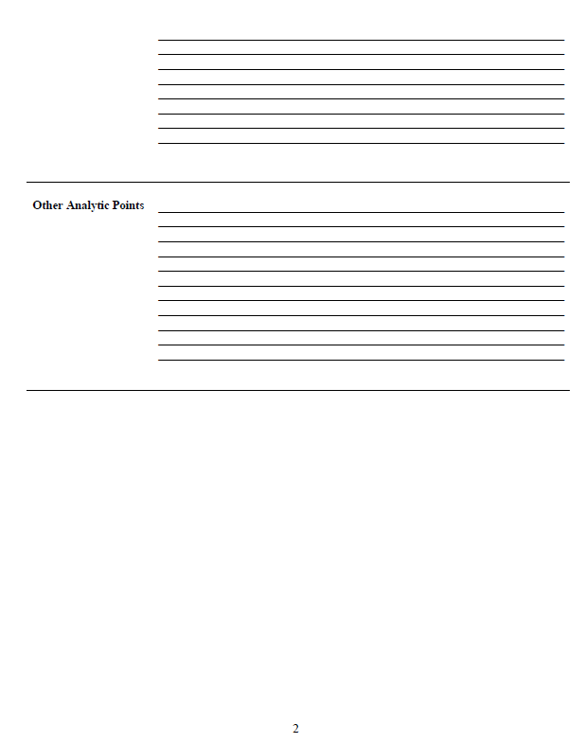
Use the resources at your disposal
Writing Consultant Nitya Chagti
Materials on Blackboard
Style guides and dictionaries
Handouts from professors
(and templates/rubrics)
HANDOUT C

Slide 23
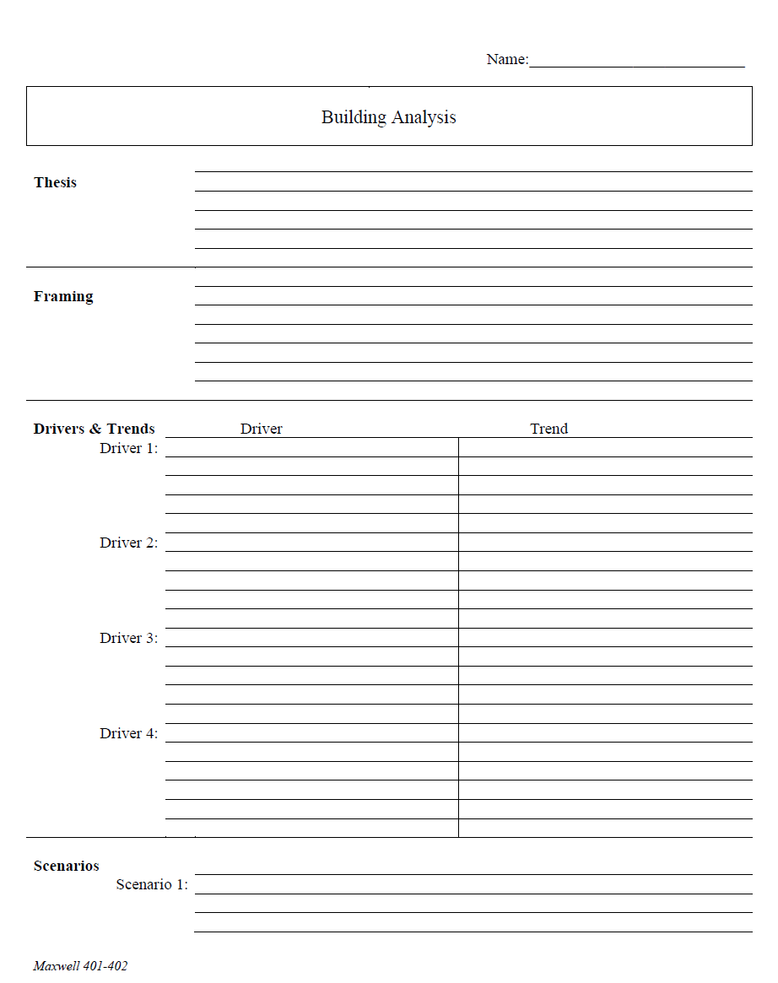
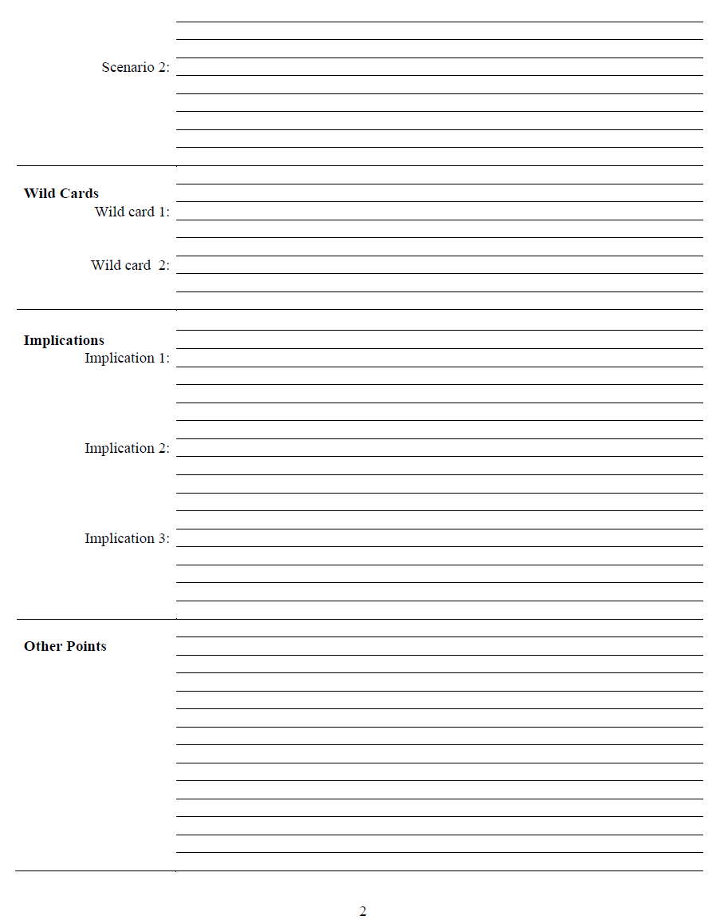
Use the resources at your disposal
Writing Consultant Nitya Chagti
Materials on Blackboard
Style guides and dictionaries
Handouts from professors
(and templates/rubrics)
PLUS …
List of options
Pro’s and con’s
Agency positions
Recommendation
HANDOUT D

Slide 24
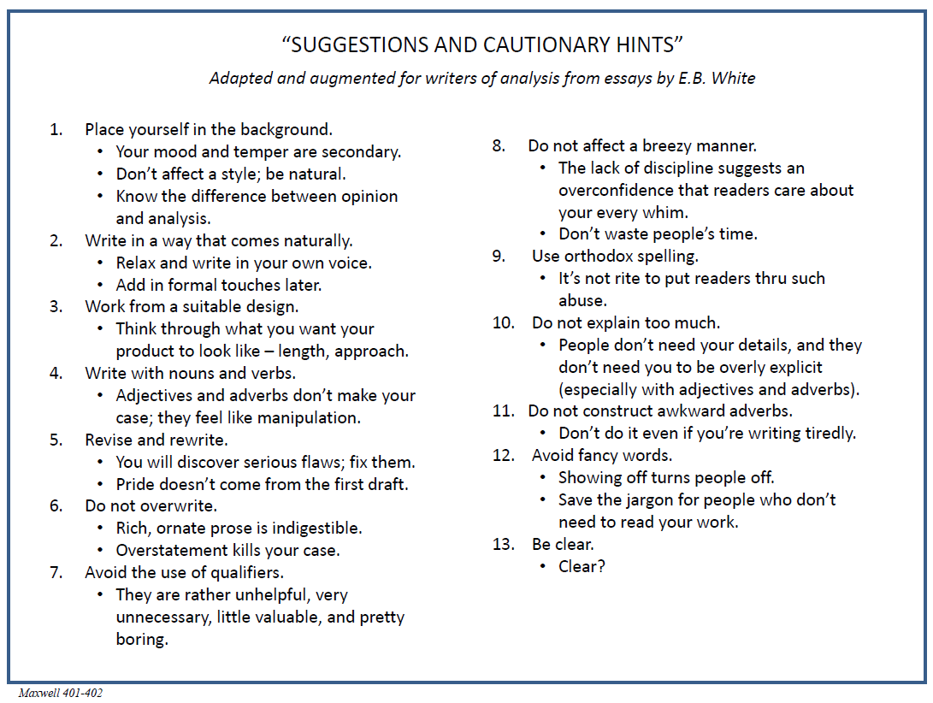
Use the resources at your disposal
Writing Consultant Nitya Chagti
Materials on Blackboard
Style guides and dictionaries
Handouts from professors
(and templates/rubrics)
HANDOUT E

Slide 25
One last thought …
This semester (and the “Washington Memo” artform) give you an opportunity to un-learn some bad habits and form new ones.
ENJOY WRITING.
Plan and prepare.
Feel the power of a clear thought.
Feel the power of brevity.
Write with purpose.
Liberate yourself from being linear.

Slide 26
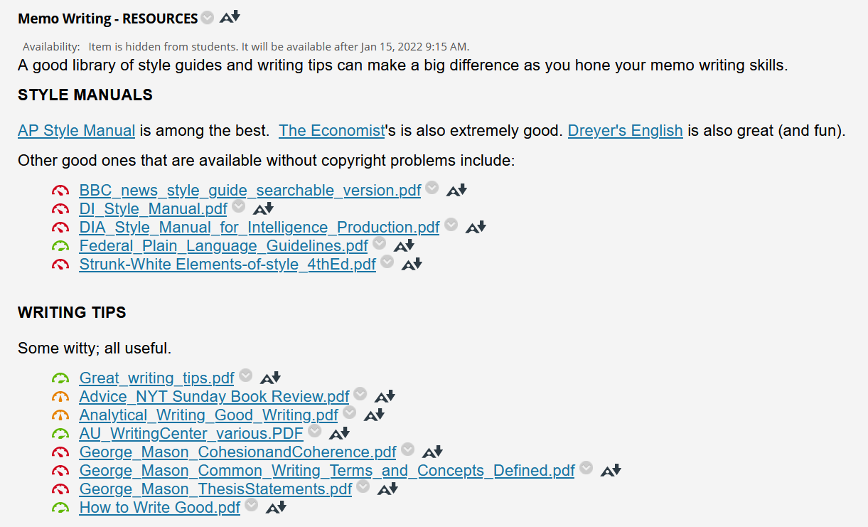
What do you do this semester?
Use the resources at your disposal (here and on SU sites)

Slide 27
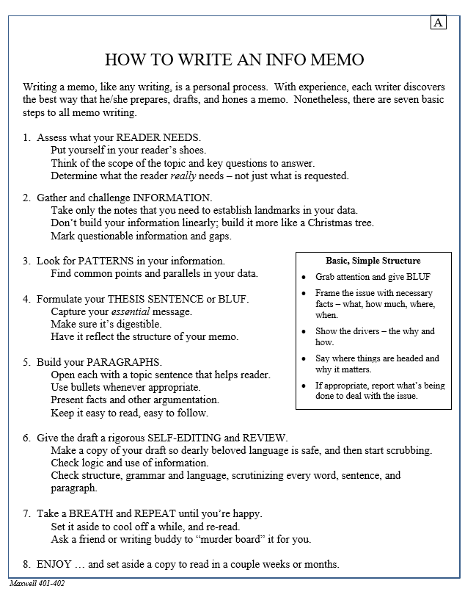
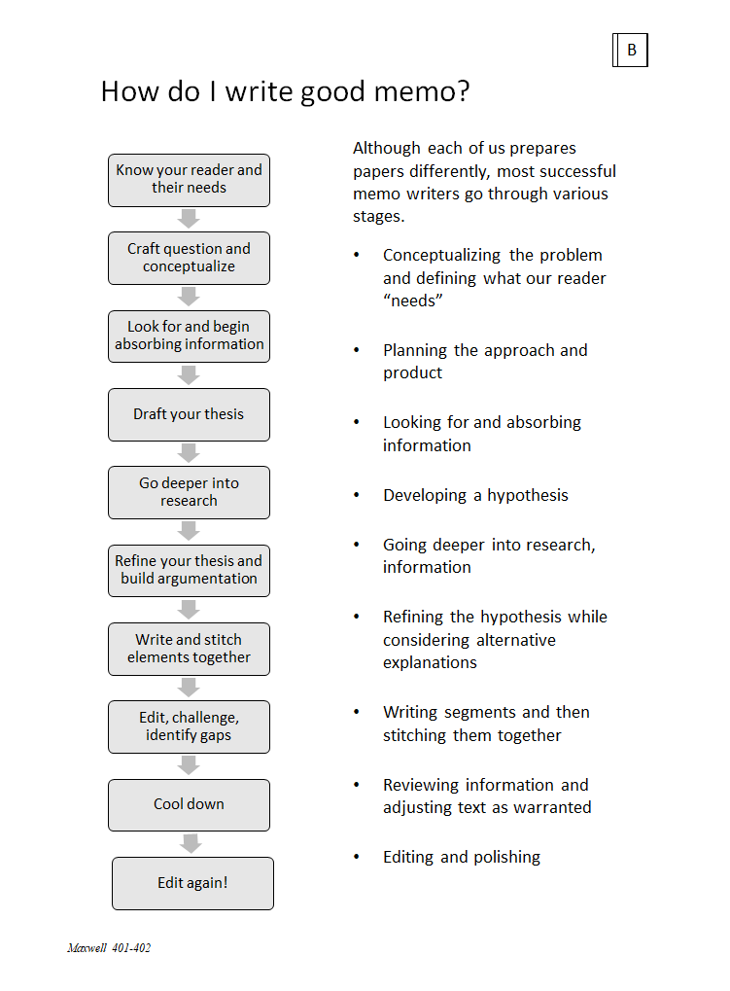
A little taste …
BUT … REPEAT … REPEAT … SUCCESS DEPENDS ON YOU.

Slide 28
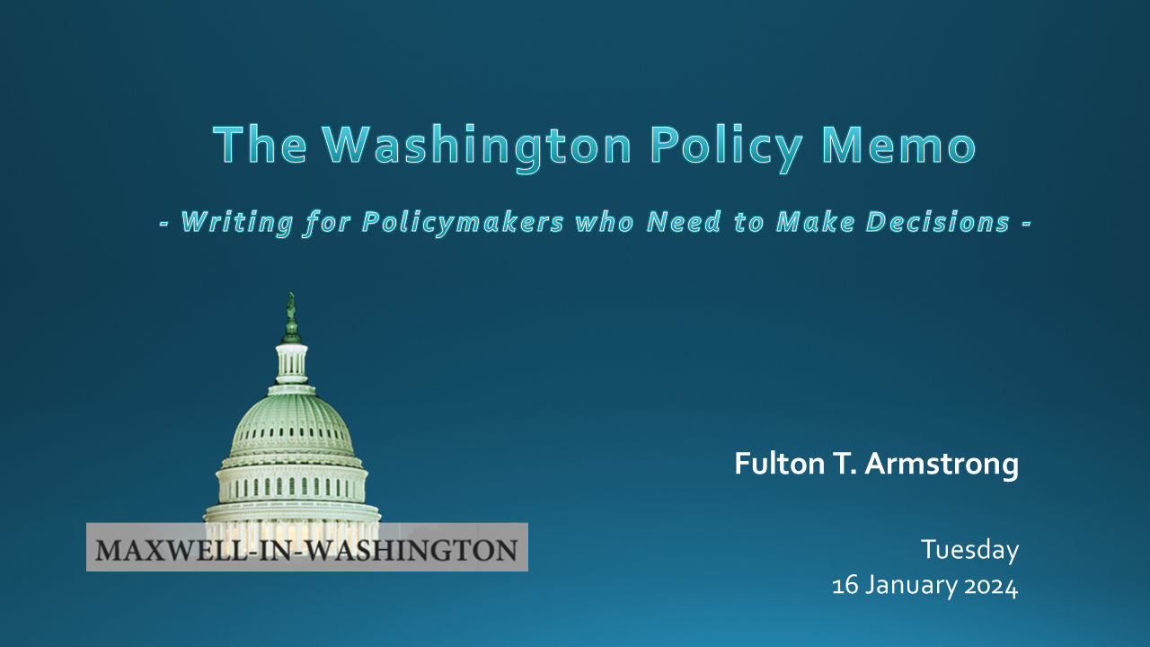
Questions? Comments?
Feel free to drop me an e-mail at farmstro@syr.edu

