Slide 1
The Washington Analytical Memo
- An Analytical Model for Making Information Actionable -
Fulton T. Armstrong
Wednesday 17 January 2024

Slide 2
What is analysis?
What is it about someone that makes you think, “That person is intelligent”?

Slide 3
My Main Bias:
Good information and good analysis are at the heart of ALL good policy.
And bad information and bad analysis are at the heart of ALL bad policy.
A SECOND bias:
There’s rarely a *single* right answer.

Slide 4
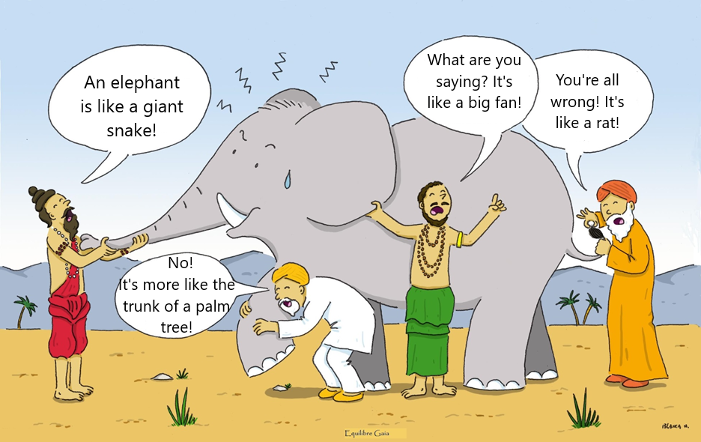
The Role of Intelligence: The Blind Men and the Elephant
First Purpose: Getting facts to say WHAT we perceive.
SECOND Purpose: Make sense of it -- what it means.
Notes:
Somos como en la historia india … los ciegos que quieren entender qué es un elefante. Cada uno lo toca, pero nadie entiende qué es hasta que se unan sus observaciones.
Un analista de una agencia de inteligencia … o un académico … o un periodista … o un representante de un negocio … quizás tenga información interesante, pero no es inteligencia hasta que, como sociedad, se una lo que saben y opinan del fenómeno que están observando.

Slide 5
The Role of Intelligence: The Blind Men and the Elephant
Are they developing good analysis?
Notes:
Somos como en la historia india … los ciegos que quieren entender qué es un elefante. Cada uno lo toca, pero nadie entiende qué es hasta que se unan sus observaciones.
Un analista de una agencia de inteligencia … o un académico … o un periodista … o un representante de un negocio … quizás tenga información interesante, pero no es inteligencia hasta que, como sociedad, se una lo que saben y opinan del fenómeno que están observando.

Slide 6
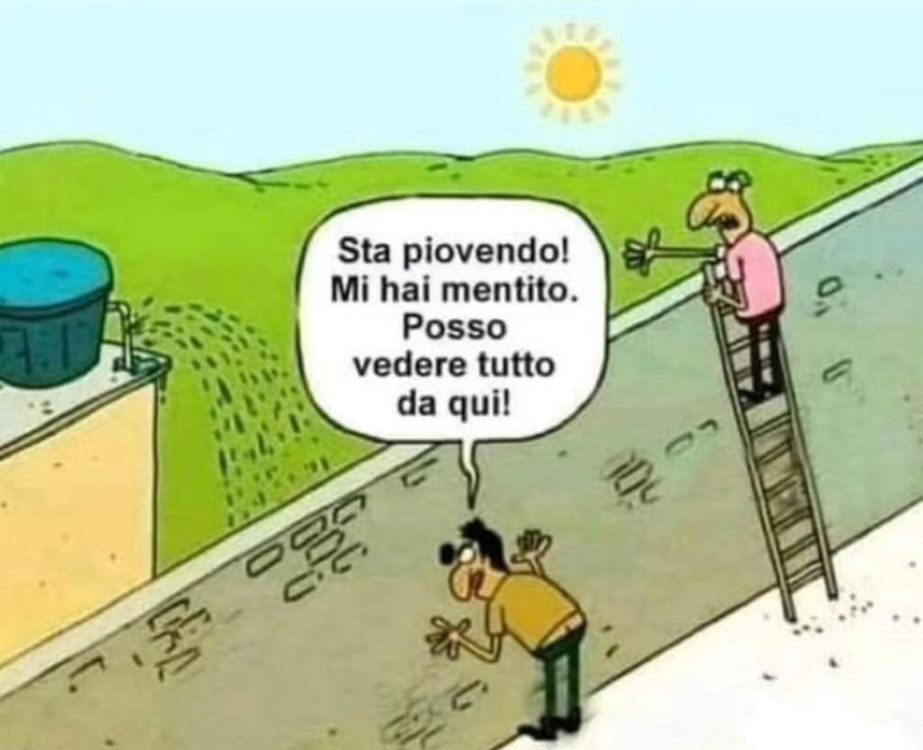
Italian version: Two men and a wall
It's raining!!! You lied! I can see everything from here!!!
Both are “right” … and
Both are wrong.
Does this help?
Notes:
Somos como en la historia india … los ciegos que quieren entender qué es un elefante. Cada uno lo toca, pero nadie entiende qué es hasta que se unan sus observaciones.
Un analista de una agencia de inteligencia … o un académico … o un periodista … o un representante de un negocio … quizás tenga información interesante, pero no es inteligencia hasta que, como sociedad, se una lo que saben y opinan del fenómeno que están observando.

Slide 7
What is analysis?
Telling our readers or audiences …
What we know about what’s happening Who, what, when, where
But more importantly … WHY it’s happening HOW it’s happening And WHAT WILL happen and WHY we should care
And by doing that – without being prescriptive – showing what they can do about it
This makes it
ACTIONABLE
analysis!

Slide 8
Why do we (or others) make mistakes?
Bad or inadequate information?
Inability to understand the meaning and consequences?
Unable or unwilling to take on new info?
Conflict of interest?
Too much pressure surrounding info or interpretation?
Unable to articulate info and/or analysis?
Sloppy presentation, with unclear bottom line?
Inability to get access to deliver message?
How can we improve?

Slide 9
More important than ever.

Slide 10
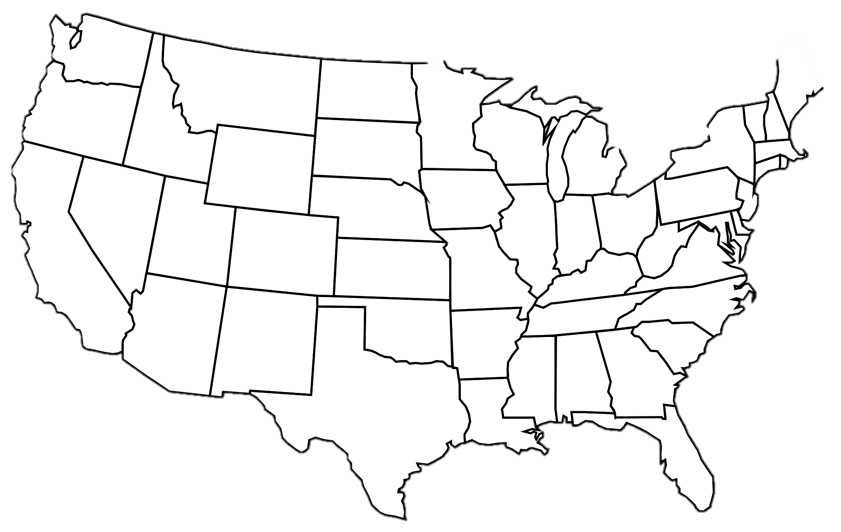
Simultaneous Crises
Violence and Crime
Three Branches: Executive
Legislative
Judicial
Pandemic
Uncertainty
Economy
Culture wars
Fake news
Traditional media
Politicization of religion
Institutions
Scientists
Journalists
Academics
Clergy
Race issues
Inequality
Environmental challenges

Slide 11
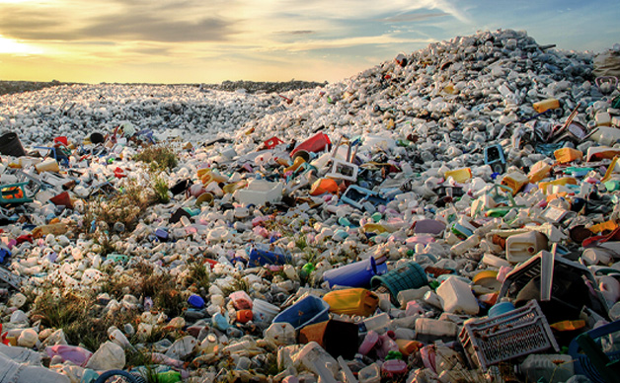
GARBAGE
FAKE NEWS
CRISIS of | LEADERSHIP
CONSPIRACY THEORIES
CRISIS of | FOLLOWERS
DISINFORMATION
CRISIS of | INTELLIGENCE Information Analysis Communication
MANIPULATION
“ANTI-INTELLIGENCE”

Slide 12
Fulton T. Armstrong
A spontaneous career in information, analysis, policy and politics
Forty years of analysis
Linguistics and study in Spain
journalism in Taiwan
U.S. House of Representatives
CIA
State Department
National Security Council
National Intelligence Council
U.S. Military – Intelligence Advisor
U.S. Senate
SU … AU … and others

Slide 13
What do decision-makers need?
What is intelligence? What is analysis?
Once we have a defined analytical question …
Once we have some basic information …
What is our FIRST analytic contribution on an issue?
And how do we do it?

Slide 14
Evaluate the reliability of the “facts”
Let’s play a game…
What do we see and believe in the following video and pictures?

Slide 15
A bystander takes a video of something they saw.
Posts it in social media,
as an example of “police incompetence.”
What is happening?
How do we know?

Slide 16
What happened?

Slide 18
How do we know what we “know”?
What’s REAL and what’s FAKE?
Exercise #2: Real or Fake?

Slide 19
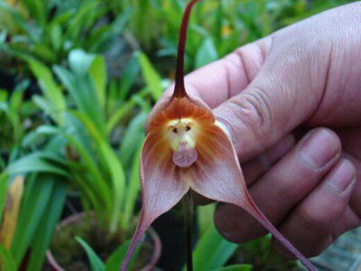
Is this orchid blossom real or fake?
Real
Notes:
HOW DO YOU KNOW??

Slide 20
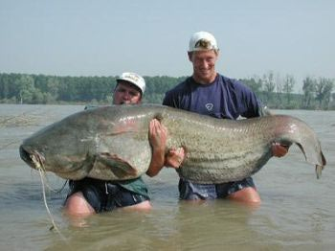
Is this catfish real or fake?
Real
Notes:
HOW DO YOU KNOW??

Slide 21
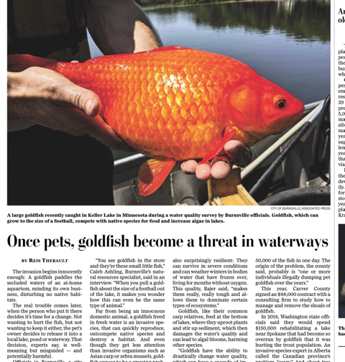
Is this goldfish real or fake?
Real

Slide 22
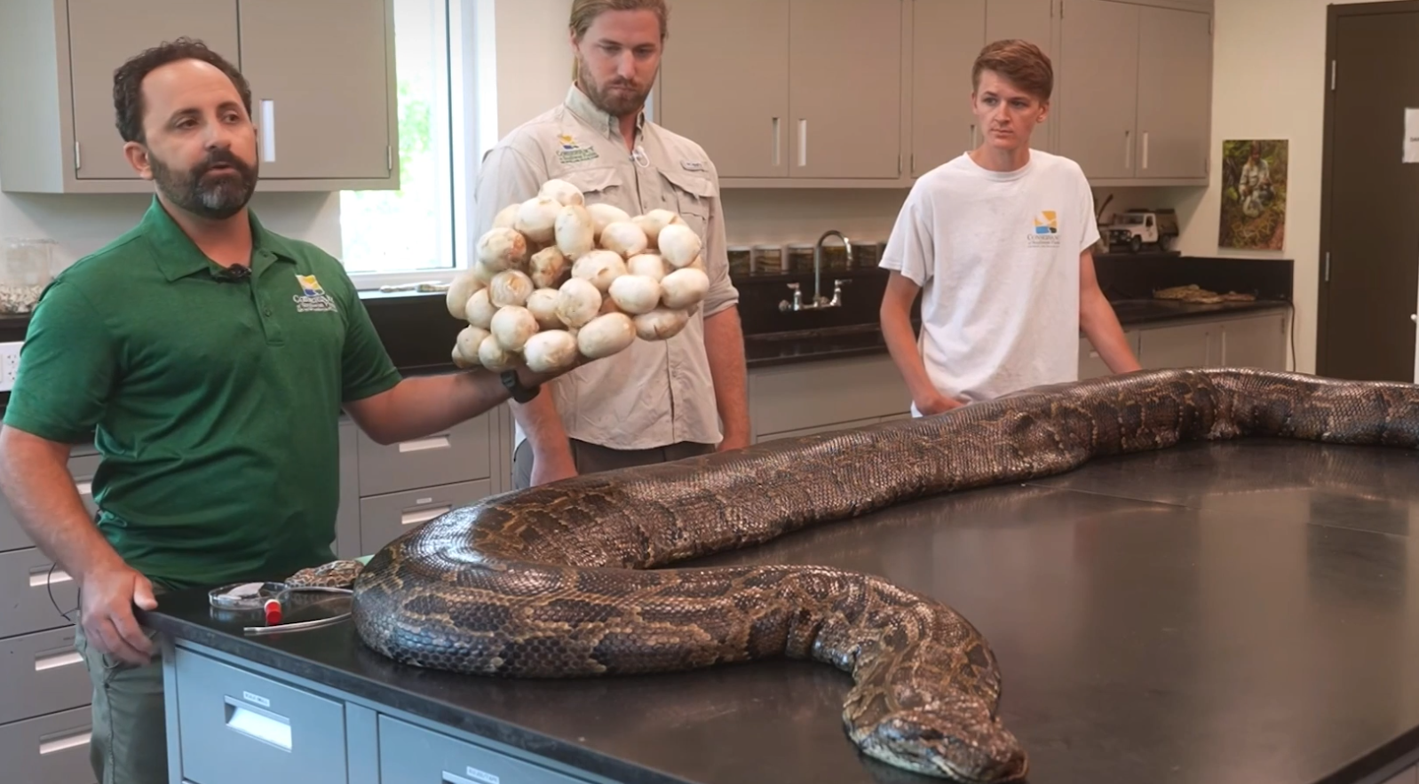
Is this Burmese Python (98kg and 5.5m) found in Florida real or fake?
Real
Notes:
HOW DO YOU KNOW??

Slide 23
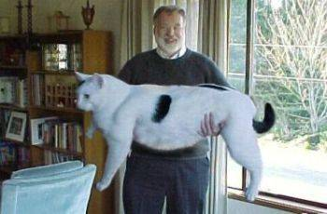
Is this house cat real or fake?
FAKE
Notes:
HOW DO YOU KNOW??

Slide 24
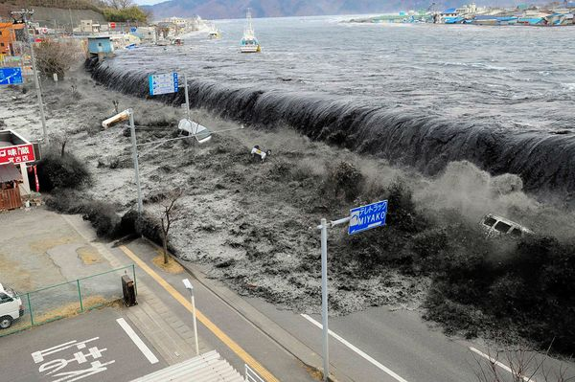
Is this tsunami in Miyako, Japan, real or fake?
Real
Notes:
HOW DO YOU KNOW??

Slide 25
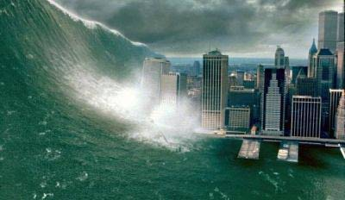
Is this tsunami in New York City real or fake?
FAKE
Notes:
HOW DO YOU KNOW??

Slide 26
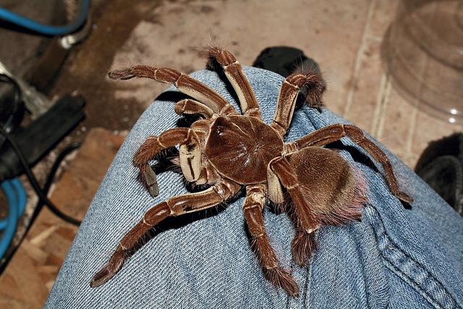
Is this goliath birdeater tarantula real or fake?
Real

Slide 27
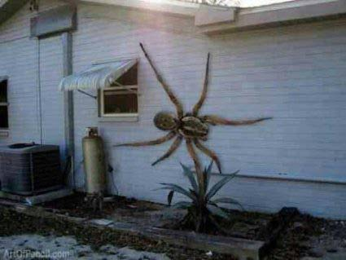
Is this wall spider in a beach town real or fake?
FAKE
Notes:
HOW DO YOU KNOW??

Slide 28
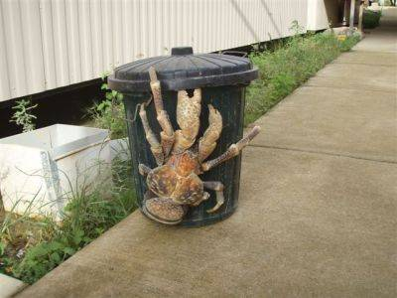
Is this coconut crab real or fake?
Real
Notes:
HOW DO YOU KNOW??

Slide 29
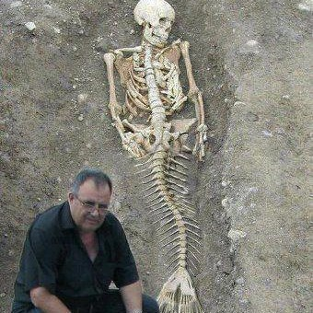
Is this mermaid skeleton found near the Black Sea real or fake?
FAKE
Notes:
HOW DO YOU KNOW??

Slide 30
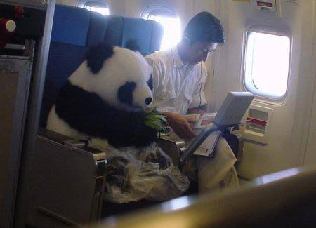
Is this flying panda real or fake?
FAKE
Notes:
HOW DO YOU KNOW??

Slide 31
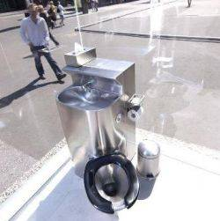
Is this public toilet with one-way glass walls real or fake?
Real
Notes:
HOW DO YOU KNOW??

Slide 32
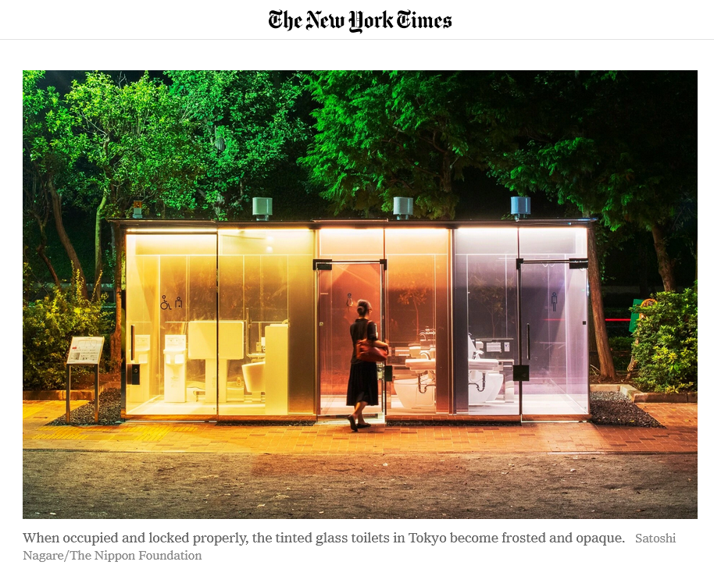
19 August 2020

Slide 33
Real
Is this man in Paris using a (legal) public urinal?

Slide 34
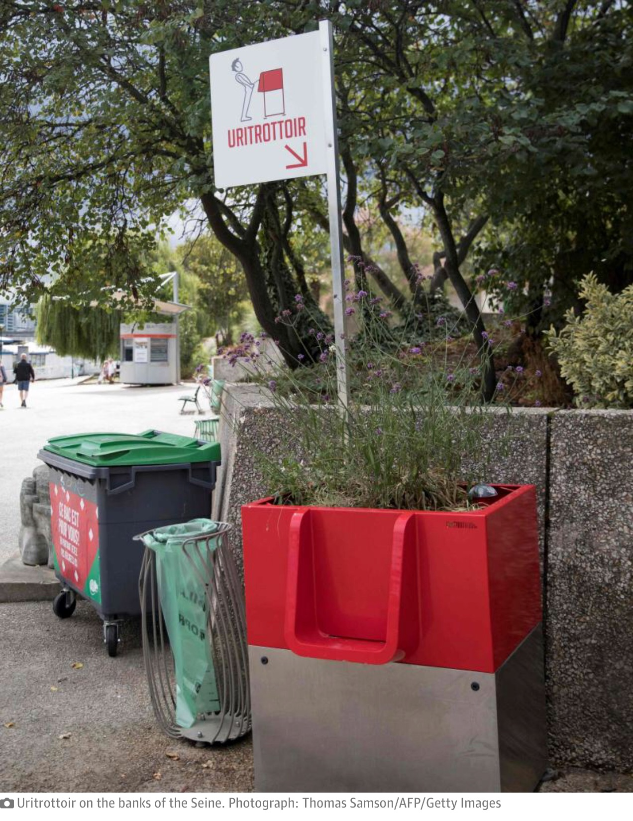
Real
Notes:
HOW DO YOU KNOW??

Slide 35
https://uritrottoir.com/

Slide 36
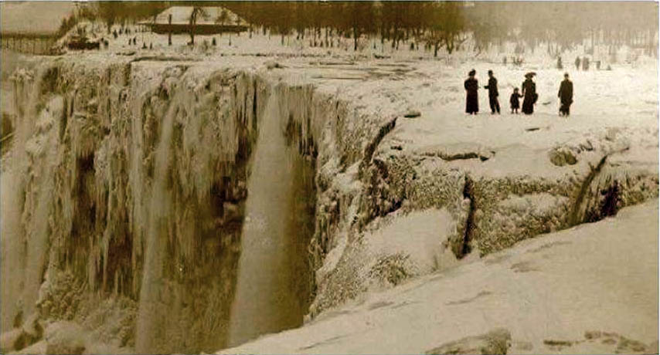
Is this frozen Niagara Falls (in the early 1900s) real or fake?
Real

Slide 37
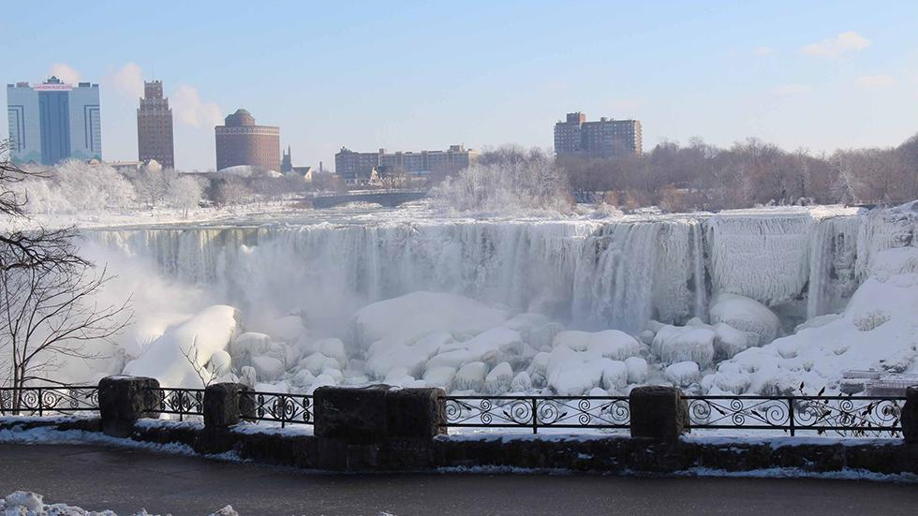
Niagara Falls - Jan. 9, 2014

Slide 38
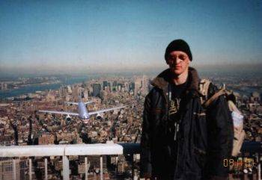
Is this 9/11 tourist snapshot real or fake?
FAKE

Slide 39
How did you determine “real” or “fake”?
Because you really know something as fact?
Because you can tell that a photo has been Photoshopped?
By some sort of logic?
Because you know of precedents or parallels?
An analyst is conscious of all this.
How did you process your information?
Did wishes or biases or fears influence you?

Slide 40
Can you trust your eyes if it’s multimedia?

Slide 41
One KEY purpose of analysis …
To evaluate the “facts.”
Our job is to assign levels of confidence in our information … to be honest … to know our limits.
No bluffing. No exaggerating. But no copping out.
Notes:
YES!!!! … And so should we be. … Video is one of the most PURSUASIVE TOOLS.

Slide 42
How do we “do” analysis?
What are its main characteristics?
How do we write it?
Ready to dive in?

Slide 43
The Snowflake: A simple analysis

Slide 44
THREE MAIN ELEMENTS
What’s happening?
Why or how is it happening?
What’s going to happen? or Why does it matter?
SNOWFLAKE
In 40 words,
A thesis or conclusion (“BLUF”).
An argument or explanation.
Something about future or implications.
EXAMPLE

Slide 45
WRITE
EXAMPLE: What does collapse of Afghanistan mean?
The Taliban victory in Kabul has created conditions of repression and instability in Afghanistan. … Restoration of Sharia Law, which international community rejects, will provoke suspension of financial, humanitarian aid, intensifying economic crisis and hunger. … Taliban reaction may result in collaboration with terrorists.
MAIN MESSAGE
INFORMA-
TION &
ARGUMENTATION
IMPLICATION
41 words!

Slide 46
EXAMPLE
What does collapse of Afghanistan mean?
The Taliban victory in Kabul has created conditions of repression and instability in Afghanistan. … Restoration of Sharia Law, which international community rejects, has provoked suspension of financial, humanitarian aid, intensifying economic crisis and hunger. … Taliban reaction may result in collaboration with terrorists.
BLUF
INFO / ARGU- MENTATION
PREDICTION / IMPLICATION
41 words!

Slide 47
WRITE
EXAMPLE: What does collapse of Afghanistan mean?
The Taliban victory in Kabul has created conditions of repression and instability in Afghanistan. … Restoration of Sharia Law, which international community rejects, will provoke suspension of financial, humanitarian aid, intensifying economic crisis and hunger. … Taliban reaction may result in collaboration with terrorists.
41 words!

Slide 48
Could you write one if asked?
THREE MAIN ELEMENTS
What’s happening?
Why or how is it happening?
What’s going to happen? or Why does it matter?
Tip #1:
Write a snowflake before you start writing your paper

Slide 49
Why invest time in a 40-word product?
“If you can’t say it in 30 seconds, it’s not ready for prime time.”
Purpose
Structure / Roadmap
Early thesis
It later becomes your “elevator briefing”

Slide 50
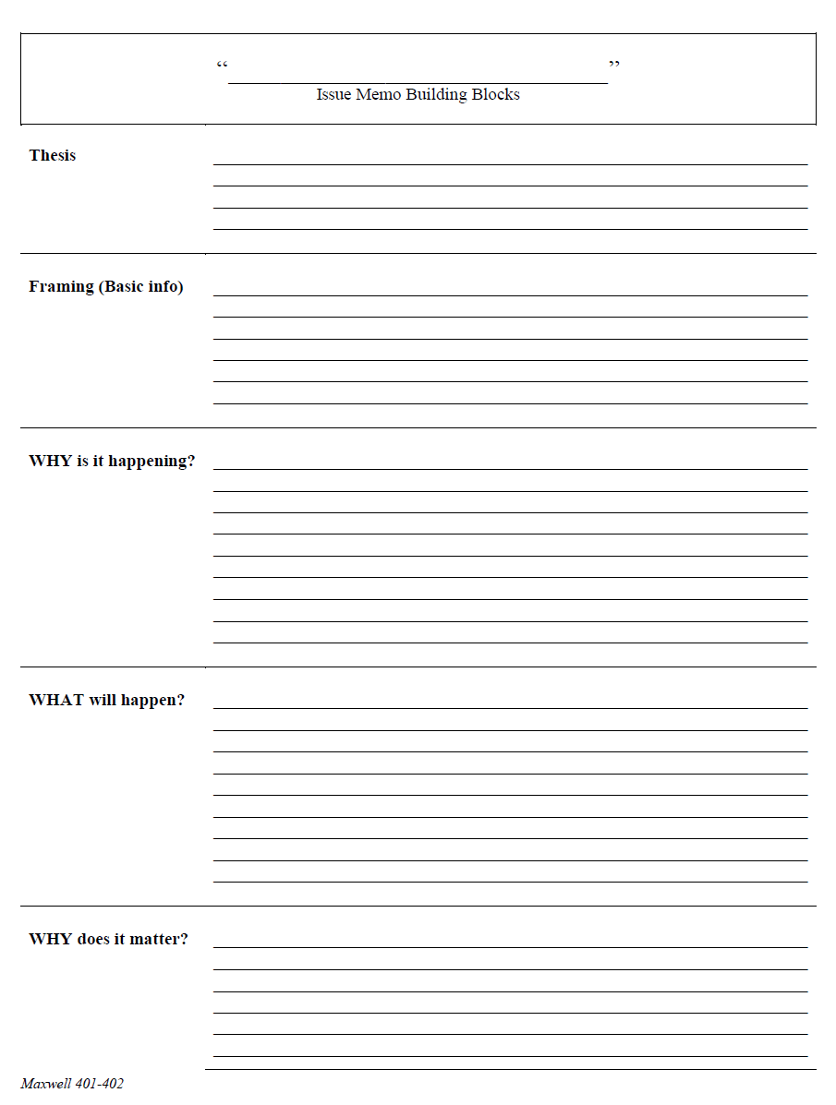
Tip #2: Identify the key elements of the story
WHAT is going on
WHY it is going on,
WHERE it is going, and
WHY we should care
HANDOUT C from YESTERDAY

Slide 51
Tip #3: Know what your decision-maker needs
And give it to them!

Slide 52
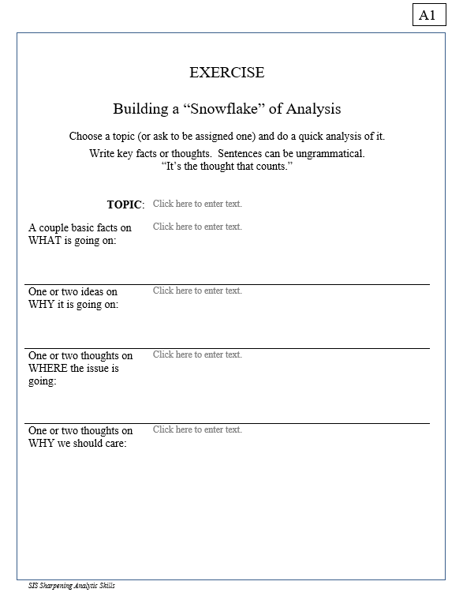
WHAT is going on
WHY it is going on,
WHERE it is going, and
WHY we should care
10 minutes
HANDOUT A1

Slide 53
A Decisionmaking Model
Problem
Analysis
Options
Decision
Results
Essential to the entire process

Slide 54
INFORMATION
Compilation
Research / collection
Evaluation / validation
Contextualization
ANALYSIS OF DRIVERS
Identification
Hierarchization
Evolution
Interrelation / dynamics
SCENARIO & IMPLICATIONS
Most probable & impact
Less probable & impact
“Wild cards” & impact
Analysis
When decisionmakers ask for analysis, what do they want and need?

Slide 55
INFORMATION
Compilation
Research / collection
Evaluation / validation
Contextualization
ANALYSIS OF DRIVERS
Identification
Hierarchization
Evolution
Interrelation / dynamics
SCENARIO & IMPLICATIONS
Most probable & impact
Less probable & impact
“Wild cards” & impact
Analysis

Slide 56
The Heartbeat of Analysis
(… and POLICY)
“DRIVERS”

Slide 57
Tip #4: Good policy decisions focus on changing drivers
So identify the drivers for your decisionmaker!

Slide 58
What are drivers?
Interests
Borrowing from the “3-i framework” …
In our PERSONAL lives …
Ideas
Institutions
Interests | Ideas | Institutions
Work Food Love - Sex Family Home Transportation Entertainment Recreation Challenges | Education Religion or values Political thought Ideology Imposed expectations | Parents Boy/Girlfriend Husband/Wife Colleagues Friends Political party Employer
drivers
HANDOUT F

Slide 59
What are drivers?
Interests
In our PERSONAL lives …
Ideas
Institutions
Interests | Ideas | Institutions
Work Food Love - Sex Family Home Transportation Entertainment Recreation Challenges | Education Religion or values Political thought Ideology Imposed expectations | Parents Boy/Girlfriend Husband/Wife Colleagues Friends Political party Employer
drivers

Slide 60
What are drivers?
Interests
In our NATIONAL lives …
Ideas
Institutions
Interests | Ideas | Institutions
Power/influence Needs Desires/ambitions Wealth Economic performance | Self-definition Nationalism History Concepts/logic Values Ideology | Leadership Abilities/constraints Economic structures Intermediation Inclusion Topography/geography Climate
drivers

Slide 61
What are drivers?
Interests
In our NATIONAL lives …
Ideas
Institutions
Interests | Ideas | Institutions
Power/influence Needs Desires/ambitions Wealth Economic performance | Self-definition Nationalism History Concepts/logic Values Ideology | Leadership Abilities/constraints Economic structures Intermediation Inclusion Topography/geography Climate
drivers

Slide 62
What are drivers?
“FUEL”
“FRICTION”
Effort/energy
Resources
Technology, etc.
to PUSH a solution.
Obstacles
Resistence
Limitations, etc.
that OBSTRUCT a solution.
“Forward” drivers
“Status Quo” or “Backward” drivers
Examples

Slide 63
React to symptoms
“sub-drivers”
o
“super-drivers”
DRIVERS
scenarios
Make policies,
programs,
operations that alter scenarios
What creates the drivers that we see in action?

Slide 64
EXAMPLE: CENTRAL AMERICAN MIGRATION
Policymaker is thinking: | What can I do about Central American migration?
Analyst is thinking: | What are the drivers of Central American migration?
PULL
PUSH
focus of most U.S. policy
in the region

Slide 65
EXAMPLE: CENTRAL AMERICAN MIGRATION
Q: Why are the “push factors” of migration from the “Northern Triangle” of Central America so strong?
Q: WHY?
Q: WHY?
Q: WHY?
A: Poverty
A: Drug cartels
A: Poor education system
Q: WHY?
Q: WHY?
A: Geography
Q: WHY?
A: Cultural attributes
A: Low cooperation
Q: WHY?
Q: WHY?
Q: WHY?
A: Weak institutions
A: Aloof elites
A: Corruption
Q: WHY?
Q: WHY?
Q: WHY?
A: U.S. guns
A: Gang deportees
A: Demographics
EACH DRIVER PRESENTS A **POSSIBLE** PLACE WHERE POLICY CAN PLAY
What is DRIVING events? How should we weight the drivers?

Slide 66
When you go to a doctor, do you want …
Treatment of symptoms?
Diagnosis of what’s wrong?
Analysis of the causes?
Or to a mechanic? Or to a psychologist? Or to a career advisor?
The real value is in understanding the
DRIVERS
of each issue.

Slide 67
How do you write it?

Slide 68
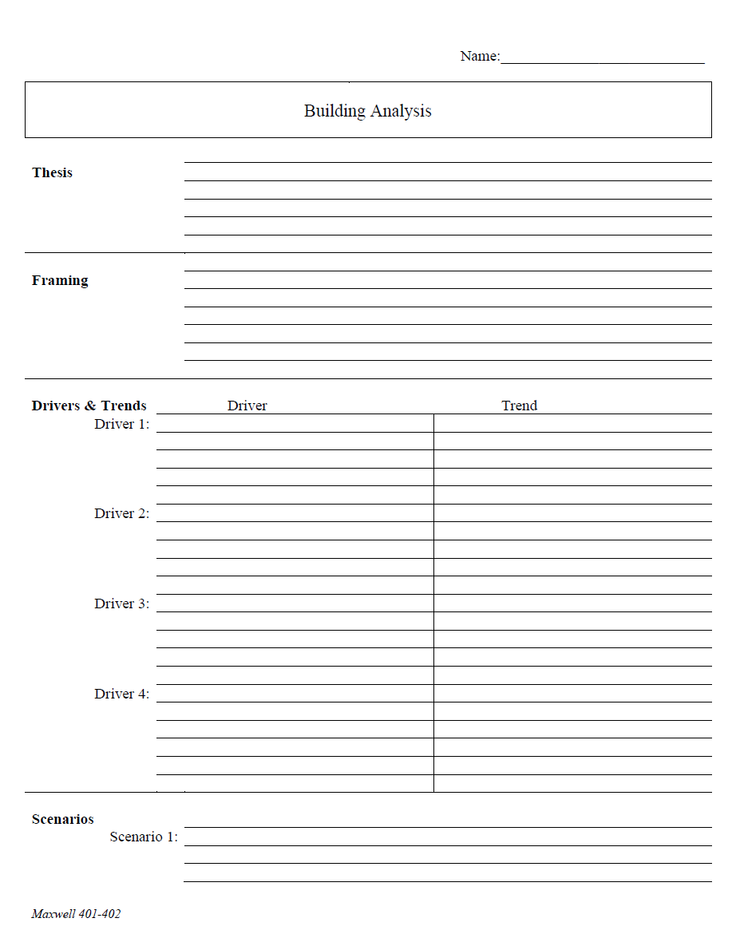
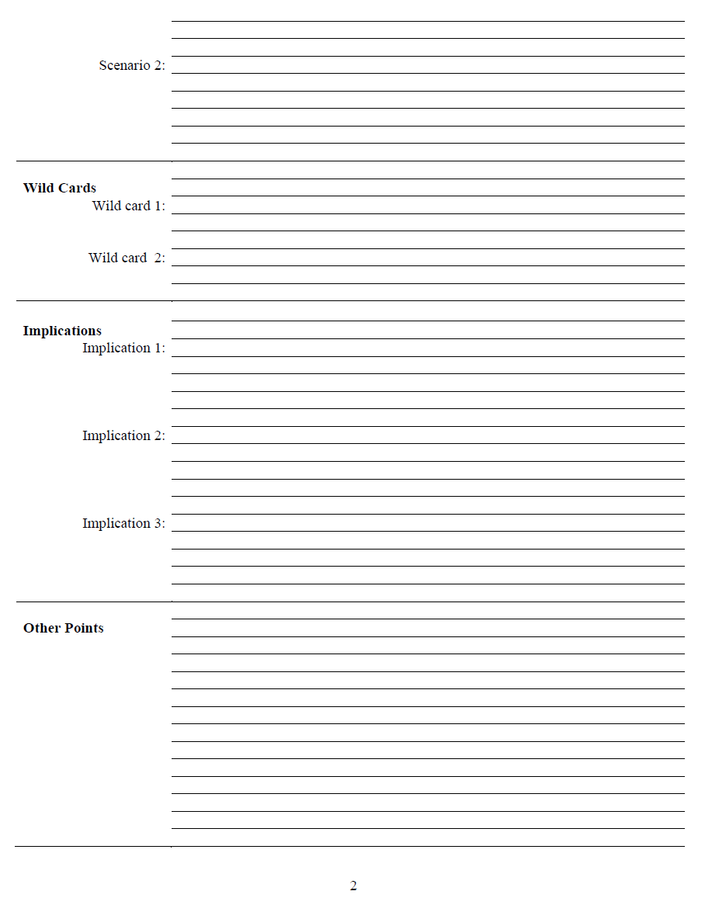
The Analytical Worksheet: One Proven, Effective Way to Build Analysis for Presentation
HANDOUT D from YESTERDAY

Slide 69
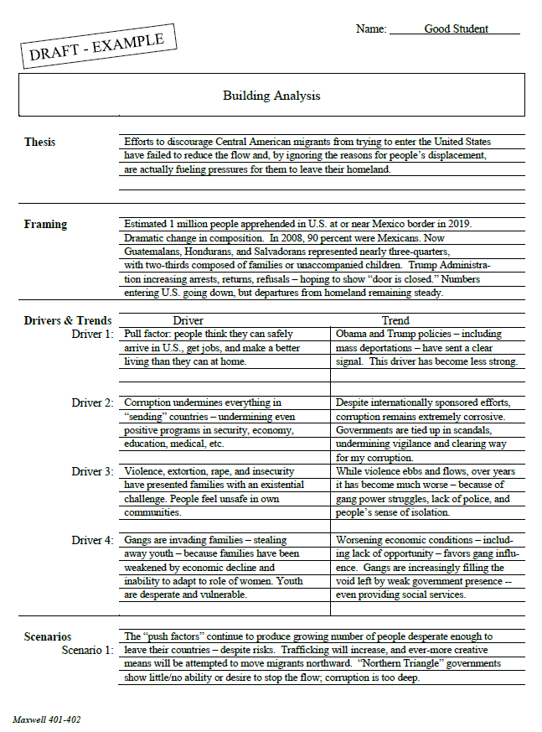
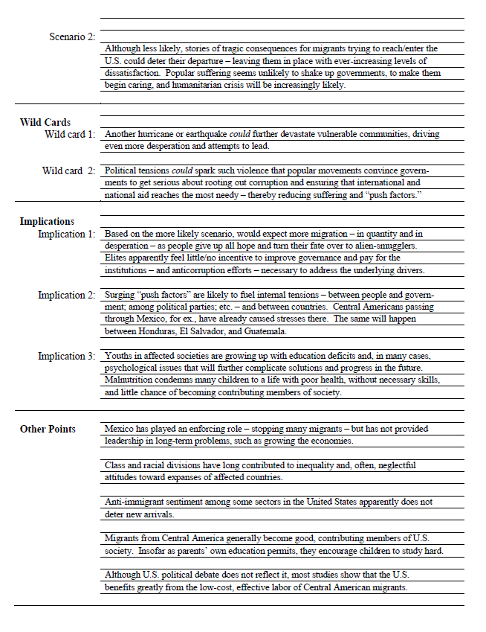
An EXAMPLE: Migration from Central America
HANDOUT G

Slide 70
Armed with a worksheet like this, the writing is easy.

Slide 71
Is there a “perfect” format for analysis (written and oral)?
A guideline:
HANDOUT H

Slide 72
TOMORROW: More on the writing aspects
Today … one more handout

Slide 73
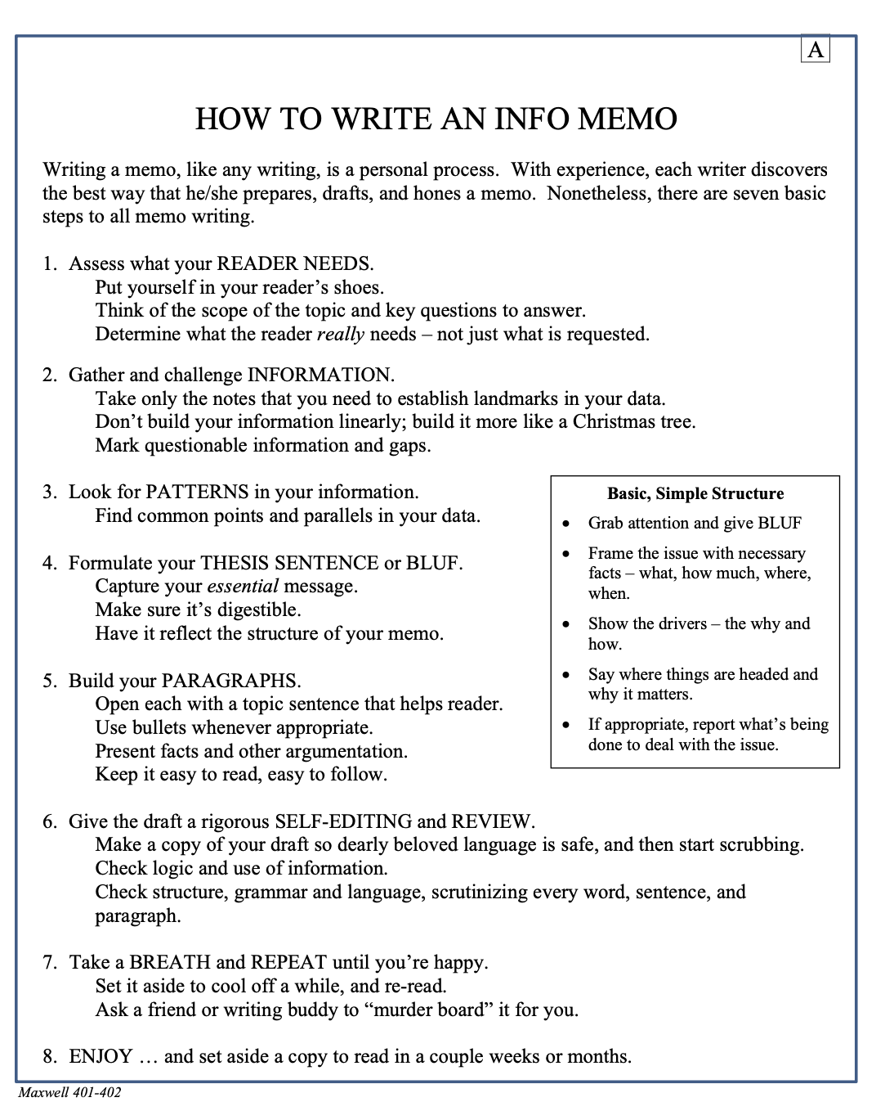
How to write good analysis?
A guideline:
HANDOUT A from YESTERDAY

Slide 74
Questions or Comments?
Feel free to drop me an e-mail at farmstro@syr.edu

Slide 75
The Washington Analytical Memo
- An Analytical Model for Making Information Actionable -
Questions or Comments?
Fulton T. Armstrong

Slide 76
QUICK
Building the Principal Scenario
driver and trend
Principal Scenario
driver and trend
driver and trend
driver and trend
driver and trend
driver and trend

Slide 77
QUICK
Building the ALTERNATIVE Scenario
driver and trend
driver and trend
driver and trend
driver and trend
Alternative Scenario
driver and trend
driver and trend

Slide 78
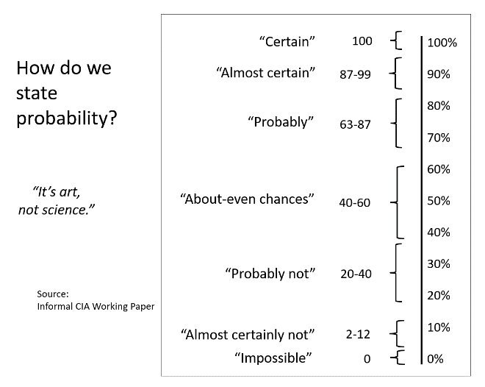
QUICK
“Certain”
100
100%
90%
80%
70%
60%
50%
40%
30%
20%
10%
0%
“Almost certain”
87-99
How do we state probability?
“Probably”
63-87
“About-even chances”
40-60
“Probably not”
20-40
“It’s art, not science.”
“Almost certainly not”
2-12
HANDOUT L
Source: Informal CIA Working Paper
“Impossible”
0

