Slide 1

Paris to Baku
Are we treading water or making progress?
Melinda Kimble
Senior Fellow, UN Foundation

Slide 2


Acronyms to Remember
IPCC – Intergovernmental Panel on Climate Change
UNFCCC – UN Framework Convention on Climate Change (adopted 1992; entry into force 1995)
GHG – Greenhouse Gases (CO₂, CH₄, N₂O, O₃, CFCs, HCFCs)
KP – Kyoto Protocol (adopted 1997; entry into force 2004); legally binding targets for developed countries who ratify it.
CBDR – Common, but differentiated responsibilities (developed countries will act first, and pay for developing country action).
COP – Conference of Parties
CMP – Conference of the Parties serving as the Meeting of the Parties to the Kyoto Protocol
SBI – Subsidiary Body on Implementation
SBSTA – Subsidiary Body on Scientific and Technological Advice
ETS – European Trading System which allows EU firms to trade allowances within the EU reduce costs.
AWG-LCA – UNFCCC Ad Hoc Working Group on Long term Cooperative Action
AWG-KP – UNFCCC Ad Hoc Working Group on the Kyoto Protocol
APA – The Paris Agreement (adopted 2015; entry into force 2016)
NDC – Nationally Determined Contributions

Slide 3
Science and Climate Governance
In the 19th Svante Arrhenius studied the greenhouse effect, highlighting how industrial emissions were augmenting atmospheric concentrations of CO₂ and methane, predicting atmospheric warming.
Later studies supported these theories; prompted creation of the IPCC in 1987.
The IPCC provides policy makers a “synthesis” of peer-reviewed climate science.
The !990 and 1992 Assessments underpinned the UN Framework Convention on Climate Change and stressed the role of human activities in key GHG emissions.
In 1995, IAR 2 asserted: “the balance of evidence suggests a discernible human influence on global climate.
This assessment shaped negotiations on the Kyoto Protocol (KP) which was adopted at COP 3 in 1997.

Slide 4

Governance Fault Lines
Decades of environmental action prompted countries to see this as a pollution problem rather than a planetary systems problem.
The Montreal Protocol action on CFCs seen as a template for climate.
Restraining energy consumption equated with limiting economic growth.
Curbing use of fossil fuels is an economic and political challenge.
CO₂ emissions required mitigation; atmosphere was focus.
Less focus placed on the ocean “carbon sink” and resulting ocean acidification which is compromising marine biodiversity.

Slide 5

Geopolitics & Climate
Philip Zelikow: “we are in the most sustained period of high crisis since 1962”
Geopolitical tensions in the Middle East, Eastern Europe, and the South China Sea create a difficult backdrop for serious negotiations.
China – US tensions have frustrated climate action since 2016; APEC meeting restored some dialogue.
Climate finance for developing countries is well short of “voluntary targets” offered by OECD.
World Bank Marrakech meeting offered hope for reform and expansion of MDB lending, but OECD countries will hold the key to these changes.
Expensive conflicts in Ukraine and now, Gaza, are likely to constrain climate funding by big donors.

Slide 6

Kyoto to Paris – Action v. Inaction
Kyoto was premised on developed countries’ action; proposed developed countries would support developing country action.
U.S. and Australia refused to ratify; EU orchestrated Russian ratification that brought KP into force in February 2005.
Progress was mixed; Japan, Canada, and Russia took minimal action; key EU countries (UK, Germany, France, and Nordics enabled bloc progress).
Kyoto experience led UNFCCC parties to explore a new approach; Copenhagen 2009 (COP 15) set stage for Paris.
Cancun 2010 offered “roadmap” and a new financing mechanism.
Obama’s leadership “all must act” led to agreement on “nationally determined contributions” (NDCs) for all parties.
IPCC IAR 5 “anthropogenic emissions are the highest in human history” underpins Paris negotiations.

Slide 7
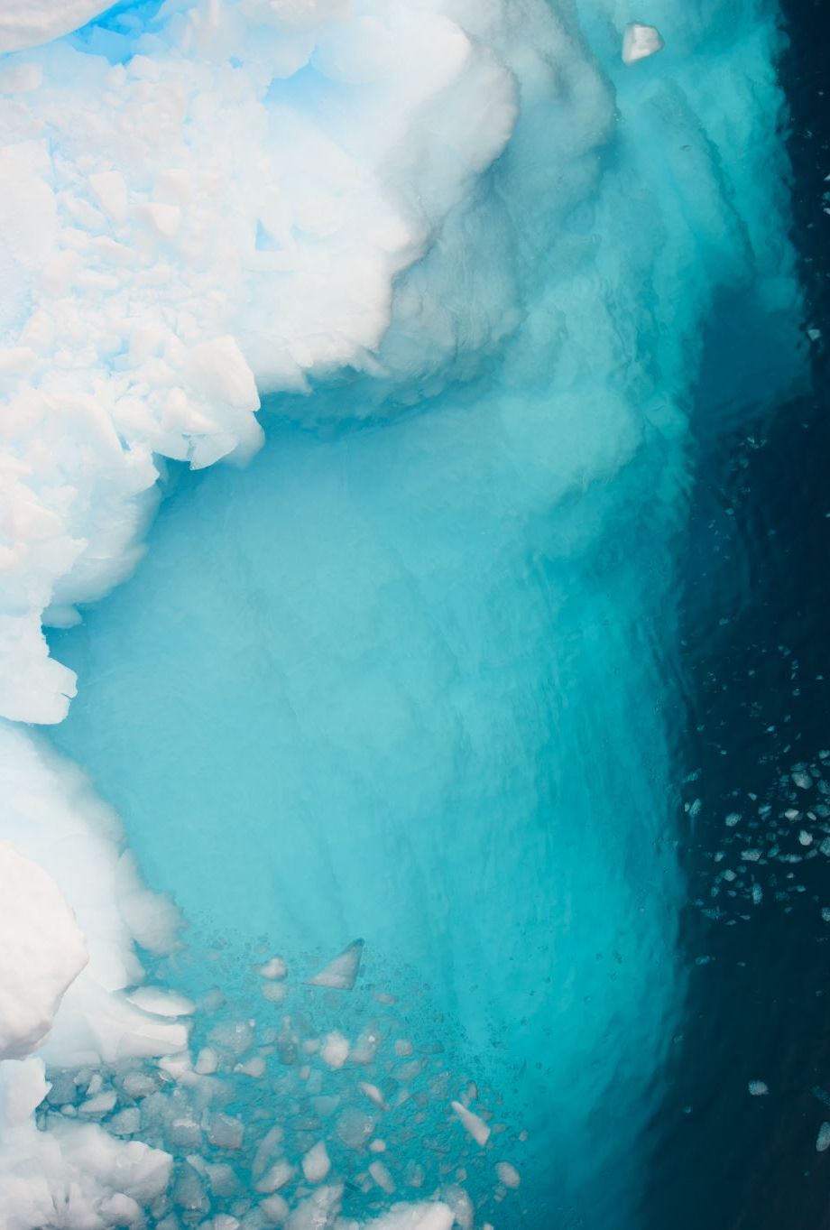
IPCC Post-Paris
Global Warming at 1.5ºC presented a range of new scenarios that indicated maintaining the lower target would require a much more rapid transition off fossil fuels than ever considered.
Oceans & Cryosphere: Highlighted ocean acidification and glacier melting. New observations suggest it’s worse than we thought!
WGI Report (2021): Human induced climate change is impacting every region of the globe. Changes in the climate system are driving extreme weather and unanticipated impacts.
WGII (2022) “Cascading, compounding and aggregate impacts on cities, infrastructure, supply chains, and services due to wildfires, floods, droughts, heat waves, storms, and sea level rise make it harder for institutions and governance systems to manage climate risks.”
WGIII (2022) : Current policy trajectories suggest the world will overshoot 1.5ºC goal highlighted in Paris, Glasgow, and Sharm-el-Sheik. Good news: some progress on industry and fossil fuel emissions; agriculture, buildings and deforestation are growing in importance.
IPCC’s 6th Assessment was delayed to 2023 by COVID; the news is not good.

Slide 8
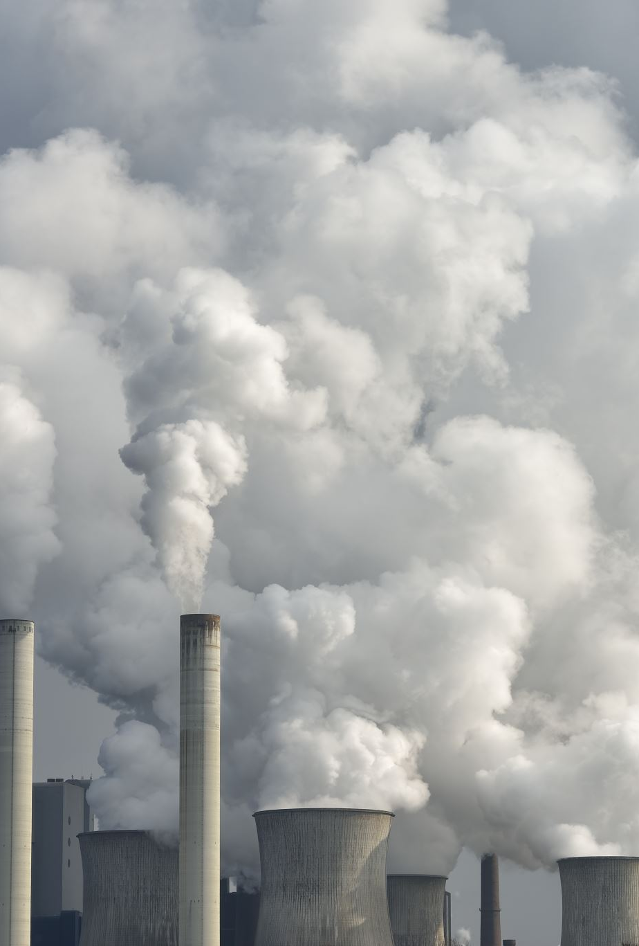
U.S. Policy Compromises Paris
U.S. and China ratify the Paris Agreement in 2016, speeding its entry into force.
U.S. emission reductions depend on EPA-designed Clean Power Plan which is stayed by the Supreme Court.
New Trump administration withdraws from Paris, rolls back climate action.
Some states and municipalities commit to meeting term of Paris; U.S. Climate Alliance leads resistance.
Agreement delays U.S. departure until 2020; federal action on curbing emissions stops.
Biden administration re-enters Paris, launches major clean energy initiatives funded by the Inflation Reduction Act.
US oil and gas production, however, continues to soar.
Biden administration raises levies on oil and gas exploration on federal lands.

Slide 9
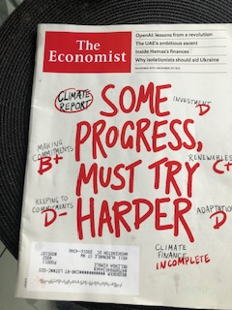
PRESS AT COP 28
Lots of rhetoric; little action
Politically controversial meeting
UAE Energy Minister chaired meeting; opportunity to promote oil & gas
Largest participation ever of oil & gas companies
Can multilateral governance solve the problem?
Agenda was the Global Stocktake (GST)
Issues: Finance & oil transition

Slide 10

HOW COP 28 UNFOLDED
Agreement on operationalizing the funding arrangements for responding to “loss and damage” and some $700 million in pledges to be managed by the World Bank.
Little progress since Paris (the Global Stocktake) as GHG emissions now exceed 2019 levels. Increases occurred in China, India, Indonesia and the U.S. Brazil, the EU, and Russia had decreases in emissions. The G20 has 76% of global emissions.
10% of global population with highest incomes accounted for 48% of emissions.
Out of 194 member states, 149 states submitted new NDCs; these show policy improvements, but implementation is uncertain.
Climate finance (mitigation, adaptation, loss & damage) remains key to aggressive implementation.
Donor commitments of $100 billion annually by 2020 (not fully met) falls far short of $2.4-2.7 trillion needed annually per the World Bank.
Increased focus on climate impacts on food, agriculture, oceans, and health as part of an effort to reach a Global Goal on Adaptation (GGA). Adaptation finance, however, remains limited.
Need to “transition away from fossil fuels” stated; but no timetable or roadmap.

Slide 11
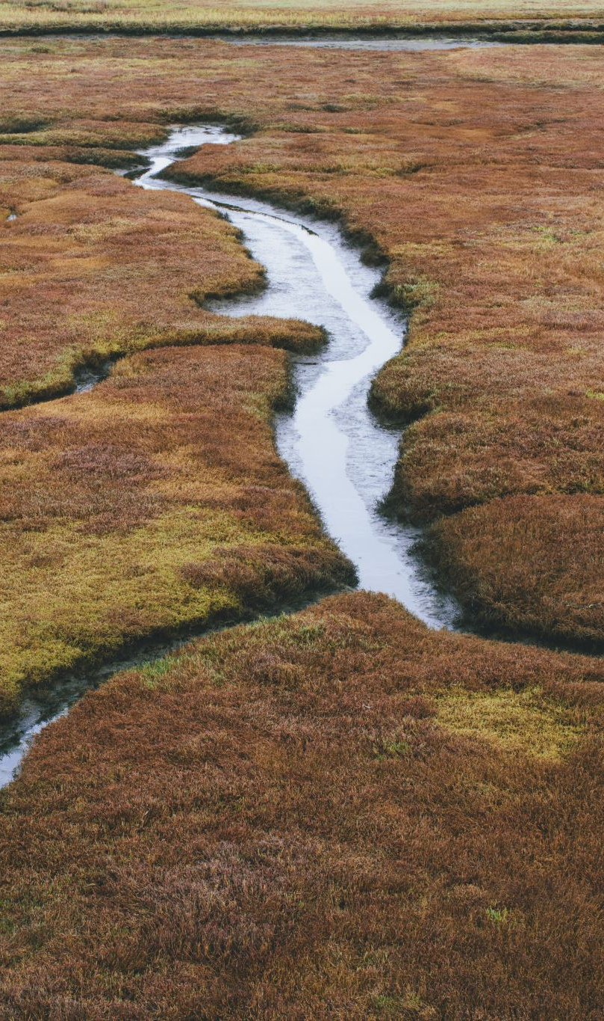
2023: A Cautionary Tale?
Record setting Canadian Wildfires – covering 18.5 million acres
Devastating flooding in Libya, Somalia, Kenya, Ethiopia, Ghana, and India.
Wildfire in Maui; 93% of Hawaii experiencing drought conditions as of October
Spring floods in California; summer flooding in New York and Vermont.
Lower Mississippi water levels at historic lows.
Summer 2023 the hottest on record (since 1880); 2023 the hottest year in history.
El Niño impacts amplified by human-induced warming.
Melting in both Arctic & Antarctic accelerates beyond projections.
U.S. corn production is forecast to decline in 23-24 period due to drought in the Midwest. U.S. exports have been weak.
Global GDP was cut 6.3% in 2022.

Slide 12

Time Limit For Action?
Key Science messages:
  Passing a limit (350 ppm CO₂ₑ or 1.5ºC) may force tipping points in the ocean or cryosphere that will shift the water cycle.
  Ocean Acidification underscores the ocean’s role as a carbon sink; our focus on atmosphere alone is inadequate.
  The next decade (2020-2030) will be critical to maintain key planetary systems
  Deforestation, industrial agriculture (crops, meat & poultry), industry, and transportation, are major contributors to GHG emissions.
  Changing weather patterns can compromise food production.
  Methane, Black carbon, and fluorinated gases need more attention.
  Sea-level rise is a threat globally.

Slide 13
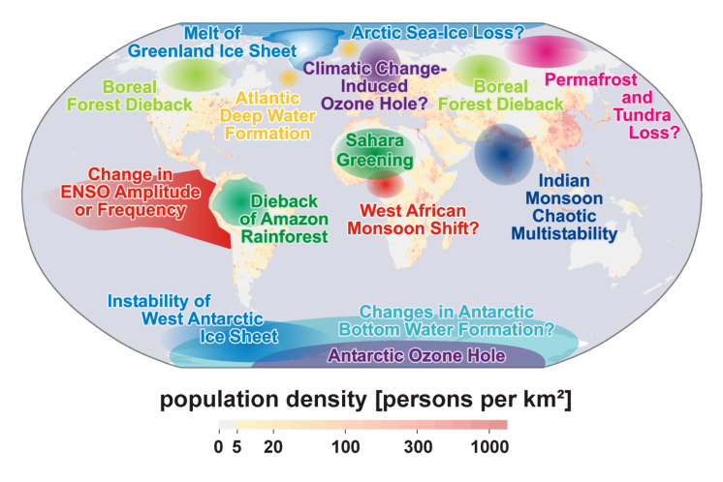
Climate tipping elements
Lenton et al. (2008) PNAS 105:1786-1793
Notes:
13

Slide 14
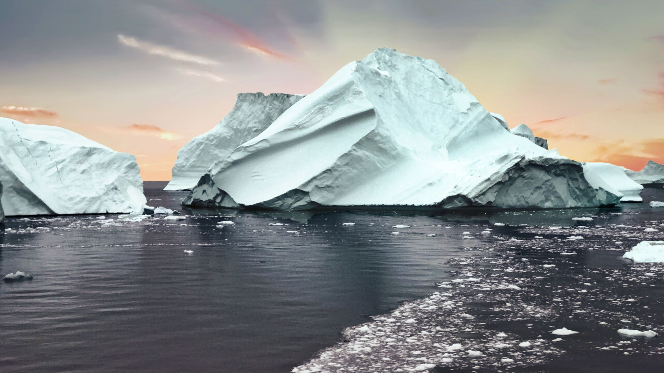
Risks in the Cyrosphere
Since the IPCC Special Report on Oceans and Cryosphere, glacier melt has accelerated in all continents and has become acute in the polar regions.
The Arctic may be permanently navigable for 6 months or more by 2035; Greenland’s ice sheets are disengrating rapidly. In the Antarctic, the ice sheets are melthing from above and below as ocean waters warm.
Reducing GHG emissions sharply, eliminating the use of HFO in ships transiting the Arctic, and controlling black carbon emissions are essential steps to reduce impacts.
Polar regions are warming 4-5 times faster than the rest of the planet and coastal indigenous communities are already experiencing impacts.
These changes accelerate sea level rise and are a particular threat to Small Island Developing States and low-lying coastal areas everywhere.
In the U.S., Florida, the Gulf Coast, and the Mid-Atlantic Seaboard are most vulnerable.

Slide 15

Greenland ice sheet
Ice loss accelerating
Arctic sea ice
Massive reduction in area
Boreal forest
Fire regime
changing
Permafrost
Thawing underway
Atlantic
circulation
15% slowdown
since 1950s
Coral reefs
Massive
die offs
Amazon
rainforest
Unprecedented
droughts
in last 15 years
West Antarctic Ice Sheet
Ice loss accelerating
Wilkes basin, East Antarctica
Ice loss accelerating

Slide 16
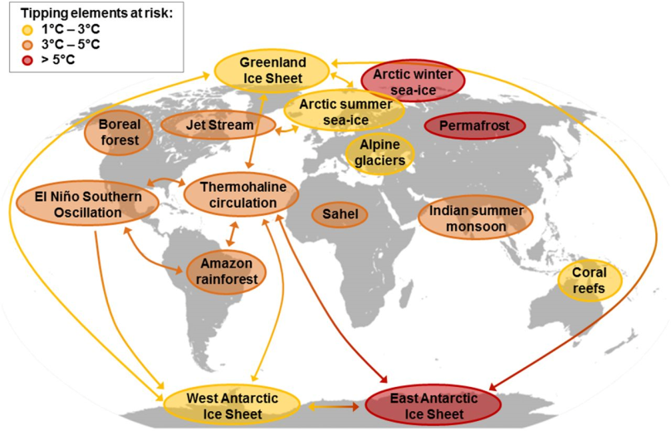
Coupling between tipping events
Steffen et al. (2018) PNAS 115:8252-9

Slide 17
Global CO₂ emissions for Paris goals
Committee on Climate Change (2019) Net Zero: The UK’s Contribution to Stopping Global Warming

Slide 18
Changing risk assessment of tipping points
IPCC
Assessment
Reports and Special Reports
2001
2007
Undetectable
Low
High
Very high
2013
2019
0
1
2
3
4
5
°C
Past
Future
1.1°C (2020)
Global average temperature above pre-industrial

Slide 19
UN Governance in 2024
  UN Decade of Ocean Science – Barcelona (April 10-12)
  Our Ocean Conference – Athens (April 16-17)
  International Negotiations on Plastics – Ottawa (April 23-29)
  Ocean Climate Dialogue – Bonn (UNFCCC June )
  UNCLOS Deep Seabed Mining – Kingston (July 21-28)
  International Maritime Organization (net-zero framework for shipping) –3 London, (Sept 30 – Oct. 4)
  COP 16 Biodiversity Convention – Cali, Colombia (Oct. 21-Nov. 1)
  COP 29 – UNFCCC Baku, Azerbaijan (Nov. 11-22)

Slide 20

Conclusions & Questions
The planet is moving to a new equilibrium driven by warming and its impacts on the global water cycle.
Mitigation remains important, but insufficient to prevent more extreme climate events.
More action and more technology is needed.
Developed countries need to invest more in both mitigation and adaptation.
Building Resilience Strategies is essential.Ho
Can the UN process succeed in these efforts?
Will US policy be sustained; will new commitments (COP 29 and 30) be implemented?
Is a carbon price the answer?

Slide 21

Thank You!
Melinda Kimble
UN Foundation

