Slide 1
Salary Negotiation: Advocating for Yourself5
Washington, DC Programs Team

Slide 2
Typical Negotiation Process
What is a Negotiation?
Negotiation: A process by which two or more parties resolve an issue or achieve an outcome through compromise
PARCC* definition: A conversation about balancing Interests and Positions
-> Position: I want a $80,000 salary plus…
-> Interest: I value work-life balance; I value challenge
Preparation – research both sides, least and most desired outcomes, tradeoffs, concessions, BATNA alternative if negotiation fails (Best Alternative to a Negotiated Agreement), ground rules
Exchange Information – each party share initial position, including underlying interests and concerns uninterrupted, what they aim to receive and why they feel that way
Clarification – discussion with justification and bolstering of claims, disagreements broached and understood
Bargain and Problem-Solve – give-and-take with proposal of counter-offers; active listening and calm feedback
Conclusion and Implementation – acceptable solution agreed upon, thank each other (maintaining good relations is key), outline expectations and write-up agreement
*PARCC: Program for the Advancement of Research on Conflict and Collaboration

Slide 3
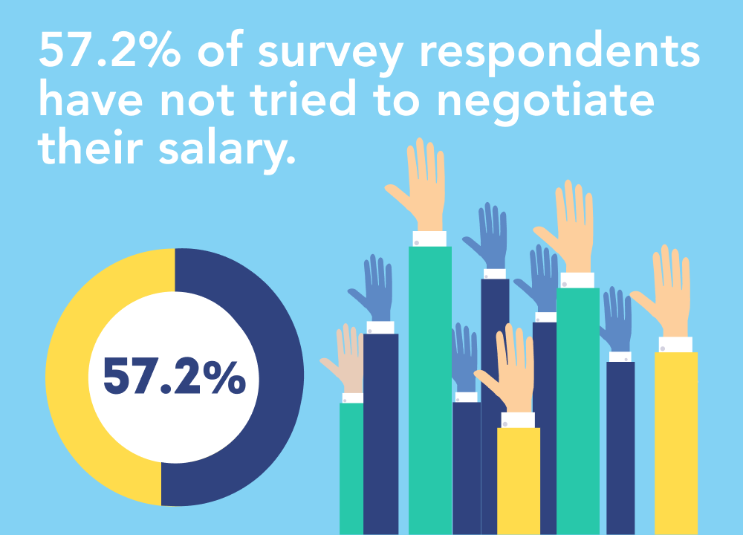
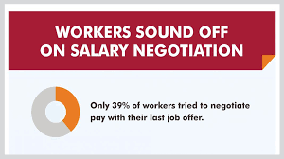
DO YOU HAVE TO ASK? Yes!!!
If you don’t ask, you definitely aren’t getting anything. This is your chance to set a foundation for future growth.
Address your fears and repeat:
Your employer EXPECTS you to negotiate
Wiggle room built-in to offers – not always salary
Do not negotiate with yourself
Do not talk yourself out of negotiating before you even start
Reassess the position and expectations after the offer
They will not rescind the offer if you negotiate in good faith
No lying or misrepresenting
If you advocate for yourself, you will advocate for the organization

Slide 4
WHEN DO YOU ASK? When they offer you the position.
Avoid (if possible) discussing salary until an offer is made; they want you!
If salary arises before an offer, ask them what the range is
Avoid mentioning salary history – illegal to ask in some states
Be prepared for the unexpected. Different companies follow different processes.
They may email all salary and benefit information before an offer
You may negotiate with a recruiter or HR representative; or remotely
Be excited by the offer and express your enthusiasm and gratitude
Avoid negotiating on the spot. Ask for offer in writing.
Reply immediately with a thank you and let them know you will get back to them in 24 hours once you have a chance to review the offer
Avoid negotiating by email – only in person or via phone/video
Reiterate how excited you are at the prospect of working together, you have questions about the offer and would like to set up a time to discuss

Slide 5
WHAT DO YOU ASK FOR? Preparation is paramount.
Know your worth – and be able to articulate it
Is the role bigger than you first imagined? After interview, reconsider skills and expectations, what you bring to the role, etc. Summarize achievements, unique values.
Do your research – browse salary guides like glassdoor.com, payscale.com and salary.com. NACE* has a guide for new graduates.
Market-rate compensation adjusted for factors like location, experience, education
Know your needs – game out a budget for location (living expenses, debt, insurance, savings, retirement, etc). Cost of Living Wizard or Cost of Living Comparison sites.
Speak to your network - friends, alums – people of different gender and race
Consider non-salary compensation - vacation time, retirement, sign-on bonus, relocation costs, performance bonuses, telework, professional development, continuing education benefits, particular role on a project, etc.
*NACE: National Association of Colleges and Employers

Slide 6
HOW DO YOU ASK? Have a plan.
Think it through - will you counter offer, walk away or accept the initial offer?
Know your Best Alternative to a Negotiated Agreement (BATNA) taking into account your wants and needs, budget, interests and worth, the payscale, etc.
How important is the salary given other aspects of the position?
Have a script and practice out loud
Actually say out loud the things you are going to say out loud
Find a script and see what feels natural for you, refine till comfortable
Say the number out loud – repeat
Based on my understanding of the role, fair market compensation (or base salary) in Washington, DC would be in the $50,000 to $60,000 range
Practice with a friend – friends who work in HR are priceless!

Slide 7
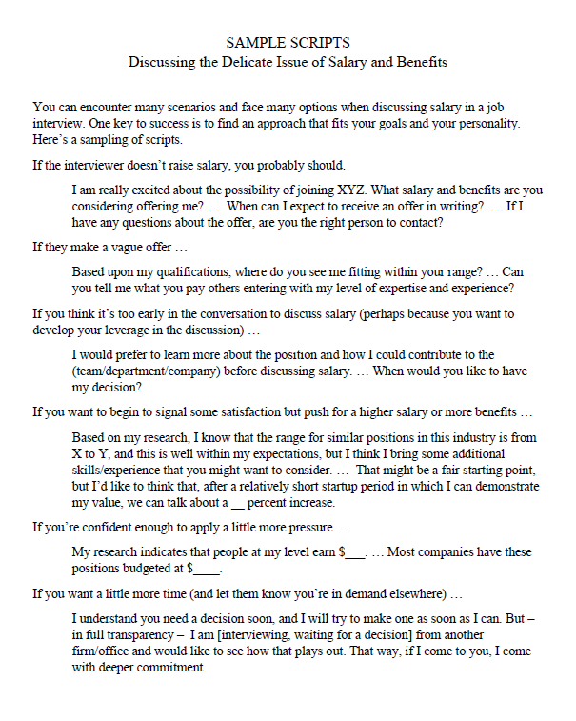
HOW DO YOU ASK? Have a plan.
Have a couple scripts on your back pocket

Slide 8
Tips and Tactics
Be collaborative not competitive
This is not a competition – aim for a win-win and think mutual gains
Consider both sides and remain positive
You and the employer have a common goal - to get you working for them with a salary you are happy with
You will be working with these people so keep a friendly demeanor – no hard feelings
Use reflective listening and summarizing
Use cooperative processes - discuss your interests and help brainstorm options
Remember: Negotiation involves conflict – which is simply an incompatibility between two (or more) interests
Demeanor
SMILE, be confident and friendly
Match their pace and energy
Detach from the outcome
Imagine you are negotiating for a friend
The organization wants to seal the deal at this point; do not waste their time by needlessly extending the negotiation

Slide 9
Tips and Tactics, continued
Language
Ask open-ended questions
Is this your final offer vs. is there room to negotiate a better offer
Use inquiry rather than interrogation, and ask clarifying and permission questions
Is there any flexibility on the salary?
Can we talk more about flextime?
Use encouraging language that connects – echo, praise and “we” language
Keep your wording positive and open
Instead of saying ‘no’ try
Is it possible…
I’d be more comfortable with…
Focus on points of agreement
Reiterate things you’ve already agreed upon
Start date – works well
Benefits – look great
Always
Reinforce your excitement
Listen carefully
Only talk as much as you need to
The more they talk, the more you learn

Slide 10
More Tips and Tactics
Use ranges to your advantage
Have a range in mind, but use concrete numbers in discussion
If forced to give a number and you have a range of $40,000-$50,000, say $50,000 but include that you would like to consider the whole package
Do not make the first move
Organizations will always have a salary range for a position
Avoid giving them a number
Avoid disclosing past salary (illegal in some places to ask!)
Ask them if you can discuss after you’ve had a chance to learn more about the role and expectations and determined if you are a good fit
Turn the question back on them
Can you tell me if you have a certain budget/range in mind?
Do Not
Say you are sorry or apologize
Overshare about your personal expenses
Compare salary to a co-worker
Make an ultimatum
Move forward without an offer letter

Slide 11
Pay Gaps: Gender AND Ethnicity
Women earn $0.82 per dollar men earn
Disparity starts right out of college
Men initiate negotiations four times more often than women
Men view negotiations as a game; women as a painful confrontation
Socialization
Assume employers will be fair
Fear of backlash
Perception
Closing the Gaps: Be an ally
Women are more likely to negotiate when an employer explicitly states that wages are negotiable
Women are less likely to negotiate face to face
Be aware of bias and prejudice
Gender Pay Gap in U.S. Held Steady in 2020, Amanda Barroso and Anna Brown, Pew Research Center, May 25, 2021, pewresearch.org

Slide 12
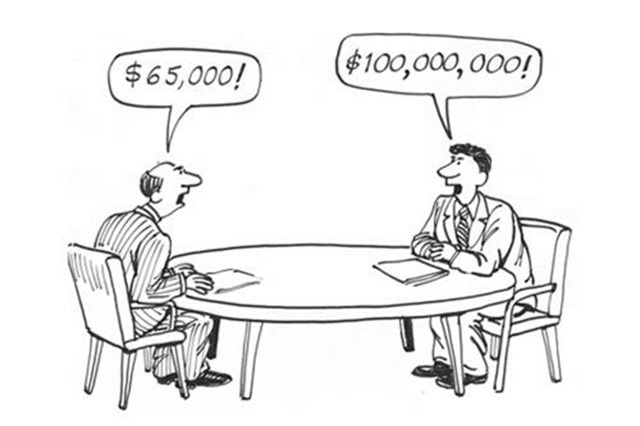
What If They Say No?
Don’t Panic
They may be convinced the salary is competitive and not willing to budge – it may be their best and final offer
You can inquire about other benefits or perks
They will not think poorly of you if you accept original offer
Thank them for taking the time to hear out and discuss your concerns
Accept the offer enthusiastically
Be Proud of Yourself
You demonstrated that you value yourself and your work
You can ask about a timeline for when it would be appropriate to reassess a possible raise
Negotiating in a straightforward, professional and polite manner demonstrates that you can handle difficult conversations and are not afraid to advocate for things that are important to you

Slide 13
Salary Negotiation Exercise
Ground Rules
This is our confidential space to share and make mistakes
Everyone is learning; this is not a competition
This is an art, not a science
Read your role and prepare your thinking (5 minutes)
Find your number partner, introduce yourself, sit down and negotiate a salary agreement (10 minutes)

Slide 14
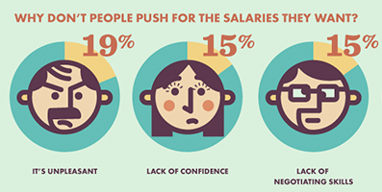
Salary Negotiation Exercise - DEBRIEF
Share how well you each did in meeting your needs
How are you feeling?
What were the techniques and tactics you used?
What was the most difficult part
Who scored a fat salary?
Who felt comfortable with a lower salary?

Slide 15
How do you get better?
Practice in a mirror, on video, with friends
Say the words
Pay attention to your language –
I think, I’m not sure, I guess
Be aware of any triggers
Great resources are everywhere

Slide 16
Questions? 3

