Slide 1
Paris to Belém
A Study in Policy Discontinuity

Slide 2
Paris Offered a Road Map
Involved all countries with a system of Nationally Determined Contributions (NDCs) that were designed to be strengthened within each successive 4-5 year period.
Committed to keeping global temperature rise “well below 2 degrees Celsius” above pre-industrial levels and to pursuing efforts to “limit the temperature increase to 1.5 degrees Celsius.”
Introduced new reporting requirements on mitigation efforts and established a Global Stocktake (GST) every five years to assess progress toward goals.
Entered into Force (EIF) November 4, 2016.
To date 194 countries have ratified the agreement, although the United States notified the UNFCCC of its intent to withdraw effective January 21, 2026 (for the second time).

Slide 3

U.S. Policy Post-Paris
Major EPA effort to phase out coal power generation through the Clean Power Plan provided incentives for states to reduce or eliminate coal. States sued and implementation stalled.
Obama Administration takes other steps to implement the Paris Agreement – formally joining the Paris Agreement 2016.
States and Cities are encouraged to adopt zero emission targets.
U.S. initiates action within the Montreal Protocol to phase out Hydrofluorocarbons (HFCs) –a refrigerant with high global warming potential (GWP).
Trump Administration’s opposition to climate action (2017) slows action; Trump withdraws from Paris Agreement in November 2019 effective in 2020.
Biden Administration re-enters Paris Agreement in 2021.

Slide 4

The Biden Approach to Paris
New administration seeks to incentivize action through legislation.
The Infrastructure Act aims to modernize the economy through support for cleaner energy and innovation.
The Inflation Reduction Act offered new incentives to states and individuals, supporting clean power production and development of new products – advanced batteries, electric vehicles, wind and solar systems.
At COP 29, John Podesta argued that the U. S. energy transition would continue as the legislation was backed by appropriations.
Optimism proved unfounded as the new administration dismantled the legislation and rescinded appropriations without opposition from a GOP-controlled Congress.

Slide 5

U.S. Abandons COP 30
COP 30 was designed.d to strengthen original NDCs.
U.S. withdrawal has compromised the process; strong U.S. NDC undermined; U.S. support for international climate action eliminated.
China’s new NDC shows little ambition despite China’s major role in renewable energy production.
Despite promise of Paris no new climate leadership emerges.
Geopolitical tensions lower priority for climate action.

Slide 6
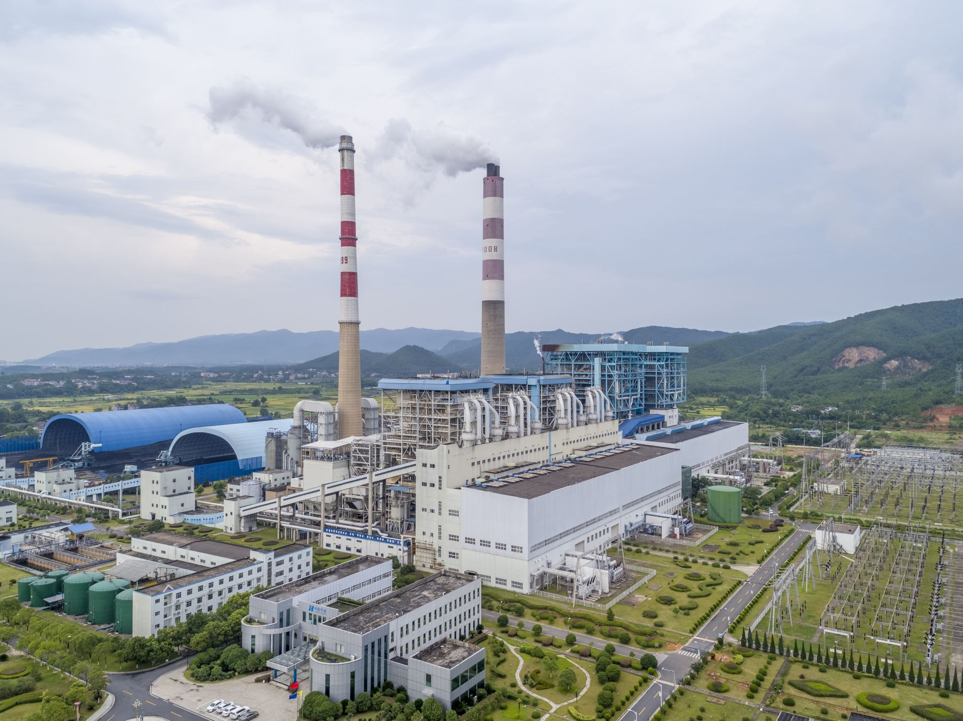
Policy Assumptions
U.S. environmental policy was focused on mitigation.
Success with SO² (sulfur) and CFCs (ozone) offered examples.
Assumed fossil fuel interests would accept science that CO² was a pollutant.
Ignored differences in earlier efforts which were directly linked to human health.
Dismissed the scale of the problem: in 1987 fossil fuels represented 81% of Total primary energy supply (TPES).
Regulating CO² required penalizing the energy sector.
Public understood CO² was an essential part of the earth’s biome.

Slide 7

Resistance to Action
In 1992 Congress ratified UNFCCC as it called for study; imposed no constraints.
UNFCCC entered into force; failure of parties to meet 1990 emission levels triggers Kyoto protocol negotiations.
Congress adopts Byrd-Hagel resolution cautioning against harming U.S. economy.
Fossil fuel interests mount public campaign against Kyoto action.
Climate change and environmental action become polarizing – more conflict emerges along party lines.
Trump embodies these perceptions even as climate change impacts become visible.

Slide 8

Political Polarization Stalled Climate Action
Fossil fuel abundance shaped the Post WWII World.
Environmental activists thought science could overcome public resistance.
Emissions trading (like SO² approach) dominated discussions.
Climate was seen as a global problem; all industrialized countries must act.
Oil companies argued U.S. would face disproportionate constraints; developing countries would benefit at our expense.

Slide 9

COP 30
In 2019, China and EU sought to fill vacuum, U.S. still participated.
Brazil has sought to create a sense of collaborative multilateralism.
Ambition in NDCs is limited; finance is a constraint.
Dilemma: Emissions since Paris only fell during the pandemic; 2024 emissions surged.
TPES in 2024 is still 81% fossil fuels despite steady growth of renewables.
New energy demands in OECD and Asia poses challenges for action.
Geopolitics poses serious challenges.

Slide 10

Solving the Impasse?
Reframe the issue?
Fossil energy remains an economic option. How do we raise the price and ration the supply?
Can the UNFCCC shape these outcomes?
How do we adapt to a rapidly changing planet?
Is U.S. re-engagement in the Post WWII order possible?

