Slide 1


Salary Negotiation: Advocating for Yourself5
Samantha Clemence
17 April 2026

Slide 2
Typical Formal Negotiation Process
What is a Negotiation?
Negotiation: A process by which two or more parties resolve an issue or achieve an outcome through compromise
PARCC* definition: A conversation about balancing Interests and Positions
-> Position: I want a $80,000 salary plus…
-> Interest: I value my lifestyle
Preparation – research both sides, least and most desired outcomes, tradeoffs, concessions, BATNA alternative if negotiation fails (Best Alternative to a Negotiated Agreement), ground rules
Exchange Information – each party share initial position, including underlying interests and concerns uninterrupted, what they aim to receive and why they feel that way
Clarification – discussion with justification and bolstering of claims, disagreements broached and understood
Bargain and Problem-Solve – give-and-take with proposal of counter-offers; active listening and calm feedback
Conclusion and Implementation – acceptable solution agreed upon, thank each other (maintaining good relations is key), outline expectations and write-up agreement
*PARCC: Program for the Advancement of Research on Conflict and Collaboration

Slide 3


Necessary Evil or Fun Challenge?

Slide 4
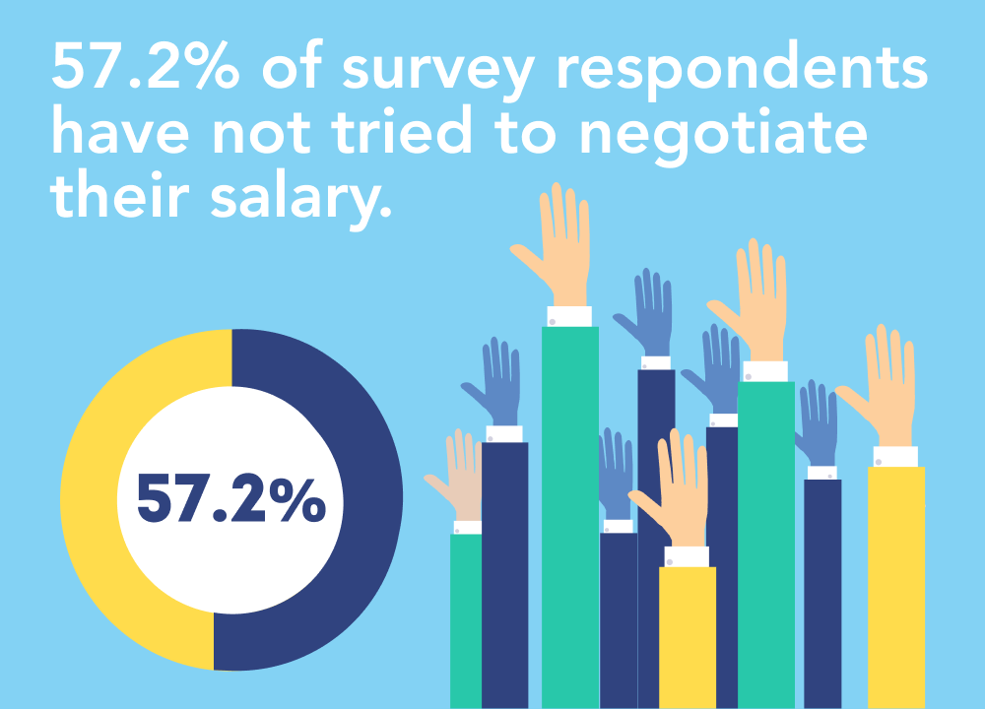
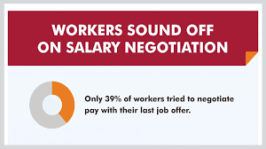
DO YOU HAVE TO ASK? Yes!!!
If you don’t ask, you aren’t getting anything. This is your chance to set a foundation for future growth.
  Your employer EXPECTS you to negotiate
    Wiggle room built into offers – not always salary
  Do not negotiate with yourself
    Do not talk yourself out of negotiating before you even start
    Reassess the position and expectations after you receive offer
  They will not rescind the offer if you negotiate in good faith
    No lying or misrepresenting
    If you advocate for yourself, you will advocate for the organization

Slide 5
Salary Negotiation Exercise
  Ground Rules
    This is our confidential space to share and make mistakes
    Everyone is learning; this is not a competition
    This is an art, not a science
  Read your role and prepare your thinking (5 minutes)
  Find your number partner, introduce yourself, sit down and negotiate a salary agreement (10 minutes)

Slide 6
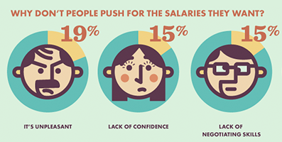
Salary Negotiation Exercise - DEBRIEF
  CANDIDATES
    How are you feeling?
    What was the most difficult part?
    Who feels like they scored a fat salary?
    Who felt comfortable with a lower salary?
  HIRING MANAGER
    How are you feeling?
    What was the most difficult part?
  ALL
    What were the techniques and tactics you used?

Slide 7
WHEN DO YOU ASK? When they offer you the position.
Avoid (if possible) discussing salary until an offer is made; they want you!
  If salary arises before an offer, ask them what the range is
Be prepared for the unexpected. Different companies follow different processes.
  They may email all salary and benefit information before an offer
  You may negotiate with a recruiter or HR representative
Be excited by the offer and express your enthusiasm and gratitude (almost always)
  Avoid negotiating on the spot. Ask for offer in writing.
    Reply immediately with a thank you and let them know you will get back to them in 24 hours once you have a chance to review the offer
  Avoid negotiating by email – only in person or via phone/video
    Reiterate how excited you are at the prospect of working together, you have questions about the offer and would like to set up a time to discuss

Slide 8
WHAT DO YOU ASK FOR? Preparation is paramount.
Know your worth – and be able to articulate it
  Is the role bigger than you first imagined? After interview, reconsider skills and expectations, what you bring to the role, etc. Summarize achievements, unique values.
Do your research – browse salary guides like glassdoor.com, payscale.com and salary.com. NACE* has a guide for new graduates.
  Market-rate compensation adjusted for factors like location, experience, education
Know your needs – game out a budget for location (living expenses, debt, insurance, savings, retirement, etc). Cost of Living Wizard or Cost of Living Comparison sites.
Speak to your network - friends, alums – people of different gender and ethnicity
Consider non-salary compensation - vacation time, retirement, sign-on bonus, relocation costs, performance bonuses, telework/remote work, professional development, continuing education benefits, particular role on a project, etc.
*NACE: National Association of Colleges and Employers

Slide 9
HOW DO YOU ASK? Have a plan.
Think it through - will you counteroffer, walk away, or accept the initial offer?
  Know your Best Alternative to a Negotiated Agreement (BATNA) taking into account your wants and needs, budget, interests and worth, the payscale, etc.
  How important is the salary given other aspects of the position?
Have a script and practice out loud
  Actually say out loud the things you are going to say out loud
    Find a script and see what feels natural for you, refine till comfortable
    Say the number out loud – repeat
      Based on my understanding of the role, fair market compensation (or base salary) in Washington, DC would be in the $50,000 to $60,000 range
    Practice with a friend – friends who work in HR are priceless!

Slide 10
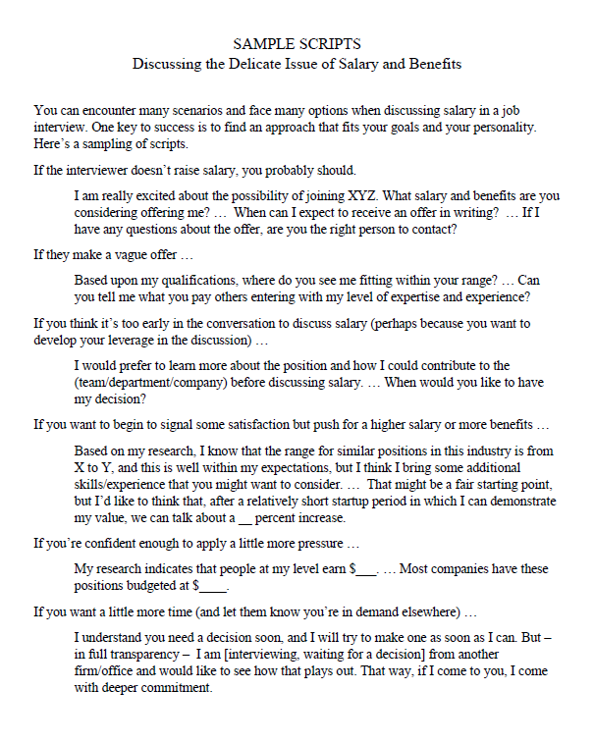
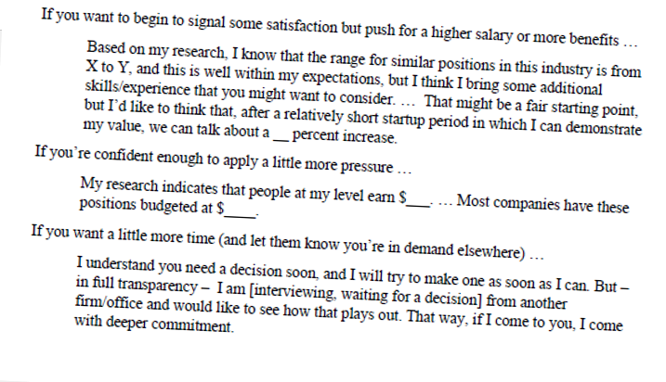
HOW DO YOU ASK? Have a plan.
Have a couple scripts in your
back pocket

Slide 11
Tips and Tactics
Be collaborative not competitive
This is not a competition – aim for a win-win and think mutual gains
Consider both sides and remain positive
  You and the employer have a common goal - to get you working for them with a salary you are happy with
You will be working with these people so keep a friendly demeanor – no hard feelings
Use reflective listening and summarizing
Use cooperative processes - discuss your interests and help brainstorm options
Remember: Negotiation involves conflict – which is simply an incompatibility between two (or more) interests
Demeanor
SMILE, be confident and friendly
Match their pace and energy
Detach from the outcome
  Imagine you are negotiating for a friend
The organization wants to seal the deal at this point; do not waste their time by needlessly extending the negotiation

Slide 12

Tips and Tactics, continued
Language
Ask open-ended questions
  “Is this your final offer?” vs. “Is there room to negotiate a better offer?”
Use inquiry rather than interrogation, and ask clarifying and permission questions
  Is there any flexibility on the salary?
  Can we talk more about flextime?
Use encouraging language that connects – echo, praise and “we” language
Keep your wording positive and open
  Instead of saying ‘no’ try
    Is it possible…
    I’d be more comfortable with…
Focus on points of agreement
Reiterate things you’ve already agreed upon
  Start date – works well
  Benefits – look great
Always
Reinforce your excitement
Listen carefully
Only talk as much as you need to
  The more they talk, the more you learn

Slide 13
More Tips and Tactics
Use ranges to your advantage
Have a range in mind, but use concrete numbers in discussion
If forced to give a number and you have a range of $40,000-$50,000, say $55,000-$60,000 but include that you would like to consider the whole package
Do not make the first move
Organizations will always have a salary range for a position
  Avoid giving them a number
  Avoid disclosing past salary (illegal in some places to ask!)
Ask them if you can discuss after you’ve had a chance to learn more about the role and expectations and determined if you are a good fit
Turn the question back on them
  Can you tell me what range has been budgeted for this position?
Do Not
  Say you are sorry or apologize
  Overshare about your personal expenses
  Compare salary to a co-worker
  Make an ultimatum
  Move forward without an offer letter

Slide 14

Pay Gaps: Gender and Ethnicity
Women earn $0.82 per dollar men earn
Disparity starts right out of college
Men initiate negotiations four times more often than women
  Socialization
    Game vs painful confrontation
  Assume employers will be fair
  Fear of backlash
  Perception
Closing the Gaps: Be an ally
People are more likely to negotiate when an employer explicitly states that wages are negotiable
Some people are less likely to negotiate face to face
Be aware of bias and prejudice
Gender Pay Gap in U.S. Held Steady in 2020, Amanda Barroso and Anna Brown, Pew Research Center, May 25, 2021, pewresearch.org

Slide 15
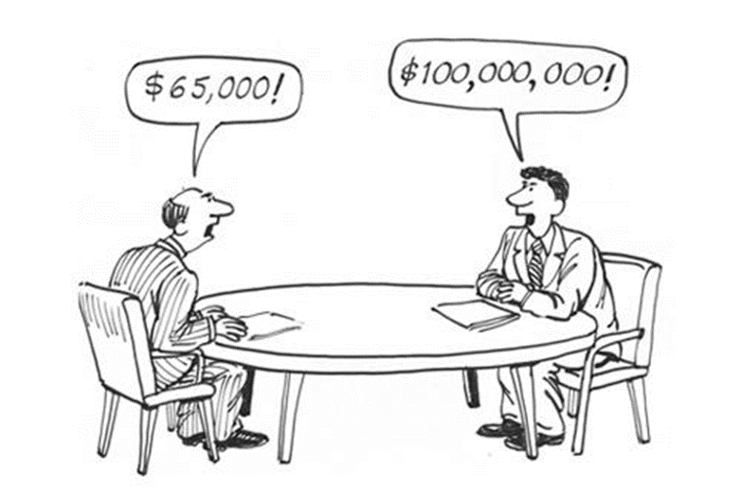
What If They Say No?
Don’t Panic
They may be convinced the salary is competitive and not willing to budge – it may be their best and final offer
You can inquire about other benefits or perks
You can ask about a timeline for when it would be appropriate to reassess a possible raise
They will not think poorly of you if you accept original offer
Thank them for taking the time to hear out and discuss your concerns
Accept the offer enthusiastically
Be Proud of Yourself
You demonstrated that you value yourself and your work
Negotiating in a straightforward, professional and polite manner demonstrates that you can handle difficult conversations and are not afraid to advocate for things that are important to you

Slide 16


How do you get better?
Practice in a mirror, on video, with friends
Say the words
Pay attention to your language –
  I think, I’m not sure, I guess
Be aware of any triggers
Great resources are everywhere
  Look at scripts!

Slide 17
Questions? 3

Slide 18
Salary Negotiation: Advocating for Yourself5
Samantha Clemence
17 April 2026

