Slide 1
Overcoming “Impostor Syndrome”
Understanding it’s natural. Building confidence. Channeling adrenaline.
Samantha Clemence
Fulton Armstrong
23 January 2026

Slide 2
Overcoming “Impostor Syndrome”
Avoiding
and
Building confidence.
Understanding it’s natural.
Channeling adrenaline.
Big majority
Healthy
Not forever
Prepare
Visualize
Breathe
Experience
Skills
Awareness
Exorcism

Slide 3
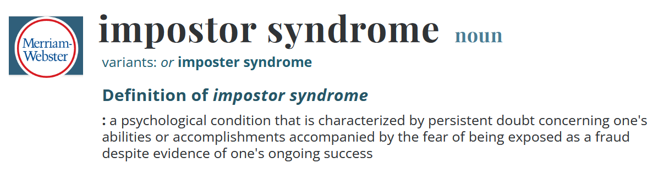

Slide 4
Famous “Impostors”
Tom Hanks
“When are they going to discover that I am, in fact, a fraud?”
Maya Angelou
“I’m running a game on everybody, and they’re going to find me out.”
Albert Einstein
“I’m an involuntary swindler.”
Arianna Huffington
“… the voice in my head that I call my obnoxious roommate.”
Stefani Joanne Angelina Germanotta
“I still sometimes feel like the loser kid in high school.”
Sonia Sotomayor
“I am always looking over my shoulder wondering if I measure up.”

Slide 5
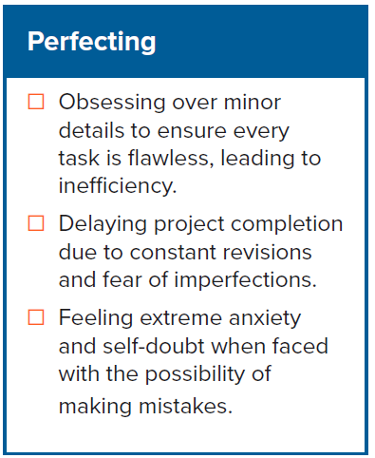

The 5 P’s of Impostor Syndrome
Can call them symptoms.

Slide 6
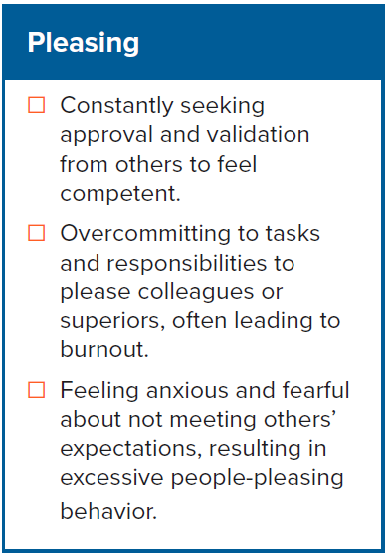
The 5 P’s of Impostor Syndrome

Slide 7
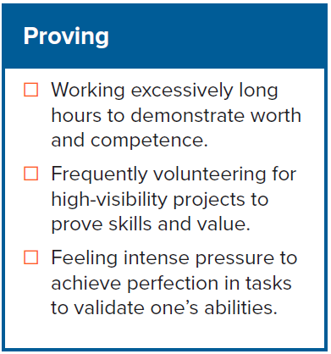
The 5 P’s of Impostor Syndrome

Slide 8
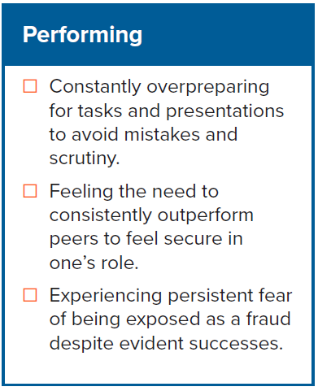
The 5 P’s of Impostor Syndrome

Slide 9
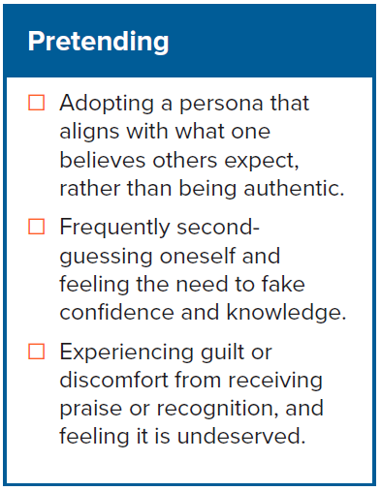
The 5 P’s of Impostor Syndrome

Slide 10
Different Stereotypes of Sufferers
“Perfectionists”
Unachievable goals
Deeply ingrained
“Experts”
Feel need to know everything
Train, collect so much that they miss opportunities
“Natural genius”
Hit upon situation in which they, finally, have to work like the rest of us
“Soloists”
Feel they have to do everything themselves
To accept help is to admit weakness
“Supermen” or “Superwomen”
Work harder than anyone to prove themselves – in everything they do
Consumed with competition
ALL … non-pathological cases … ALL “normal” people … ALL like US!

Slide 11
Understanding it’s natural.
70 percent of us, according to International Journal of Behavioral Science
Equally across genders*, ages, races; most careers
Can have deep roots, including genes, childhood, peers
Can be driven by factors beyond our control
- socio-economic - company policies
- cultural values - well-intended initiatives
Can have GOOD underlying factors: You CARE.
Even based on some common wisdom: “Fake it till you make it.”
* Originally more research on women as moving into workforce, but now equaled out.

Slide 12
It is …
NOT a lack of smarts, skills
NOT a mental illness
NOT a sign of depression, anxiety
NOT a sign of low self-esteem
It is …
a sense of sometimes feeling not deserving of
opportunities
accolades
distinctions
It is …
that voice … in the back of your mind … that sows doubt
… as if healthy modesty became
an obstacle to self-visualization
almost superstitiousness about being happy

Slide 13

The Impostor Cycle
Discounting
Achievement-related
Tasks
Anxiety
Self-doubt
Worry
Over-prepare
Procrastinate
Accomplishment
Feeling of relief
Perceived Fraudulence
Increased Self-doubt
Anxiety
Effort
Luck or other
Positive feedback
Discounted
© International Journal of Behavioral Science, 2011

Slide 14
Multiplied by the inaccurate belief that we’re alone.
“No one else feels these self-doubts.”
And … even worse … if we ask the wrong person about their possible doubts …
competitive ones may … may … may LIE.

Slide 15
Building confidence.
#1 Know that you are not alone.
** Ask a Mentor or someone outside the organization.**
You want to trust the organization – a “sense of belonging” is important – but choose wisely.

Slide 16
Building confidence.
One cardinal rule to observe even before you start: Be Honest.
“Put your best foot forward,” of course,
but be careful of
misrepresentation, excessive exaggeration –
because they might believe in you more than you believe in yourself.

Slide 17
Building confidence.
Seek challenges
Incrementally; welcome scutwork
Focus on skills
“Get rid of the fear by doing the work” (for many)
Time and Experience
Awareness
Skills
Psychology
Collect the facts
Document the good
Don’t judge hastily; do a “6−week review”
Assess your assessors
“Cognitive self-therapy”
(when dark fog moves in)
- Stop doubt in its tracks a.s.a.p.
- Listen to your Aunt Betty-Lou*
- Challenge negative feelings
- Write questions and honest answers
Never stop building skills
Keys to “success,” confidence
Tools you take everywhere
Investment in yourself
* Wise truthteller who loves you and tells you to cut the sh__.

Slide 18
Building confidence.
Seek challenges
Incrementally; welcome scutwork
Focus on skills
“Get rid of the fear by doing the work” (for many)
Time and Experience
Awareness
Skills
Psychology
Collect the facts
Document the good
Don’t judge hastily; do a “6−week review”
Assess your assessors
“Cognitive self-therapy”
(when dark fog moves in)
- Stop doubt in its tracks a.s.a.p.
- Listen to your Aunt Betty-Lou*
- Challenge negative feelings
- Write questions and honest answers
Never stop building skills
Keys to “success,” confidence
Tools you take everywhere
Investment in yourself
* Wise truthteller who loves you and tells you to cut the sh__.

Slide 19
Doubt attacks can flare up with nerves and adrenaline.

Slide 20
Channeling adrenaline.
Prepare well
Know your readers/audience
Script as works for you
Rehearse
Perhaps “murder board”
Prepare to shine
Do a “ceremony”
Enjoy
Visualize
Find your space (solitude or distraction)
Think positive thoughts
Think you’re briefing someone you love and trust
Be yourself
Know audience is with you
Smile
Breathe

Slide 21
What’s the longer-term objective?
Find ways to build strong base of confidence.
Stretch, but don’t over-sell.
Reassure yourself that you deserve what you have.

Slide 22



BREAK the Cycle
Discounting
Achievement-related
Tasks
Anxiety
Self-doubt
Worry
REPEAT: Embrace feedback
Learn how to accept praise without saying something stupid
If feedback is not all great, write it down, cool off, make a plan – trust your skills
Over-prepare
Procrastinate
Accomplishment
Perceived Fraudulence
Increased Self-doubt
Depression
Anxiety
Feeling of relief
Effort
Luck or other
Positive feedback
Discounted
© International Journal of Behavioral Science, 2011

Slide 23
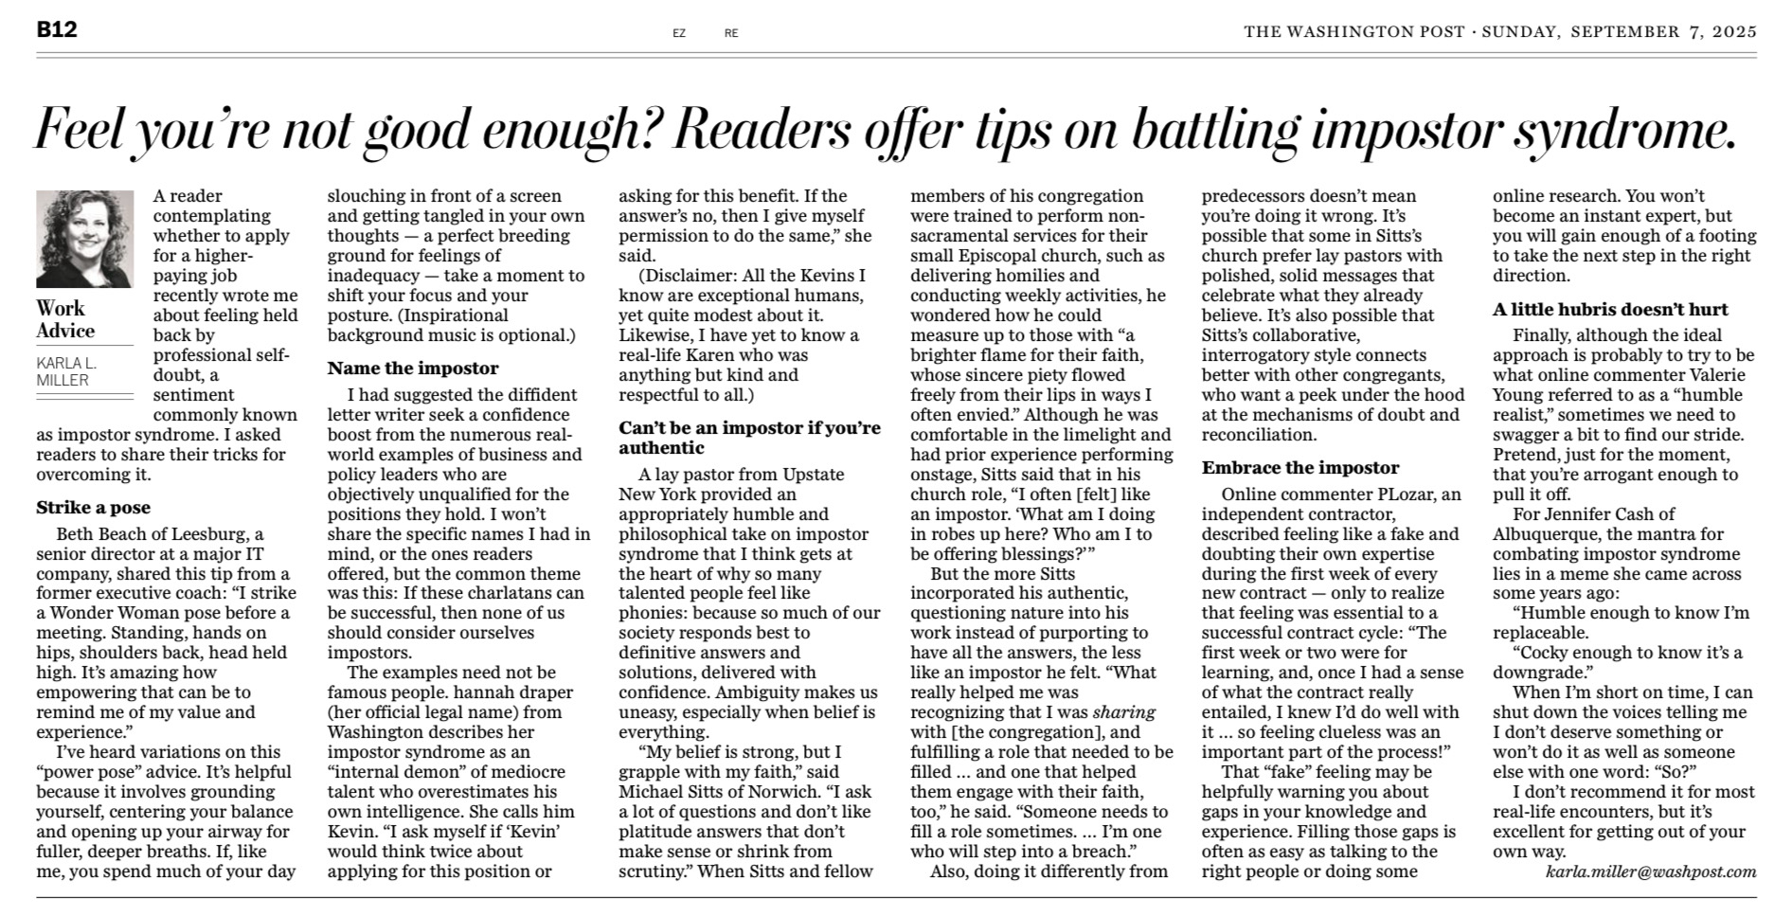
WP 7 Sep 2025
A little hubris
doesn’t hurt
Name the impostor
Can’t be an impostor if you’re authentic
Embrace the impostor
Strike a pose

Slide 24
A career is a process. In each job …
Stay focused
Stay in “learning mode”
Stay honest
Arm yourself to …
Beat fear.
Beat self-doubt.
Beat impostor syndrome.
Questions? Comments? Experiences to share?

Slide 25
Overcoming “Impostor Syndrome”
Understanding it’s natural. Building confidence. Channeling adrenaline.
Samantha Clemence
Fulton Armstrong
23 January 2026

