Slide 1

Global Policy Seminar and NSC Simulation
IRP 401 - IRP 402
Week Two 23 January 2026
Prof. Fulton T. Armstrong

Slide 2
Week 1 (16 Jan)
Week 2 (23 Jan)
Week 3 (30 Jan)
Week 4 (6 Feb)
Week 5 (13 Feb)
Week 6 (20 Feb)
Week 7 (27 Feb)
Week 8 (6 Mar)
Spring Break
Week 9 (20 March)
Week 10 (27 Mar)
Week 11 (3 Apr)
Week 12 (10 Apr)
Week 13 (17 Apri)
Week 14 (24 Apr)
Spring 2026

Slide 3
TODAY’S AGENDA
9:00 | Skills session – Impostor Syndrome
10:15 | Quick Review of Interagency Process
10:30 | Guest Speaker: Mike Orfini Former Aide to Vice Presidents The Interagency as seen from OVP - introduced by John
11:45 | Syllabus and Projects - II and preps for afternoon excursion
12:30 | Lunch and Metro to International Spy Museum
2:00 | International Spy Museum: Role of Intel in Policy Formulation and Implementation
~3:30 | Wrapup and depart from museum

Slide 4
TODAY’S AGENDA
9:00 | Skills session – Impostor Syndrome
10:15 | Quick Review of Interagency Process
10:30 | Guest Speaker: Mike Orfini Former Aide to Vice Presidents The Interagency as seen from OVP - introduced by John
11:45 | Syllabus and Projects - II and preps for afternoon excursion
12:30 | Lunch and Metro to International Spy Museum
2:00 | International Spy Museum: Role of Intel in Policy Formulation and Implementation
~3:30 | Wrapup and depart from museum

Slide 5

Professional Skills

Slide 6

The United States Government
How does it formulate foreign policy?

Slide 7
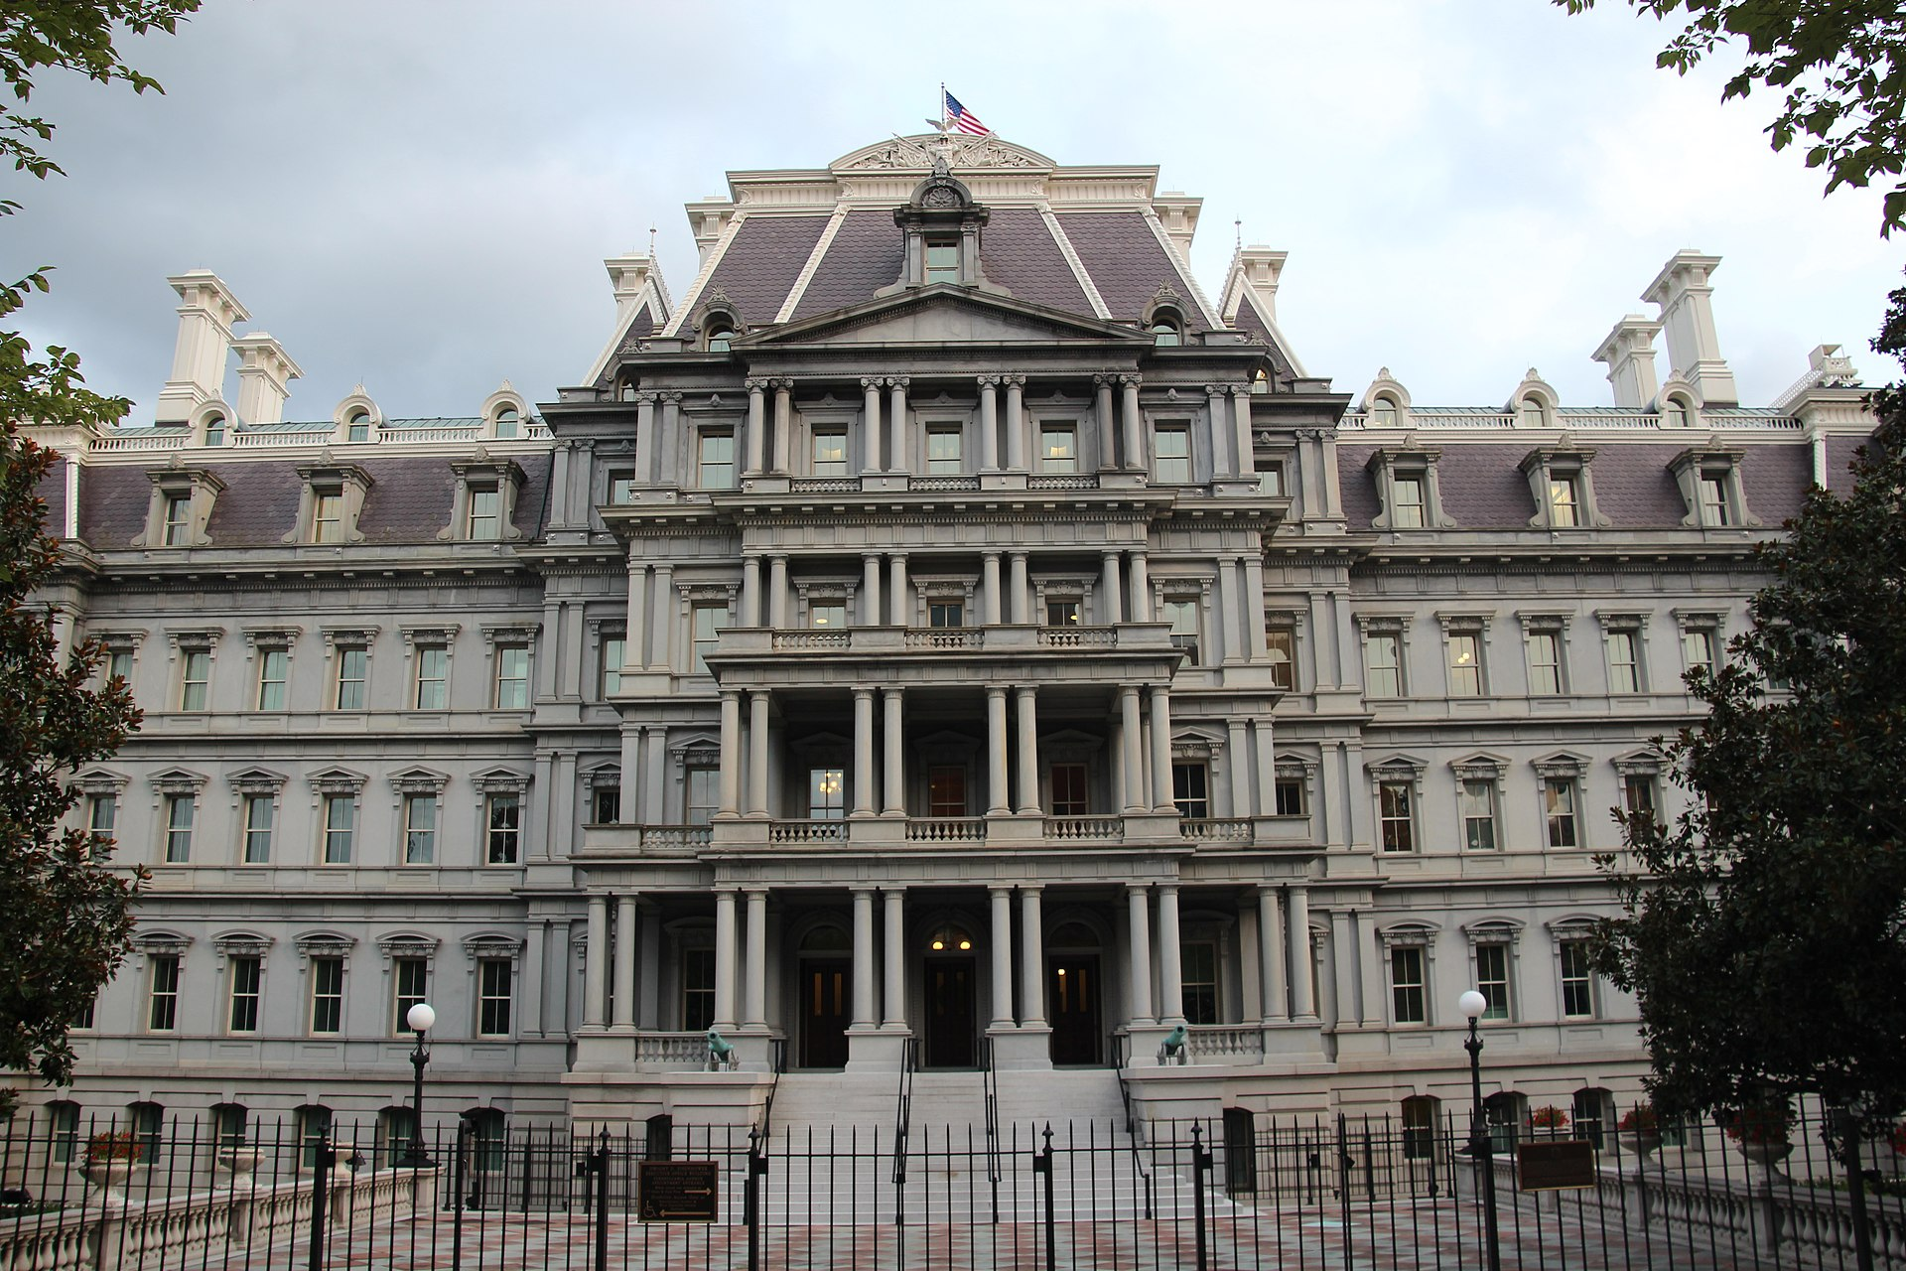
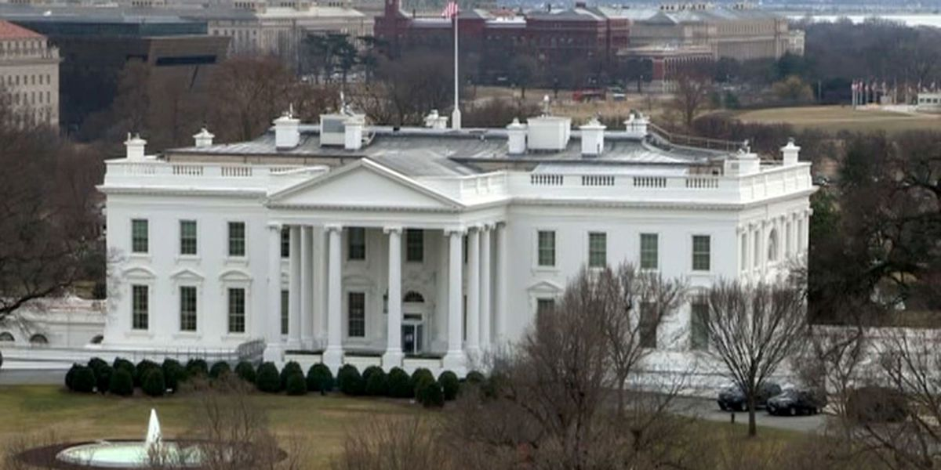
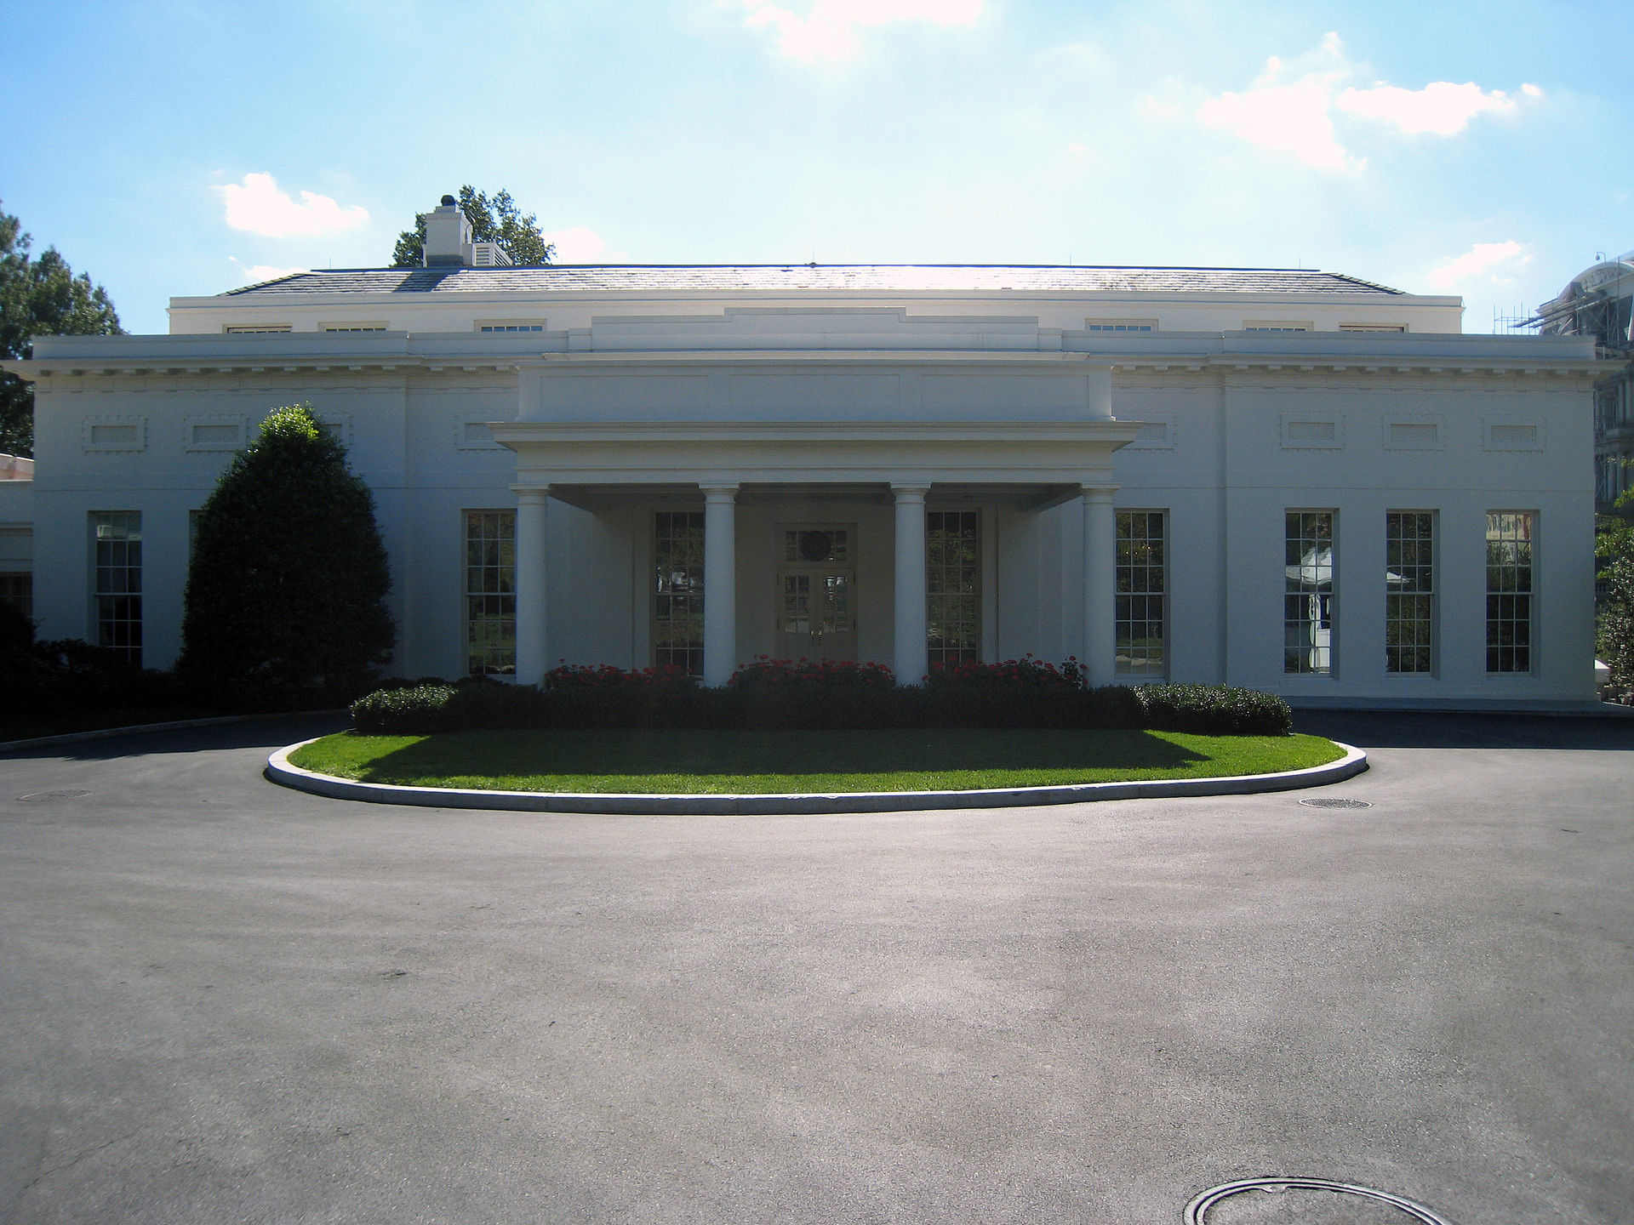
The National Security Council
NSC SIMULATION

Slide 8
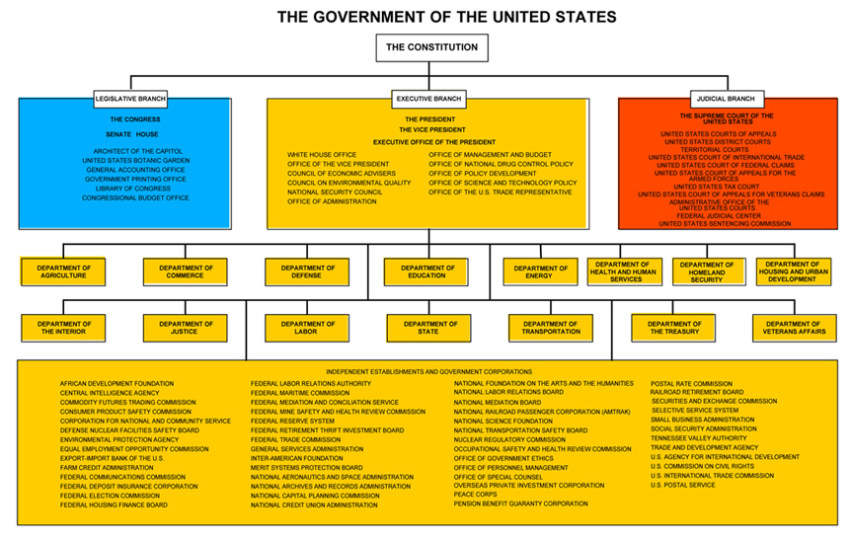
© Columbia University Library

Slide 9
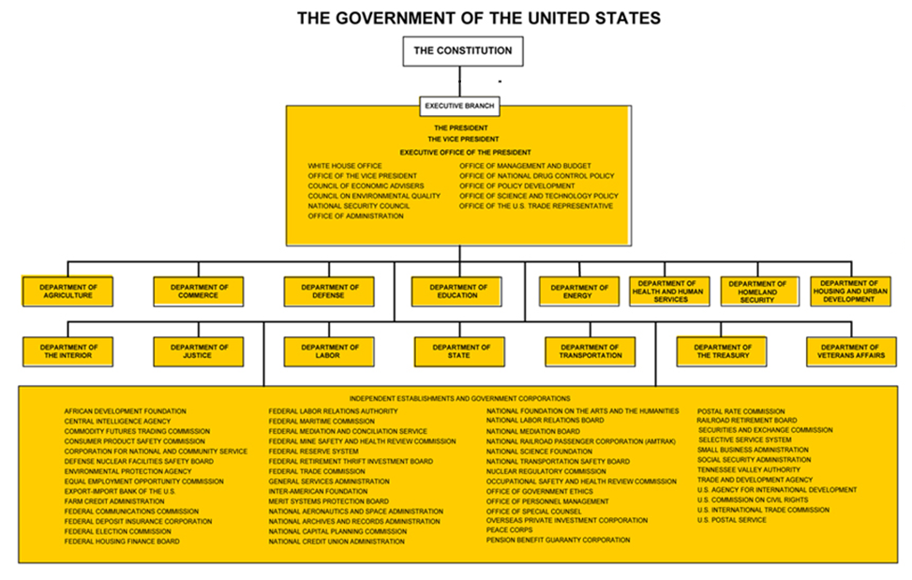
How do they
communicate?
intermediate?
coordinate?
The “Interagency Process”
NSC Principals
NSC Deputies
Interagency Policy Committees
Informal tools
© Columbia University Library

Slide 10
The U.S. “Interagency”
A super-fast tour
White House through NSC (and OMB)
“The interagency process”
Departments/agencies
State
Defense (OSD and JCS)
USTR
DHS (and agencies)
DOJ
Others with international role

Slide 11
How do they stay informed?
The media
Other public sources
Government sources
Print
Electronic
Social
Congress
Interest groups
Think tanks
Intelligence
Bureaucracy
Cabinet

Slide 12

The U.S. Intelligence Community

Slide 13
The U.S. Intelligence Community 18 member agencies
INDEPENDENT | DEPT OF DEFENSE | OTHERS
DNI | DIA | DOE
CIA | NSA | DHS
 | NGA | USCG
 | NRO | FBI
 | Army | DEA
 | Navy | INR
 | Air Force | DOTreasury
 | Marines
 | Space Force

Slide 14
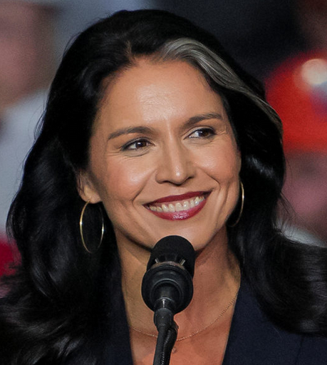
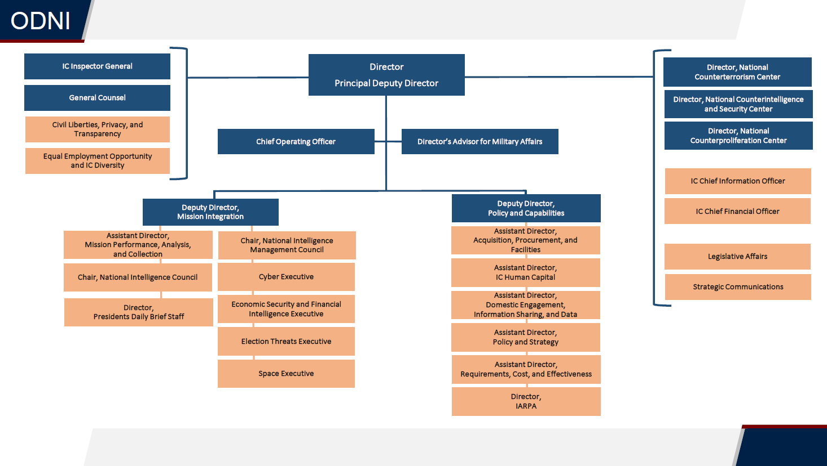
Tulsi Gabbard

Slide 15
The U.S. Intelligence Community is composed of the following 18 organizations:
Two independent agencies—the Office of the Director of National Intelligence (ODNI) and the Central Intelligence Agency (CIA);
Nine Department of Defense elements—the Defense Intelligence Agency (DIA), the National Security Agency (NSA), the National Geospatial- Intelligence Agency (NGA), the National Reconnaissance Office (NRO), and intelligence elements of the five DoD services; the Army, Navy, Marine Corps, Air Force, and Space Force.
Seven elements of other departments and agencies—the Department of Energy’s Office of Intelligence and Counter-Intelligence; the Department of Homeland Security’s Office of Intelligence and Analysis and U.S. Coast Guard Intelligence; the Department of Justice’s Federal Bureau of Investigation and the Drug Enforcement Agency’s Office of National Security Intelligence; the Department of State’s Bureau of Intelligence and Research; and the Department of the Treasury’s Office of Intelligence and Analysis

Slide 16

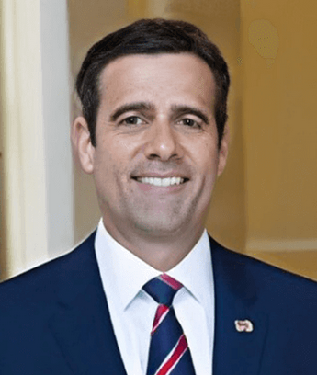
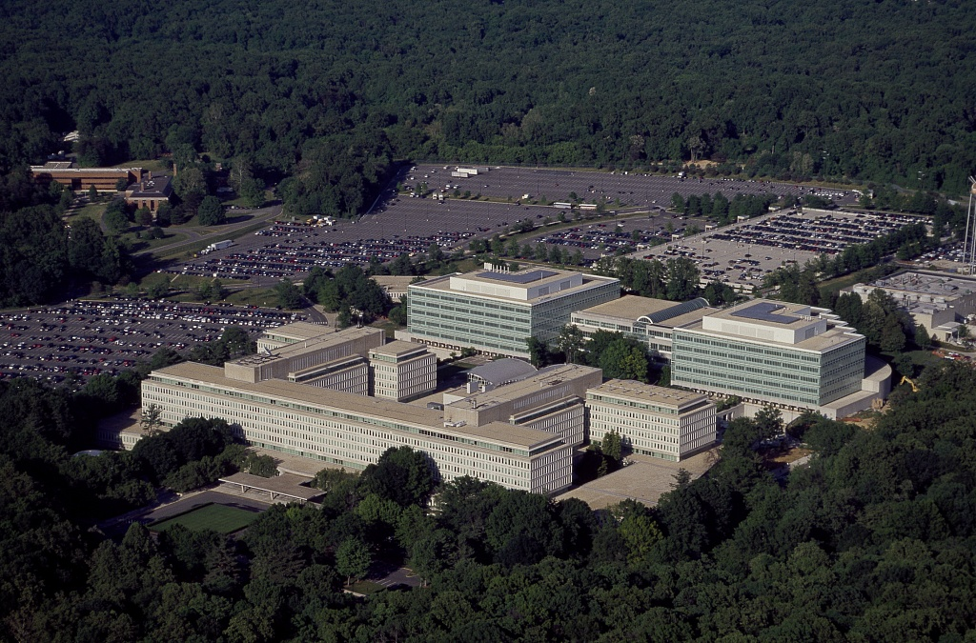
John Ratcliffe

Slide 17
“Our mission is straightforward but critical: leverage the power of information to keep our Nation safe.”
But is it just that?
Foreign Intelligence (FI)
Covert Action (CA)
Paramilitary (PM)

Slide 18
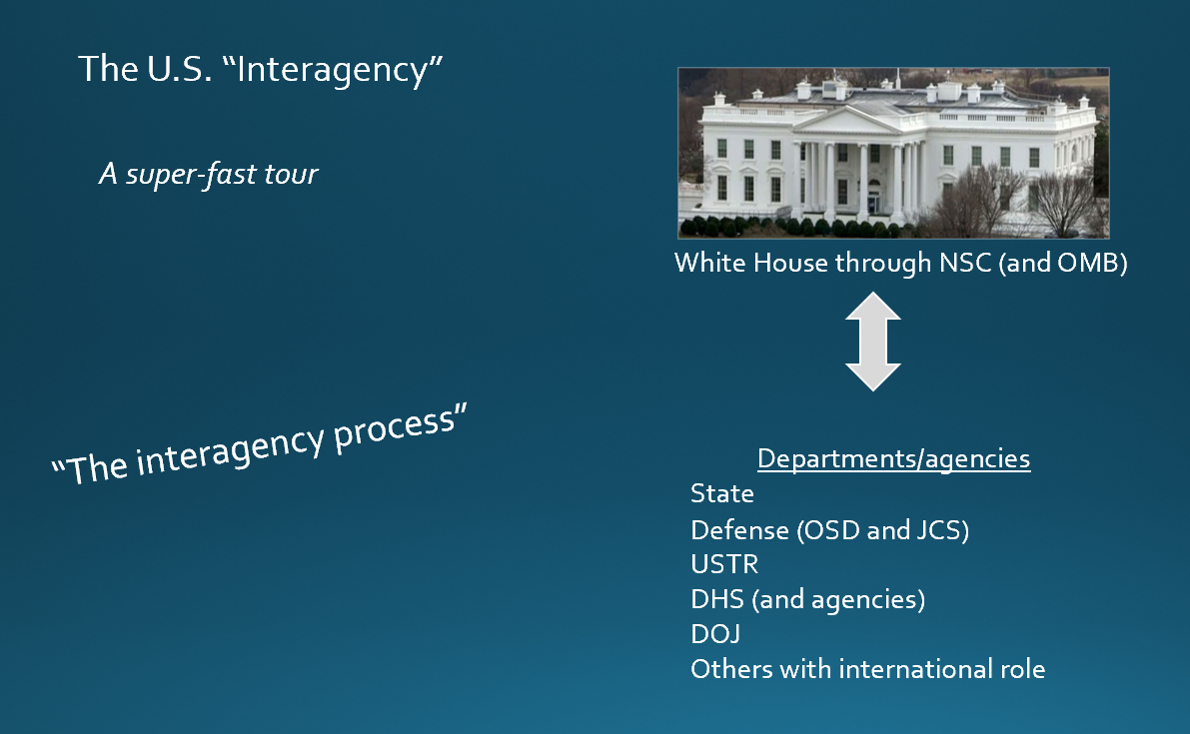
OUR SPEAKER worked in OVP

Slide 19
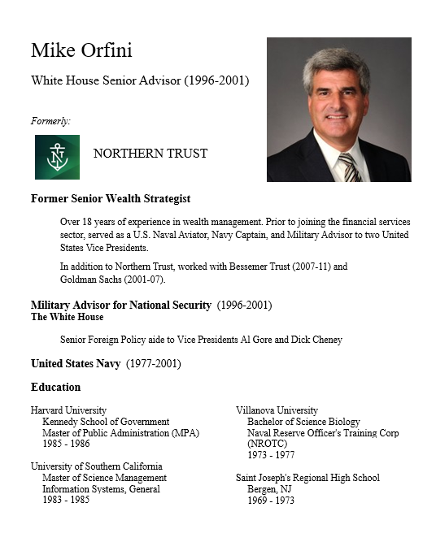
GUEST SPEAKER
Mike Orfini
Former White House Senior Advisor
- Introduced by John

Slide 20

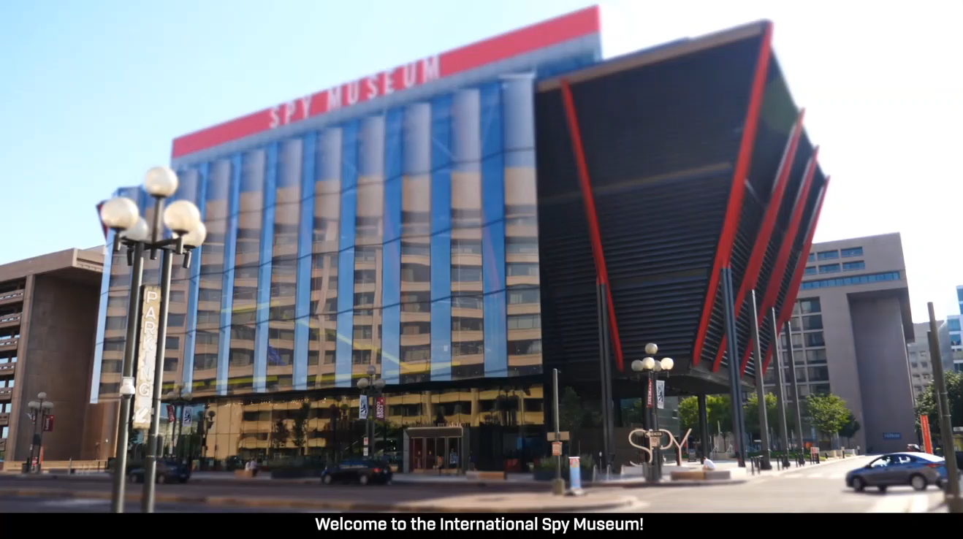
Offsite Visit
Remember …
Role of intelligence in policy
“Foreign Intelligence”
“Covert Action” and “PM”
The “INT’s”
HUMINT SIGINT
IMINT MASINT
OSINT
Evolution
Human vs technical
The International Spy Museum

Slide 21
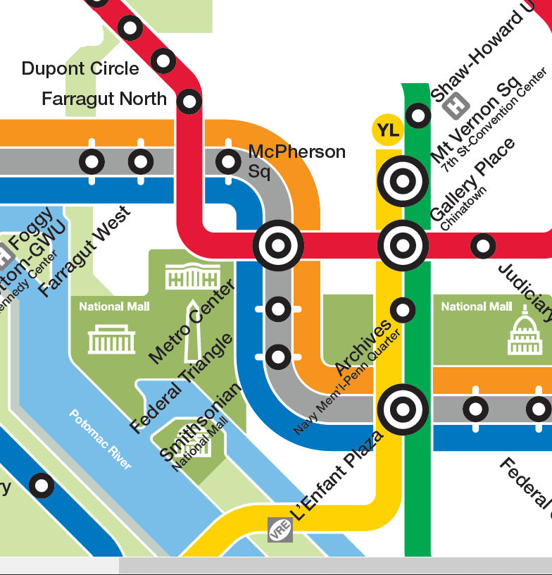
International Spy Museum
700 L'Enfant Plaza, SW Washington, DC 20024
RED LINE (→Glenmont)
from Dupont Circle to Metro Center
then
ORANGE (→New Carrollton) or BLUE (→ Largo) or SILVER (→ Largo)
from Metro Center to L’Enfant Plaza

Slide 22
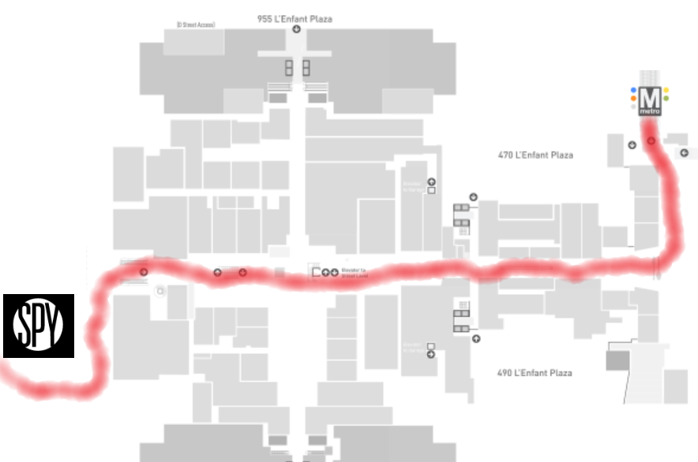


METRO: L'Enfant Plaza
L'Enfant Plaza Exit go up the escalator to enter the L’Enfant Plaza food court.
Enter at 2:00

Slide 23
OUR CLASS
Global Policy Studies (GPS)
401-402

Slide 24
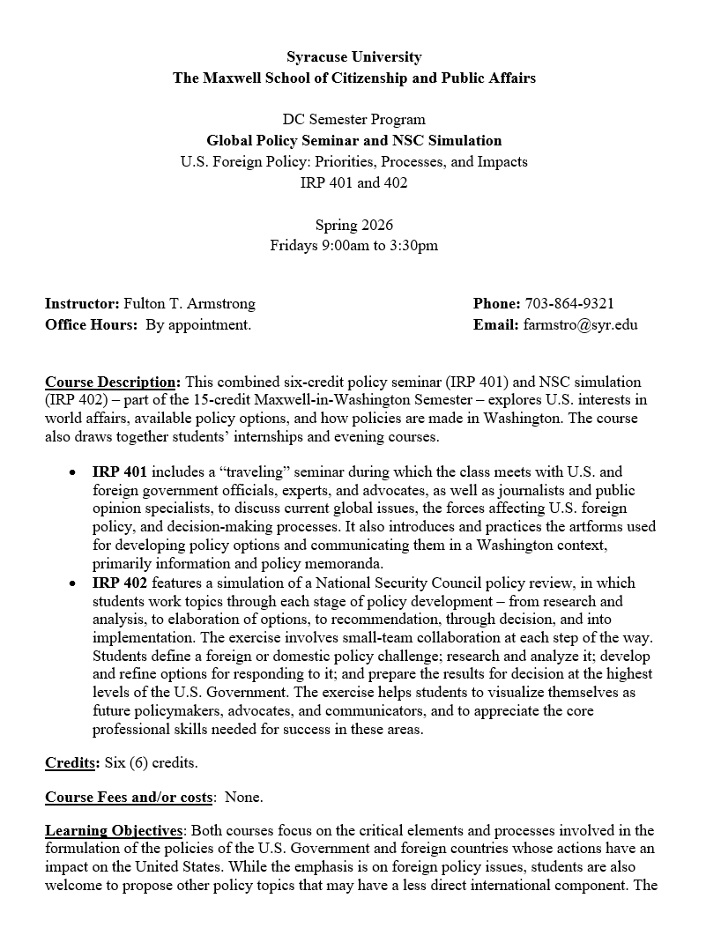
OUR CLASS
Global Policy Studies (GPS)
401-402

Slide 25
Course Description:
Combined six-credit policy seminar (IRP 401) and NSC simulation (IRP 402).
Explores U.S. interests in world affairs, available policy options, and how policies are made in Washington.
Also draws together internships and evening courses.

Slide 26
IRP 401 includes …
“Traveling” seminar that meets with U.S. and foreign government officials, experts and advocates, as well as journalists and public opinion specialists.
Introduction and practice of artforms used for developing policy options and communicating them in a Washington context, primarily information and policy memoranda.

Slide 27
IRP 402 features …
Simulation of a National Security Council policy review, through each stage – from analysis, to elaboration of options, to recommendation, through decision, and into implementation.
Small-team collaboration and responsibility.
Activities that should help you visualize selves as future policymakers, advocates and communicators.
Appreciation of the core professional skills needed for success in these areas.

Slide 28
Learning Objectives:
Critical elements and processes of the U.S. Government and foreign countries whose actions impact the United States.
Practical steps to identify and pursue opportunities in Washington, DC.
Learning from intern experiences, including workplace challenges and personal aspects of coping.

Slide 29
After taking this course, you will be better able to:
Evaluate U.S. foreign policy and the many the forces influencing it.
Understand different roles of the Executive Branch, Congress, media, NGOs, diplomatic missions in Washington, and international organizations.
Find, validate, and effectively use publicly available information. Obtain information from busy officials, activists, and media professionals.
Create, self-edit, and communicate analysis and policy proposals in both written (policy memos) and verbal (presentations, simulations) forms.
Think about your own futures.

Slide 30
Course Requirements and Expectations:
For the policy seminar (IRP 401), you will prepare three memos – two on a pressing policy topic, and one with personal reflections on policy and related processes over the course of the semester. You will also brief the class on their topics and on their internship experiences. You will prepare the following written and oral products (per guidance and examples provided):
A running individual journal, with short (one- or two-paragraph) entries in a reserved, private space in Blackboard with key observations and conclusions from your interaction with guest speakers and visits made as a class each week.
A completed analytical worksheet (“Memo #1”) on a topic of your choosing (coordinated with the professor).
A short (two-page) memorandum (“Memo #2”) updating and analyzing information on the same topic; identifying the U.S. government’s policy options as currently understood; and predicting how the policy debate will play out and why.
A briefing to the class on the conclusions reached during development of the analytical worksheet and memorandum (if time permits).
At the end of the semester, a short (two- page) memorandum of reflections on key takeaways from the semester work and experiences, including, if desired, how they influenced your perceptions of their career interests.

Slide 31
For the National Security Council simulation (IRP 402), you – working in teams of two – will conduct a National Security Project, beginning with a mock National Security Council tasking memo, moving through each stage of policy preparation, and ending with a memo to the NSC “Deputies Committee” proposing a policy for the President’s approval. You will prepare the following written and oral products (per guidance and examples provided):
A project proposal (in the form of an NSC memo) on an issue in which you and teammate have interest and enough expertise to start, as coordinated with the professor.
A memo reporting on a Congressional hearing or public forum relevant to the chosen issue (by one team member) and a memo on U.S. and foreign public opinion relevant to that issue (by the other).
A memo reporting on an interview (one by each team member) with an expert source on the topic.
A final policy recommendation memo (jointly written) for the NSC “Deputies Committee” to consider on the issue with a final recommendation to the President.
A PowerPoint briefing for the simulated NSC meeting at which the team will brief the “Deputies” on its issue, including analysis, key interagency positions, and recommendations.

Slide 32
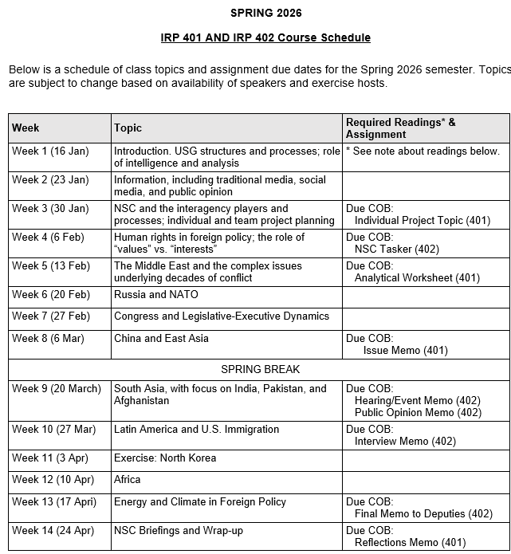
✓
✓
✓
✓
✓
✓
✓
✓
✓
✓
✓
✓
✓
✓
✓
✓
✓
✓
✓
✓
✓
✓
✓
✓
✓
✓
✓

Slide 33
✓
✓
✓
✓
✓
✓
✓
✓
✓
✓
✓
✓
✓
✓
✓
✓
✓
✓
✓
✓
✓
✓

Slide 34
✓
✓
✓
✓
401
✓
✓
✓
✓
✓
✓
✓
✓
402
✓
✓
✓
✓
✓
✓
✓
✓
✓
✓
✓
✓
✓
✓
✓
✓
✓
✓
✓
✓
✓
✓
✓
✓

Slide 35
✓
✓
✓
✓
401
Look like a lot?
✓
✓
✓
✓
✓
✓
✓
✓
402
✓
✓
✓
✓
✓
✓
✓
✓
✓
✓
✓
✓
✓
✓
✓
✓
✓
✓
✓
✓
✓
✓
✓
✓

Slide 36
FORMAT NOTE
Submit all products in PDF format – so I can see exactly how you want it to appear (and so you have flexibility in software you use).
Use TIMES NEW ROMAN or APTOS (or CALIBRI); 12 point.
Paragraphs should be:
Single-spaced
NOT justified margins
With 12 points between them
1” margin top, bottom, left, right
WRITE CLEARLY, SIMPLY, CONCISELY. PROOFREAD!!!!!

Slide 37
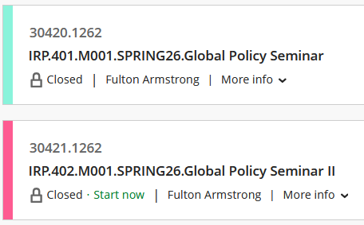
BLACKBOARD NOTES
We will use only 401.

Slide 38
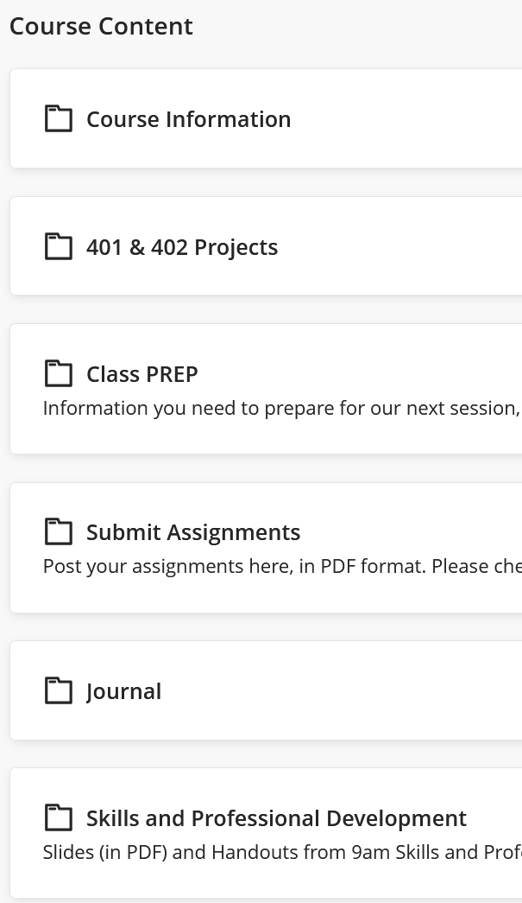
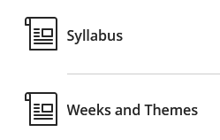

Slide 39
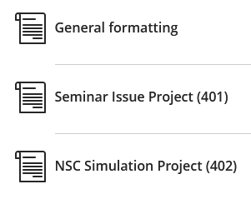
Guidance and Templates

Slide 40
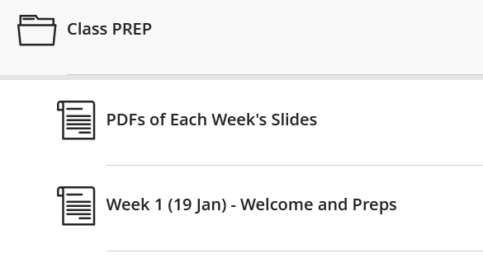
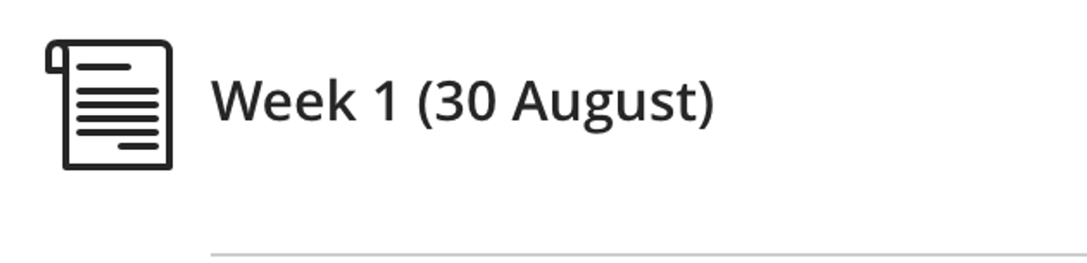
(Date)
Weekly prep e-mails from me
Saturday or Sunday; updated as needed
Schedule
Readings (for discussions and quizzes)
Assigned introductions of guests

Slide 41
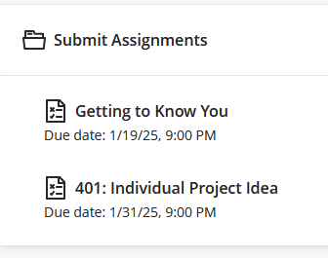

Slide 42
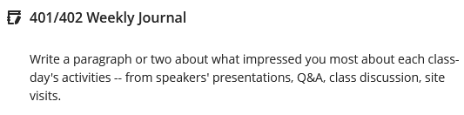
Weekly highlights from activities, speakers, readings
Short, but thoughtful
Counts toward participation grade but not graded each week

Slide 43
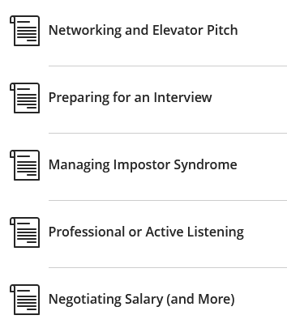

Slide 44
Soon to be added: Quizzes
On readings or current events
Brief writing exercises
Count toward participation grade

Slide 45
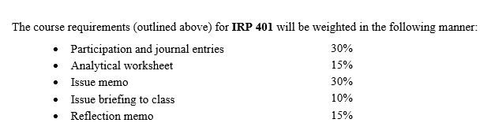
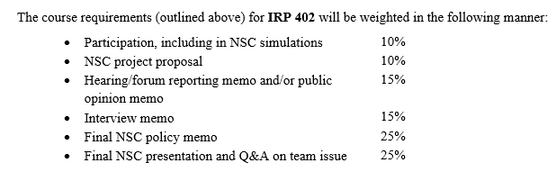
Grading
The course will provide varied opportunities for students to succeed and grow, and effort – as well as accomplishment – will be evaluated. Full attendance and active participation, including coming to each session prepared to discuss the readings and engage in thoughtful discussion with guest speakers, are expected.
Participation includes effective use of guest speakers to - Learn about the issues - Learn/practice elicitation - Explore new ideas

Slide 46
Religious Observance Notification Deadline: Monday, 2 February
Attendance and Preparation: Students are expected to attend (and be on time for) every class. Each Friday’s schedule is aggressive and requires that absences be for only exceptional purposes and be approved by the professor in advance. (Religious observances, health emergencies, and other compelling circumstances are understandable. Pursuit of long weekends is not an exceptional purpose.)
If you are absent, you will write a one-page (400 words) paper on the readings for that day.
If you feel that you cannot commit to attending every class, this may not be the right semester for you to be in the program.

Slide 47
Several words of wisdom:
Sometimes I will call you out, but … even if I don’t … don’t assume I don’t know what you’re doing.
Same thing on ethics issues such as use of ChatGPT.
I am concerned about artificial intelligence, but I worry more about natural stupidity.

Slide 48
Academic Integrity and “Artificial Intelligence”
Syracuse’s academic integrity expectations extend to the fast-growing realm of artificial intelligence (AI). In 401-402, some limited use of AI is permitted, per below.
Based on the specific learning outcomes and assignments in this course, artificial intelligence (e.g., ChatGPT) is permitted on the following: Memo #1 (for 401) and the research (pre-drafting) phase of the Project Proposal, Public Opinion, and Final Memo (for 402). Tools that aid in good writing, such as Grammarly, are also permitted. See each assignment for more information about what artificial intelligence tools are permitted and to what extent, as well as citation requirements. If no instructions are provided for a specific assignment, then no use of any artificial intelligence tool is permitted. Any AI use beyond that which is detailed in course assignments is explicitly prohibited except when documented permission is granted.
In other words, the professor’s policy is that the work for 401 and 402 must be original and produced by the students themselves. Students can use ChatGPT and other AI tools, as well as the usual search tools like Google, during the research phase of their projects (such as in building Memo #1) – to find information and identify possible primary sources of information – but the reasoning, analysis, and writing must be entirely their own. They will be required to certify that everything they submit is written by themselves and that they “have appropriately identified elements taken from other sources.”
pp. 4-5 of Syllabus

Slide 49
Late Assignment Policy: All work should be handed in on time unless otherwise arranged with the professor. Five points (or one-half grade) will be deducted for each day an assignment is late. For example, if an assignment is due on a Friday – at which time it would receive a grade of 80 – Saturday submission will lower the grade to 75.

Slide 50
THREE TASKS TO START FOR TODAY
1. Think of topics you would like to do for 401 and 402.
Interested in.
Relevant to U.S.
Developing, evolving.
International or domestic.
Some policy decision.
Balance between tactical and strategic.
You do it alone.
You do with one partner.
2. Start talking with potential partners.
(Not just a friend. Look for value-added.)
3. Here’s a list of candidate issues for team project.

Slide 51
TOPICS FOR YOUR CONSIDERATION
What should the United States do about … ?
Ukraine cease-fire or treaty
Gaza war, sovereignty, future
Israel relations after Netanyahu
Iran and its evolving nationalism
China (multiple aspects)
Enhancing cybersecurity
Aid to Gaza
DPRK and Kim’s strategy
UN environmental efforts
Russia and dealing with Putin
U.S. culture wars
Microplastics and PFAS
AI and socio-economic
Cryptocurrency risks
Declining birth rates
Economic, trade competition
Southeast Asia
Taiwan
Other challenges.
CRITERIA:
Interesting to classmates.
Relevant.
Already know something.
Dynamic, evolving.
Articulable U.S. interest.

Slide 52
Ukraine cease-fire or treaty
Gaza war, sovereignty, future
Israel relations after Netanyahu
Iran and its evolving nationalism
China (multiple aspects)
Enhancing cybersecurity
Aid to Gaza
DPRK and Kim’s strategy
UN environmental efforts
Russia and dealing with Putin
U.S. culture wars
Microplastics and PFAS
AI and socio-economic
Cryptocurrency risks
Declining birth rates
WANT TO EXPRESS AN INTEREST NOW?
Send me TWO e-mails by 9pm tonight (23 January):
One on your individual project proposal.
One – with proposed partner – on a team proposal.
Topic with one sentence on main story and one sentence on policy options.

Slide 53
REPEAT
THREE TASKS TO START IMMEDIATELY
1. Think of topics you would like to do for 401 and 402.
2. Start talking with potential partners for 402.
3. By 9pm tonight (23 January), send me e-mails with proposals for BOTH.
One as individual on your individual (401) topic.
One with proposed partner on your NSC (402) topic.

Slide 54
Also …
Journal entry each week (begin today)
short, short, short
insightful
main takeaway or impression

Slide 55
QUESTIONS or COMMENTS?
About …
the syllabus?
your 401 and 402 projects?
the guest speakers and off-campus visits?
the immediate deadlines?

Slide 56
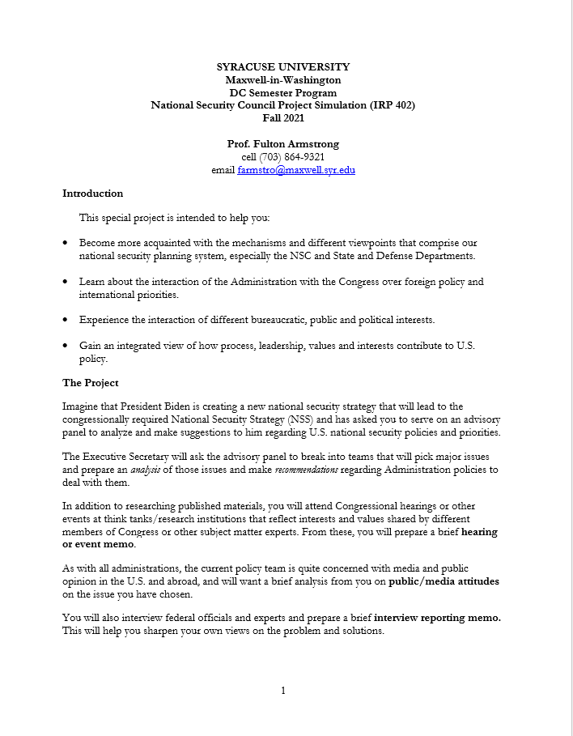
NSC PROJECT
From BlackBoard
Objectives
Design
Assignments
Grading
Any early ideas on topics you’d like to work?

Slide 57
NSC PROJECT
Teams and Proposals
1 or 2 people
“Major international issues and challenges to U.S. national security interests” or OTHER
Sample list in tasker
Other ideas, including non-IR
Common interest,
complementary skills, background

Slide 58
NSC PROJECT
DEADLINES
Choose partners and topics | Discuss today
Seek each other’s agreement and propose to me by e-mail | Deadline: 9pm on Friday, 26 Jan
Finalize Teams and topics by e-mail with me | Deadline: 9pm on Friday, 2 Feb
Finalize proposals; submit tasker | 9 Feb
Hearing/event memo | 22 Mar
Public opinion memo | 22 Mar
Interview memo | 29 Mar
Final memo | 19 Apr
Presentation and Defense | 26 Apr

Slide 59
SEMINAR PROJECT
“Issue focus worksheet”
DEADLINES
Choose a topic you’re interested in and already know pretty well | As soon as reasonable
Propose that topic to me in “Submit Assignments” area | Deadline: 9pm on Friday, 2 Feb
Begin organizing thoughts, finding info to fill gaps, thinking about issue. | As soon as reasonable
Prepare 1- or 2-sentence briefing on your topic for class | 9 Feb (in class)
Submit analytical worksheet | Deadline: 9pm on Friday, 16 Feb

Slide 60
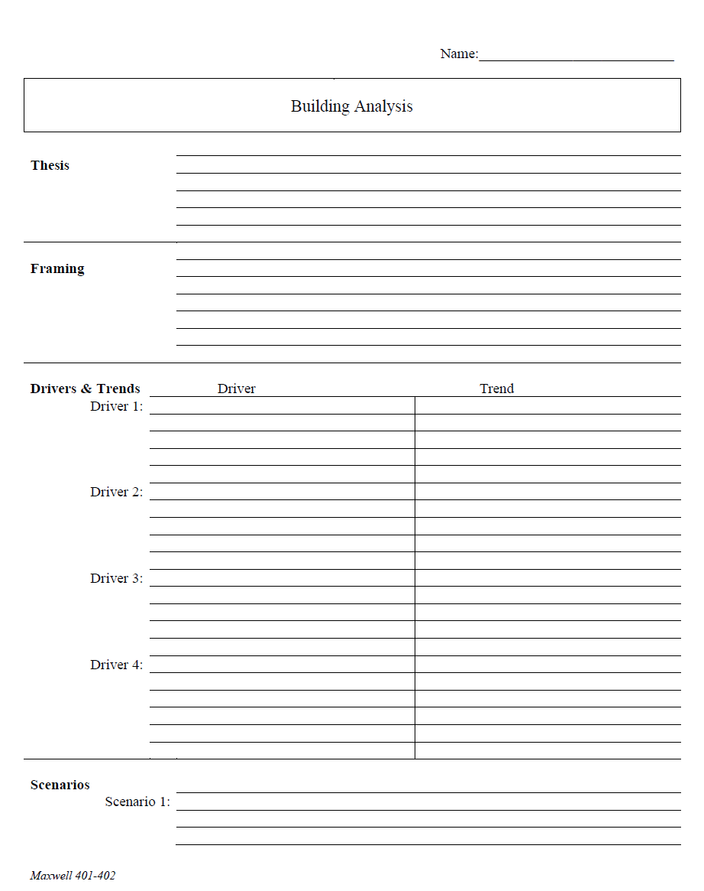
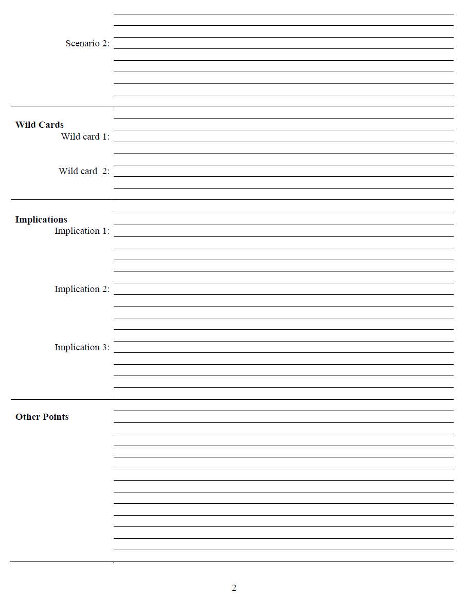
What is an analytical worksheet?
Purpose
Forms
ONE KIND
HANDOUT D

Slide 61
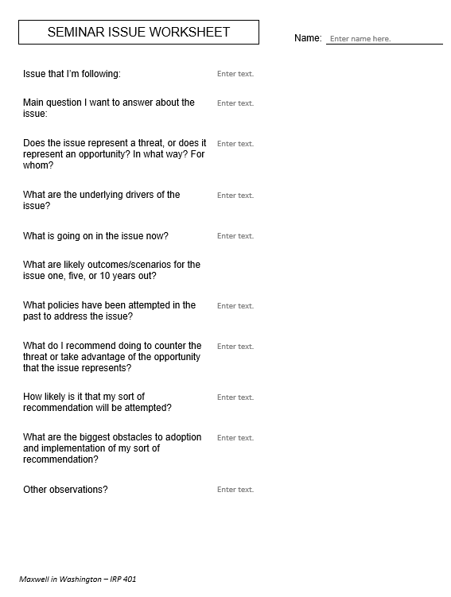
Issue that I’m following:
Main question I want to answer about the issue:
Does the issue represent a threat, or does it represent an opportunity? In what way? For whom?
What are the underlying drivers of the issue?
What is going on in the issue now?
What are likely outcomes/scenarios for the issue one, five, or 10 years out?
What policies have been attempted in the past to address the issue?
What do I recommend doing to counter the threat or take advantage of the opportunity that the issue represents?
How likely is it that my sort of recommendation will be attempted?
What are the biggest obstacles to adoption and implementation of my sort of recommendation?
Other observations?
for 401
drivers!!

Slide 62
Are you clear on what you’re going to do, and when?

Slide 63
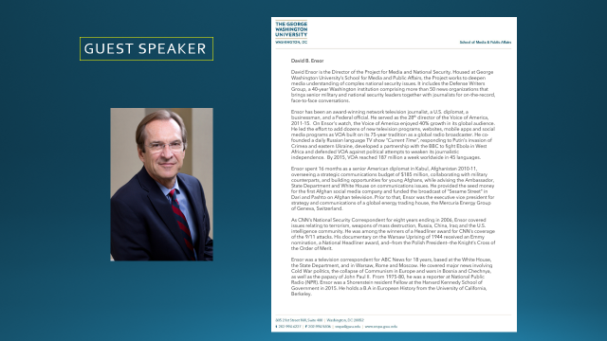

Break?
Guest?
Discussion?

Slide 64

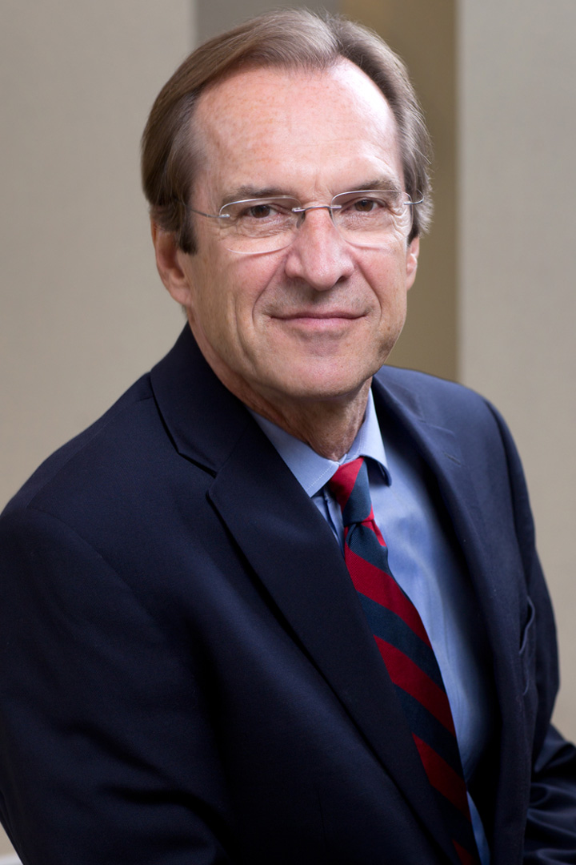
GUEST SPEAKER

Slide 65
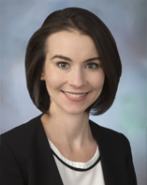
GUEST SPEAKER
Siobhan Sheils
Associate Vice President with The Cohen Group
2015-2017 | - NSC Director for Central America and the Caribbean - Reestablishment of US-Cuba ties
Prior | - Special Assistant to two Deputy Secretaries of State and the Under Secretary of State for Political Affairs
 | - Desk Officer for Guatemala; resolve CAFTA trade dispute
 | - Bureau of Human Resources and Staff Assistant in the Bureau of Western Hemisphere Affairs
 | - Superior honor award and four meritorious honor awards
Teach for America | Taught eighth grade English for four years in the South Bronx and Newark, New Jersey
Higher Education | Master’s of International Relations and Master’s in Public Relations, Syracuse University
 | Bachelor’s, Boston College

Slide 66
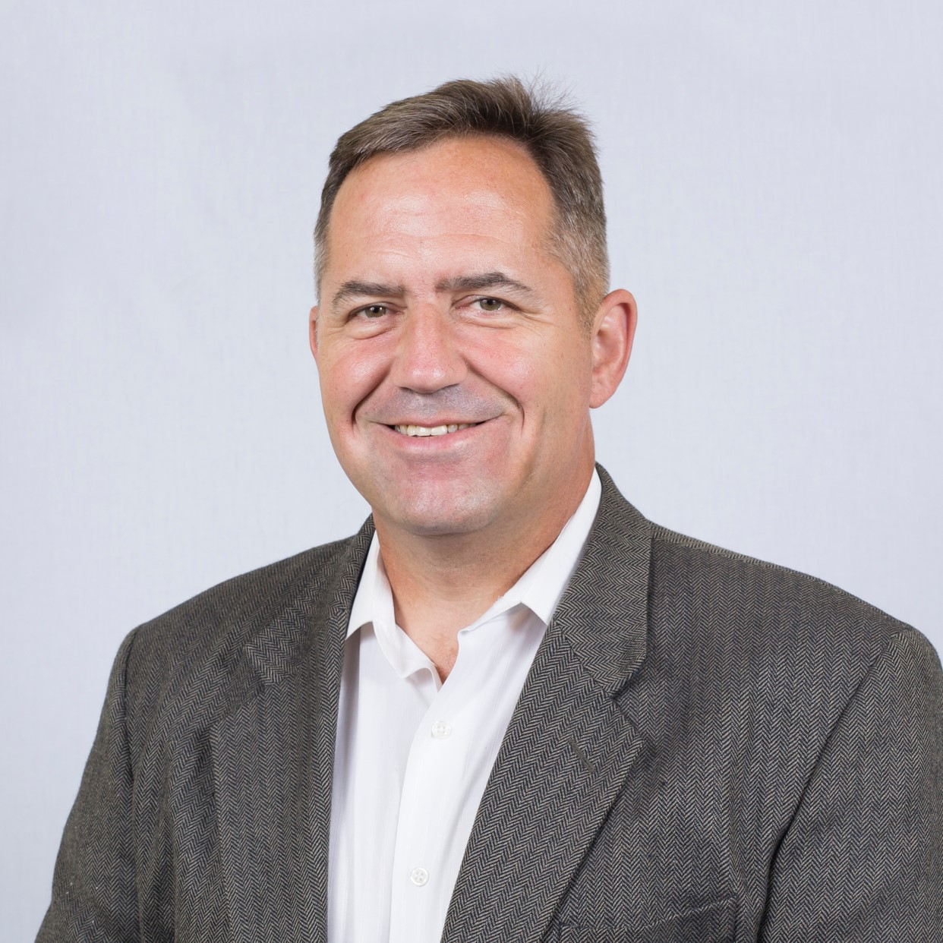
GUEST SPEAKER
COL (R) Bob Wilson
Director, Strategic Initiatives Global Venture National Resources Consulting Organic farmer Freelance writer
 | 27 years, U.S. Army Special Forces Northern and Western Africa CT activities Including al Qaeda, ISIS, Boko Haram Special Ops in Afghanistan
 | NSC Director for Counterterrorism, with focus on Africa
Education | MBA, Webster University
 | Master’s, Resource Strategy, NDU
 | Master’s, Military Arts and Sciences, School of Advanced Military Studies
 | Bachelor’s, Finance, UConn

Slide 67



It is engraved …
John 8:32
CIA MOTTO

Slide 68
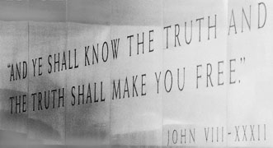
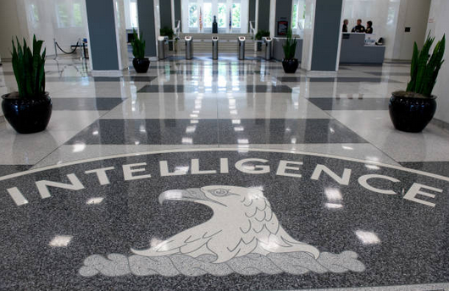
CIA Motto

Slide 69
The INTELLIGENCE CYCLE
Direction and Planning
Collection
Processing
Analysis
Dissemina-tion
Self- and consumer feedback
What information do we and our decisionmakers need?
How do we get our info/analysis to our “consumers”?
Where do we find the information? With what INT? How do we determine its reliability?
How do we prepare the info/data for analytical exploitation? What technology can help us?
What does what we’re seeing mean? In what context is the issue evolving?

Slide 70
Discussion and Synthesis
What are your impressions of how decisions are made in Washington?
What voices influence it?
Do you think the mix of voices is correct?
Given the Intelligence Community’s mixed record, do you think it should be given more responsibility or less?
What improvements, if any, do you think should be considered, and who do you think should consider them or push them?

Slide 71
GUEST SPEAKERS

Slide 72

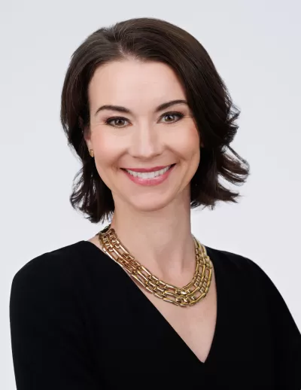
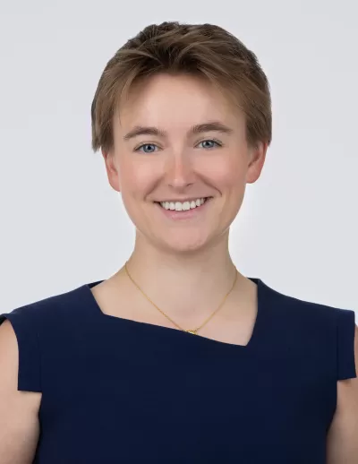
GUEST SPEAKERS
Introduced by Jessica
Siobhan Sheils
Katie Tyner

Slide 73
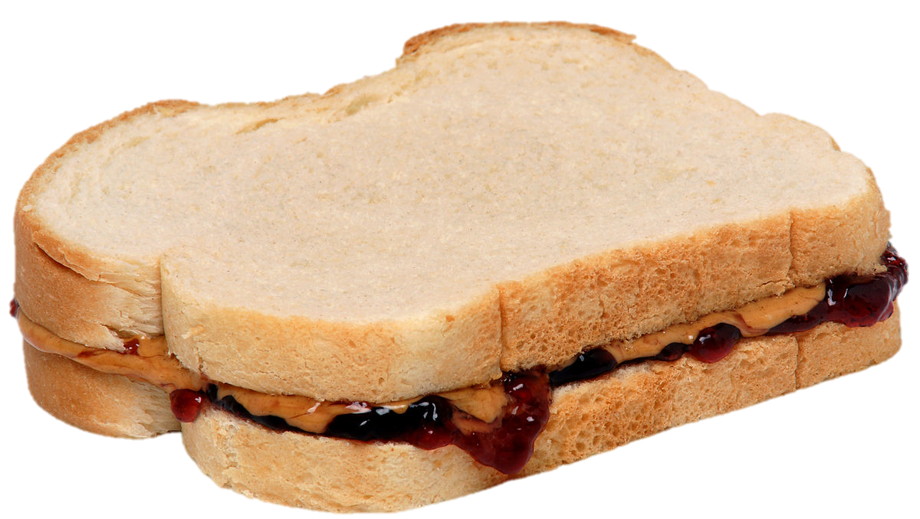
LUNCH

Slide 74
Interest
Expertise
Relevance
PROJECT ISSUES
Relevance
Information
Time
How to choose them?
How to frame them?
How to build them?
How to make them actionable?
Assess info and gaps
Develop hypothesis
Develop arguments
Develop options
Stay loyal to analysis
Write clearly, efficiently

Slide 75

The Heartbeat of Analysis (and Policy)
“DRIVERS”
The forces, needs, desires, and other factors that make things happen and influence outcomes.

Slide 76

What are drivers?
Interests
Borrowing from the “3-i framework” …
Ideas
Institutions
In our PERSONAL lives …
Interests | Ideas | Institutions
Work Food Love - Sex Family Home Transportation Entertainment Recreation Challenges | Education Religion or values Political thought Ideology Imposed expectations | Parents Boy/Girlfriend Husband/Wife Colleagues Friends Political party Employer
drivers

Slide 77
What are drivers?
Interests
BOOTCAMP
Borrowing from the “3-i framework” …
Ideas
Institutions
In our PERSONAL lives …
Interests | Ideas | Institutions
Work Food Love - Sex Family Home Transportation Entertainment Recreation Challenges | Education Religion or values Political thought Ideology Imposed expectations | Parents Boy/Girlfriend Husband/Wife Colleagues Friends Political party Employer
drivers

Slide 78
What are drivers?
Interests
Borrowing from the “3-i framework” …
Ideas
Institutions
In our NATIONAL lives …
Interests | Ideas | Institutions
Power/influence Needs Desires/ambitions Wealth Economic performance | Self-definition Nationalism History Concepts/logic Values Ideology | Leadership Abilities/constraints Economic structures Intermediation Inclusion Topography/geography Climate
drivers

Slide 79
What are drivers?
Interests
BOOTCAMP
Borrowing from the “3-i framework” …
Ideas
Institutions
In our NATIONAL lives …
Interests | Ideas | Institutions
Power/influence Needs Desires/ambitions Wealth Economic performance | Self-definition Nationalism History Concepts/logic Values Ideology | Leadership Abilities/constraints Economic structures Intermediation Inclusion Topography/geography Climate
drivers

Slide 80
What are drivers?
BOOTCAMP
“FUEL”
“FRICTION”
Effort/energy
Resources
Technology, etc.
to PUSH a solution.
Obstacles
Resistance
Limitations, etc.
that OBSTRUCT a solution.
“Forward” drivers
“Status Quo” or “Backward” drivers

Slide 81

The GOAL
For your work to be strong.
For you to be efficient.
For you to be confident.

Slide 82
Issue that I’m following:
Main question I want to answer about the issue:
Does the issue represent a threat, or does it represent an opportunity? In what way? For whom?
What are the underlying drivers of the issue?
What is going on in the issue now?
What are likely outcomes/scenarios for the issue one, five, or 10 years out?
What policies have been attempted in the past to address the issue?
What do I recommend doing to counter the threat or take advantage of the opportunity that the issue represents?
How likely is it that my sort of recommendation will be attempted?
What are the biggest obstacles to adoption and implementation of my sort of recommendation?
Other observations?
ALL CLEAR??

Slide 83
What topics are you interested in?
402 (team) project?
E-mail agreement on partners and topic:
Next Friday (26 Jan) evening
E-mail final agreement:
Friday, 2 Feb, evening
401 (individual) project?
E-mail on topic :
Next Friday (26 Jan) evening
Submit proposal as assignment:
Friday, 2 Feb, evening

Slide 84
Global Policy Seminar and NSC Simulation
IRP 401 - IRP 402
Week One 19 January 2024
Prof. Fulton T. Armstrong

Slide 85
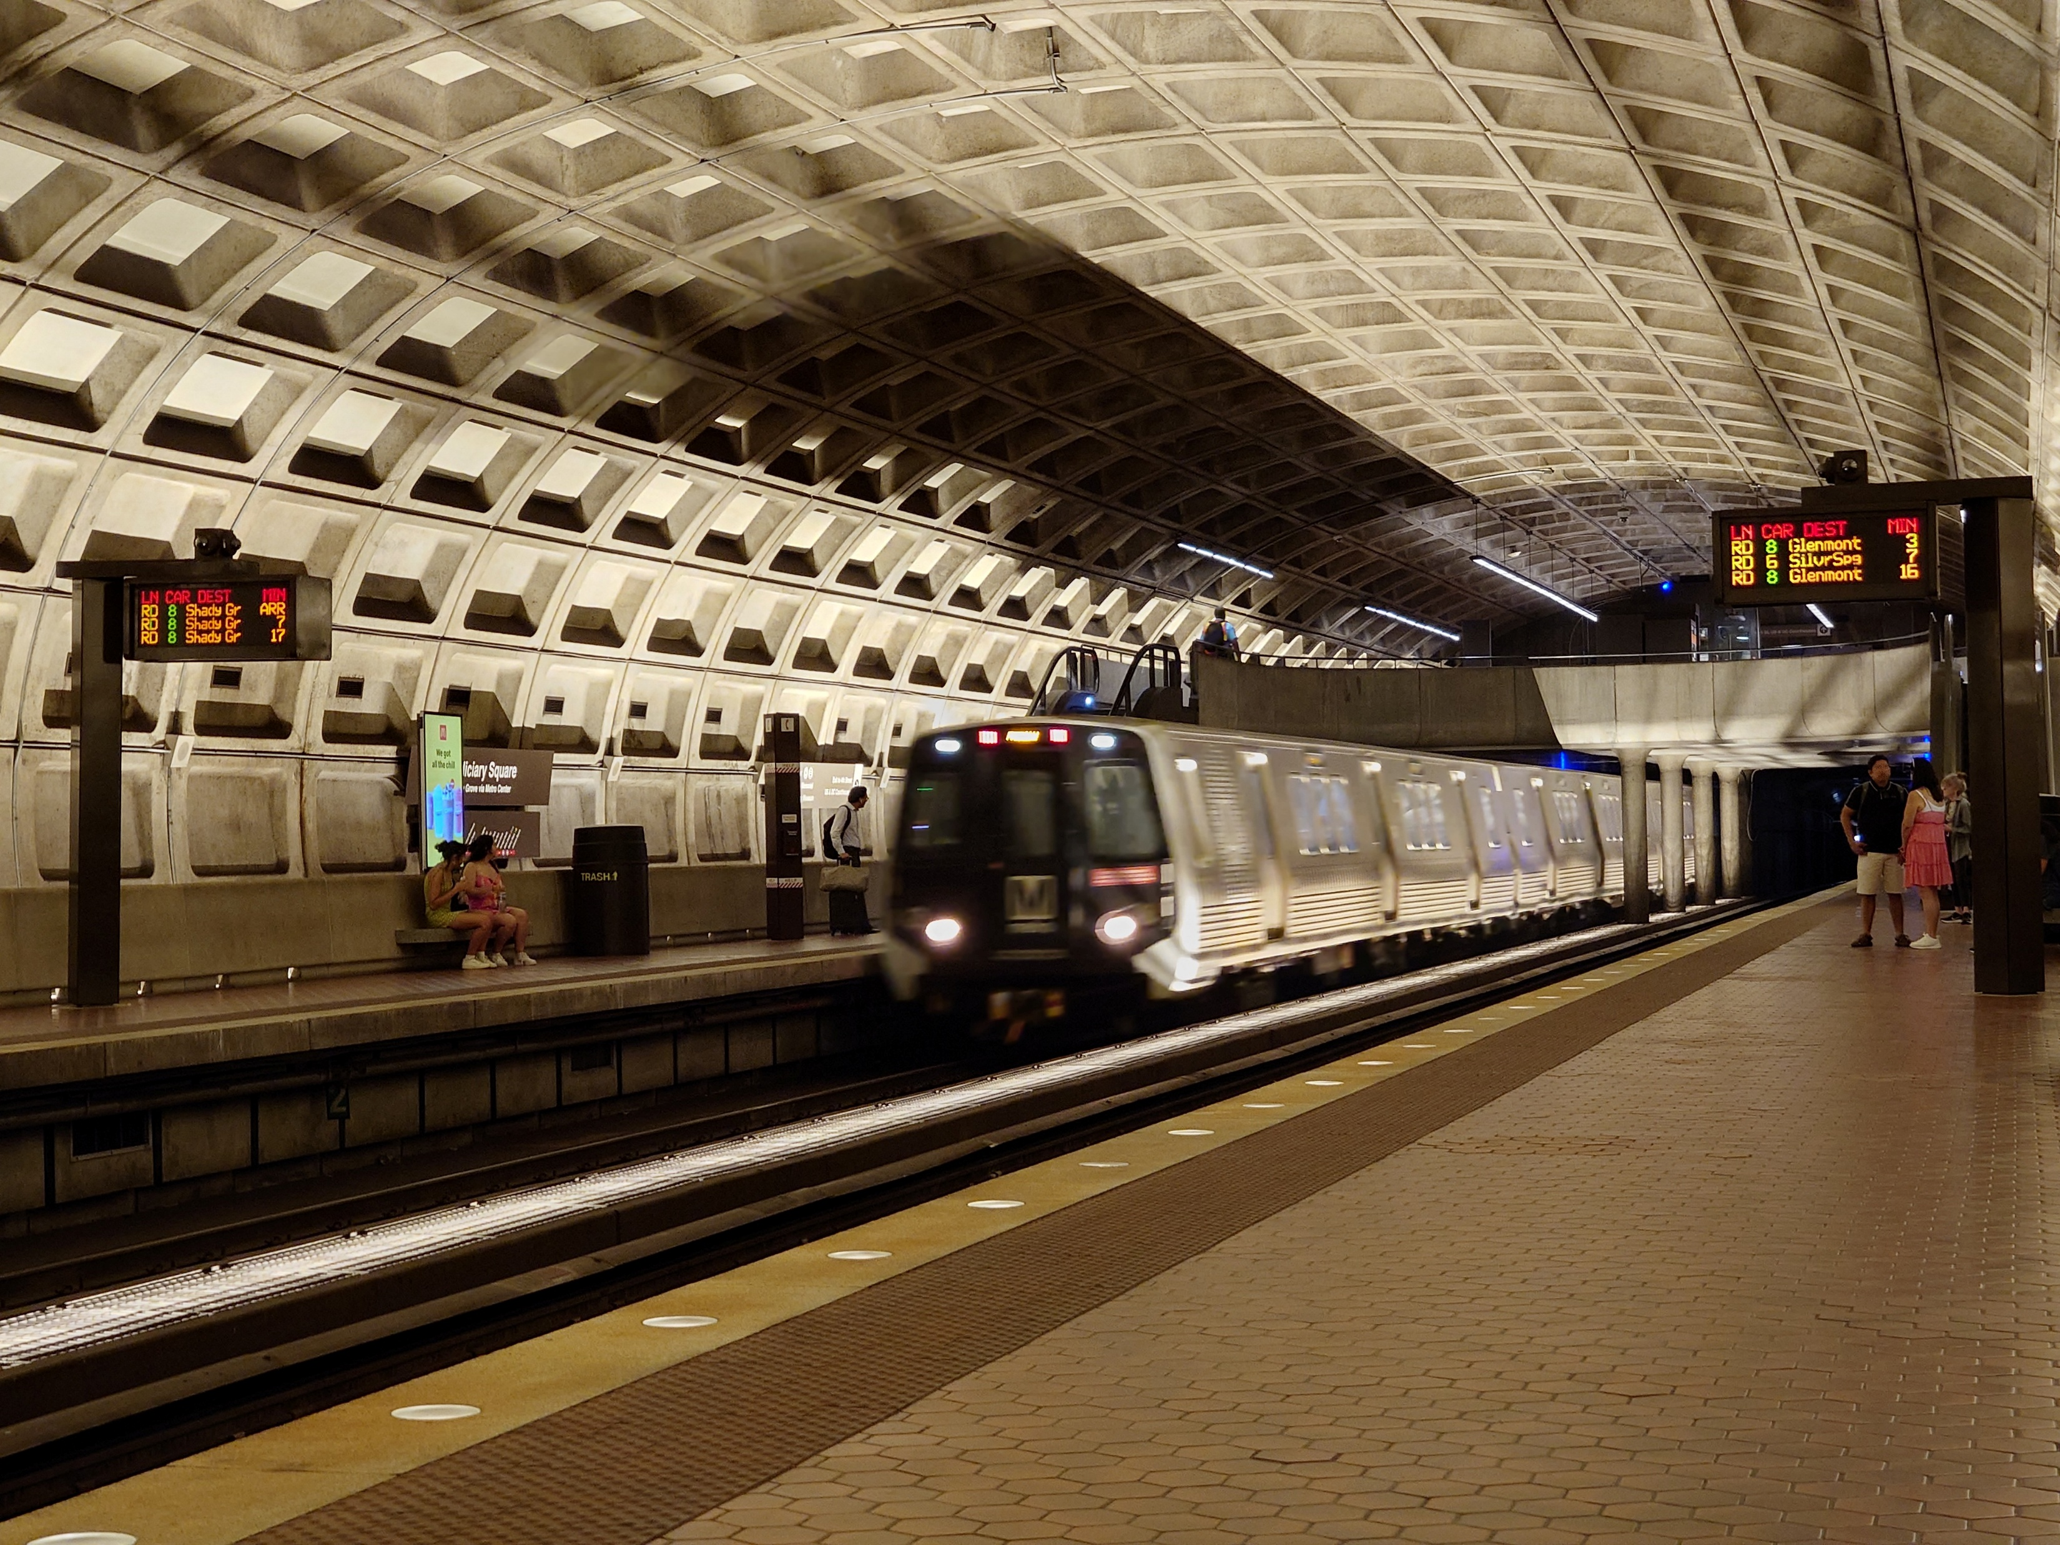
LUNCH and METRO to L’Enfant Plaza and Spy Museum

Slide 86

International Spy Museum
700 L'Enfant Plaza, SW Washington, DC 20024
RED LINE (→Glenmont)
from Dupont Circle to Metro Center
then
ORANGE (→New Carrollton) or BLUE (→ Largo) or SILVER (→ Largo)
from Metro Center to L’Enfant Plaza

Slide 87
METRO: L'Enfant Plaza
L'Enfant Plaza Exit go up the escalator to enter the L’Enfant Plaza food court.
Enter at 2:00

Slide 88
The United States Government
Executive
Departments and Agencies
Legislative
House-Senate and Agencies
Judiciary

Slide 89
Questions? Comments? Observations? Experiences?

Slide 90

LUNCH

Slide 91
LUNCH

Slide 92

WRAPUP

Slide 93
TODAY’S AGENDA
9:00 | Skills session – Impostor Syndrome
10:15 | Quick Review of Interagency Process
10:30 | Guest Speaker: Mike Orfini Former Aide to Vice Presidents The Interagency as seen from OVP - introduced by John
11:45 | Syllabus and Projects - II and preps for afternoon excursion
12:30 | Lunch and Metro to International Spy Museum
2:00 | International Spy Museum: Role of Intel in Policy Formulation and Implementation
~3:30 | Wrapup and depart from museum

Slide 94
Global Policy Seminar and NSC Simulation
IRP 401 - IRP 402
Week Two 23 January 2026
Prof. Fulton T. Armstrong

