Slide 1
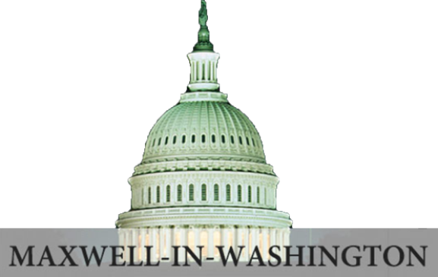
Global Policy Seminar and NSC Simulation
IRP 401 - IRP 402
Week Two 26 January 2024
Prof. Fulton T. Armstrong

Slide 2
Week 1 (19 Jan)
Week 2 (26 Jan)
Week 3 (2 Feb)
Week 4 (9 Feb)
Week 5 (16 Feb)
Week 6 (23 Feb)
Week 7 (1 Mar)
Week 8 (8 Mar)
BREAK
Week 9 (22 Mar)
Week 10 (29 Mar)
Week 11 (5 Apr)
Week 12 (12 Apr)
Week 13 (19 Apr)
Week 14 (26 Apr)
SPRING 2024

Slide 3
TODAY’S AGENDA
9:00 | Discussion Readings Project planning – 401 and 402 Policy information inputs
10:00 | Guest Speakers: Rafael and Bill introduced by themselves , but Meghan first question
11:30 | Ms. Yasmeen Alamiri Senior Editor for video and special projects PBS NewsHour introduced by Akosua
12:45 | Lunch and Transport to National Press Building
1:55 | Meet in National Press Club lobby downstairs
2:00 | Mr. Jerry Zremski University of Maryland and Buffalo News introduced by Bryce

Slide 4
TODAY’S AGENDA
9:00 | Discussion Readings Project planning – 401 and 402 Policy information inputs
10:00 | Guest Speakers: Rafael and Bill introduced by themselves , but Meghan first question
11:30 | Ms. Yasmeen Alamiri Senior Editor for video and special projects PBS NewsHour introduced by Akosua
12:45 | Lunch and Transport to National Press Building
1:55 | Meet in National Press Club lobby downstairs
2:00 | Mr. Jerry Zremski University of Maryland and Buffalo News introduced by Bryce

Slide 5
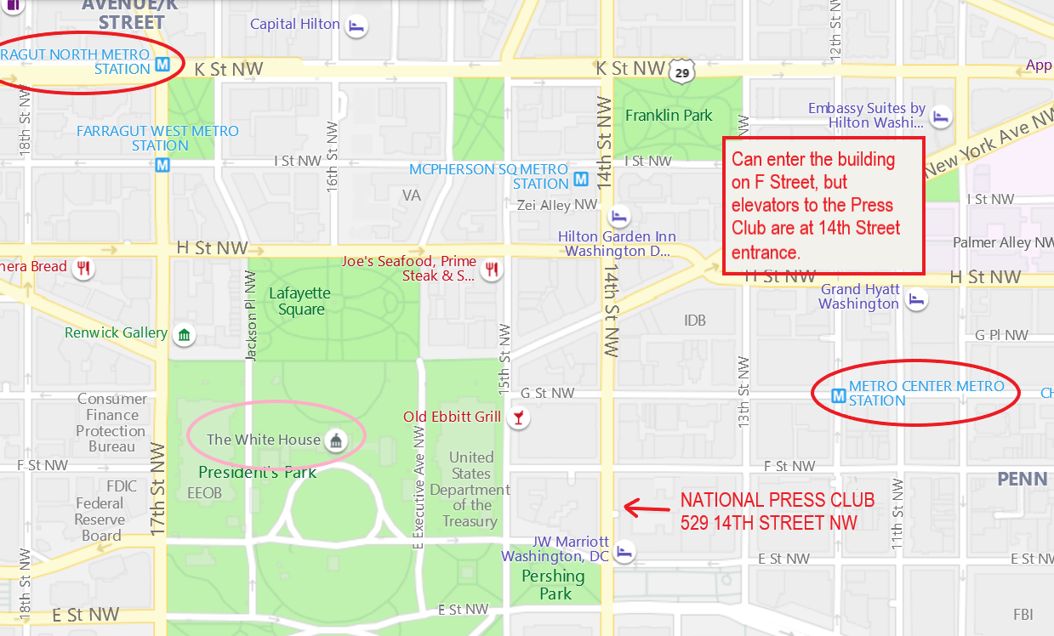
National Press Club - 529 14th Street NW - Meet in lobby (downstairs) at 2:25

Slide 6
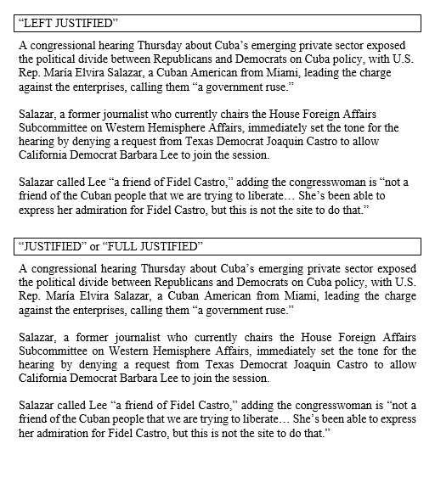
“Justification”
Microsoft Word

Slide 7
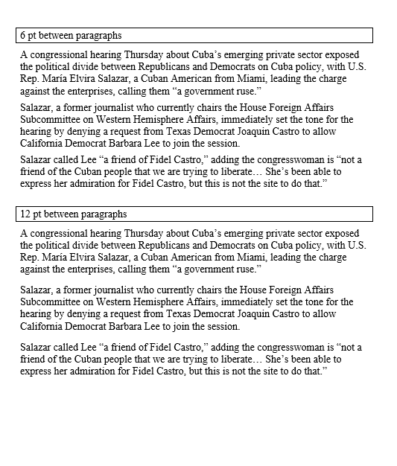
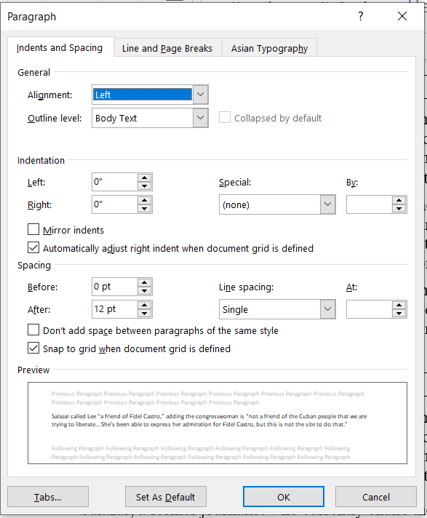
Paragraph Spacing

Slide 8
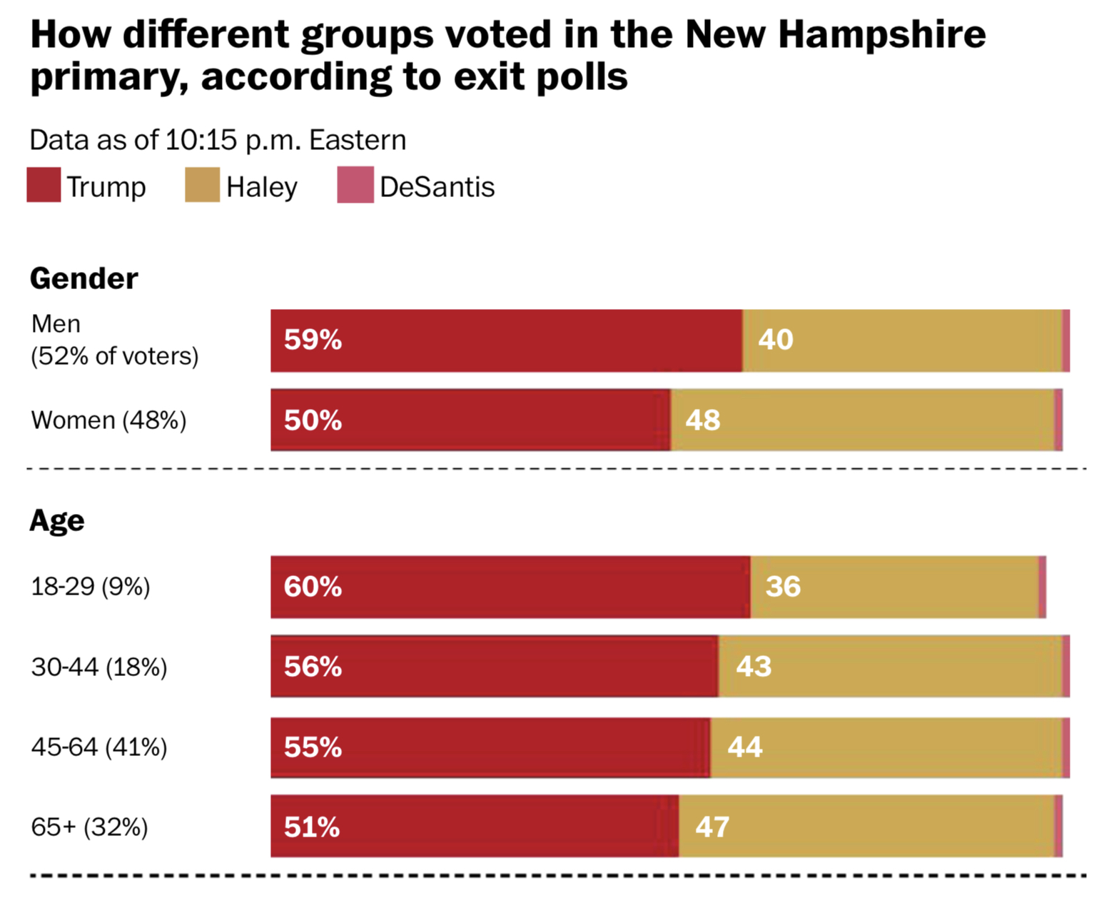
UPDATE
What does this chart show?

Slide 9
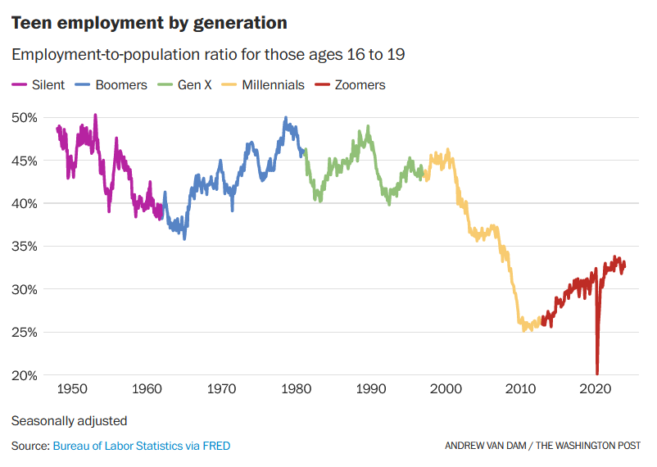
UPDATE
What does this chart show?

Slide 10
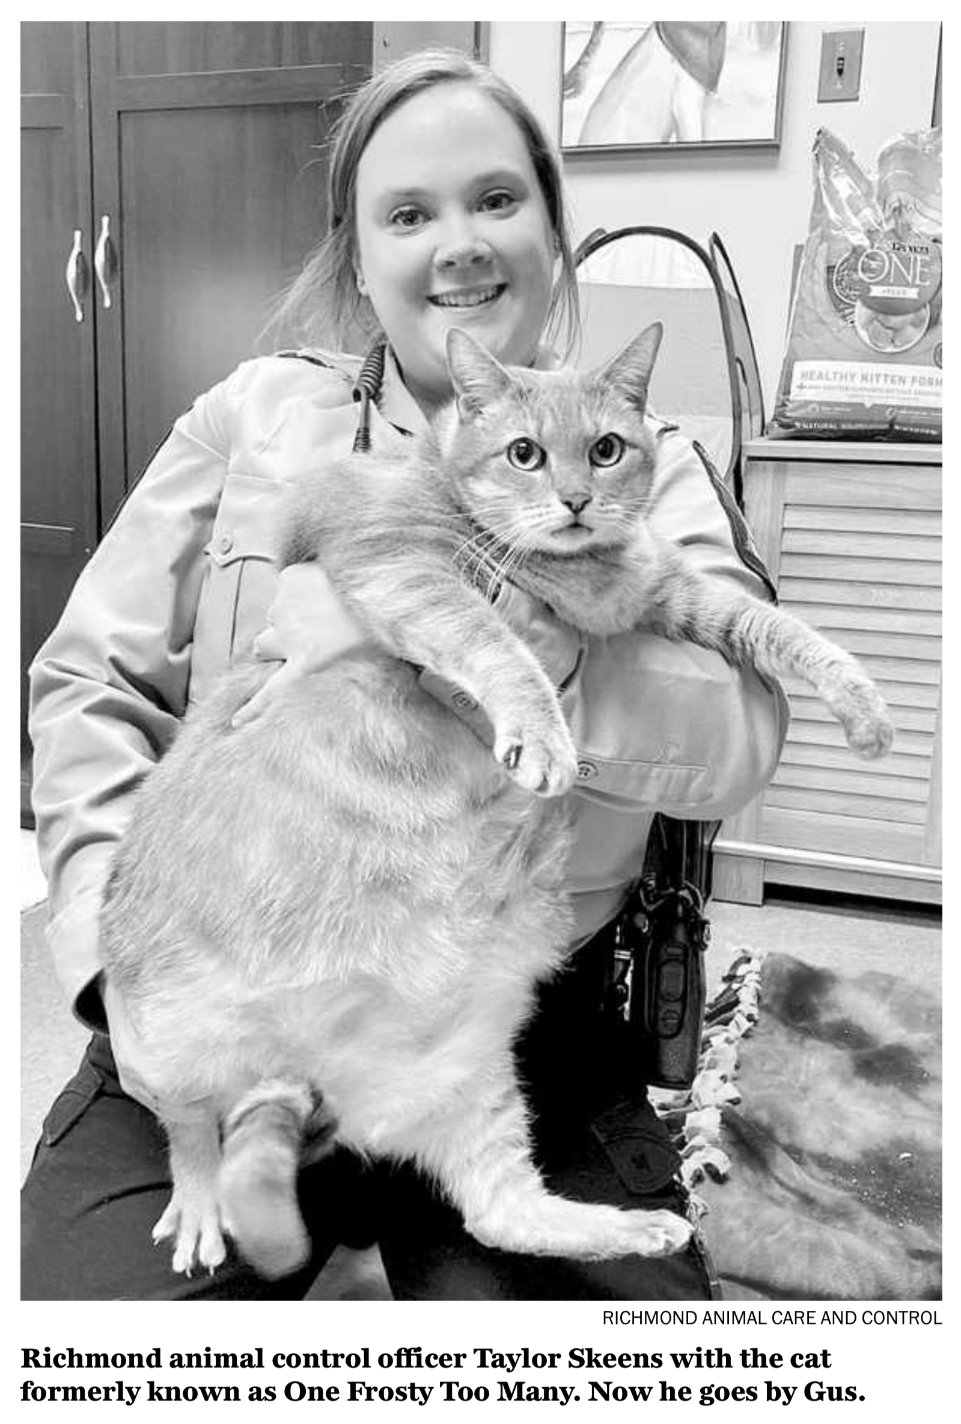
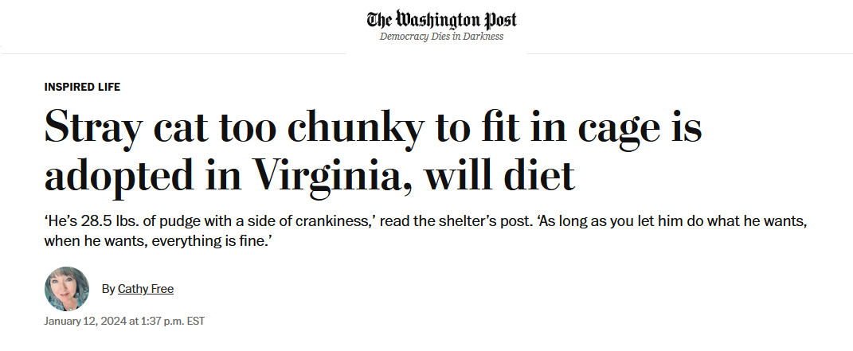
UPDATE

Slide 11
DISCUSSION
Project planning
Topics for individual (401) and partnered (402) projects?
Clear on criteria?
Clear on products and feasibility?
Ideas?
Readings
Who informs the policy process?
Role of Intelligence Community, and quality?
Role of covert action, and related processes?
Sources of news information, and trends?

Slide 12
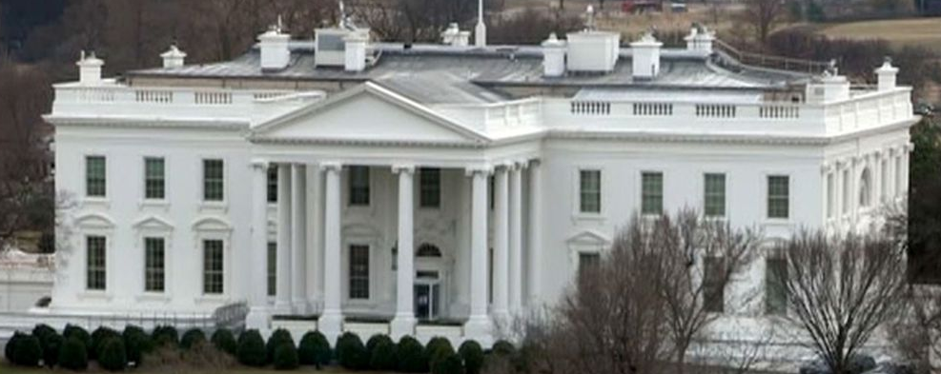
The U.S. “Interagency”
A super-fast tour
White House through NSC (and OMB)
“The interagency process”
Departments/agencies
State
Defense (OSD and JCS)
USTR
DHS (and agencies)
DOJ
Others with international role

Slide 13
How do they stay informed?
The media
Other public sources
Government sources
Print
Electronic
Social
Congress
Interest groups
Think tanks
Intelligence
Bureaucracy
Cabinet

Slide 14
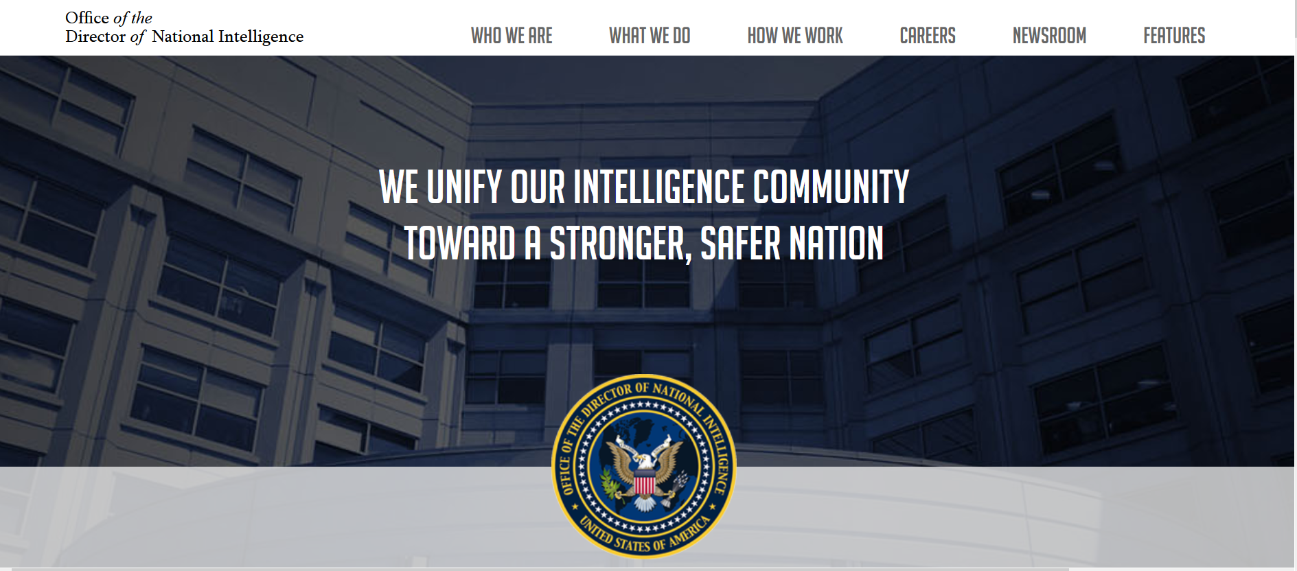
The U.S. Intelligence Community

Slide 15
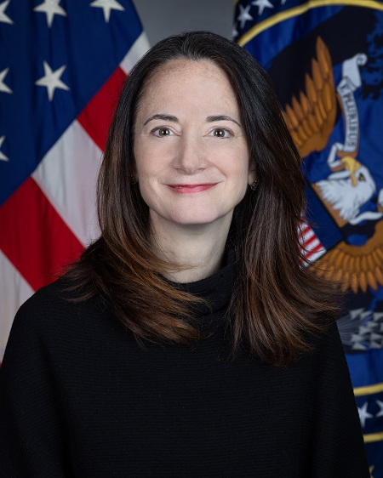
Avril Haines

Slide 16
The U.S. Intelligence Community is composed of the following 18 organizations:
Two independent agencies—the Office of the Director of National Intelligence (ODNI) and the Central Intelligence Agency (CIA);
Nine Department of Defense elements—the Defense Intelligence Agency (DIA), the National Security Agency (NSA), the National Geospatial- Intelligence Agency (NGA), the National Reconnaissance Office (NRO), and intelligence elements of the five DoD services; the Army, Navy, Marine Corps, Air Force, and Space Force.
Seven elements of other departments and agencies—the Department of Energy’s Office of Intelligence and Counter-Intelligence; the Department of Homeland Security’s Office of Intelligence and Analysis and U.S. Coast Guard Intelligence; the Department of Justice’s Federal Bureau of Investigation and the Drug Enforcement Agency’s Office of National Security Intelligence; the Department of State’s Bureau of Intelligence and Research; and the Department of the Treasury’s Office of Intelligence and Analysis

Slide 17
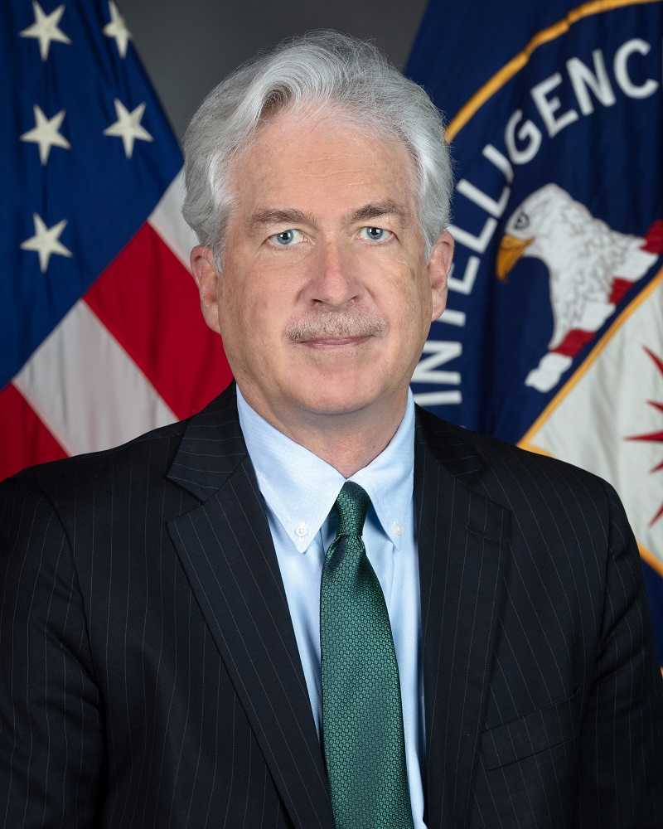
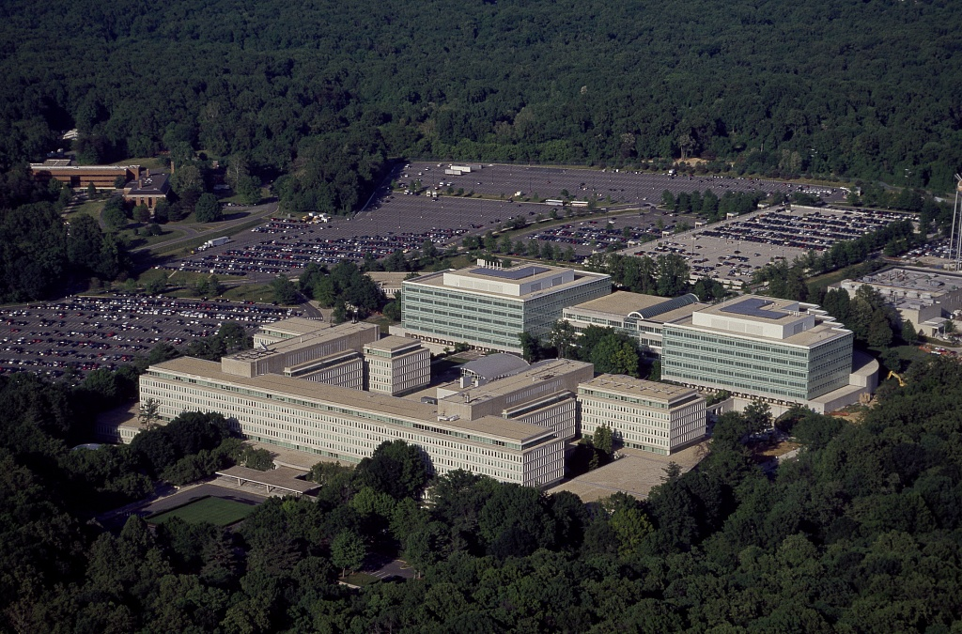
William J. Burns

Slide 18
“Our mission is straightforward but critical: leverage the power of information to keep our Nation safe.”
But is it just that?
Foreign Intelligence (FI)
Covert Action (CA)
Paramilitary (PM)

Slide 19
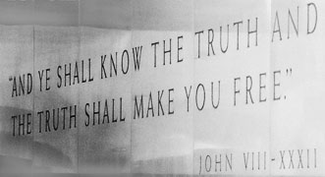
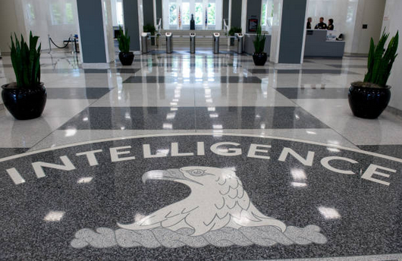
CIA (Informal) Motto??

Slide 20
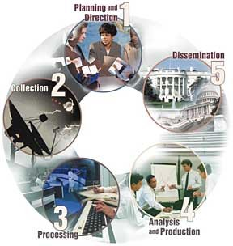
The “Intelligence Cycle”
“Requirements”

Slide 21
Discussion and Synthesis
What are your impressions of how decisions are made in Washington?
What voices influence it?
Do you think the mix of voices is correct?
Given the Intelligence Community’s mixed record, do you think it should be given more responsibility or less?
What improvements, if any, do you think should be considered, and who do you think should consider them or push them?

Slide 22
GUEST SPEAKERS
Former intelligence officers.
What do intelligence agencies do, and what is their role in Washington policy processes?

Slide 23
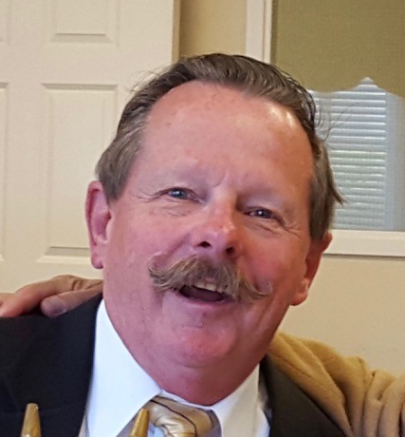
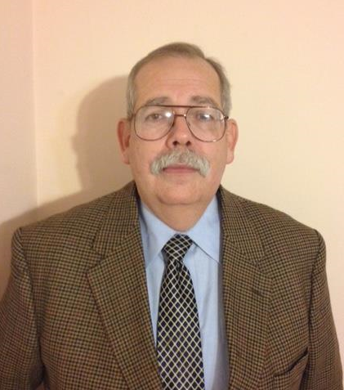
GUEST SPEAKERS
What is the role of intelligence and covert action in U.S. foreign policy?
How are intelligence collection and operations planned and conducted?
What are the Intelligence Community’s strengths and weaknesses?
William Ortman
Rafael Aguirre-Sacasa

Slide 24
BREAK

Slide 25
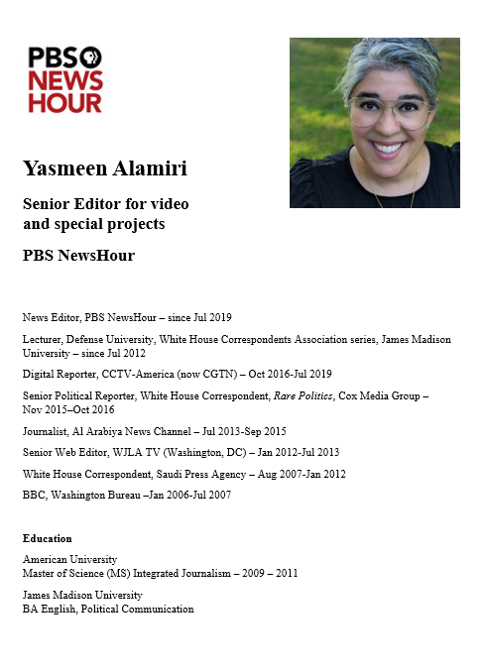
GUEST SPEAKER
Yasmeen Alamiri
- introduced by Akosua

Slide 26
BREAK

Slide 27
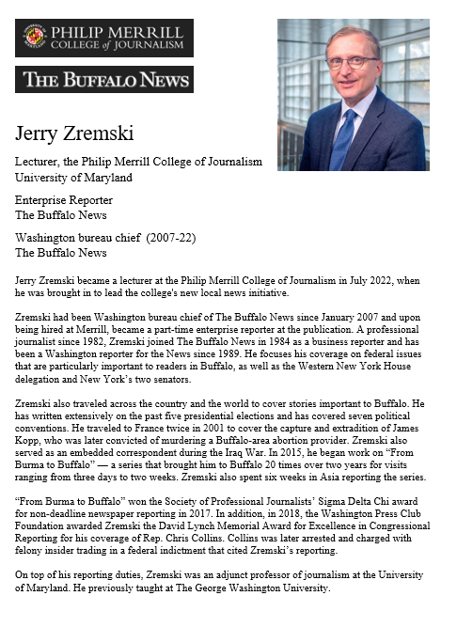
GUEST SPEAKER
Jerry Zremski
University of Maryland Merrill College of Journalism
The Buffalo News
- Introduced by Bryce

Slide 28
National Press Club - 529 14th Street NW - Meet in lobby (downstairs) at 2:25

Slide 29
NEXT WEEK …
The Pentagon

Slide 30
Global Policy Seminar and NSC Simulation
IRP 401 - IRP 402
Week Two 26 January 2024
Prof. Fulton T. Armstrong

Slide 31
WRAPUP

Slide 32
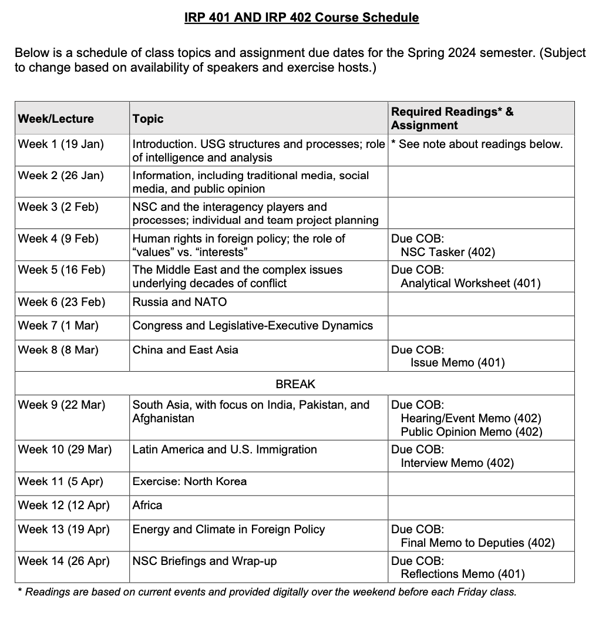
✓
401
402
✓
✓
✓
✓
QUESTIONS?
✓
✓

