Slide 1

Global Policy Seminar and NSC Simulation
IRP 401 - IRP 402
Week Five 13 February 2026
Prof. Fulton T. Armstrong

Slide 2
Week 1 (16 Jan)
Week 2 (23 Jan)
Week 3 (30 Jan)
Week 4 (6 Feb)
Week 5 (13 Feb)
Week 6 (20 Feb)
Week 7 (27 Feb)
Week 8 (6 Mar)
Spring Break
Week 9 (20 March)
Week 10 (27 Mar)
Week 11 (3 Apr)
Week 12 (10 Apr)
Week 13 (17 Apri)
Week 14 (24 Apr)
Spring 2026

Slide 3
TODAY’S AGENDA
9:00 | Class Discussion and Quiz Latin America, Cuba, Venezuela
9:45 | Class Discussion: Project Updates
9:55 | Go downstairs
10:30 | Ambassador Lianys Torres, Embassy of Cuba - Introduced by Megha
12:15 | Lunch and Metrobus to Georgetown University
1:55 | Meet in “Red Square” – entrance to Intercultural Center Georgetown University
2:00 | Professor Angelo RIVERO Santos, Georgetown University - Introduced by Diego
~3:30 | Wrapup and depart from GU

Slide 4
TODAY’S AGENDA
9:00 | Class Discussion and Quiz Latin America, Cuba, Venezuela
9:45 | Class Discussion: Project Updates
9:55 | Go downstairs
10:30 | Ambassador Lianys Torres, Embassy of Cuba - Introduced by Megha
12:15 | Lunch and Metrobus to Georgetown University
1:55 | Meet in “Red Square” – entrance to Intercultural Center Georgetown University
2:00 | Professor Angelo RIVERO Santos, Georgetown University - Introduced by Diego
~3:30 | Wrapup and depart from GU

Slide 5

GUEST SPEAKER

Slide 6
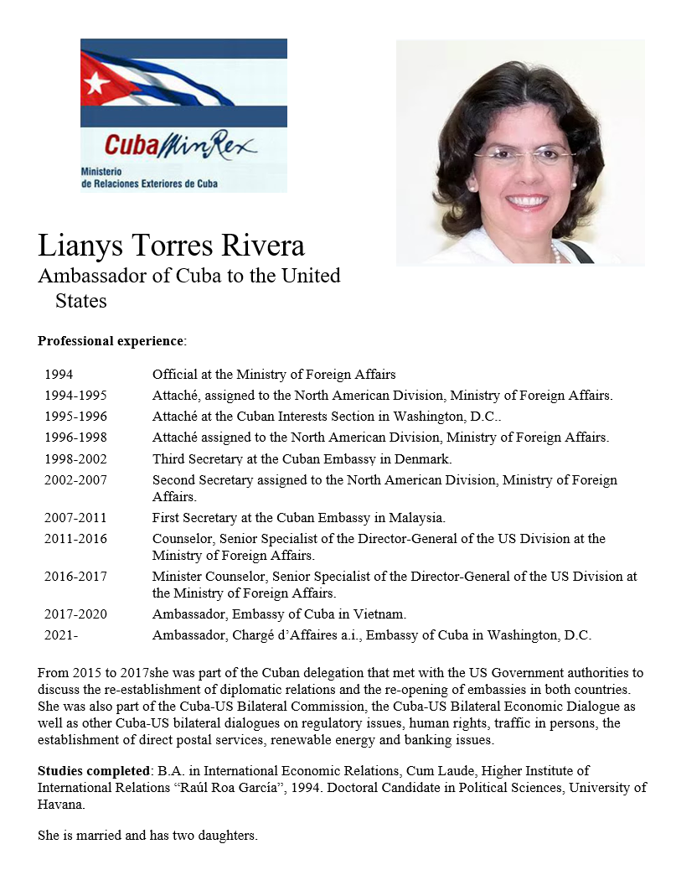

GUEST SPEAKER
Amb. Lianys Torres
Embassy of Cuba
- introduced by Megha

Slide 7

GUEST SPEAKER

Slide 8
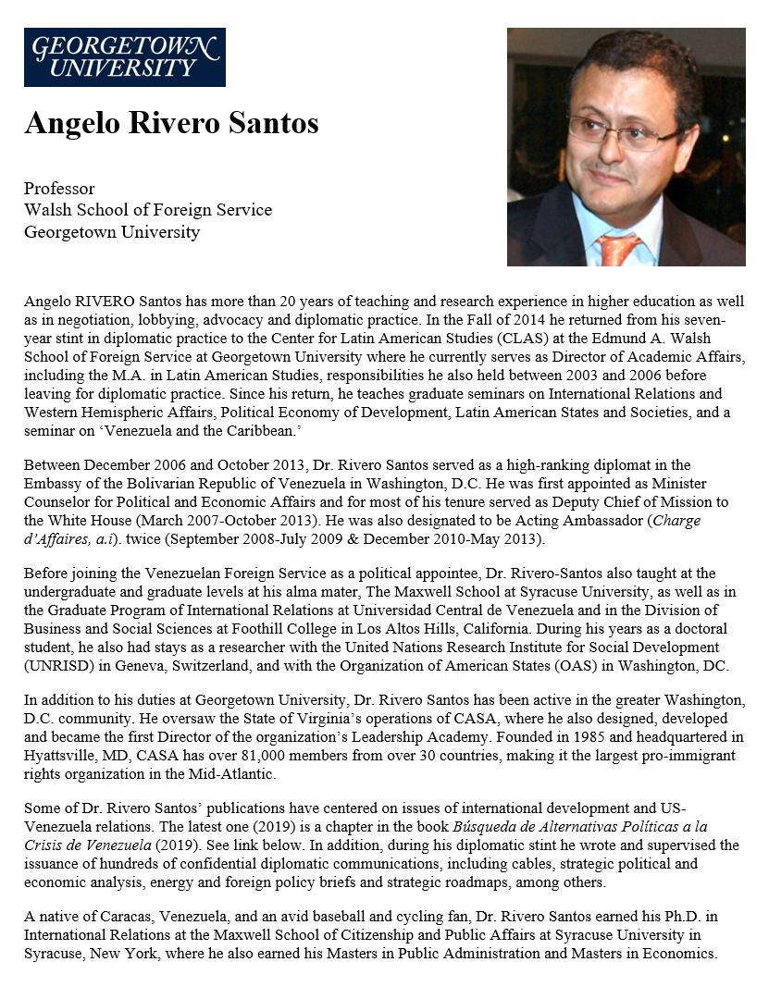

GUEST SPEAKER
Prof Angelo RIVERO Santos
Latin America Expert and Fmr Diplomat, Venezuela
- introduced by Diego

Slide 9
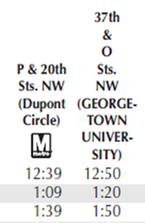
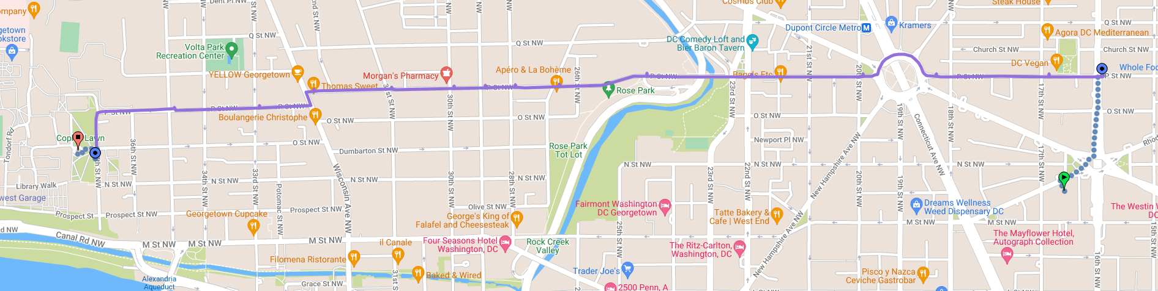

C91 Metrobus
37th & O
20th & P
18th & P

Slide 10
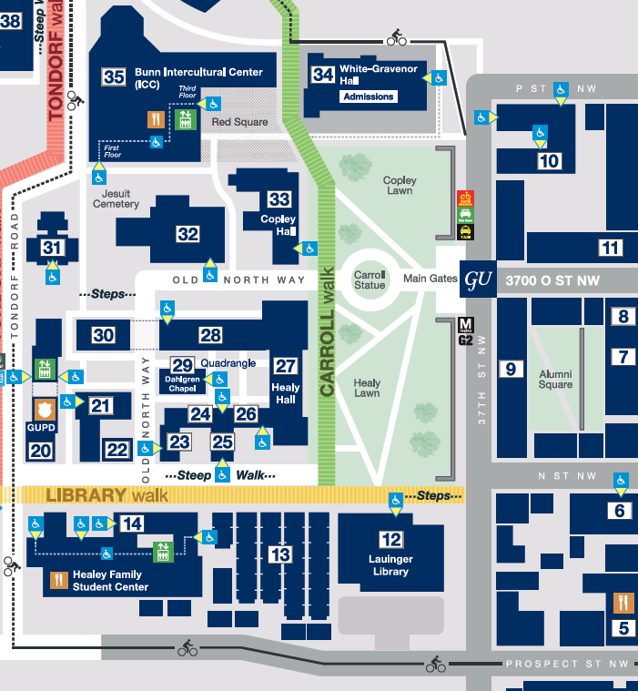



ICC
“Red Square”
1:55 sharp

Slide 11
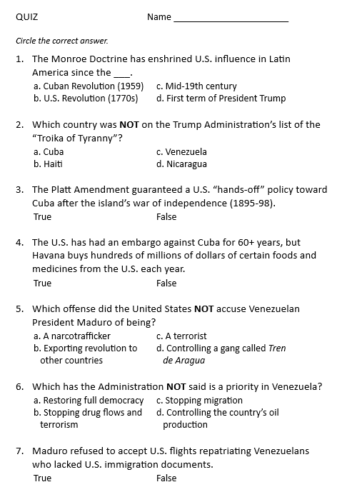
QUIZ

Slide 12
DISCUSSION
Cuba
What’s going on?
What should the USG do?
What bearing does the Venezuela operation have?

Slide 13
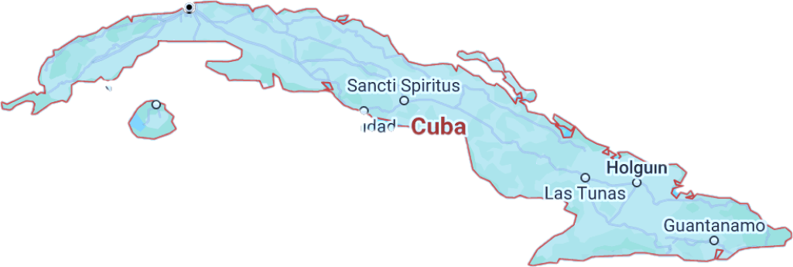
Cuba … and U.S. Policy
Notes:
REMEMBER CHATS ARE ON T.V.

Slide 14
The issue before us … “THE CUBA QUESTION”
What is happening and why?
Where are things headed?
What is the U.S. angle?
Our role?
Our interests?
Our policies?
Notes:
Want to provoke you … intellectually … to challenge analysis, including mine, and policy.
Will put to you whether policy represents best of American values – hr, democracy, etc., on one side, but HOW.
Will ask you whether policy should be based on process or results.

Slide 15

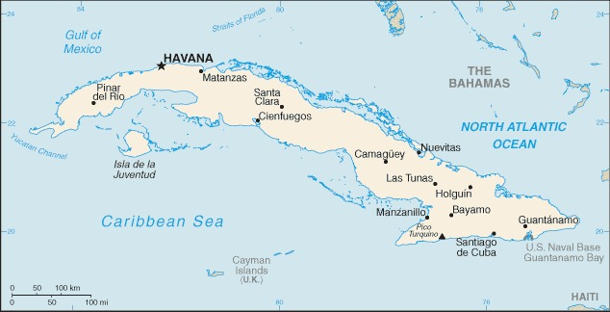
740m (1,250km)across

Slide 16
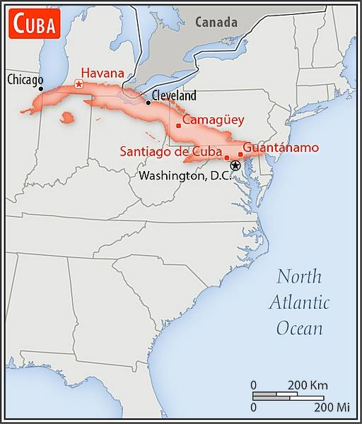

Slide 17
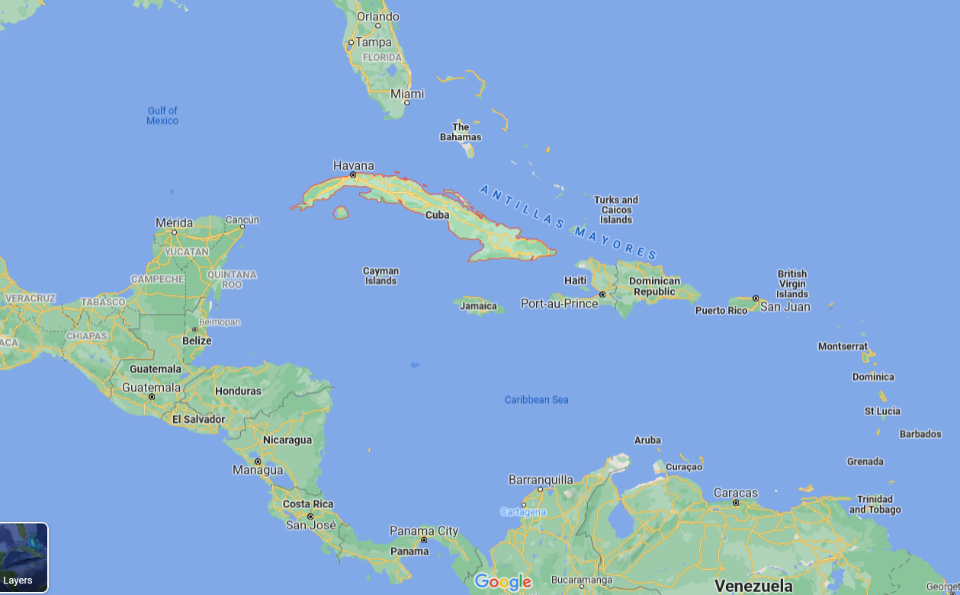
La Perla de las Antillas

Slide 18
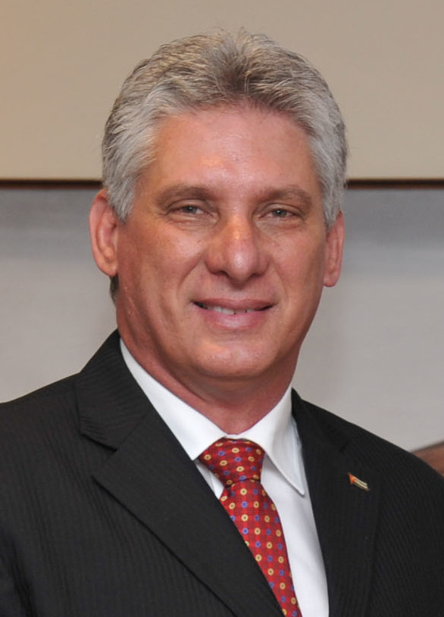
Chief of State
President Miguel DÍAZ-CANEL Bermúdez
President of the Council of State and the Council of Ministers since April 2018
First Secretary of the Communist Party of Cuba since April 2021
Prime Minister Manuel MARRERO Cruz
Head of Government (Council of Ministers) since December 2019

Slide 19
Life is TOUGH in Cuba.
Shortages of everything, including food and medicine
Unemployment/underemployment
Inflation
Electricity outages; fuel shortages
Sick and tired of it all

Slide 20
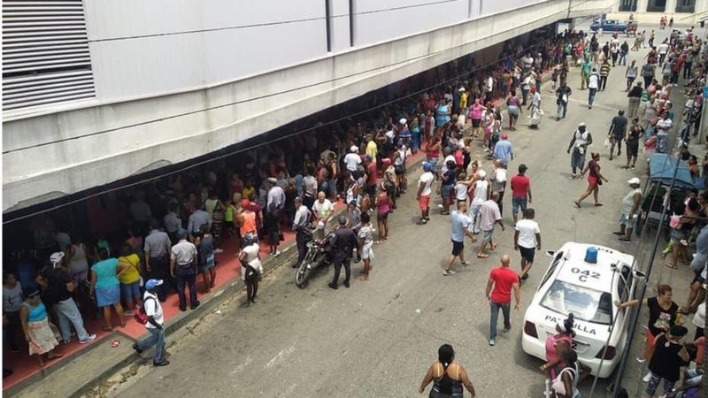
ECONOMY (NEVER GOOD) WORSE
Contracting 10% or more each year
Continued bad this year
SHORTAGES (NEVER GOOD) WORSE
Hours in line for basics
Hospitals short of supplies
Power outages in summer heat
Worst since “Special Period” in early ‘90s

Slide 21

ANALYTICAL DEBATE: Why’s the economy so bad?
Some controversy on how to rank reasons, but my ranking in recent years:
AGGRAVATING IT ALL:
Government failure to reform inefficient centrally controlled economy
Promised repeatedly
Done piecemeal, haltingly
Not delivered
Even good reform turned bad
COVID
Trump and Biden suspended licenses for U.S. travel
Trump essentially shut down remittances; Biden reopened w/o banks
Trump pressed ahead with Title III, etc., and Biden continued
Trump and Biden put Cuba back on SSOT list, and Biden enforced punitive ESTA measures.
~$3.5 billion
2%-3% GDP
56 percent of families
U.S. SANCTIONS
Shut door to tourists, source of $3 billion/year
Depressed domestic production, consumption
Just generally wore people down
VENEZUELA
Reduced source of hard-currency for services
Reduced source of subsidized oil
Estimated 70% drop in supplies; formerly ~112k barrels/day

Slide 22
U.S. Policy?
Notes:
REMEMBER CHATS ARE ON T.V.

Slide 23
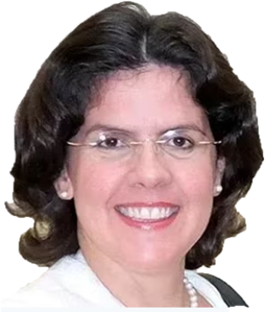
“Maximum pressure”
WHY?
Cuban actions past/present?
Human rights?
U.S. domestic political issues?
Economic embargo since 1962 “Extraterritorial sanctions” Diplomatic isolation
“Democracy promotion” Radio/TV Martí Various clandestine actions
Notes:
REMEMBER CHATS ARE ON T.V.

Slide 24
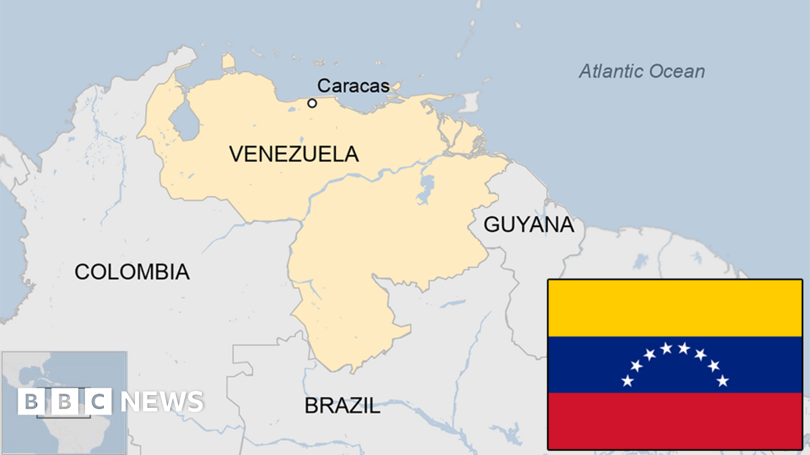

Slide 25
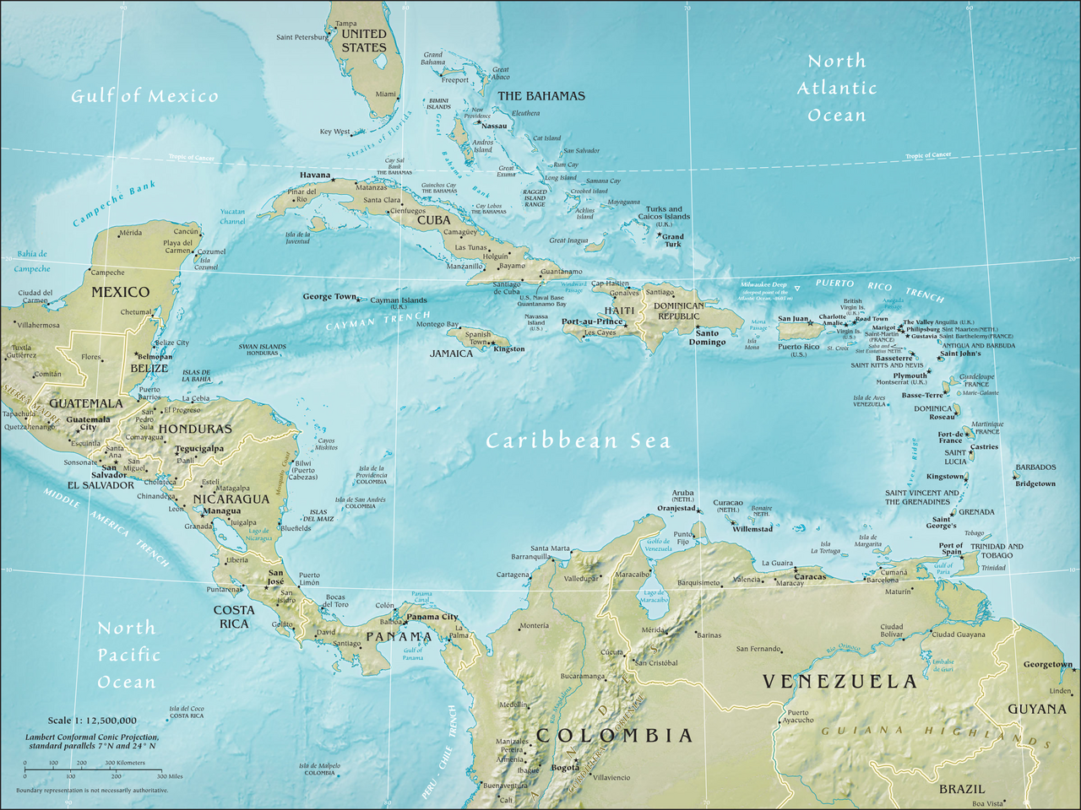
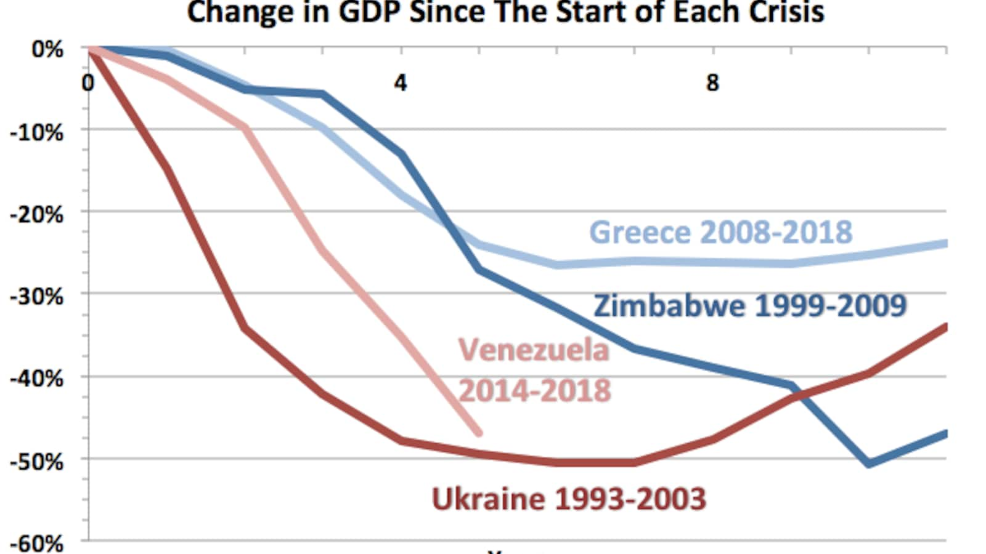


Population was 30m.
Washington Post, 2019

Slide 26


Population was 30m.
Washington Post, 2019

Slide 27
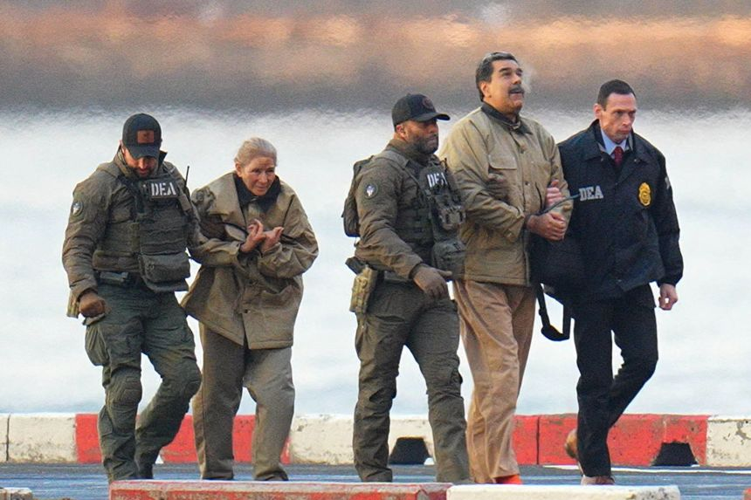
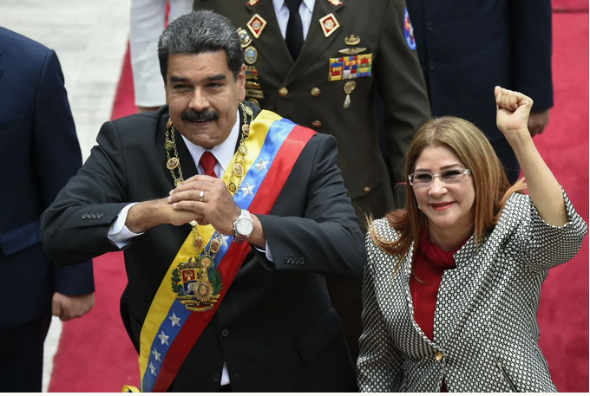
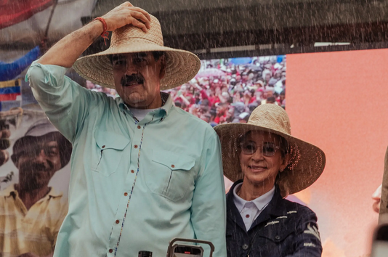
President Nicolás MADURO
First Lady Cilia FLORES

Slide 28
Operation Absolute Resolve
3 Jan 2026

Slide 29
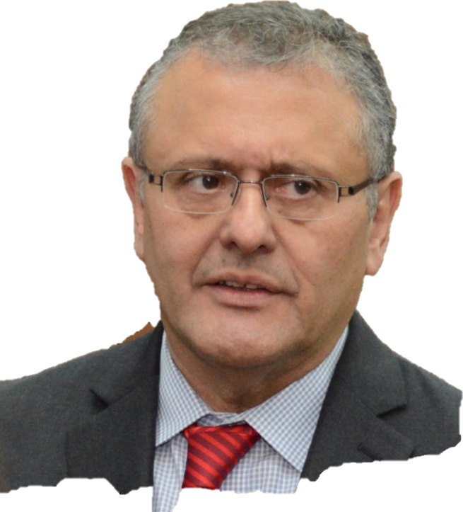
ANALYTICAL DEBATE: What happened?
Could U.S. just not abide a nationalistic (“socialist”) government in Vzla?
Or did Chávez and Maduro pose a real threat? Have bad friends?
Did U.S. policy make conflict more/less “necessary”?
What’s going to happen now?
direct?
indirect?

Slide 30
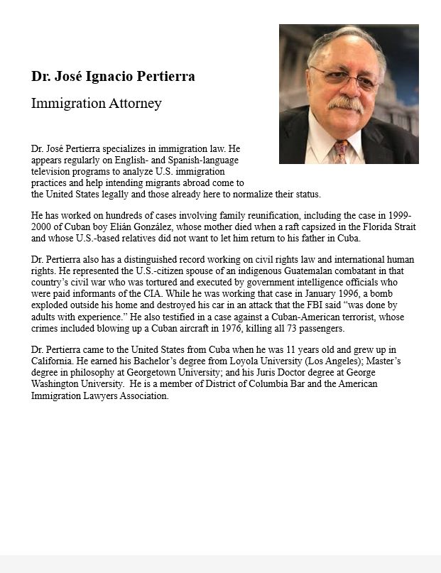
GUEST SPEAKER
José Pertierra
Immigration Lawyer and expert on immigration law and Latin America
- Introduced by Sarina

Slide 31
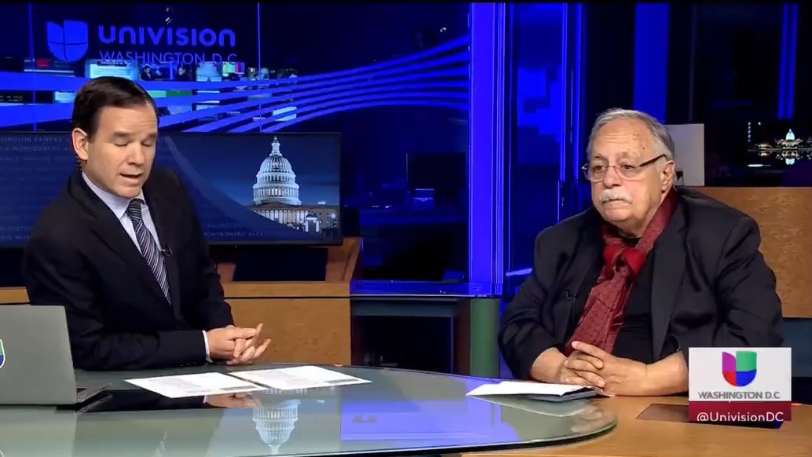

GUEST SPEAKER
José Pertierra

Slide 32
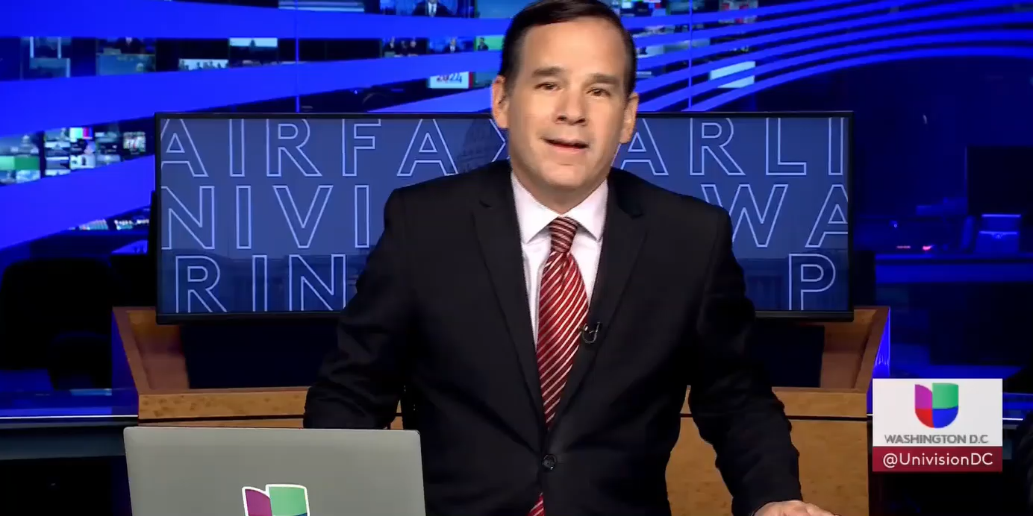
GUEST SPEAKER
José Pertierra

Slide 33
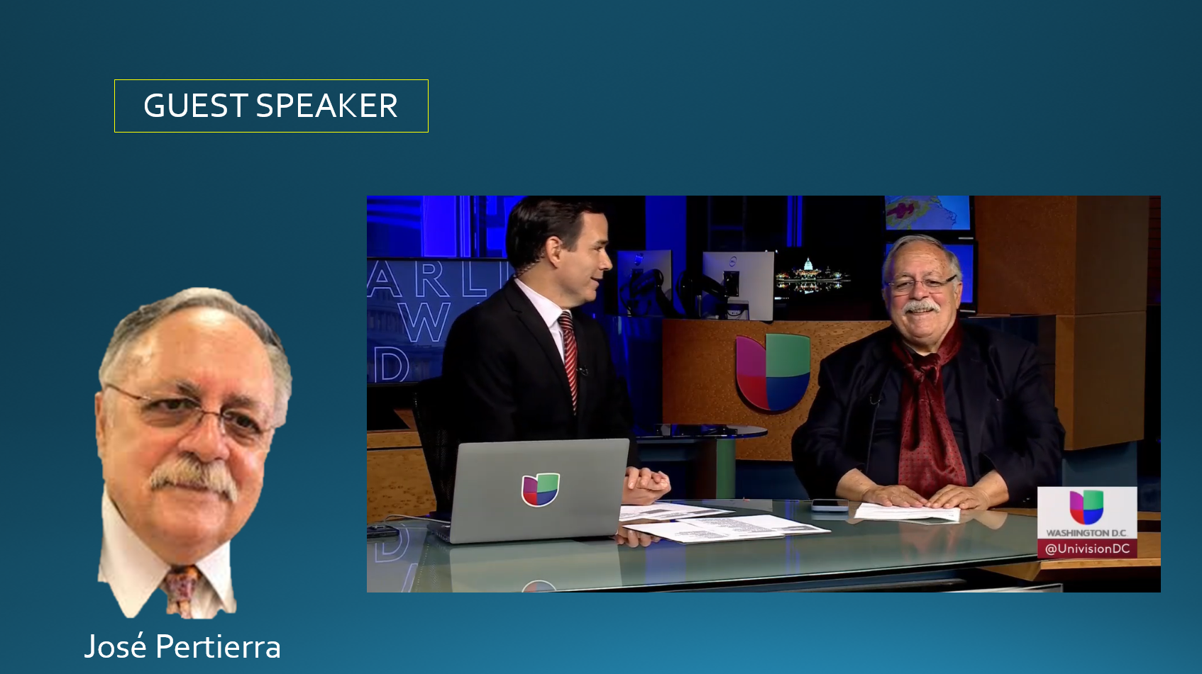
[[ video ]]

Slide 34
PROJECT UPDATES

Slide 35
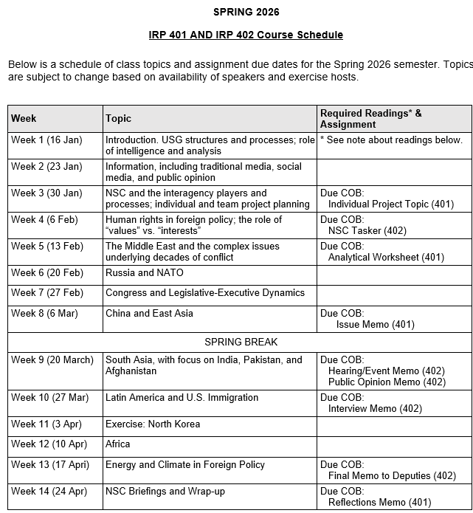
✓
✓
✓
✓
401
✓
✓
✓
✓
✓
✓
✓
✓
402
✓
✓
✓
✓
✓
✓
✓
✓
✓
✓
✓
✓
✓
✓
✓
✓
✓
✓
✓
✓
✓
✓
✓
✓

Slide 36
PROJECT PLANNING
Emmett | Countering “CRINK” Alignment | Danger of one-dimensional energy sector
John | Innovation and Environmental Capacity
Miles | Capitalism and Environment Protection | Climate change and refugees/sovereignty
Kennedy | Taiwan Prosperity and U.S. Interests
Eli | Prediction Markets | Iran-US relations
Michael | Foreign Manipulation of U.S. Elections
Diego | Russian Invasion of Ukraine | Globalization and environmental impact
Molisa | U.S.-China Competition in Critical Technologies
Kaiwen | U.S.-China Economic and Trade Competition | China’s Influence in Africa
Yvette | Rwanda-DRC Conflict and Resolution
Bijan | Housing Shortage and its Implications | Humanitarian Crisis in Gaza
Megha | Restrictive U.S. Immigration and Visa Policies
Filippo | Transatlantic Relations | North Korea illegal ops to support goals
David | ???? | ??????

Slide 37
DISCUSSION
Comfortable?
Topics
How partnership will work
The purposes
Substance, process, skills
The elements
401
Analysis
“Memo #2”
402
Proposal
Hearing/event
Public opinion
Interviews
DC memo
Briefing

Slide 38
DISCUSSION
DUE last Friday: | Memo proposing 402 project
DUE tonight: | “Analytical Worksheet” or “Seminar Issue Worksheet” for 401 project

Slide 39
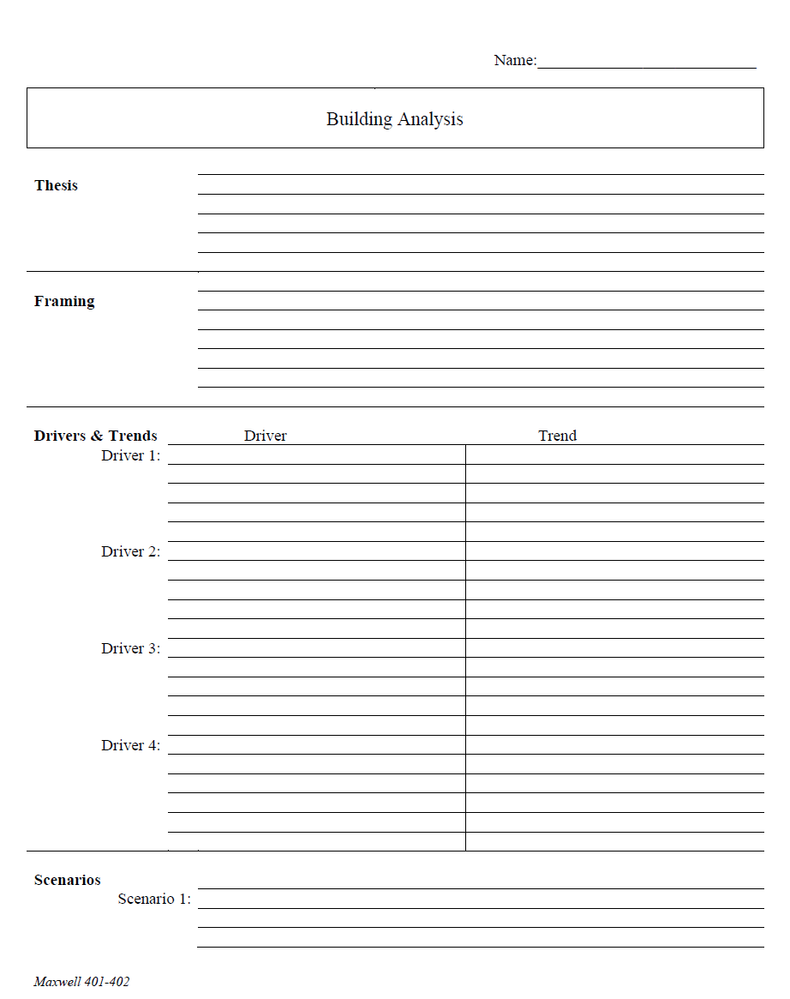
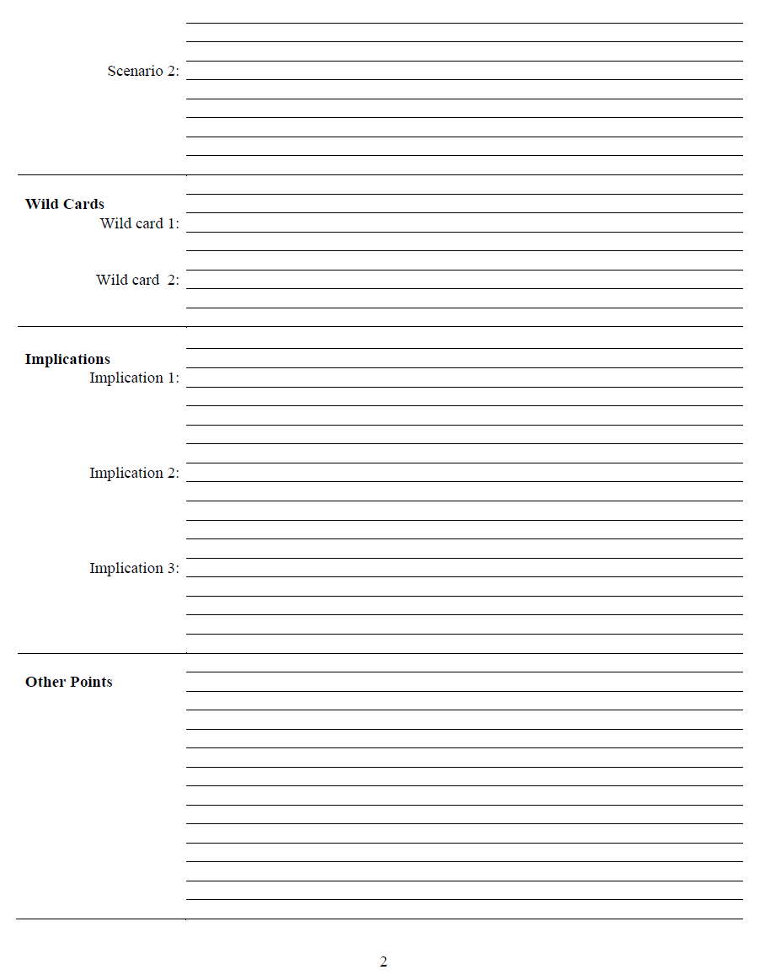
The Analytical Worksheet: One Proven, Effective Way to Build Analysis for Presentation

Slide 40
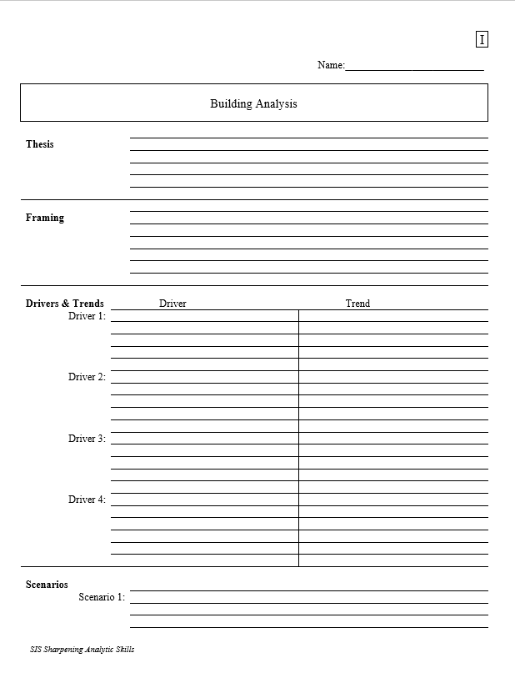
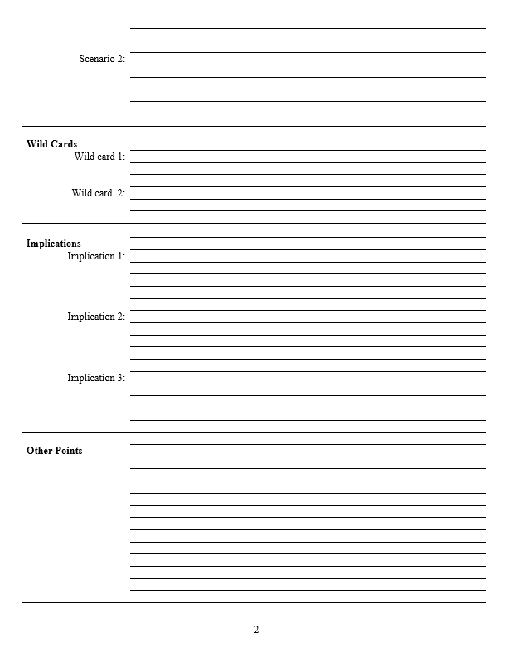
With a thesis sentence at the top, here’s the whole model.
Other Points | Things that don’t fit in rigid structure
 | Give color, texture to analysis
 | Useful in building “narrative” when you write
 | Pet facts, thoughts that you like (and show you care)
Thesis sentence(s): Main conclusion.
“Bottom Line Up Front.”
Short, concise summary – including as many elements as needed to tell the whole story.
Framing: The information your decisionmaker needs to get into the story.
Basics
Not “research or encylopedia”

Slide 41
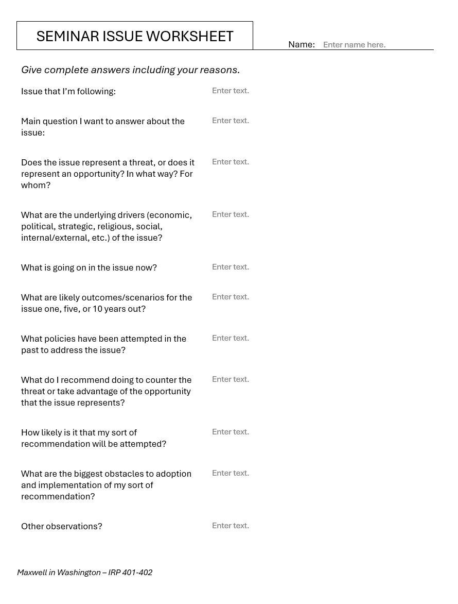
Alternative
Should be two or three pages of text.

Slide 42
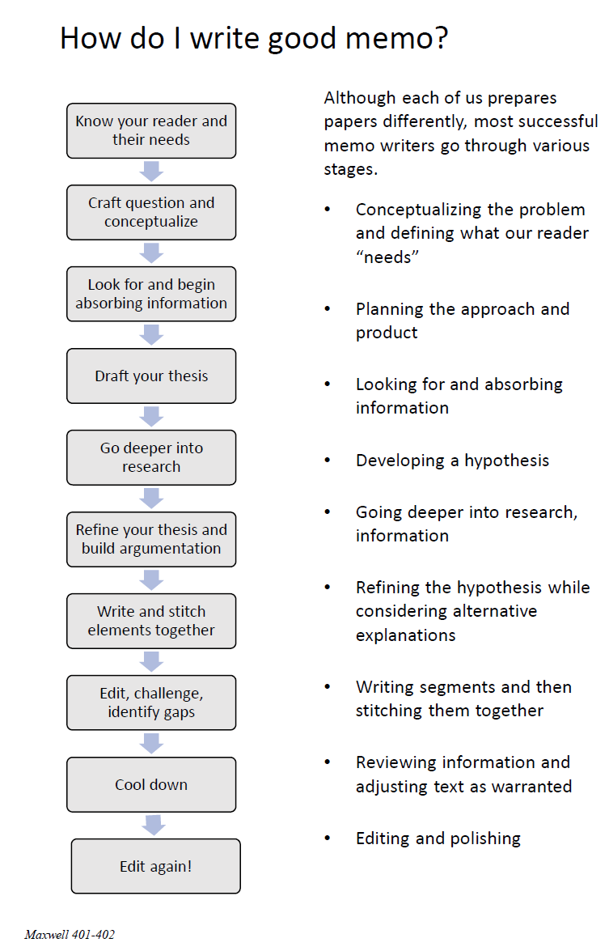
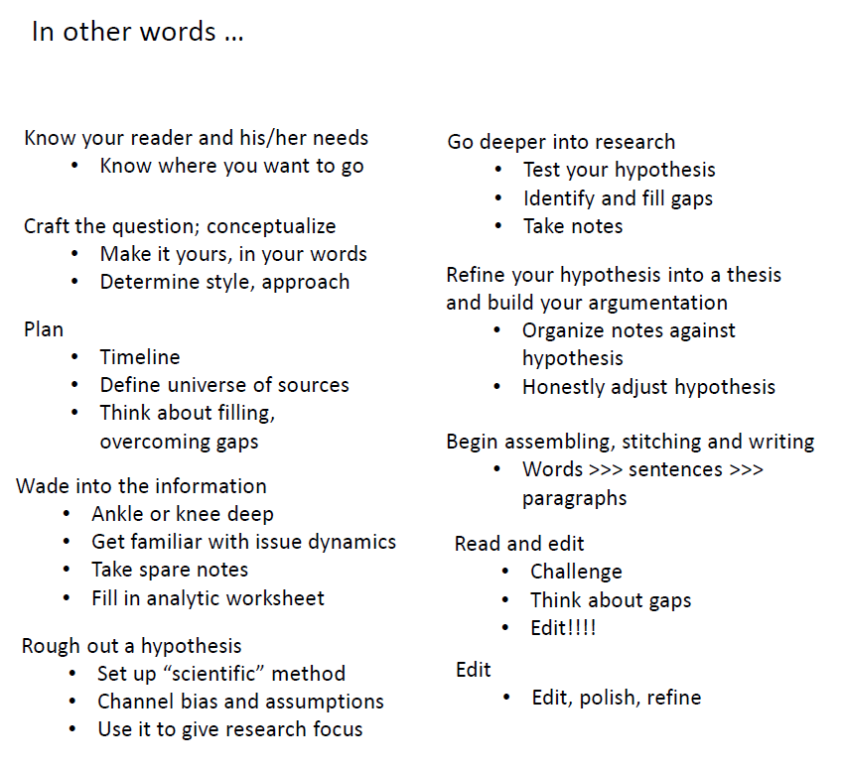
The overall process

Slide 43

QUESTIONS ?

Slide 44
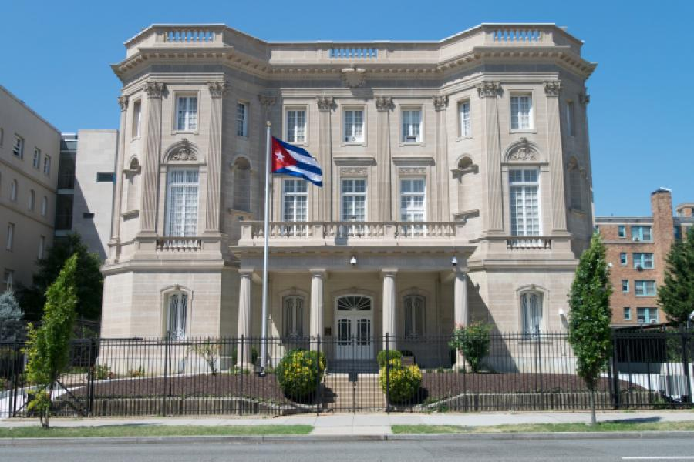

Slide 45
C91 Metrobus
37th & O
20th & P
18th & P

Slide 46
C91 Metrobus
20th & P
18th & P

Slide 47
ICC
“Red Square”
1:55 sharp

Slide 48
Human Rights in Foreign Policy
How effectively has the United States promoted human rights?
Have we achieved a good balance?
Implications for your 401 and 402 issues

Slide 49
READINGS
The U.S. Reaction to the Holocaust and Other Evil
https://encyclopedia.ushmm.org/content/en/article/the-united-states-and-the-holocaust
https://www.theatlantic.com/culture/archive/2022/09/ken-burns-documentary-the-us-and-the-holocaust-review/671455/
Views of the state of human rights.
https://www.state.gov/reports/2023-country-reports-on-human-rights-practices/
https://www.hrw.org/world-report/2025
https://freedomhouse.org/report/nations-transit/2021/antidemocratic-turn
https://freedomhouse.org/explore-the-map?type=fiw&year=2024
https://www.amnestyusa.org/issues/
International human rights agreements and organizations
https://www.ohchr.org/EN/UDHR/Documents/UDHR_Translations/eng.pdf
https://www.ohchr.org/en/professionalinterest/pages/vienna.aspx
https://www.ohchr.org/en/professionalinterest/pages/ccpr.aspx

Slide 50
QUESTIONS
Is consistency important?
If so, is it OK to have different policies on h.r. and democracy in China and Saudi Arabia? Or Venezuela and El Salvador? Or Hungary and Türkiye?
Are results important?
If so, why do we continue some policies that don’t seem to work? Moral satisfaction? Domestic politics? (Is that OK?)
How can we know when to intervene?
To what degree should we involve ourselves in other countries’ human rights situations?
How and when should we “engage”?
What principles guide this engagement? Our values? Or our interests? Or an interplay of the two?
In which U.S. policies and regions do you see a consistent emphasis on human rights? In which is the emphasis inconsistent? Does the United States play favorites? Why?

Slide 51

The individual interest … the social interest?

Slide 52
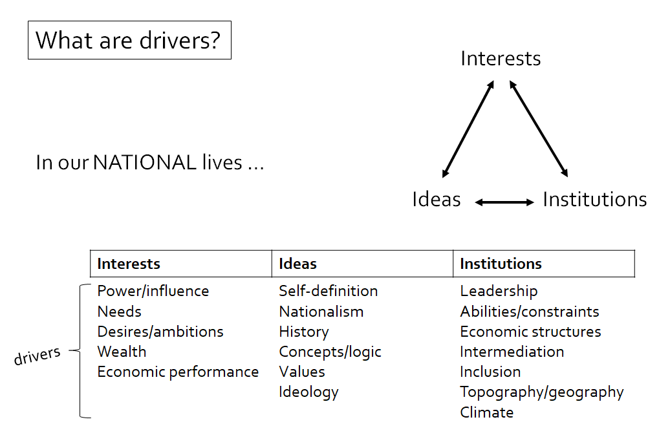
QUESTIONS
Is consistency important?
If so, is it OK to have different policies on h.r. and democracy in China and Saudi Arabia? Or Venezuela and El Salvador? Or Hungary and Türkiye?
Are results important?
If so, why do we continue some policies that don’t seem to work? Moral satisfaction? Domestic politics? (Is that OK?)
How can we know when to intervene?
To what degree should we involve ourselves in other countries’ human rights situations?
How and when should we “engage”?
What principles guide this engagement? Our values? Or our interests? Or an interplay of the two?
In which U.S. policies and regions do you see a consistent emphasis on human rights? In which is the emphasis inconsistent? Does the United States play favorites? Why?

Slide 53
QUESTIONS
Is consistency important?
If so, is it OK to have different policies on h.r. and democracy in China and Saudi Arabia? Or Venezuela and El Salvador? Or Hungary and Türkiye?
Are results important?
If so, why do we continue some policies that don’t seem to work? Moral satisfaction? Domestic politics? (Is that OK?)
How can we know when to intervene?
To what degree should we involve ourselves in other countries’ human rights situations?
How and when should we “engage”?
What principles guide this engagement? Our values? Or our interests? Or an interplay of the two?
In which U.S. policies and regions do you see a consistent emphasis on human rights? In which is the emphasis inconsistent? Does the United States play favorites? Why?

Slide 54
TO DISCUSS LATER
Military intervention (in defense of human rights or democracy) is in our national interest when ___________.
Non-military intervention (sanctions, threats, etc.) is in our national interest when _____________.
We should give _________ priority to applying our values of democracy and human rights consistently?
When a friend or ally violates human rights or other democratic norms, we should _________.
When we (the United States) stray from the norms that we espouse, we should _______.

Slide 55
TODAY’S AGENDA
9:00 | Class Discussion and Quiz Latin America, Cuba, Venezuela
9:45 | Class Discussion: Project Updates
~10:00 | Go downstairs
10:30 | Ambassador Lianys Torres, Embassy of Cuba - Introduced by Megha
12:15 | Lunch and Metrobus to Georgetown University
1:55 | Meet in “Red Square” – entrance to Intercultural Center Georgetown University
2:00 | Professor Angelo RIVERO Santos, Georgetown University - Introduced by Diego
~3:30 | Wrapup and depart from GU

Slide 56
Global Policy Seminar and NSC Simulation
IRP 401 - IRP 402
Week Five 13 February 2026
Prof. Fulton T. Armstrong

Slide 57
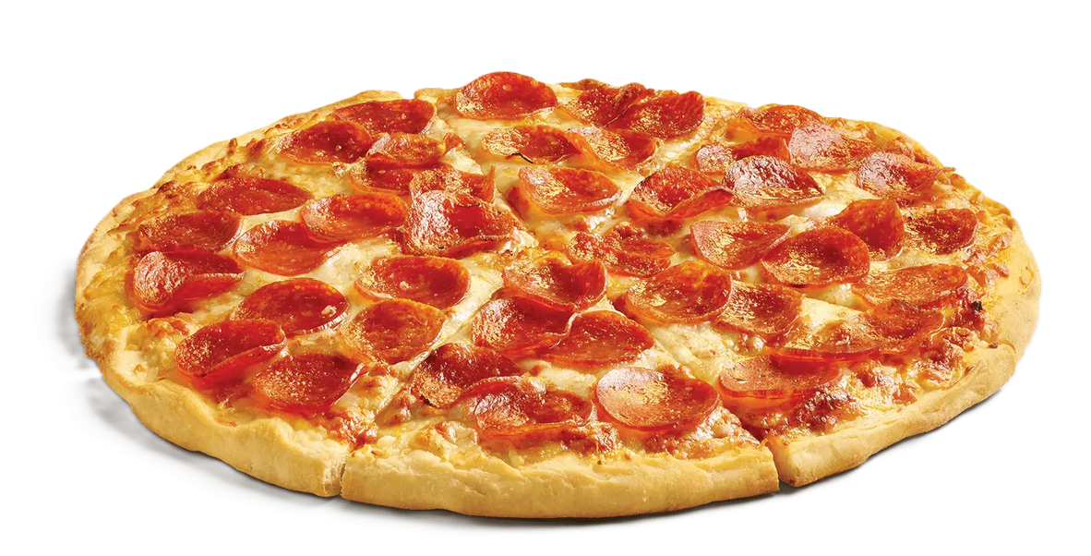
LUNCH

Slide 58
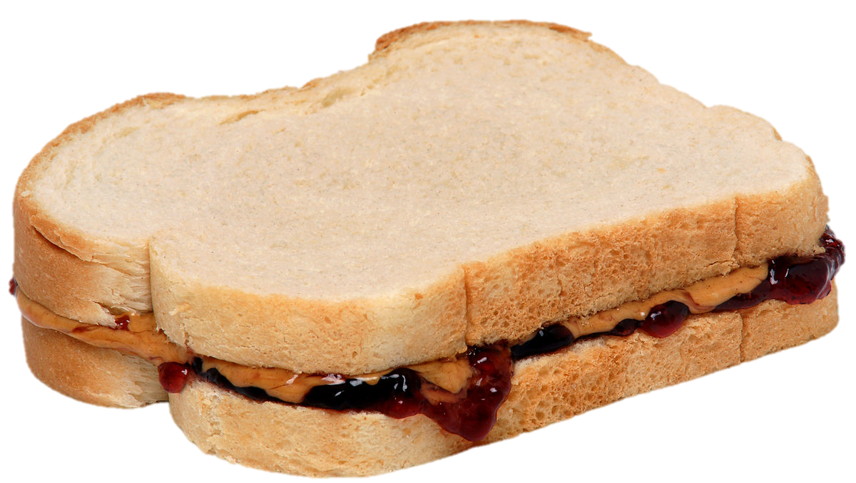
LUNCH

Slide 59

WRAPUP

