Slide 1

Global Policy Seminar and NSC Simulation
IRP 401 - IRP 402
Week Six 20 February 2026
Prof. Fulton T. Armstrong

Slide 2
Week 1 (16 Jan)
Week 2 (23 Jan)
Week 3 (30 Jan)
Week 4 (6 Feb)
Week 5 (13 Feb)
Week 6 (20 Feb)
Week 7 (27 Feb)
Week 8 (6 Mar)
Spring Break
Week 9 (20 March)
Week 10 (27 Mar)
Week 11 (3 Apr)
Week 12 (10 Apr)
Week 13 (17 Apri)
Week 14 (24 Apr)
Spring 2026

Slide 3
TODAY’S AGENDA
9:00 | Class Discussion – Readings, current events updates, and meeting preps
10:00 | Go downstairs
10:10 | Depart by Uber for Embassy of Israel
10:30 | Minister Counselor (TBD) Embassy of Israel
~12:00 | Metro back to SUDC and lunch
1:30 | Class Discussion – Project Updates
2:00 | Mitchell Plitnick President, ReThinking Foreign Policy - introduced by Molisa
~3:30 | Wrapup
Ms. Efrat Hochstetler (Counselor for Public Diplomacy)
Ms. Ayala Singer (Academic Outreach)

Slide 4
TODAY’S AGENDA
9:00 | Class Discussion – Readings, current events updates, and meeting preps
10:00 | Go downstairs
10:10 | Depart by Uber for Embassy of Israel
10:30 | Minister Counselor (TBD) Embassy of Israel
~12:00 | Metro back to SUDC and lunch
1:30 | Class Discussion – Project Updates
2:00 | Mitchell Plitnick President, ReThinking Foreign Policy - introduced by Molisa
~3:30 | Wrapup
Ms. Efrat Hochstetler (Counselor for Public Diplomacy)
Ms. Ayala Singer (Academic Outreach)

Slide 5
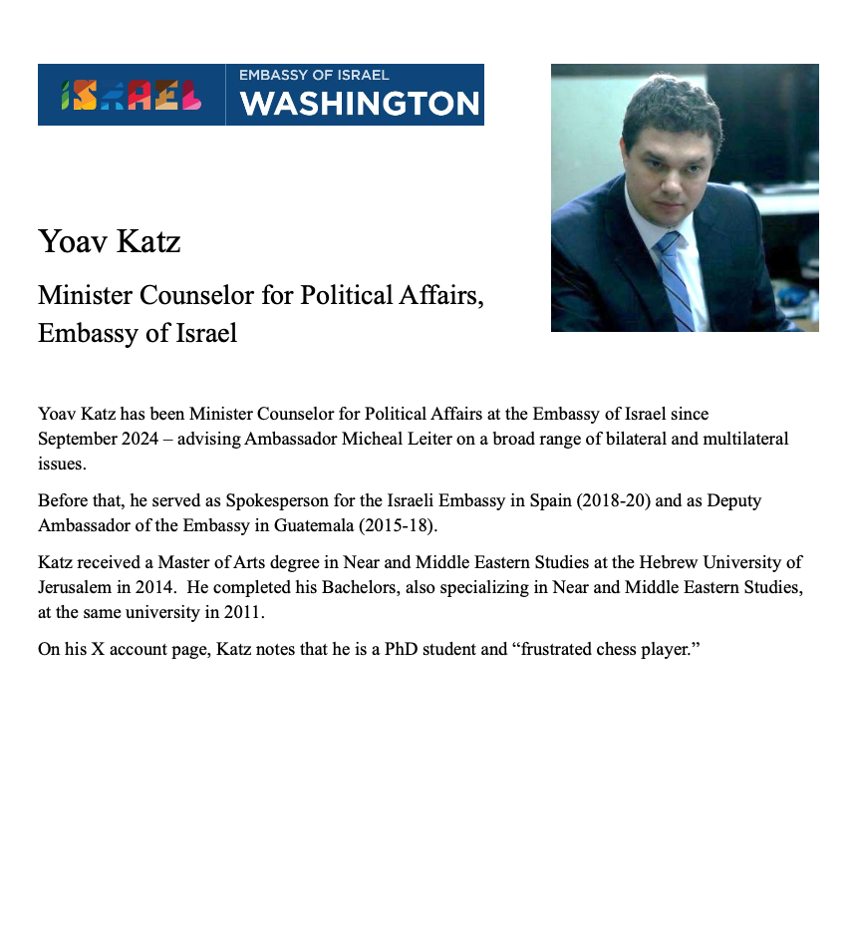
SPEAKER
Yoav Katz
- introduced by ___

Slide 6
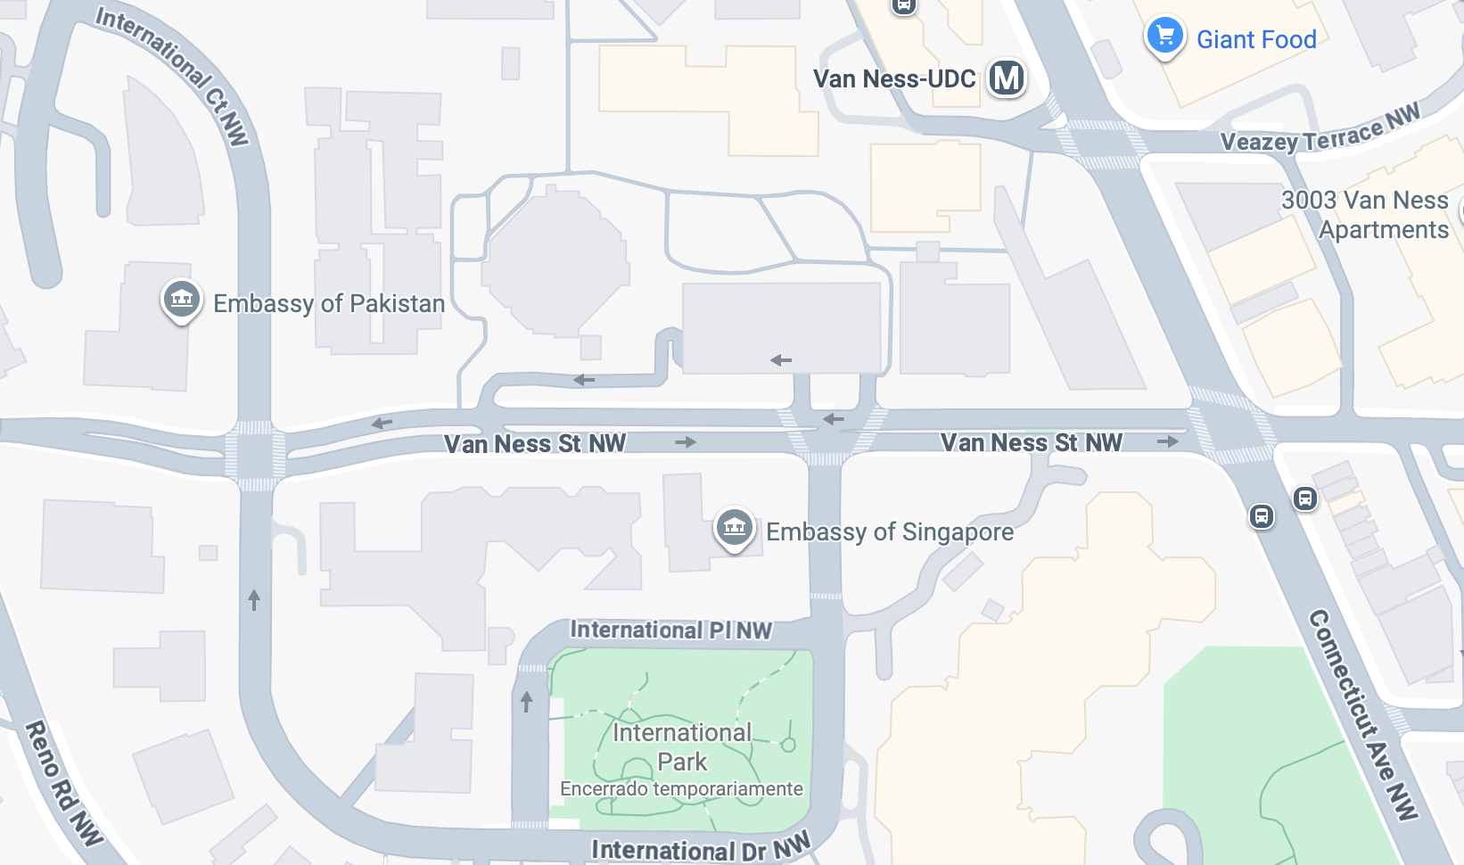




Embassy of Israel

Slide 7

Security Team asks …
Government-issued photo ID (such as license or passport) required.
Security screening.
No laptops or similar.
Recommend not bringing phones if don’t need.
No luggage or baggage.
No weapons, explosives, self-defense items.

Slide 8
WHO’S WHO IN AN EMBASSY?
CONSULATES
Consul General
Consul
Vice Consul
INTERNATIONAL ORGANIZATIONS
Permanent Representative
Deputy Permanent Representative
Ambassador
(Deputy Chief of Mission)
Minister
Minister-Counselor
Counselor
First Secretary
Second Secretary
Third Secretary
Attaché
Assistant Attaché
Yoav Katz – Minister-Counselor
Denys Sienek - DCM
TAO Song – Counselor for Political Affairs
Gervasio HSU – Chief of Political Affairs
Examples of job titles
Political Officer
Economics Officer
Regional Security Officer
Administrative Officer
Public Affairs Officer
Defense Attache
MilGroup Member
FLEXIBILITY
Ambassador-at-Large
Envoy or Special Envoy

Slide 9
ETIQUETTE or PROTOCOL
In ANY meeting … if guest/speaker is repeating self, consider …
Using body language to signal “message received”
Depending on your style, interrupting gently with a brief …
“thanks” or “I understand” or “I see”
paraphrasing
segue to colleague’s question/point
ask if you can ask followup
UNDERSTAND this: some people feel obligated to fill the time.

Slide 10

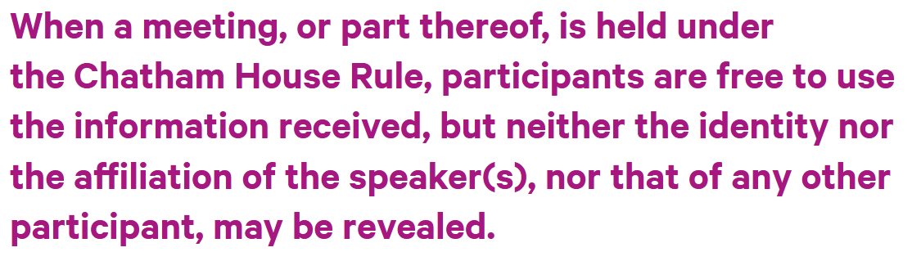
REMINDER
ETIQUETTE or PROTOCOL
Personal vs official views
Chatham House Rule
St. James’s Square London

Slide 11
REMINDER
ETIQUETTE or PROTOCOL
Professional respect
Smart, analytical questions
Non-combative tone
Depending on your style, perhaps preface question
What is your perspective on …?
What should we make of reports that …?
What do we need to know to understand …
Neutral vocabulary

Slide 12
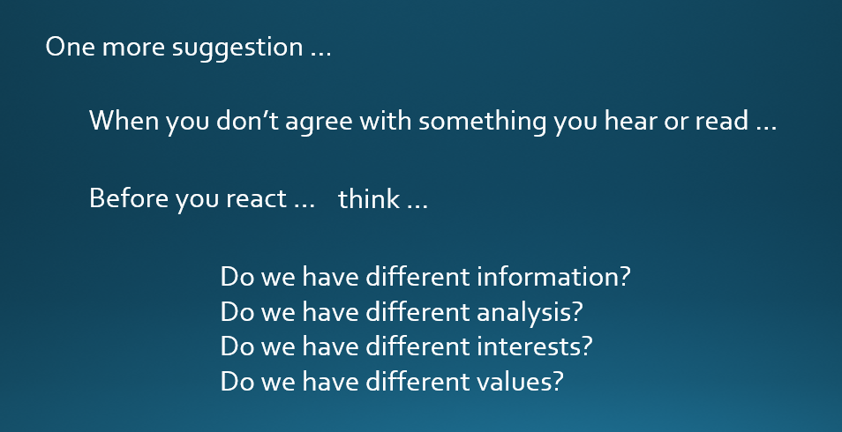
DISCUSSION
Can discuss sensitive, complex, politicized issues.
Remember …
Understand that words can have different meanings.
OUR MISSION (among ourselves and with guests):
TO UNDERSTAND AND ANALYZE
(NOT TO JUDGE)
LISTEN, THINK, TRY TO UNDERSTAND, BE DIPLOMATIC

Slide 13
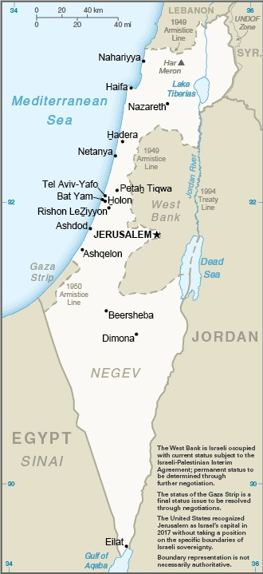
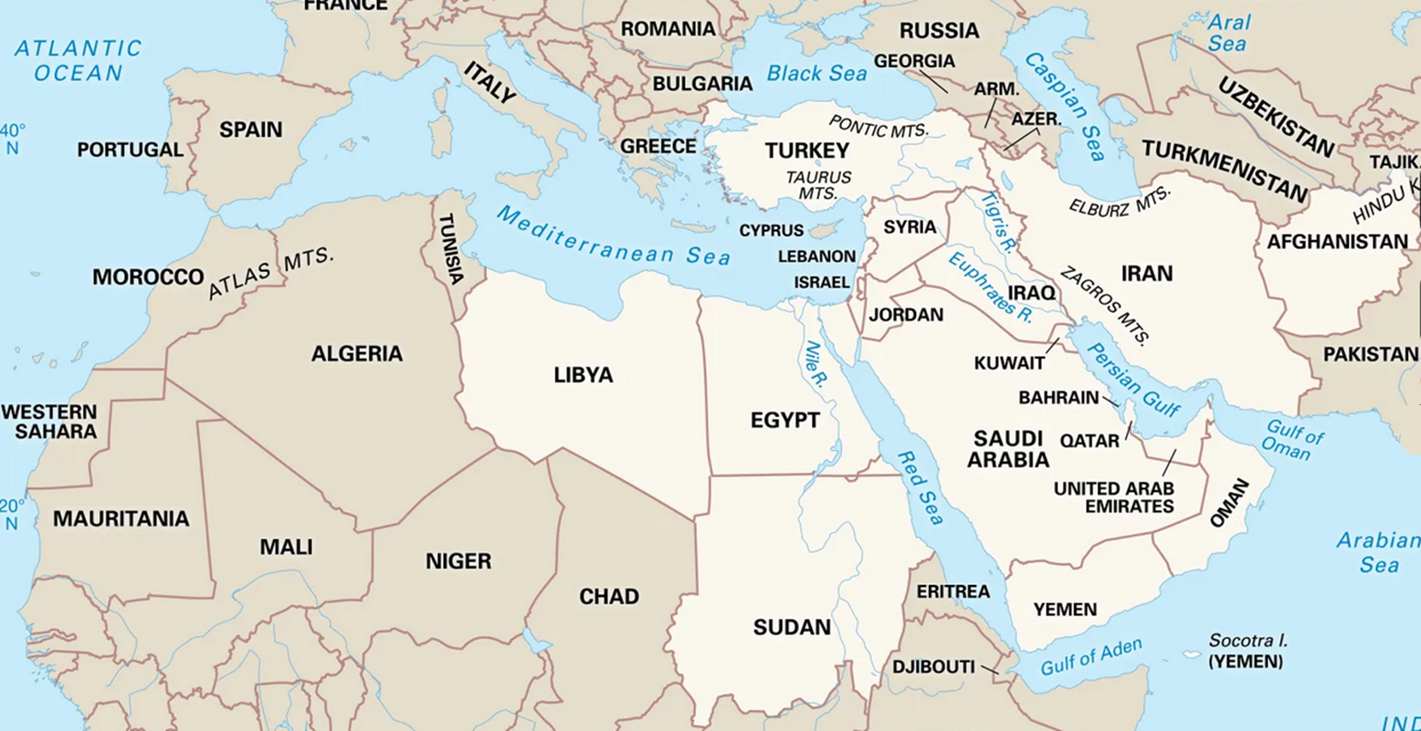
DISCUSSION

Slide 14
DISCUSSION

Slide 15
DISCUSSION
Some of the basics …
Creation of Jewish State in 1948.
Never resolved Palestinian homeland issues.
Six-Day War in 1967; Yom Kippur War in 1973.
Intifadas in 1987-93 and 2000-05.
Camp David Accords in 1978.
Oslo Accords in 1993 and 1995.
Numerous failed attempts.

Slide 16
DISCUSSION
Some of the basics …
Abraham Accords (2020) did not include Palestine.
UAE, Bahrain first.
Sudan, Morocco later.
Saudi Arabia talk but not sign.
Gaza War
7 Oct 2023 – Hamas attack, killing 1.3K.
War (>75k dead), dislocations, disaster.

Slide 17
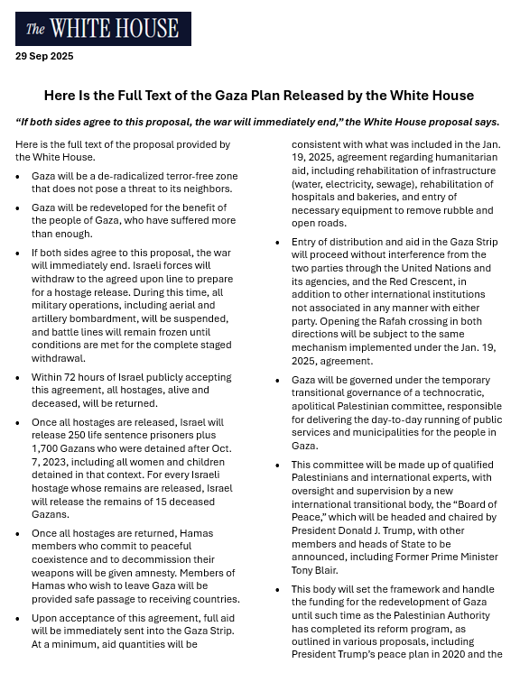
President Trump’s
“20-point plan” (29 Sep)
Framework for ceasefire, stabilization, reconstruction.
Endorsed by UN.

Slide 18
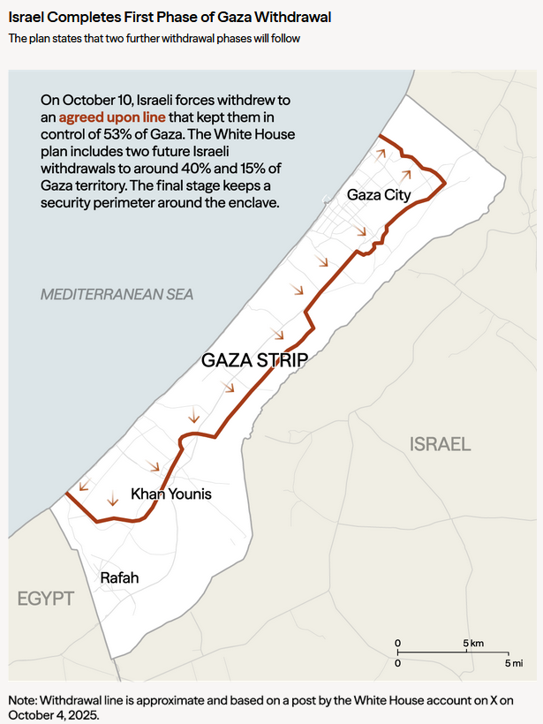
Ceasefire (since October)
But … deadlock in negotiations
Hamas disarmament
Israeli withdrawal
Future arrangements

Slide 19
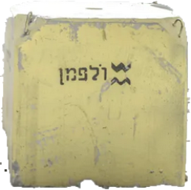
Marker Blocks

Slide 20
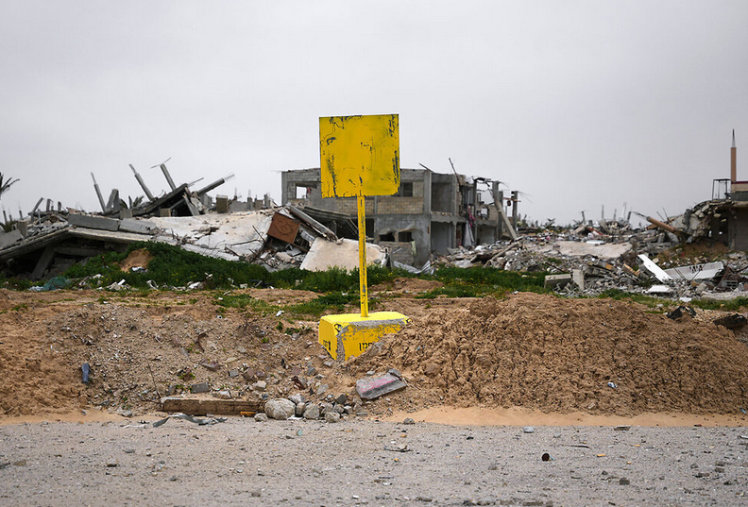
Anyone crossing the line will be “met with fire.”
- DefMin Katz

Slide 21
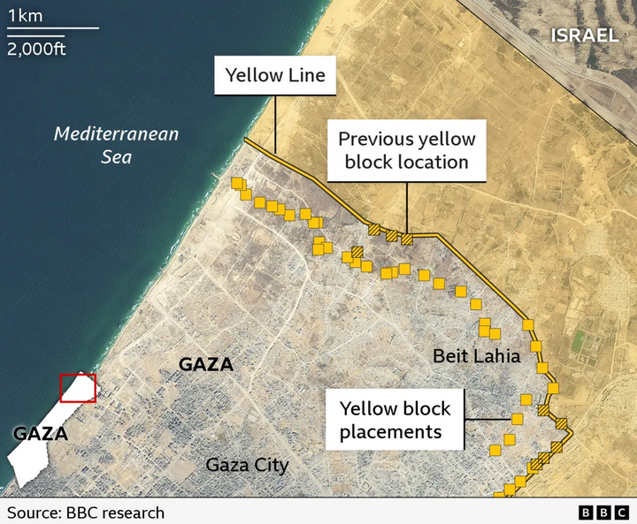
OCT
15 JAN

Slide 22
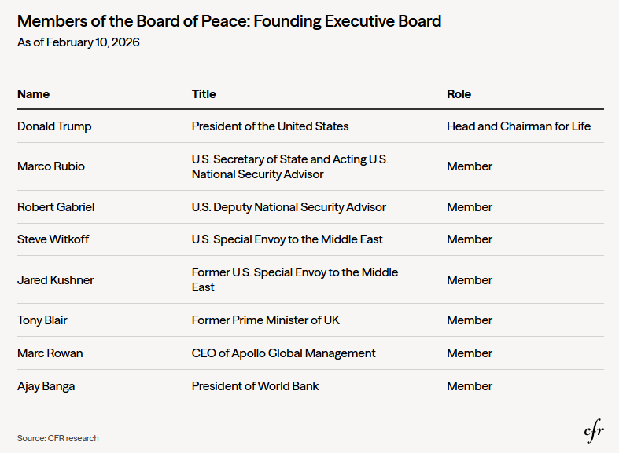
Board of Peace
formed January as one of 20 points
inaugural meeting ydy
~2 dozen members (and many no’s)
$1 b in cash each
Mandate evolving. Stated as Gaza only, but now suspected as replacement from UN.

Slide 23
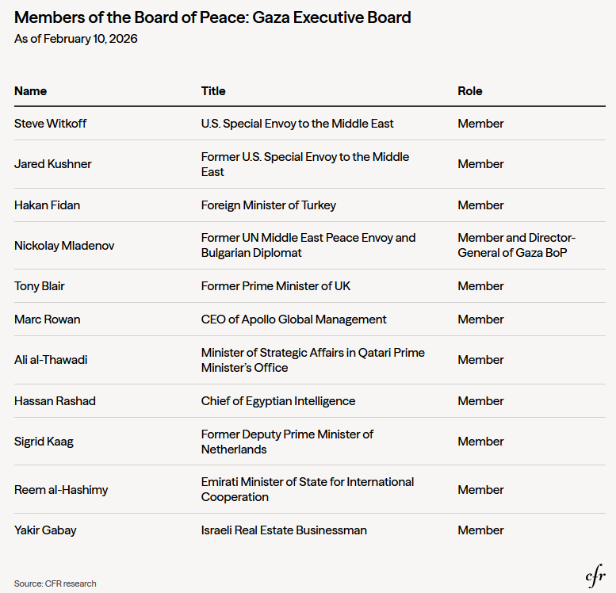
Board of Peace
Executive Board
Where are the Palestinians and Israelis?
National Committee for the Administration of Gaza (NCAG): Technocrats now waiting in Cairo

Slide 24
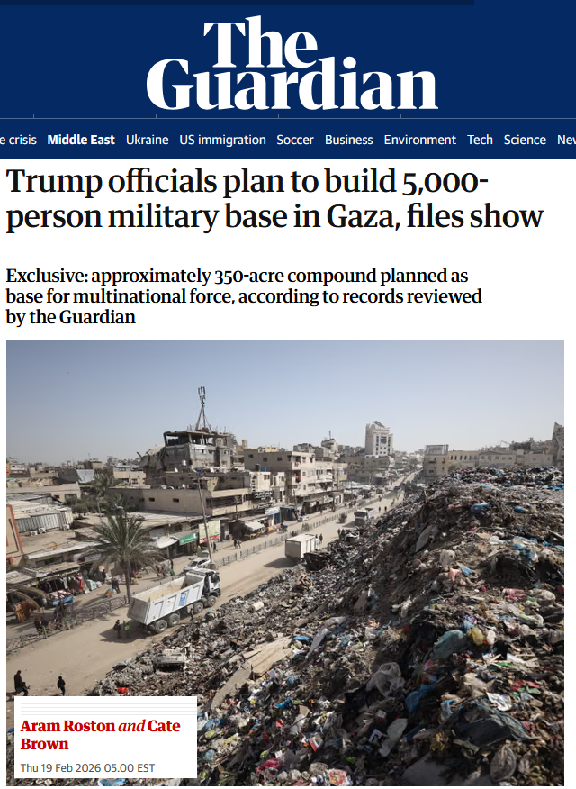
Board of Peace
International Stabilization Force (ISF)
Many details unclear

Slide 25
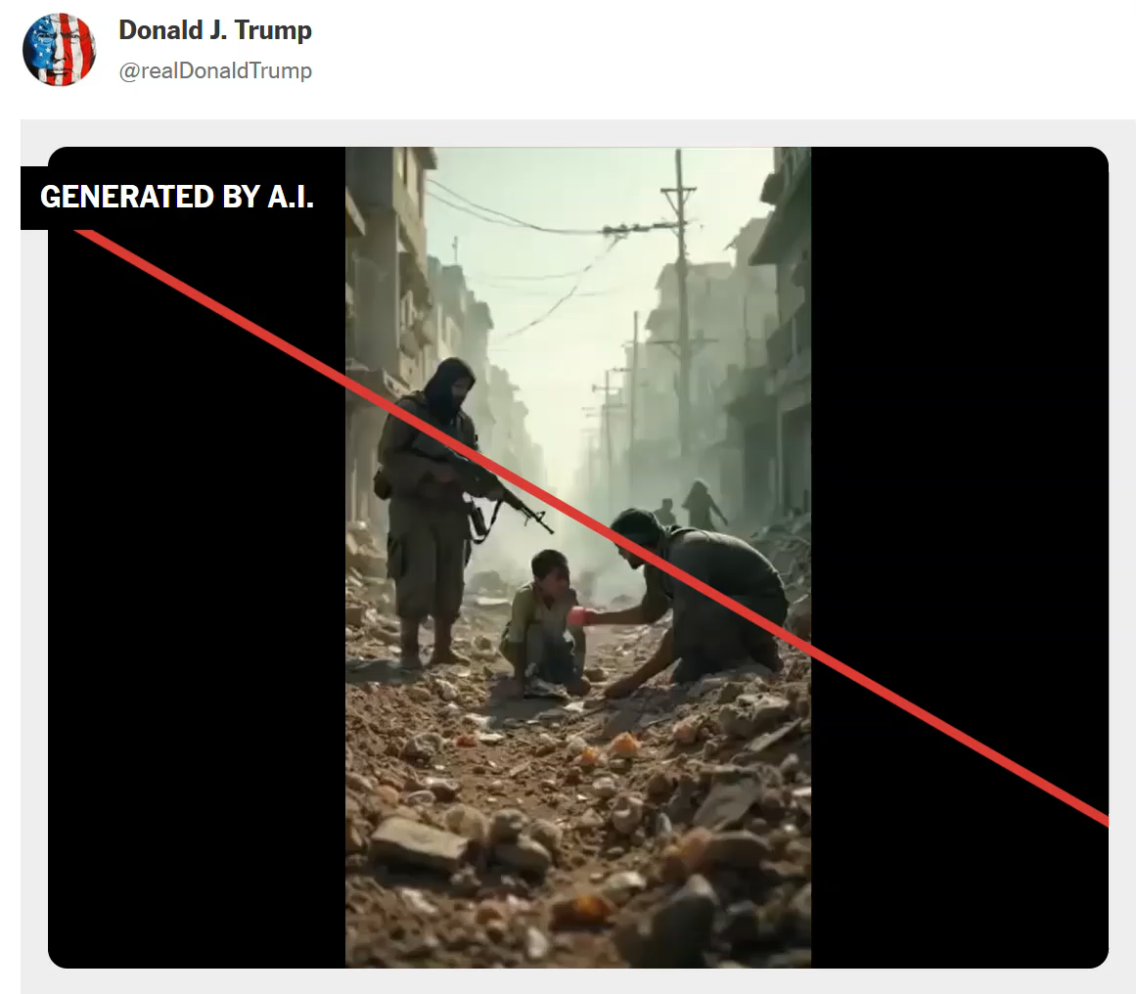
White House A.I. video

Slide 26
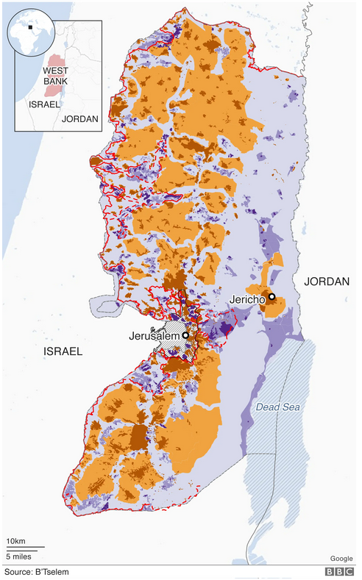
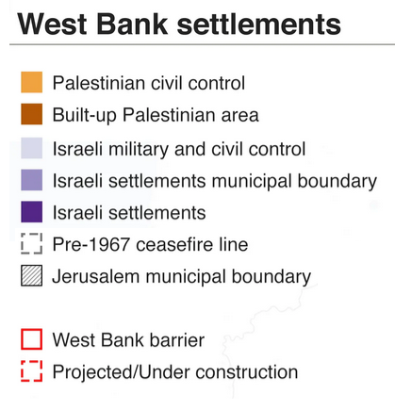
West Bank Judea and Samaria
Israeli-occupied since 1967
3 m Palestinians
500 k Israelis
1,300 Palestinians killed by settlers since 2022, says UN

Slide 27
Past | Trump Administration displeased by expansion in West Bank
8 Feb | Israel announces measures paving way for more settlements.
9 Feb | WH calls for “a stable West Bank.”
10 Feb | Trump: “I am against annexation.”
11 Feb | Netanyahu makes seventh visit to WH, with Iran at top of agenda.
15 Feb | Israeli cabinet announces further expansion measures.

Slide 28
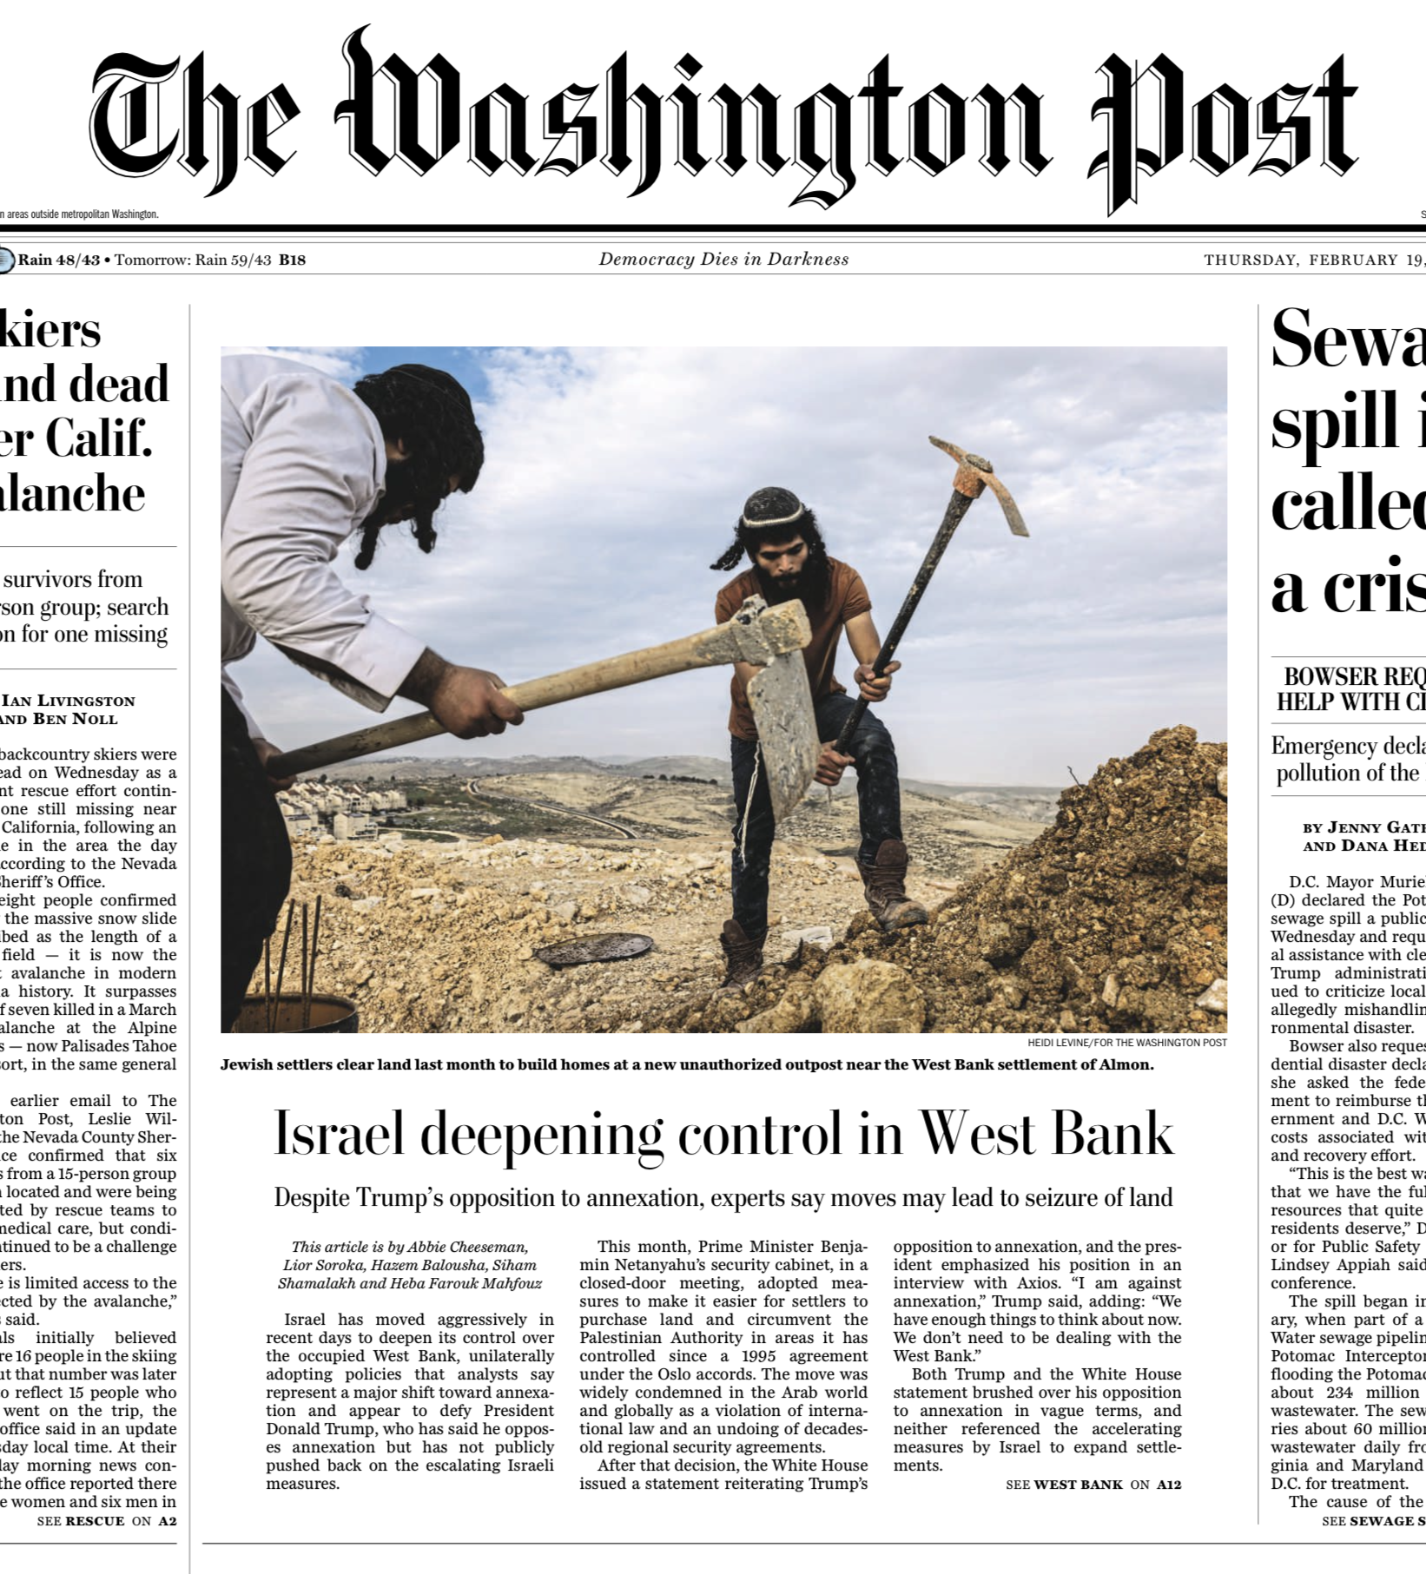

Slide 29
DISCUSSION
What questions have you developed?
About …
What will happen in Gaza
Trump plans
Netanyahu’s plans
Humanitarian flotilla and aid
West Bank settlements/annexation
Next steps on Iran
Two-State solution
Future of broader Palestine

Slide 30
Embassy of Israel

Slide 31

Be on 19th Street at 10:00
BRING GOVERNMENT-ISSUED PHOTO I.D.
DON’T BRING PHONES UNLESS YOU MUST.

Slide 32
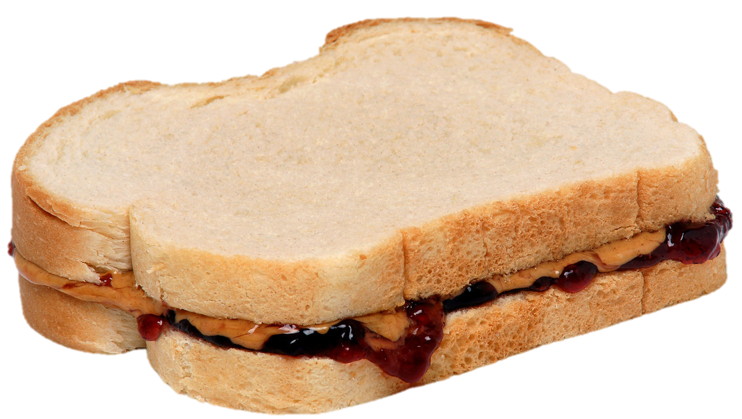
LUNCH

Slide 33
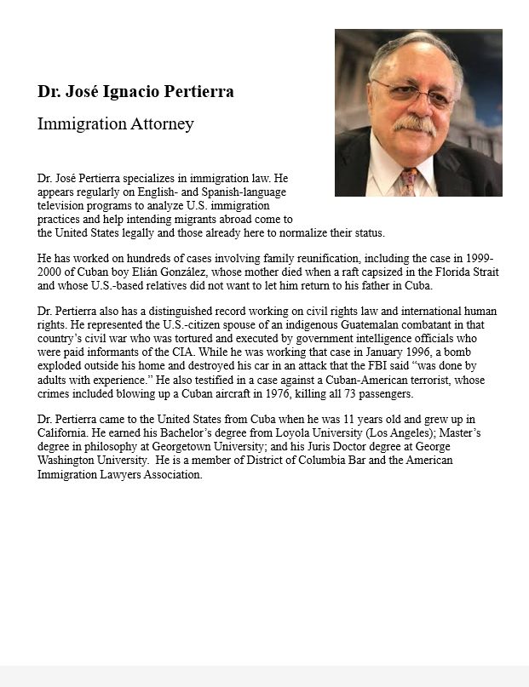
GUEST SPEAKER
José Pertierra
Immigration Lawyer and expert on immigration law and Latin America
- Introduced by Sarina

Slide 34
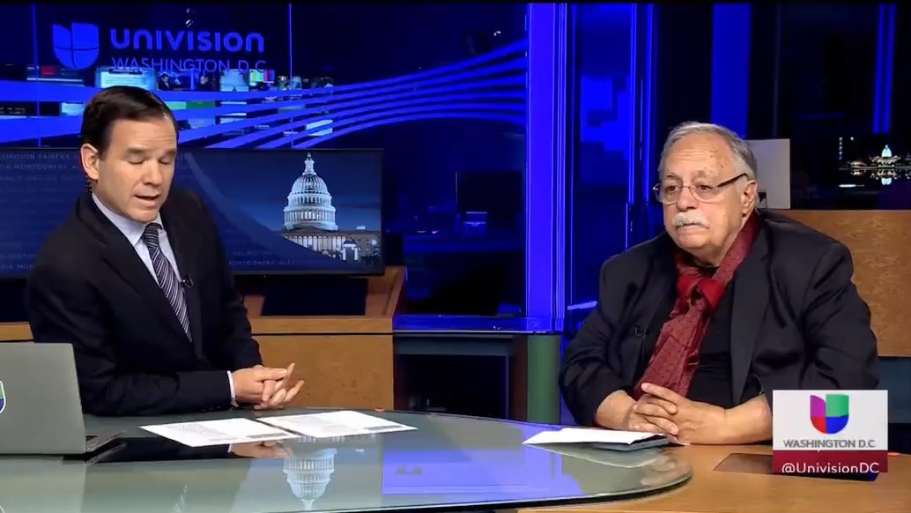
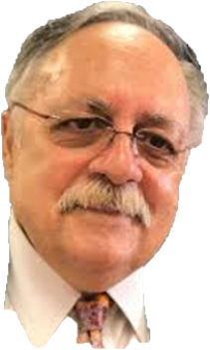
GUEST SPEAKER
José Pertierra

Slide 35
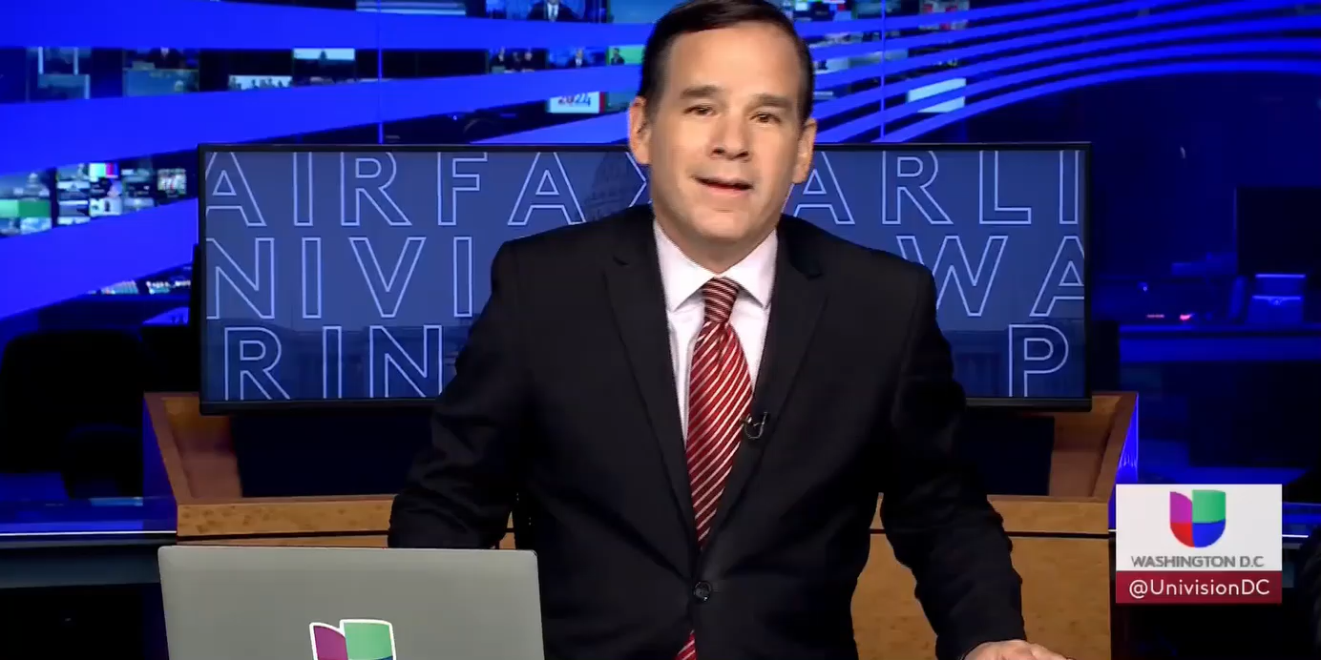
GUEST SPEAKER
José Pertierra

Slide 36
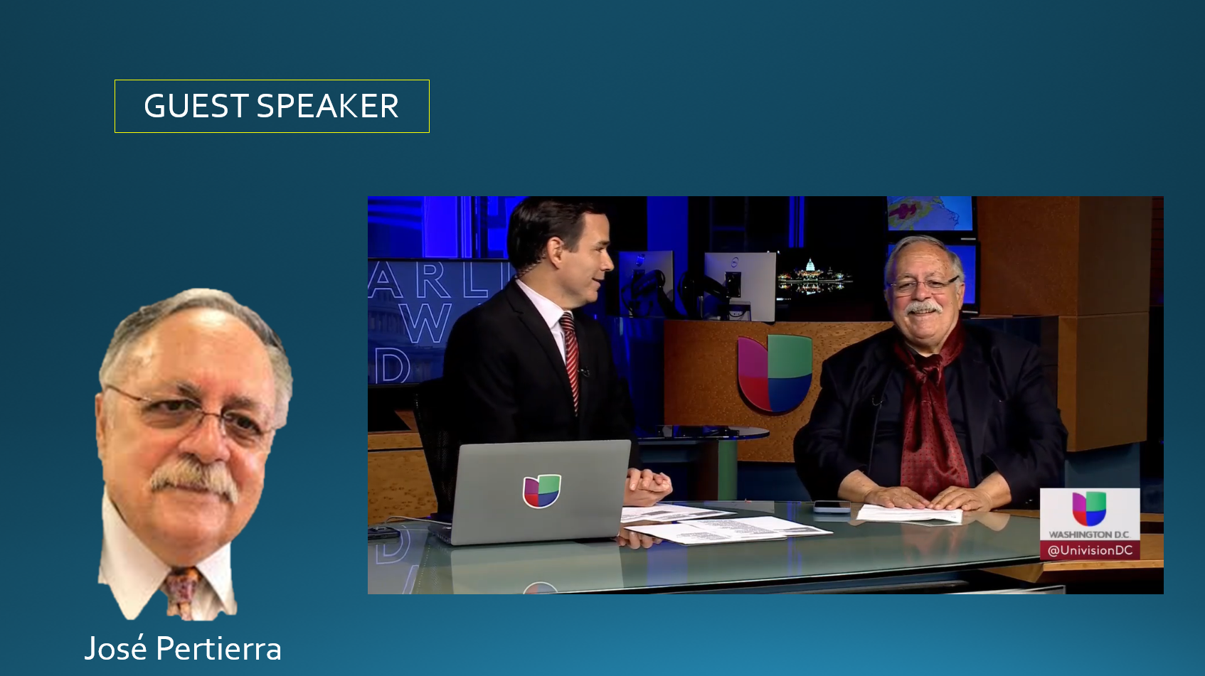
[[ video ]]

Slide 37
PROJECT UPDATES

Slide 38
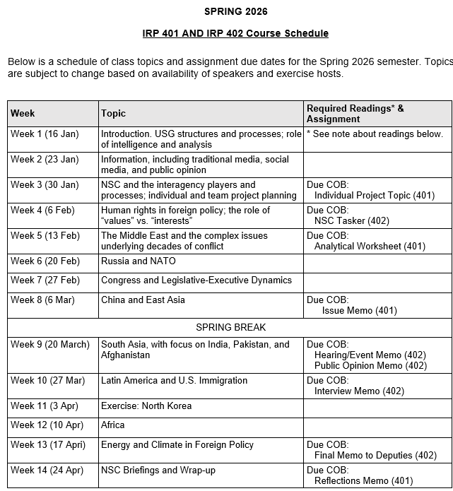
✓
✓
✓
✓
401
✓
✓
✓
✓
✓
✓
✓
✓
402
✓
✓
✓
✓
✓
✓
✓
✓
✓
✓
✓
✓
✓
✓
✓
✓
✓
✓
✓
✓
✓
✓
✓
✓

Slide 39
PROJECT PLANNING
Emmett | Countering “CRINK” Alignment | Danger of one-dimensional energy sector
John | Innovation and Environmental Capacity
Miles | Capitalism and Environment Protection | Climate change and refugees/sovereignty
Kennedy | Taiwan Prosperity and U.S. Interests
Eli | Prediction Markets | Iran-US relations
Michael | Foreign Manipulation of U.S. Elections
Diego | Russian Invasion of Ukraine | Globalization and environmental impact
Molisa | U.S.-China Competition in Critical Technologies
Kaiwen | U.S.-China Economic and Trade Competition | China’s Influence in Africa
Yvette | Rwanda-DRC Conflict and Resolution
Bijan | Housing Shortage and its Implications | Humanitarian Crisis in Gaza
Megha | Restrictive U.S. Immigration and Visa Policies
Filippo | Transatlantic Relations | North Korea illegal ops to support goals
David | ???? | ??????

Slide 40
DISCUSSION
Comfortable?
Topics
How partnership will work
The purposes
Substance, process, skills
The elements
401
Analysis
“Memo #2”
402
Proposal
Hearing/event
Public opinion
Interviews
DC memo
Briefing

Slide 41
DISCUSSION
DUE last Friday: | Memo proposing 402 project
DUE tonight: | “Analytical Worksheet” or “Seminar Issue Worksheet” for 401 project

Slide 42
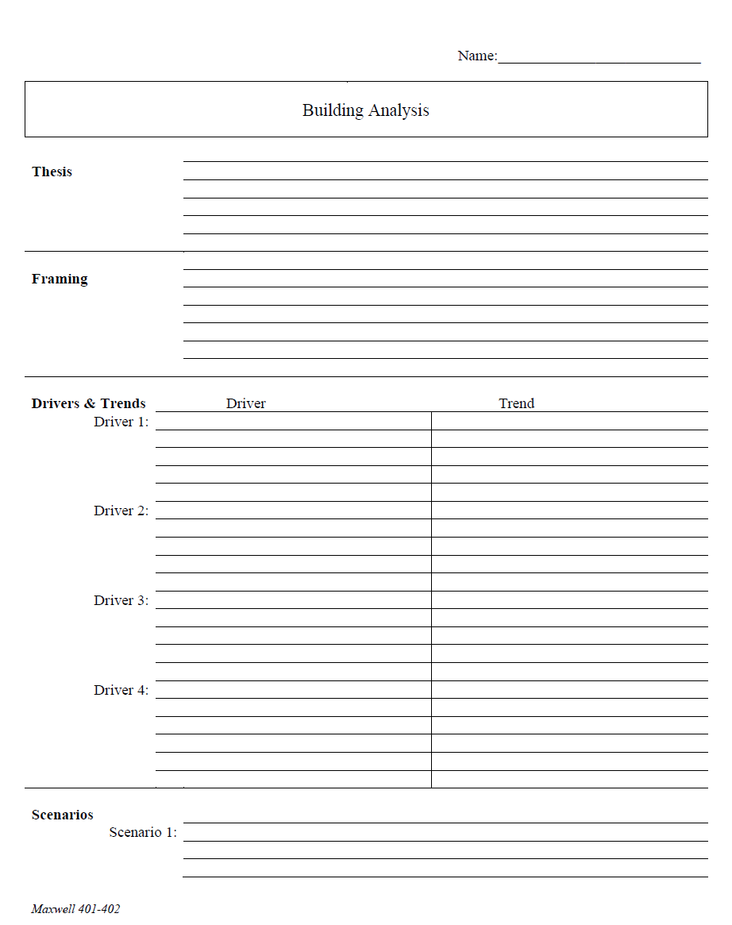
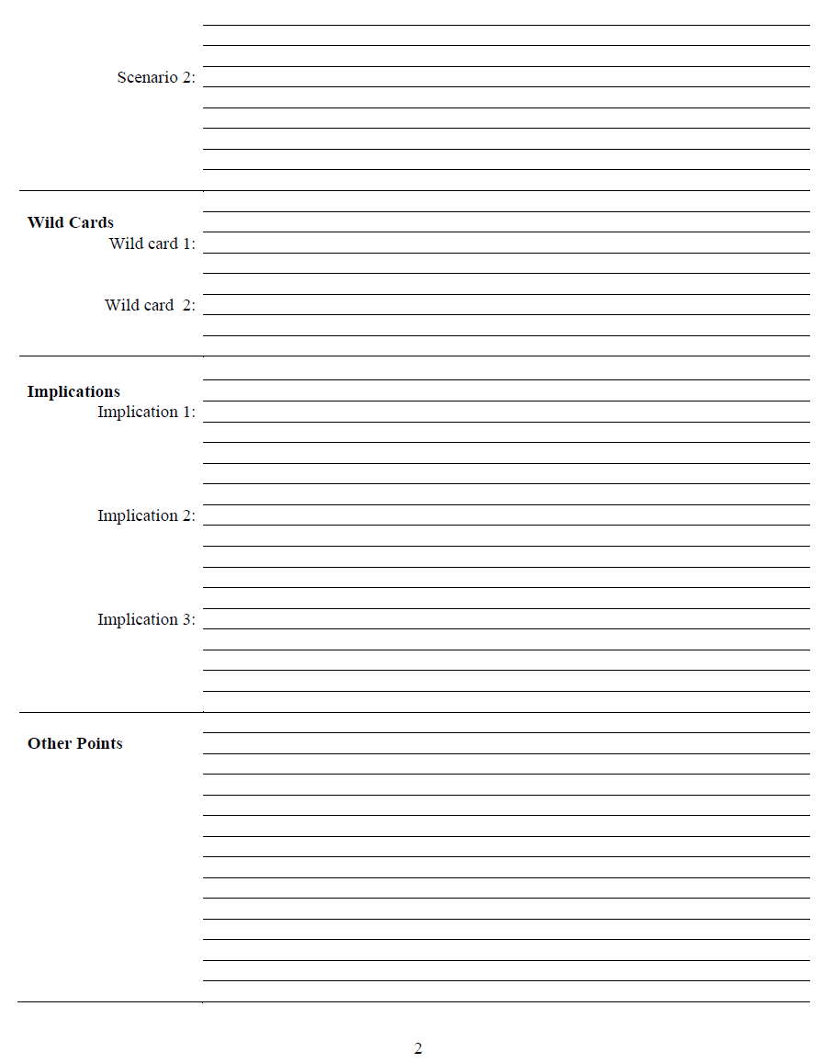
The Analytical Worksheet: One Proven, Effective Way to Build Analysis for Presentation

Slide 43
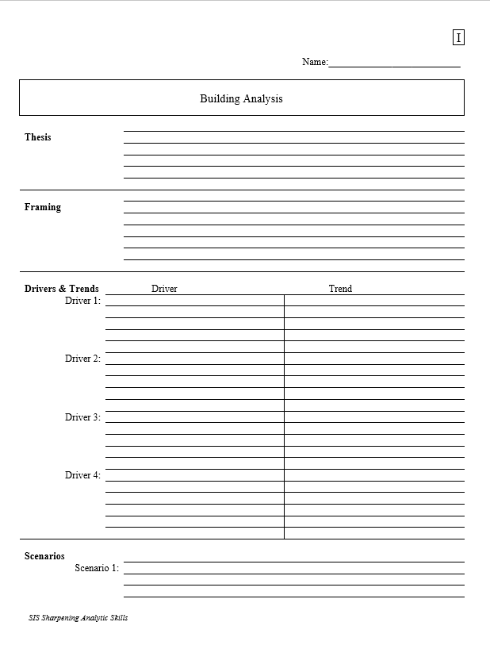
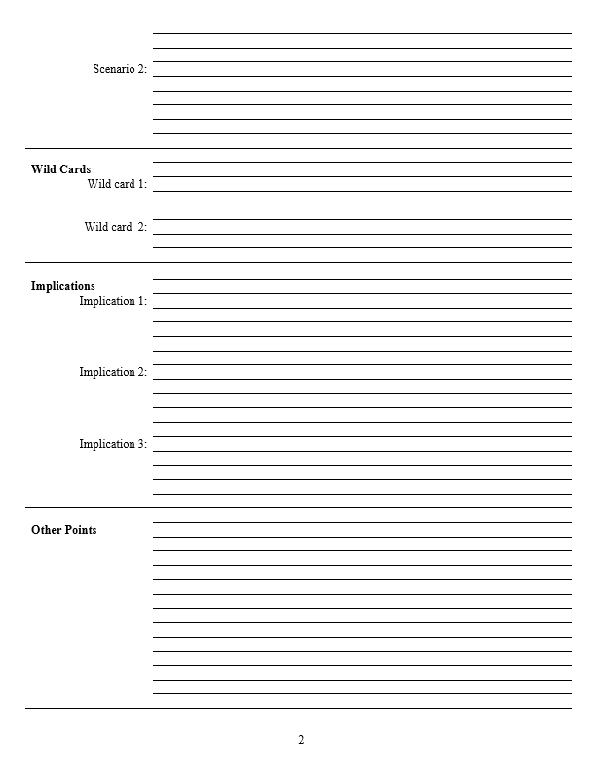
With a thesis sentence at the top, here’s the whole model.
Other Points | Things that don’t fit in rigid structure
 | Give color, texture to analysis
 | Useful in building “narrative” when you write
 | Pet facts, thoughts that you like (and show you care)
Thesis sentence(s): Main conclusion.
“Bottom Line Up Front.”
Short, concise summary – including as many elements as needed to tell the whole story.
Framing: The information your decisionmaker needs to get into the story.
Basics
Not “research or encylopedia”

Slide 44
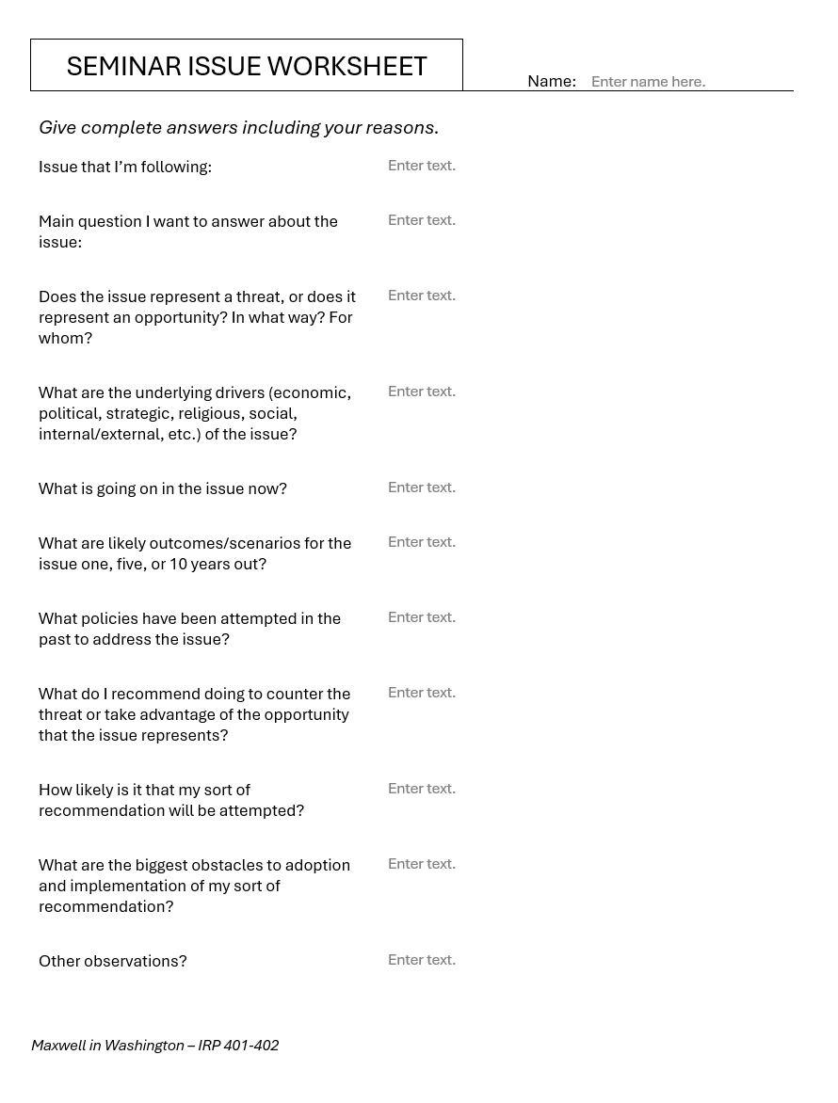
Alternative
Should be two or three pages of text.

Slide 45
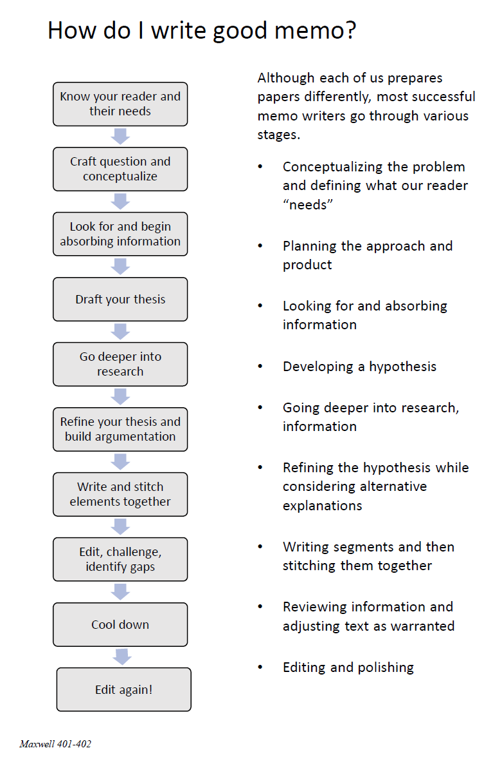
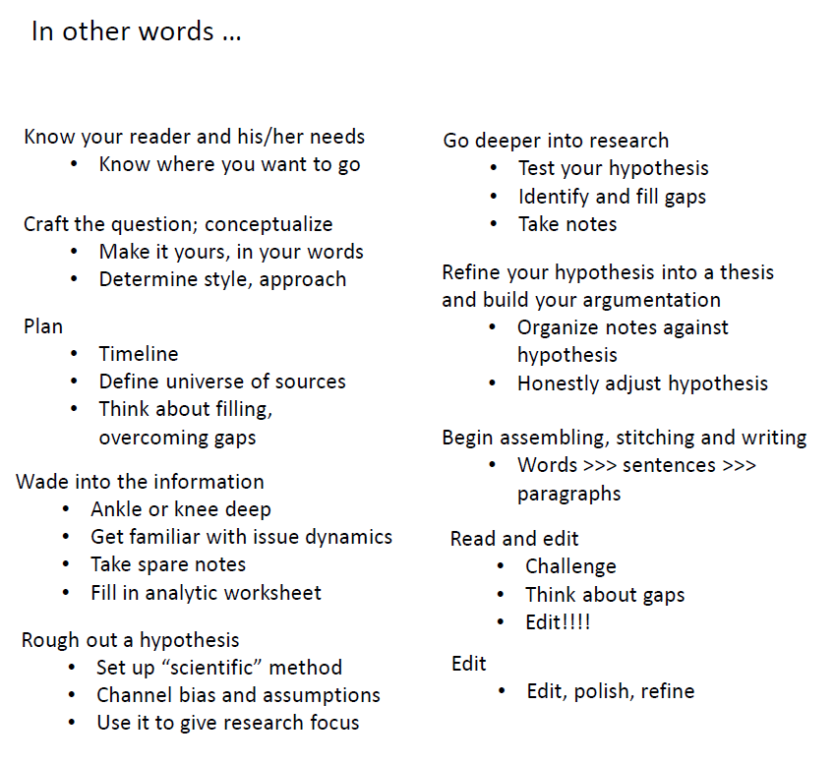
The overall process

Slide 46
DISCUSSION
Comfortable?
Topics
How partnership will work
The purposes
Substance, process, skills
The elements
All OK?
PREPARING AND PLANNING?
401
Analysis
“Memo #2”
402
Proposal
Hearing/event
Public opinion
Interviews
DC memo
Briefing

Slide 47
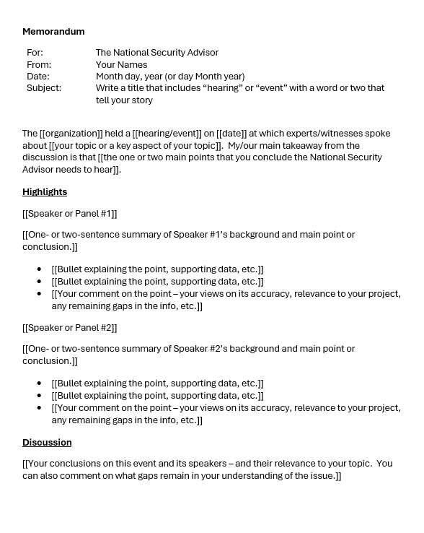
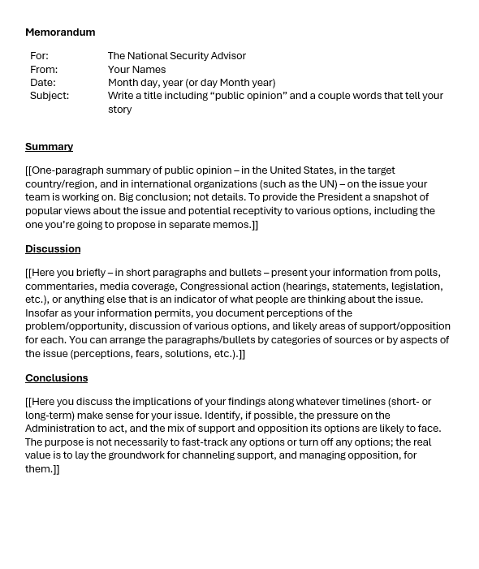
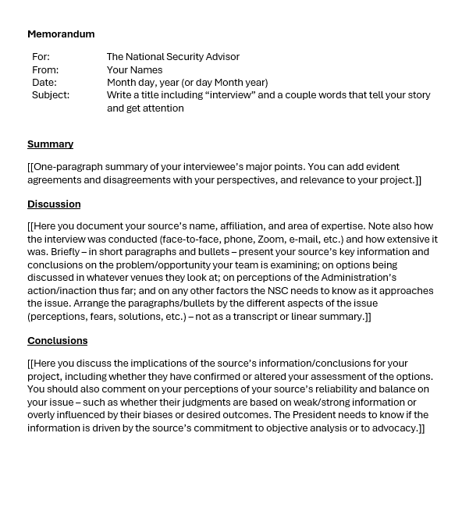
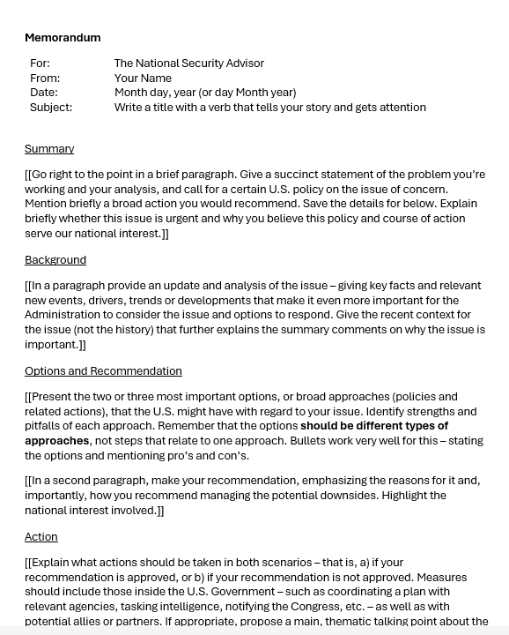
The Templates
402
401

Slide 48

QUESTIONS ?

Slide 49
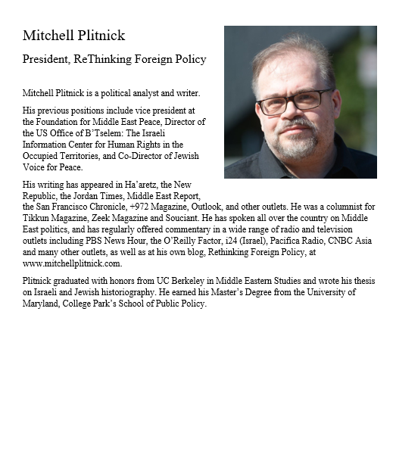
GUEST SPEAKER
Mitchell Plitnick
President, Re-Thinking Foreign Policy
- Introduced by Molisa

Slide 50
DISCUSSION

Slide 51
DISCUSSION
I asked: What questions have you developed?
Now I ask:
What do you make of the answers?
What do you think the future holds?
What is U.S. policy, and what should be?
What lessons should learn from this?

Slide 52
REVIEW
DISCUSSION
Other aspects …
Gaza
West Bank
Syria
Iran
Netanyahu’s political problems
The USA

Slide 53
TODAY’S AGENDA
9:00 | Class Discussion – Readings, current events updates, and meeting preps
10:00 | Go downstairs
10:10 | Depart by Uber for Embassy of Israel
10:30 | Minister Counselor (TBD) Embassy of Israel
~12:00 | Metro back to SUDC and lunch
1:30 | Class Discussion – Project Updates
2:00 | Mitchell Plitnick President, ReThinking Foreign Policy - introduced by Molisa
~3:30 | Wrapup
Ms. Efrat Hochstetler (Counselor for Public Diplomacy)
Ms. Ayala Singer (Academic Outreach)

Slide 54
Global Policy Seminar and NSC Simulation
IRP 401 - IRP 402
Week Six 20 February 2026
Prof. Fulton T. Armstrong

Slide 55

LUNCH

Slide 56

WRAPUP

