Slide 1

Global Policy Seminar and NSC Simulation
IRP 401 - IRP 402
Week Seven
10 October 2025
Prof. Fulton T. Armstrong

Slide 2
Week 1 (29 Aug)
Week 2 (5 Sep)
Week 3 (12 Sep)
Week 4 (19 Sep)
Week 5 (26 Sep)
Week 6 (3 Oct)
Week 7 (10 Oct)
Week 8 (17 Oct)
Week 9 (24 Oct)
Week 10 (31 Oct )
Week 11 (7 Nov)
Week 12 (14 Nov)
Week 13 (21 Nov)
Thanksgiving Break
Week 14 (5 Dec)
Fall 2025

Slide 3
TODAY’S AGENDA
9:00 | Class Discussion - Readings, quiz - Meeting review and preps
10:15 | Metro to Capitol South Station - Quick familiarization walking tour of Hill
11:00 | Brian Duckworth - Legislative Director, Rep. John Mannion (NY-22) 1516 Longworth House Office Building - Introduced by Sarina
~12:15 | Lunch
1:00 | Miranda Peterson Policy Advisor, Energy and Commerce Committee 2107 Rayburn House Office Building - Introduced by Esme
~2:15 | Wrapup

Slide 4
TODAY’S AGENDA
9:00 | Class Discussion - Readings, quiz - Meeting review and preps
10:15 | Metro to Capitol South Station - Quick familiarization walking tour of Hill
11:00 | Brian Duckworth - Legislative Director, Rep. John Mannion (NY-22) 1516 Longworth House Office Building - Introduced by Sarina
~12:15 | Lunch
1:00 | Miranda Peterson Policy Advisor, Energy and Commerce Committee 2107 Rayburn House Office Building - Introduced by Esme
~2:15 | Wrapup

Slide 5
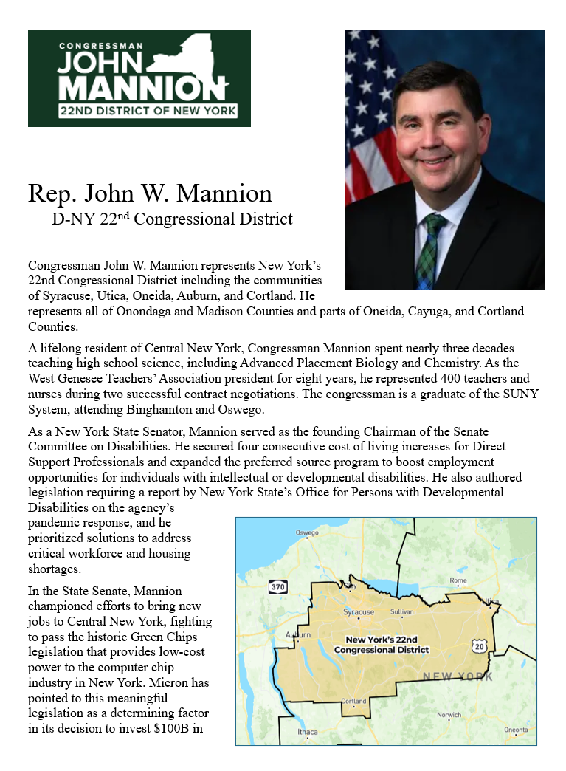
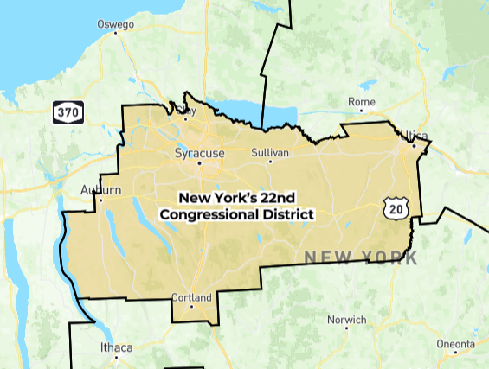
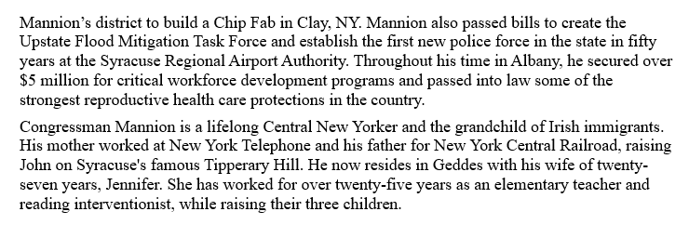
Rep. John Mannion
  Lifelong central NY
  Syracuse Tipperary Hill
  SUNY graduate
  H.S. science teacher
  NY State Senate
  Elected November ‘24

Slide 6
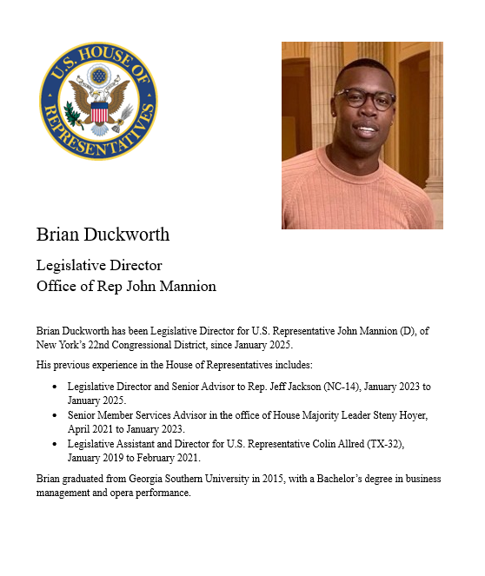
GUEST SPEAKER
Brian Duckworth
Legislative Director
Representative John Mannion
NY-22
- Introduced by Sarina

Slide 7
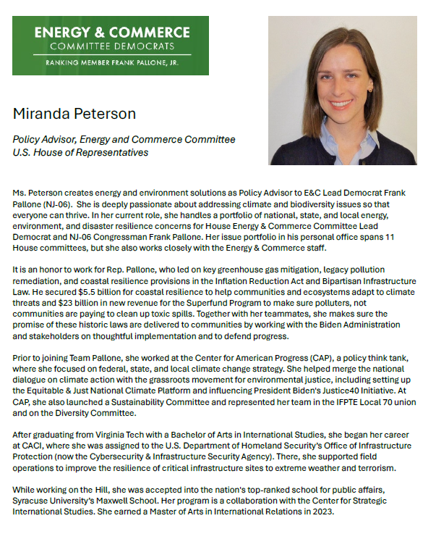
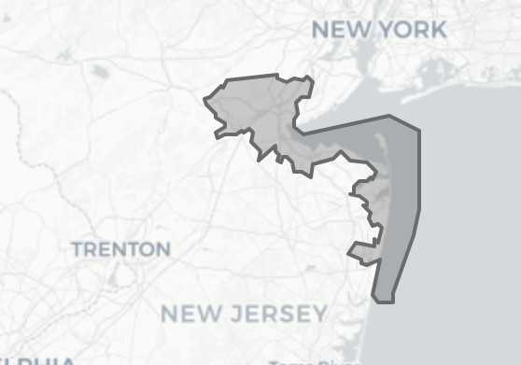
GUEST SPEAKER
Miranda Peterson
Policy Advisor, Energy and Commerce Committee
(Rep Frank Pallone NJ-06)
- Introduced by Esme

Slide 8

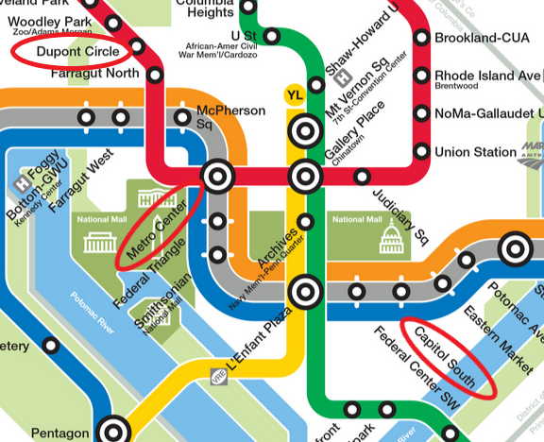
Metro to U.S. Capitol
(House side)
RED LINE (→Glenmont)
from Dupont Circle to Metro Center
then
ORANGE (→New Carrollton) or
BLUE (→ Largo) or SILVER (→ Largo)
from Metro Center to Capitol South

Slide 9
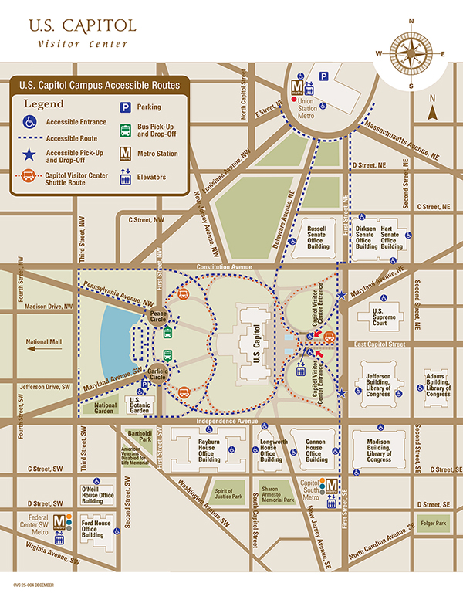


Slide 11
Lunch and Metro

Slide 12
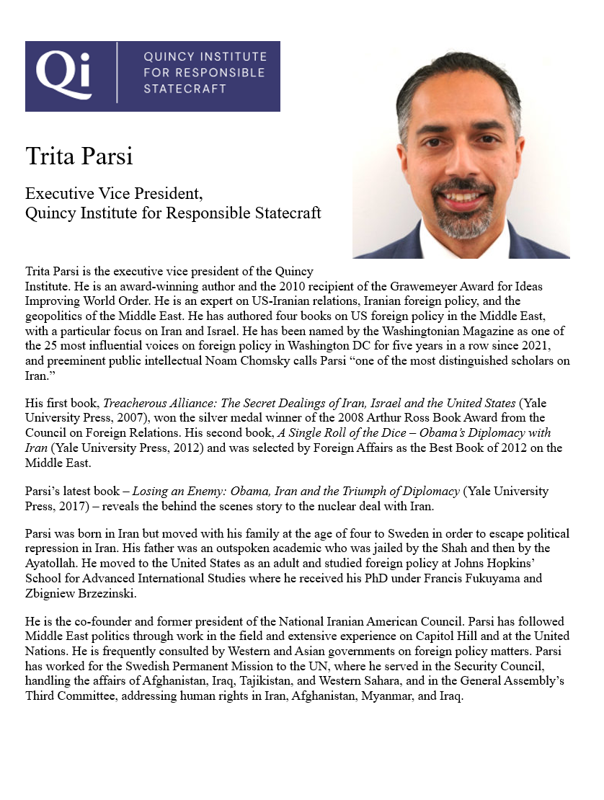
GUEST SPEAKER
Trita Parsi
Executive Vice President
Quincy Institute for Responsible Statecraft
- Introduced by Syarra

Slide 13
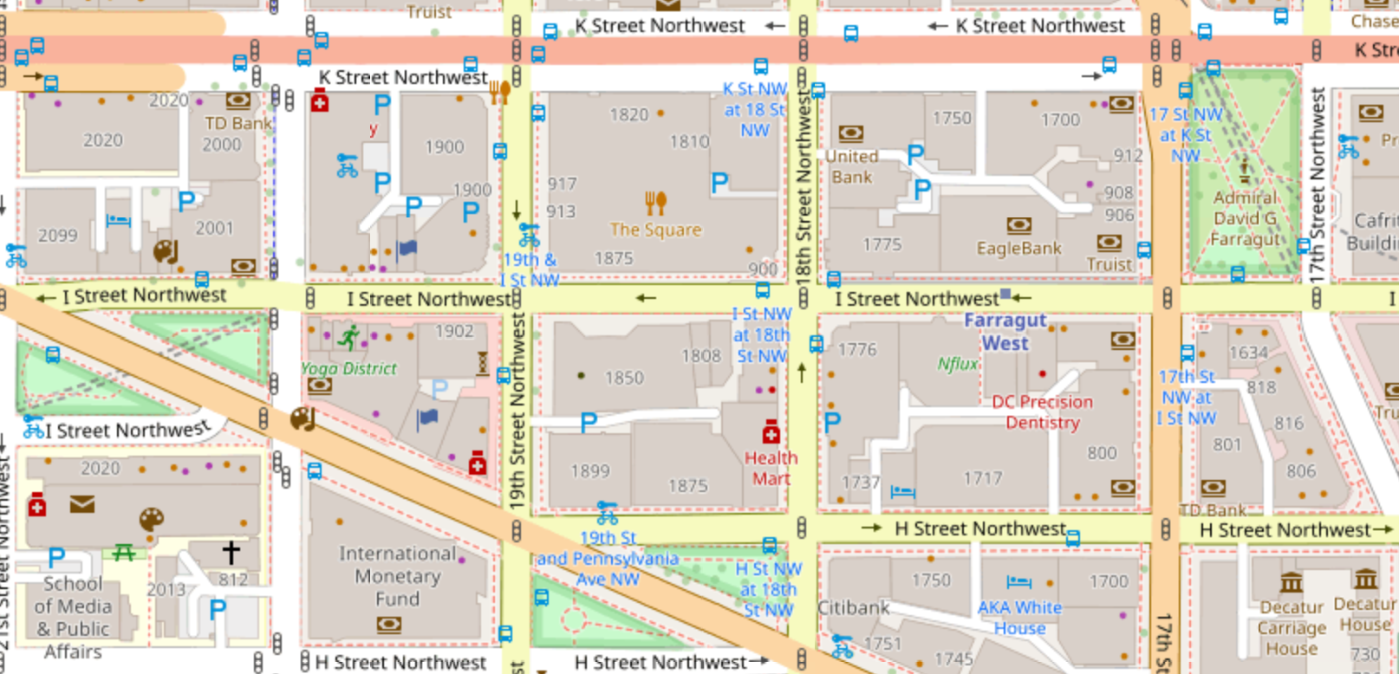

2oth Street Northwest
FARRAGUT WEST station
2000 Penn Ave

Slide 14
2oth Street Northwest
FARRAGUT WEST station
2000 Penn Ave

Slide 15
ETIQUETTE or PROTOCOL
In ANY meeting … if guest/speaker is repeating self, consider …
  Using body language to signal “message received”
  Depending on your style, interrupting gently with a brief …
    “thanks” or “I understand” or “I see”
    paraphrasing
    segue to colleague’s question/point
    ask if you can ask followup
UNDERSTAND this: some people feel obligated to fill the time.

Slide 16
QUIZ

Slide 17
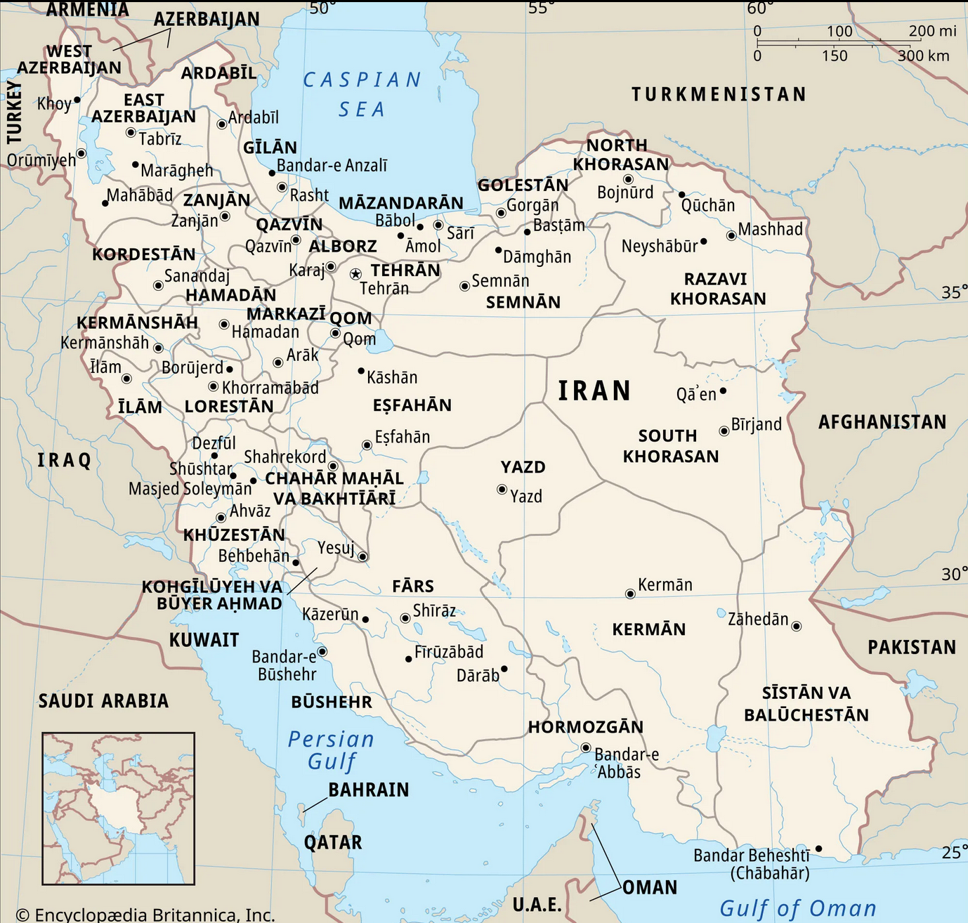
IRAN
Key things to know

Slide 18
IRAN
Key things to know
JCPOA
Iran-Israel
Terrorism
Internal
Syarra - Alex

Slide 19
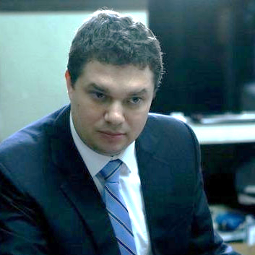
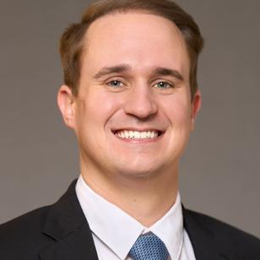
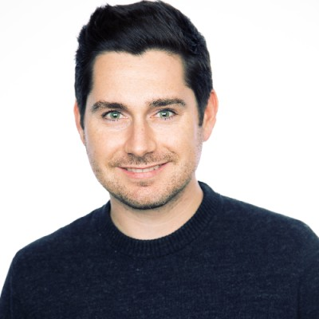
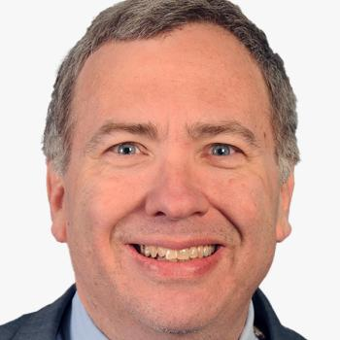
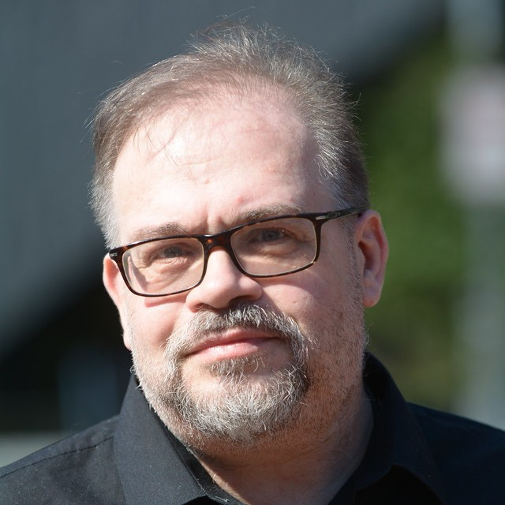
OBSERVATIONS from last week ?
Yoav KATZ
Hunter STOLL
D.J. SHEA
David MAKOVSKY
Mitchell PLITNICK

Slide 20
OBSERVATIONS from last week ?
Yoav KATZ
Hunter STOLL
D.J. SHEA

Slide 21

孙子
Sun Tzu
知己知彼，百战不殆。
Zhījǐzhībǐ, bǎizhànbúdài
The Art of War
Know yourself as you know your enemy, and you will win all battles.

Slide 22
Role of Congress in foreign policy
    What is it?
    House vs. Senate?
    Who are the actors?
What do the readings tell you?

Slide 23
THE LEGISLATIVE PROCESS
LAW
The basics that we all learn in school
Sent to President
Passes other body
Sent to other body
Pass House/Senate
Put on calendar
Lots of factors/voices along the way,
such as …??
Sent to full House/Senate
Referral to Committees
Bill drafted

Slide 24
THE LEGISLATIVE PROCESS
LAW
IS IT A PERFECT PROCESS?
“No one pretends that democracy is perfect or all-wise. Indeed it has been said that democracy is the worst form of Government except for all those other forms that have been tried from time to time.…”
-- Winston S Churchill, 11 November 1947
The basics that we all learn in school
Sent to President
Passes other body
Sent to other body
Pass House/Senate
Put on calendar
Sent to full House/Senate
Referral to Committees
Bill drafted

Slide 25
THE LEGISLATIVE PROCESS
LAW
The basics that we all learn in school
Sent to President
LOOKING AT BROADER PROCESS …
What drives policy and its processes in broader government context?
Passes other body
Sent to other body
Pass House/Senate
Put on calendar
Sent to full House/Senate
Referral to Committees
Bill drafted

Slide 26
THE POLICY PROCESS
The policy process
    How does a government make a “policy”?
    What are the inputs?
    Who are the actors?
The legislative inputs
    What are they? House vs. Senate?
    Who are the actors?

Slide 27
Problem - Opportunity
Info - Analysis
Options
Discussion or Debate
Decision
Execution –
Implementation
THE POLICY PROCESS
In simplest form …
In reality …
Many internal and external voices
Many implicit and explicit influences
Many stages
Sometimes “hidden hands”
WHAT ARE THEY?

Slide 28
Role of Congress in foreign policy
    What is it?
    House vs. Senate?
    Who are the actors?

Slide 29
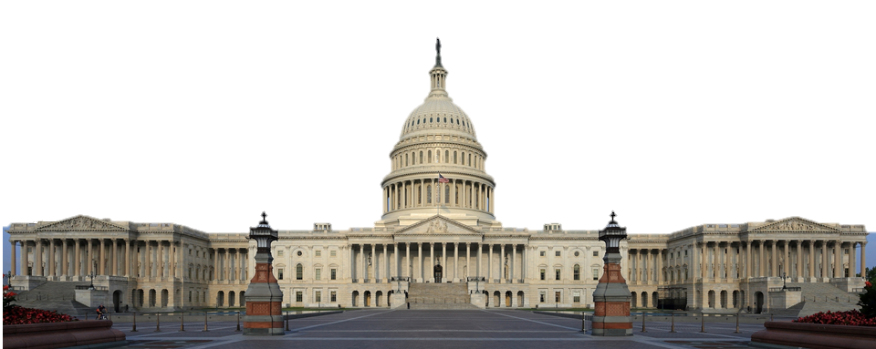
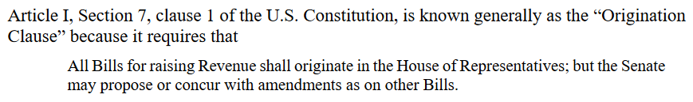
Role of Congress in Foreign Policy
General …
Fund government – civilian and military
Regulation of foreign commerce
Declare war
Oversight
Stimulate debate and drive public opinion
Specific powers of House
Specific powers of Senate
Confirmations (“advice and consent”; simple majority)
Treaties (with 2/3 of members)
Originate all spending
Impeach federal officials

Slide 30
What’s the War Powers Resolution?
Why did Congress legislate it?
How well has it worked?

Slide 31
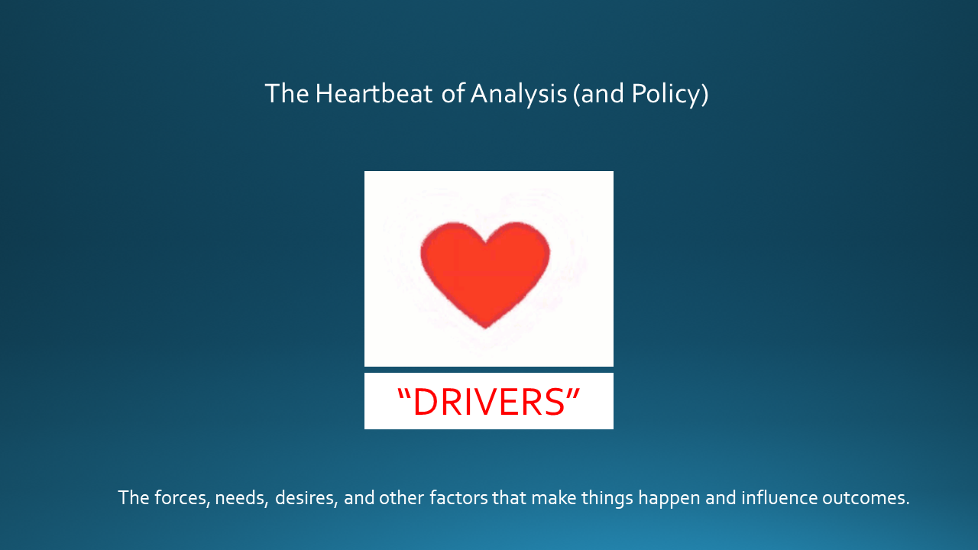
Does the system work?
Does policy usually reflect the best possible option?
Does policy appear driven by analysis of “the problem”?
How can the process – or results – be improved?

Slide 32
Are there parts of the policy process
in which you are interested?

Slide 33

WRAPUP

Slide 34
PROJECT PLANNING
Maisie | Microplastics | U.S. Declining Birth Rates
Skye | Ending the war in Sudan
Esme | Immigration and Balancing Interests | U.S. Culture Wars
Camille | Microplastics and PFAS
Erik | Ukraine Innovative Use of Drones | Israeli Use of Lavender AI in Targeting
Richard | Enhancing Cybersecurity
Alex | China’s Increasing Military Strength | Iranian Nationalism
Syarra | Russian Influence in Eastern Europe
Maeve | Israeli Use of AI in Military Strikes in Gaza | U.S. Declining Birth Rates
Kiana | Impact of Federal Spending … or inflation
Mo | Aid to Gaza | Impact of U.S.-China Tariffs
Bobby | U.S. Health Care: High Cost of Prescription Drugs
Gabby | U.S. Culture Wars and How Policy Fuels them | U.S.-Israel Relations After Netanyahu
Katelyn | Russia-Ukraine Negotiations
Sarina | Foreign Disinformation Targets U.S. Elections | Crisis of Legal Immigration Pathways in the U.S.
Priya | China’s Advances in Renewable Energy and EVs
Looking at others’ topics, what are you interested in learning about from them? What analysis and policy?
(Give them guidance.)

Slide 35
DISCUSSION
Comfortable?
  Topics
  How partnership will work
The purposes
  Substance, process, skills
The elements
All OK?
PREPARING AND PLANNING?
401
  Analysis
  “Memo #2”
402
  Proposal
  Hearing/event
  Public opinion
  Interviews
  DC memo
  Briefing

Slide 36
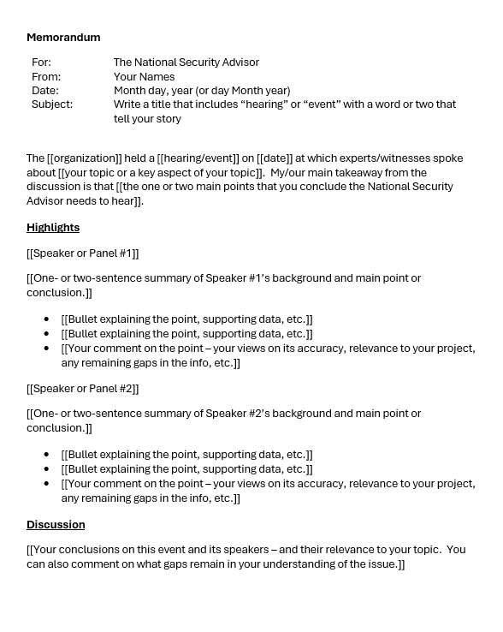
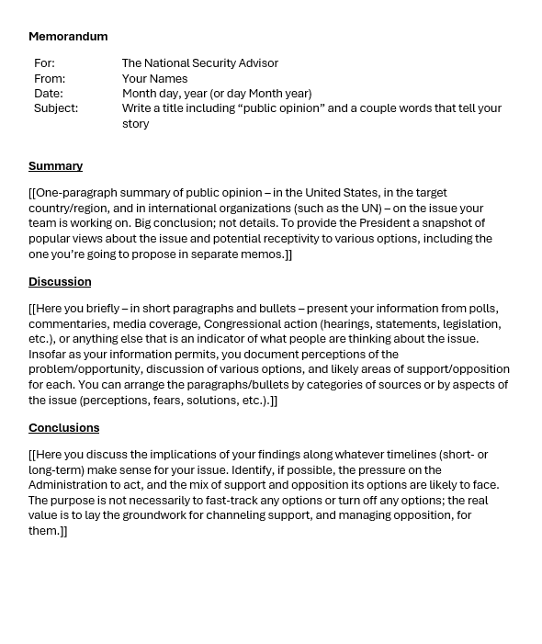
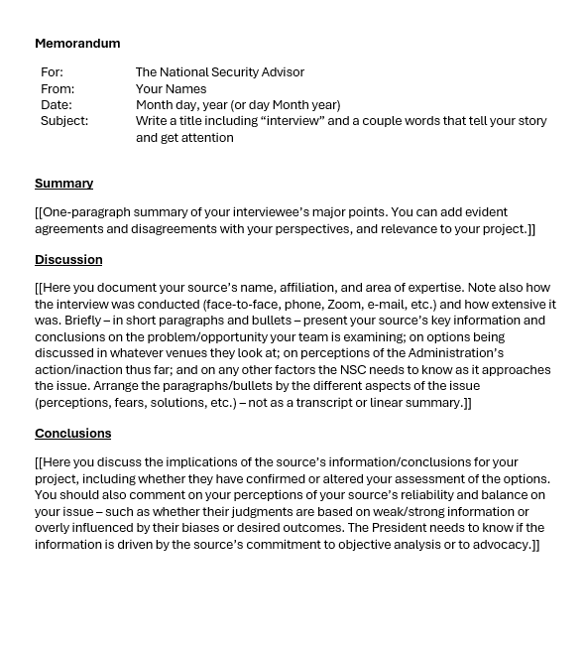
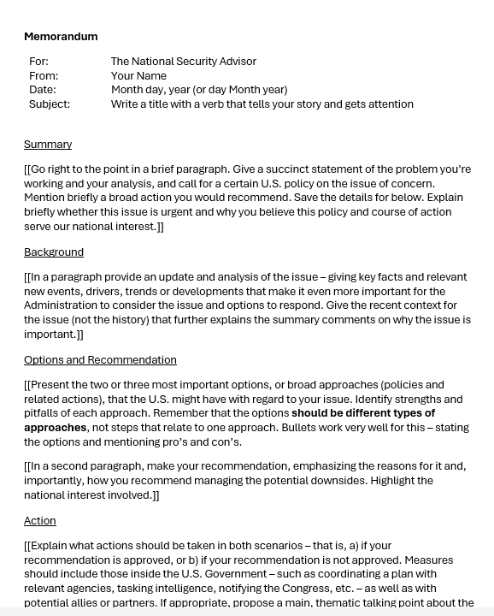
The Templates
402
401

Slide 37
NEXT WEEK

Slide 38
Anything else?

Slide 39
Global Policy Seminar and NSC Simulation
IRP 401 - IRP 402
Week Seven
10 October 2025
Prof. Fulton T. Armstrong

