Slide 1
Global Policy Seminar and NSC Simulation
IRP 401 - IRP 402
Week Seven 1 March 2024
Prof. Fulton T. Armstrong

Slide 2
Week 1 (19 Jan)
Week 2 (26 Jan)
Week 3 (2 Feb)
Week 4 (9 Feb)
Week 5 (16 Feb)
Week 6 (23 Feb)
Week 7 (1 Mar)
Week 8 (8 Mar)
BREAK
Week 9 (22 Mar)
Week 10 (29 Mar)
Week 11 (5 Apr)
Week 12 (12 Apr)
Week 13 (19 Apr)
Week 14 (26 Apr)
SPRING 2024

Slide 3
Washington dialect
“Please submit it in the appropriate format.”

Slide 4
TODAY’S AGENDA
9:15 | Meet at Capitol South Metro
9:30 | Prof. Chris Casey Quick walking tour of Library of Congress
10:15 | Representative Brandon Williams Republican – 22nd District, NY - introduced by Gavin
after | Staff Tour
1:30 | Class Discussion - Readings on Role of Congress - Project Updates
2:30 | Professional Development: Imposter Syndrome - Prof. Andrew London and Fulton
3:15 | Wrapup

Slide 5
TODAY’S AGENDA
9:15 | Meet at Capitol South Metro
9:30 | Prof. Chris Casey Quick walking tour of Library of Congress
10:15 | Representative Brandon Williams Republican – 22nd District, NY - introduced by Gavin
after | Staff Tour
1:30 | Class Discussion - Readings on Role of Congress - Project Updates
2:30 | Professional Development: Imposter Syndrome - Prof. Andrew London and Fulton
3:15 | Wrapup

Slide 6
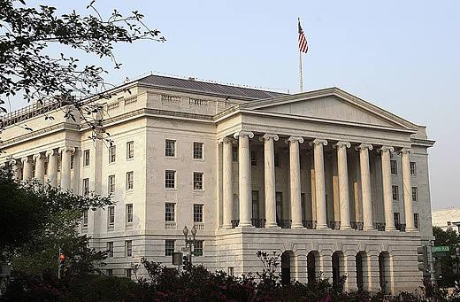
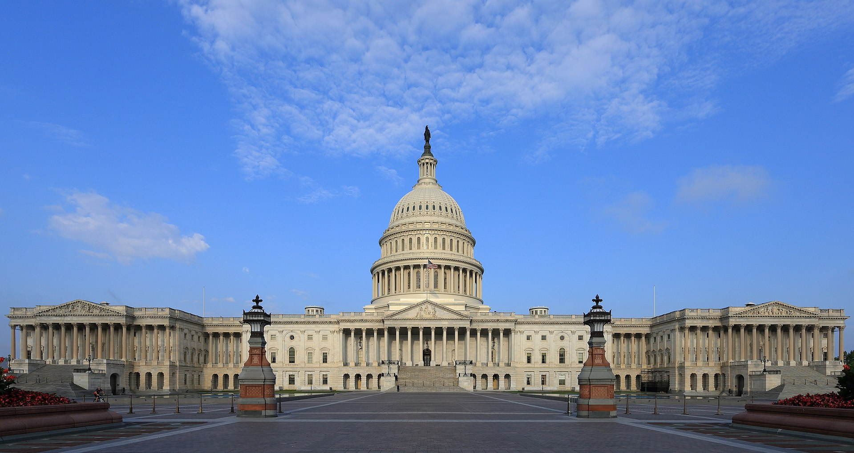
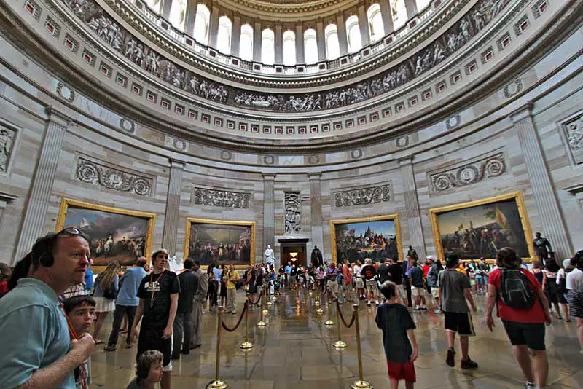
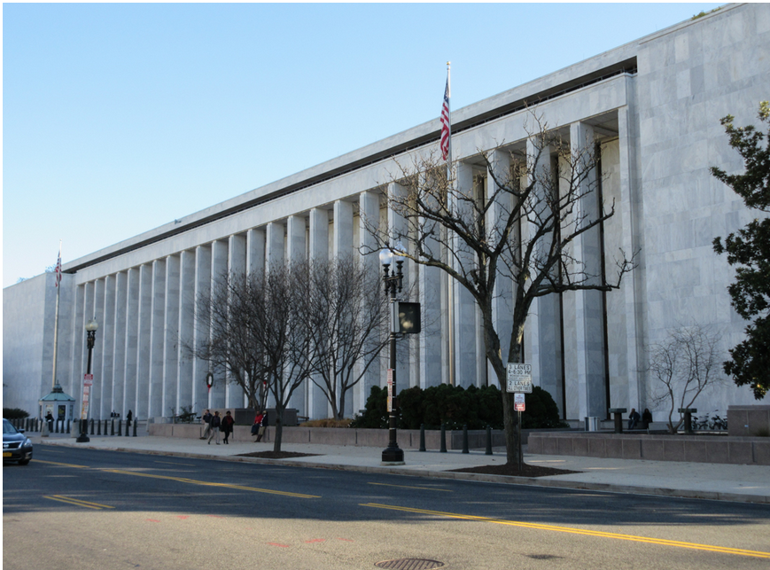
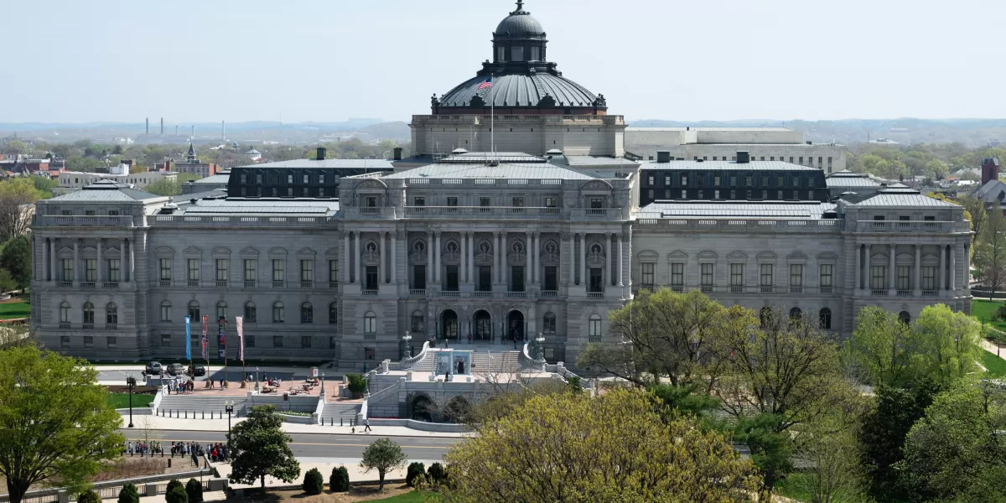
Offsite Visit

Slide 7
Joe Guy
Chief of Staff
Michael Inguanta
Legislative Director
Bradyn Lawrence
Legislative Correspondent
Rachel Lent
Executive Assistant
House Telephone Directory (Feb 2024)

Slide 8
Impressions?

Slide 9
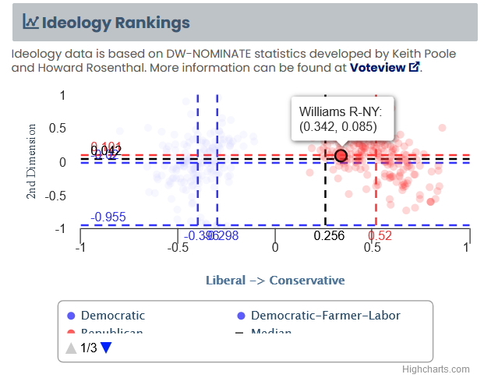

Slide 10
Role of Congress in foreign policy
What is it?
House vs. Senate?
Who are the actors?
What do the readings tell you?

Slide 11
THE LEGISLATIVE PROCESS
LAW
The basics that we all learn in school
Sent to President
Passes other body
Sent to other body
Pass House/Senate
Put on calendar
Lots of factors/voices along the way, such as …??
Sent to full House/Senate
Referral to Committees
Bill drafted

Slide 12
THE LEGISLATIVE PROCESS
LAW
IS IT A PERFECT PROCESS?
“No one pretends that democracy is perfect or all-wise. Indeed it has been said that democracy is the worst form of Government except for all those other forms that have been tried from time to time.…”
-- Winston S Churchill, 11 November 1947
The basics that we all learn in school
Sent to President
Passes other body
Sent to other body
Pass House/Senate
Put on calendar
Sent to full House/Senate
Referral to Committees
Bill drafted

Slide 13
THE LEGISLATIVE PROCESS
LAW
The basics that we all learn in school
Sent to President
LOOKING AT BROADER PROCESS …
What drives policy and its processes in broader government context?
Passes other body
Sent to other body
Pass House/Senate
Put on calendar
Sent to full House/Senate
Referral to Committees
Bill drafted

Slide 14
THE POLICY PROCESS
The policy process
How does a government make a “policy”?
What are the inputs?
Who are the actors?
The legislative inputs
What are they? House vs. Senate?
Who are the actors?

Slide 15
Problem - Opportunity
Info - Analysis
Options
Discussion or Debate
Decision
Execution – Implementation
THE POLICY PROCESS
In simplest form …
In reality …
Many internal and external voices
Many implicit and explicit influences
Many stages
Sometimes “hidden hands”
WHAT ARE THEY?

Slide 16
Role of Congress in foreign policy
What is it?
House vs. Senate?
Who are the actors?

Slide 17
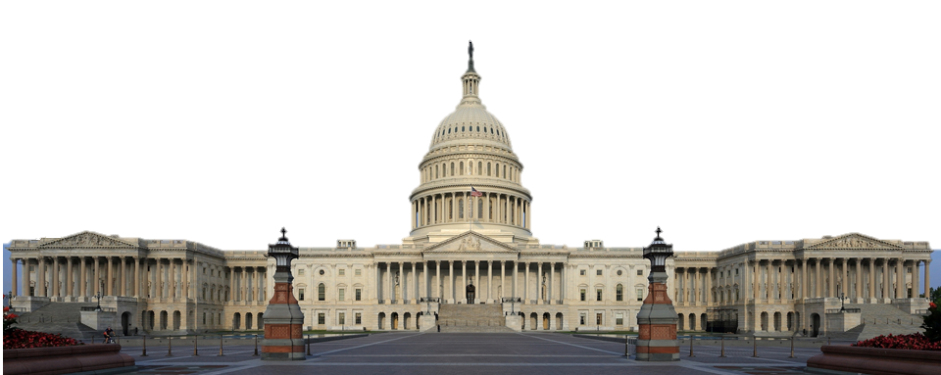
Role of Congress in Foreign Policy
General …
Fund government – civilian and military
Regulation of foreign commerce
Declare war
Oversight
Stimulate debate and drive public opinion
Specific powers of House
Specific powers of Senate
Confirmations (“advice and consent”; simple majority)
Treaties (with 2/3 of members)
Originate all spending
Impeach federal officials

Slide 18
What’s the War Powers Resolution?
Why did Congress legislate it?
How well has it worked?

Slide 19
Does the system work?
Does policy usually reflect the best possible option?
Does policy appear driven by analysis of “the problem”?
How can the process – or results – be improved?

Slide 20
In which part of the processes that we’ve discussed are you most interested?

Slide 21
Project Updates

Slide 22
Project Planning
Akosua | U.S.-Russia: How constrain Putin? | Ensuring microchip competition and supply
Nicolas | U.S.-North Korea: How constrain Kim?
Marcus | U.S.-Vietnam tech/innovation ties | U.S. education deficits
Mimi | Youth homelessness
Vaughn | Central America migration | Israel-Palestine: Two-state solution possible?
Matt | Crisis in Haiti
Gavin | Impact of COVID on mental health | U.S. policy toward Yemen and the Houthis
Noah | Reducing reliance on China trade
Meghan | Russia/Wagner influence in Africa | Impact of climate change on insurgency
Bryce | Improving gun control background checks
Emily | Russia WMD in wake of Ukraine war | How to deal with climate migrants/refugees
Tashakee | Negative impact of cobalt mining in DRC
Reese | South America climate migration | “War time policy”
Emma | U.S.-Mexico border deaths
Ding | Calming tensions on Korean peninsula | U.S. border-state challenges from immigration
Abby | Human trafficking | U.S. support to Ukraine defense against Russia
Jessica | Stopping the flow of fentanyl into U.S.

Slide 23
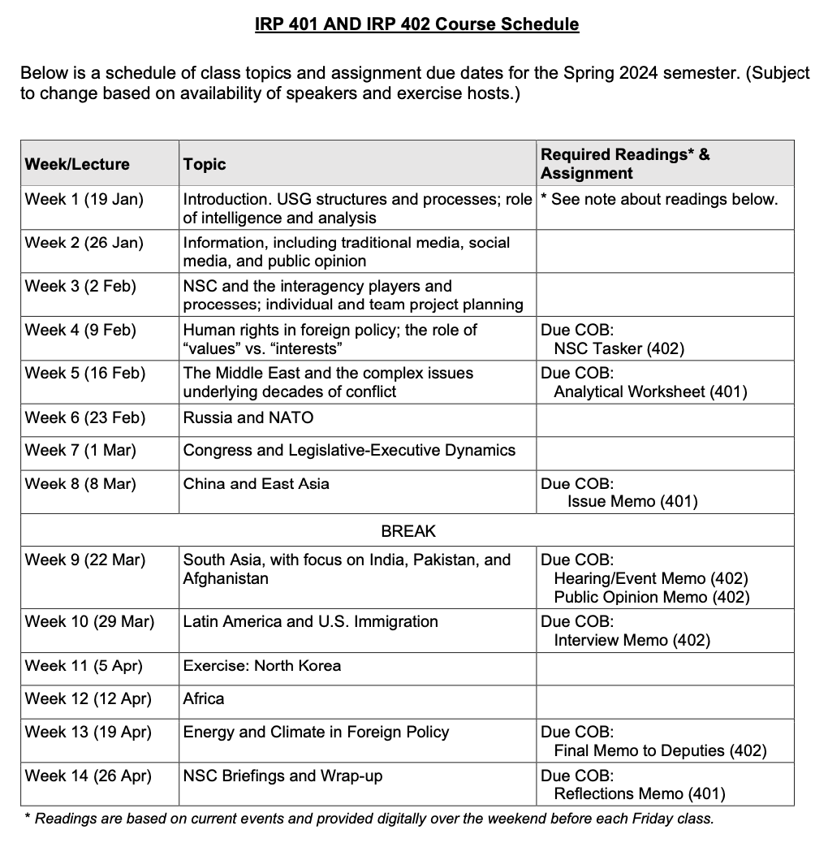
✓
401
402
✓
✓
Confirm: Everyone has a plan?
✓
✓
QUESTIONS?
✓
✓

Slide 24
Are you running into any difficulties?
- Finding information
- Doing analysis
- Developing 0ptions
- Formulating a recommendation
Do you remember the elements of a memo?
Are the templates working for you?

Slide 26
Encryption
Securely sending information
“One-time pad”
Book code or book cipher
Encryption machines
Computer encryption

Slide 27
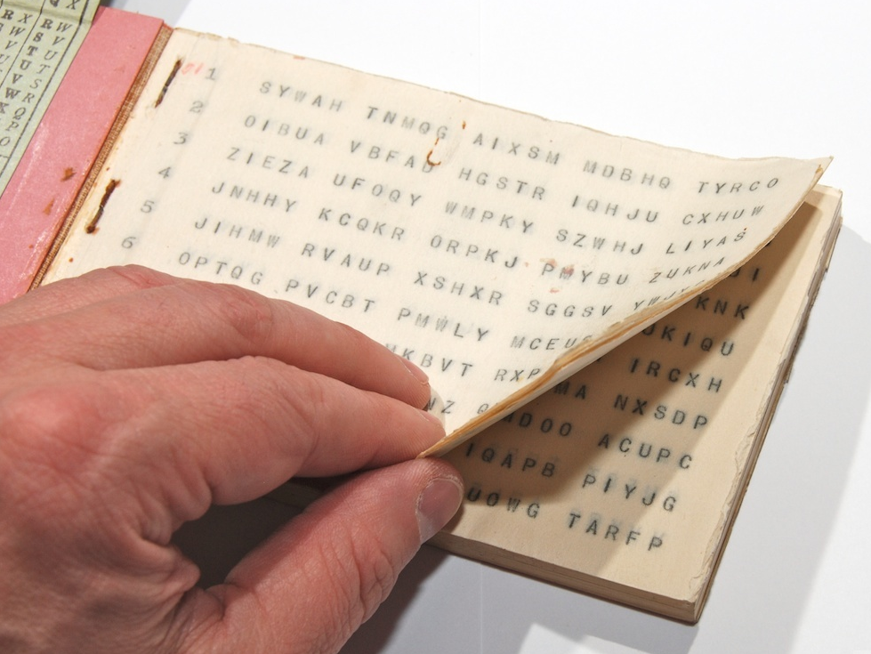
“One-time pad”
keys
A series of groups of letters
Two identical copies
Used agreed-upon day/time
Extremely secure (if pad is secure)
Notes:
NOTE FIVE GROUPS OF FIVE LETTERS – because A=0

Slide 28
“One-time pad”
keys
A series of groups of letters
Two identical copies
Used agreed-upon day/time
Extremely secure (if pad is secure)
AN EXAMPLE … Let’s say …
First key is SBMHR
Your requirement is: What is the enemy having for lunch?
Notes:
NOTE FIVE GROUPS OF FIVE LETTERS – because A=0

Slide 29
Key begins with: SBMHR
Message you want to send: PIZZA
Message: | P |  | I |  | Z |  | Z |  | A
Values: | 14 |  | 8 |  | 25 |  | 25 |  | 0
Key: | S |  | B |  | M |  | H |  | R
Values: | 17 |  | 1 |  | 12 |  | 7 |  | 16
Sum: | 5 |  | 9 |  | 11 |  | 6 |  | 16
Ciphertext: | F |  | J |  | L |  | G |  | R

Slide 30
Key begins with: SBMHR
Message you want to send: PIZZA
Message: | P |  | I |  | Z |  | Z |  | A
Values: | 14 |  | 8 |  | 25 |  | 25 |  | 0
Key: | S |  | B |  | M |  | H |  | R
Values: | 17 |  | 1 |  | 12 |  | 7 |  | 16
Sum: | 5 |  | 9 |  | 11 |  | 6 |  | 16
Ciphertext: | F |  | J |  | L |  | G |  | R
Notes:
Once again!!!

Slide 31
MSG from HQS:
What is the enemy going to eat for lunch?
Your encoded REPLY:
F J L G R
On subsequent mentions of PIZZA, you will not repeat F J L G R, because you’ll use a different key from the OTP.

Slide 32
“Book Code”
Two identical copies of a book
Commercially available; doesn’t look like a codebook
Flexible date/time
Caution: Vocabulary has to be appropriate to intelligence information

Slide 33
“Book Code”
page/line/word | 842914
paragraph/word | 1586

Slide 34
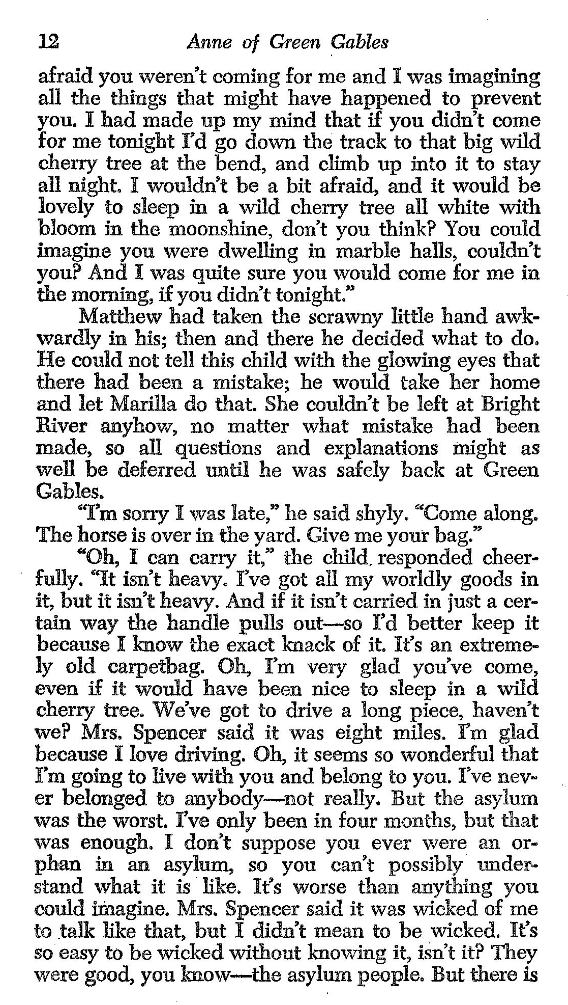
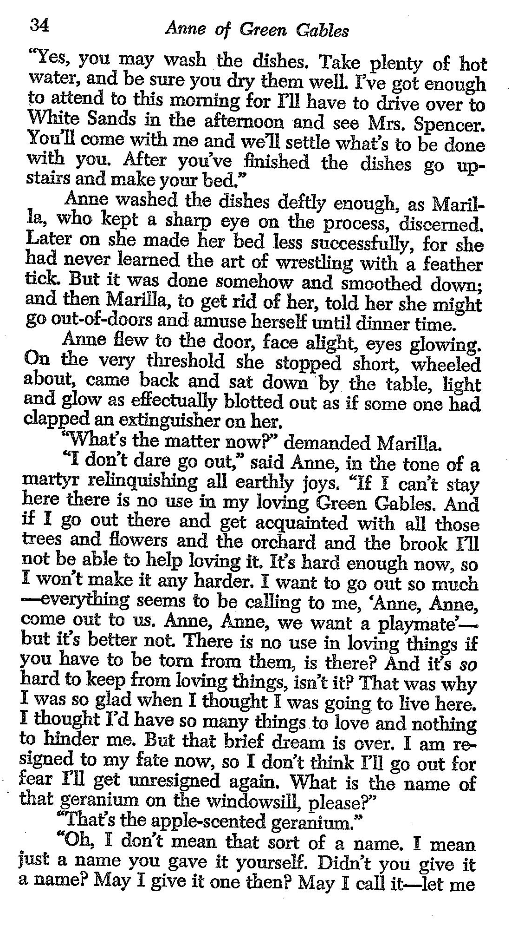
121003
343409
340102
I
LOVE
YOU

Slide 35
REMINDER
In ANY meeting … if guest/speaker is repeating self, consider …
Using body language to signal “message received”
Depending on your style, interrupting gently with a brief …
“thanks” or “I understand” or “I see”
paraphrasing
segue to colleague’s question/point
ask if you can ask followup
UNDERSTAND this: some people feel obligated to fill the time.

Slide 37
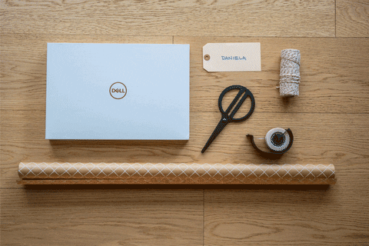
WRAPUP

Slide 38
Next week
China internal
China-U.S.
China-Taiwan
China
Begin INTERNSHIP discussions
Three volunteers to start?
Anything else?

Slide 39
Global Policy Seminar and NSC Simulation
IRP 401 - IRP 402
Week Seven 1 March 2024
Prof. Fulton T. Armstrong

