Slide 1

Global Policy Seminar and NSC Simulation
IRP 401 - IRP 402
Week Eight
17 October 2025
Prof. Fulton T. Armstrong

Slide 2
Week 1 (29 Aug)
Week 2 (5 Sep)
Week 3 (12 Sep)
Week 4 (19 Sep)
Week 5 (26 Sep)
Week 6 (3 Oct)
Week 7 (10 Oct)
Week 8 (17 Oct)
Week 9 (24 Oct)
Week 10 (31 Oct )
Week 11 (7 Nov)
Week 12 (14 Nov)
Week 13 (21 Nov)
Thanksgiving Break
Week 14 (5 Dec)
Fall 2025

Slide 3
TODAY’S AGENDA
9:00 | Class Discussion - China-Taiwan readings and updates - Preps for HSU and TAO meetings - Internship conversations
10:00 | Gervasio HSU - Chief, Political Section, TECRO - Welcome by Maisie
11:30 | Lunch
12:45 | Skills Presentation: The Impostor Syndrome Fulton and Samantha
2:00 | Uber to Embassy of China
2:30 | Counselor TAO Song Chief, Bilateral Affairs, Embassy of China - Welcome by Alex
3:45 | Wrapup and Metro back

Slide 4
TODAY’S AGENDA
9:00 | Class Discussion - China-Taiwan readings and updates - Preps for HSU and TAO meetings - Internship conversations
10:00 | Gervasio HSU - Chief, Political Section, TECRO - Welcome by Maisie
11:30 | Lunch
12:45 | Skills Presentation: The Impostor Syndrome Fulton and Samantha
2:00 | Uber to Embassy of China
2:30 | Counselor TAO Song Chief, Bilateral Affairs, Embassy of China - Welcome by Alex
3:45 | Wrapup and Metro back

Slide 5
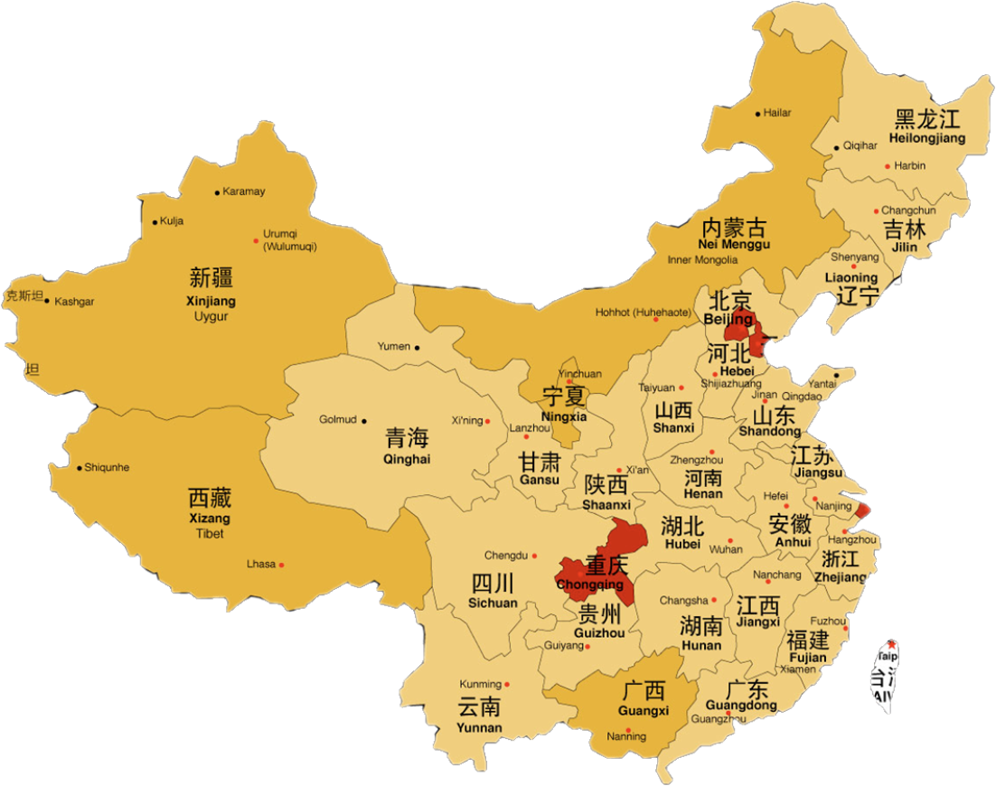
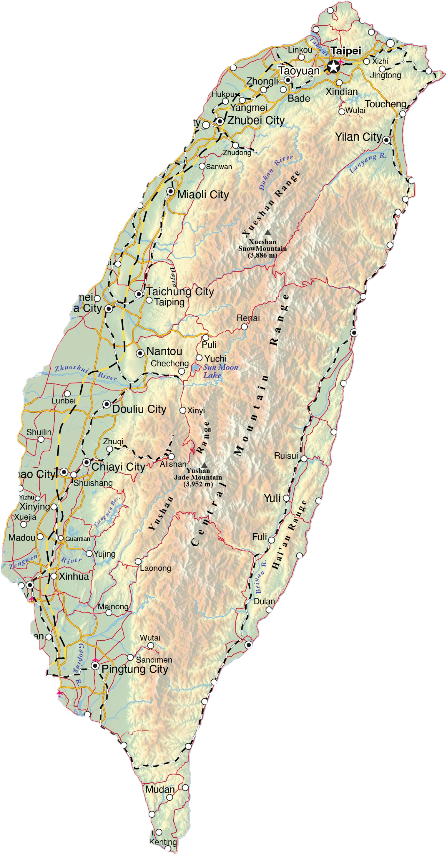
China and Taiwan

Slide 6
REFRESH
Diplomatic elicitation
Remember your objective is to learn and understand, not to judge, persuade, or score points.
Pursue the questions that you want.
Ask questions with sensitivity that you would want if someone were probing you.
Consider this sort of useful devices:
  “I realize it’s sensitive, but I’d like to ask – if I may – what …?”
  “What should we think when we see reports that …?”
  “What is your (or your government’s) perspective on …?”
  “What do ___ people think about …?”
  “What do you see as a solution to ____ problem?”

Slide 7
NON- QUIZ
1. Name of Taiwan’s big semiconductor producer. | 10. Level of highest-level contacts between Ch and Tw
2. Year that U.S. “normalized” relations with China. | 11. Areas of U.S.-China cooperation (2)
3. When “One China” policy started. | 12. Relationship w/ Tw China proposed in late 1990s.
4. Legislation that defines U.S.-Taiwan ties. | 13. Difference between de facto and de jure.
5. Distance from Taiwan to China mainland. | 14. Drug U.S. accuses China of turning blind eye to.
6. Names of the ruling parties in China and Taiwan. | 15. Methods of Chinese pressure on Taiwan (2).
7. Percentage of “Taiwanese” in Taiwan population. | 16. Words dropped from DOS website in January.
8. Term for key U.S. policy on “Taiwan issue” (a). | 17. Names of Chinese and Taiwan presidents.
9. Term for key U.S. policy on “Taiwan issue” (b). | 18. Percentage of tariffs T put on Chinese products.

Slide 8
NON- QUIZ
(Pick a number 1-18.)
1. Name of Taiwan’s big semiconductor producer. | 10. Level of highest-level contacts between Ch and Tw
2. Year that U.S. “normalized” relations with China. | 11. Areas of U.S.-China cooperation (2)
3. When “One China” policy started. | 12. Relationship w/ Tw China proposed in late 1990s.
4. Legislation that defines U.S.-Taiwan ties. | 13. Difference between de facto and de jure.
5. Distance from Taiwan to China mainland. | 14. Drug U.S. accuses China of turning blind eye to.
6. Names of the ruling parties in China and Taiwan. | 15. Methods of Chinese pressure on Taiwan (2).
7. Percentage of “Taiwanese” in Taiwan population. | 16. Words dropped from DOS website in January.
8. Term for key U.S. policy on “Taiwan issue” (a) | 17. Names of Chinese and Taiwan presidents.
9. Term for key U.S. policy on “Taiwan issue” (b) | 18. Percentage of tariffs T put on Chinese products.

Slide 9
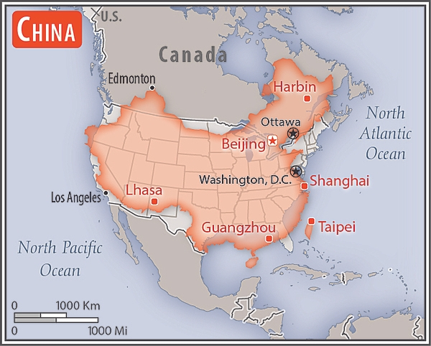

中华人民共和国
中国
9,595,960 sq km
Slightly smaller than the United States (9,984,670 sq km).
People’s Republic of China

Slide 10
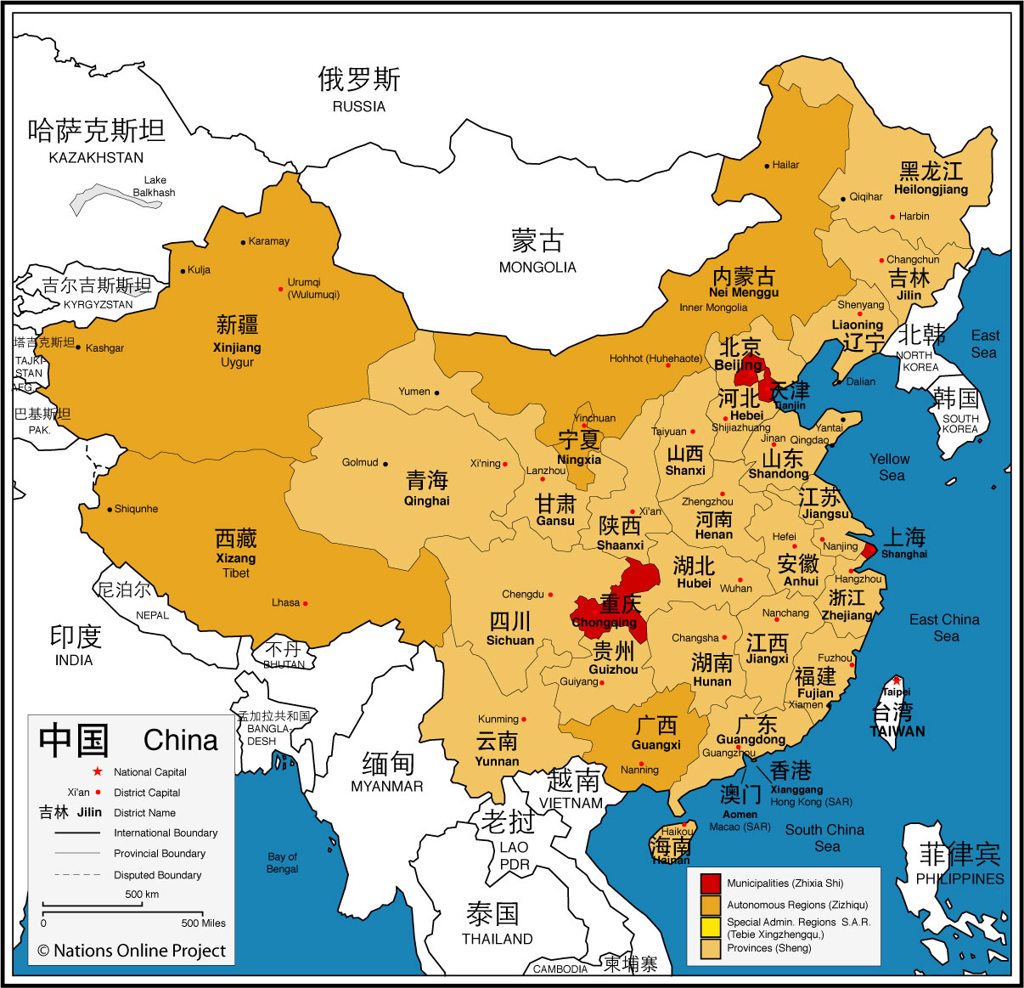
CHINA
1.4 billion
HAN = 91.1 percent
PRC recognizes 56 ethnic groups. Biggest include:
Han Zhang Hui Manchu Uighur Miao Yi Tujia Tibetan Mongol | Dong Buyei Yao Bai Korean Hani Li Kazakh Dai

Slide 11
CHINA
23 provinces
4 direct municipalities (Zhixia Shi)
北京 Beijing
重庆 Chongqing
上海 Shanghai
and 天津 Tianjin
Self-governing districts under the direct jurisdiction of the central government.

Slide 12
CHINA
Autonomous Regions (Zizhiqu)
广西 Guangxi
内蒙古 Inner Mongolia
宁夏 Ningxia
西藏 Tibet
新疆 Xinjiang Uyghur
Autonomous Region

Slide 13
CHINA
Special Administrative Regions (SAR)
香港 Hong Kong
澳门 Macau
This Special Administrative Regions under the policy of
"One Country, Two Systems.”

Slide 14



中華民國 台灣
Republic of China (on Taiwan)

Slide 15
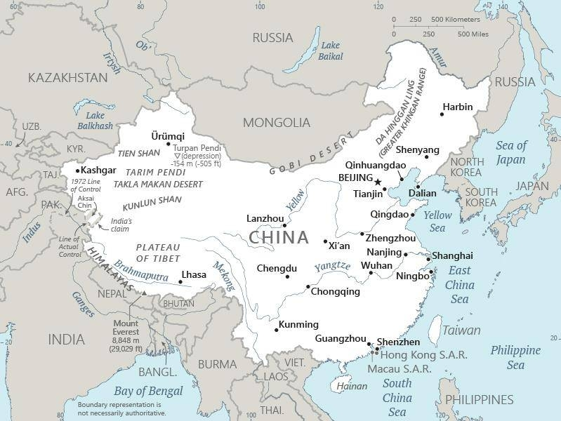

Slide 16
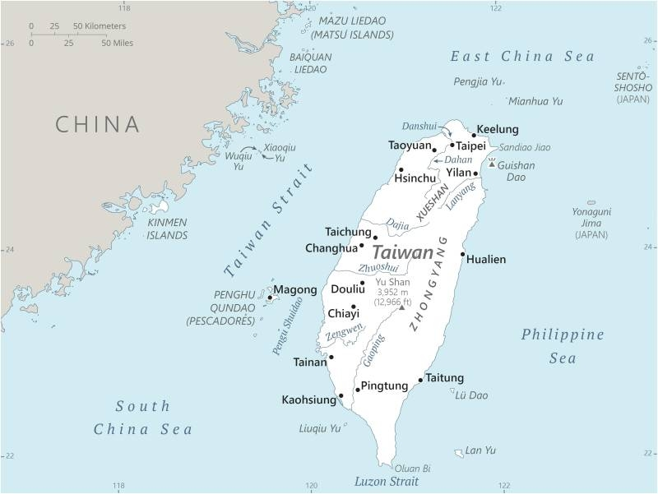
A little smaller than Maryland
250 miles long
100 miles from mainland
Population: 24 million
95-97 % ethnic Han
Languages:
Taiwanese/Hokkienese
Chinese
Hakka

Slide 17
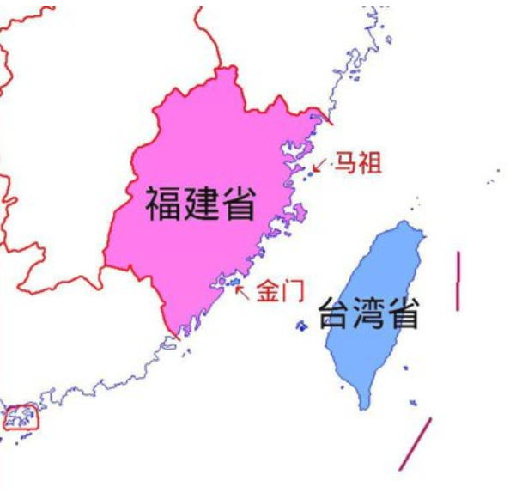
福州
廈門
Jinmen-Xiamen = 2 mi.
Mazu-Fuzhou = 10 mi.

Slide 18
When you think of China, Taiwan, and the “Taiwan issue”
what comes to mind?

Slide 19
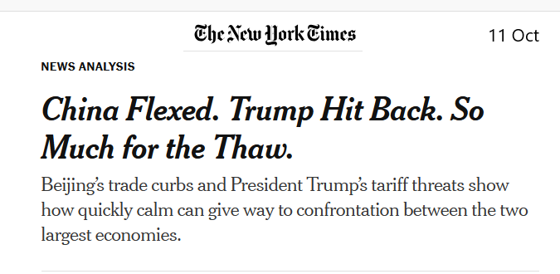
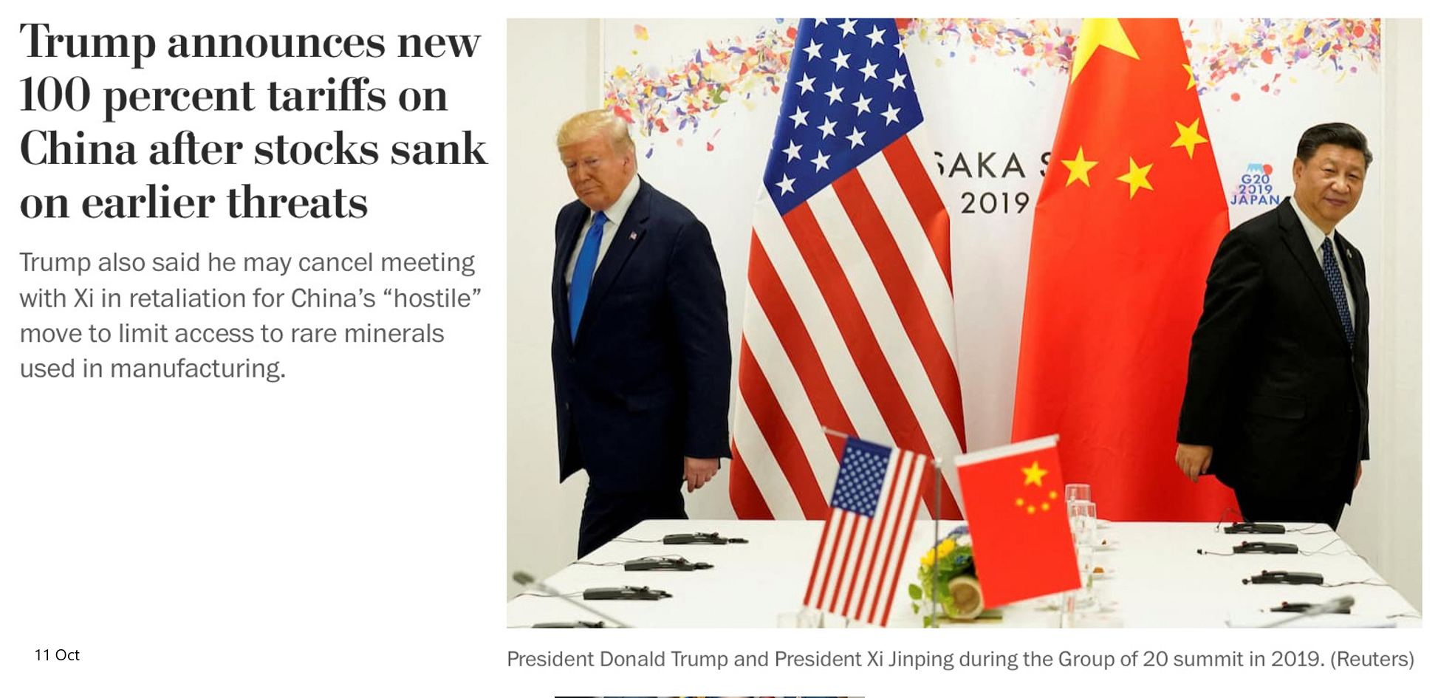
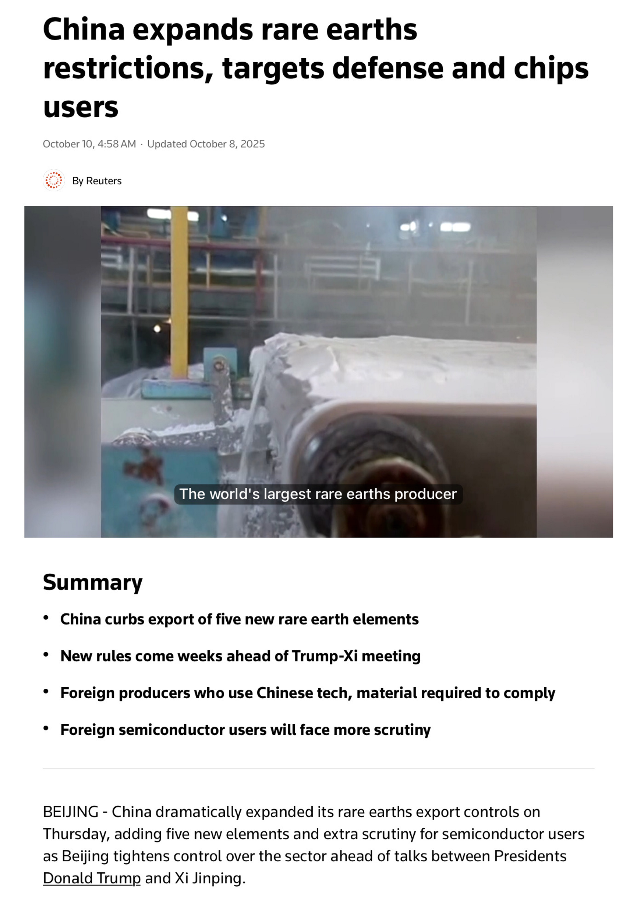
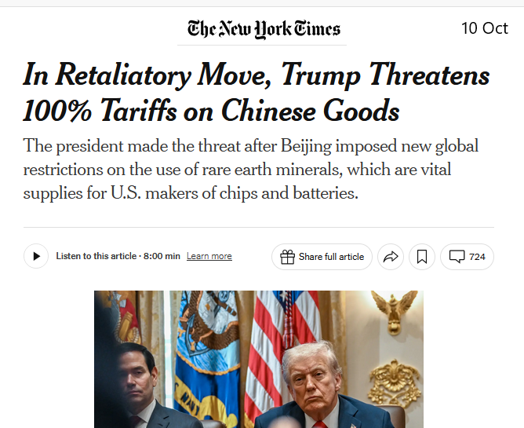

Slide 20

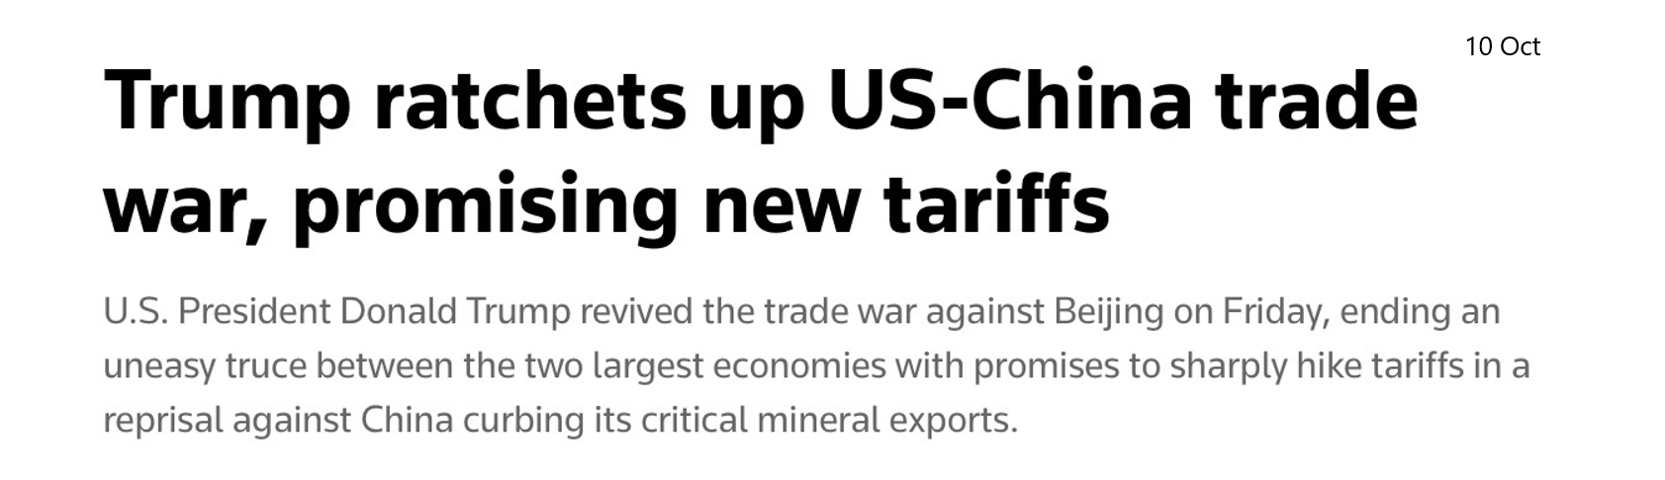
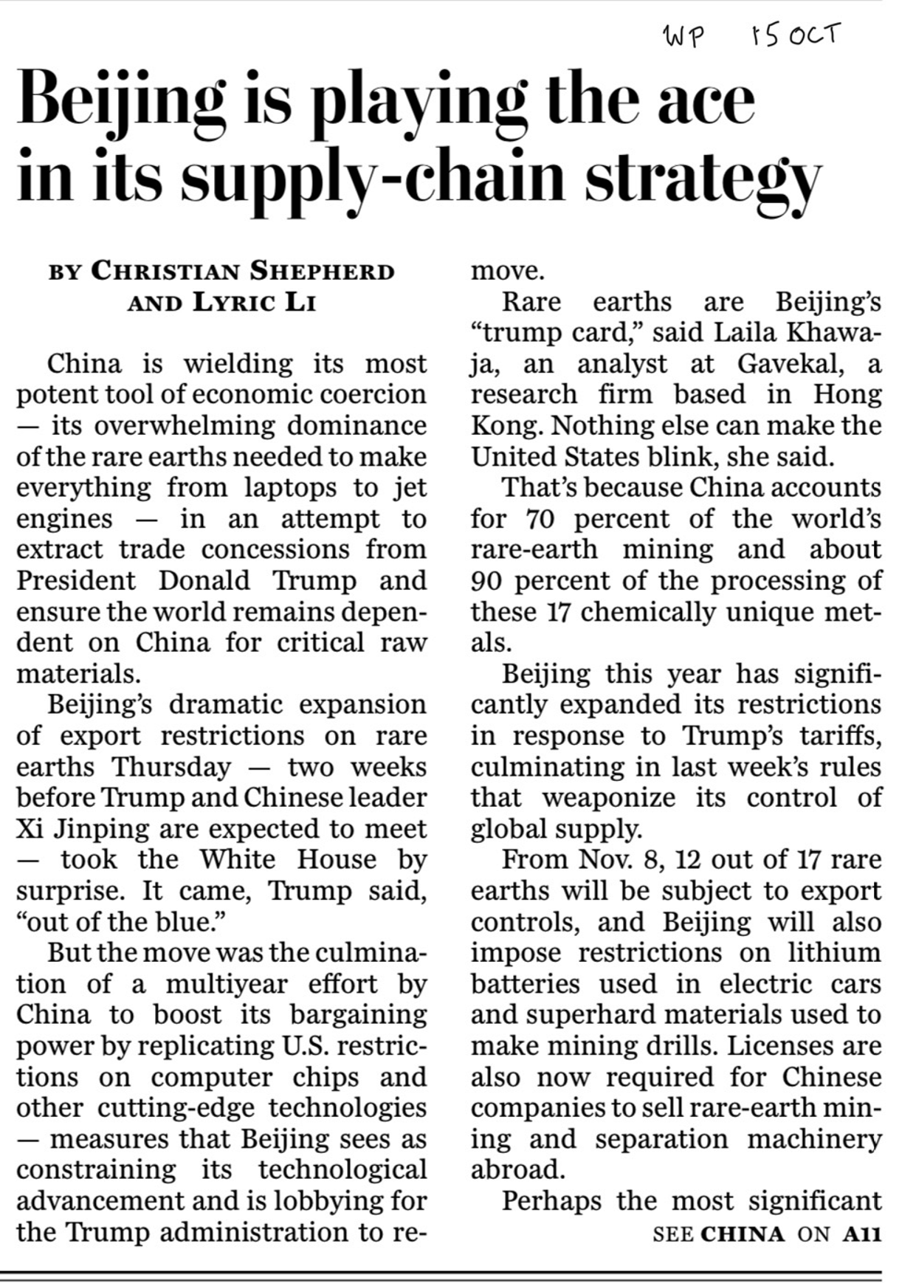
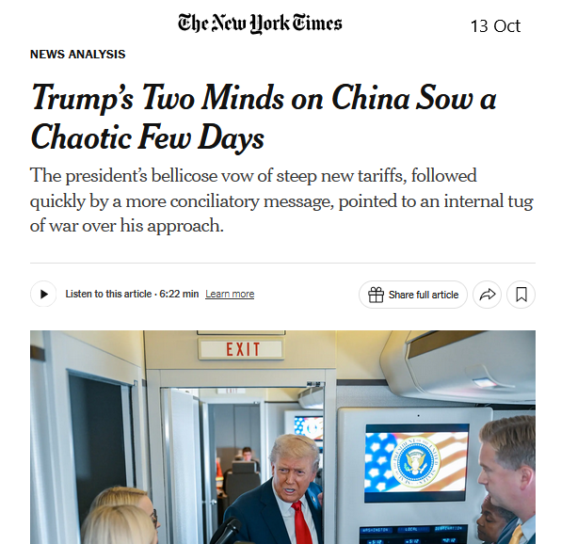

Slide 21
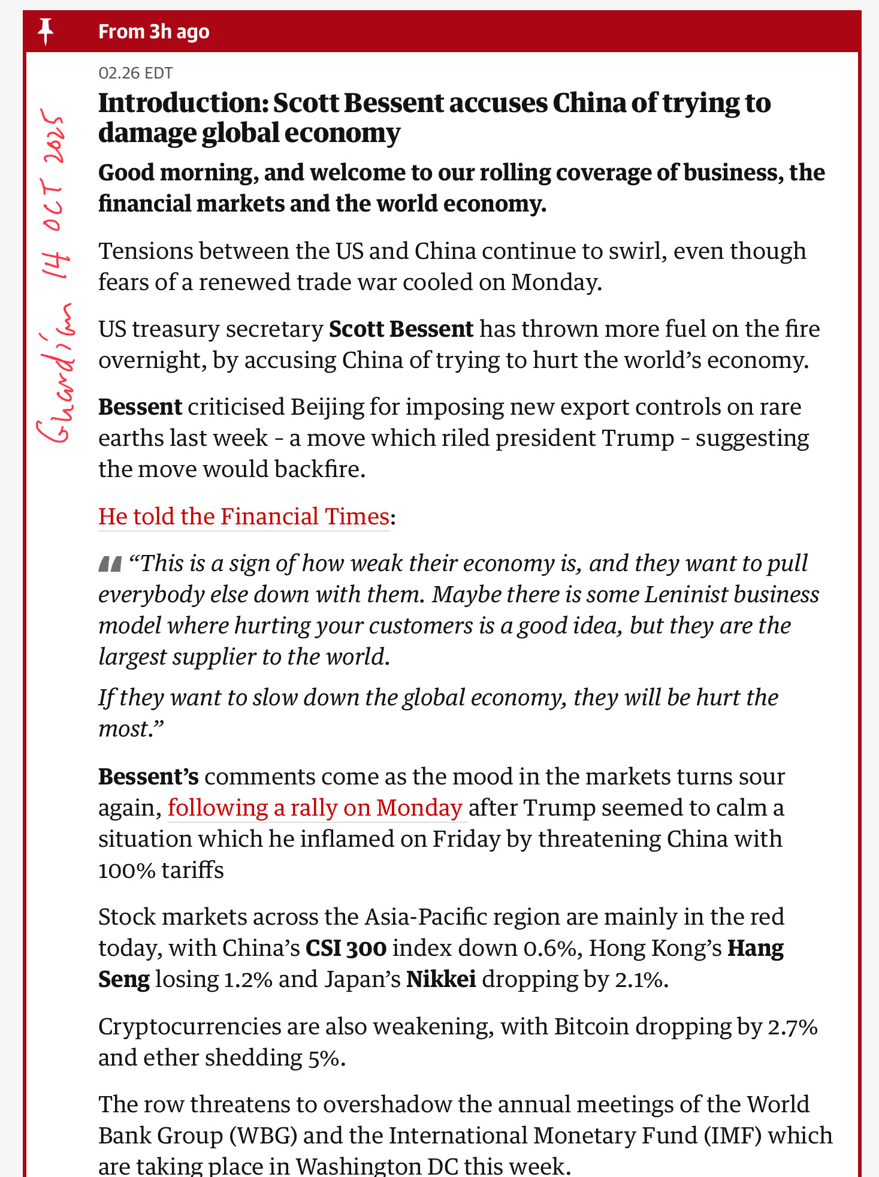
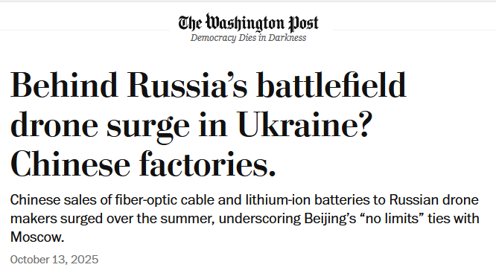
BUT … what else is going on?

Slide 23
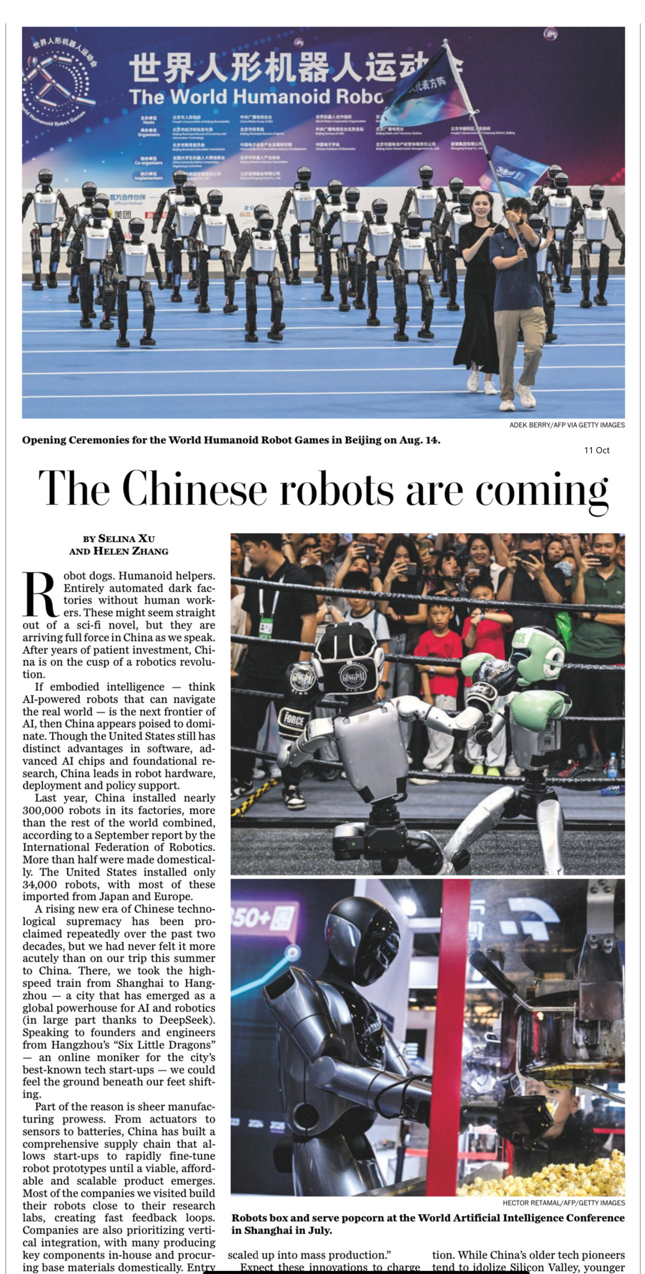
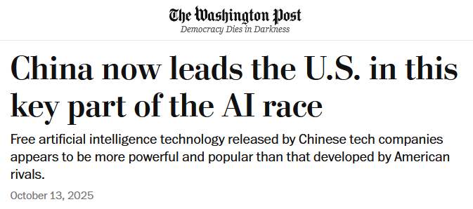
BUT … what else is going on?

Slide 25

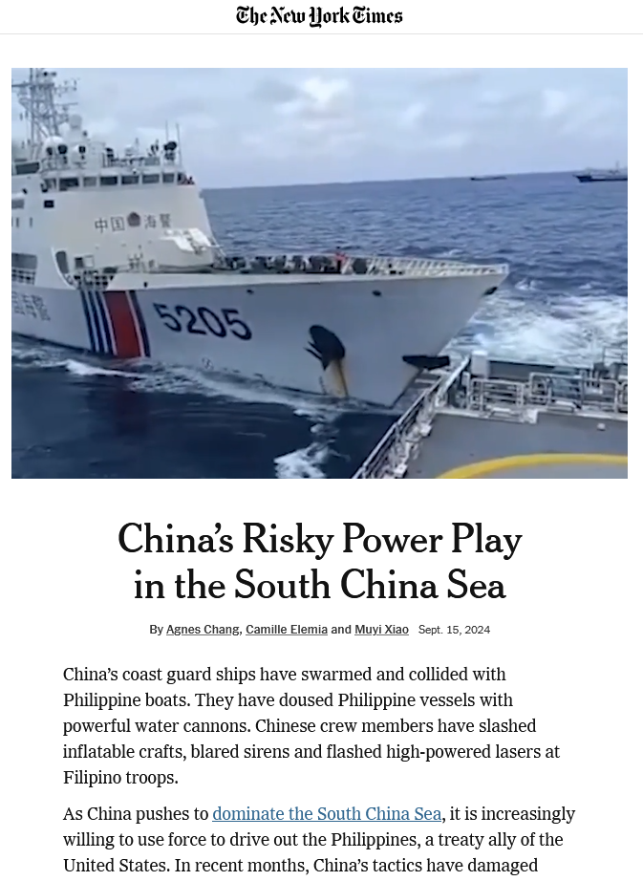
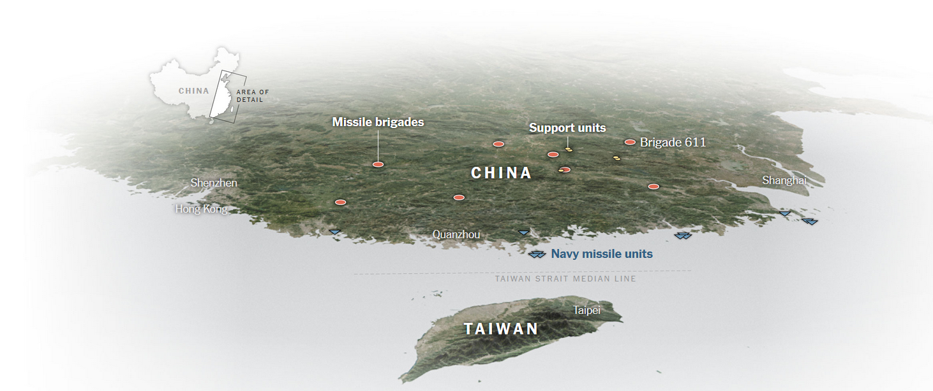

Slide 26
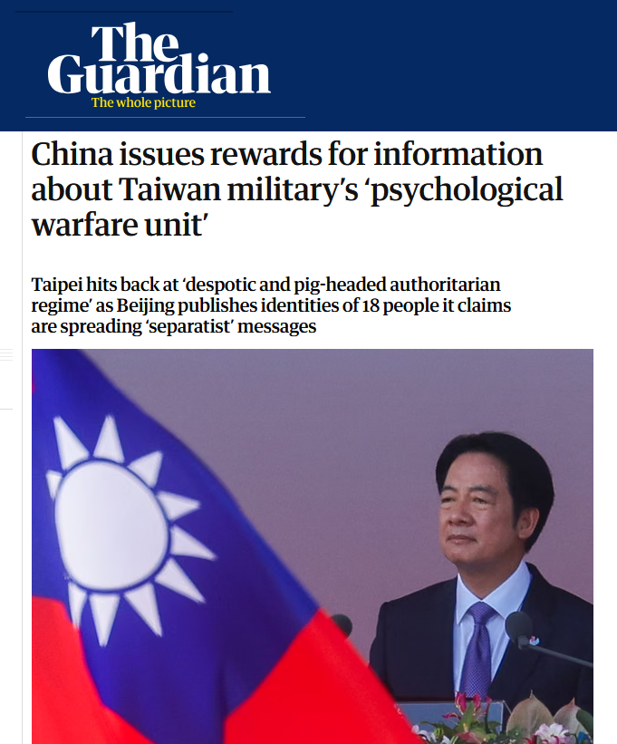

Slide 27
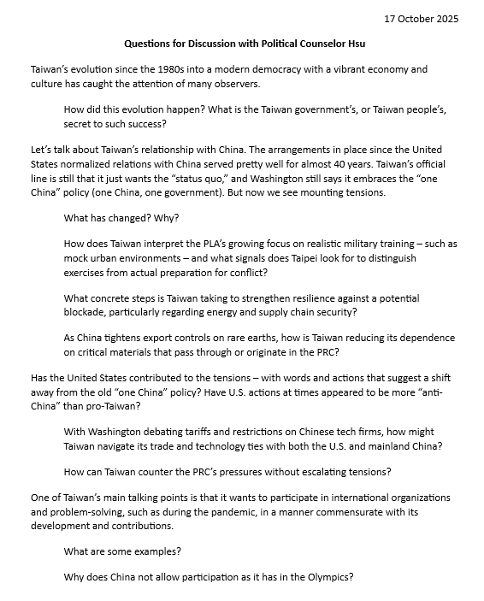

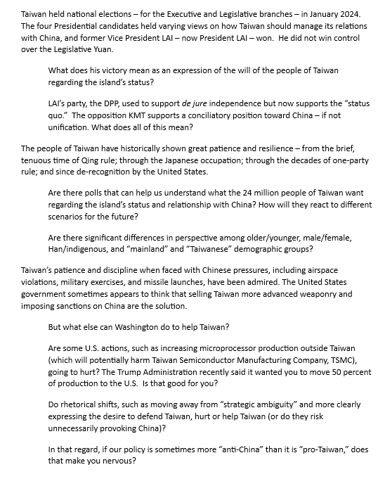
Mr. Gervasio HSU, Chief of Political Section
Ms. Sarah HSIEH
Maisie will intro and ask first question.

Slide 28
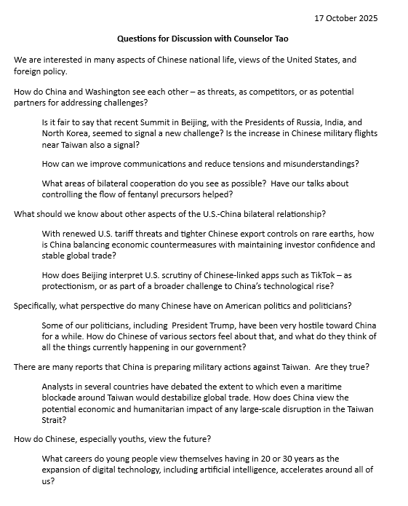

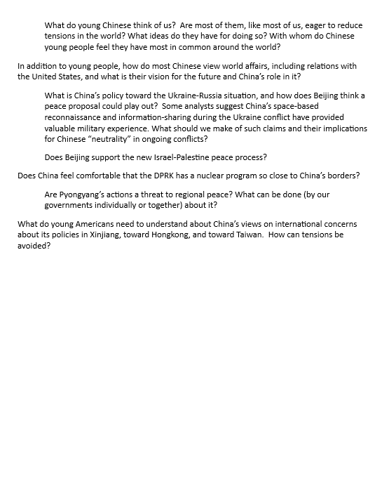
Mr. TAO Song, Counselor and Chief of Political Affairs
Ms. GAO Shuang
Alex will intro and ask first question.

Slide 29
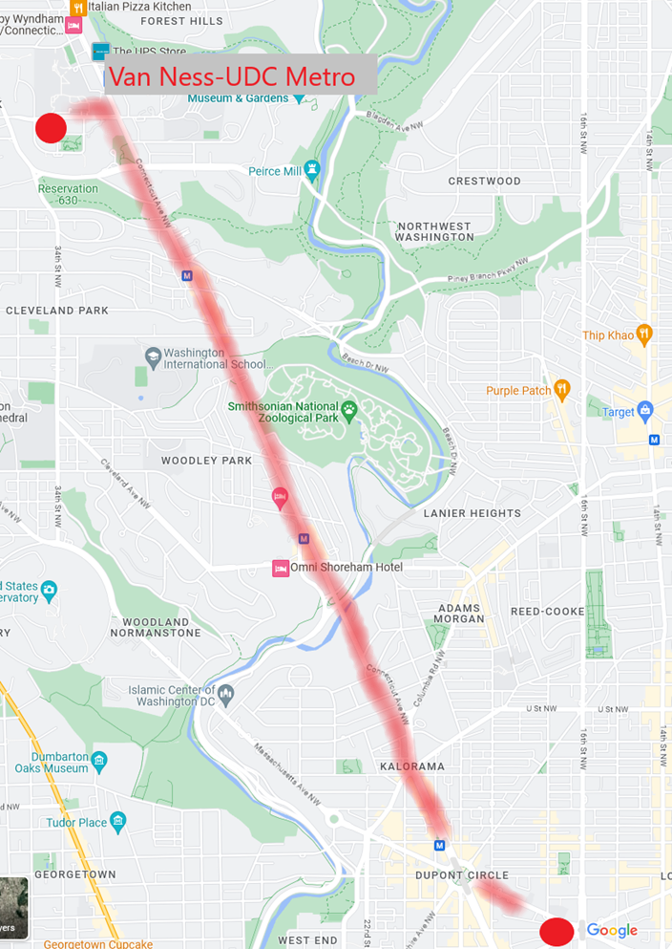
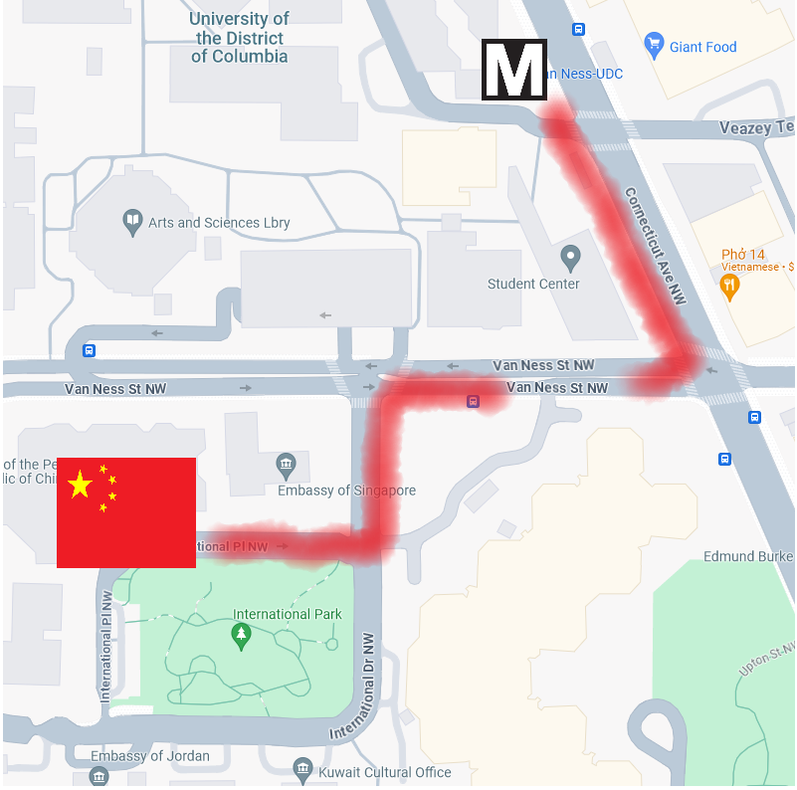
DEPART CSIS at 2:00pm

Slide 30
Internship conversations
INFORMAL DISCUSSION
Organization name and business
In-person, virtual, hybrid
My tasks and responsibilities
Communications and team dynamics
Fun things and challenges
Several minutes each --
      Bobby
      Kiana
      Syarra

Slide 31
GUEST SPEAKER

Slide 32
Mr. Gervasio HSU
Chief of Political Section
Taipei Economic and Cultural Representative Office
(TECRO)
Maisie welcomes and asks first question.

Slide 33
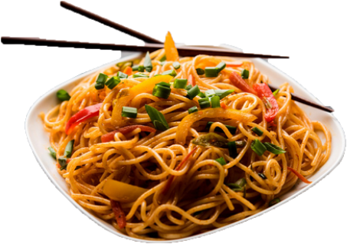
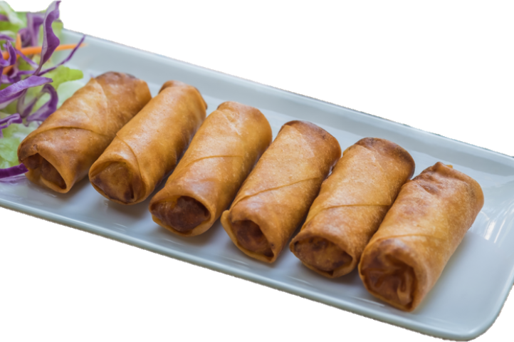
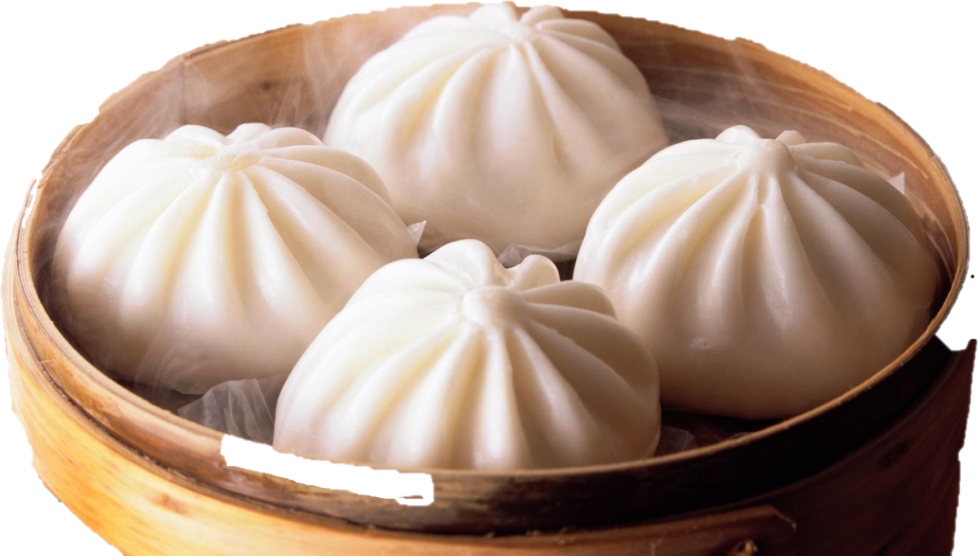
LUNCH

Slide 34


Slide 35

WRAPUP

Slide 36
401 Projects
If you saw comments on your analytical sheet that didn’t make sense (or you don’t agree with), let’s talk.
PLEASE …
remember “Memo #2” has to be well-written.
build on worksheets and ADD POLICY options and recommendation.
try to make sense, make interesting, make relevant.
maximum two pages (single-space).
Correct. Clean up.
Add to. Supplement. Extend.
Make more sophisticated. Raise up.
Anticipate readers’ interests, needs.
OK?

Slide 37
PROJECT PLANNING
Maisie | Microplastics | U.S. Declining Birth Rates
Skye | Ending the war in Sudan
Esme | Immigration and Balancing Interests | U.S. Culture Wars
Camille | Microplastics and PFAS
Erik | Ukraine Innovative Use of Drones | Israeli Use of Lavender AI in Targeting
Richard | Enhancing Cybersecurity
Alex | China’s Increasing Military Strength | Iranian Nationalism
Syarra | Russian Influence in Eastern Europe
Maeve | Israeli Use of AI in Military Strikes in Gaza | U.S. Declining Birth Rates
Kiana | Impact of Federal Spending … or inflation
Mo | Aid to Gaza | Impact of U.S.-China Tariffs
Bobby | U.S. Health Care: High Cost of Prescription Drugs
Gabby | U.S. Culture Wars and How Policy Fuels them | U.S.-Israel Relations After Netanyahu
Katelyn | Russia-Ukraine Negotiations
Sarina | Foreign Disinformation Targets U.S. Elections | Crisis of Legal Immigration Pathways in the U.S.
Priya | China’s Advances in Renewable Energy and EVs

Slide 38
DISCUSSION
Comfortable?
  Topics
  How partnership will work
The purposes
  Substance, process, skills
The elements
All OK?
PREPARING AND PLANNING?
401
  Analysis
  “Memo #2”
402
  Proposal
  Hearing/event
  Public opinion
  Interviews
  DC memo
  Briefing

Slide 39
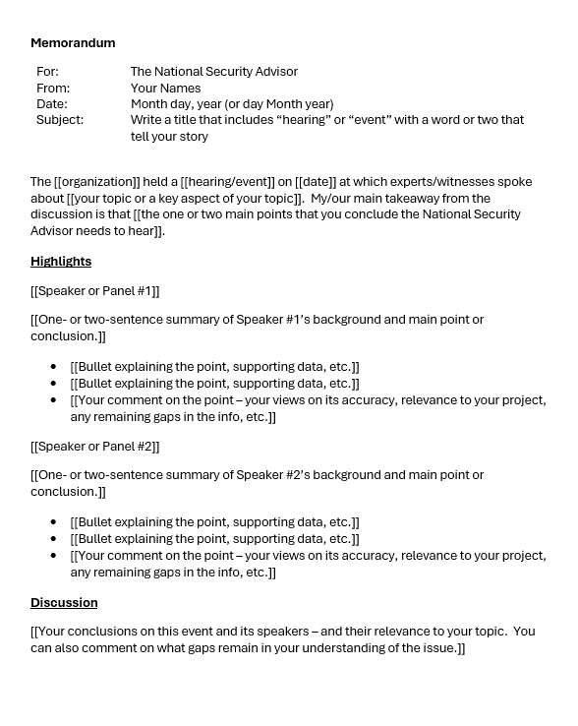
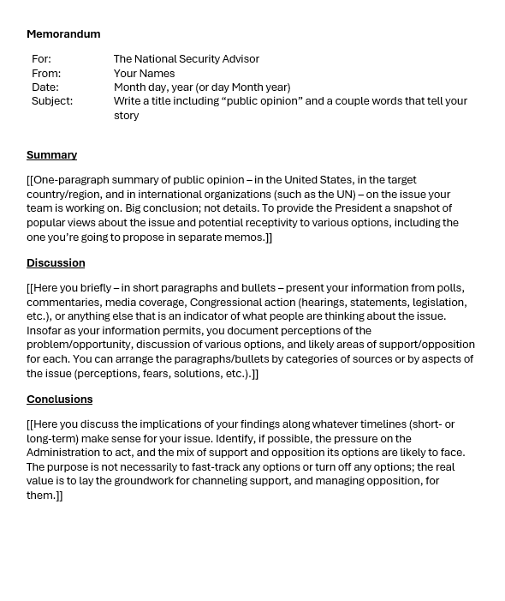
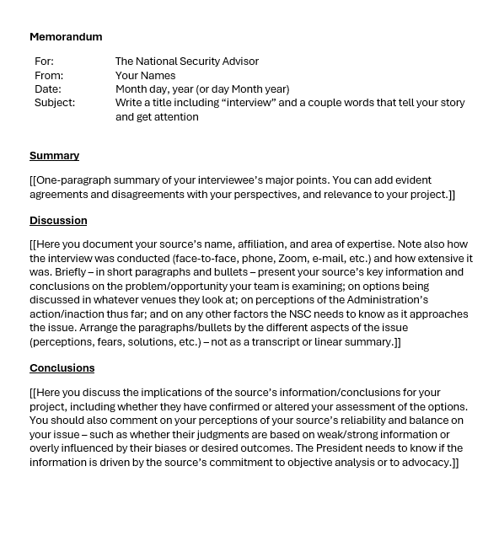
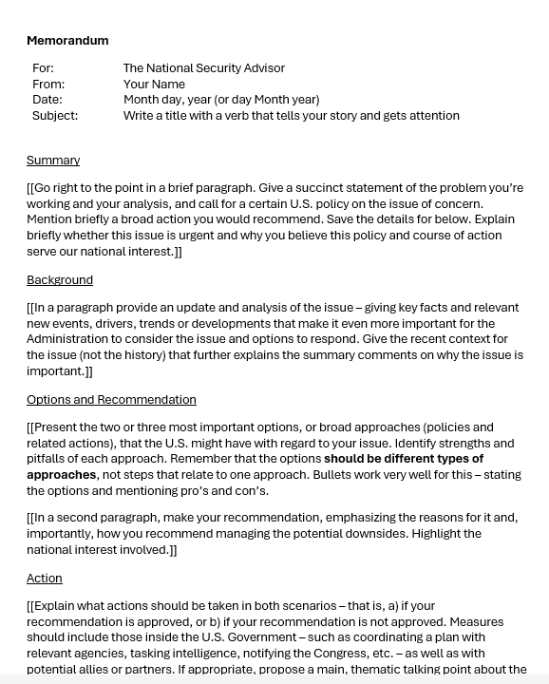
The Templates
402
401

Slide 40
NEXT WEEK

Slide 41
Anything else?

Slide 42
Global Policy Seminar and NSC Simulation
IRP 401 - IRP 402
Week Eight
17 October 2025
Prof. Fulton T. Armstrong

