Slide 1
Global Policy Seminar and NSC Simulation
IRP 401 - IRP 402
Week Eleven 5 April 2024
Prof. Fulton T. Armstrong

Slide 2
Week 1 (19 Jan)
Week 2 (26 Jan)
Week 3 (2 Feb)
Week 4 (9 Feb)
Week 5 (16 Feb)
Week 6 (23 Feb)
Week 7 (1 Mar)
Week 8 (8 Mar)
BREAK
Week 9 (22 Mar)
Week 10 (29 Mar)
Week 11 (5 Apr)
Week 12 (12 Apr)
Week 13 (19 Apr)
Week 14 (26 Apr)
SPRING 2024

Slide 3
TODAY’S AGENDA
9:45 | Six-Party Talks KEI – Clint Work
1:00 | Depart KEI
1:50 | Discussion (at CSIS) Conclusions from exercise and other activities Internship discussions Noah Akosua Emma
2:30 | DJ Shea Lead Client Solutions Manager LinkedIn - Introduced by Mimi
3:30 | Wrap up

Slide 4
TODAY’S AGENDA
9:45 | Six-Party Talks KEI – Clint Work
1:00 | Depart KEI
1:50 | Discussion (at CSIS) Conclusions from exercise and other activities Internship discussions Noah Akosua Emma
2:30 | DJ Shea Lead Client Solutions Manager LinkedIn - Introduced by Mimi
3:30 | Wrap up

Slide 5
The Six-Party Talks
Observations?
 | Republic of Korea (South Korea) | Democratic People’s Republic of Korea (North Korea) | USA | People’s Republic of China | Japan | Russia
Team 1 | Marcus | Ding | Mimi | Meghan | Jessica | Matthew
Team 2 | Emily | Akosua | Abby | Bryce | Reese | Vaughn
Team 3 | [KEI] | Nicolas | Tashakee | Noah | Emma | Gavin

Slide 6
Comments on Latin America and Immigration?

Slide 7
Internship conversations
2-3 minutes each --
Noah
Akosua
Emma
INFORMAL DISCUSSION
Organization name and business
In-person, virtual, hybrid
My tasks and responsibilities
Communications and team dynamics
Fun things and challenges

Slide 8
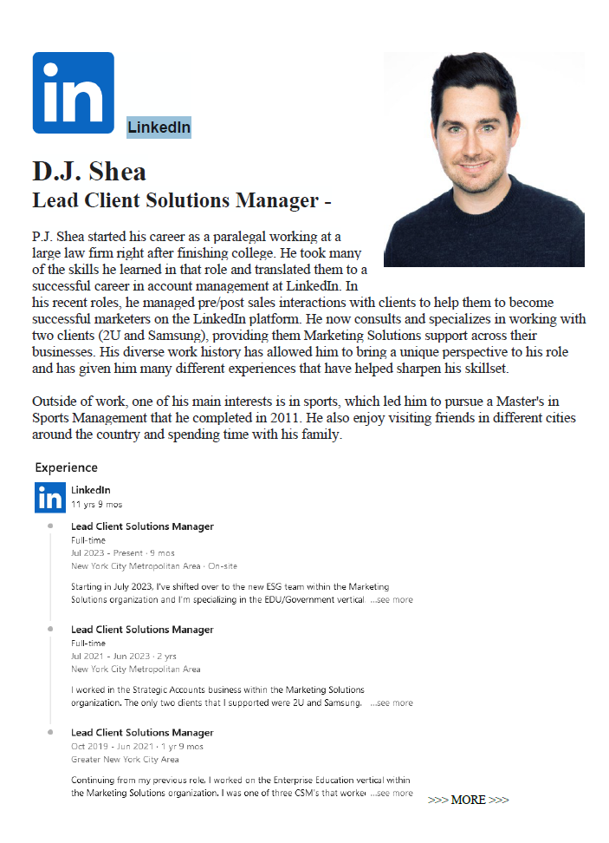
LinkedIn
D.J. Shea
Lead Client Solutions Manager

Slide 9
LUNCH

Slide 10
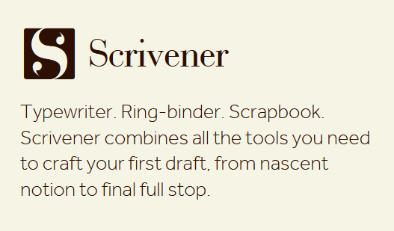

Slide 13
WRAPUP

Slide 14
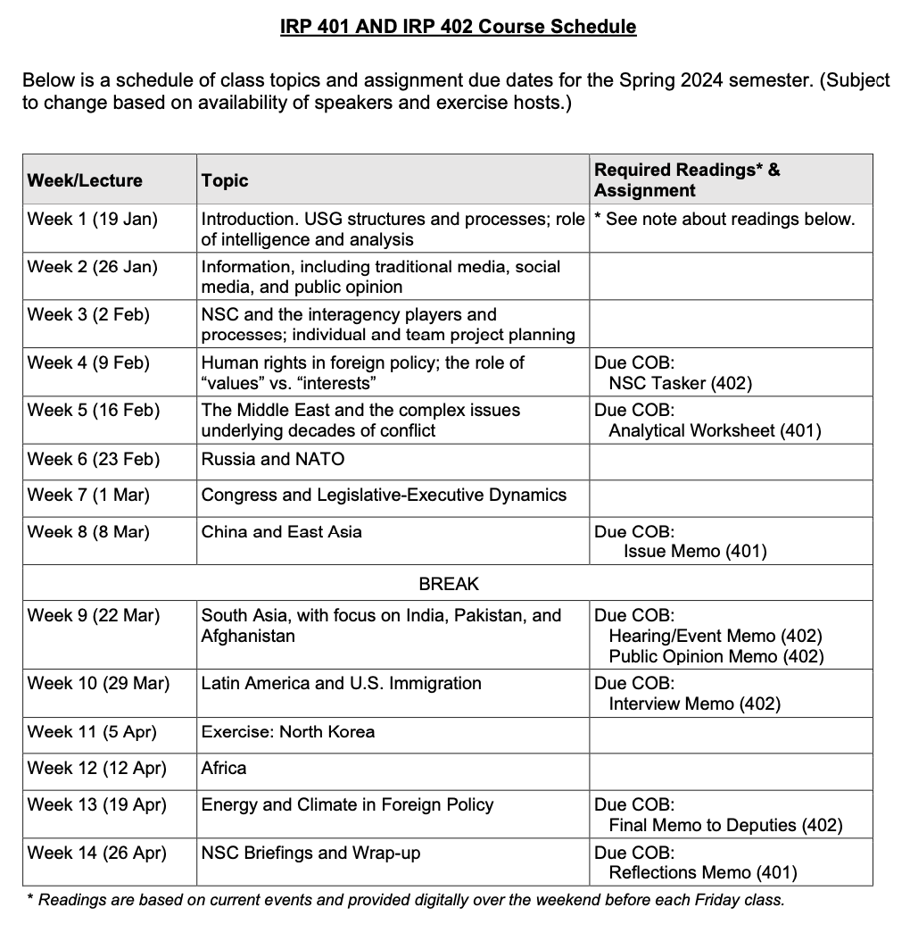
✓
401
402
✓
✓
✓
✓
QUESTIONS?
✓
✓

Slide 15
DEPUTIES COMMITTEE
deputies
Akosua | Ensuring microchip competition and supply
Nicolas
Marcus | U.S. education deficits
Mimi
Vaughn | Israel-Palestine: Two-state solution possible?
Matt
Gavin | U.S. policy toward Yemen and the Houthis
Noah
Meghan | Impact of climate change on insurgency
Bryce
Emily | How to deal with climate migrants/refugees
Tashakee
Reese | “War time policy”
Emma
Ding | U.S. border-state challenges from immigration | (2)
Abby | U.S. support to Ukraine defense against Russia
Jessica
NEXT WEEK WILL ASK
deputies
order

Slide 16
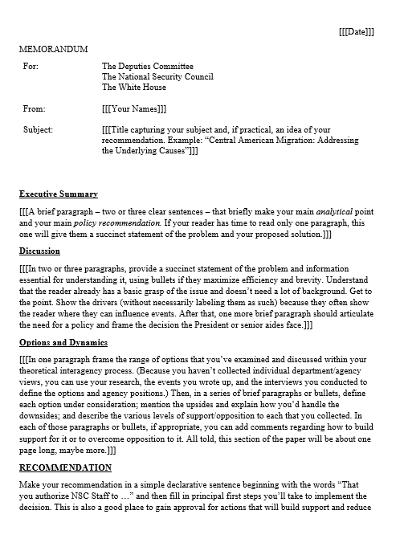
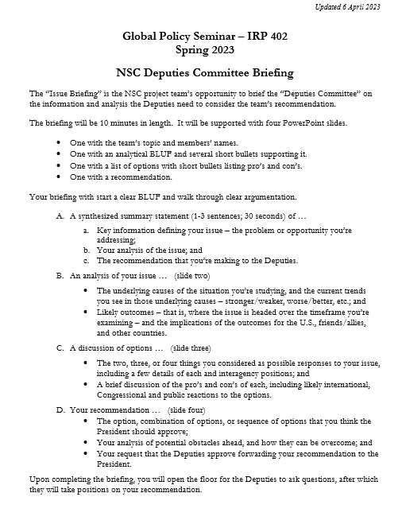
“DEPUTIES COMMITTEE” EXERCISE
GUIDANCE ON MEMO
GUIDANCE ON BRIEFING

Slide 17
Project Planning
Akosua | U.S.-Russia: How constrain Putin? | Ensuring microchip competition and supply
Nicolas | U.S.-North Korea: How constrain Kim?
Marcus | U.S.-Vietnam tech/innovation ties | U.S. education deficits
Mimi | Youth homelessness
Vaughn | Central America migration | Israel-Palestine: Two-state solution possible?
Matt | Crisis in Haiti
Gavin | Impact of COVID on mental health | U.S. policy toward Yemen and the Houthis
Noah | Reducing reliance on China trade
Meghan | Russia/Wagner influence in Africa | Impact of climate change on insurgency
Bryce | Improving gun control background checks
Emily | Russia WMD in wake of Ukraine war | How to deal with climate migrants/refugees
Tashakee | Negative impact of cobalt mining in DRC
Reese | South America climate migration | “War time policy”
Emma | U.S.-Mexico border deaths
Ding | Calming tensions on Korean peninsula | U.S. border-state challenges from immigration
Abby | Human trafficking | U.S. support to Ukraine defense against Russia
Jessica | Stopping the flow of fentanyl into U.S.

Slide 18
Next Week
Africa
More INTERNSHIP discussions Three volunteers?

Slide 19
Global Policy Seminar and NSC Simulation
IRP 401 - IRP 402
Week Eleven 5 April 2024
Prof. Fulton T. Armstrong

