Slide 1
Global Policy Seminar and NSC Simulation
IRP 401 - IRP 402
Week Twelve 12 April 2024
Prof. Fulton T. Armstrong

Slide 2
Week 1 (19 Jan)
Week 2 (26 Jan)
Week 3 (2 Feb)
Week 4 (9 Feb)
Week 5 (16 Feb)
Week 6 (23 Feb)
Week 7 (1 Mar)
Week 8 (8 Mar)
BREAK
Week 9 (22 Mar)
Week 10 (29 Mar)
Week 11 (5 Apr)
Week 12 (12 Apr)
Week 13 (19 Apr)
Week 14 (26 Apr)
SPRING 2024

Slide 3
TODAY’S AGENDA
9:00 | Class Discussion Readings Project updates Internship conversations: Noah, Akosua, Emma
10:00 | Michael SHURKIN Shurbros Global Strategies and Atlantic Council introduced by Akosua
11:30 | Ambassador Mark BELLAMY Former U.S. Ambassador to Kenya introduced by Bryce
12:45 | Lunch and Transportation to Wisconsin Ave
2:30 | Ambassador Hilda SUKA-MAFUDZE Embassy of the African Union 1640 Wisconsin Avenue NW - Introduced by Jessica

Slide 4
TODAY’S AGENDA
9:00 | Class Discussion Readings Project updates Internship conversations: Noah, Akosua, Emma
10:00 | Michael SHURKIN Shurbros Global Strategies and Atlantic Council introduced by Akosua
11:30 | Ambassador Mark BELLAMY Former U.S. Ambassador to Kenya introduced by Bryce
12:45 | Lunch and Transportation to Wisconsin Ave
2:30 | Ambassador Hilda SUKA-MAFUDZE Embassy of the African Union 1640 Wisconsin Avenue NW - Introduced by Jessica

Slide 5
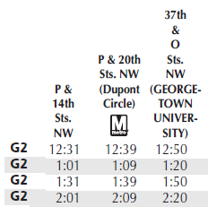
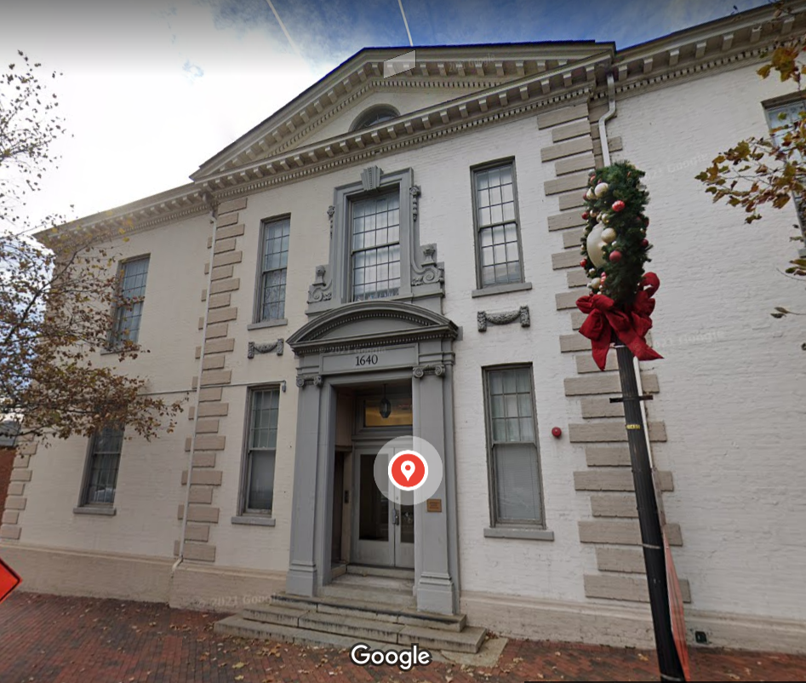
G2 Metrobus
~12:31
~1:01
~1:31
~2:01
16th & P
20th & P
18th & P
1640 Wisconsin Avenue NW
2:30 start

Slide 6
TODAY’S AGENDA
9:00 | Class Discussion Readings Project updates Internship conversations: Noah, Akosua, Emma
10:00 | Michael SHURKIN Shurbros Global Strategies and Atlantic Council introduced by Akosua
11:30 | Ambassador Mark BELLAMY Former U.S. Ambassador to Kenya introduced by Bryce
12:45 | Lunch
2:15 | Professional Development: Word Processing “Tricks”
2:30 | Professional Development: Listening Skills Fulton and Prof. London
3:15 | Wrapup

Slide 7
TODAY’S AGENDA
9:00 | Class Discussion Readings Project updates Internship conversations: Noah, Akosua, Emma
10:00 | Michael SHURKIN Shurbros Global Strategies and Atlantic Council introduced by Akosua
11:30 | Ambassador Mark BELLAMY Former U.S. Ambassador to Kenya introduced by Bryce
12:45 | Lunch
2:15 | Professional Development: Word Processing “Tricks”
2:30 | Professional Development: Listening Skills Fulton and Prof. London
3:15 | Wrapup

Slide 9
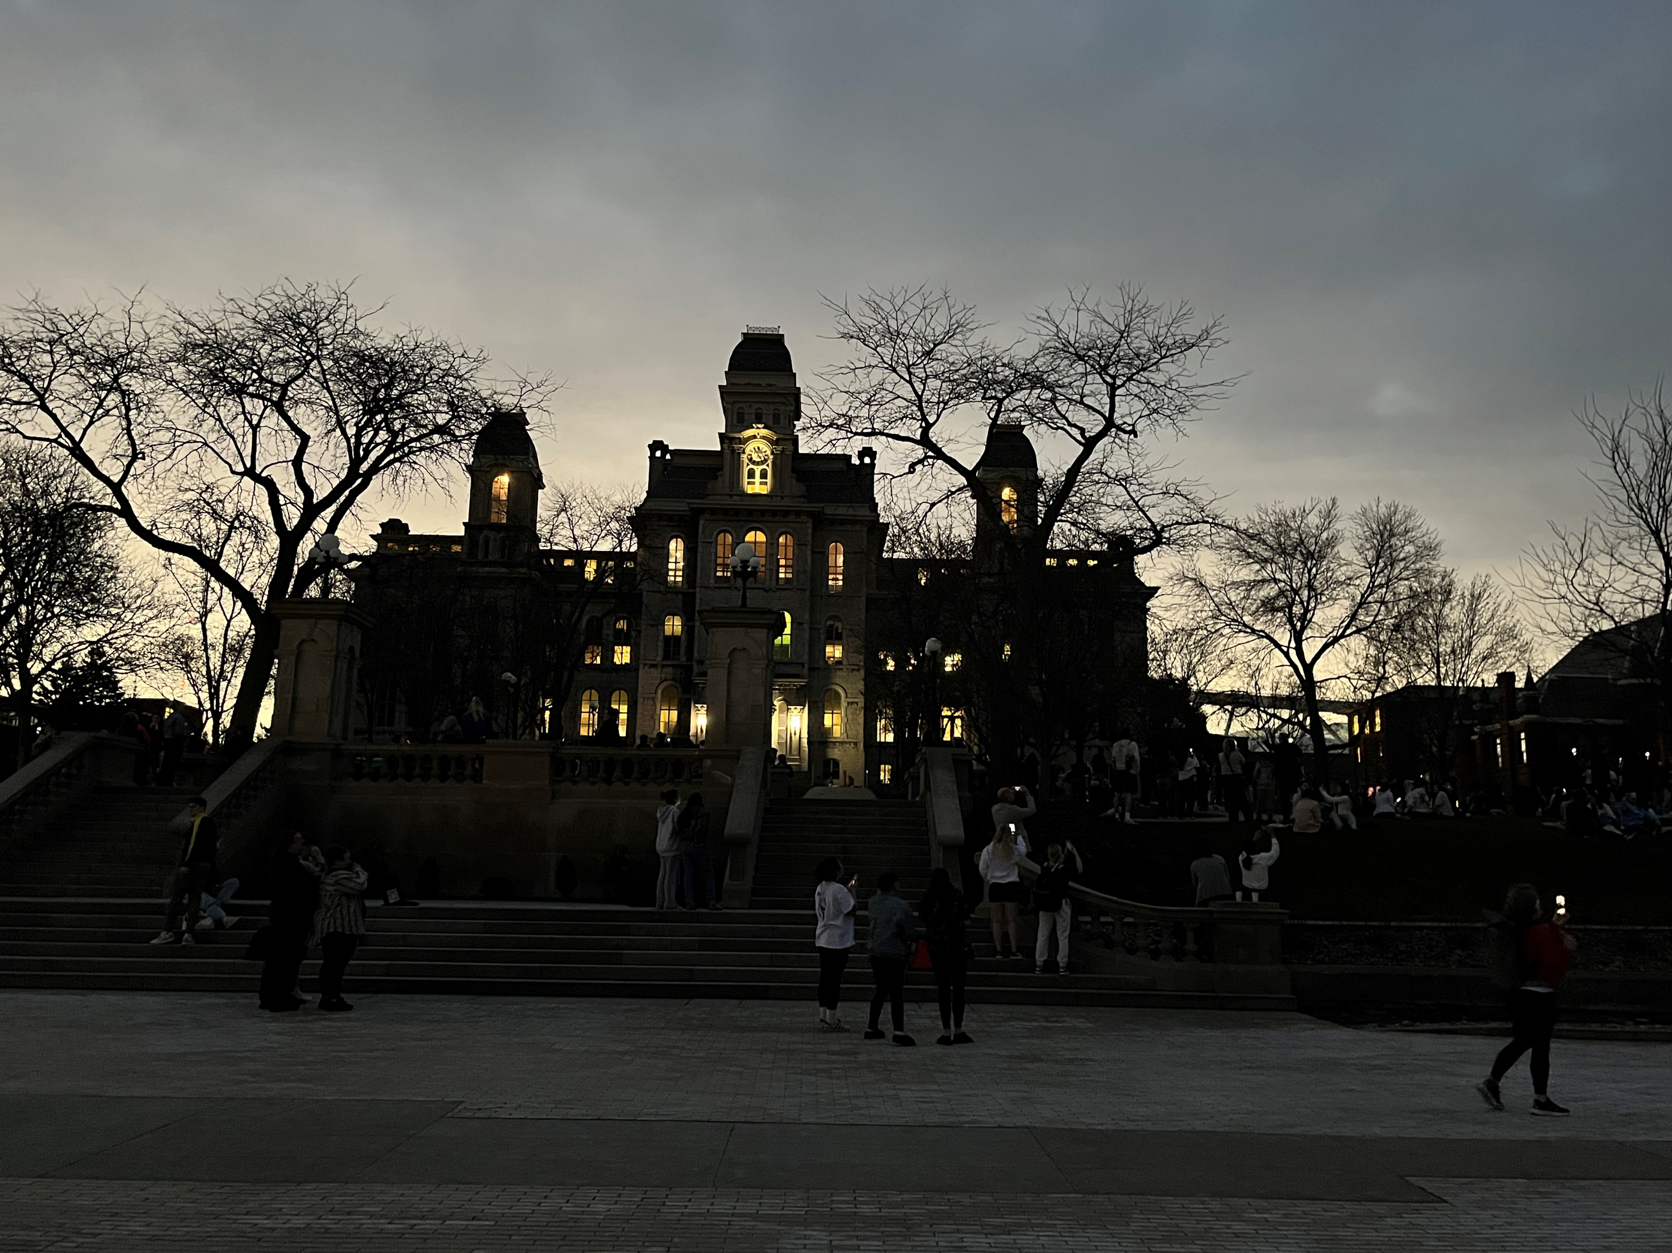

Slide 10
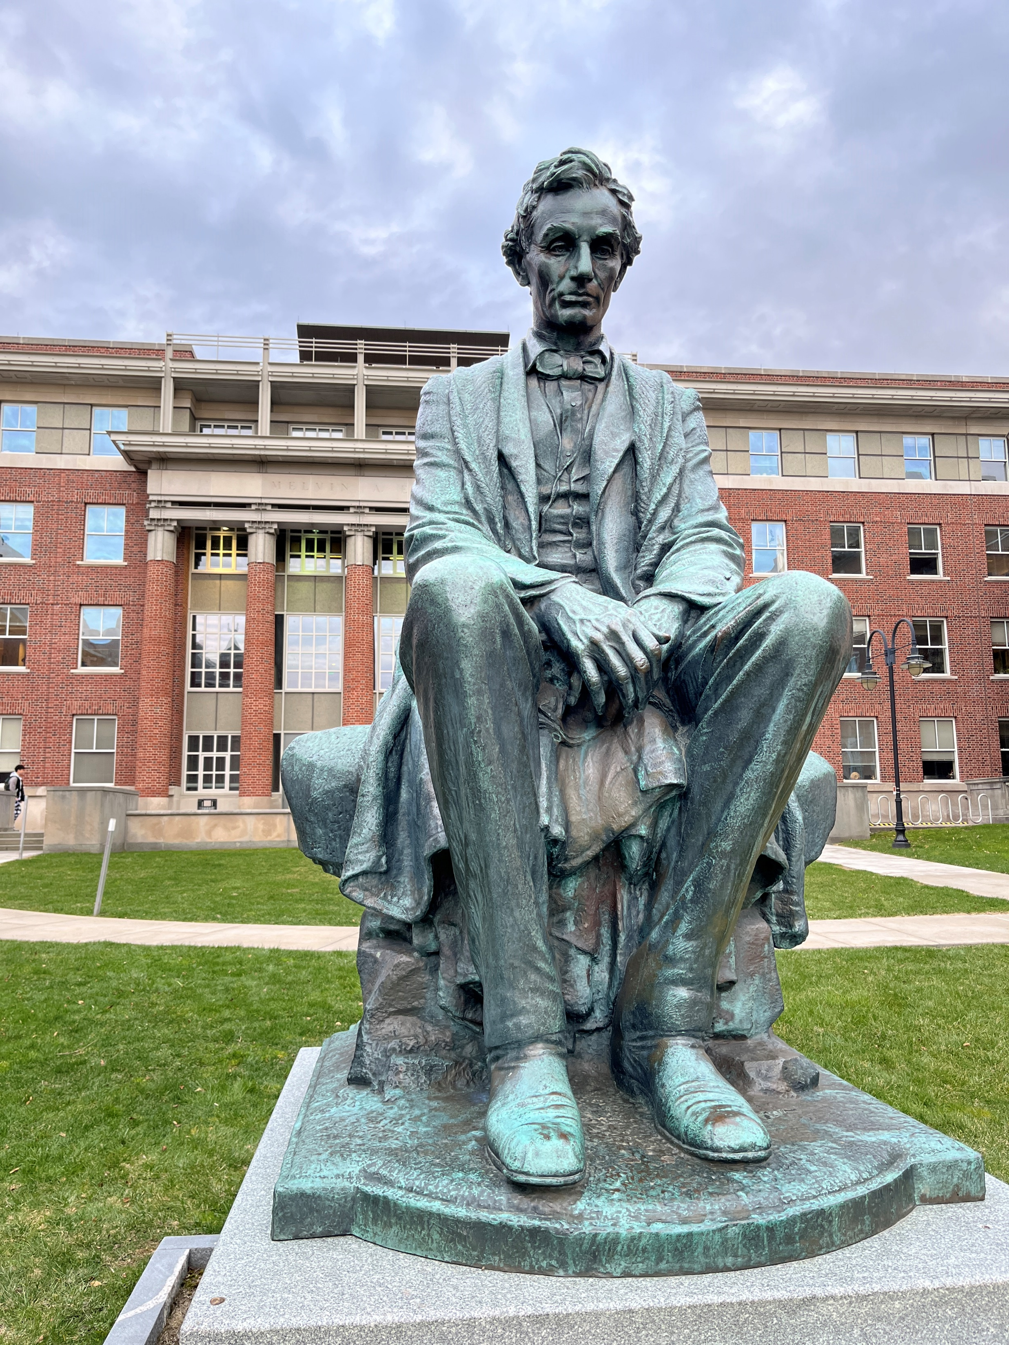

Slide 11
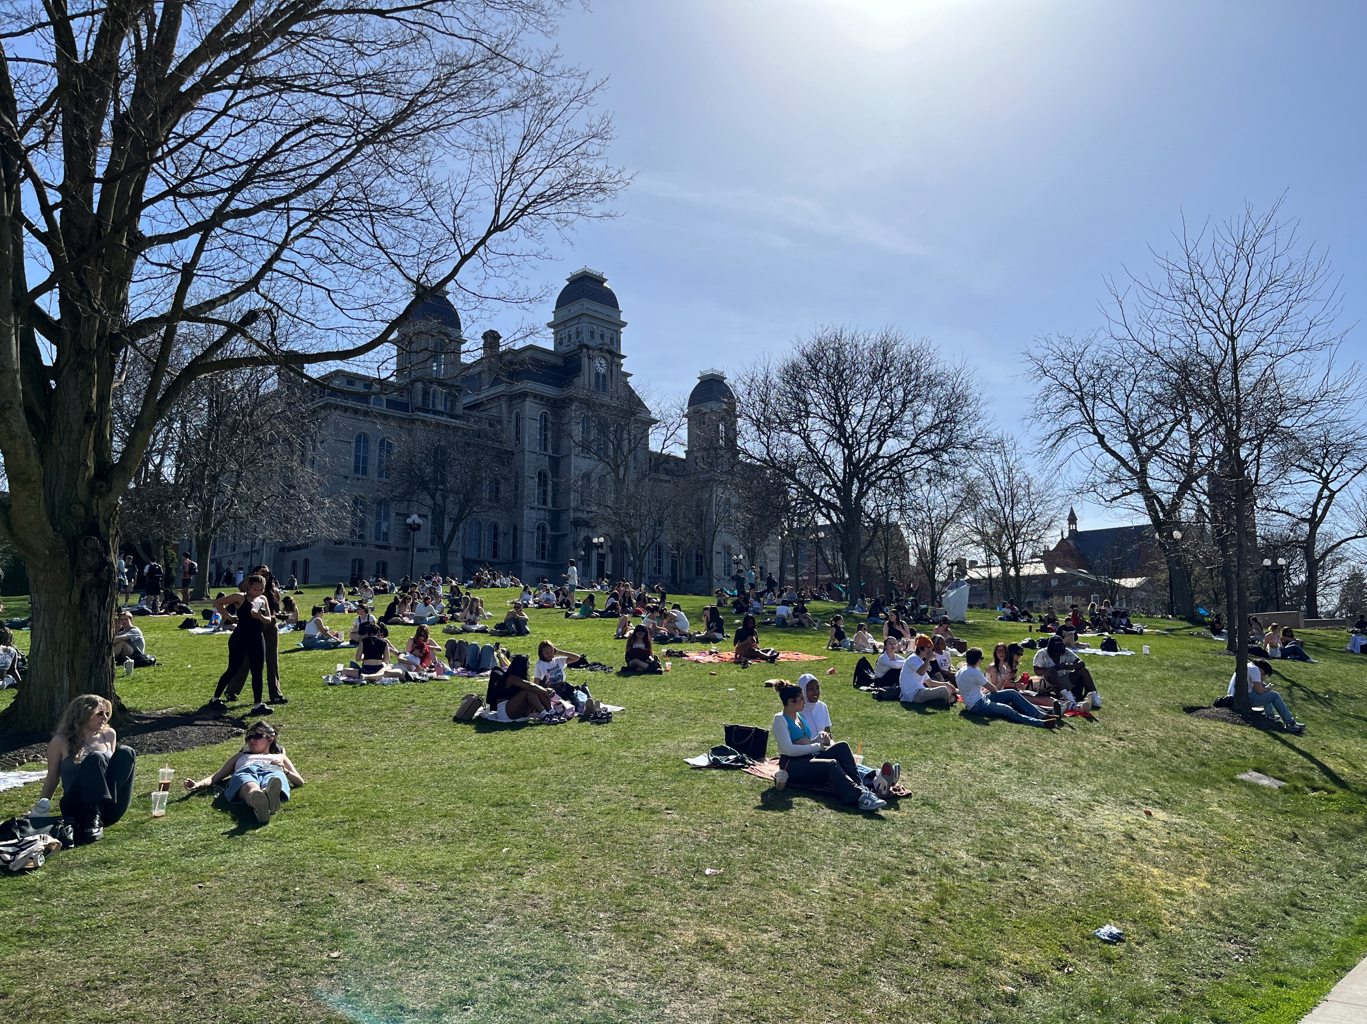
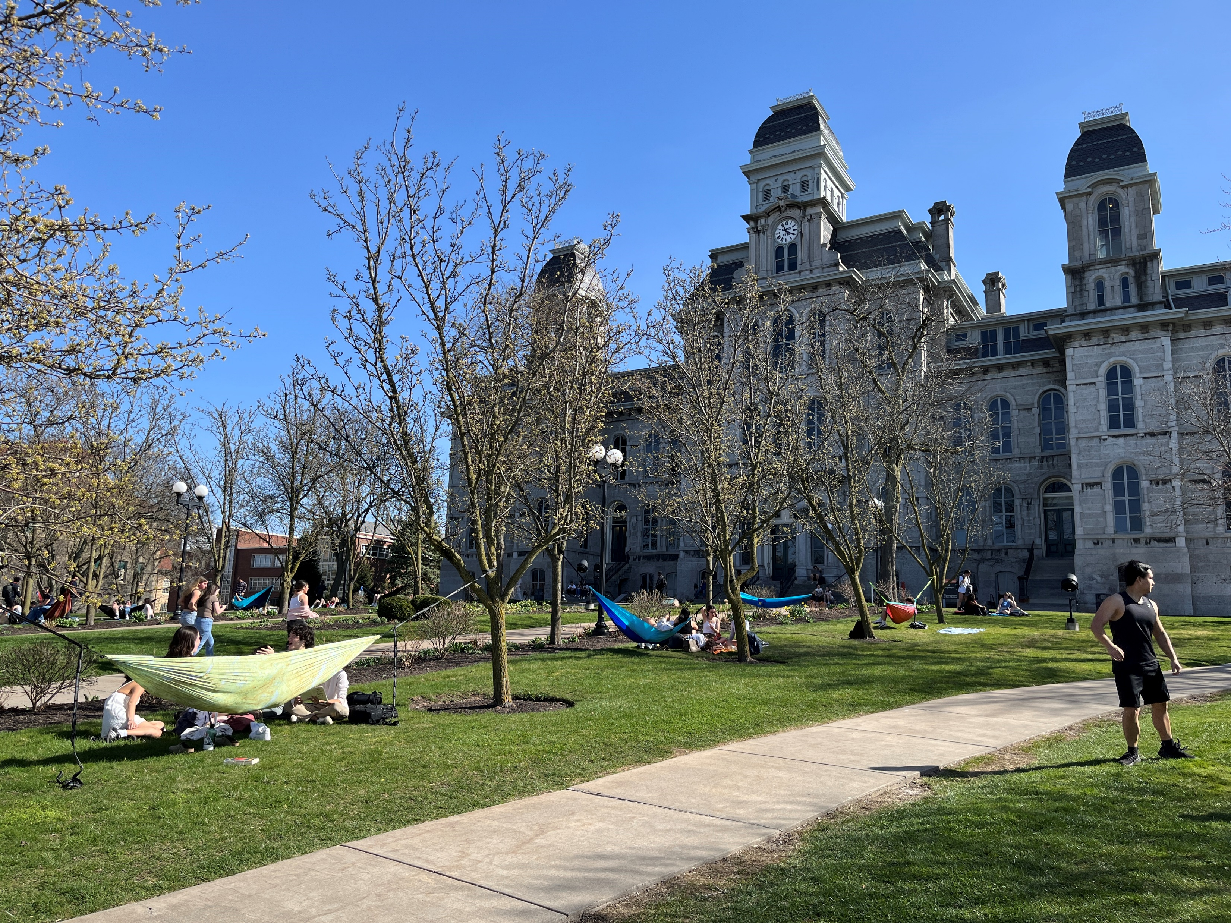

Slide 12
Impressions of campus … Maxwell … F’23 cohort .

Slide 13
Game starts 6:45

Slide 14
DEPUTIES COMMITTEE
deputies
Akosua | Ensuring microchip competition and supply
Nicolas
Marcus | U.S. education deficits
Mimi
Vaughn | Israel-Palestine: Two-state solution possible?
Matt
Gavin | U.S. policy toward Yemen and the Houthis
Noah
Meghan | Impact of climate change on insurgency
Bryce
Emily | How to deal with climate migrants/refugees
Tashakee
Reese | “War time policy”
Emma
Ding | U.S. border-state challenges from immigration | (2)
Abby | U.S. support to Ukraine defense against Russia
Jessica
For 26 April DC Meeting
What is final wording of topics?
Who will be your deputies?
In what order will you present?

Slide 15
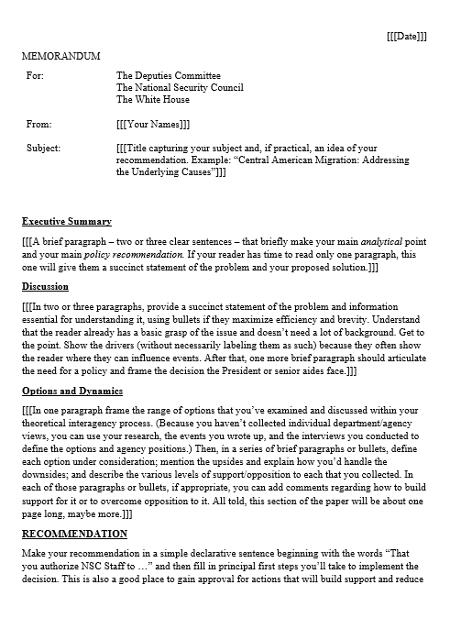
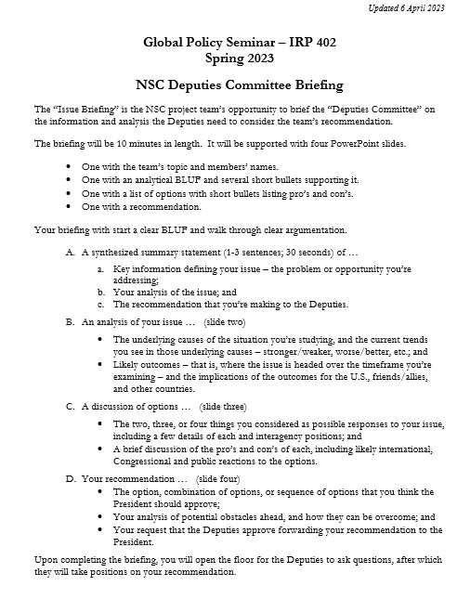
“DEPUTIES COMMITTEE” EXERCISE
GUIDANCE ON MEMO
GUIDANCE ON BRIEFING

Slide 16
DC BRIEFING
Scott Morgan’s MODEL
MODEL for our memo
Structure:
BLUF
“Framing”
Drivers/Trends
Options
Recommendation
Problem
Problem
Analysis
Options
Recommendation
Vivid Examples
&
Evidence
Solution
Next Steps
Morgan:
“If I buy your analysis, I’m much more likely to buy your recommendation.”

Slide 17
DC BRIEFING
Scott Morgan’s SIX words
MODEL for our memo
Core word.
The answer.
What you visualize.
The problem.
Best recommendation.
“Cool part.”
BLUF.
Framing facts (just essential).
Drivers and trends.
Options.
Recommendation.
(Cool facts where they fit.)

Slide 18
DC BRIEFING
Scott Morgan’s SLIDE advice
To avoid over-taxing the Central Executive Function …
Use only one phonological loop at a time. - read - speak - listen
Aid listener with visiospatial sketchpad (“cool picture”).*
Just one “message” per slide.
Never read your briefing or your slide.
“Lede-quality” photo on title slide, maybe.
MODEL for our memo: See handout.
* Baddely and Hitch 1976: Working Memory Model

Slide 19
Any questions?

Slide 20
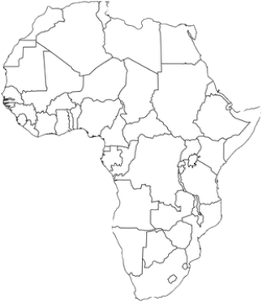
Population | 1 billion
Number of countries | 54
Special distinction (among many) | “Cradle of humankind”
Amount of world’s arable land | One sixth
Rank in size among continents | Second
Highest point | Kilimanjaro, Tanzania
Number of languages spoken | 1,500 (Arabic biggest)
Religions | Islam and Christianity (~40 % each)
Average economic growth rate | Above 7 %
Rank among world’s hot deserts | Biggest
Rank among world’s rivers | Longest (The Nile)
Biggest producer of … | Diamonds, gold, platinum, cocoa beans
AFRICA AT A GLANCE

Slide 21
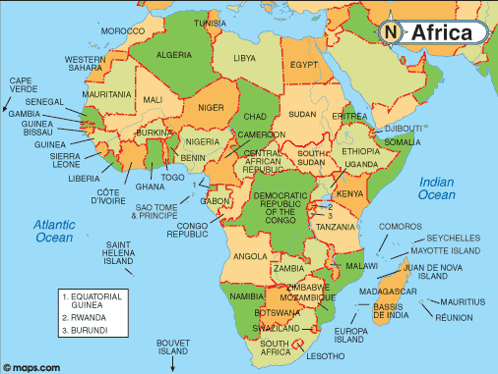

Slide 22
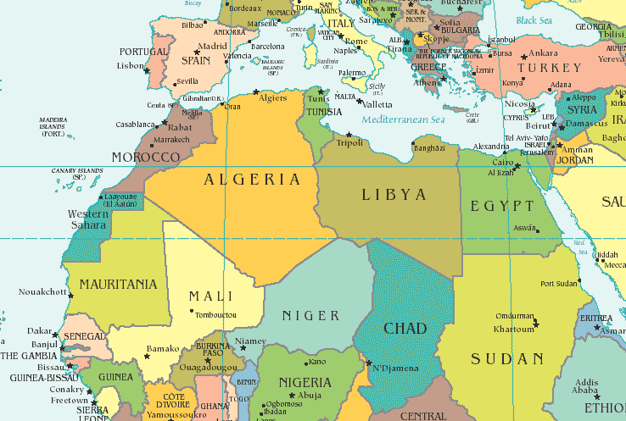
NORTH

Slide 23
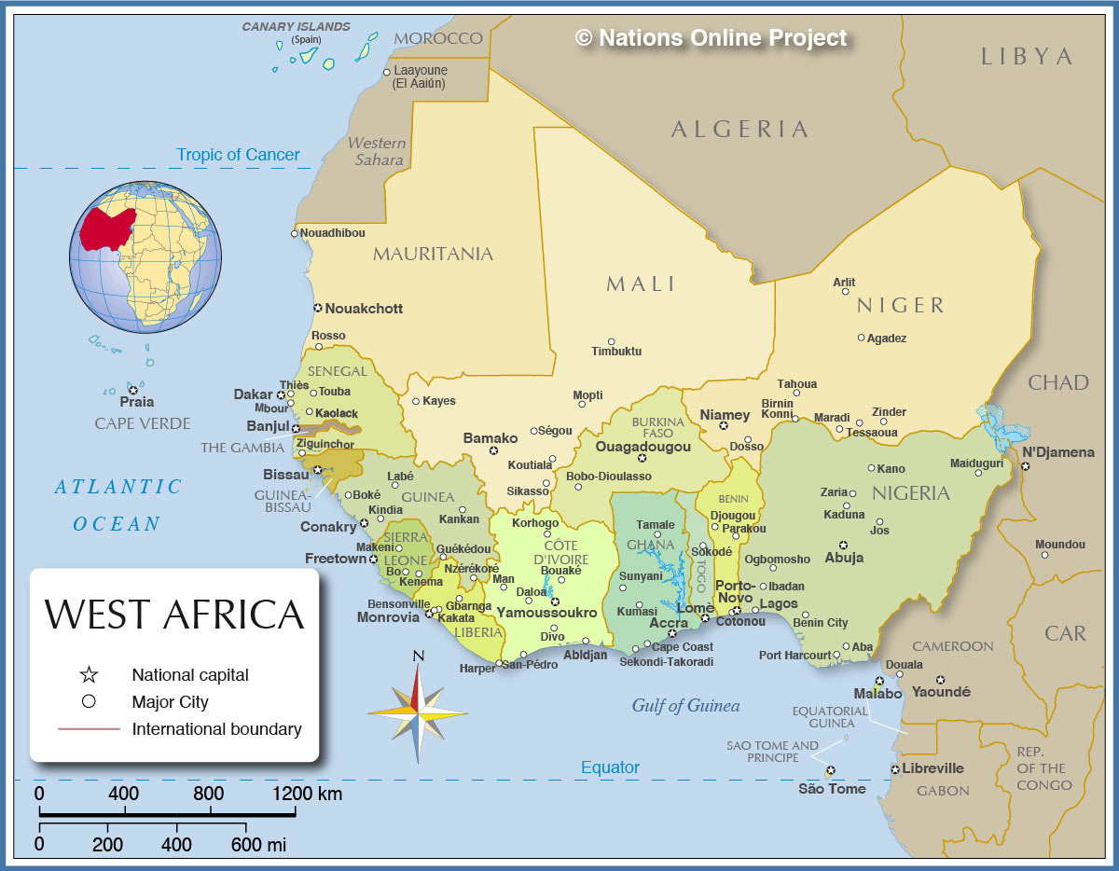
WEST

Slide 24
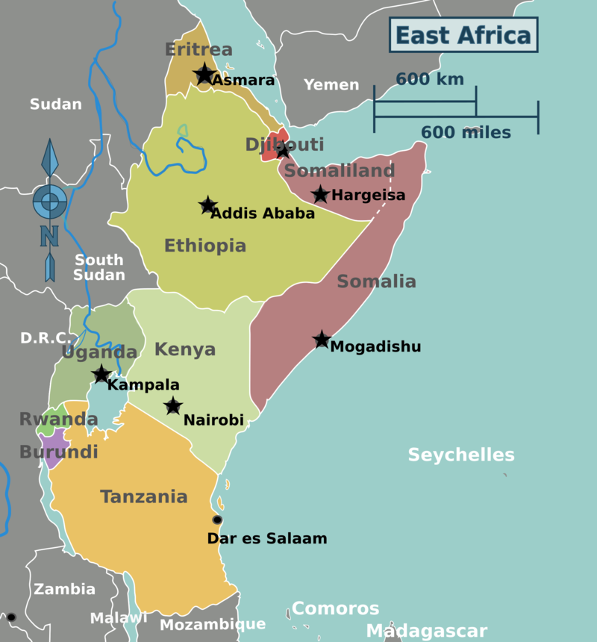
EAST

Slide 25
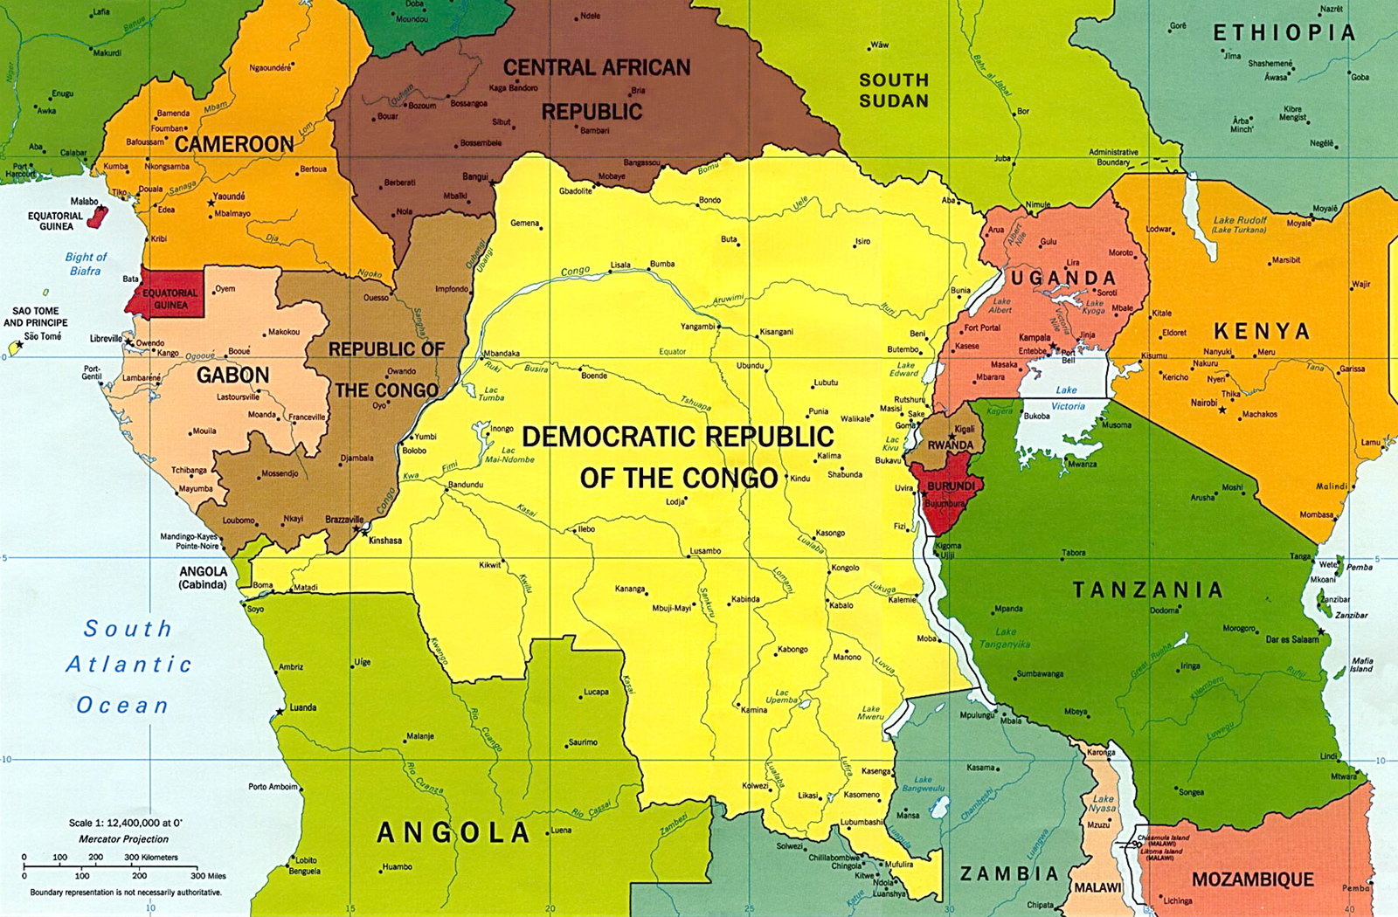
CENTRAL

Slide 26
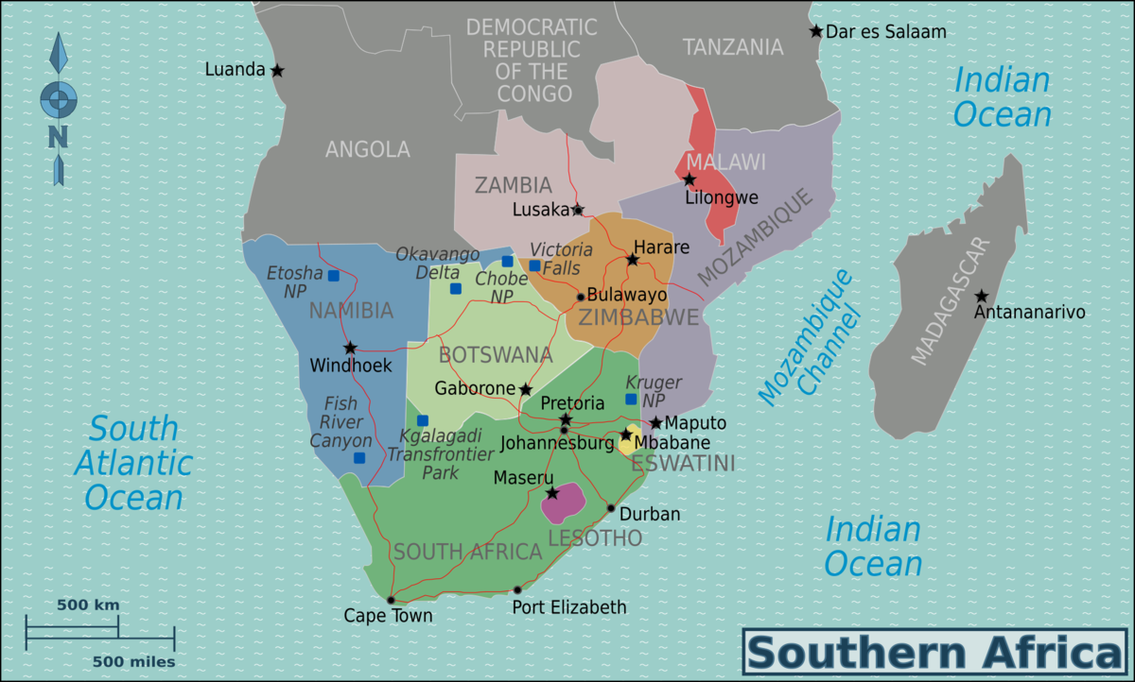
SOUTHERN

Slide 27
Population | 1 billion
Number of countries | 54
Special distinction (among several) | “Cradle of humankind”
Amount of world’s arable land | One sixth
Rank in size among continents | Second
Highest point | Kilimanjaro, Tanzania
Number of languages spoken | 1,500 (Arabic biggest)
Religions | Islam and Christianity (~40 % each)
Average economic growth rate | Above 7 %
Rank among world’s hot deserts | Biggest
Rank among world’s rivers | Longest (The Nile)
Biggest producer of … | Diamonds, gold, platinum, cocoa beans
AFRICA AT A GLANCE

Slide 28
READINGS
What are the main issues in U.S. relations with Sub-Saharan Africa?
And with East Africa?
Why are foreign powers scrambling to court Africa?
What priority should Washington give counterterrorism in Africa? Where?

Slide 29
INTERNSHIP CONVERSATIONS
INFORMAL DISCUSSION
Organization
Tasks and Responsibilities
Communications and Team Dynamics
Fun Things and Challenges
This week:
Noah Akosua Emma
Next week?

Slide 30
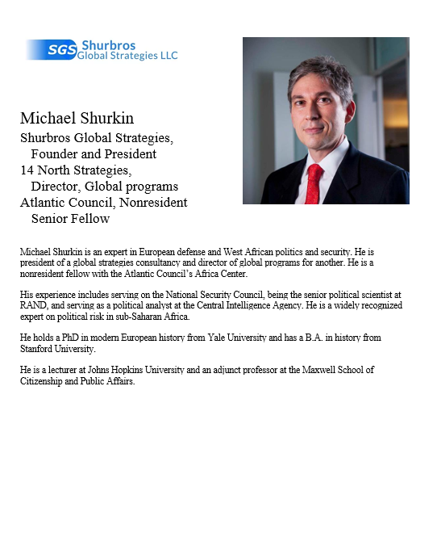
GUEST SPEAKER
Michael Shurkin
Shurbros Global Strategies, Founder and President
14 North Strategies, Director, Global programs
Atlantic Council, Nonresident Senior Fellow
- introduced by Akosua

Slide 31
break

Slide 32
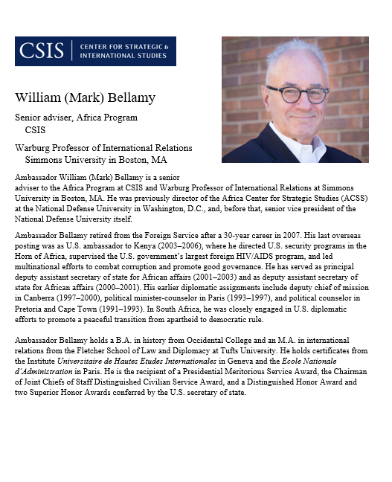
GUEST SPEAKER
Ambassador Mark Bellamy
Senior adviser, Africa Program CSIS
Warburg Professor of International Relations Simmons University in Boston, MA
- introduced by Bryce

Slide 33
LUNCH

Slide 34
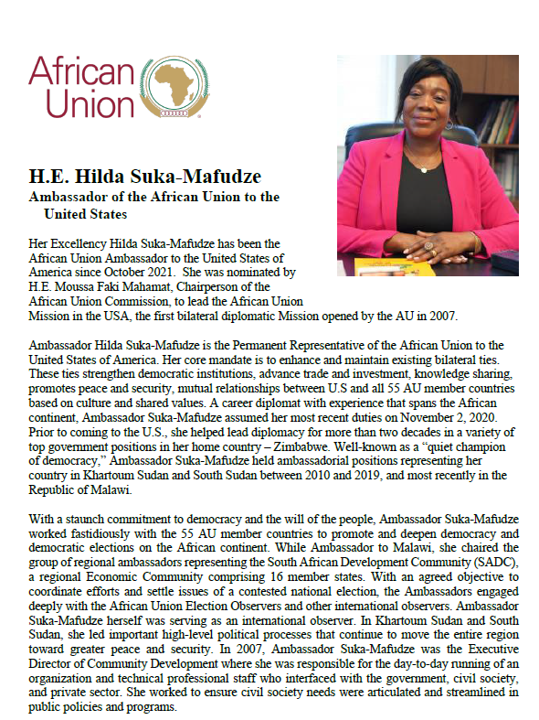
GUEST SPEAKER
Ambassador Hilda Suka-Mafudze
Ambassador of the African Union to the United States
- introduced by Jessica

Slide 35
Microsoft WORD tips and tricks

Slide 36
Professional Development Presentation and Discussion

Slide 37
WRAPUP

Slide 38
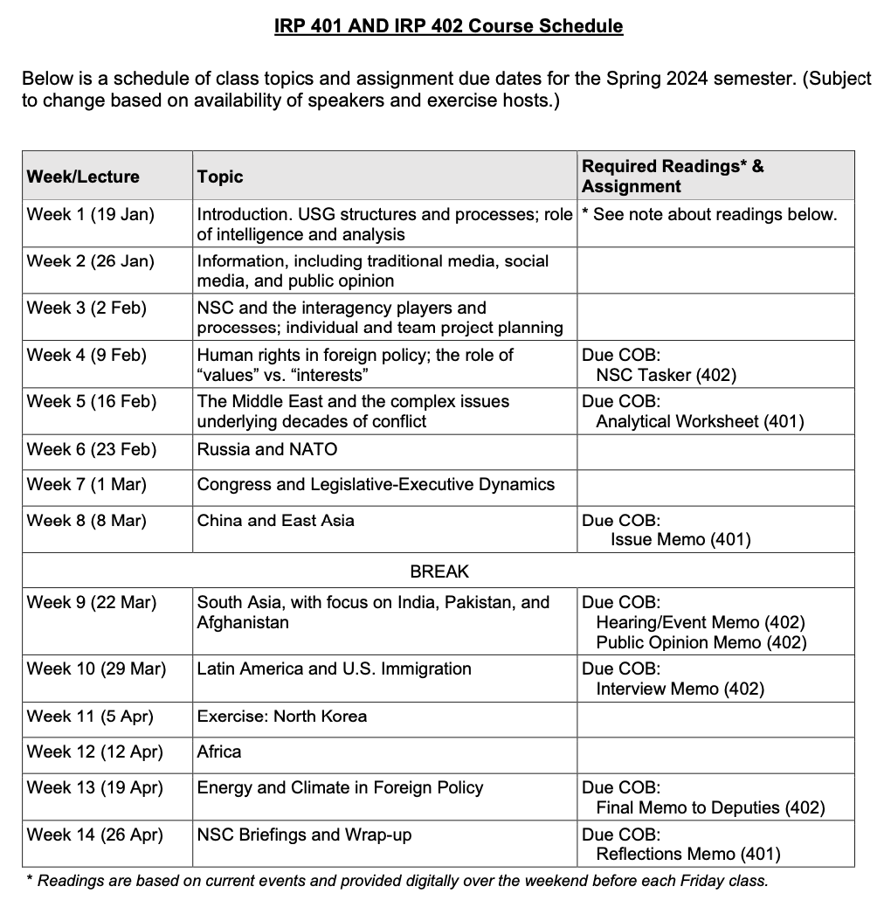
✓
401
402
✓
✓
✓
✓
QUESTIONS?
✓
✓

Slide 39
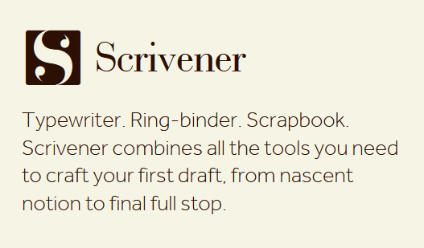

Slide 42
WRAPUP

Slide 43
Project Planning
Akosua | U.S.-Russia: How constrain Putin? | Ensuring microchip competition and supply
Nicolas | U.S.-North Korea: How constrain Kim?
Marcus | U.S.-Vietnam tech/innovation ties | U.S. education deficits
Mimi | Youth homelessness
Vaughn | Central America migration | Israel-Palestine: Two-state solution possible?
Matt | Crisis in Haiti
Gavin | Impact of COVID on mental health | U.S. policy toward Yemen and the Houthis
Noah | Reducing reliance on China trade
Meghan | Russia/Wagner influence in Africa | Impact of climate change on insurgency
Bryce | Improving gun control background checks
Emily | Russia WMD in wake of Ukraine war | How to deal with climate migrants/refugees
Tashakee | Negative impact of cobalt mining in DRC
Reese | South America climate migration | “War time policy”
Emma | U.S.-Mexico border deaths
Ding | Calming tensions on Korean peninsula | U.S. border-state challenges from immigration
Abby | Human trafficking | U.S. support to Ukraine defense against Russia
Jessica | Stopping the flow of fentanyl into U.S.

Slide 44
Next Week
Environment, Energy, and Foreign Policy
John Conger, Center for Climate and Security
Melinda Kimble, United Nations Foundation
More INTERNSHIP discussions Three volunteers?

Slide 45
Global Policy Seminar and NSC Simulation
IRP 401 - IRP 402
Week Twelve 12 April 2024
Prof. Fulton T. Armstrong

