Slide 1

Global Policy Seminar and NSC Simulation
IRP 401 - IRP 402
Week Thirteen 17 Apr 2026
Prof. Fulton T. Armstrong

Slide 2
Week 1 (16 Jan)
Week 2 (23 Jan)
Week 3 (30 Jan)
Week 4 (6 Feb)
Week 5 (13 Feb)
Week 6 (20 Feb)
Week 7 (27 Feb)
Week 8 (6 Mar)
Spring Break
Week 9 (20 Mar)
Week 10 (27 Mar)
Week 11 (3 Apr)
Week 12 (10 Apr)
Week 13 (17 Apri)
Week 14 (24 Apr)
Spring 2026

Slide 3
TODAY’S AGENDA
9:00 | Skills Discussion: Negotiating Salary for Internships and Jobs Samantha Clemence
10:15 | Canva Workshop Emma Carroll Hudson
11:15 | Internship Conversations Eli, Kennedy, Yvette, Kaiwen, Megha, Molisa, Emmett
~12:15 | Lunch Discussion: “The Evolving Business Model of the News Media” Merrill Brown, Visiting Professional Fellow, the Institute for Democracy, Journalism and Citizenship (IDJC) Nayyera Haq, Assistant Dean, Maxwell in DC
~1:30pm | Preps for Deputies Exercise Final guidances Team coordination time
~2:45 | Wrapup

Slide 4
TODAY’S AGENDA
9:00 | Skills Discussion: Negotiating Salary for Internships and Jobs Samantha Clemence
10:15 | Canva Workshop Emma Carroll Hudson
11:15 | Internship Conversations Eli, Kennedy, Yvette, Kaiwen, Megha, Molisa, Emmett
~12:15 | Lunch Discussion: “The Evolving Business Model of the News Media” Merrill Brown, Visiting Professional Fellow, the Institute for Democracy, Journalism and Citizenship (IDJC) Nayyera Haq, Assistant Dean, Maxwell in DC
~1:30pm | Preps for Deputies Exercise Final guidances Team coordination time
~2:45 | Wrapup

Slide 5


Slide 6


Slide 7

Canva Workshop
Emma Carroll Hudson

Slide 8
INTERNSHIP CONVERSATIONS
Informal Discussion
Launched with 2-3 mins on …
Organization name, business, structure
Your role – team, function, purpose
Typical duties and responsibilities
Most challenging aspect; most rewarding aspect
Your takeaway: what you’ve learned about yourself and future interests
Eli
Kennedy
Yvette
Kaiwen
Megha
Molisa
Emmett

Slide 9


Lunch Discussion
“The Evolving Business Model of the News Media”
Merrill Brown Visiting Professional Fellow, the Institute for Democracy, Journalism and Citizenship (IDJC)
Nayyera Haq Assistant Dean, Maxwell in DC

Slide 10
BREAK

Slide 11
DISCUSSION and PLANNING
Deputies Committee Exercise
ALL CLEAR?

Slide 12
DISCUSSION and PLANNING
The Deputies Paper
Due: TONIGHT

Slide 13

NSC DEPUTIES SIMULATION
Friday, 24 April
TWO ROLES
NSC Directors or Senior Directors briefing the issue and proposals.
“The Deputies” receiving the briefing, asking the questions, and making the decisions.

Slide 14
DEPUTIES COMMITTEE
STAFF | TOPIC | DECISIONMAKERS | DEPUTIES
Emmett | Danger of one-dimensional energy sector | Current Admin | Diego, Eli
John
Miles | Climate change and refugees/sovereignty | UN SecGen Staff | Yvette, Kaiwen
Kennedy
Eli | Iran-US relations | Current Admin | Bijan, Megha
Michael
Diego | Globalization and environmental impact | Current Admin | Filippo, Michael
Molisa
Kaiwen | China’s Influence in Africa | Current Admin | Megha, Molisa
Yvette
Bijan | Humanitarian Crisis in Gaza | UN Aid Coord Staff | Emmett, John
Megha
Filippo | North Korea illegal ops to support goals | Current Admin | Kennedy, Miles

Slide 15
PICK AN ANIMAL

Slide 16
PICK AN ANIMAL

Slide 17
READY?
PICK AN ANIMAL
2
6
5
3
7
4
8
1

Slide 18
NSC DEPUTIES SIMULATION
“The Deputies” receiving the briefing, asking the questions, and making the decisions.
Who are your decisionmakers?

Slide 19
Who attends?
National Security Advisor or Deputy
Deputy Secretary of State +1
Deputy Secretary of Defense +1
Deputy Secretary of Homeland Security +1
Deputy Secretary of Treasury +1
OVP National Security Advisor +1
NSC staff
OMB leadership or staff
Advisors
Joint Chiefs of Staff (JCS)
DNI and/or CIA
And other affected Deputies
NSC DEPUTIES

Slide 20
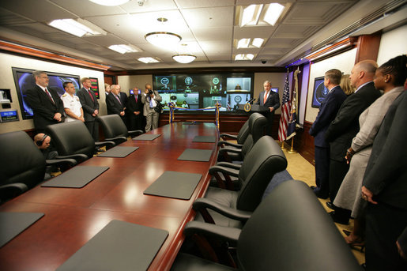
The Situation Room

Slide 21
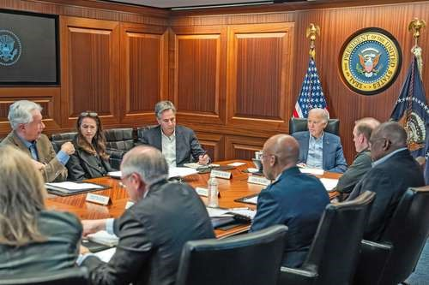
BURNS
HAINES
BLINKEN
SULLIVAN
BIDEN
AUSTIN
BROWN

Slide 22
What will the briefers do?
Serve as NSC Senior Directors or Directors briefing the issue and proposals.
BLUF on issue and proposal
Briefly …
Define the problem and status
Report key analysis (based on research, hearing/event, interviews, discussions)
Present recommendation and pro’s and con’s
Sum up with request for Deputies’ approval for main proposal
4 PowerPoint Slides
8-9 MINUTES (but Deputies can interrupt)

Slide 23
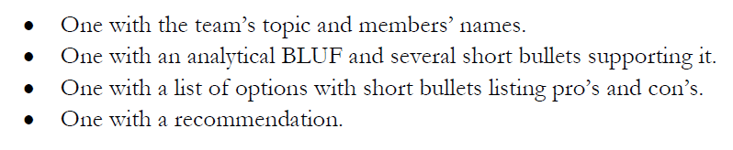
DC BRIEFING
The four PowerPoint slides
DEADLINE to submit in Blackboard: Wednesday (22 April) at 9pm.

Slide 24
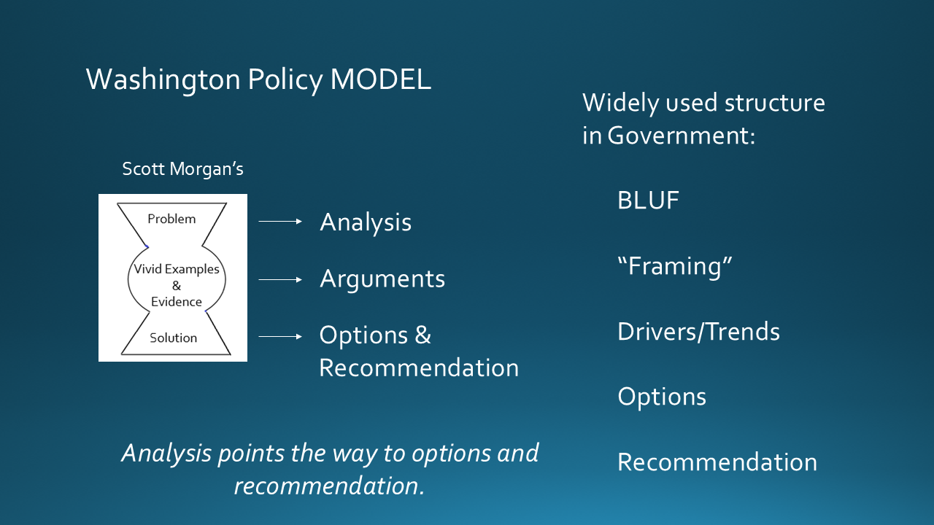
DC BRIEFING

Slide 25

DC BRIEFING
Scott Morgan’s MODEL
MODEL for our memo
Structure:
BLUF
“Framing”
Drivers/Trends
Options
Recommendation
Problem
Problem
Analysis
Options
Recommendation
Vivid Examples
&
Evidence
Solution
Next Steps
Morgan:
“If I buy your analysis, I’m much more likely to buy your recommendation.”

Slide 26
What will the deputies do?
Serve as decisionmakers.
READ and ABSORB materials provided in advance
LISTEN to the briefing but INTERRUPT if briefing is unclear
ASK questions about analysis and proposal
EXPRESS position on issue and proposal
After pause for all to “vote” …
Approve as is.
Approve with SPECIFIC, DIRECTED conditions.
Remand to Interagency Working Group for re-work.
Disapprove with prejudice.
Q&A and discussion: 8-9 MINUTES
All of you are deputies and will vote, but LEAD deputies will “sit at the table” and discuss their votes.

Slide 27
Who
do you want to be your deputies?
will be your deputies?

Slide 28
DEPUTIES COMMITTEE
STAFF | TOPIC | DEPUTIES
Emmett | Danger of one-dimensional energy sector
John
Miles | Climate change and refugees/sovereignty
Kennedy
Eli | Iran-US relations
Michael
Diego | Globalization and environmental impact
Molisa
Kaiwen | China’s Influence in Africa
Yvette
Bijan | Humanitarian Crisis in Gaza
Megha
Filippo | North Korea illegal ops to support goals
David

Slide 29
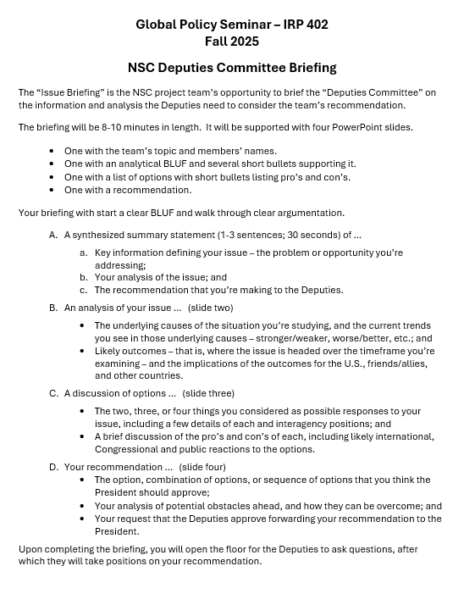
“DEPUTIES COMMITTEE” EXERCISE
GUIDANCE ON BRIEFING
All set?
All good on slides?

Slide 30
Any questions?

Slide 31
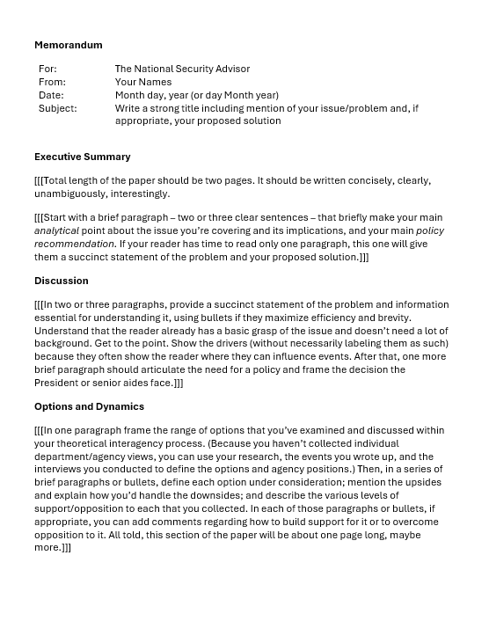
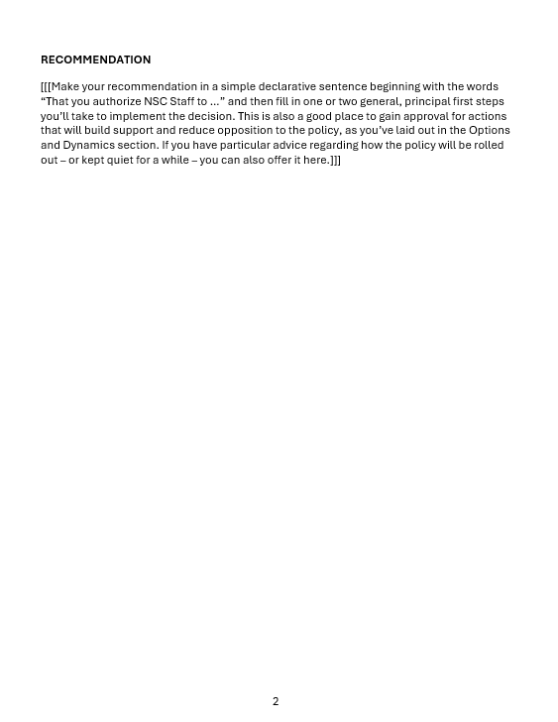
“The DEPUTIES Memo”

Slide 32
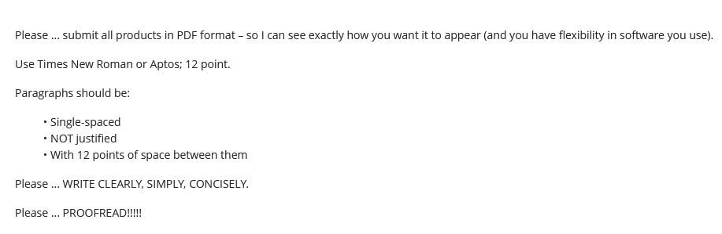
Guidance on Format

Slide 33
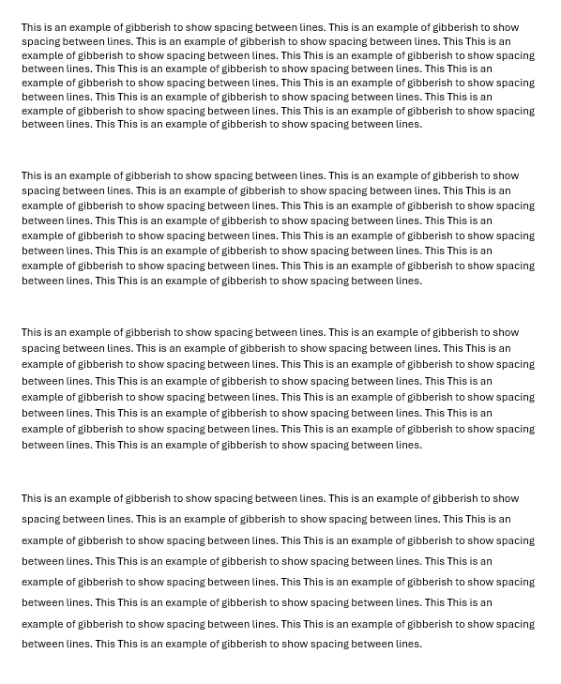
Single space (1.0)
Multiple (1.08)
Multiple (1.16)
1.5 lines (1.5)

Slide 34
REVIEW
What do good memos have in common?
JOB ONE:
MAKE IT EASY FOR YOUR READER TO GET WHAT THEY NEED TO KNOW.
Brevity | They don’t waste readers’ time.
Conciseness | They’re not sloppy, long-winded.
Clarity, precision | They don’t make reader sort through ambiguity.
Relevance | They don’t burden reader with clutter.
Objectivity | They don’t get bogged down in values, norms.
Readability | They’re not obtuse, ornate, distracting.

Slide 35
REVIEW
JOB ONE:
MAKE IT EASY FOR YOUR READER TO GET WHAT THEY NEED TO KNOW.
Digestible declarative sentences
Good, practical grammar
Unambiguous but “normal” vocabulary
Clear logic
Transparent drafter
Zero, minimal, or clearly labeled editorializing

Slide 36
REVIEW
What are the differences between academic writing and memo-writing?
“Washington Memo”
Purpose(s)
“Action”; empower reader by educating.
Scope
Background
Relevance
Only what reader needs to know to decide.
Only what’s relevant.
Examples to show point, not encyclopedia.
Style
Language
Length
Voice
Concise, direct, active.
“As brief as possible” (usually two pages).
Objective, not ornate.
Structure

Slide 37
REVIEW
Standard Info Memo
Standard Decision Memo
Subject: | Clear, crisp
Subject: | Clear, crisp
Thesis: | BLUF, analytical
Thesis: | BLUF, analytical
Framing: | What, when, who, where
Framing: | What, when, who, where
Dynamics: | Why, how
Dynamics: | Why, how
OPTIONS: | Stated, assessed; interagency views
Outcomes: | Likely, less likely (and why)
Outcomes: | Likely, less likely (and why)
Implications: | Why matter?
Implications: | Why matter?
RECOMMENDATION

Slide 38
REVIEW
Standard Info Memo
Standard Decision Memo
Subject: | Clear, crisp
Subject: | Clear, crisp
Thesis: | BLUF, analytical
Thesis: | BLUF, analytical
Framing: | What, when, who, where
STANDARD BRIEFING, TOO!
Framing: | What, when, who, where
Dynamics: | Why, how
Dynamics: | Why, how
OPTIONS | Stated, assessed; interagency views
Outcomes: | Likely, less likely (and why)
Outcomes: | Likely, less likely (and why)
Implications: | Why matter?
Implications: | Why matter?
RECOMMENDATION

Slide 39
REVIEW
The ways Washington memos are prepared, researched, drafted, and edited are different from academic, too.
Obsessively ask ourselves ...
What does the reader need to know (based on my understanding of my issue and their world)?
Does every word, phrase, sentence, and paragraph make it easy for my reader to grab and run?
If necessary, can I summarize my conclusions/ recommendations in 30 seconds or less?

Slide 40
REVIEW
Why is it important to be able to write a good “Washington Memo”?
Good writing is the single most important skill in this business because it shows …
you can think
you can communicate
you know what’s relevant
you are ready to operate
Other skills are important, but writing is central to almost all of them.

Slide 41
“The DEPUTIES Memo” -- STEP BY STEP
STEP BY STEP

Slide 42
IMPORTANT to note if you’re writing for anyone else.
For: | The National Security Advisor
From: | Your Names
Date: | Month day, year (or day Month year)
Subject: | Write a strong title including mention of your issue/problem and, if appropriate, your proposed solution

Slide 43
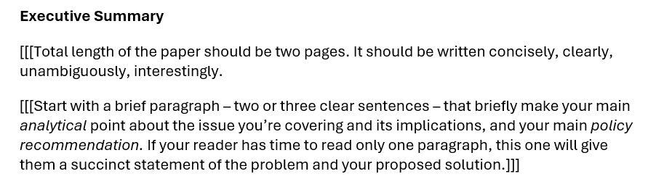

Slide 44
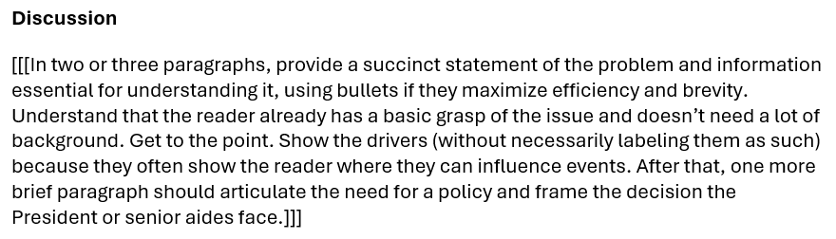

Slide 45
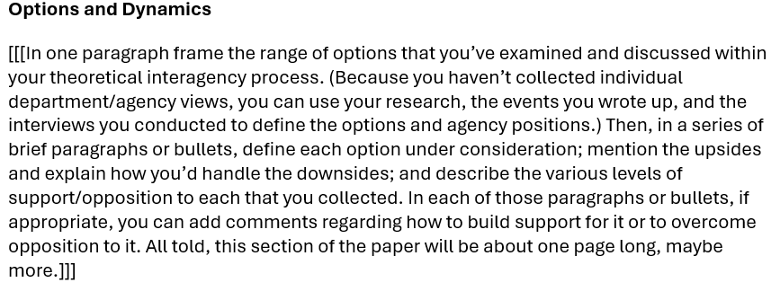

Slide 46
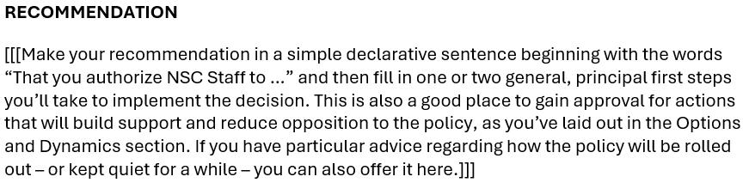

Slide 47
The memo must be good.
TONIGHT → | Memo post as assignment in BB.
Saturday/Sunday, 18-19 Apr → | I will send memo to Deputies – for them to review, digest, and prepare questions.
Wednesday evening, 22 Apr → | Slides posted as assignment in BB.
Friday, 24 Apr→ | Deputies exercise.
Questions?

Slide 48
The exercise is your final exam.
Prepare and perform accordingly.
As briefers/staff and as Deputies

Slide 49
The memo must be good.
TONIGHT → | Memo post as assignment in BB.
Saturday/Sunday, 18-19 Apr → | I will send memo to Deputies – for them to review, digest, and prepare questions.
Wednesday evening, 22 Apr → | Slides posted as assignment in BB.
Friday, 24 Apr→ | Deputies exercise.
Questions?

Slide 50
Any Questions or Comments about the Deputies Memo, Briefings, or Slides?
CLASS TIME for Team Coordination

Slide 51
Any Questions or Comments about the Deputies Memo, Briefings, or Slides?
CLASS TIME for Team Coordination

Slide 52
Any Questions or Comments about the Deputies Memo, Briefings, or Slides?
Ready to excel next Friday?

Slide 53


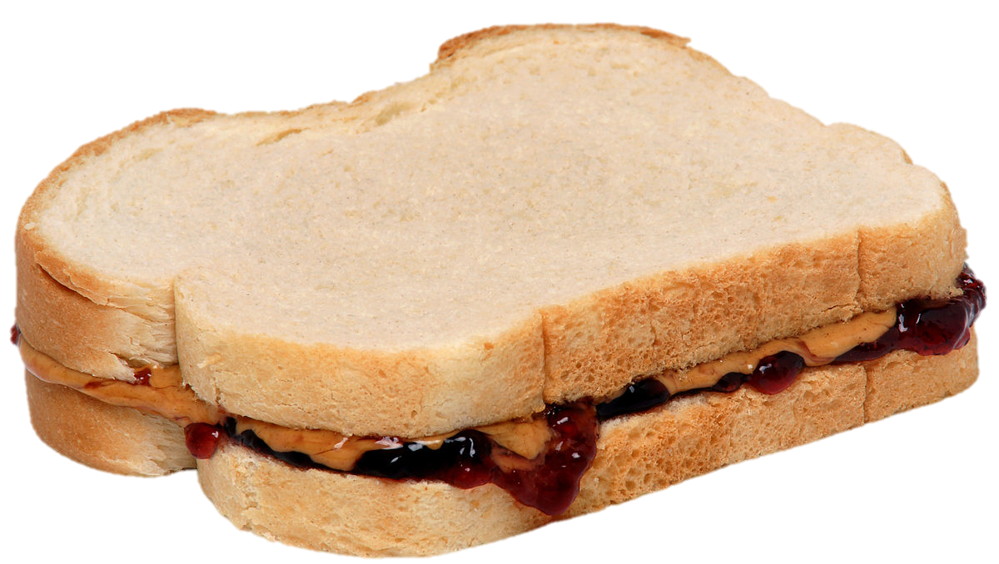
LUNCH

Slide 54
PROJECT UPDATES

Slide 55
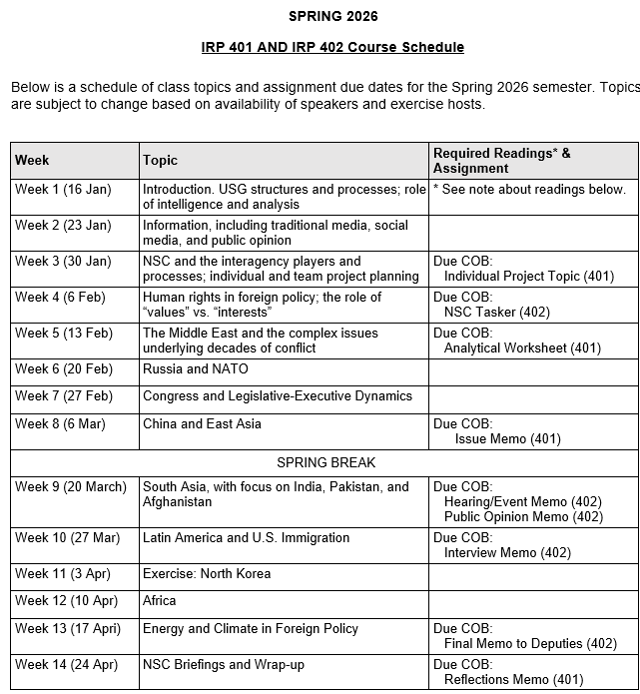
✓
✓
✓
✓
401
✓
✓
✓
✓
✓
✓
✓
✓
402
✓
✓
✓
✓
✓
✓
✓
✓
✓
✓
✓
✓
✓
✓
✓
✓
✓
✓
✓
✓
✓
✓
✓
✓

Slide 56
PROJECT PLANNING
Emmett | Countering “CRINK” Alignment | Danger of one-dimensional energy sector
John | Innovation and Environmental Capacity
Miles | Capitalism and Environment Protection | Climate change and refugees/sovereignty
Kennedy | Taiwan Prosperity and U.S. Interests
Eli | Prediction Markets | Iran-US relations
Michael | Foreign Manipulation of U.S. Elections
Diego | Russian Invasion of Ukraine | Globalization and environmental impact
Molisa | U.S.-China Competition in Critical Technologies
Kaiwen | U.S.-China Economic and Trade Competition | China’s Influence in Africa
Yvette | Rwanda-DRC Conflict and Resolution
Bijan | Housing Shortage and its Implications | Humanitarian Crisis in Gaza
Megha | Restrictive U.S. Immigration and Visa Policies
Filippo | Transatlantic Relations | North Korea illegal ops to support goals
David | ???? | ??????

Slide 57
DISCUSSION
Comfortable?
Topics
How partnership will work
The purposes
Substance, process, skills
The elements
401
Analysis
“Memo #2”
402
Proposal
Hearing/event
Public opinion
Interviews
DC memo
Briefing

Slide 58
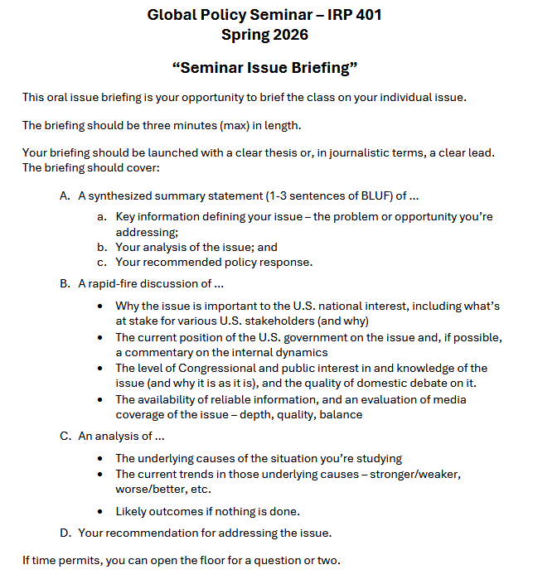
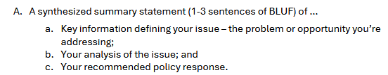
BRIEFINGS
One-Minute Briefing
Your 401 topic
For intelligent non-specialist
Problem-drivers-options- recommendation
Interesting

Slide 59
BRIEFINGS
One-Minute Briefing
Your 401 topic
For intelligent non-specialist
Problem-drivers-options- recommendation
Interesting
FEEL GOOD?
Diego | Eli | Filippo | Michael
Emmett | Meghavarshini | Kennedy | Kaiwen
John | Miles | Molisa | Bijan
Yvette

Slide 60
Next week …

Slide 61

WRAPUP

Slide 62
Questions? Comments? Concerns? Suggestions?

Slide 63
Global Policy Seminar and NSC Simulation
IRP 401 - IRP 402
Week Thirteen 17 Apr 2026
Prof. Fulton T. Armstrong

