Slide 1

Global Policy Seminar and NSC Simulation
IRP 401 - IRP 402
Week Thirteen 21 November 2025
Prof. Fulton T. Armstrong

Slide 2
Week 1 (29 Aug)
Week 2 (5 Sep)
Week 3 (12 Sep)
Week 4 (19 Sep)
Week 5 (26 Sep)
Week 6 (3 Oct)
Week 7 (10 Oct)
Week 8 (17 Oct)
Week 9 (24 Oct)
Week 10 (31 Oct )
Week 11 (7 Nov)
Week 12 (14 Nov)
Week 13 (21 Nov)
Thanksgiving Break
Week 14 (5 Dec)
Fall 2025

Slide 3
TODAY’S AGENDA
9:00 | Class discussion on Cuba and readings
9:30 | Ubers
10:00 | Ambassador Lianys Torres Embassy of Cuba - Introduced by Maeve
~11:30 | Ubers back to SUDC
12:00 | Lunch
1:00 | Melinda Kimble Senior Fellow, United Nations Foundation - Introduced by Priya
2:15 | Thomas Hoang - Professional Skill Development – Money Essentials for Young Professionals - introduced by Richard
~3:30 | Wrapup

Slide 4
TODAY’S AGENDA
9:00 | Class discussion on Cuba and readings
9:30 | Ubers
10:00 | Ambassador Lianys Torres Embassy of Cuba - Introduced by Maeve
~11:30 | Ubers back to SUDC
12:00 | Lunch
1:00 | Melinda Kimble Senior Fellow, United Nations Foundation - Introduced by Priya
2:15 | Thomas Hoang - Professional Skill Development – Money Essentials for Young Professionals - introduced by Richard
~3:30 | Wrapup

Slide 5
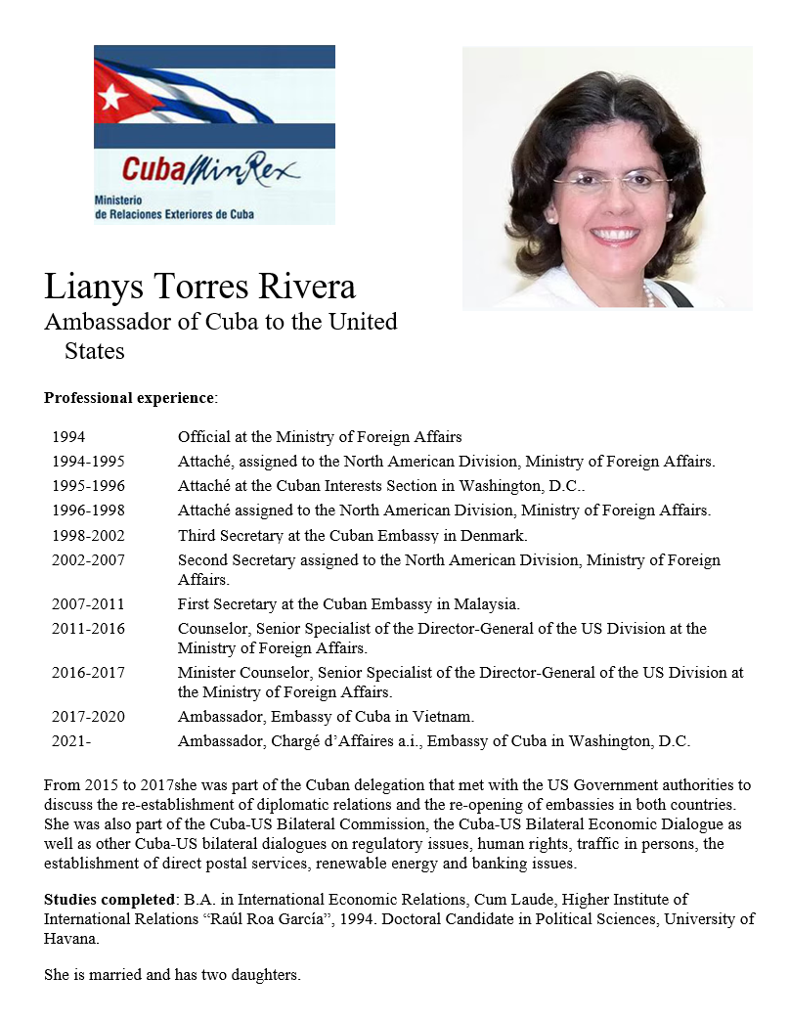
GUEST SPEAKER
Amb. Lianys Torres
Embassy of Cuba
- Introduced by Maeve

Slide 6
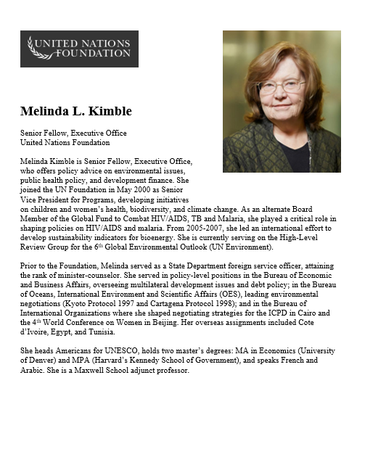
GUEST SPEAKER
Melinda Kimble
UN Foundation
- Introduced by Priya

Slide 7
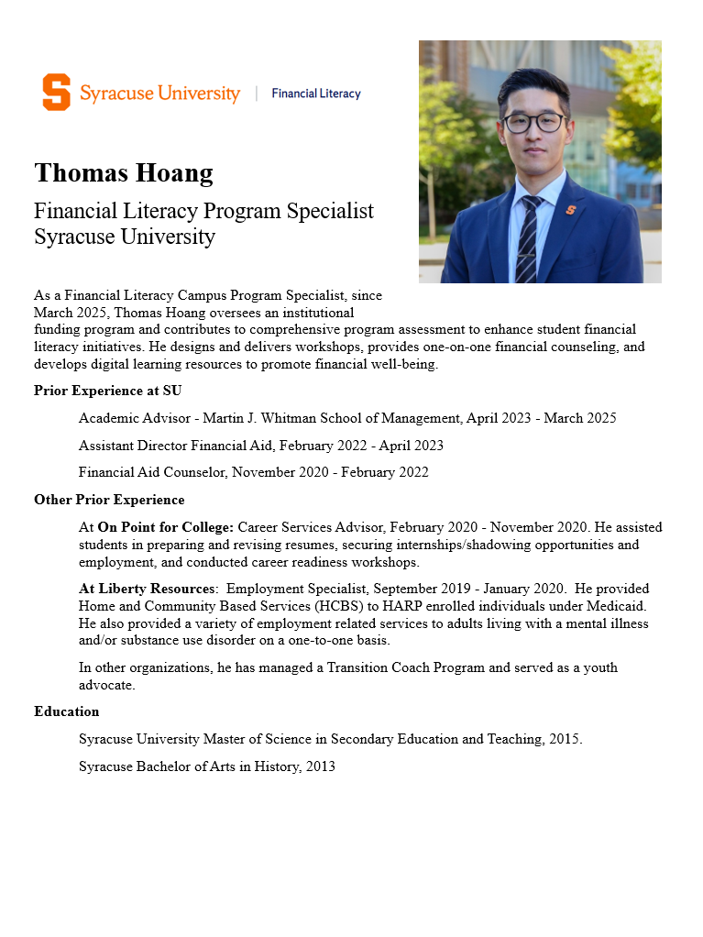
GUEST SPEAKER
Thomas Hoang
SU Financial Literacy
- Introduced by Richard

Slide 8
DISCUSSION
Cuba
What’s going on?
What should the USG do?
What bearing does the Venezuela operation have?

Slide 9
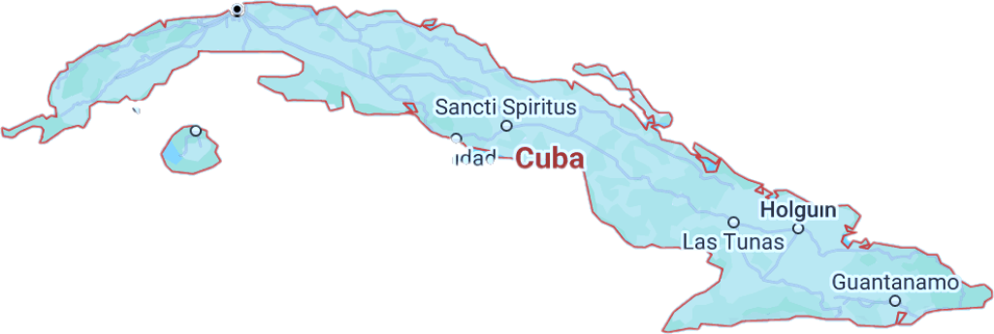
Cuba … and U.S. Policy
Notes:
REMEMBER CHATS ARE ON T.V.

Slide 10
The issue before us … “THE CUBA QUESTION”
What is happening and why?
Where are things headed?
What is the U.S. angle?
Our role?
Our interests?
Our policies?
Notes:
Want to provoke you … intellectually … to challenge analysis, including mine, and policy.
Will put to you whether policy represents best of American values – hr, democracy, etc., on one side, but HOW.
Will ask you whether policy should be based on process or results.

Slide 11

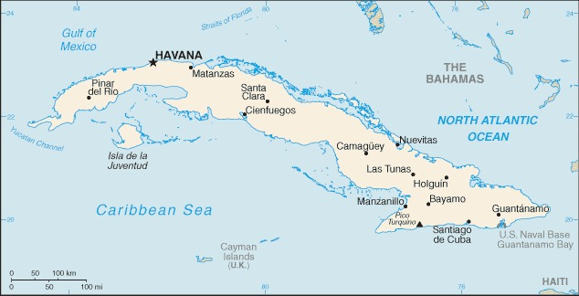
740m (1,250km)across

Slide 12
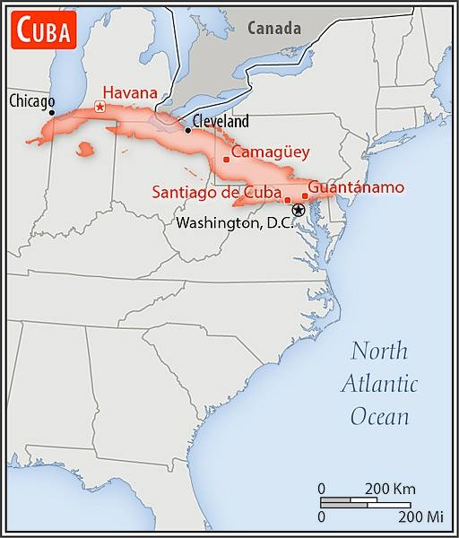

Slide 13
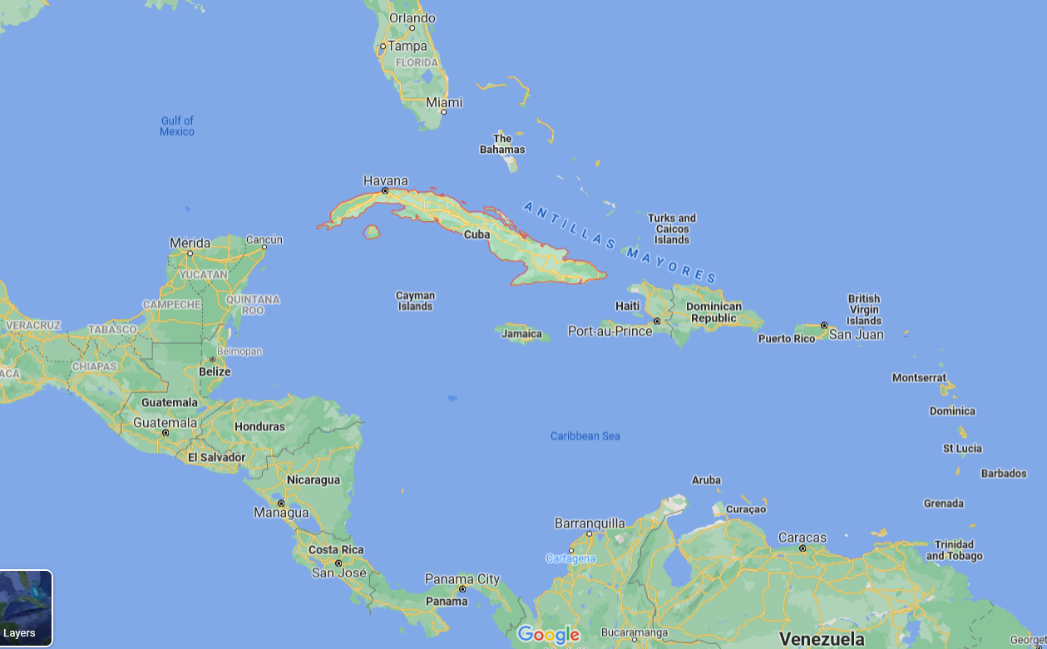
La Perla de las Antillas

Slide 14
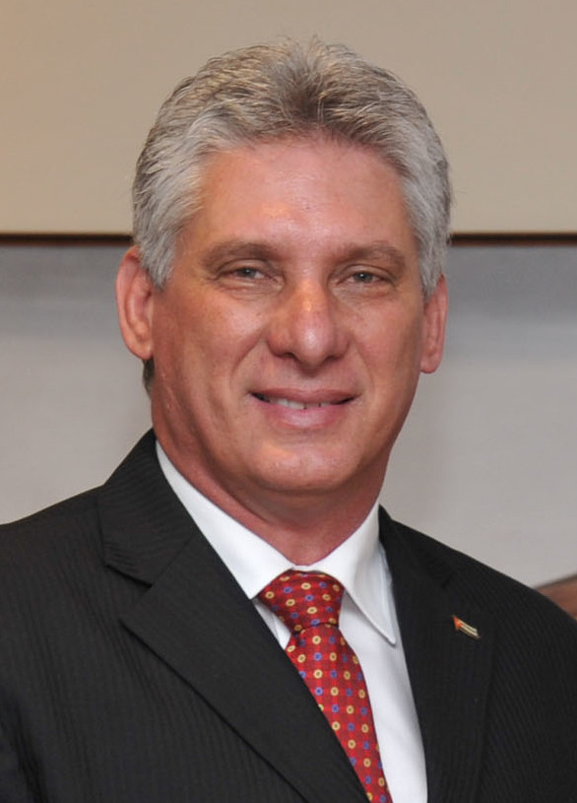
Chief of State
President Miguel DÍAZ-CANEL Bermúdez
President of the Council of State and the Council of Ministers since April 2018
First Secretary of the Communist Party of Cuba since April 2021
Prime Minister Manuel MARRERO Cruz
Head of Government (Council of Ministers) since December 2019

Slide 15
Life is TOUGH in Cuba.
Shortages of everything, including food and medicine
Unemployment/underemployment
Inflation
Electricity outages; fuel shortages
Sick and tired of it all

Slide 16
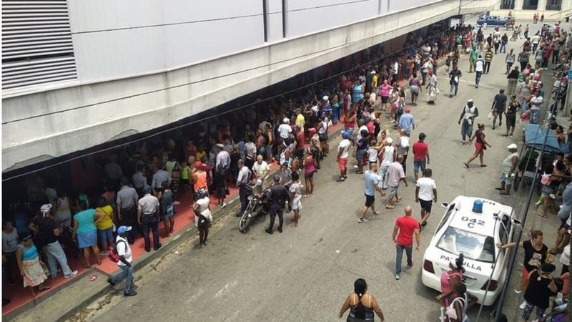
ECONOMY (NEVER GOOD) WORSE
Contracting 10% or more each year
Continued bad this year
SHORTAGES (NEVER GOOD) WORSE
Hours in line for basics
Hospitals short of supplies
Power outages in summer heat
Worst since “Special Period” in early ‘90s

Slide 17

ANALYTICAL DEBATE: Why’s the economy so bad?
Some controversy on how to rank reasons, but my ranking in recent years:
AGGRAVATING IT ALL:
Government failure to reform inefficient centrally controlled economy
Promised repeatedly
Done piecemeal, haltingly
Not delivered
Even good reform turned bad
COVID
Trump and Biden suspended licenses for U.S. travel
Trump essentially shut down remittances; Biden reopened w/o banks
Trump pressed ahead with Title III, etc., and Biden continued
Trump and Biden put Cuba back on SSOT list, and Biden enforced punitive ESTA measures.
~$3.5 billion
2%-3% GDP
56 percent of families
U.S. SANCTIONS
Shut door to tourists, source of $3 billion/year
Depressed domestic production, consumption
Just generally wore people down
VENEZUELA
Reduced source of hard-currency for services
Reduced source of subsidized oil
Estimated 50% drop in supplies; formerly ~112k barrels/day

Slide 18
U.S. Policy?
Notes:
REMEMBER CHATS ARE ON T.V.

Slide 19
“Maximum pressure”
WHY?
Cuban actions past/present?
Human rights?
U.S. domestic political issues?
Economic embargo since 1962 “Extraterritorial sanctions” Diplomatic isolation
“Democracy promotion” Radio/TV Martí Various clandestine actions
Notes:
REMEMBER CHATS ARE ON T.V.

Slide 20


Slide 21


Slide 22
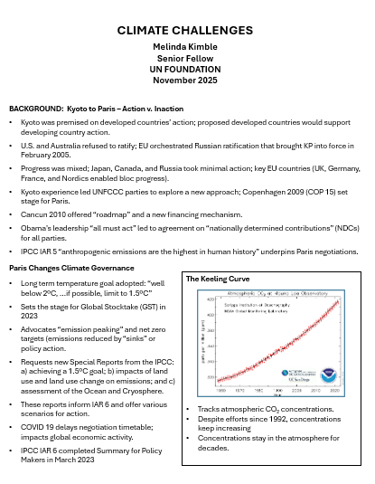
GUEST SPEAKER
Melinda Kimble
UN Foundation
4pp

Slide 23
GUEST SPEAKER
Melinda Kimble
UN Foundation
- introduced by Priya

Slide 24
GUEST SPEAKER
Thomas Hoang
SU Financial Literacy
- Introduced by Richard

Slide 25


Slide 26
DISCUSSION and PLANNING
Deputies Committee Exercise

Slide 27

NSC DEPUTIES SIMULATION
Friday, 5 December
ALL CLEAR????
TWO ROLES
NSC Directors or Senior Directors briefing the issue and proposals.
“The Deputies” receiving the briefing, asking the questions, and making the decisions.

Slide 28
What will the briefers do?
ALL CLEAR????
Serve as NSC Senior Directors or Directors briefing the issue and proposals.
BLUF on issue and proposal
Briefly …
Define the problem and status
Report key analysis (based on research, hearing/event, interviews, discussions)
Present recommendation and pro’s and con’s
Sum up with request for Deputies’ approval for main proposal
4 PowerPoint Slides
8-9 MINUTES (but Deputies can interrupt)

Slide 29
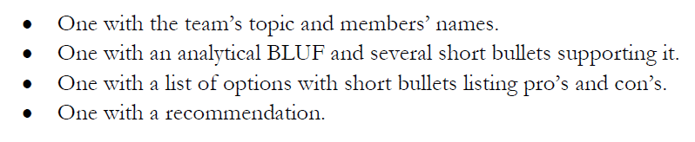
DC BRIEFING
The four PowerPoint slides
DEADLINE to submit in Blackboard: Wednesday (3 Dec) at 9pm.

Slide 30
What will the deputies do?
ALL CLEAR????
Serve as decisionmakers.
READ and ABSORB materials provided in advance
LISTEN to the briefing but INTERRUPT if briefing is unclear
ASK questions about analysis and proposal
EXPRESS position on issue and proposal
After pause for all to “vote” …
Approve as is.
Approve with SPECIFIC, DIRECTED conditions.
Remand to Interagency Working Group for re-work.
Disapprove with prejudice.
Q&A and discussion: 8-9 MINUTES
All of you are deputies and will vote, but LEAD deputies will “sit at the table” and discuss their votes.

Slide 31
DEPUTIES EXERCISE
STAFF | TOPIC | “DEPUTIES” | DEPUTIES
Maisie | U.S. Declining Birth Rates | Senate Committee on Health, Education, Labor, Pensions (Chair and Ranking Member) | Esme Camille
Skye
Esme | U.S. Culture Wars | Democratic Caucus, U.S. Senate | Skye Maisie
Camille
Erik | Israeli Use of Lavender AI in Targeting | Current NSC | Alex Bobby
Richard
Alex | Iranian Nationalism | Senate Foreign Relations Committee (both parties) | Erik Katelyn
Syarra
Maeve | U.S. Declining Birth Rates | Current NSC | Syarra Priya
Kiana
Mo | Impact of U.S.-China Tariffs | Current NSC | Richard Kiana
Bobby
Gabby | U.S.-Israel Relations After Netanyahu | Current NSC | Sarina Maeve
Katelyn
Sarina | Crisis of Legal Immigration Pathways in the U.S. | Senate Foreign Relations Committee (Dems only) | Mo Gabby
Priya

Slide 32
The memo must be good.
Last Friday → | Choose your Deputies.
Tonight → | Memo post as assignment in BB.
Tomorrow/Sunday → | I will send memo to Deputies – for them to review, digest, and prepare questions.
Wednesday evening, 3 Dec → | Slides posted as assignment in BB.
Friday, 5 Dec → | Deputies exercise.
Questions?

Slide 33
The exercise is your final exam.
Prepare and perform accordingly.
As briefers/staff and as Deputies

Slide 34
The memo must be good.
Friday, 14 Nov → | Choose your Deputies.
Friday evening , 21 Nov → | Memo post as assignment in BB.
Saturday/Sunday, 22-23 Nov → | I will send memo to Deputies – for them to review, digest, and prepare questions.
Wednesday evening, 3 Dec → | Slides posted as assignment in BB.
Friday, 5 Dec → | Deputies exercise.
Questions?

Slide 35
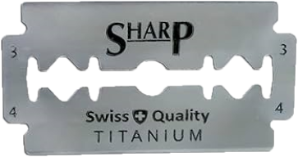
Next class 5 Dec 2025
EARLY START
Breakfast at 8:40
Deputies Committee at 9:00 SHARP
and
Lunch at 2:00

Slide 36

Happy Thanksgiving

Slide 37
Global Policy Seminar and NSC Simulation
IRP 401 - IRP 402
Week Thirteen 21 November 2025
Prof. Fulton T. Armstrong

