Slide 1
Global Policy Seminar and NSC Simulation
IRP 401 - IRP 402
Week Thirteen 19 April 2024
Prof. Fulton T. Armstrong

Slide 2
Week 1 (19 Jan)
Week 2 (26 Jan)
Week 3 (2 Feb)
Week 4 (9 Feb)
Week 5 (16 Feb)
Week 6 (23 Feb)
Week 7 (1 Mar)
Week 8 (8 Mar)
BREAK
Week 9 (22 Mar)
Week 10 (29 Mar)
Week 11 (5 Apr)
Week 12 (12 Apr)
Week 13 (19 Apr)
Week 14 (26 Apr)
SPRING 2024

Slide 3
TODAY’S AGENDA
9:00 | Class Discussion Readings and Quiz Project updates Internship conversations – Matthew, Marcus – and conclusions (all)
10:00 | Melinda KIMBLE Senior Fellow, United Nations Foundation introduced by Jessica
11:30 | Professional Development Presentation and Exercise: Negotiating a Salary Fulton and Prof. London
12:30 | Lunch
2:00 | Planning
2:30 | John CONGER Director Emeritus, Center for Climate and Security - Introduced by Reese

Slide 4
TODAY’S AGENDA
9:00 | Class Discussion Readings and Quiz Project updates Internship conversations – Matthew, Marcus – and conclusions (all)
10:00 | Melinda KIMBLE Senior Fellow, United Nations Foundation introduced by Jessica
11:30 | Professional Development Presentation and Exercise: Negotiating a Salary Fulton and Prof. London
12:30 | Lunch
2:00 | Planning
2:30 | John CONGER Director Emeritus, Center for Climate and Security - Introduced by Reese

Slide 5
Gates open 5:30
Game starts 6:45

Slide 6
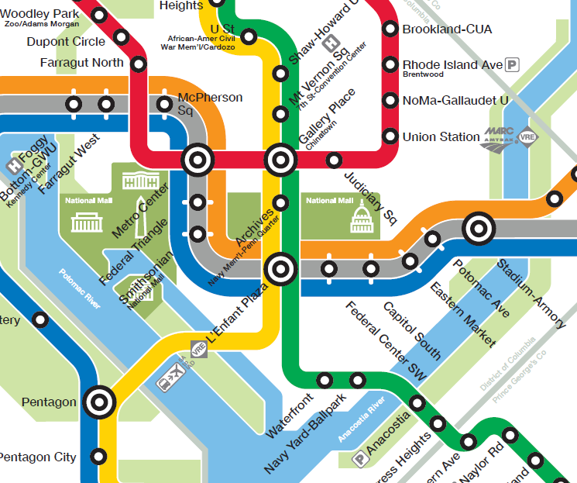
RED line (direction: Glenmont)
→ Gallery Place
GREEN line (direction: Branch Ave)
→ Navy Yard-Ballpark
S/O/B line (toward Capitol Hill)
→ L’Enfant Plaza
GREEN line (direction: Branch Ave)
→ Navy Yard-Ballpark

Slide 7
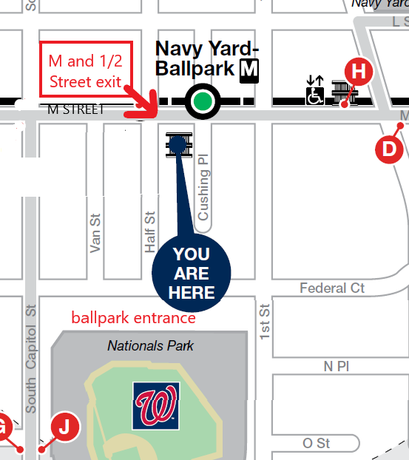
EXIT –
SE corner M & Half Sts., SE

Slide 8
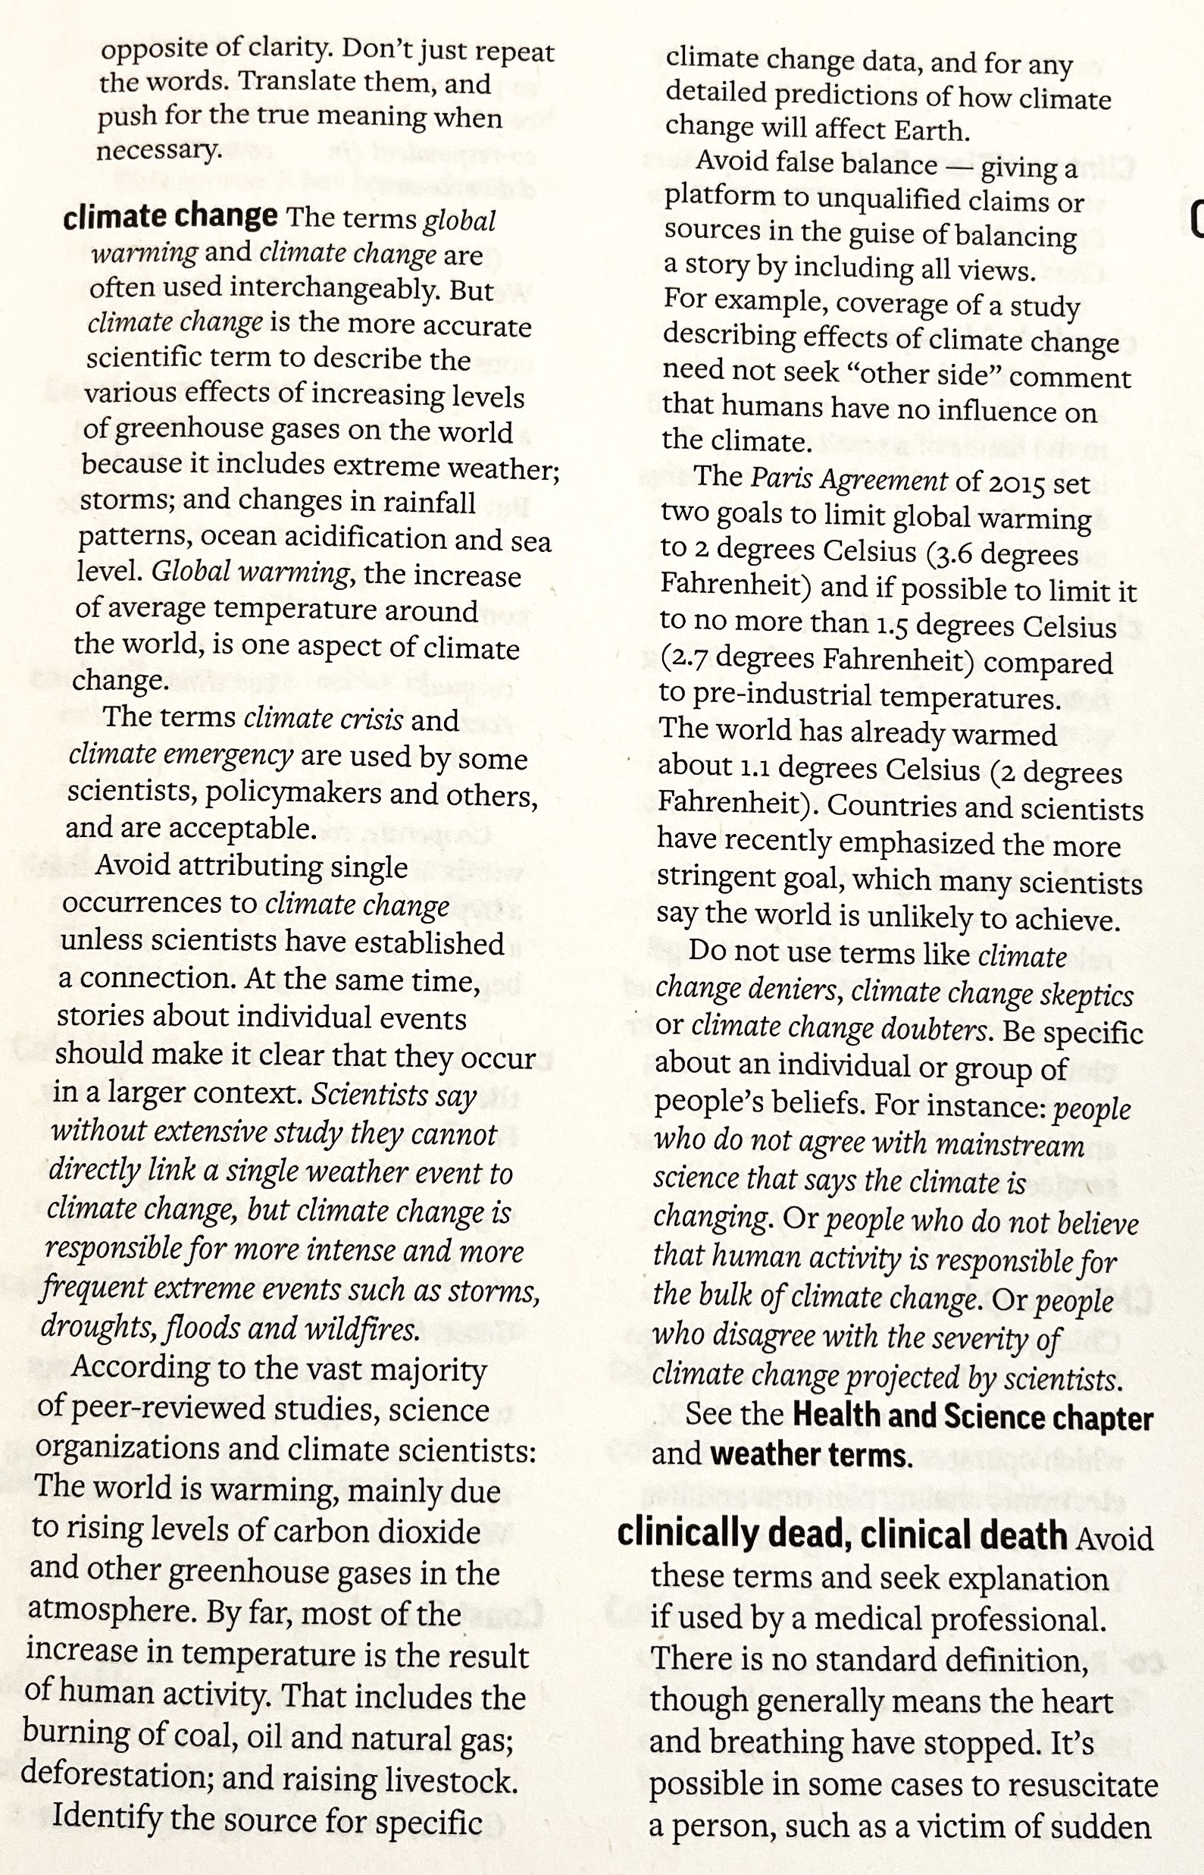
READINGS
Terms
Climate change
vs
Global Warming

Slide 9
READINGS
A summary (by the organizers) of the achievements of the UN Climate Change COP 28 conference in November, which they said was “particularly momentous” for several reasons.
A longer (but not required reading) summary of COP 28’s “successes and failures” prepared by the Brookings Institution.
The Executive Summary and Introduction of a paper published by guest-speaker John Conger’s organization.
The factsheet covering the documents (in a combined PDF) released by the White House in late October 2021 about the climate crisis from various government departments and agencies – PLUS the key judgments (pp i-ii) of the Intelligence Community assessment. The WH document has short summaries of each the papers by the Intelligence Community, Department of Defense, Department of Homeland Security, and its own report on the impact of climate change on migration.
QUIZ →

Slide 10
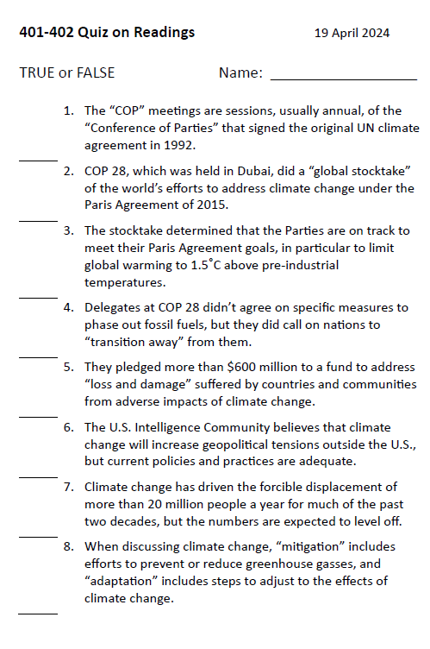
QUIZ

Slide 11
INTERNSHIP CONVERSATIONS
INFORMAL DISCUSSION
Organization
Tasks and Responsibilities
Communications and Team Dynamics
Fun Things and Challenges
This week:
Mathew Marcus
(Group discussion on internship experiences)

Slide 12
Any questions?

Slide 13
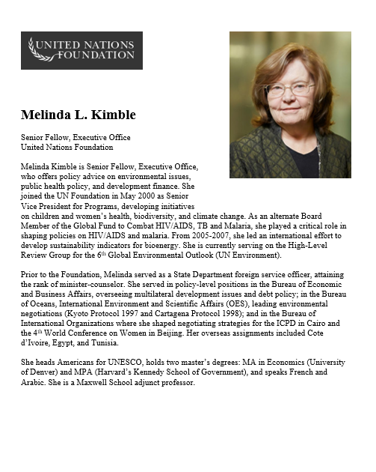
GUEST SPEAKER
Melinda Kimble
UN Foundation
- introduced by Jessica

Slide 14
break

Slide 16
LUNCH

Slide 17
DISCUSSION and PLANNING
Deputies Committee Exercise

Slide 18
NSC DEPUTIES SIMULATION
Friday, 26 April
TWO ROLES
NSC Directors or Senior Directors briefing the issue and proposals.
“The Deputies” receiving the briefing, asking the questions, and making the decisions.

Slide 19
NSC DEPUTIES
Who attends?
National Security Advisor or Deputy
Deputy Secretary of State +1
Deputy Secretary of Defense +1
Deputy Secretary of Homeland Security +1
Deputy Secretary of Treasury +1
OVP National Security Advisor +1
NSC staff
OMB leadership or staff
Advisors
Joint Chiefs of Staff (JCS)
DNI and/or CIA
And other affected Deputies

Slide 20
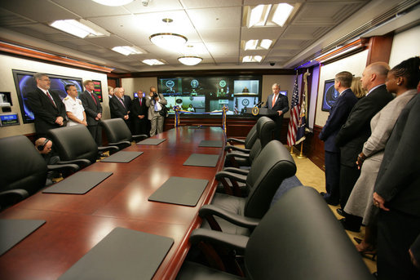
The Situation Room

Slide 21
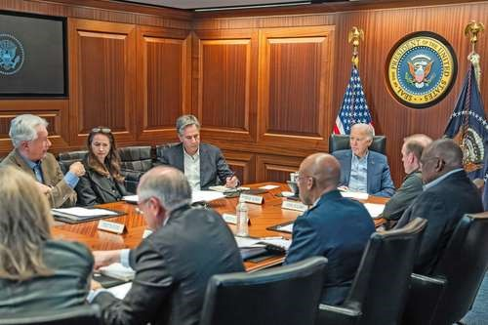
BURNS
HAINES
BLINKEN
SULLIVAN
BIDEN
AUSTIN
BROWN

Slide 22
What will the briefers do?
Serve as NSC Senior Directors or Directors briefing the issue and proposals.
BLUF on issue and proposal
Briefly …
Define the problem and status
Report key analysis (based on research, hearing/event, interviews, discussions)
Present recommendation and pro’s and con’s
Sum up with request for Deputies’ approval for main proposal
4 PowerPoint Slides
8-10 MINUTES (but Deputies can interrupt)

Slide 23
DC BRIEFING
The four PowerPoint slides
DEADLINE to submit in Blackboard: Thursday at NOON.

Slide 24
DC BRIEFING
Scott Morgan’s MODEL
MODEL for our memo
Structure:
BLUF
“Framing”
Drivers/Trends
Options
Recommendation
Problem
Problem
Analysis
Options
Recommendation
Vivid Examples
&
Evidence
Solution
Next Steps
Morgan:
“If I buy your analysis, I’m much more likely to buy your recommendation.”

Slide 25
What will the deputies do?
Serve as decisionmakers.
READ and ABSORB materials provided in advance
LISTEN to the briefing but INTERRUPT if briefing is unclear
ASK questions about analysis and proposal
EXPRESS position on issue and proposal
After pause for all to “vote” …
Approve as is.
Approve with SPECIFIC, DIRECTED conditions.
Remand to Interagency Working Group for re-work.
Disapprove with prejudice.
Q&A and discussion: 8-10 MINUTES
All of you are deputies and will vote, but LEAD deputies will “sit at the table” and discuss their votes.

Slide 26
DEPUTIES COMMITTEE
NSC staff
Deputies
1.
2.
3.
4.
5.
6.
7.
8.
9.
Reese | Conflict in Sudan | Meghan
Emma |  | Abby
Meghan | Impact of climate change on insurgency | Matthew
Bryce |  | Emily
Akosua | Ensuring microchip competition and supply | Jessica
Nicolas |  | Marcus
Abby | U.S. support to Ukraine defense against Russia | Ding
Jessica |  | Gavin
Emily | How to deal with climate migrants/refugees | Reese
Tashakee |  | Gavin
Vaughn | Israel-Palestine: Two-state solution possible? | Bryce
Matt |  | Noah
Gavin | U.S. policy toward Yemen and the Houthis | Nicolas
Noah |  | Vaughn
Marcus | Low Reading, Math Scores in U.S. Public Schools | Emma
Mimi |  | Akosua
Ding | U.S. border-state challenges from immigration | Mimi, Tashakee

Slide 27
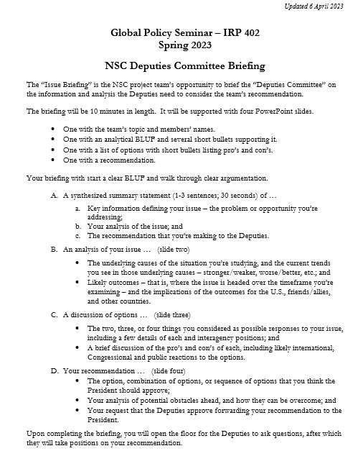
“DEPUTIES COMMITTEE” EXERCISE
GUIDANCE ON BRIEFING
All set?
All good on slides?

Slide 28
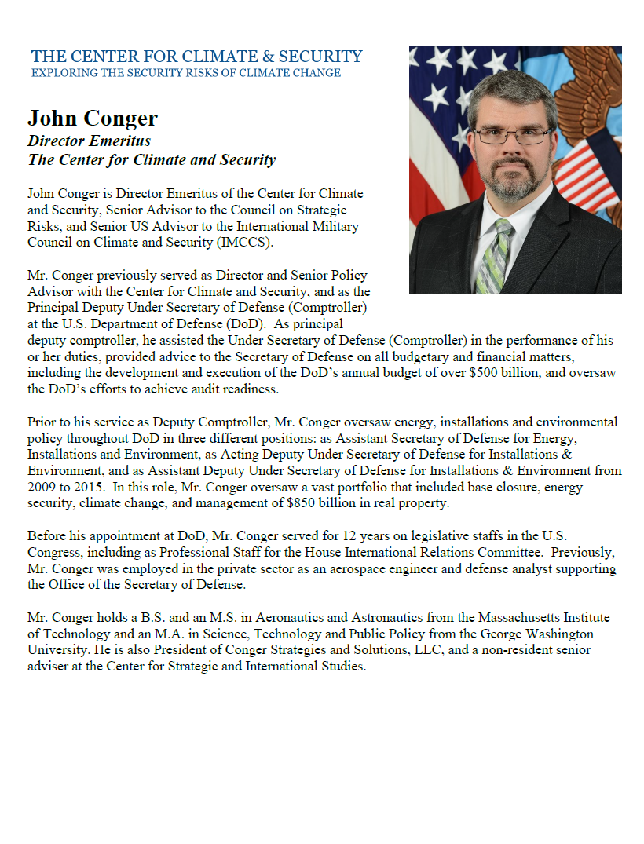
GUEST SPEAKER
John Conger
Director Emeritus, Center for Climate and Security
- introduced by Reese

Slide 29
WRAPUP

Slide 30
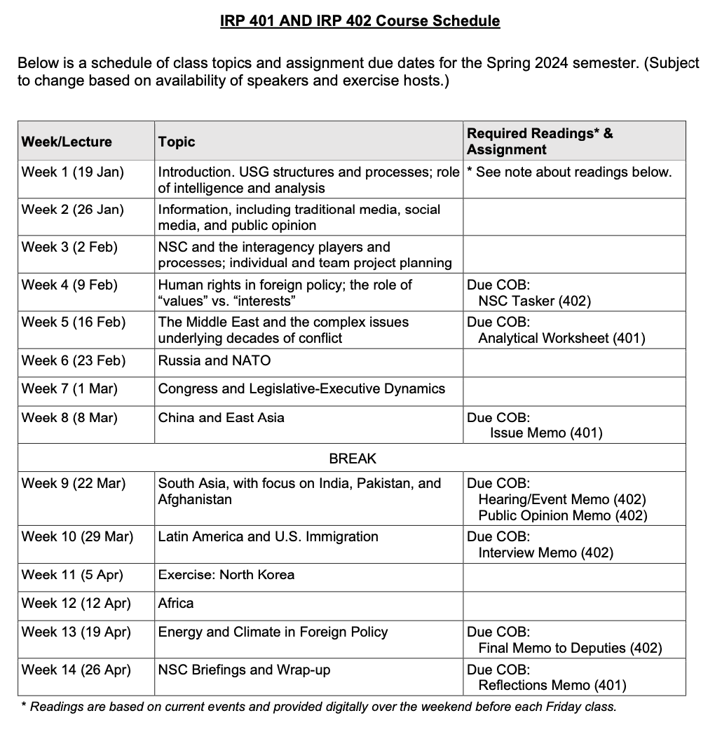
✓
401
402
✓
✓
✓
✓
QUESTIONS?
✓
✓

Slide 31
Project Planning
Akosua | U.S.-Russia: How constrain Putin? | Ensuring microchip competition and supply
Nicolas | U.S.-North Korea: How constrain Kim?
Marcus | U.S.-Vietnam tech/innovation ties | U.S. education deficits
Mimi | Youth homelessness
Vaughn | Central America migration | Israel-Palestine: Two-state solution possible?
Matt | Crisis in Haiti
Gavin | Impact of COVID on mental health | U.S. policy toward Yemen and the Houthis
Noah | Reducing reliance on China trade
Meghan | Russia/Wagner influence in Africa | Impact of climate change on insurgency
Bryce | Improving gun control background checks
Emily | Russia WMD in wake of Ukraine war | How to deal with climate migrants/refugees
Tashakee | Negative impact of cobalt mining in DRC
Reese | South America climate migration | “War time policy”
Emma | U.S.-Mexico border deaths
Ding | Calming tensions on Korean peninsula | U.S. border-state challenges from immigration
Abby | Human trafficking | U.S. support to Ukraine defense against Russia
Jessica | Stopping the flow of fentanyl into U.S.

Slide 32
Next Week
Deputies Committee
and
Lunch

Slide 33
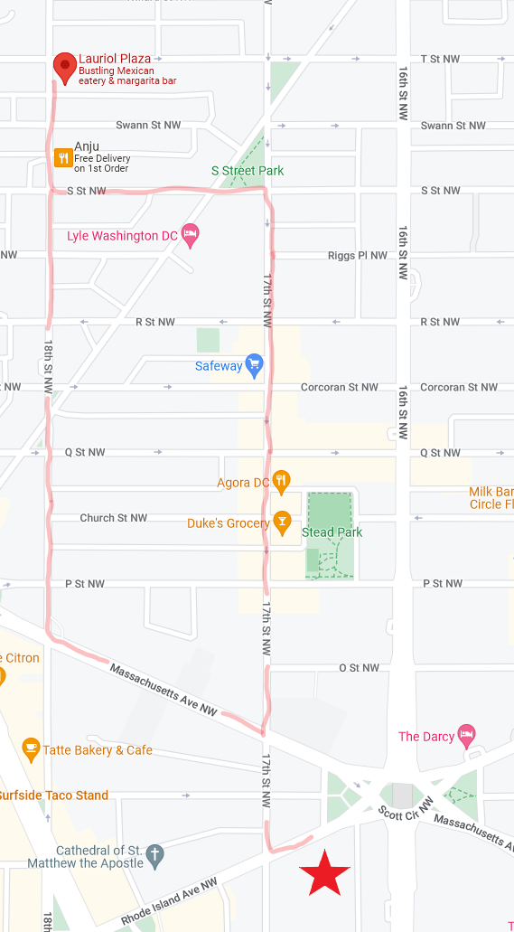
2:00 NEXT FRIDAY
Lauriol Plaza
1835 18th St NW

Slide 34
Gates open 5:30
Game starts 6:45

Slide 35
RED line (direction: Glenmont)
→ Gallery Place
GREEN line (direction: Branch Ave)
→ Navy Yard-Ballpark
S/O/B line (toward Capitol Hill)
→ L’Enfant Plaza
GREEN line (direction: Branch Ave)
→ Navy Yard-Ballpark

Slide 36
EXIT –
SE corner M & Half Sts., SE

Slide 37
Global Policy Seminar and NSC Simulation
IRP 401 - IRP 402
Week Thirteen 19 April 2024
Prof. Fulton T. Armstrong

Slide 38
