Slide 1

Global Policy Seminar and NSC Simulation
IRP 401 - IRP 402
Week Fourteen 05 December 2025
Prof. Fulton T. Armstrong

Slide 2

Week 1 (29 Aug)
Week 2 (5 Sep)
Week 3 (12 Sep)
Week 4 (19 Sep)
Week 5 (26 Sep)
Week 6 (3 Oct)
Week 7 (10 Oct)
Week 8 (17 Oct)
Week 9 (24 Oct)
Week 10 (31 Oct )
Week 11 (7 Nov)
Week 12 (14 Nov)
Week 13 (21 Nov)
Thanksgiving Break
Week 14 (5 Dec)
Fall 2025

Slide 3


TODAY’S AGENDA

Slide 4
Horse | 1 | Bobby – Mo
Dog | 2 | Alex – Syarra
Unicorn | 3 | Kiana – Maeve
Tiger | 4 | Priya – Sarina
Cat | 5 | Esme – Camille
Bird | 6 | Erik – Richard
Seal | 7 | Skye – Maisie
Lion | 8 | Gabby - Katelyn

Slide 5
DEPUTIES COMMITTEE
1 | 9:05-9:25 | Bobby – Mo
2 | 9:30-9:50 | Alex – Syarra
3 | 9:55-10:15 | Kiana – Maeve
10m break | 10:15-10:25 break
4 | 10:25-10:45 | Priya – Sarina
5 | 10:50-11:10 | Esme – Camille
6 | 11:15-11:35 | Erik – Richard
10m break | 11:35-11:45 break
7 | 11:45-12:05 | Skye – Maisie
8 | 12:10-12:30 | Gabby - Katelyn

Slide 6
DEPUTIES EXERCISE
STAFF | TOPIC | “DEPUTIES” | DEPUTIES
Maisie | U.S. Declining Birth Rates | Senate Committee on Health, Education, Labor, Pensions (Chair and Ranking Member) | Esme Camille
Skye
Esme | U.S. Culture Wars | Democratic Caucus, U.S. Senate | Skye Maisie
Camille
Erik | Israeli Use of Lavender AI in Targeting | Current NSC | Alex Bobby
Richard
Alex | Iranian Nationalism | Senate Foreign Relations Committee (both parties) | Erik Katelyn
Syarra
Maeve | U.S. Declining Birth Rates | Current NSC | Syarra Priya
Kiana
Mo | Impact of U.S.-China Tariffs | Current NSC | Richard Kiana
Bobby
Gabby | U.S.-Israel Relations After Netanyahu | Current NSC | Sarina Maeve
Katelyn
Sarina | Crisis of Legal Immigration Pathways in the U.S. | Senate Foreign Relations Committee (Dems only) | Mo Gabby
Priya
❐
⑤
□
②
③
①
❑
④

Slide 7
Deputies Committee Exercise

Slide 8
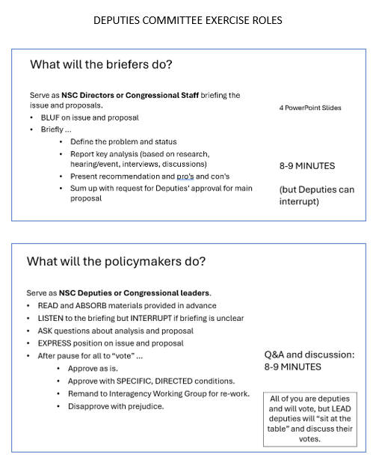

NSC DEPUTIES SIMULATION
TWO ROLES
NSC Directors or Committee Staff briefing the issue and proposals.
The Deputies or Senators/Congressmembers receiving the briefing, asking the questions, and making the decisions.

Slide 9

Set two times
for briefers
for Deputies/ Senators
50 seconds
1 minute, 20 seconds
7 minutes

Slide 10
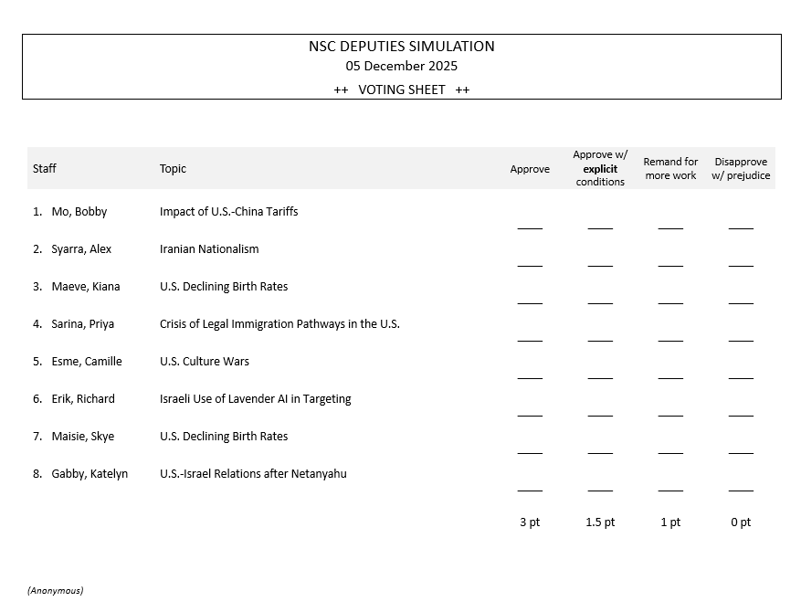
Deputies at table MUST give EXPLICIT guidance
YOUR VOTES WILL BE BASED ON
Are you convinced?
Do you support the recommendation?
Are you prepared to put your personal credibility and your agency/department’s resources on the line for the recommendation?
Approve as is.
Approve with SPECIFIC, DIRECTED conditions.
Remand to Interagency Working Group for re-work.
Disapprove with prejudice.
Just a ✓mark

Slide 11
Any questions?

Slide 12
Horse | 1 | Bobby – Mo
Dog | 2 | Alex – Syarra
Unicorn | 3 | Kiana – Maeve
Tiger | 4 | Priya – Sarina
Cat | 5 | Esme – Camille
Bird | 6 | Erik – Richard
Seal | 7 | Skye – Maisie
Lion | 8 | Gabby - Katelyn

Slide 13
Managing domestic costs while preserving leverage on china
Bobby Anzaldua & Mo Barry

Slide 14
Analysis
The administration’s tariffs on Chinese imports signal a tough stance toward China, but they are now raising costs for consumers and businesses without improving supply-chain security. Public opinion, industry data, and expert interviews show growing concern that this approach is becoming more expensive and less effective. To protect U.S. interests while easing domestic pressure, the recommended strategy is to replace broad tariffs with targeted tariffs and stronger export controls, supported by coordinated agreements with key partners to build shared supply-chain standards.
Drivers
Bipartisan firm stance on China
Tariff pass-through now hitting consumers
US lacks reshoring capability
Small firms disproportionately impacted
Implications
Continued price pressure
Declining public support
Weaker competitiveness

Slide 15
Options
Option 1 — Keep Broad Tariffs
Pros: Strong leverage; tough stance on China Cons: Higher prices + inflation; harms small businesses Support: Political advisors, some Republicans, domestic manufacturers Opposition: Treasury, retailers, consumer groups, Local Businesses
Option 2 — Targeted Tariffs + Export Controls
Pros: Protects key tech sectors; limits consumer price increases Cons: Risk of China targeting U.S. farmers/minerals in retaliation Support: Commerce, Defense, Treasury, import-reliant firms Opposition: Industries benefiting from current broad tariffs
Option 3 — Ally Supply-Chain Agreements
Pros: Reduces reliance on China; strengthens competitiveness long term Cons: Slow results (can take years to negotiate); some unions and firms fear more competition Support: State Dept., allies, stability-focused industries Opposition: Labor groups, U.S.-only producers, protected industries

Slide 16
Recommendation
Two-Track Strategy
Targeted tariffs + strengthened export controls
Plurilateral supply chain agreements
Implementation
Shared priority sector list
Harmonized enforcement with allies
Standards for minerals and chips
Request
Deputies approve forwarding strategy to the president

Slide 17
Horse | 1 | Bobby – Mo
Dog | 2 | Alex – Syarra
Unicorn | 3 | Kiana – Maeve
Tiger | 4 | Priya – Sarina
Cat | 5 | Esme – Camille
Bird | 6 | Erik – Richard
Seal | 7 | Skye – Maisie
Lion | 8 | Gabby - Katelyn

Slide 18
Countering Iranian Nationalism
By Alex Tingley and Syarra Goldstein

Slide 19
Analysis
Both Iran’s public and governmental nationalism is on the rise, pushing the country to a more aggressive posture.
Factors:
Regional insecurity and external strikes
Economic struggles
Evolving national identity
Proxy conflicts
Reduced U.S. support for military action among the public

Slide 20
Options
Option 1: Regime Change Strikes
Pros:
Removes nationalist leaders
Strong Israeli/AIPAC support
Cons:
Regional instability
Possible backlash
Military commitment
Option 2: Steps Toward Normalization
Pros:
New U.S.-Iranian narrative
Non-proliferation progress
Diasporic support
Cons:
Israeli opposition
Inconsistent with current hawkish U.S. approach
Option 3: Engage With Diaspora
Pros:
Low risk
Iranian diaspora in the U.S. supports
Cons:
No short-term change
Indirect action enables the ongoing national security risk

Slide 21
Recommendation
Steps Toward Normalization
Encourage administrative action towards reopening direct Iranian dialogue
Engage with allies with established diplomatic relations
Hold hearing on Iranian Nationalism and regional public diplomacy approaches
Prevent further attacks or sanctions while negotiations are in progress
Rally support for treaty ratification next year

Slide 22
Horse | 1 | Bobby – Mo
Dog | 2 | Alex – Syarra
Unicorn | 3 | Kiana – Maeve
Tiger | 4 | Priya – Sarina
Cat | 5 | Esme – Camille
Bird | 6 | Erik – Richard
Seal | 7 | Skye – Maisie
Lion | 8 | Gabby - Katelyn

Slide 23



DECLINING U.S. BIRTH RATES: ECONOMIC AND CULTURAL PRESSURES ON FAMILY FORMATION
Maeve Ryan & Kiana Tan
Global Policy Seminar – IRP 402
NSC Deputies Committee Briefing | Fall 2025

Slide 24



BLUF:
U.S. birth rates are falling due to rising economic burdens and shifting cultural norms. Without intervention, the U.S. faces long-term labor shortages, demographic imbalance, and reduced global competitiveness. We recommend a two-track federal strategy combining targeted family-economic relief with women’s-health transparency and cultural support for family formation.
Supporting Points
Birth rates down nearly 20% since 2007; no single demographic or policy factor explains the decline.
High childcare costs, housing barriers, and student debt delay family formation.
Cash is not enough, decisions hinge on women’s individual fertility goals.
Cultural shifts, delayed marriage, contraceptive norms, modern feminism’s framing of motherhood, affect intentions even among women who want children.
Consequences: smaller workforce, rising dependency ratio, state-level revenue declines, weakened long-term economic and strategic capacity.

Slide 25


Option 1 — Targeted Economic Support for Families
Pros: Addresses core financial barriers; bipartisan potential; improves stability for young parents.
Cons: Requires new spending; deficit concerns among fiscal conservatives.
Option 3 — Cultural & Structural Incentives for Family Formation
Pros: Addresses long-term cultural drivers identified in interviews and events; complements economic reforms.
Cons: Opposition from groups wary of “traditional family” framing; impact emerges slowly.
Option 2 — Women’s Health Transparency & Education Initiatives
Pros: Supports informed decision-making; aligns with public-health best practices; politically flexible.
Cons: Messaging could be politicized; requires coordination with DHHS and states.

Slide 26




RECOMMENDATION
Recommendation:
Authorize NSC Staff to launch a Family Resilience Initiative combining (1) targeted economic support, childcare access, housing incentives, employer flexibility, and (2) a national women’s-health transparency effort focused on fertility education, reproductive timelines, and informed contraceptive decision-making.
Why This Approach:
Integrates economic and cultural factors driving the decline (per interview & Harvard event).
Avoids one-size-fits-all fixes while addressing both immediate barriers and long-term demographic sustainability.
Politically defensible: focuses on transparency, family stability, and workforce resilience.
Next Steps:
Coordinate with Domestic Policy Council, Treasury, and DHHS for program design.
Build bipartisan support using data, cost-neutral offsets, and framing centered on U.S. competitiveness and family wellbeing.
Request Deputies’ approval to advance this recommendation to the President.

Slide 27
Horse | 1 | Bobby – Mo
Dog | 2 | Alex – Syarra
Unicorn | 3 | Kiana – Maeve
Tiger | 4 | Priya – Sarina
Cat | 5 | Esme – Camille
Bird | 6 | Erik – Richard
Seal | 7 | Skye – Maisie
Lion | 8 | Gabby - Katelyn

Slide 28

Strengthening U.S. Legal Immigration Pathways by Rebalancing Federal Resources
SFRC DEMOCRATS DEPUTIES BRIEFING: SARINA DANG AND PRIYA HANLEY

Slide 29

BLUF + Key Analysis
The U.S. legal immigration system is overwhelmed due to enforcement-heavy resource shifts, USCIS capacity cuts, legal inconsistencies, and rising application volumes. Our analysis shows these structural gaps drive today’s backlogs and shape public views on unauthorized immigration. We recommend rebalancing federal resources toward USCIS staffing and digital modernization.
Underlying cause: Trump-era policies expanding enforcement; punitive documentation requirements; inconsistently managed immigration courts; outdated quotas.
Trend: Surging visa applications across all categories + stagnant USCIS capacity → worsening backlogs in both processing and immigration courts.
Implications: Weaker trust in legal pathways, strain on allied relationships, and declining public confidence.

Slide 30
Options
Option 1 — Increase USCIS Staffing & Modernization
Pros: Faster processing and greater transparency.
Cons: Viewed as shifting resources away from enforcement.
Reactions: USCIS support; OMB cost concerns; ICE opposition.
Option 2 — Establish an Independent Article I Immigration Court
Pros: More consistent decisions and less political influence.
Cons: Major long-term structural reform requiring congressional action.
Reactions: Trump DOJ opposition; legal advocates support.
Option 3 — Shift Enforcement Priorities to High-Risk Individuals
Pros: Frees agency capacity and reduces low-priority caseloads.
Cons: Criticizes as weakening enforcement.
Reactions: Trump administration and ICE resistance; humanitarian group support.

Slide 31
Recommendation
Option 1 — Rebalance resources toward USCIS staffing and digital modernization.
Obstacles: Perception of weak enforcement; jurisdiction overlap.
Rationale: Directly addresses core capacity deficit created during Trump I and deepened in 2025. Produces fastest measurable improvements.
Ask: SFRC coordinate with DHS, Judiciary, and Appropriations Committees.
Next steps: reallocate FY-2026 appropriations; launch a DHS-State task force; prioritize infrastructure improvements.

Slide 32
Horse | 1 | Bobby – Mo
Dog | 2 | Alex – Syarra
Unicorn | 3 | Kiana – Maeve
Tiger | 4 | Priya – Sarina
Cat | 5 | Esme – Camille
Bird | 6 | Erik – Richard
Seal | 7 | Skye – Maisie
Lion | 8 | Gabby - Katelyn

Slide 33
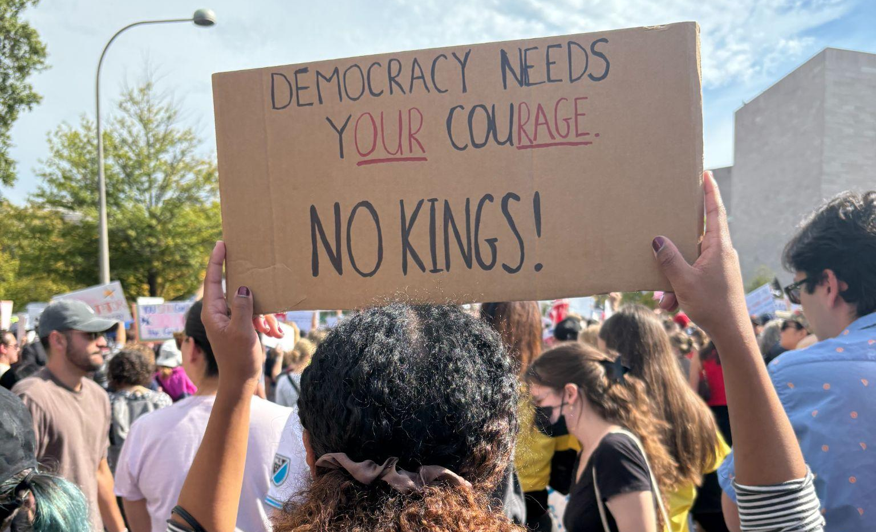
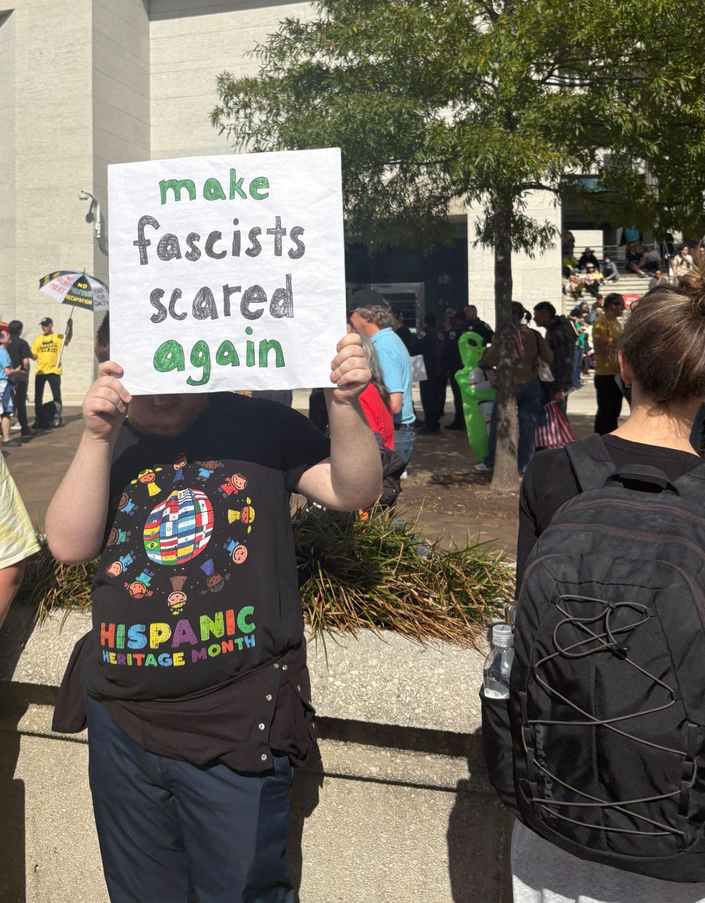
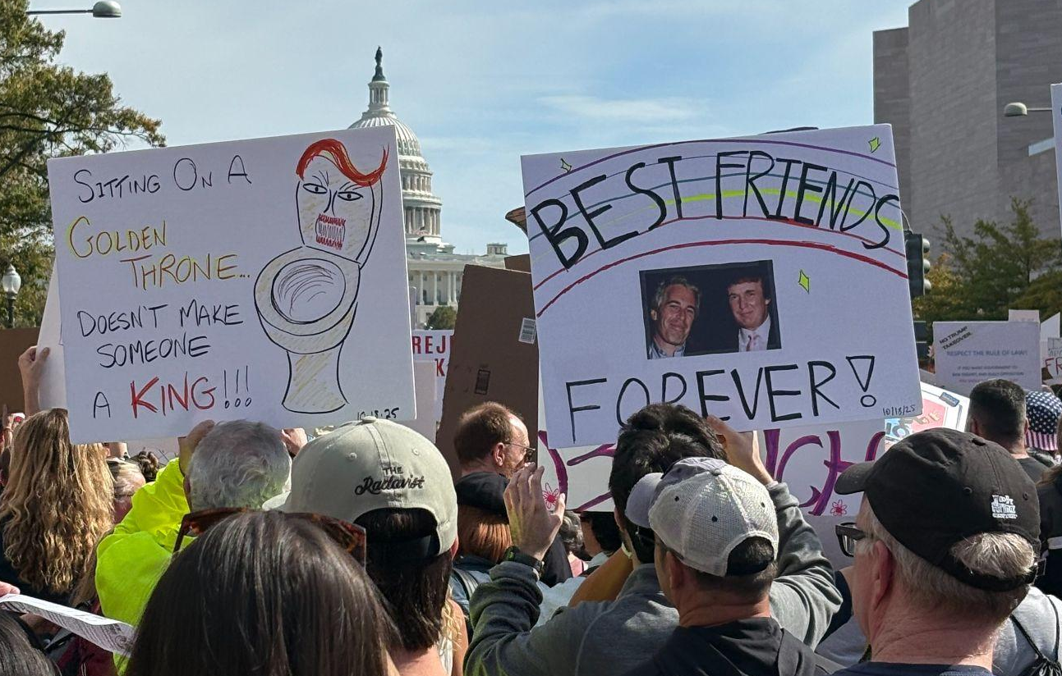
Culture Wars, Polarization, News Biases, and the Implementation of Ranked Choice Voting
Prepared By: Camille Valdez and Esme Dorcellus
December 2025

Slide 34
BLUF
Escalating culture wars fueled by deepening polarization, expanding presidential influence, and the decline of local news have become a risk to U.S. democratic stability and national security. We recommend that the Democratic Caucus urge the Administration to support two national reforms: implementing ranked-choice voting (RCV) and strengthening local news outlets.
Drivers
Outcomes
Trends
Political exploitation of identity-based issues.
Polarization across education, religion, military policy, and DEI initiatives.
Further democratic backsliding.
Declining civic engagement.
Heightened susceptibility to disinformation campaigns.
Increasing executive power over education, speech, and the military.
Culture war conflicts are intensifying.

Slide 35
OPTIONS
1. Nationwide Expansion of RCV
2. Strengthen Local News Ecosystems
Pros:
-Reduces incentives for extreme positioning.
-Increases political representation.
-No constitutional amendment required for RCV to be adopted.
Cons:
-Resistance from politicians who benefit from the current system.
-Many misconceptions about the legality of RCV adoption.
Pros:
-More nuanced, better informed, less polarized news coverage.
-Increases government accountability and voter turnout.
Cons:
-Requires Congressional appropriations and may face partisan scrutiny.
-Fear of gov’t interference in independent journalism.

Slide 36
RECOMMENDATION
We ask the Democratic Caucus to support our recommendation of a combined approach: nationwide adoption of RCV and alongside federal incentives to strengthen local news organizations. The Caucus can assure voters that RCV would mitigate the need to vote for “the lesser of two evils,” a huge issue within the liberal voter base. Local news organizations would be able to promote RCV, and in turn gain viewership.
Obstacle
Solution
Perceptions of RCV vary by state.
Supportive messaging surrounding RCV must be tailored to the regional political landscape.

Slide 37
Horse | 1 | Bobby – Mo
Dog | 2 | Alex – Syarra
Unicorn | 3 | Kiana – Maeve
Tiger | 4 | Priya – Sarina
Cat | 5 | Esme – Camille
Bird | 6 | Erik – Richard
Seal | 7 | Skye – Maisie
Lion | 8 | Gabby - Katelyn

Slide 38
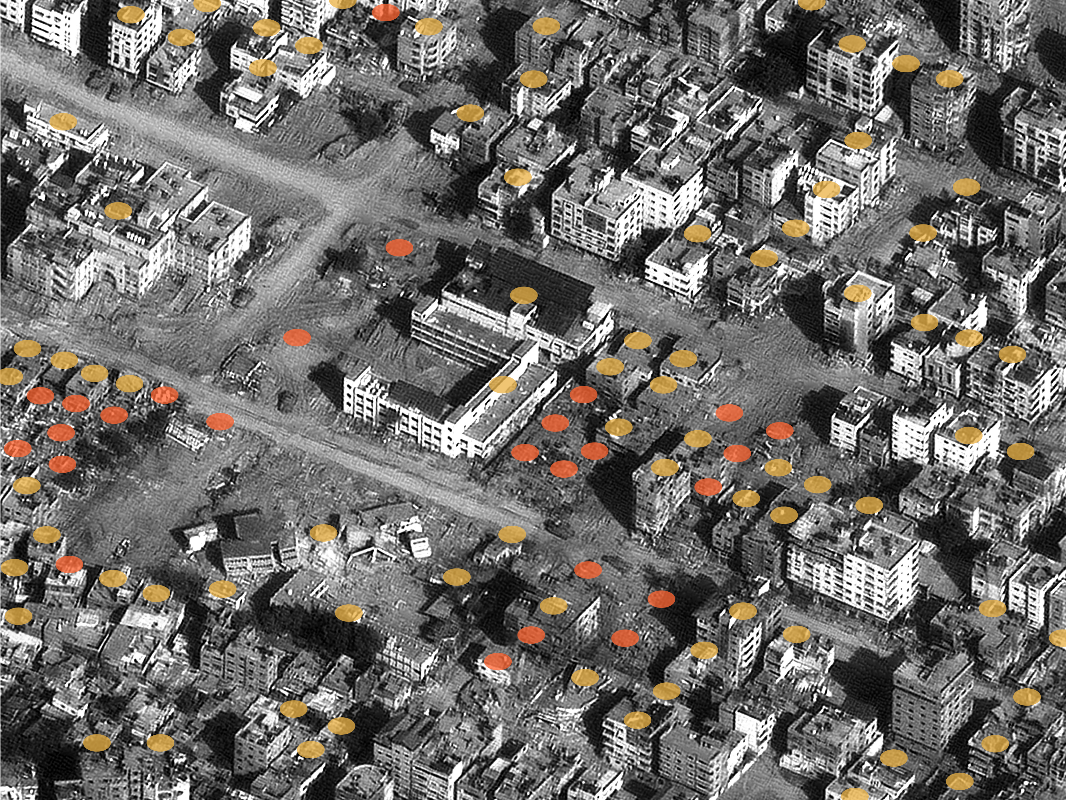
AI-Driven Targeting in Israel: Protecting U.S. Interests Domestically and Abroad
AI-Driven Targeting in Israel: Protecting U.S. Interests Domestically and Abroad
AI-Driven Targeting in Israel: Protecting U.S. Interests Domestically and Abroad
Richard Condino, Erik Rees

Slide 39
Proposal
Lavender AI is an LLM trained on Palestinian security data to create lists of Hamas militant targets.
Lavender has reduced human oversight of intelligence gathering, posing operational and ethical risks when integrated with the modern battlefield.
The U.S. is at risk if our adversaries use AI targeting systems. As such, we suggest:
The U.S. should lead the development of international humanitarian frameworks on AI in warfare.
The U.S. should strengthen defenses against AI-enabled data exploitation.
Key Information
Individually identified, sensitive data can be sold to data brokers at a low price with minimal vetting.
Americans are sharing more data than ever, leaving us vulnerable.
No existing international law governing AI attacks.
Lavender: 10% error rate when suggesting potential militants.
Trained to broadly target “Hamas Operatives” - a vaguely defined selection parameter.

Slide 40
Options
Maintain the Status Quo
Positives: Avoids friction with Israel.
Negatives: Rising domestic dissatisfaction and international criticism; leaves U.S. personnel vulnerable to AI-targeting.
Mitigating negatives:
Avoid public statements, quietly distance the U.S. from Israel’s attacks, and maintain a neutral stance.
Speak out against the use of AI-targeting. Emphasize respect for Israel’s autonomy and avoid directly criticizing Israel, only the specific action of AI-targeting.
Lead Development of an International Framework for AI in Warfare
Positives: Asserts U.S. international leadership; aligns with domestic and international concerns; establishes norms for accountability and human oversight - reduces potential for similar systems to be used against the U.S.
Negatives: Opposes Israel and risks conflict with an important ally.
Mitigating negatives:
Involve Israel early.
Frame Israel’s position as one with expertise, since its targeting systems are more developed than any other nation.
Strengthen U.S. Defenses Against AI-Targeting
Positives: Addresses vulnerabilities identified in congressional hearings and our interviews; enhances personnel protection; politically uncontroversial.
Negatives: Requires resources and coordination.
Mitigating negatives:
Leverage existing infrastructure and guidelines.
Ensure a gradual and well-researched implementation process.

Slide 41
Our Recommendations
Recommendation 1:
Launch a U.S.-led effort to develop international guidelines for AI-enabled targeting that includes Israel and key allies.
…begin by discussing with allies, including Israel, potential frameworks for international law.
Recommendation 2:
Coordinate with government agencies to strengthen U.S. defenses against AI-enabled data exploitation, improving the protection of U.S. personnel.
… begin by investigating the strengths and weaknesses of current guidelines set forth by agencies like CISA and NIST, as well as executive orders regarding data protection.
With your approval, we kindly request that you forward these recommendations to the President.

Slide 42
Horse | 1 | Bobby – Mo
Dog | 2 | Alex – Syarra
Unicorn | 3 | Kiana – Maeve
Tiger | 4 | Priya – Sarina
Cat | 5 | Esme – Camille
Bird | 6 | Erik – Richard
Seal | 7 | Skye – Maisie
Lion | 8 | Gabby - Katelyn

Slide 43
Addressing Declining Birth Rates in the United States
Skye Faison & Maisie Heisey
Joint Economics Committee Staffers

Slide 44
Birth Rates are Rapidly Declining and Negatively Impacting the U.S. Economy
Cultural shift
Work-life balance
Cost of having children
Less people = less economic contributors

Slide 45
Option 1: Annual Immigration Caps
Immediate workforce solution, adjusted based on labor need, contributes to population stability
Immigration is a polarizing issue
Option 2: Remote and Flexible Work Options
Easier access to childcare, low government cost, less pressure to choose between career and children
Productivity loss, employer disagreement
Option 3: Financial Package
Federal standard for parental leave, partial coverage of fertility treatments, federal caps on childcare costs
Federal funding

Slide 46
Recommendation: Financial Package
Step 1: Recommended parental leave is 12 weeks
Step 2: Medicaid covers up to 1/3 of fertility treatment cost
Step 3: Cap on cost of childcare at 8 percent of household income
Developed by the Joint Economic Committee
​
Addresses major barriers to parenthood, increases participation in labor force, raises tax revenues over time to offset federal funding

Slide 47
Horse | 1 | Bobby – Mo
Dog | 2 | Alex – Syarra
Unicorn | 3 | Kiana – Maeve
Tiger | 4 | Priya – Sarina
Cat | 5 | Esme – Camille
Bird | 6 | Erik – Richard
Seal | 7 | Skye – Maisie
Lion | 8 | Gabby - Katelyn

Slide 48



For the National Security Council
ADJUSTING U.S. POLICY TOWARD ISRAEL IN THE POST-NETANYAHU ERA
Gabriella Gabel and Katelyn Kosloff

Slide 49

01
Underlying Causes and Trends:
02/10
Netanyahu’s weakening position and long-term radicalization within Israeli politics limit the impact of leadership transition.
Regional actors support the 20-point peace plan only if the U.S. enforces it, making credibility contingent on follow-through.
Domestic polarization on Israel and Middle East policy reduces bipartisan space for U.S. diplomacy.
Structural drivers: U.S. military aid → significant but inconsistently used leverage; rising regional escalation risks; strained alliances after Israeli actions in Qatar.
Global scrutiny: genocide findings + growing recognition of Palestinian statehood complicate U.S. alignment with Israel.
Public fatigue with Middle East involvement narrows the Administration’s freedom of action.
BLUF
U.S.–Israel relations are entering a volatile period marked by political uncertainty in Israel, regional reactions to the 20-point peace plan, and rising domestic polarization in the United States. Our analysis shows that the status quo weakens U.S. leverage, risks regional escalation, and undermines American credibility. We recommend a calibrated strategy combining targeted conditionality, multilateral enforcement, and a shift toward treating Israel as a “normal ally” to protect U.S. interests and stabilize the region.
02
Likely Outcomes Without Policy Adjustment:
Continued Israeli escalation with Iran, risking collapse of the peace plan.
Waning U.S. credibility with Arab and European partners.
Reduced influence over Israeli behavior post-Netanyahu.
Growing domestic costs for maintaining unconditional support.

Slide 50


Option 1: Maintain Current Support
Pros: Preserves stability and deterrence; avoids tensions.
Cons: Undermines peace plan; signals unconditional alignment; weakens leverage.
Interagency: Supported by DoD, some congressional Republicans; opposed by State Dept and allies.
Option 2: Targeted Conditionality on Military Aid
Pros: Uses U.S. leverage; encourages compliance; aligns with U.S. public opinion.
Cons: Israeli backlash; sensitivity regarding Iran deterrence.
Interagency: Supported by State Dept; opposed by DoD; manageable with phased rollout.
Option 3: Multilateral Enforcement (UN + Gulf States)
Pros: Burden-sharing; boosts credibility; reduces U.S. political exposure.
Cons: Heavy coordination; Israel resists expanded UN role.
Interagency: Supported by State/USAID; mixed DoD.
Option 4: Treat Israel as a “Normal Ally”
Pros: Restores U.S. autonomy; reduces domestic political costs; addresses polarization.
Cons: Politically sensitive in Congress; requires gradual shift.
Interagency: Quiet support from some; opposed by congressional Israel advocates.
Pros/Cons

Slide 51

We recommend a hybrid approach combining:
Targeted conditionality on U.S. military assistance to ensure compliance with the 20-point peace plan.
Multilateral enforcement mechanisms coordinated with the UN, Qatar, Saudi Arabia, and the UAE.
A phased shift toward a “normal ally” framework to restore U.S. strategic autonomy and credibility.
Obstacles
Israeli political backlash
Congressional resistance from pro-Israel members
Regional sensitivity around UN involvement
How to Overcome Them
Implement conditionality gradually with clear security assurances
Conduct quiet congressional outreach before public rollout
Coordinate closely with Gulf partners to distribute political and diplomatic costs
04/04
Final Recommendation
Deputies Committee Ask
We request authorization to forward this strategy to the President as the recommended U.S. approach to managing Israel policy in the post-Netanyahu era.

Slide 52
CONGRATULATIONS!

Slide 53

WRAPUP

Slide 54
Looking back …
Substance and Process
Diplomats and spies
Academics and think-tankers
Journalists
Hill types
Museums
Readings
Defining issues: Israel-Palestine
Ukraine-Russia
China-Taiwan
But also …
North Korea
Afghanistan
Latin America
How to prepare “actionable” products
Research (various inputs) →→ Analysis →→ Recommendation
(In clear, concise, transparent style.)
DRIVERS!!!!

Slide 55
Professional Development Series
How to do Analysis
Word Processing
Using AI Responsibly and Effectively
Networking skills
Writing the Washington Memo
Healthy Conversation and Elicitation
Overcoming “Impostor Syndrome”
Acing the Interview
Money Essentials for Young Professionals
Negotiating for Salary/Benefits
Briefing and PowerPoint Skills

Slide 56
Next steps …
Celebration lunch
Reflections Memo (Sunday night)
Journal
Count for class participation, but not just “for the grade.”

Slide 57
WHEN YOU CAN: COURSE EVALUATION
(401 only)
It’s important.

Slide 58
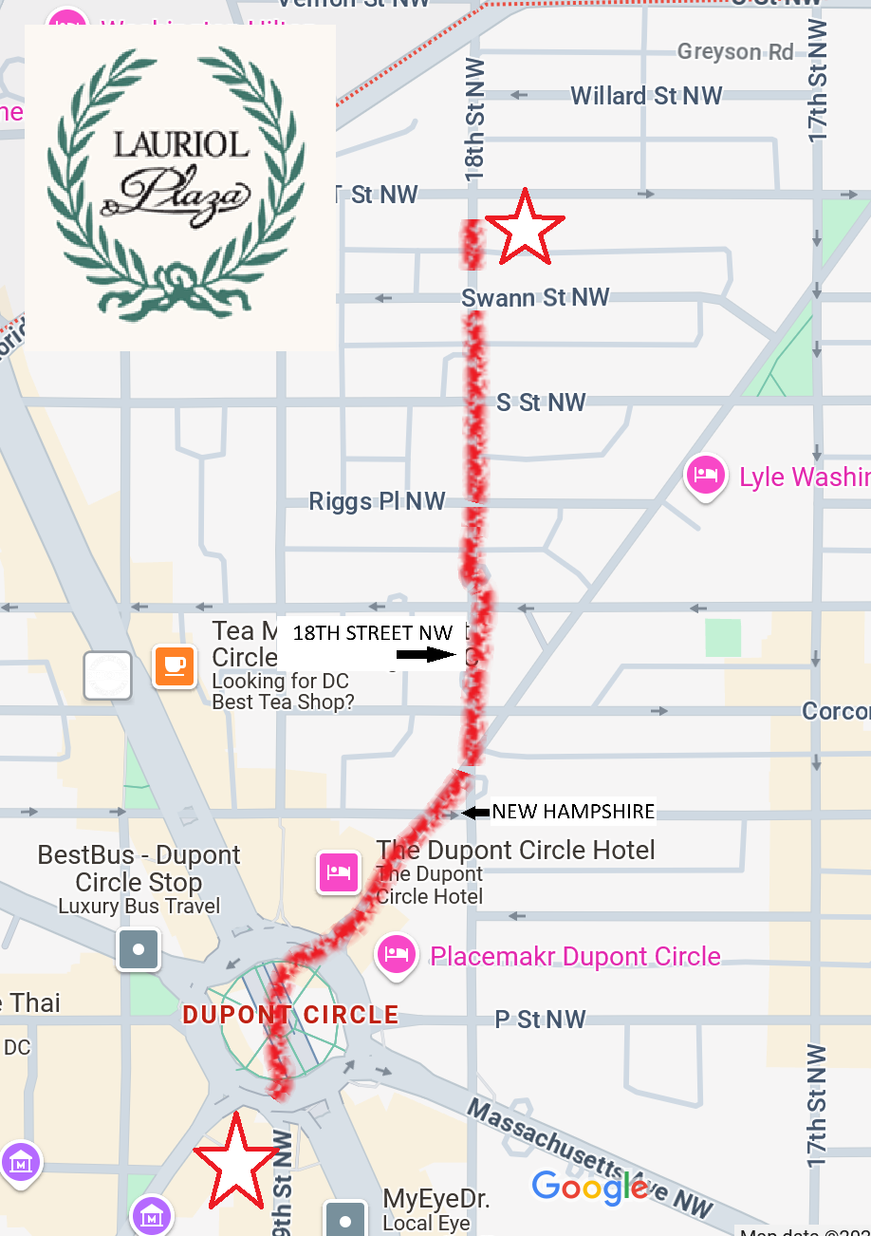

2:00 TODAY
Lauriol Plaza
1835 18th St NW (Corner with T)

Slide 59
Several comments
About the game and the skills.
Look around the room.
What’s happening in Washington and the country.

Slide 60

“QUESTIONS? SUGGESTIONS? CONCERNS?”
It’s been fun!

Slide 61
Global Policy Seminar and NSC Simulation
IRP 401 - IRP 402
Week Fourteen 05 December 2025
Prof. Fulton T. Armstrong

