Slide 1

Global Policy Seminar and NSC Simulation
IRP 401 - IRP 402
Week Fourteen 24 Apr 2026
Prof. Fulton T. Armstrong

Slide 2
Week 1 (16 Jan)
Week 2 (23 Jan)
Week 3 (30 Jan)
Week 4 (6 Feb)
Week 5 (13 Feb)
Week 6 (20 Feb)
Week 7 (27 Feb)
Week 8 (6 Mar)
Spring Break
Week 9 (20 Mar)
Week 10 (27 Mar)
Week 11 (3 Apr)
Week 12 (10 Apr)
Week 13 (17 Apri)
Week 14 (24 Apr)
Spring 2026

Slide 3


TODAY’S AGENDA

Slide 4
DEPUTIES COMMITTEE
STAFF | TOPIC | DECISIONMAKERS | DEPUTIES
Filippo | North Korea illegal ops to support goals | Current Admin | Kennedy, Miles
Emmett | Danger of one-dimensional energy sector | Current Admin | Diego, Eli
John
Eli | Iran-US relations | Current Admin | Bijan, Megha
Michael
Diego | Globalization and environmental impact | Current Admin | Filippo, Michael
Molisa
Miles | Climate change and refugees/sovereignty | UN SecGen Staff | Yvette, Kaiwen
Kennedy
Kaiwen | China’s Influence in Africa | Current Admin | Megha, Molisa
Yvette
Bijan | Humanitarian Crisis in Gaza | UN Aid Coord Staff | Emmett, John
Megha
1
2
3
4
5
6
7

Slide 5

NSC DEPUTIES SIMULATION
TWO ROLES
NSC Directors or Committee Staff briefing the issue and proposals.
The Deputies or Senators/Congressmembers receiving the briefing, asking the questions, and making the decisions.

Slide 6
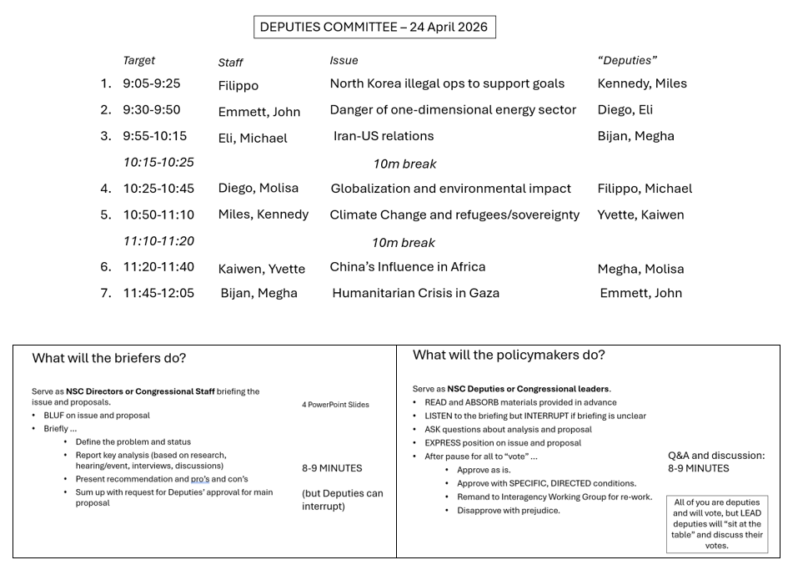
HANDOUT

Slide 7
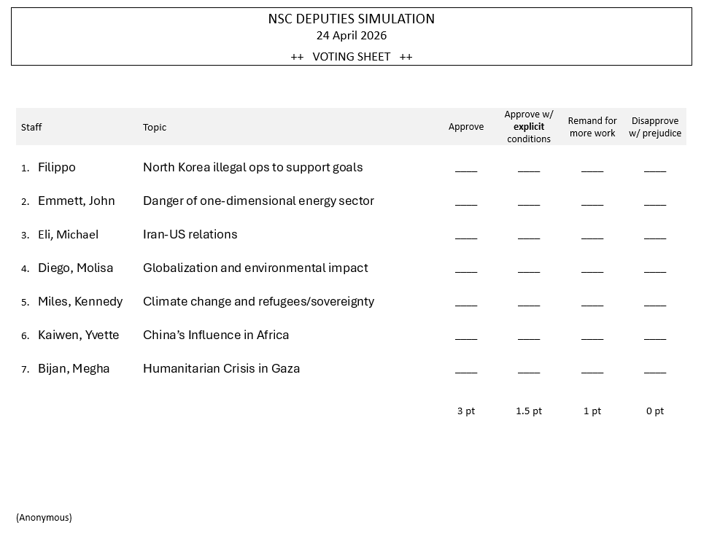
HANDOUT

Slide 8
Deputies Committee Exercise

Slide 9
Deputies at table MUST give EXPLICIT guidance
YOUR VOTES WILL BE BASED ON
Are you convinced?
Do you support the recommendation?
Are you prepared to put your personal credibility and your agency/department’s resources on the line for the recommendation?
NOT BASED on … familiarity or “easy issue.”
Approve as is.
Approve with SPECIFIC, DIRECTED conditions.
Remand to Interagency Working Group for re-work.
Disapprove with prejudice.
Just a ✓mark

Slide 10

Set two times
for briefers
for Deputies/ UN decision-makers
50 seconds
1 minute, 20 seconds
7 minutes

Slide 11
Any questions?

Slide 12
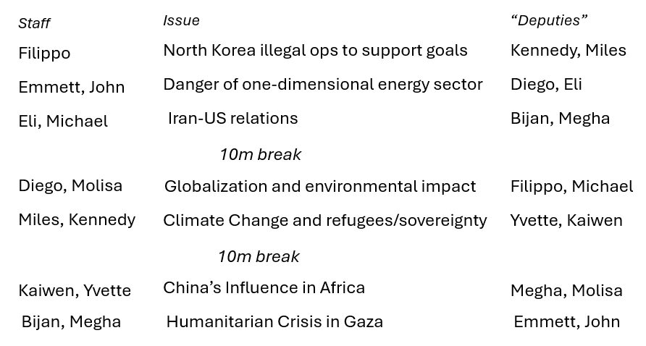

Slide 13
POLICY BRIEF · APRIL 2026
THE DPRK AND WMD:
ILLICIT FINANCE
TEAM
Filippo Donà

Slide 14
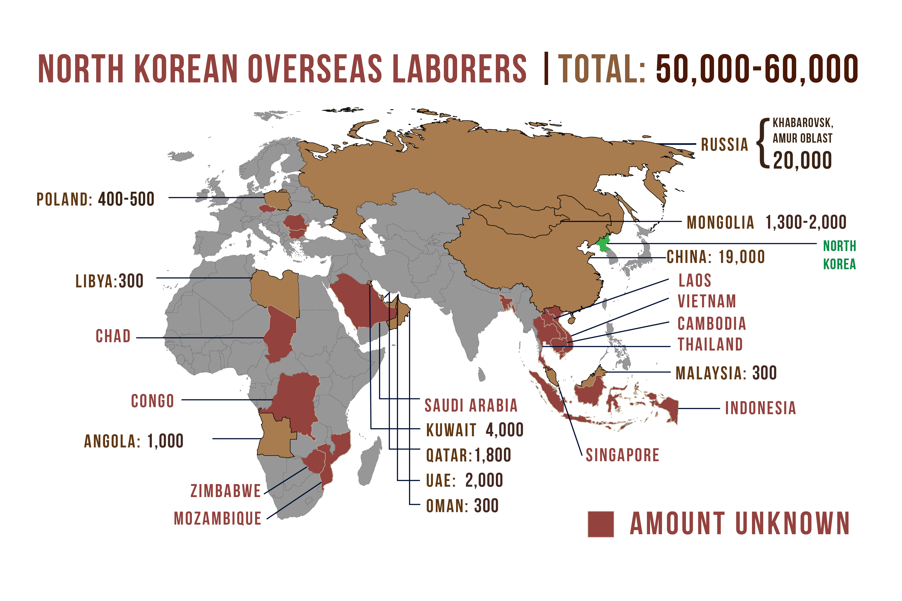
BOTTOM LINE UP FRONT
North Korea has built a sanctions-proof digital revenue system that directly funds its missile program. U.S. policy and International sanctions, both built for a physical-asset world, are reactive and fragmented. Closing the gap requires pressing global enforcement, additional domestic legislation in the near term, and a parallel diplomatic track
WHAT THE DATA SHOWS
$6.75B stolen via crypto to date, directly funding WMD
60,000+ North Korean workers placed abroad. +225% in Western Firms in 2025; 300+ U.S. companies, including S&P 500 firms, unknowingly hired them.
Russia vetoed renewal of the UN monitoring body in April 2024; China actively shields North Korea at the UN Security Council
> 19 Chinese banks are used to launder North Korean funds

Slide 15
PATH FORWARD
Three options to counter North Korea's digital sanctions evasion
01
02
03
ENFORCE Globally
LEGISLATE domestically
TALK
Freeze wallets, and sanction foreign banks
Enhance resources and coordination of enforcement bodies (FBI, Treasury); Target in synchronized waves, not one at a time
Use access to U.S. dollar payments as leverage against foreign actors who do not cooperate in investigations
Extend money-laundering rules beyond banks and large exchanges
Delegate verification to private sector, punish by exclusion from USD
Enhanced verification for prospective workers. Require hiring and freelance platforms to verify worker identities
Frame Options 1 + 2 as conditions for a credible deal
Tie any sanctions relief to a verifiable stop of crypto theft.
Coordinate with PRC
0–6 MONTHS · No new laws needed
6–18 MONTHS · Protects U.S. business
PARALLEL · Condition-based
Authorize Options 1 + 2 as an integrated package now. Run Option 3 in parallel as diplomatic framing.

Slide 16
Recommendation
01
ENFORCE GLOBALLY
02
LEGISLATE DOMESTICALLY
03
TALK
0–6 MONTHS
6–18 MONTHS
PARALLEL TRACK
+ PROS
+ PROS
+ PROS
Uses intelligence we already have
Uses existing laws. Works immediately
Increases cost and risk of theft
USD and EUR clearing have global reach. US would lead intl. efforts
Shifts compliance cost from government to industry
Extends rules to the platforms the DPRK actually uses
Closes the system, so new bad actors are covered automatically
Converts enforcement into diplomatic leverage
Sets an achievable bar: cyber theft, not full denuclearization
Is easily reversible, but guarantees first steps toward normalization
— CONS
— CONS
— CONS
Rulemaking can be a lengthy process
Must be designed to be compatible with current deregulation regime
Experts warn cyber theft is now strategically embedded in DPRK strategy
Behavioral change not guaranteed, even with a deal. Deals historically degrade once relief is granted and supply chains adjust
Requires a commitment to sustained tempo
Reactive, and DPRK reacts faster
Cannot force foreign banks into compliance with existing laws

Slide 18
Energy Diversity for Security and Competitiveness
By Emmett Gallardo and John Maley

Slide 19
BLUF:
The energy sector represents a pressure point for geopolitical shocks and a key source of leverage in the future
Diversifying energy sourcing presents a viable option for protecting against these shocks
Solutions found using global economic leverage and domestic industrial policy

Slide 20
Option Class 1:
Option Class 2:
Option Class 3:
Foreign Trade Leverage
Border Carbon Adjustment Mechanism
Preferential Trade Agreements
Domestic Regulation and Support
Subsidies for Renewables and Nuclear Generation
Quotas for integration during transmission upgrading
Environmental Regulation
Set Goal Temperature
Fossil Fuel and Natural Gas consumption limitations
Reinstate Greenhouse Gas Regulation

Slide 21
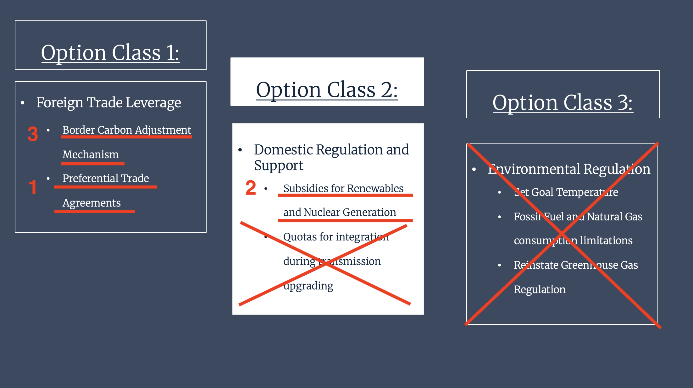
Multi-Step Recommendation:

Slide 23
US-Iran Conflict: Converting Military Leverage into a Durable Nuclear and Regional Security Settlement
By: Michael Fisher and Eli Brand

Slide 24
Analysis (BLUF + bullets)
BLUF: The U.S holds leverage over Iran now, but that advantage will fade without a diplomatic endgame. We recommend negotiating from strength while sustaining military pressure.
Iran remains weakened but durable ; military force alone cannot resolve the nuclear issue
U.S. leverage is strongest now, but will erode as costs, fatigue, and allied friction grow.
Negotiating from strength offers the best chance for a durable regional and nuclear outcome.

Slide 25
Options
Option 1: Sustain Current Campaign
Pro: Maintains pressure; supports deterrence
Con: No end state; Rising costs; Strategic drift
Option 2: Escalate Further
Pro: Greater damage to Iranian capabilities
Con: Regional war risk; higher costs; limited durability
Option 3: Peace and Nuclear Deal While Maintaining Military Pressure
Pro: Converts leverage into lasting gains; lower war risk
Con: Risk of stalling; requires strict enforcement

Slide 26
Recommendation
Open diplomatic back channel through Oman within 30 days for a peace and nuclear deal with verified limits on uranium enrichment in exchange for phased sanctions relief
Gulf states including Saudi Arabia engaged as regional partners to add pressure
Failure means a full naval blockade of Iranian ports cutting off all remaining oil exports

Slide 28
Reducing Transportation Emissions in Global Supply Chains
By Diego Biel and Molisa Xiao
NSC Deputies Committee Briefing

Slide 29
Analysis
U.S. lacks policy for global shipping emissions
High-cost, outdated Infrastructure
Fragmented governance
Market incentives
Insufficient industry readiness

Slide 30
Options
Option 1: Maintain Current Domestic Focus
Option 2: Expand International Regulatory Engagement
Option 3: Invest in Clean Shipping Infrastructure and Incentives for Businesses

Slide 31
Recommendation
That you use option 2 and option 3, authorizing NSC Staff to expand U.S. engagement in international shipping emissions efforts
Support domestic industry through investment and incentives for cleaner shipping infrastructure

Slide 33






THE CLIMATE SOVEREIGNTY FRAMEWORK
“IF YOU KNEW YOUR HOME WAS SINKING, WHAT WOULD YOU DO?”
A PLAN FOR SMALL ISLAND DEVELOPING STATES
PREPARED BY MILES SCHERER AND KENNEDY KING

Slide 34

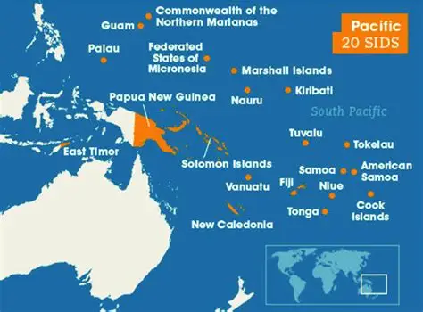
THE CRISIS
3+
PACIFIC ISLAND NATIONS FACE TOTAL SUBMERSION IN THE NEXT 15 YEARS
1951
WAS THE LAST MAJOR UPDATE TO UN REFUGEE CONVENTION; CLIMATE REFUGEES HAVE NO PROTECTIONS
7MIL
PACIFIC ISLANDERS AFFECTED THUS FAR; U.S. BASES IN THE REGION, MIGRATION TRENDS, AND CAPACITY ARE STRAINED
THE DRIVERS
Rising sea levels from climate change will submerge sovereign territory
Bilateral agreements have been problematic (Falepili, etc.)
Culture and governance is tied to land.

Slide 35






THE FRAMEWORK
PHASE 1
PHASE 2
PHASE 3
BILATERAL AGREEMENTS
ECONOMIC SOLUTIONS
LEGAL RECOGNITION
Agreements focused between host countries and affected countries
Focus on cultural and governance preservation
AUS, NZ, and SIDS are the foundation of these agreements
Utilize and study the viability of Exclusive Economic Zones (EEZs)
The idea is for states to fund their activities in host countries from the profits of EEZs
Reframe climate action as economic opportunity
Codify “climate refugee” status under international law through a new UN resolution.
Durable legal recognition is the key
Must build on prior phases
WHERE HAVE EEZ’S BEEN UTILIZED?
JAPAN
PALAU
NORWAY
Wind Farms
Blue Economy
Energy & Sovereign Wealth
80% EEZ economy
$1.4 trillion based in offshore EEZ
NAURU AGREEMENT
8 SIDS // sell fishing rights instead of open access
Fishing industry went from $60M ⟶ $500M annually

Slide 36

THE RECOMMENDATION
SEQUENCING & EXECUTION
NOW
2 YRS
5 YRS
Organize a regional summit to include SIDS and major players
Promote bilateral discussions to execute treaties at the summit
Conduct a six-month feasibility study on EEZ revenue possibilities for at-risk states
Present findings at the UN Summit on Sea Level Rise
Draft and present a new UN resolution that secures binding relocation quotas, asylum pathways, and work rights for climate refugees
FINAL INSIGHTS FROM CLIMATE DISPLACEMENT AND REFUGEE EXPERTS
A UN Framework must have committed state partners
Bilateral agreements are the most realistic pathway in the near future
The legal definition of a “climate refugee” is not a starting point, it is the end goal.
EEZ-based funding is a viable model
Many larger states will only act after displacement has already happened
That is why leadership by the United Nations is key. We must be proactive.

Slide 38
Adjusting U.S. Strategy Toward
China's Expanding Influence in Africa
for the National Security Advisor
Kaiwen Liu & Yvette Uwase

Slide 39
THE PROBLEM
U.S. Influence in Africa Is Falling Behind
China's Approach
U.S. Current Approach
Fast and visible results
Infrastructure, jobs, and financing
Consistent long-term investment
Translates into political influence
and resource access
Expanded into critical minerals
and green technology
Governance, aid, institution-building
Slow delivery; rarely visible to
partner governments
Reducing engagement in key sectors
Delivery gap, not a resource gap
Programs like Power Africa exist
but remain too small to compete

Slide 40
POLICY OPTIONS
Three Paths Forward
Stay the Course
Confrontational Strategy
Selective Competition
LOW RISK — LOW REWARD
HIGH RISK — BACKFIRES
RECOMMENDED
Maintain governance and aid focus
Low political risk
Does not fix delivery gap
U.S. influence continues to decline
Broad economic restrictions on China
Looks strong politically
Does not rebuild U.S. presence
Pushes Africa closer to Beijing
Focus on infrastructure, energy,
critical minerals
Build on existing programs that work
Treat Africa as partner, not recipient
Flexible, targeted, and scalable

Slide 41
RECOMMENDATION
Authorize a Strategy of Selective Competition
Concrete First Steps
Mutual Benefits
For the United States
Expand DFC financing for large-scale
infrastructure projects
Launch annual U.S.-Africa Investment
Forum as a standing platform
Increase embassy economic staffing
in priority countries
Fast-track U.S. private sector
project approvals
Secures critical minerals for clean energy
and manufacturing supply chains
Opens new markets for U.S. businesses
Builds political ties in a region that is
growing in global trade and security
For African Partners
Faster delivery of investment and projects
Greater say in project design
Balanced partner options, reducing
dependence on any single country

Slide 43
Improving Humanitarian Aid in Gaza
UN Office for the Coordination of Humanitarian Aid
Meghavarshini Iska
Bijan Starr

Slide 44
BLUF
Israeli-controlled access and entry restrictions are limiting aid delivery
Israeli security & political barriers limit delivery ​
UN coordination lacks leverage over access
Infrastructure damage disrupts distribution
More aid ≠ better outcomes without access
Notes:
Coordination – point this is where we can talk about the Isreal attacks need precision and working with the US tech can help be much more precise and have to accept that this is a long due process not something happens overnight.

Slide 45
OPTIONS
Options | Drivers | Pros | Cons
Coordinated Inspection Protocols | Delays at crossings | Faster, standardized delivery | Requires Israeli agreement; complex rollout
Strengthen OCHA Engagement | Internal inefficiencies in certain UN bodies | Improves responsiveness, politically feasible | Delays in structural change
Deepen Member State Coordination | Political leverage of UN members | Advances geopolitical stability, conflict de-escalation | Politically sensitive, incremental progress

Slide 46
RECOMMENDATIONS
Option 1 and Option 2 + 3 (Combined Approach)
Negotiate Israel inspection pilot agreement
Launch time-bound technical pilot
Fast-track pre-cleared aid convoys​
Strengthen OCHA and member state coordination capacity
UN anchors aid as core priority
Thank you.

Slide 47
CONGRATULATIONS!

Slide 48

WRAPUP

Slide 49
Looking back …
Substance and Process
Diplomats and spies
Academics and think-tankers
Journalists
Museums
Readings
Defining issues: Iran Israel-Palestine
Ukraine-Russia
China-Taiwan
Cuba and Venezuela
But also …
North Korea
Afghanistan
Africa
Immigration
Enviroment

Slide 50
Looking back …
Substance and Process
How to prepare “actionable” products
Research (various inputs) →→ Analysis →→ Options →→ Recommendation
DRIVERS!!!!
(In clear, concise, transparent style.)

Slide 51
Professional Development Series
How to do Analysis
Word Processing
Networking skills
Writing the Washington Memo
Professional listening
Overcoming “Impostor Syndrome”
Acing the Interview
Negotiating for Salary/Benefits
Briefing and PowerPoint Skills

Slide 52
Professional Development Series
How to do Analysis
Word Processing
Using AI Responsibly and Effectively
Networking skills
Writing the Washington Memo
Healthy Conversation and Elicitation
Overcoming “Impostor Syndrome”
Acing the Interview
Money Essentials for Young Professionals
Negotiating for Salary/Benefits
Briefing and PowerPoint Skills

Slide 53
Next steps …
Celebration lunch
Reflections Memo (Sunday night)
Journal
Count for class participation, but not just “for the grade.”

Slide 54
COURSE EVALUATION
(401 only)
It’s important.

Slide 55
Several comments
About the game and the skills.
Look around the room.
What’s happening in Washington, the country, the world.

Slide 56
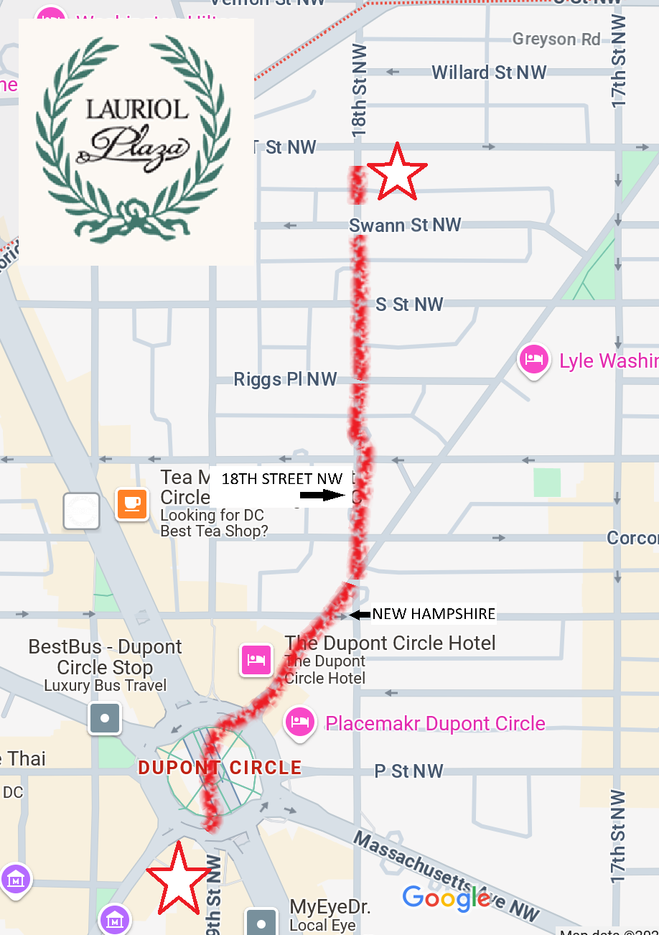

1:00 TODAY
Lauriol Plaza
1835 18th St NW (Corner with T)
GoogleMaps says:
0.5 mi 15 mins

Slide 57

“QUESTIONS? SUGGESTIONS? CONCERNS?”
It’s been fun!

Slide 58
Global Policy Seminar and NSC Simulation
IRP 401 - IRP 402
Week Fourteen 24 Apr 2026
Prof. Fulton T. Armstrong

