Slide 1
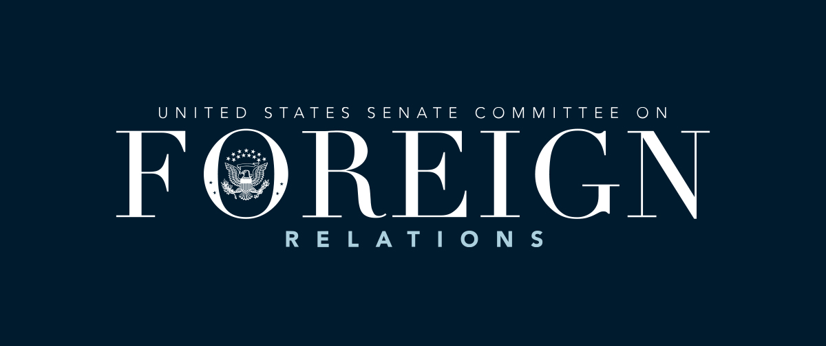
Strengthening U.S. Legal Immigration Pathways by Rebalancing Federal Resources
SFRC Democrats Deputies Briefing: Sarina Dang and Priya Hanley

Slide 2

BLUF + Key Analysis
The U.S. legal immigration system is overwhelmed due to enforcement-heavy resource shifts, USCIS capacity cuts, legal inconsistencies, and rising application volumes. Our analysis shows these structural gaps drive today’s backlogs and shape public views on unauthorized immigration. We recommend rebalancing federal resources toward USCIS staffing and digital modernization.
  Underlying cause: Trump-era policies expanding enforcement; punitive documentation requirements; inconsistently managed immigration courts; outdated quotas.
  Trend: Surging visa applications across all categories + stagnant USCIS capacity → worsening backlogs in both processing and immigration courts.
  Implications: Weaker trust in legal pathways, strain on allied relationships, and declining public confidence.

Slide 3
Options
Option 1 — Increase USCIS Staffing & Modernization
  Pros: Faster processing and greater transparency.
  Cons: Viewed as shifting resources away from enforcement.
  Reactions: USCIS support; OMB cost concerns; ICE opposition.
Option 2 — Establish an Independent Article I Immigration Court
  Pros: More consistent decisions and less political influence.
  Cons: Major long-term structural reform requiring congressional action.
  Reactions: Trump DOJ opposition; legal advocates support.
Option 3 — Shift Enforcement Priorities to High-Risk Individuals
  Pros: Frees agency capacity and reduces low-priority caseloads.
  Cons: Criticizes as weakening enforcement.
  Reactions: Trump administration and ICE resistance; humanitarian group support.

Slide 4
Recommendation
Option 1 — Rebalance resources toward USCIS staffing and digital modernization.
Obstacles: Perception of weak enforcement; jurisdiction overlap.
Rationale: Directly addresses core capacity deficit created during Trump I and deepened in 2025. Produces fastest measurable improvements.
Ask: SFRC coordinate with DHS, Judiciary, and Appropriations Committees.
Next steps: reallocate FY-2026 appropriations; launch a DHS-State task force; prioritize infrastructure improvements.

