Slide 1
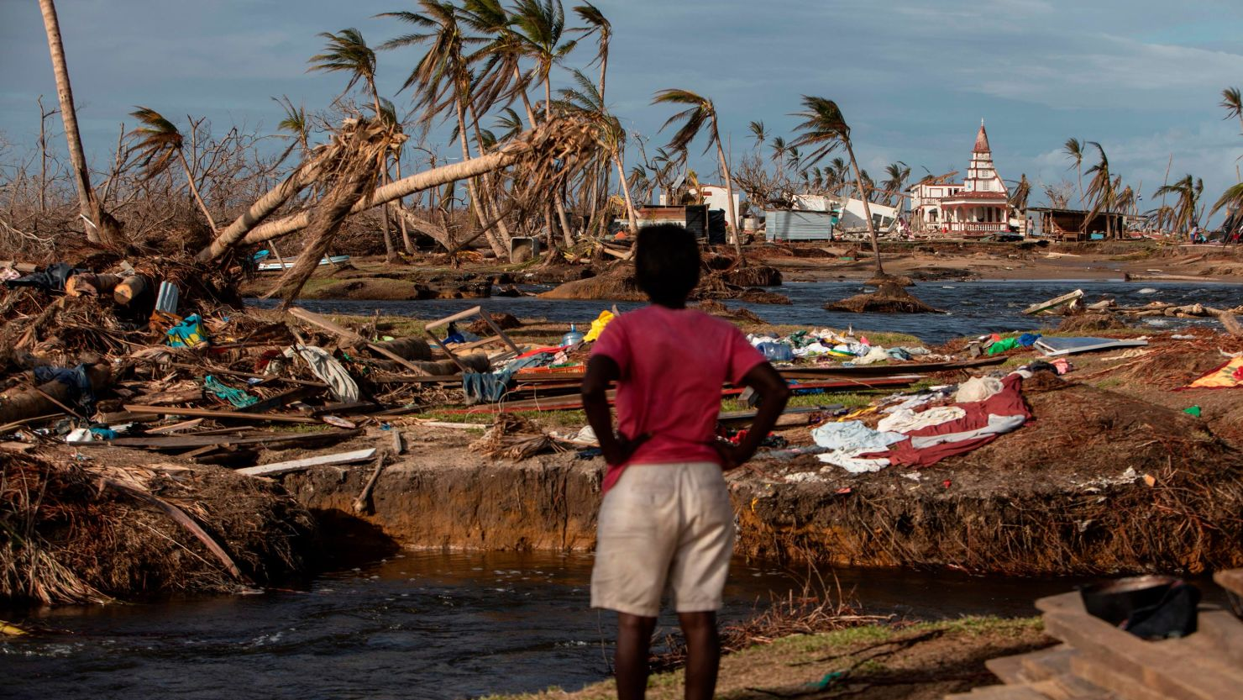
Climate Migration: Navigating Legal Implications to Ensure Adequate Support for Climate Migrants
By: Emily Herrera &Tashakee Ledgister

Slide 2
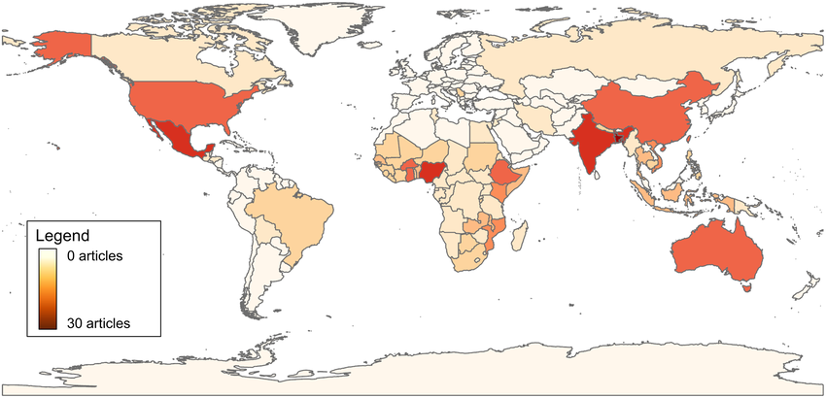
Issue
Climate migrants are fueling a migration surge at the southwest borders.
Under international law, climate migrants are not granted refugee status.
With no legal status as refugee, there is a lack of adequate resettlement system and insufficient protection for climate migrants.

Slide 3
Options
Option 1: Advocate for a resolution granting climate migrants refugee status.
Pro:​ Existing structures, mobilize global support
Option 2: Explore resettlement strategies in shrinking populations. ​
Pro: Offer integration programs
Con: : Host countries may be hesitant due to cultural barriers
Option 3: Introduce a climate-specific Temporary Protected Status (TPS).​
Pro: Legal Pathway to the U.S.
Con: Only Temporary and security issues
Con: Potential obligations

Slide 4
Recommendation 1:
US initiate an international conference with the UN to advocate for a resolution granting climate migrants refugee status.
Recommendation 2 :
Propose a follow up conference to discuss resettlement strategies for climate migrants in nations with shrinking poppulations.

