Slide 1
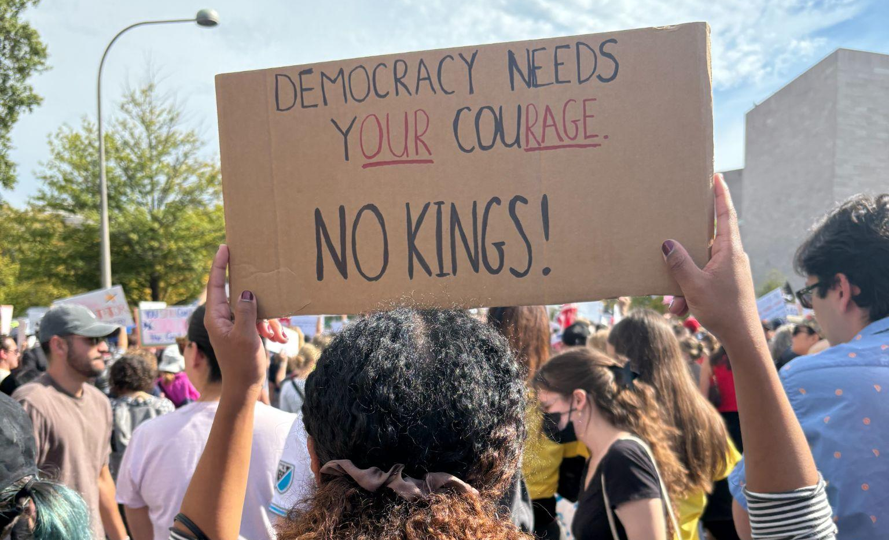

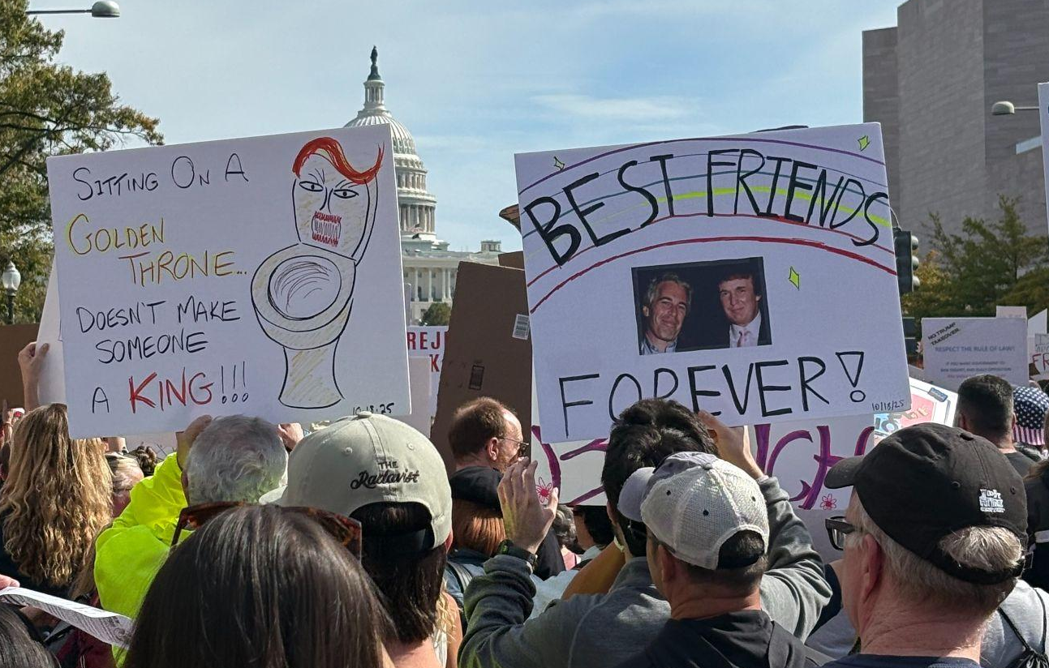
Culture Wars, Polarization, News Biases, and the Implementation of Ranked Choice Voting
Prepared By: Camille Valdez and Esme Dorcellus
December 2025

Slide 2
BLUF
Escalating culture wars fueled by deepening polarization, expanding presidential influence, and the decline of local news have become a risk to U.S. democratic stability and national security. We recommend that the Democratic Caucus urge the Administration to support two national reforms: implementing ranked-choice voting (RCV) and strengthening local news outlets.
Outcomes
Trends
Political exploitation of identity-based issues.
Polarization across education, religion, military policy, and DEI initiatives.
Further democratic backsliding.
Declining civic engagement.
Heightened susceptibility to disinformation campaigns.
Increasing executive power over education, speech, and the military.
Culture war conflicts are intensifying.
Drivers

Slide 3
OPTIONS
1. Nationwide Expansion of RCV
2. Strengthen Local News Ecosystems
Pros:
-Reduces incentives for extreme positioning.
-Increases political representation.
-No constitutional amendment required for RCV to be adopted.
Cons:
-Resistance from politicians who benefit from the current system.
-Many misconceptions about the legality of RCV adoption.
Pros:
-More nuanced, better informed, less polarized news coverage.
-Increases government accountability and voter turnout.
Cons:
-Requires Congressional appropriations and may face partisan scrutiny.
-Fear of gov’t interference in independent journalism.
List the features of this product or service. Two or more.
Pros:

Slide 4
RECOMMENDATION
We ask the Democratic Caucus to support our recommendation of a combined approach: nationwide adoption of RCV and alongside federal incentives to strengthen local news organizations. The Caucus can assure voters that RCV would mitigate the need to vote for “the lesser of two evils,” a huge issue within the liberal voter base. Local news organizations would be able to promote RCV, and in turn gain viewership.
Obstacle Solution
Supportive messaging surrounding RCV must be tailored to the regional political landscape.
Perceptions of RCV vary by state.

