Slide 1
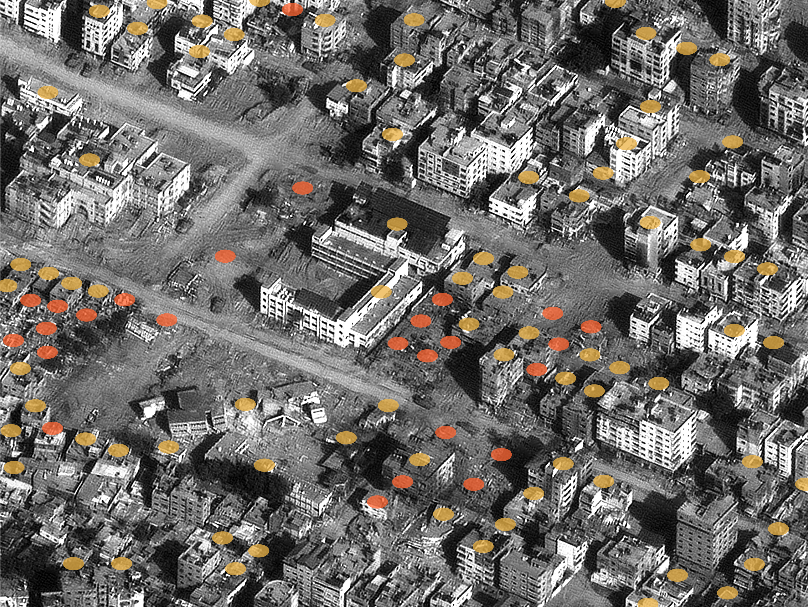
AI-Driven Targeting in Israel: Protecting U.S. Interests Domestically and Abroad
AI-Driven Targeting in Israel: Protecting U.S. Interests Domestically and Abroad
AI-Driven Targeting in Israel: Protecting U.S. Interests Domestically and Abroad
Richard Condino, Erik Rees

Slide 2
Proposal
Lavender AI is an LLM trained on Palestinian security data to create lists of Hamas militant targets.
Lavender has reduced human oversight of intelligence gathering, posing operational and ethical risks when integrated with the modern battlefield.
The U.S. is at risk if our adversaries use AI targeting systems. As such, we suggest:
The U.S. should lead the development of international humanitarian frameworks on AI in warfare.
The U.S. should strengthen defenses against AI-enabled data exploitation.
Key Information
Individually identified, sensitive data can be sold to data brokers at a low price with minimal vetting.
Americans are sharing more data than ever, leaving us vulnerable.
No existing international law governing AI attacks.
Lavender: 10% error rate when suggesting potential militants.
Trained to broadly target “Hamas Operatives” - a vaguely defined selection parameter.

Slide 3
Options
Maintain the Status Quo
Positives: Avoids friction with Israel.
Negatives: Rising domestic dissatisfaction and international criticism; leaves U.S. personnel vulnerable to AI-targeting.
Mitigating negatives:
Avoid public statements, quietly distance the U.S. from Israel’s attacks, and maintain a neutral stance.
Speak out against the use of AI-targeting. Emphasize respect for Israel’s autonomy and avoid directly criticizing Israel, only the specific action of AI-targeting.
Lead Development of an International Framework for AI in Warfare
Positives: Asserts U.S. international leadership; aligns with domestic and international concerns; establishes norms for accountability and human oversight - reduces potential for similar systems to be used against the U.S.
Negatives: Opposes Israel and risks conflict with an important ally.
Mitigating negatives:
Involve Israel early.
Frame Israel’s position as one with expertise, since its targeting systems are more developed than any other nation.
Strengthen U.S. Defenses Against AI-Targeting
Positives: Addresses vulnerabilities identified in congressional hearings and our interviews; enhances personnel protection; politically uncontroversial.
Negatives: Requires resources and coordination.
Mitigating negatives:
Leverage existing infrastructure and guidelines.
Ensure a gradual and well-researched implementation process.

Slide 4
Our Recommendations
Recommendation 1:
Launch a U.S.-led effort to develop international guidelines for AI-enabled targeting that includes Israel and key allies.
…begin by discussing with allies, including Israel, potential frameworks for international law.
Recommendation 2:
Coordinate with government agencies to strengthen U.S. defenses against AI-enabled data exploitation, improving the protection of U.S. personnel.
… begin by investigating the strengths and weaknesses of current guidelines set forth by agencies like CISA and NIST, as well as executive orders regarding data protection.
With your approval, we kindly request that you forward these recommendations to the President.

