Slide 1
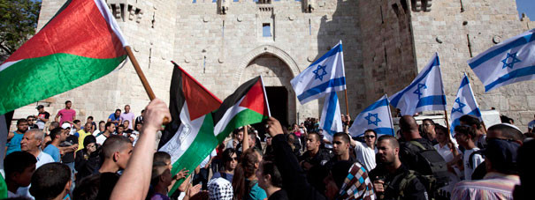
The Two-State Solution: Reevaluating U.S. Policy
Matthew Byrne, Vaughn Reardon

Slide 2
Analysis
Palestinians continue to be dispossessed of their land by Israeli settlers—no land, no state
Gov’t remains ideologically opposed to two-state solution—impossible while Netanyahu remains in power
No legitimate representative for Palestinian people—PA deeply unpopular; reforms necessary
Underlying obstacles to Palestinian development remain unaddressed—will retard development of Palestinian state
Continued war will isolate Israel
Maintaining close relationship with Israel while settlements/offensive continue will damage international and regional credibility and complicate relations with Arab states
The President direly needs to be able to point to concrete support for Palestinians

Slide 3
Options
Aid—send more humanitarian and economic development aid to Gaza and the West Bank
Help build goodwill
May be used as a precondition to secure significant reforms of PA
Working Group—create an interagency working group to draw up plans to guide development of future Palestinian state
Signal commitment to and allow us to influence development of a Palestinian state
Israelis may not like the implication of a Palestinian state
Palestinian Mission—reopen a Washington, D.C. office for Palestinian representative entity
Give legitimacy to Palestinian leadership, demonstrate commitment to Palestinians, closer ties
Should only occur if PA is reformed or replaced
Recognition of Palestine–full recognition of a Palestinian state within the pre-1967 borders
Fullest possible demonstration of support for Palestinians, much closer ties, boost credibility
Will need to take harder stance on settlements, Israelis will likely see it as betrayal

Slide 4
Recommendation
In an ideal situation we would incorporate all options into our recommendation
Our goal now is not to impose a specific peace deal – we plan on enabling the mechanisms that will eventually lead to a climate where one can be reached
Continuation of aid and the creation of an interagency working group are top priorities
Obstacles – current Israeli leading coalition and leadership, concerns inside Israel, corruption within organizations
Overcome through new leadership, United States pressure, and new Palestinian leadership

