Slide 1
Energy Diversity for Security and Competitiveness
By Emmett Gallardo and John Maley

Slide 2
BLUF:
The energy sector represents a pressure point for geopolitical shocks and a key source of leverage in the future
Diversifying energy sourcing presents a viable option for protecting against these shocks
Solutions found using global economic leverage and domestic industrial policy

Slide 3
Option Class 1:
Option Class 2:
Option Class 3:
Foreign Trade Leverage
Border Carbon Adjustment Mechanism
Preferential Trade Agreements
Domestic Regulation and Support
Subsidies for Renewables and Nuclear Generation
Quotas for integration during transmission upgrading
Environmental Regulation
Set Goal Temperature
Fossil Fuel and Natural Gas consumption limitations
Reinstate Greenhouse Gas Regulation

Slide 4
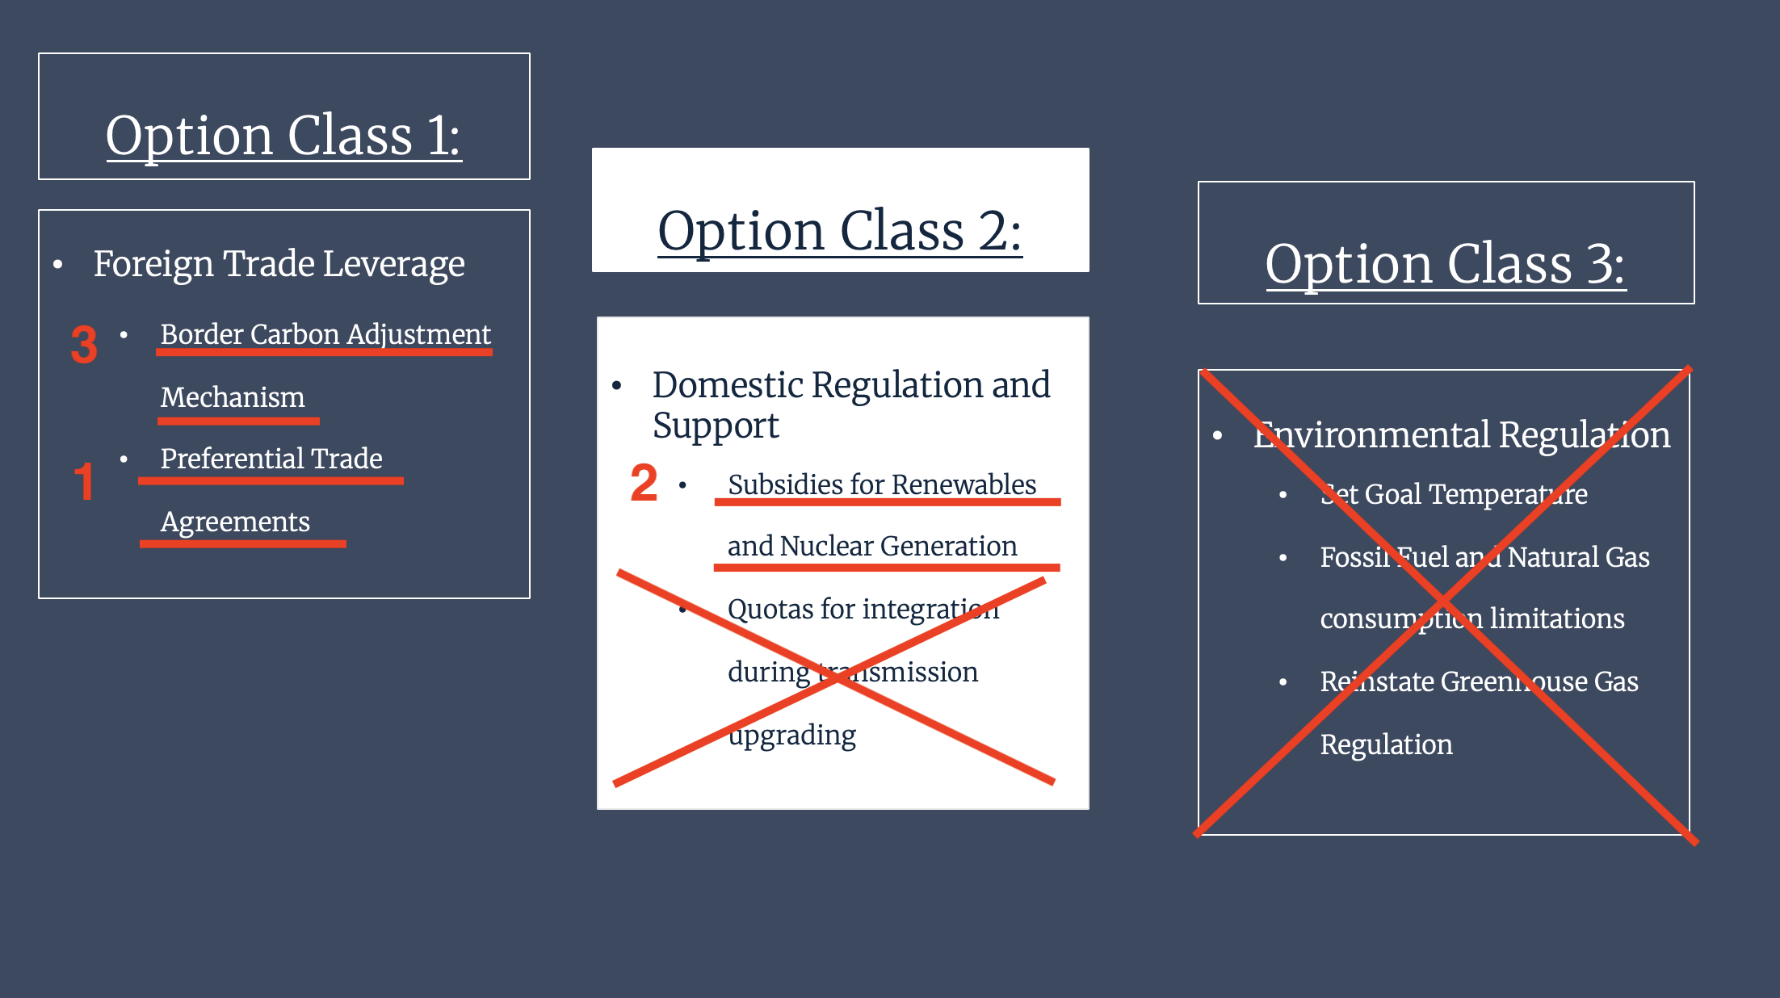
Multi-Step Recommendation:

