Slide 1
POLICY BRIEF · APRIL 2026
THE DPRK AND WMD:
ILLICIT FINANCE
TEAM
Filippo Donà

Slide 2
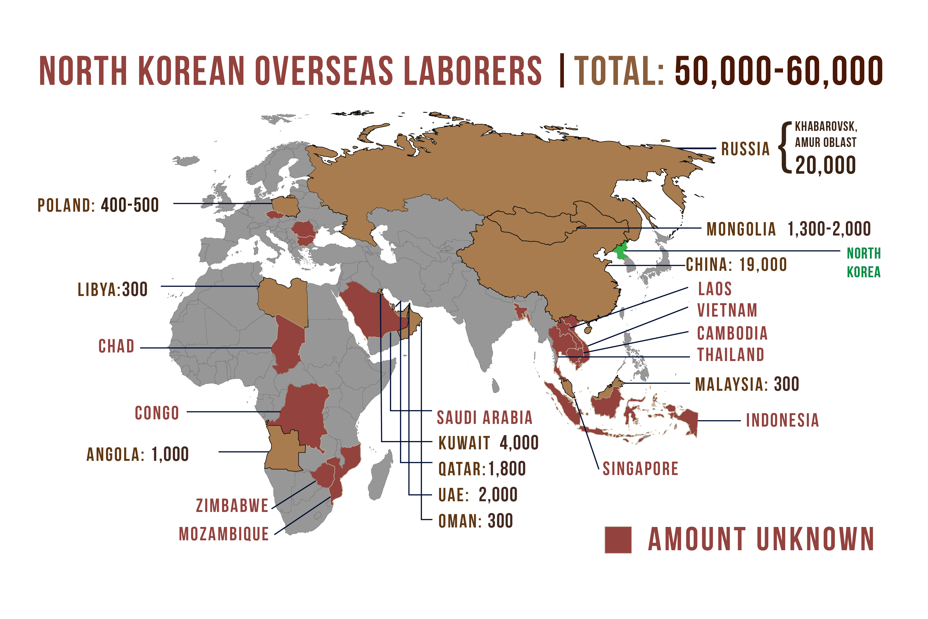
BOTTOM LINE UP FRONT
North Korea has built a sanctions-proof digital revenue system that directly funds its missile program. U.S. policy and International sanctions, both built for a physical-asset world, are reactive and fragmented. Closing the gap requires pressing global enforcement, additional domestic legislation in the near term, and a parallel diplomatic track
WHAT THE DATA SHOWS
$6.75B stolen via crypto to date, directly funding WMD
60,000+ North Korean workers placed abroad. +225% in Western Firms in 2025; 300+ U.S. companies, including S&P 500 firms, unknowingly hired them.
Russia vetoed renewal of the UN monitoring body in April 2024; China actively shields North Korea at the UN Security Council
> 19 Chinese banks are used to launder North Korean funds

Slide 3
PATH FORWARD
Three options to counter North Korea's digital sanctions evasion
01
02
03
ENFORCE Globally
LEGISLATE domestically
TALK
Freeze wallets, and sanction foreign banks
Enhance resources and coordination of enforcement bodies (FBI, Treasury); Target in synchronized waves, not one at a time
Use access to U.S. dollar payments as leverage against foreign actors who do not cooperate in investigations
Extend money-laundering rules beyond banks and large exchanges
Delegate verification to private sector, punish by exclusion from USD
Enhanced verification for prospective workers. Require hiring and freelance platforms to verify worker identities
Frame Options 1 + 2 as conditions for a credible deal
Tie any sanctions relief to a verifiable stop of crypto theft.
Coordinate with PRC
0–6 MONTHS · No new laws needed
6–18 MONTHS · Protects U.S. business
PARALLEL · Condition-based
Authorize Options 1 + 2 as an integrated package now. Run Option 3 in parallel as diplomatic framing.

Slide 4
Recommendation
01
ENFORCE GLOBALLY
02
LEGISLATE DOMESTICALLY
03
TALK
0–6 MONTHS
6–18 MONTHS
PARALLEL TRACK
+ PROS
+ PROS
+ PROS
Uses intelligence we already have
Uses existing laws. Works immediately
Increases cost and risk of theft
USD and EUR clearing have global reach. US would lead intl. efforts
Shifts compliance cost from government to industry
Extends rules to the platforms the DPRK actually uses
Closes the system, so new bad actors are covered automatically
Converts enforcement into diplomatic leverage
Sets an achievable bar: cyber theft, not full denuclearization
Is easily reversible, but guarantees first steps toward normalization
— CONS
— CONS
— CONS
Rulemaking can be a lengthy process
Must be designed to be compatible with current deregulation regime
Experts warn cyber theft is now strategically embedded in DPRK strategy
Behavioral change not guaranteed, even with a deal. Deals historically degrade once relief is granted and supply chains adjust
Requires a commitment to sustained tempo
Reactive, and DPRK reacts faster
Cannot force foreign banks into compliance with existing laws

