Slide 1





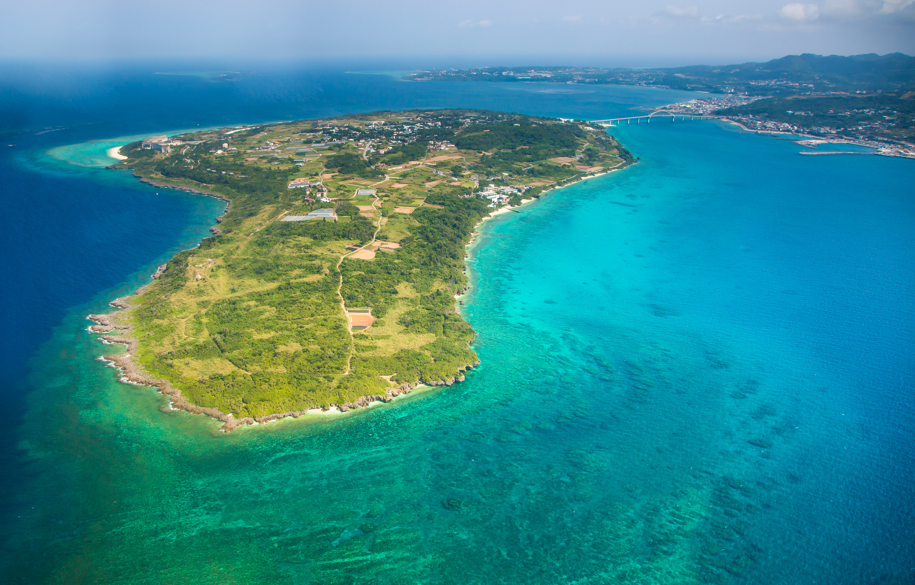
THE CLIMATE SOVEREIGNTY FRAMEWORK
“IF YOU KNEW YOUR HOME WAS SINKING, WHAT WOULD YOU DO?”
A PLAN FOR SMALL ISLAND DEVELOPING STATES
PREPARED BY MILES SCHERER AND KENNEDY KING

Slide 2

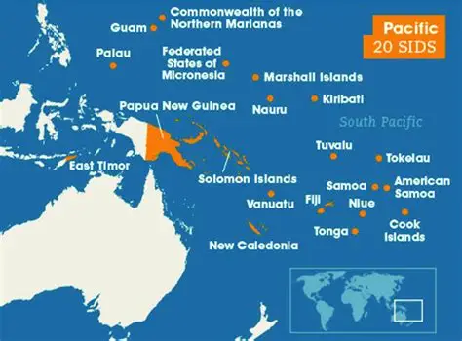
THE CRISIS
3+
PACIFIC ISLAND NATIONS FACE TOTAL SUBMERSION IN THE NEXT 15 YEARS
1951
WAS THE LAST MAJOR UPDATE TO UN REFUGEE CONVENTION; CLIMATE REFUGEES HAVE NO PROTECTIONS
7MIL
PACIFIC ISLANDERS AFFECTED THUS FAR; U.S. BASES IN THE REGION, MIGRATION TRENDS, AND CAPACITY ARE STRAINED
THE DRIVERS
Rising sea levels from climate change will submerge sovereign territory
Bilateral agreements have been problematic (Falepili, etc.)
Culture and governance is tied to land.

Slide 3






THE FRAMEWORK
PHASE 1
PHASE 2
PHASE 3
BILATERAL AGREEMENTS
ECONOMIC SOLUTIONS
LEGAL RECOGNITION
Agreements focused between host countries and affected countries
Focus on cultural and governance preservation
AUS, NZ, and SIDS are the foundation of these agreements
Utilize and study the viability of Exclusive Economic Zones (EEZs)
The idea is for states to fund their activities in host countries from the profits of EEZs
Reframe climate action as economic opportunity
Codify “climate refugee” status under international law through a new UN resolution.
Durable legal recognition is the key
Must build on prior phases
WHERE HAVE EEZ’S BEEN UTILIZED?
JAPAN
PALAU
NORWAY
Wind Farms
Blue Economy
Energy & Sovereign Wealth
80% EEZ economy
$1.4 trillion based in offshore EEZ
NAURU AGREEMENT
8 SIDS // sell fishing rights instead of open access
Fishing industry went from $60M ⟶ $500M annually

Slide 4

THE RECOMMENDATION
SEQUENCING & EXECUTION
NOW
2 YRS
5 YRS
Organize a regional summit to include SIDS and major players
Promote bilateral discussions to execute treaties at the summit
Conduct a six-month feasibility study on EEZ revenue possibilities for at-risk states
Present findings at the UN Summit on Sea Level Rise
Draft and present a new UN resolution that secures binding relocation quotas, asylum pathways, and work rights for climate refugees
FINAL INSIGHTS FROM CLIMATE DISPLACEMENT AND REFUGEE EXPERTS
A UN Framework must have committed state partners
Bilateral agreements are the most realistic pathway in the near future
The legal definition of a “climate refugee” is not a starting point, it is the end goal.
EEZ-based funding is a viable model
Many larger states will only act after displacement has already happened
That is why leadership by the United Nations is key. We must be proactive.

